Slide 1

CSE 321a
Computer Organization (1)
تنظيم الحاسبات (1)
3rd year, Computer Engineering
Fall 2016
Lecture #8
Dr. Hazem Ibrahim Shehata
Dept. of Computer & Systems Engineering
Credits to Dr. Ahmed Abdul-Monem Ahmed for the slides

Slide 2
Administrivia
Assignment #2:
Due: Today
Solution will be posted tomorrow
Midterm:
New Date: Tuesday, Dec. 5, 2016
New Time: 11:00am - 12:30pm
Location: classroom #27321 (قاعة 4د)
Coverage: lecture #1 ➔ lecture #6
Website: http://hshehata.github.io/courses/zu/cse321a/
Office hours: Sunday 12:00pm – 1:00pm

Slide 3
Chapter 12. Instruction Sets: Characteristics and Functions (cont.)

Slide 4
Outline
Machine Instruction Characteristics
Elements of machine instructions, instruction representation, instruction types, number of addresses, instruction set design issues.
Types of Operands
Addresses, numbers, characters, logical data
Example: x86 data types
Types of Operations
Data transfer, arithmetic, logical, conversion, input/output, system control, transfer of control.

Slide 5
4. Conversion
Instructions that change the format of data.
e. g., convert from binary to BCD.
Example: Translate (TR) instruction in IBM System 390.
TR R1 (L), R2
R1: starting address of source; L: number of bytes to be translated; R2: starting address of a table of 8-bit codes.
Each byte of the source bytes is replaced by a table entry indexed by that byte.
IRA
EBCDIC
162
R2
100
IRA
115
97
109
R1
115
50
:
97
128
128
100+97
Translate
109
:
s a m
148
148
100+109
MVI R1, 50
:
MVI R2, 100
162
100+115
EBCDIC
162
128
148
TR R1 (3), R2
:

Slide 6
5. Input/Output
May be done using data movement instructions
memory-mapped i/o
May be using specific i/o instructions
isolated i/o
May be done by a separate controller
DMA
Notes:
23

Slide 7
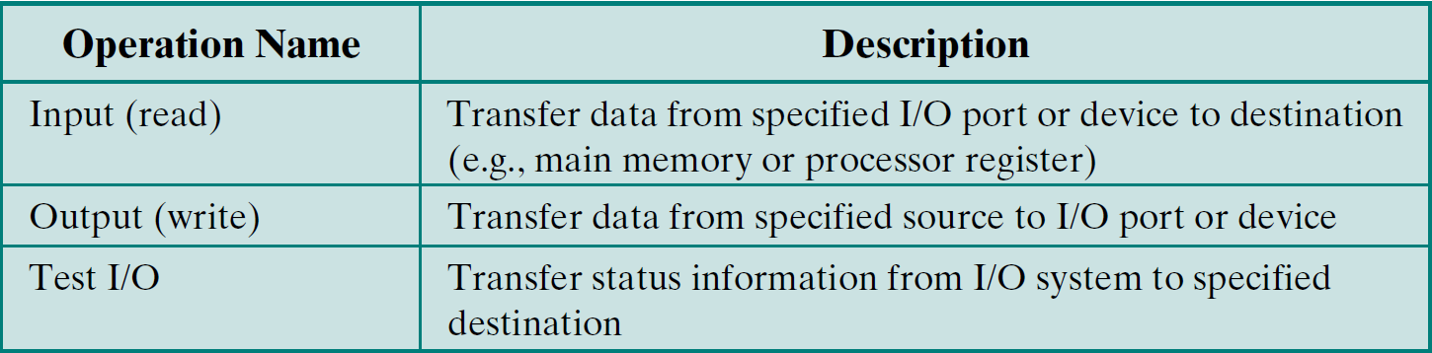
5. Input/Output – Common Operations
Notes:
23

Slide 8
6. System Control
Privileged instructions.
Executed only when the processor is in a certain privileged state
e.g., ring 0, supervisor mode, kernel mode, ... etc.
Reserved for operating systems use.
Example Instructions:
Modify storage protection keys.
Access process control blocks (ID, address space, priority, … etc).
…
Notes:
24

Slide 9
7. Transfer of Control
Most common transfer-of-control operations:
branch, skip, and procedure call/return.
Branch (jump):
Types: unconditional or conditional.
Unconditional: always take the branch (update PC to equal address specified in operand).
Ex.: BR X → branch to location X
Conditional: take the branch if a condition is met, otherwise continue.
Condition: test a flag set as a result of a recent operation, or perform a comparison (need three-address instruction)
Ex.: BRP X → Branch to location X if result is positive.
Ex.: BRE R1, R2, X → Branch to location X if [R1] equals [R2].
Branches can be either forward or backward.
Notes:
25

Slide 10
7. Transfer of Control – Branch Instructions

Slide 11
7. Transfer of Control
Skip:
Types: unconditional or conditional.
Unconditional: always skip following instn. (update PC to equal address of following instn. plus Δ).
Conditional: skip following instruction if condition is met, otherwise continue.
Typical Example: increment-and-skip-if-zero (ISZ)
301 …
… …
309 ISZ R1
310 BR 301
311 …
Notes:
25

Slide 12
7. Transfer of Control
Procedure call/return:
Call: save address of following instruction (i.e., return address) and branch to target procedure.
Return address can be saved: in special register, at start of called procedure, or on top of stack.
Ex.: Call X → call the procedure at location X
Return: Return to calling procedure.
Load PC with the return address
Ex.: Ret → return to where you came from!
c.f. interrupt call/return
Register | Procedure Start | Stack Top
RN ← [PC] PC ← X | X ← [PC] PC ← X+1 | Push [PC] to stack PC ← X
Register | Procedure Start | Stack Top
PC ← [RN] | PC ← [X] | Pop [PC] from stack
Notes:
25

Slide 13
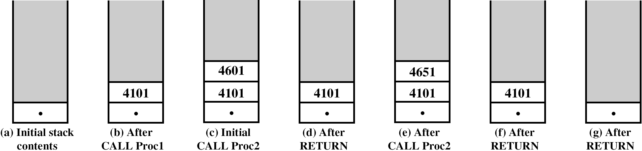
7. Transfer of Control – Nested Procedure Calls

Slide 14
Stack Frame Growth – Parameter Passing
Stack frame: set of (parameters + local variables + return address) necessary for a procedure call.
P
Q
PUSH FP
MOV FP, SP
................
................
................
PUSH x1
PUSH x2
CALL Q
POP R0
POP T
POP FP
RETURN
PUSH FP
MOV FP, SP
...............
PUSH y1
PUSH y2
...............
Use FP to access x₁, x₂
...............
POP y2
POP y1
POP FP
RETURN
Stack Pointer
Stack Pointer
y2
Stack
Stack Pointer
y1
Frame Pointer
Stack Pointer
Old FP Value
Stack Pointer
Return Point [Q]
Stack Pointer
x2
Stack Pointer
x1
Frame Pointer
Stack Pointer
Old FP Value
Stack Pointer
Return Point [P]

Slide 15
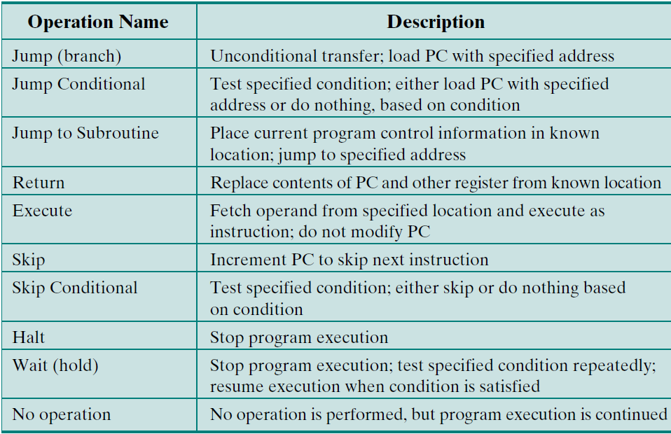
7. Transfer of Control – Common Op’s
Notes:
25

Slide 16
Byte Order
In what order do we read numbers that occupy more than one byte? e.g. (numbers in hex) 12345678 can be stored in 4x8-bit locations as follows:
The problem is called Endian.
Highest significant byte in lowest address:
Big-endian.
Least significant byte in lowest address:
Little-endian.
Address
184
185
186
187
Value (1)
12
34
56
78
Value (2)
78
56
34
12
Big endian
Little endian
Notes:
27

Slide 17
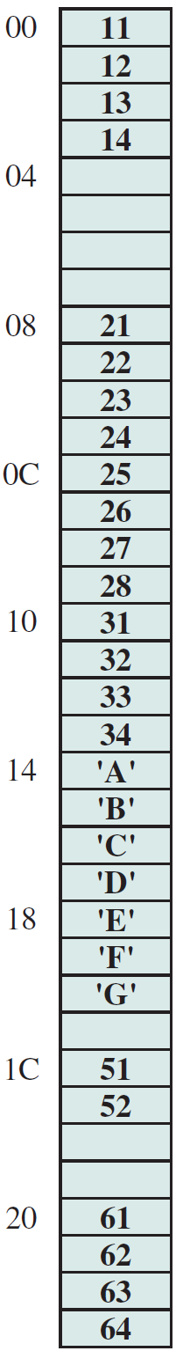
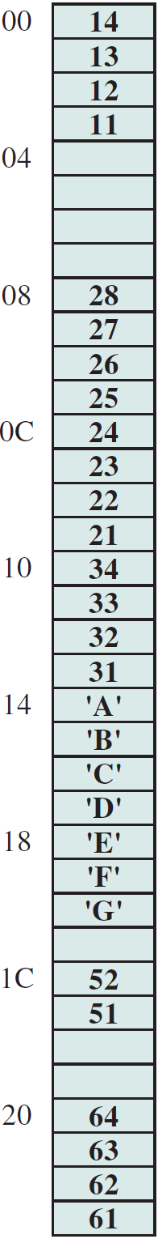
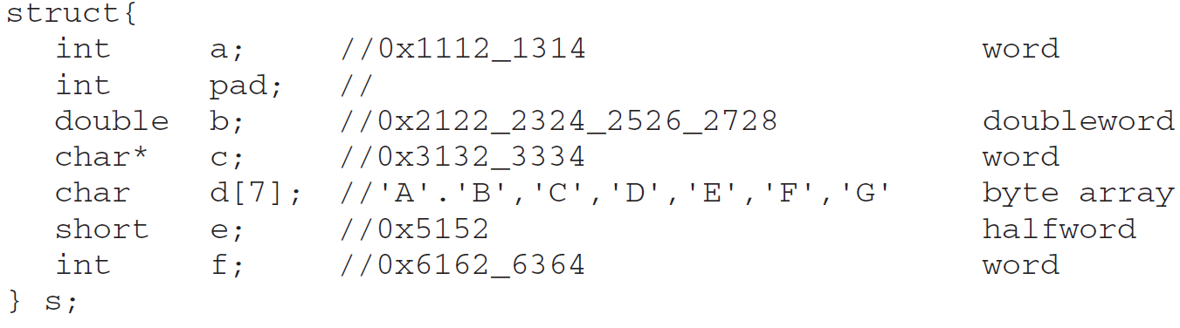
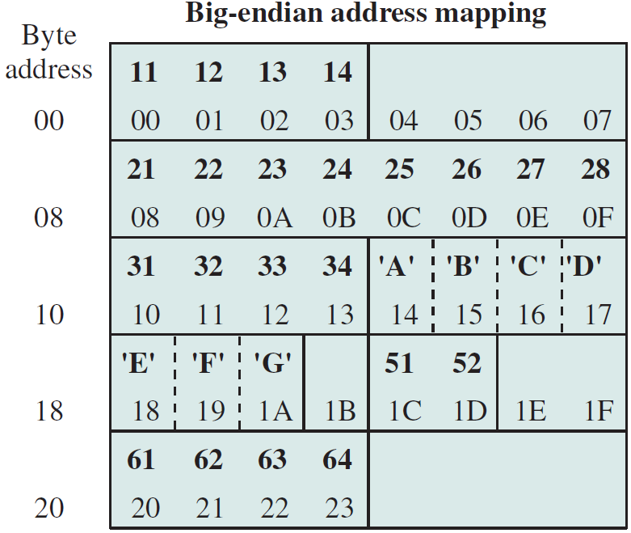
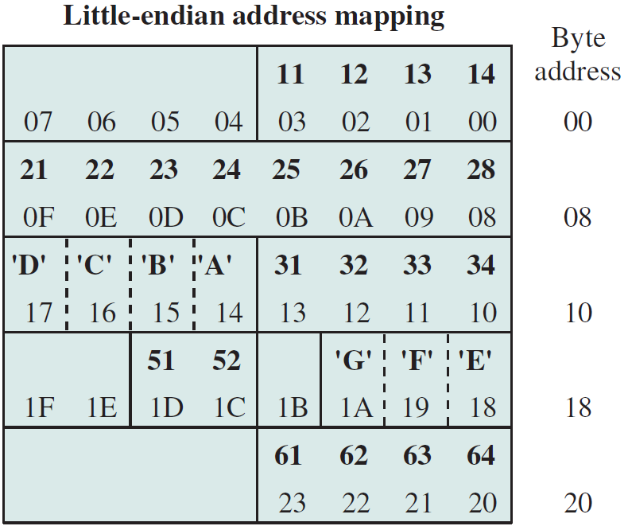
Example of C Data Structure

Slide 18
Standard…What Standard?
X86 and VAX are little-endian.
IBM System 370/390, Sun SPARC, and most RISC are big-endian.
Big-endian is favored for:
Character-string sorting: multiple bytes can be compared in parallel.
Decimal/ASCII dumps: values can be printed left to right without causing confusion.
Consistent order: integers and character strings are stored in the same order.
Little-endian is favored for:
32-to-16-bit integer conversion: no need to increment address to access least-significant 2 bytes.
Higher-precision arithmetic: no need to find the least-significant byte and move backward.
Notes:
30

Slide 19
Reading Material
Stallings, Chapter 12:
Pages 425 – 431
Pages 447 – 450

