Slide 1

CSE 321a
Computer Organization (1)
تنظيم الحاسبات (1)
3rd year, Computer Engineering
Fall 2016
Lecture #7
Dr. Hazem Ibrahim Shehata
Dept. of Computer & Systems Engineering
Credits to Dr. Ahmed Abdul-Monem Ahmed for the slides

Slide 2
Administrivia
Assignment #2:
Due: Thursday, Nov. 10, 2016.
Solution will posted on Friday.
Midterm:
Date: Thursday, Nov. 17, 2016.
Time: 12:30pm – 2:00pm.
Location: قاعة 4د.
Coverage: lecture #1 ➔ lecture #6.
Previous midterms were posted.
Website: http://hshehata.github.io/courses/zu/cse321a
Office hours: Sunday 12:00pm-1:00pm

Slide 3
Chapter 12. Instruction Sets: Characteristics and Functions

Slide 4
Outline
Machine Instruction Characteristics
Elements of machine instructions, instruction representation, instruction types, number of addresses, instruction set design issues.
Types of Operands
Addresses, numbers, characters, logical data.
Example: x86 data types.
Types of Operations
Data transfer, arithmetic, logical, conversion, input/output, system control, transfer of control.

Slide 5
Outline
Machine Instruction Characteristics
Elements of machine instructions, instruction representation, instruction types, number of addresses, instruction set design issues.
Types of Operands
Addresses, numbers, characters, logical data.
Example: x86 data types.
Types of Operations
Data transfer, arithmetic, logical, conversion, input/output, system control, transfer of control.

Slide 6
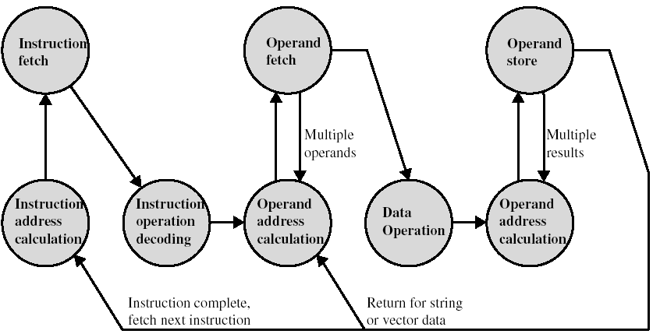
Instruction Cycle State Diagram

Slide 7
Instructions
Instruction set
Complete collection of instructions that are understood by a certain CPU, i.e., the set of all machine instructions.
Instructions are represented in a binary form (machine language), or a symbolic form (assembly language).
Elements of an instruction
Operation code (opcode)
Do this … (e.g., ADD, I/O).
Source operand(s) reference
To this …
Result operand reference
Put the answer here …
Next instruction reference
When you have done that, do this next ...
Usually implicit (from PC).
Immediate: value.
Main memory: address.
CPU register: register number. Implicit if one register exists.
I/O device: I/O module & device. MM address if memory-mapped I/O.
Notes:
2

Slide 8
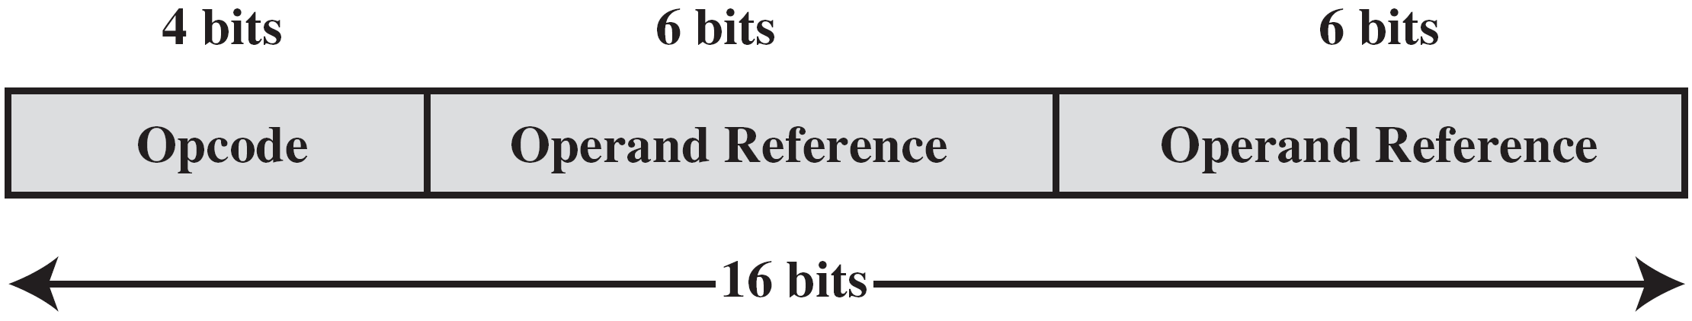
Instruction Representation
Within computer, each instruction is represented by a sequence of bits, divided into fields.
During the execution phase, an instruction is read from the IR register.
CPU extracts the data from these fields to perform the required operation.
Programmers represent instructions symbolically:
Opcodes ➔ mnemonics, e.g., ADD, SUB, LOAD.
Operands ➔ symbolic names, e.g., Y = 514.
Example: ADD R1, Y
Notes:
5

Slide 9
Types of Instructions
Data processing
Arithmetic and logic instructions.
Arithmetic: computations (processing) on numeric data.
Logic: operate on the bits of a word (any data type).
Data storage
Memory instructions.
Data movement
I/O instructions.
Program flow control
Jump and branch instructions.
Notes:
6

Slide 10
Number of Addresses (1)
What is the maximum number of addresses that need to be represented in an instruction?
“addresses” here means “explicit operand references”.
Instructions that perform binary arithmetic/logic operations (e.g., +, &) require most # of “addresses”.
2 addresses to specify source operands, 1 to specify destination operand (i.e., result), 1 to specify next instruction.
Four addresses must be specified in this case!
Problem: Specifying 4 addresses ➔ too long instruction!
Solution: Specify some operands implicitly!
Address of next instruction is implicitly known ➔ [PC]+1!
Destination: same as source, or always the accumulator!
In most architectures, most instructions are one-, two-, or three-address instructions.
Notes:
7

Slide 11
Program to Execute: Y = (A–B)/(C+D×E)
3-address instructions
1-address instructions
2-address instructions
“MPY D, E” would alter D. So, it is replaced by these two instructions!
Notes:
10

Slide 12
Number of Addresses (2)
3 addresses
Operand 1, Operand 2, Result.
Template: a = b + c.
Needs very long words to hold everything.
2 addresses
One address doubles as operand and result.
Template: a = a + b.
Reduces length of instruction.
Requires some extra work.
Temporary storage to hold some results!
Notes:
8

Slide 13
Number of Addresses (3)
1 address
Implicit second address.
Usually a register (accumulator: AC).
Common on early machines.
0 (zero) addresses
All addresses implicit.
Usually the top element(s) of the stack.
Stack: set of locations used as last-in-first-out buffer.
Ex.:
c = a + b
push 3
push a
push b
add
pop c
pop a
pop b
Top of stack
3
pop c
Top of stack
19
push 5
Top of stack
745
Stack
(Last-In First-Out)
5
Top of stack
.
.
.
.
.
.
.
.
.
Notes:
9

Slide 14
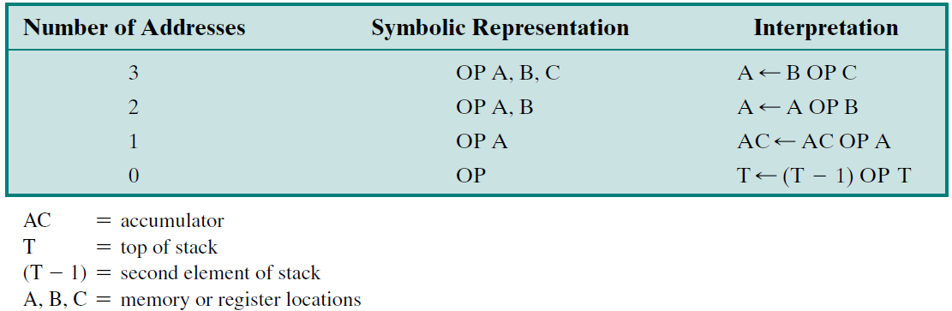
Instruction Addresses (nonbranching instructions)
Notes:
10

Slide 15


Summary: How Many Addresses?
More addresses
More complex instructions ➔ more complex CPU.
Longer-length instructions ➔ slower fetch/execution.
Fewer instructions per program.
More registers are available ➔ more operations performed solely on registers ➔ quicker processing
Fewer addresses
More primitive instructions ➔ less complex CPU.
Shorter-length instructions ➔ faster fetch/execution.
More instructions per program.
Most modern machines employ a mixture of one-, two- and three-address instructions.
Notes:
11

Slide 16
Instruction Set Design
Instruction set defines how many functions performed by CPU ➔ significantly affects CPU implementation.
Most important issues in designing instruction set:
Operation repertoire: number of op’s, their complexity.
Data types: types of data dealt with by instructions.
Instruction formats: instruction length, number of addresses, size of various fields.
Registers: number of CPU registers available, which operations can be performed on which registers?
Addressing modes: ways of referencing operands.
Style: RISC vs CISC!
Notes:
12

Slide 17
Outline
Machine Instruction Characteristics
Elements of machine instructions, instruction representation, instruction types, number of addresses, instruction set design issues.
Types of Operands
Addresses, numbers, characters, logical data.
Example: x86 data types
Types of Operations
Data transfer, arithmetic, logical, conversion, input/output, system control, transfer of control.

Slide 18
Types of Operands
Machine instructions operate on data (strings of 1’s and 0’s) interpreted as one of the following:
Addresses
Unsigned integers representing pointers to memory locations.
Numbers
Signed/unsigned integers, floating point, BCD.
Limited ➔ limited magnitude (& precision for real numbers).
Characters
IRA (ASCII): 7-bit code. An 8th bit could be used for parity.
EBCDIC: 8-bit code (used on IBM mainframes).
Logical Data
Bit-oriented view of data ➔ array of logical values (true/false).
Each bit in the array can be individually manipulated!
Notes:
14

Slide 19
Ex.: x86 Data Types
The x86 instructions can handle so many types of data. Most common types are:
General: arbitrary binary contents.
Size: byte, word (16 bit), double-word (32 bit), quad-word (64 bit), and double-quad-word (128 bit).
Note: x86 memory is byte-addressable.
Integer: singed binary value (two’s complement)
Size: byte, word, double-word, quad-word.
Note: Multi-byte numeric data in x86 are saved in “little-endian” style, i.e., least significant bytes are stored first.
Ordinal: unsigned binary values
Size: byte, word, double-word, quad-word.
Notes:
16

Slide 20
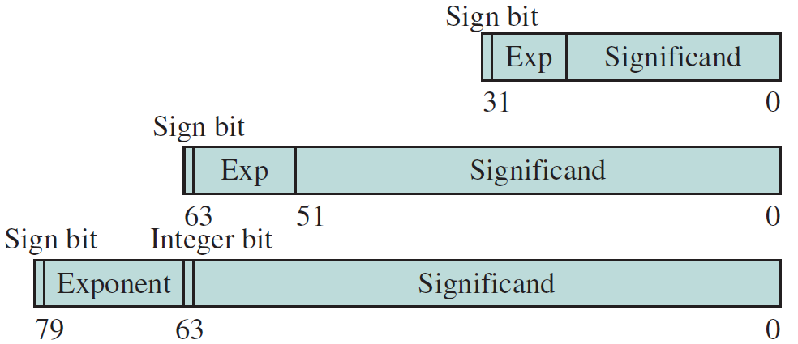
Ex.: x86 Data Types
… (cont.):
Floating-point: conforming to IEEE-754 standard.
Binary-Coded-Decimal (BCD):
Unpacked BCD: One BCD digit per byte.
Packed BCD: Two BCD digits per byte.
Bit fields: sequence of independent bits (up to 32 bits).
Byte strings: sequence of bytes, words, or double-words.
Others: near/far pointers, packed byte/word/… SIMD, and many more!!
Single precision
Double precision
Double-extended precision
Notes:
16

Slide 21
Outline
Machine Instruction Characteristics
Elements of machine instructions, instruction representation, instruction types, number of addresses, instruction set design issues.
Types of Operands
Addresses, numbers, characters, logical data.
Example: x86 data types
Types of Operations
Data transfer, arithmetic, logical, conversion, input/output, system control, transfer of control.

Slide 22
1. Data Transfer
Instruction must specify:
Location of source operand.
Location of destination operand.
Amount of data.
Addressing mode for each operand.
Location of operand and amount of data could be specified as part of opcode or operand fields:
Specified in opcode ➔ different instructions for different kinds of movements (reg./mem.) and amounts of data.
e.g. IBM EAS/390 (next slide) ➔ Disadv.: hard to program!
Specified in operand ➔ 1 instruction for same amount of data. Kind of movement is specified in operand.
e.g. VAX and x86 ➔ Disadv.: less compact!
Memory.
Register.
Top of stack.
Notes:
19

Slide 23
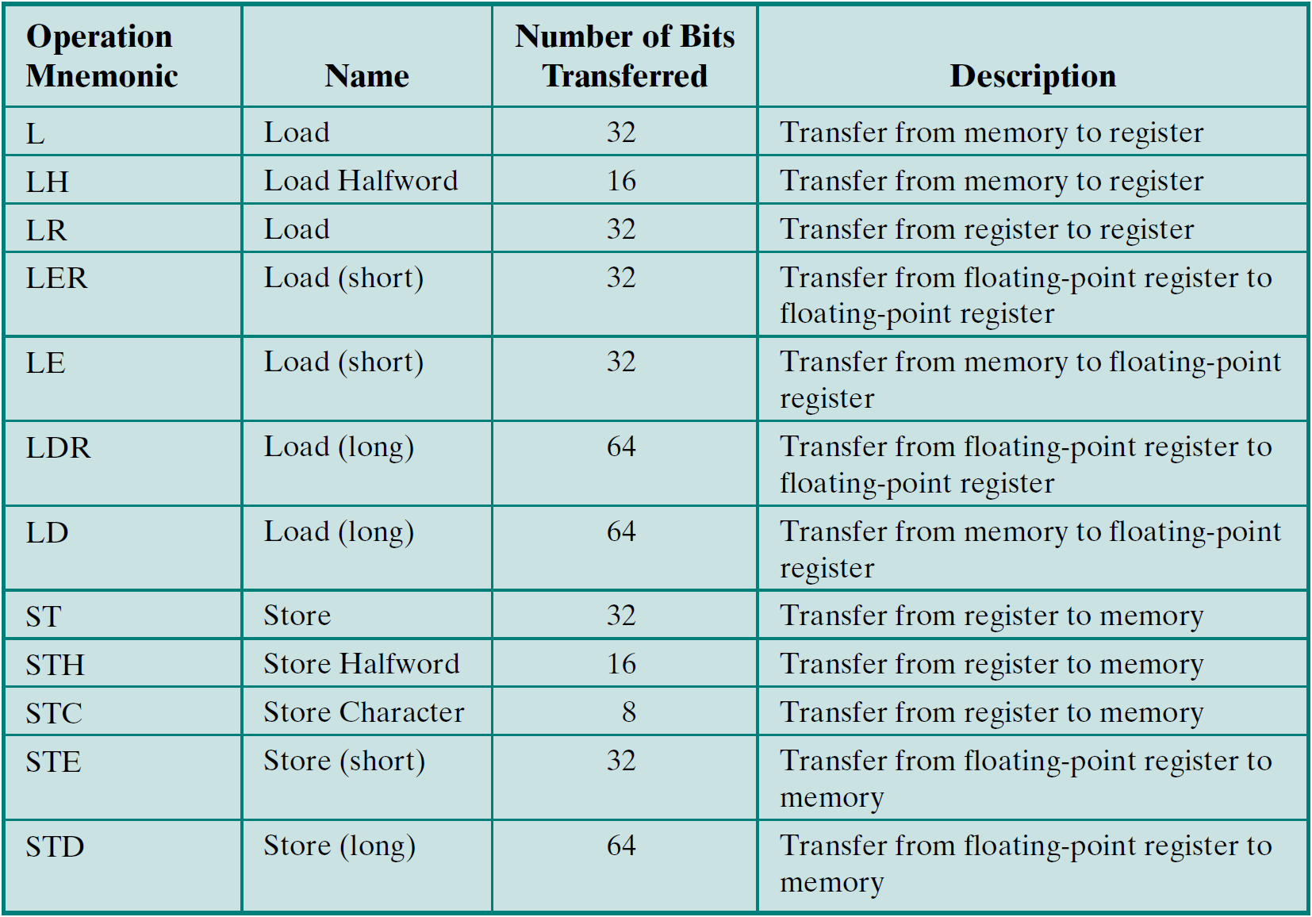
1. Data Transfer – Ex.: IBM EAS/390
Notes:
19

Slide 24
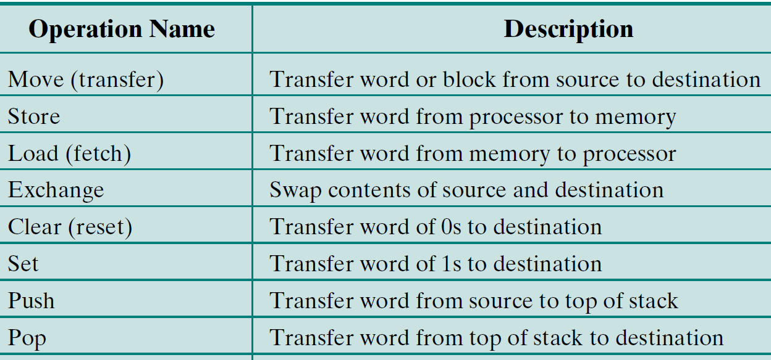
1. Data Transfer – Common Operations
Notes:
19

Slide 25
2. Arithmetic
Add, Subtract, Multiply, Divide
Signed Integer (fixed-point) numbers
Floating point numbers.
May include
Increment (a++)
Decrement (a--)
Negate (-a)
Absolute (if a<0 then -a else a)
May involve data transfer
Desired arithmetic operation performed by ALU.
Notes:
20

Slide 26
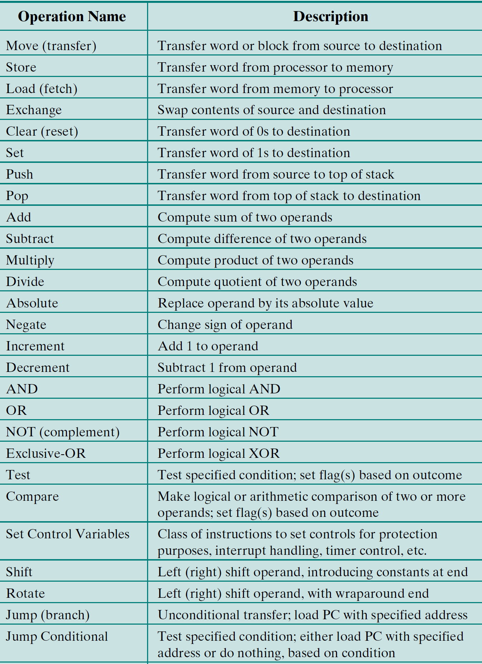
3. Logical – Common Operations
Notes:
21

Slide 27
3. Logical – AND, OR, NOT, XOR, …
To manipulate individual bits ➔ bit twiddling.
Could be used for bit masking:
Reset a specific group of bits:
Operation: AND
Mask: 0 for each bit to be reset and 1 otherwise.
Set a specific group of bits:
Operation: OR
Mask: 1 for each bit to be set and 0 otherwise.
Toggle a specific group of bits:
Operation: XOR
Mask: 1 for each bit to be inverted and 0 otherwise.
Notes:
21

Slide 28
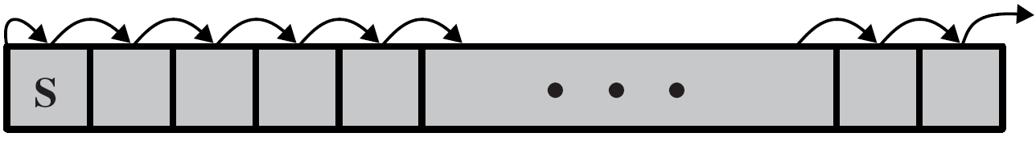
3. Logical – Shift and Rotate Operations
Logical right shift
Logical left shift
Arithmetic right shift
Arithmetic left shift
Right rotate
Left rotate

Slide 29
3. Logical – Shift and Rotate Operations
Example: suppose we wish to unpack 2 characters from 16-bit location and send them to an I/O device.
Process left-hand character:
Load word into register.
Shift 8-bit positions to right.
Perform I/O.
Process right-hand character:
Load word again into register.
AND with 0000000011111111.
Perform I/O.

Slide 30
Reading Material
Stallings, Chapter 12:
Pages 406 – 424

