Slide 1

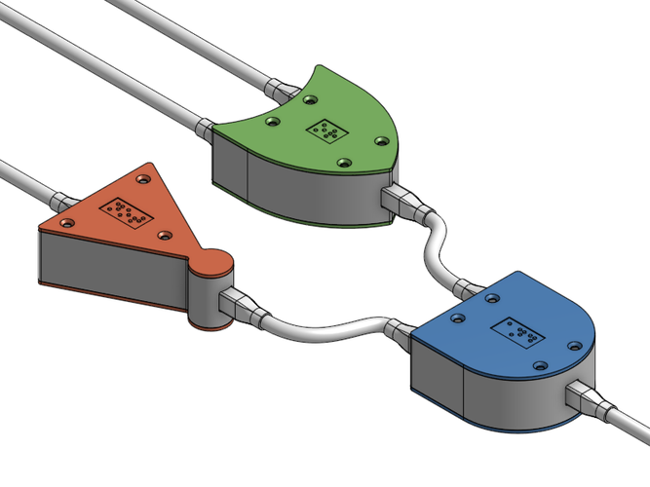
CS 211 - Digital Logic Design 211 عال - تصميم المنطق الرقمي First Term - 1439/1440 Lecture #5
Dr. Hazem Ibrahim Shehata
Assistant Professor
College of Computing and Information Technology

Slide 2
Administrivia
Assignment #1:
Released on Sunday.
Due: Sunday, October 7, 2018.
Website: http://hshehata.github.io/courses/su/cs211

Slide 3
Chapter 3: Logic Gates

Slide 4
Logic Gates/Circuits
Logic Gate: electronic device implementing a basic logical operation on 1⁺ binary input and producing 1 binary output.
Examples:
Logic Circuit: electronic circuit built out of logic gates!
Each wire carries a single bit represented in terms of voltage level.
High voltage level (e.g., 5v) ➔ logical 1.
Low voltage level (e.g., 0v) ➔ logical 0.
Example:
NOT Gate
AND Gate
OR Gate
High (1)
High (1)
Low (0)
Low (0)
Low (0)

Slide 5
Inverter (or NOT Gate)
Performs operation called inversion or complementation.
Takes 1 (single-bit) input, and produces 1 (single-bit) output.
Output value equals the inverse of input value.
Symbols:

Slide 6
Operation of Inverter
Possible scenarios:
Low voltage applied to input ➔ High voltage produced at output
High voltage applied to input ➔ Low voltage produced at output
Operation can be represented as a Truth Table, that lists all input combinations with the corresponding outputs!
Input | Output
Input | Output
Low (0)
High (1)
Input | Output
Low (0) | High (1)
High (1) | Low (0)

Slide 7
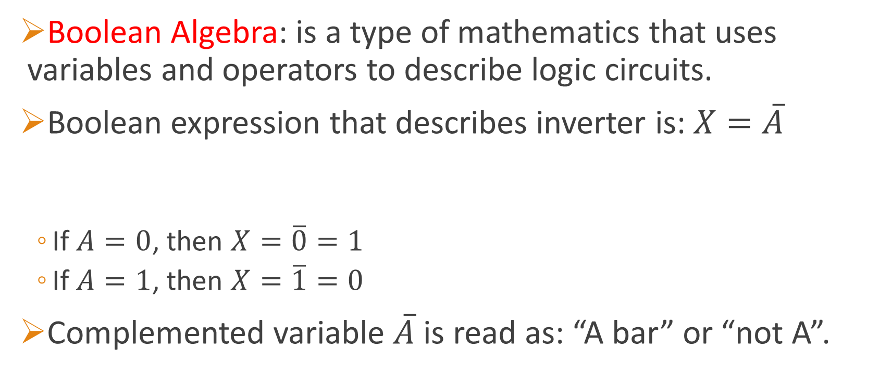
Logic Expression of Inverter
Boolean Algebra: is a type of mathematics that uses variables and operators to describe logic circuits.
Boolean expression that describes inverter is: $X=\overline{A}$
If $A=0$, then $X=\overline{0}=1$
If $A=1$, then $X=\overline{1}=0$
Complemented variable $\overline{A}$ is read as: “A bar” or “not A”.

Slide 8


Timing Diagram of Inverter
Timing Diagram: represents how signals of a logic circuit change over time.
X-axis ➔ time.
Y-axis ➔ signals values. Either High (1) or Low (0).
Example:
$$X$$
High
Low
Time
$$A$$
High
Low
Time

Slide 9
Application of Inverter
Inverters can be used to calculate 1’s complement of binary numbers.
Example: Circuit to produce 1’s comp. of an 8-bit number.

Slide 10
AND Gate
Performs operation called logical multiplication.
Takes 2⁺ inputs, and produces 1 output.
Output value is High (1) if and only if all inputs are High (1).
Output value is Low (0) if and only if 1⁺ inputs are Low (0).
Symbols:

Slide 11
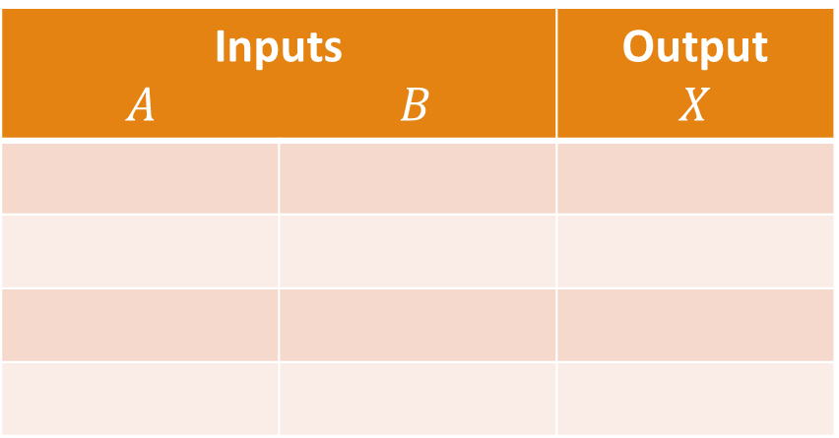

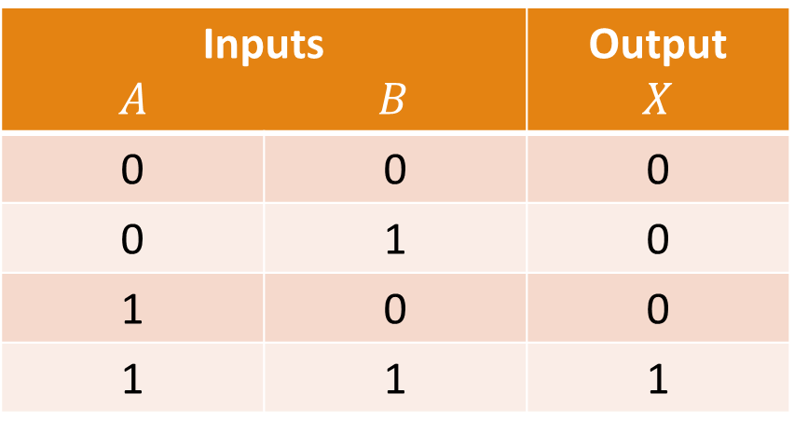
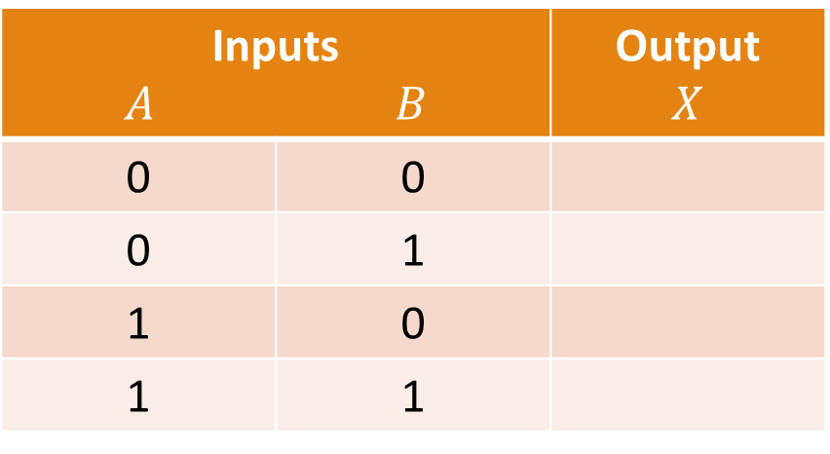
AND Gate Truth Table
For a 2-input AND Gate:
Note: Number of possible binary input combinations to an $n$-input gate is: $2^{n}$ ➔ Truth table must have $2^{n}$ rows!
Inputs $A$ $B$ |  | Output $$X$$
Inputs $A$ $B$ |  | Output $$X$$
0 | 0
0 | 1
1 | 0
1 | 1
Inputs $A$ $B$ |  | Output $$X$$
0 | 0 | 0
0 | 1 | 0
1 | 0 | 0
1 | 1 | 1

Slide 12

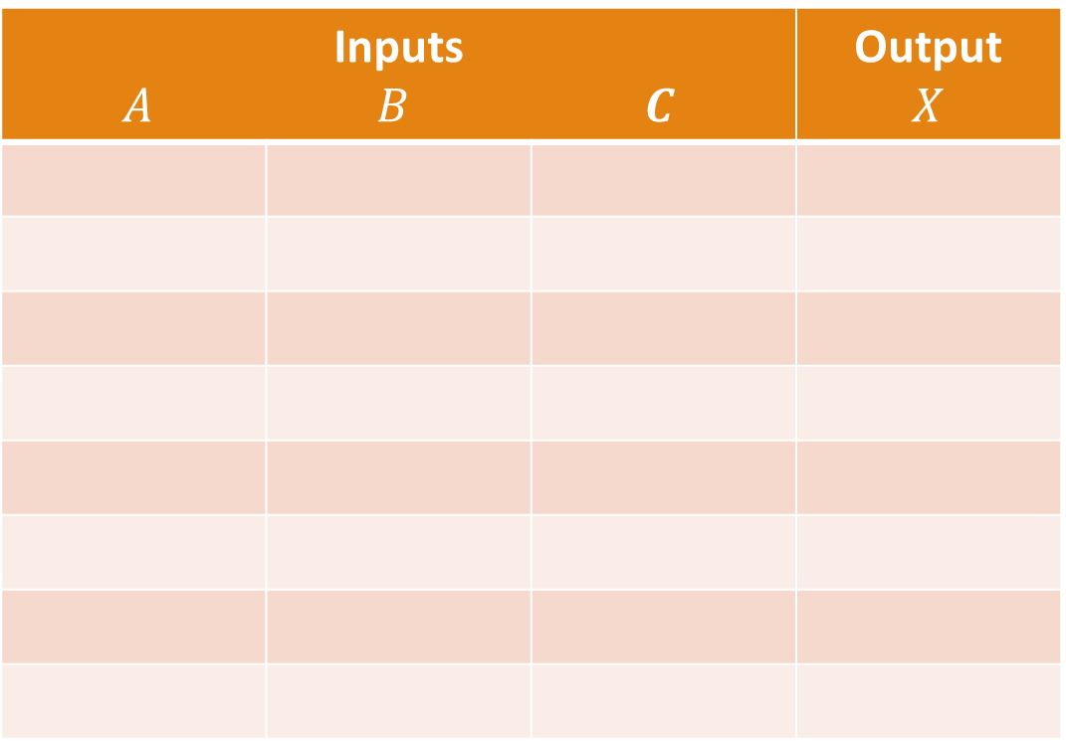
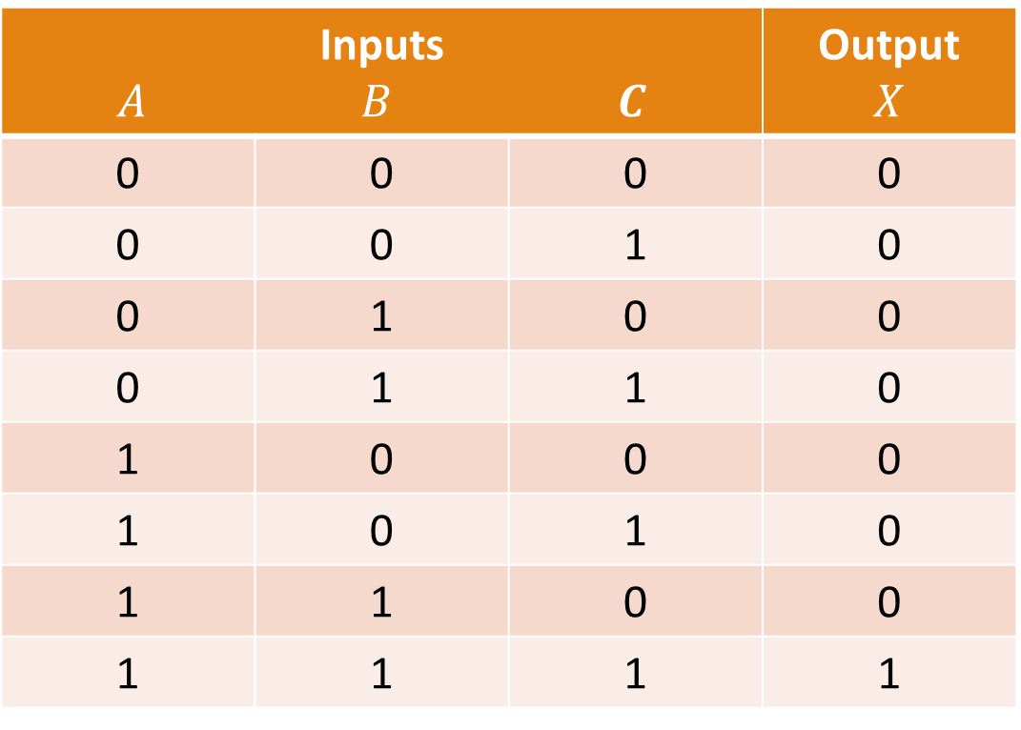
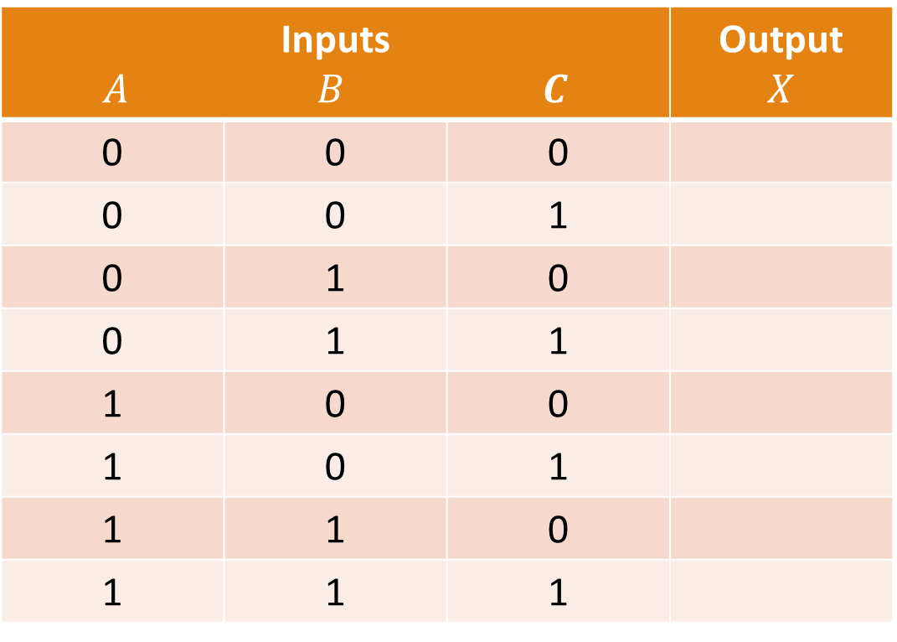
Example: Truth Table for 3-input AND Gate
Inputs $A$ $B$ $C$ |  |  | Output $$X$$
Inputs $A$ $B$ $C$ |  |  | Output $$X$$
0 | 0 | 0
0 | 0 | 1
0 | 1 | 0
0 | 1 | 1
1 | 0 | 0
1 | 0 | 1
1 | 1 | 0
1 | 1 | 1
Inputs $A$ $B$ $C$ |  |  | Output $$X$$
0 | 0 | 0 | 0
0 | 0 | 1 | 0
0 | 1 | 0 | 0
0 | 1 | 1 | 0
1 | 0 | 0 | 0
1 | 0 | 1 | 0
1 | 1 | 0 | 0
1 | 1 | 1 | 1
$n=3$ ➔ $N=2^{3}=8$

Slide 13
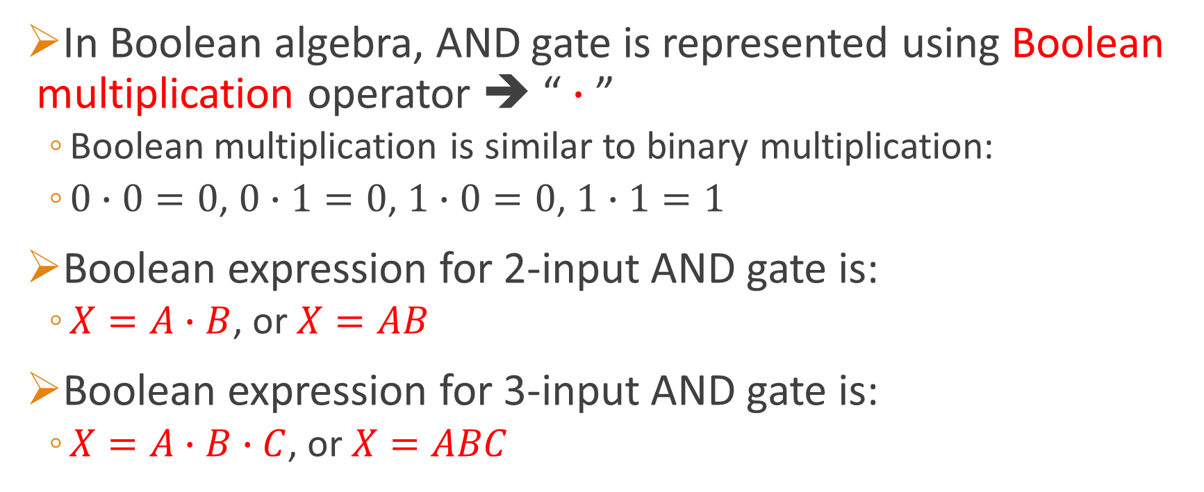
Logic Expression of AND Gate
In Boolean algebra, AND gate is represented using Boolean multiplication operator ➔ “ $∙$ ”
Boolean multiplication is similar to binary multiplication:
$0∙0=0$, $0∙1=0$, $1∙0=0$, $1∙1=1$
Boolean expression for 2-input AND gate is:
$X=A∙B$, or $X=AB$
Boolean expression for 3-input AND gate is:
$X=A∙B∙C$, or $X=ABC$

Slide 14
Timing Diagram of AND Gate
Example: 2-input AND Gate

Slide 15
Application of AND Gate
Example: Seat Belt Alarm System

Slide 16
OR Gate
Performs operation called logical addition.
Takes 2⁺ inputs, and produces 1 output.
Output value is High (1) if and only if 1⁺ inputs are High (1).
Output value is Low (0) if and only if all inputs are Low (0).
Symbols:

Slide 17
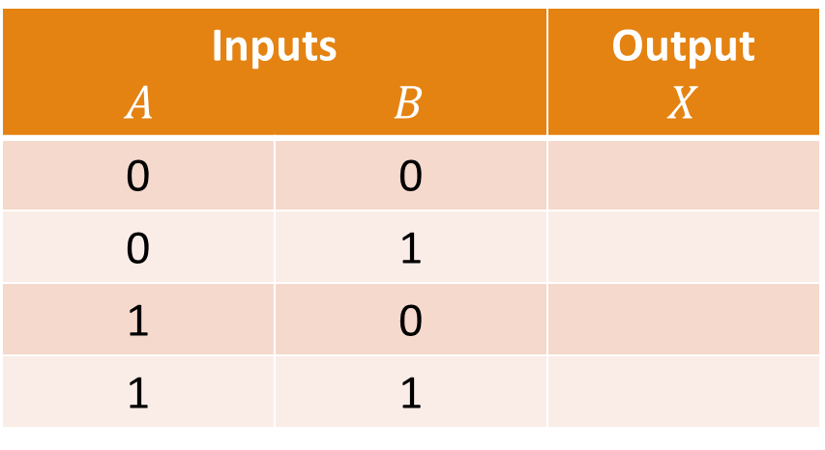
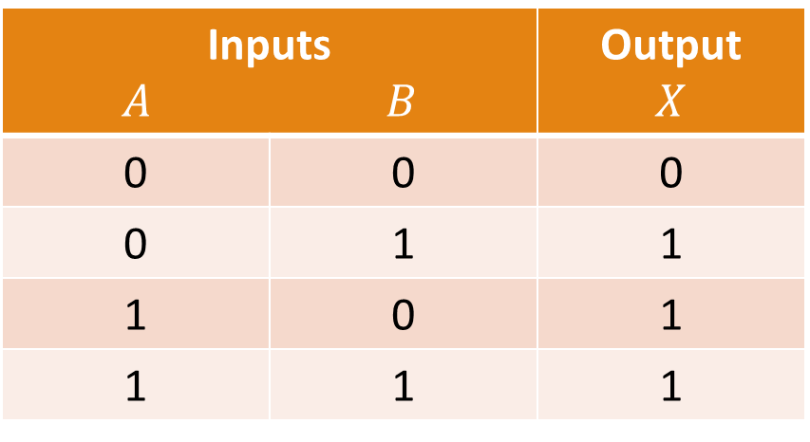
OR Gate Truth Table
For a 2-input OR Gate:
Inputs $A$ $B$ |  | Output $$X$$
0 | 0
0 | 1
1 | 0
1 | 1
Inputs $A$ $B$ |  | Output $$X$$
0 | 0 | 0
0 | 1 | 1
1 | 0 | 1
1 | 1 | 1

Slide 18
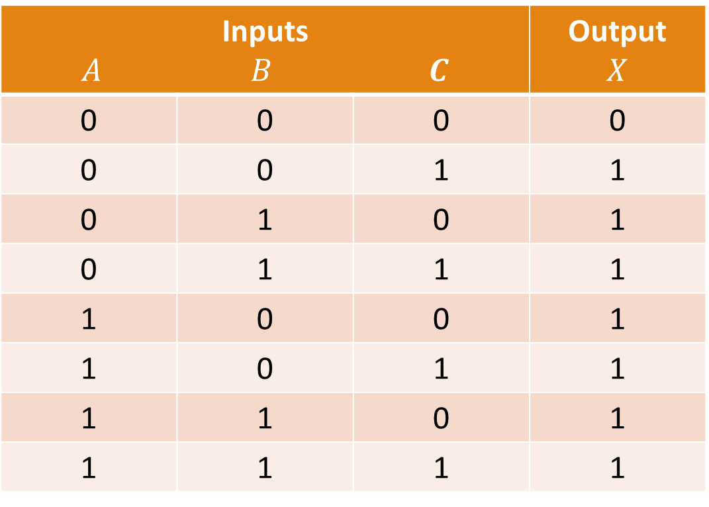
Example: Truth Table for 3-input OR Gate
Inputs $A$ $B$ $C$ |  |  | Output $$X$$
0 | 0 | 0
0 | 0 | 1
0 | 1 | 0
0 | 1 | 1
1 | 0 | 0
1 | 0 | 1
1 | 1 | 0
1 | 1 | 1
Inputs $A$ $B$ $C$ |  |  | Output $$X$$
0 | 0 | 0 | 0
0 | 0 | 1 | 1
0 | 1 | 0 | 1
0 | 1 | 1 | 1
1 | 0 | 0 | 1
1 | 0 | 1 | 1
1 | 1 | 0 | 1
1 | 1 | 1 | 1
$n=3$ ➔ $N=2^{3}=8$

Slide 19
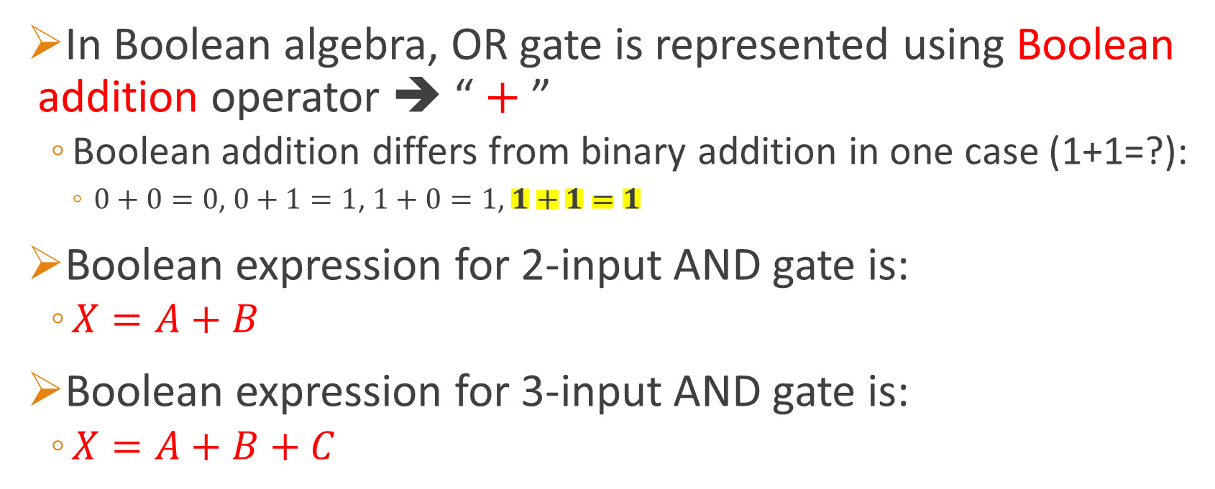
Logic Expression of OR Gate
In Boolean algebra, OR gate is represented using Boolean addition operator ➔ “ $+$ ”
Boolean addition differs from binary addition in one case (1+1=?):
$0+0=0$, $0+1=1$, $1+0=1$, $1+1=1$
Boolean expression for 2-input AND gate is:
$X=A+B$
Boolean expression for 3-input AND gate is:
$X=A+B+C$

Slide 20
Timing Diagram of OR Gate
Example: 2-input OR Gate

Slide 21
Application of OR Gate
Example: Simplified Intrusion Detection System

Slide 22
NAND Gate
Contraction of NOT-AND ➔ AND with an inverted output.
Takes 2⁺ inputs, and produces 1 output.
Output value is Low (0) if and only if all inputs are High (1).
Output value is High (1) if and only if 1⁺ inputs are Low (0).
Symbols:
Equivalent to:

Slide 23
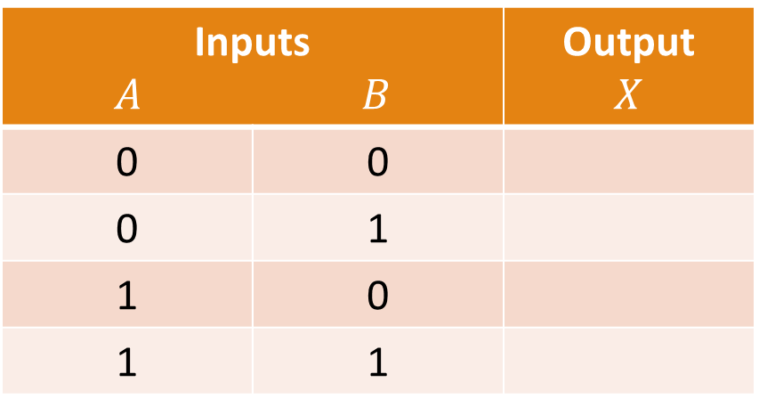
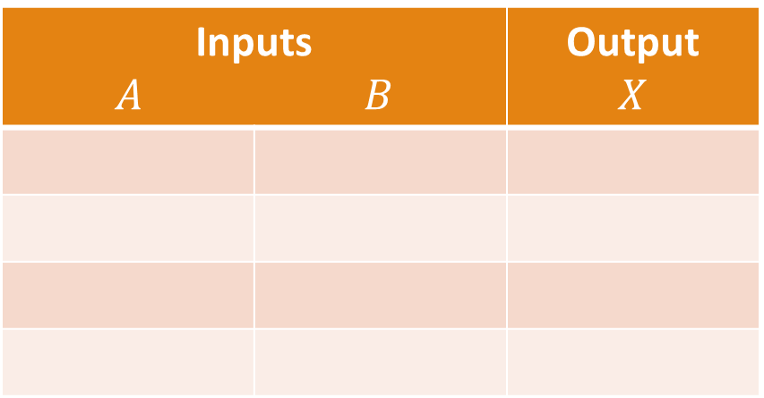
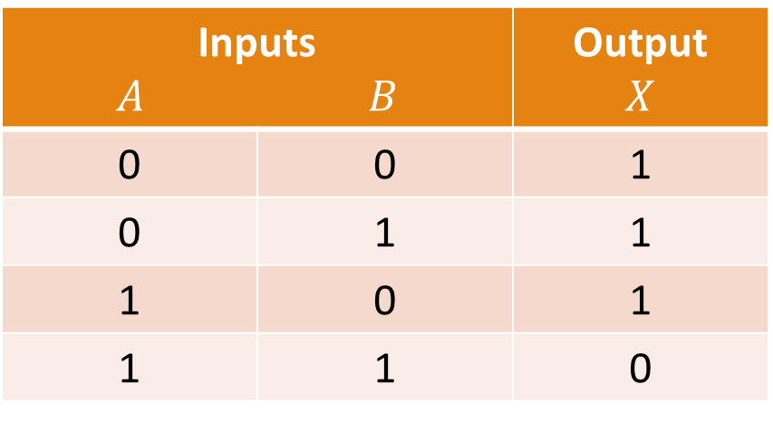
NAND Gate Truth Table
For a 2-input NAND Gate:
Note: NAND Gate is equivalent to Negative-OR Gate.
Inputs $A$ $B$ |  | Output $$X$$
Inputs $A$ $B$ |  | Output $$X$$
0 | 0
0 | 1
1 | 0
1 | 1
Inputs $A$ $B$ |  | Output $$X$$
0 | 0 | 1
0 | 1 | 1
1 | 0 | 1
1 | 1 | 0

Slide 24
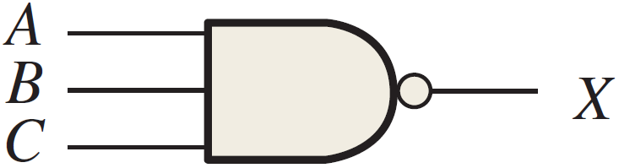
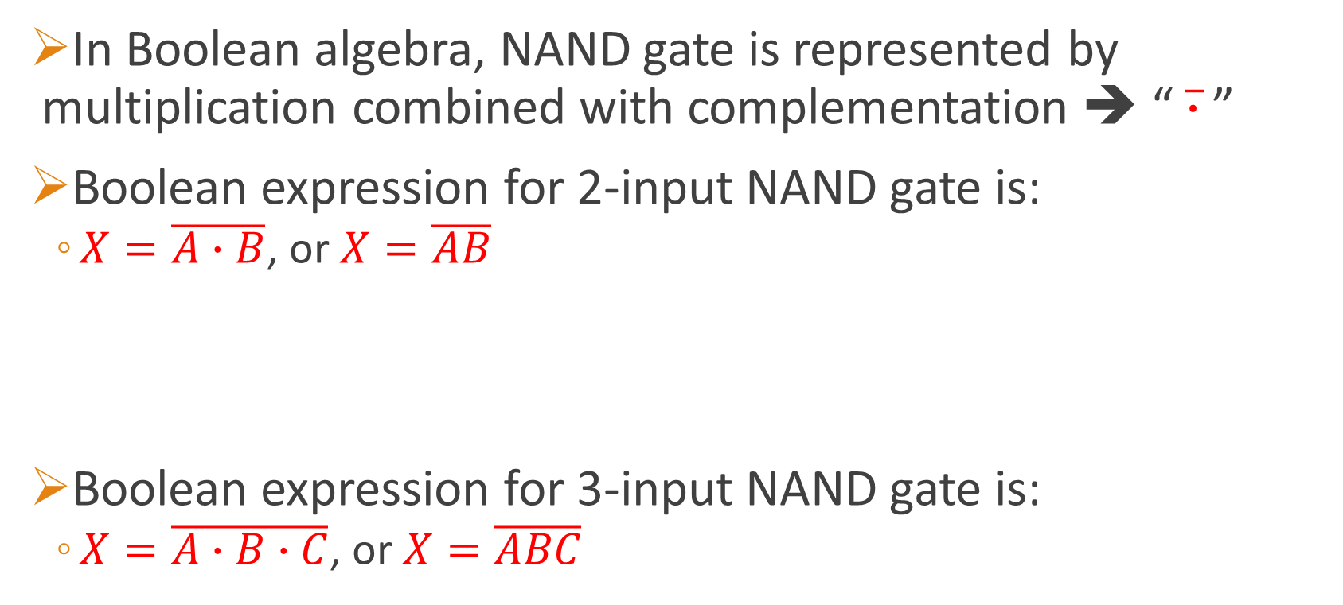
Logic Expression of NAND Gate
In Boolean algebra, NAND gate is represented by multiplication combined with complementation ➔ “ $\overline{∙}$ ”
Boolean expression for 2-input NAND gate is:
$X=\overline{A∙B}$, or $X=\overline{AB}$
Boolean expression for 3-input NAND gate is:
$X=\overline{A∙B∙C}$, or $X=\overline{ABC}$

Slide 25
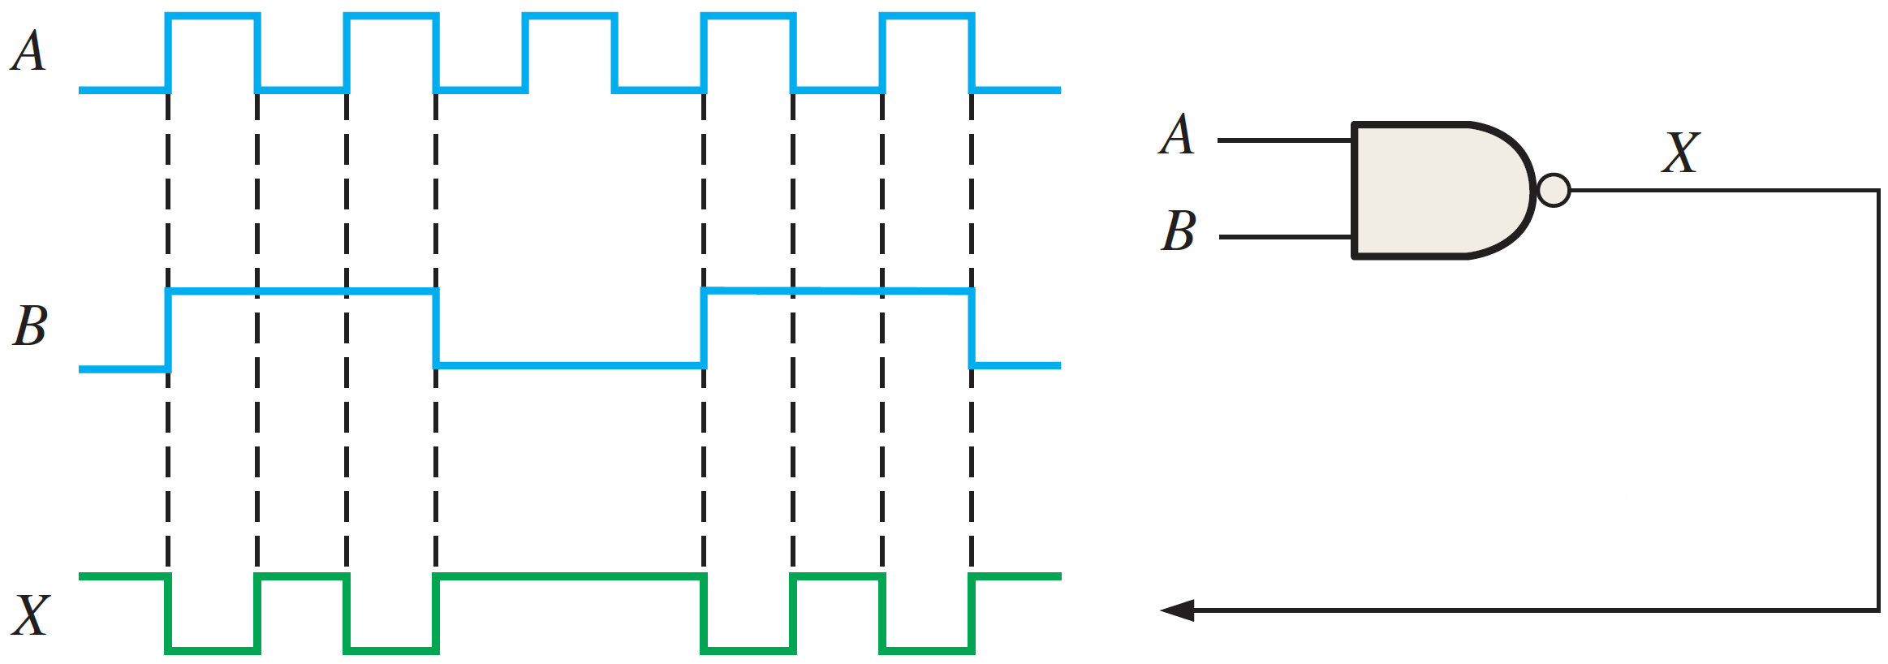
Timing Diagram of NAND Gate
Example: 2-input NAND Gate

Slide 26
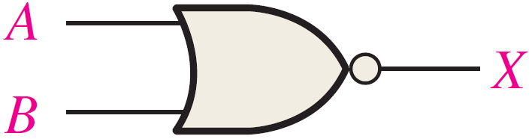
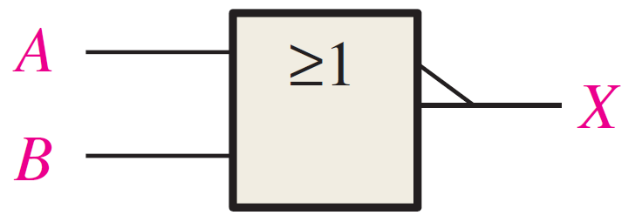
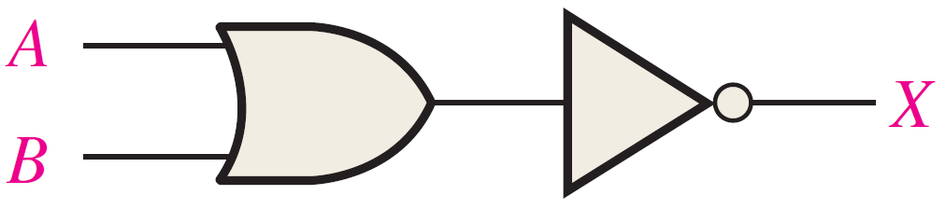
NOR Gate
Contraction of NOT-OR ➔ OR with an inverted output.
Takes 2⁺ inputs, and produces 1 output.
Output value is Low (0) if and only if 1⁺ inputs are High (1).
Output value is High (1) if and only if all inputs are Low (0).
Symbols:
Equivalent to:

Slide 27
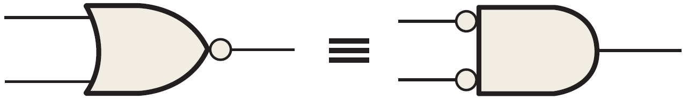
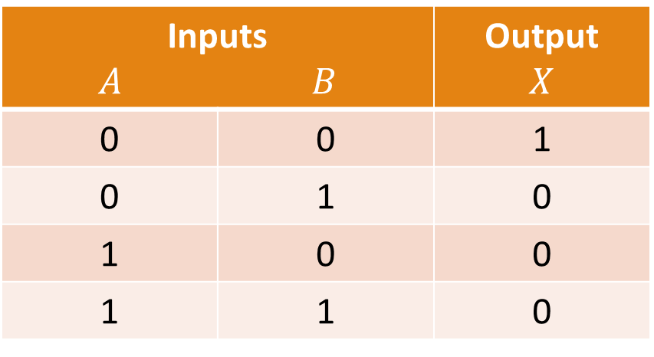
NOR Gate Truth Table
For a 2-input NOR Gate:
Note: NOR Gate is equivalent to Negative-AND Gate.
Inputs $A$ $B$ |  | Output $$X$$
Inputs $A$ $B$ |  | Output $$X$$
0 | 0
0 | 1
1 | 0
1 | 1
Inputs $A$ $B$ |  | Output $$X$$
0 | 0 | 1
0 | 1 | 0
1 | 0 | 0
1 | 1 | 0

Slide 28
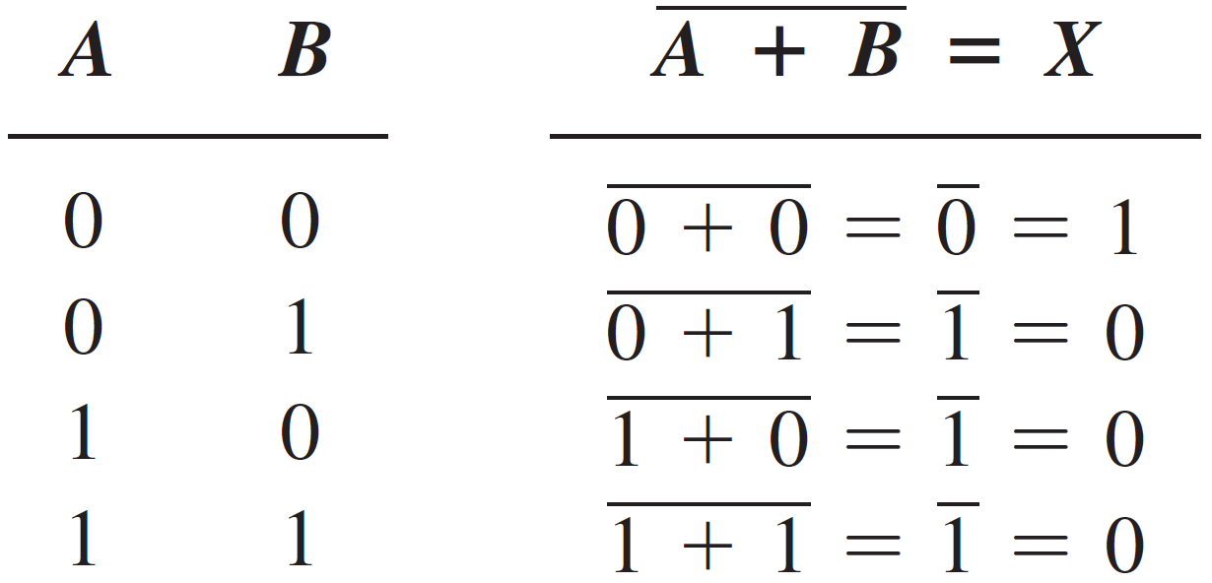
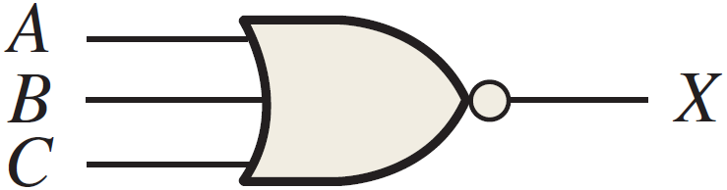
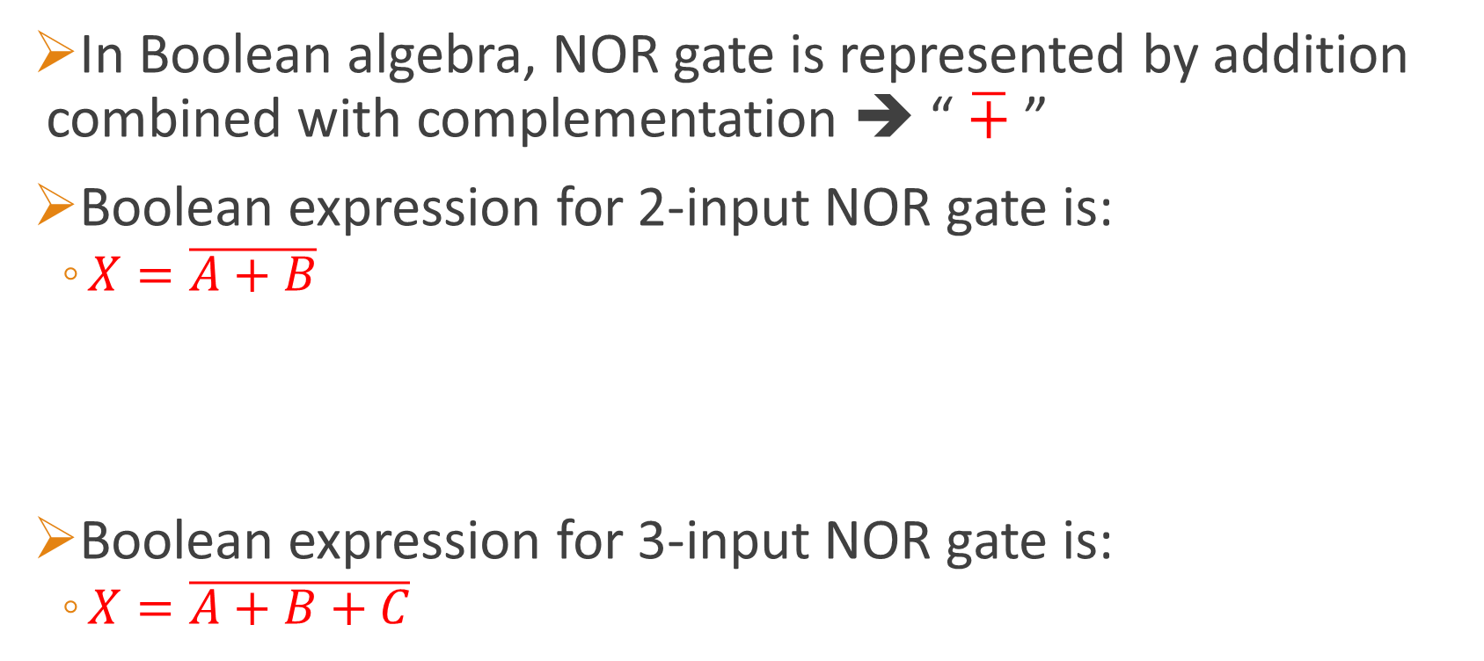
Logic Expression of NOR Gate
In Boolean algebra, NOR gate is represented by addition combined with complementation ➔ “ $\overline{+}$ ”
Boolean expression for 2-input NOR gate is:
$X=\overline{A+B}$
Boolean expression for 3-input NOR gate is:
$X=\overline{A+B+C}$

Slide 29
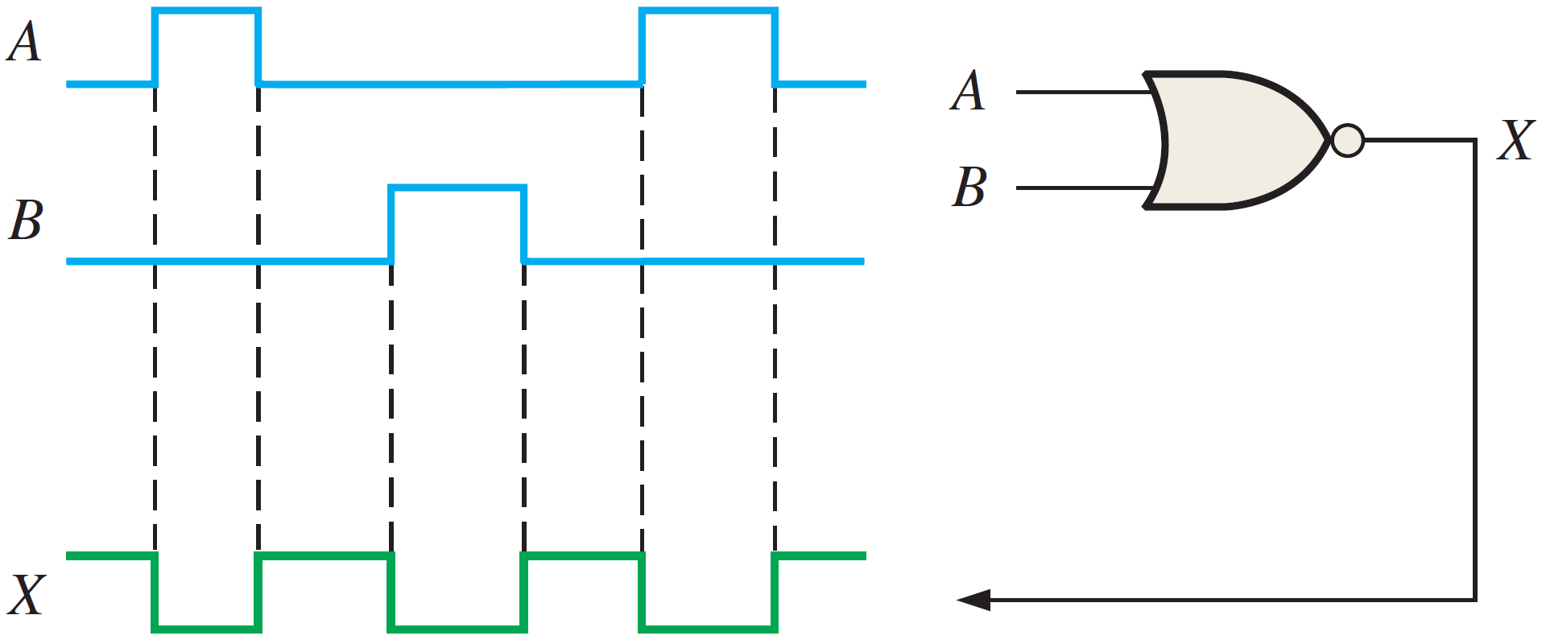
Timing Diagram of NOR Gate
Example: 2-input NOR Gate

Slide 30
Reading Material
Floyd, Chapter 3:
Pages 107 - 130

