Slide 1

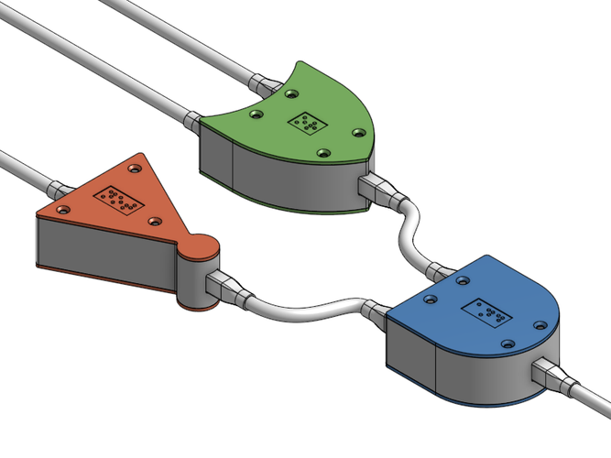
CS 211 - Digital Logic Design 211 عال - تصميم المنطق الرقمي First Term - 1439/1440 Lecture #4
Dr. Hazem Ibrahim Shehata
Assistant Professor
College of Computing and Information Technology

Slide 2
Administrivia
Assignment #1:
To be released on Sunday.
Work in groups of two.
Website: http://hshehata.github.io/courses/su/cs211

Slide 3
Floating-Point Numbers
Usage: To represent very large/small integers and positive/negative real numbers with small number of bits!
Idea: Use scientific notation ➔ number consists of three components: sign, mantissa (1+fraction), exponent.
Example:
101100100000000000₂ ➔ 1.011001 * 2¹⁰⁰⁰¹
- 0.000000000001101₂ ➔ - 1.101 * 2⁻¹¹⁰⁰
sign
mantissa
exponent

Slide 4
Single-Precision Floating-Point Numbers
In IEEE standard 754, single-precision floating-point numbers are represented by 32 bits:
Sign (S): 0 ➔ positive, 1 ➔ negative
Biased Exponent (E): Actual exponent plus 127₁₀ (or 01111111₂).
Fraction (F): Fractional part of mantissa.
32 bits
Sign (S)
Exponent (E)
Fraction (F)
1 bit
8 bits
23 bits

Slide 5
Conversion: Decimal ➔ Single-Precision
Method: Convert from decimal to binary, then rewrite binary number in the form: ±1.xxx…xxx * 2^{±xxx…xxx}
Example: Represent -100.25₁₀ as a single-precision floating-point number.
Solution:
-100.25₁₀ ➔ -1100100.01₂
➔ -1.10010001 * 2¹¹⁰
S=1, E = 110 + 01111111 = 10000101, F=10010001000…000
Number = 1 10000101 10010001000000000000000

Slide 6
Conversion: Single-Precision ➔ Decimal
Method: Convert to binary using: (-1)^{S}(1+F)(2^{E-127}), then convert to decimal.
Example: Convert the following single-precision FP number to decimal: 1 01111110 01000000000000000000000.
Solution:
Number = (-1)¹(1 + 0.010…000)(2¹²⁶⁻¹²⁷)
= -1.01 * 2⁻¹ = -0.101₂
= -(0.5 + 0.125) = -0.625

Slide 7
Digital Codes
Many specialized codes are used in digital systems:
Strictly numeric: represent numbers only.
Weighted - Arithmetic ➔ Example: Binary-Coded Decimal (BCD).
Unweighted – Non-arithmetic ➔ Example: Gray Code.
…
Alpha-numeric: represent numbers, symbols, letters, … etc.
Example: ASCII Code.
…

Slide 8
Binary-Coded Decimal (BCD)
A way of representing decimal numbers using bits!!
Each decimal digit is encoded using 4-bits:
Note: the codes 1010 through 1111 are not used in BCD!!
Decimal Digit | 0 | 1 | 2 | 3 | 4 | 5 | 6 | 7 | 8 | 9
BCD | 0000 | 0001 | 0010 | 0011 | 0100 | 0101 | 0110 | 0111 | 1000 | 1001

Slide 9
Conversion: Decimal ➔ BCD
Method: Replace each decimal digit with the appropriate 4-bit code.
Example: Convert 4905₁₀ to BCD.
Solution:
4
9
0
5
0100
1001
0000
0101

Slide 10
Conversion: BCD ➔ Decimal
Method: Group each 4 bits and replace with equivalent decimal digit.
Example: Convert 10000001011101101001_{BCD} to Decimal.
Solution:
1000
0001
0111
0110
1001
8
1
7
6
9

Slide 11
BCD Addition
Step 1: Add using rules for binary addition
Step 2: If 4-bit sum <= 9, it is a valid BCD number.
Step 3: If a 4-bit sum > 9, or if a carry out of 4-bit group generated, Add 6 (0110) to it ➔ correction.
Example:
1
0110 0101
0110 0101
0110 1000
+
0011 0001
+
0001 0111
+
0001 1001
1001 0110
0111 1100
1000 0001
+
0110
+
0110
1000 0010
1000 0111

Slide 12
BCD Subtraction
Step 1: Subtract using rules for binary addition
Step 2: If 4-bit difference <= 9, it is a valid BCD number.
Step 3: If a 4-bit sum > 9, or if a carry out of 4-bit group generated, Add 6 (0110) to it ➔ correction.
Example:
1
0110 0101
0110 0101
0110 0010
–
0011 0001
–
0001 0111
–
0001 1001
0011 0100
0100 1110
0100 1001
–
0110
–
0110
1000 1000
0100 0011

Slide 13
Gray Code
Unweighted & Non-arithmetic code
No specific weights assigned to the bit positions!
Most important feature:
Only 1-bit change from one code word to next in sequence!
Has many applications:
Whenever error susceptibility increases with number of bit changes between adjacent numbers in a sequence!

Slide 14
Four-bit Gray Code
Decimal Number | Binary Number |  |  |  | Gray Code
00 | 0 | 0 | 0 | 0
01 | 0 | 0 | 0 | 1
02 | 0 | 0 | 1 | 0
03 | 0 | 0 | 1 | 1
04 | 0 | 1 | 0 | 0
05 | 0 | 1 | 0 | 1
06 | 0 | 1 | 1 | 0
07 | 0 | 1 | 1 | 1
08 | 1 | 0 | 0 | 0
09 | 1 | 0 | 0 | 1
10 | 1 | 0 | 1 | 0
11 | 1 | 0 | 1 | 1
12 | 1 | 1 | 0 | 0
13 | 1 | 1 | 0 | 1
14 | 1 | 1 | 1 | 0
15 | 1 | 1 | 1 | 1
Decimal Number | Binary Number |  |  |  | Gray Code
00 | 0 | 0 | 0 | 0 | 0 | 0 | 0 | 0
01 | 0 | 0 | 0 | 1 | 0 | 0 | 0 | 1
02 | 0 | 0 | 1 | 0 | 0 | 0 | 1 | 1
03 | 0 | 0 | 1 | 1 | 0 | 0 | 1 | 0
04 | 0 | 1 | 0 | 0 | 0 | 1 | 1 | 0
05 | 0 | 1 | 0 | 1 | 0 | 1 | 1 | 1
06 | 0 | 1 | 1 | 0 | 0 | 1 | 0 | 1
07 | 0 | 1 | 1 | 1 | 0 | 1 | 0 | 0
08 | 1 | 0 | 0 | 0 | 1 | 1 | 0 | 0
09 | 1 | 0 | 0 | 1 | 1 | 1 | 0 | 1
10 | 1 | 0 | 1 | 0 | 1 | 1 | 1 | 1
11 | 1 | 0 | 1 | 1 | 1 | 1 | 1 | 0
12 | 1 | 1 | 0 | 0 | 1 | 0 | 1 | 0
13 | 1 | 1 | 0 | 1 | 1 | 0 | 1 | 1
14 | 1 | 1 | 1 | 0 | 1 | 0 | 0 | 1
15 | 1 | 1 | 1 | 1 | 1 | 0 | 0 | 0
Decimal Number | Binary Number |  |  |  | Gray Code
00
01
02
03
04
05
06
07
08
09
10
11
12
13
14
15

Slide 15
Conversion: Binary ➔ Gray Code
Method:
Most significant bit (MSB) in Gray code is same as corresponding MSB in binary.
Going from left to right, add each adjacent pair of binary code bits to get next Gray code bit. Discard carries.
Example: Convert 10110₂ to Gray code.
Solution:
1
+
0
+
1
+
1
+
0
1
1
1
0
1

Slide 16
Conversion: Gray Code ➔ Binary
Method:
Most significant bit in binary code is the same as corresponding bit in the Gray code.
Add each binary code bit generated to Gray code bit in next adjacent position. Discard carries.
Example: Convert Gray code 11011 to binary.
Solution:
1
1
0
1
1
+
+
+
+
1
0
0
1
0

Slide 17
ASCII Code
Stands for:
American Standard Code for Information Interchange
Alphanumeric code used in most computers.
When you enter a letter, a number, or control command on keyboard, corresponding ASCII code goes into computer.
ASCII code consists of 7 bits ➔ Represents 128 characters.

Slide 18
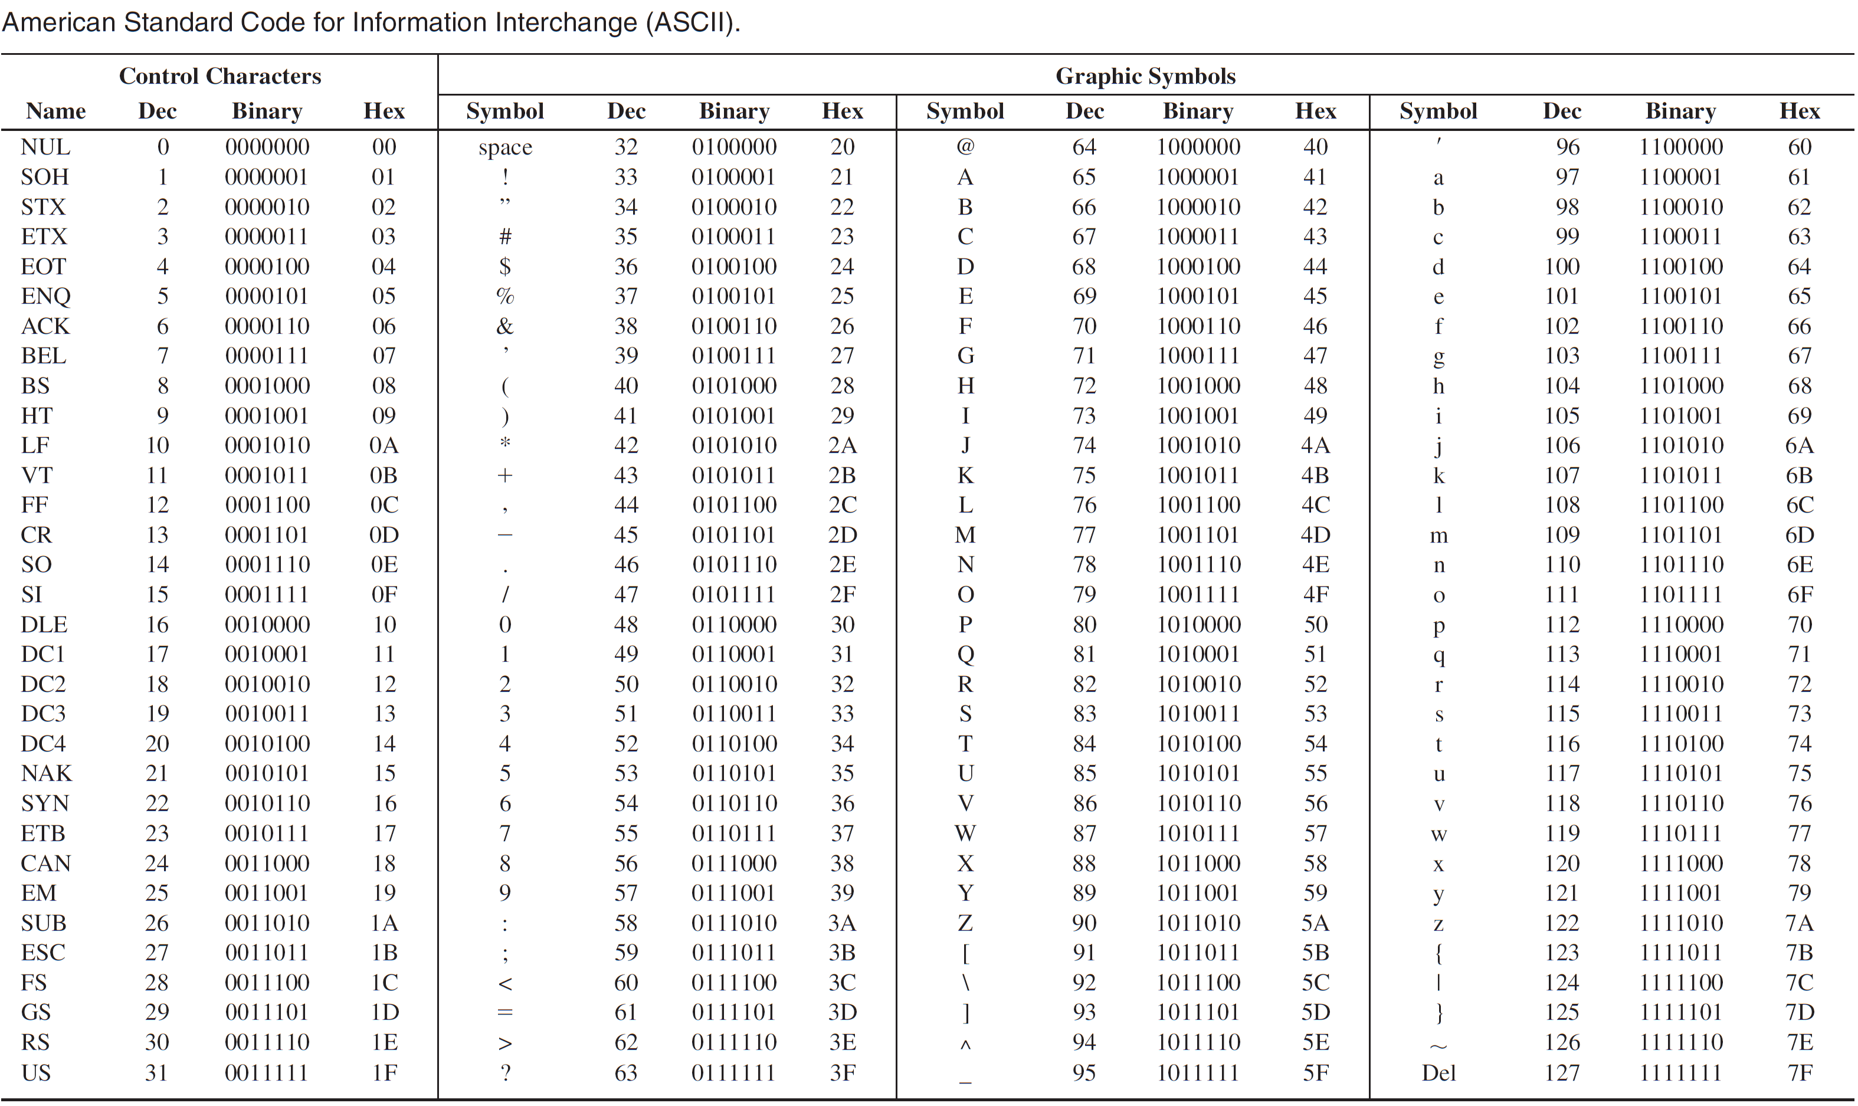

Slide 19
Error Codes
Simplest bit-error detection ➔ Parity method.
Parity method can detect simple transmission errors involving one bit (or an odd number of bits).
A parity bit is an “extra” bit attached to a group of bits to force the number of 1’s to be either even (even parity) or odd (odd parity).

Slide 20
Error Codes
Example: Add an even parity bit to the 7-bit ASCII code for the letter “K”. Then illustrate how single-bit transmission errors can be detected.
Solution:
ASCII code for “K” = 1001011
Number of 1’s is even ➔ parity bit = 0
Transmitter sends 8-bit: 01001011 (parity & ASCII code f “K”)
Suppose a single-bit error happens to 3rd bit ➔ 01001111
Receiver will find an odd number of 1’s ➔ error detected!!!

Slide 21
Reading Material
Floyd, Chapter 2:
Pages 63 - 65
Pages 82 - 90
Pages 92 - 93

