Slide 1

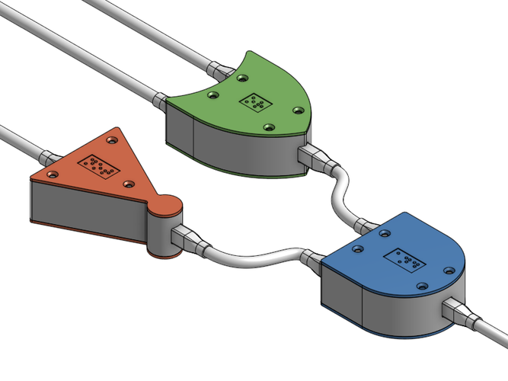
CSC 211 - Digital Logic Design 211 عال - تصميم المنطق الرقمي First Term - 1439/1440 Lecture #8
Dr. Hazem Ibrahim Shehata
Assistant Professor
College of Computing and Information Technology

Slide 2
Administrivia
Midterm #1:
Exam/Solution is available on the website.
Marks were posted to the website.
ILMS:
Will replace the website.
Please contact Mr. Nayaar to activate your accounts.
Website: http://hshehata.github.io/courses/su/cs211

Slide 3

Chapter 4: Boolean Algebra ... (... Continuing …)

Slide 4
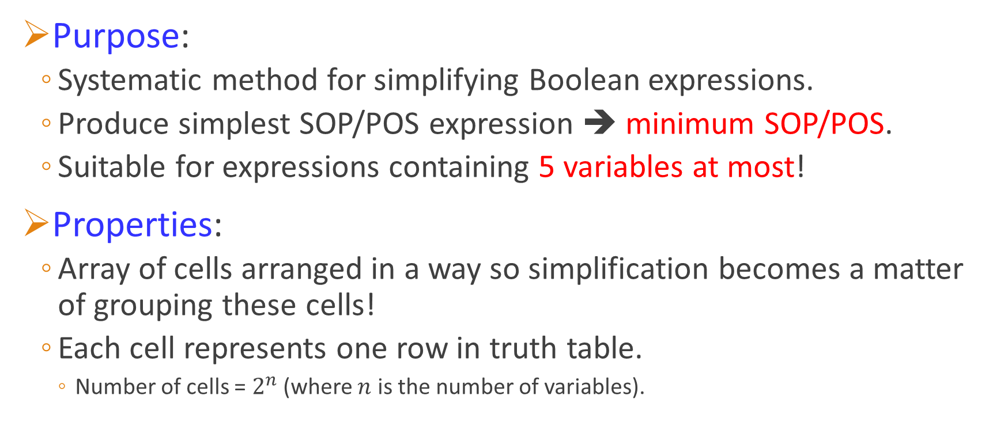
Karnaugh Map
Purpose:
Systematic method for simplifying Boolean expressions.
Produce simplest SOP/POS expression ➔ minimum SOP/POS.
Suitable for expressions containing 5 variables at most!
Properties:
Array of cells arranged in a way so simplification becomes a matter of grouping these cells!
Each cell represents one row in truth table.
Number of cells = $2^{n}$ (where $n$ is the number of variables).

Slide 5
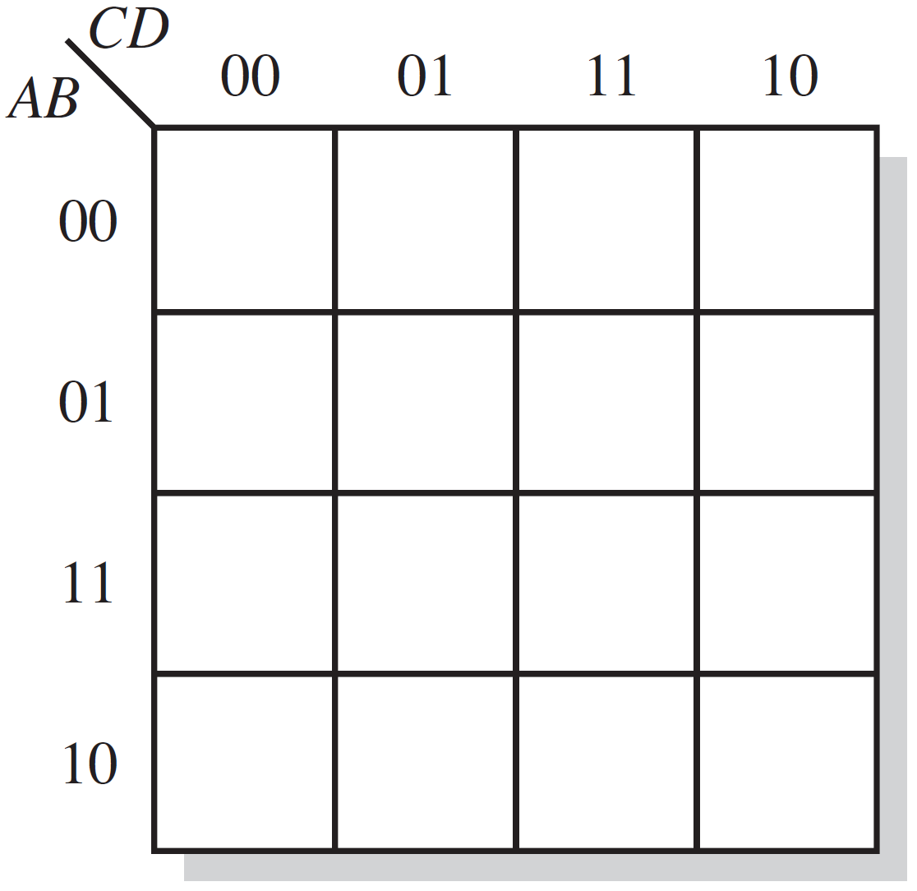
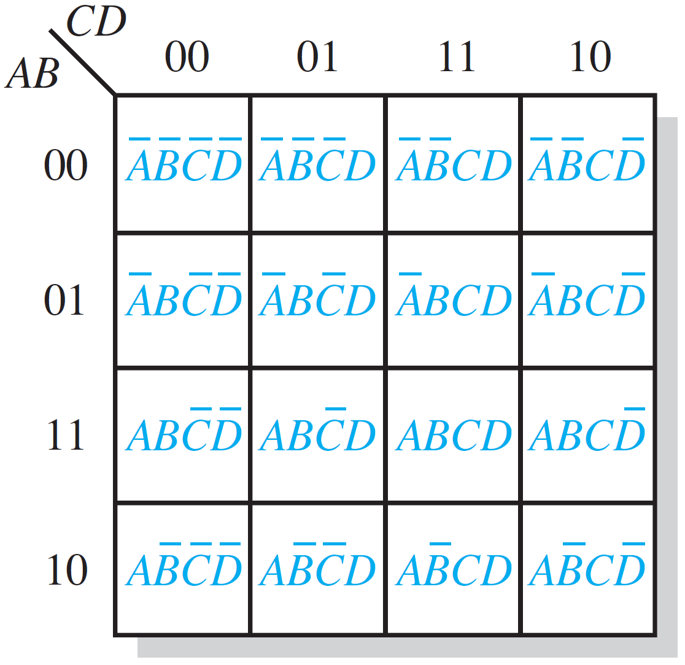
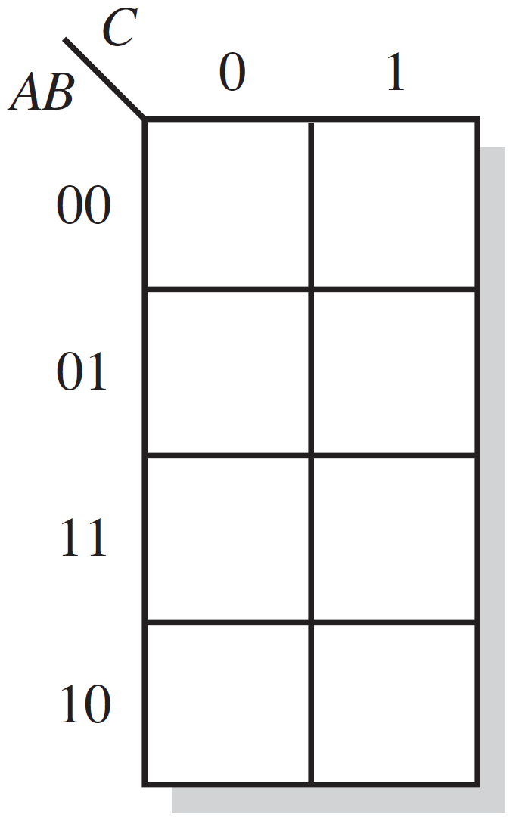
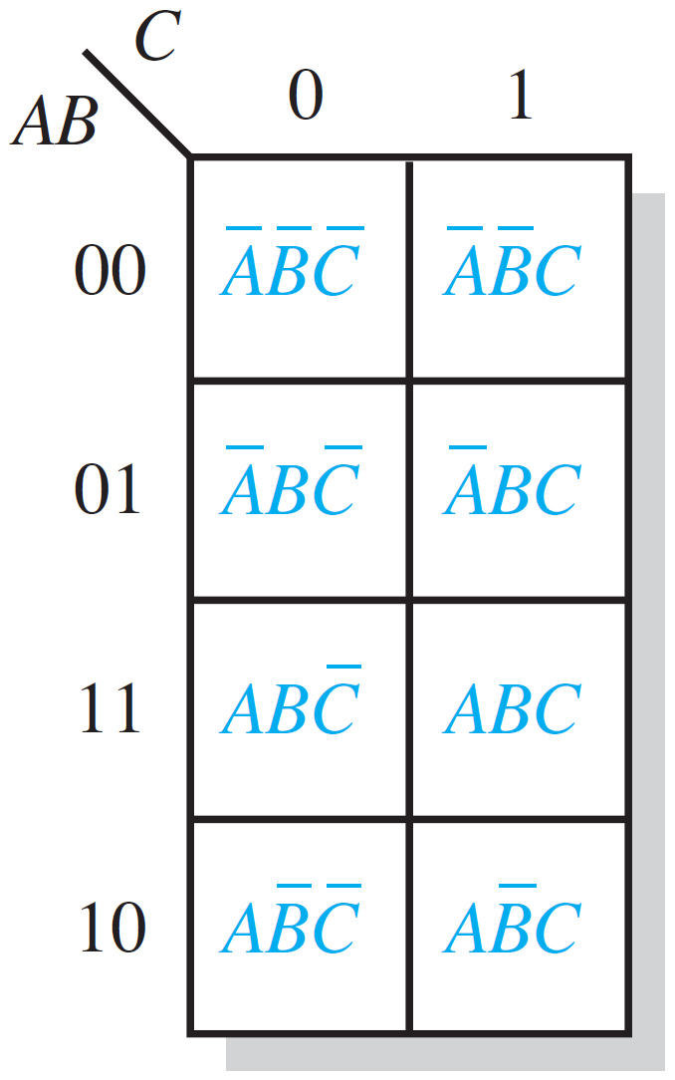
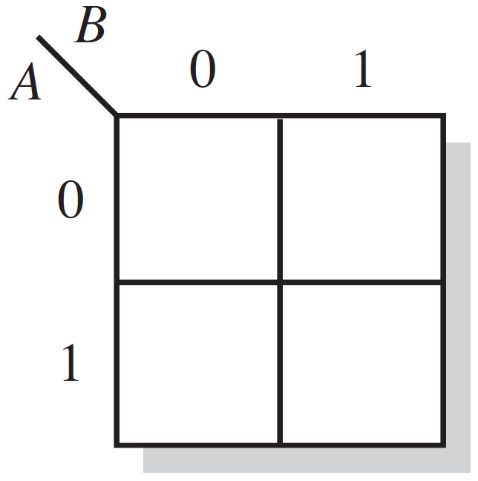
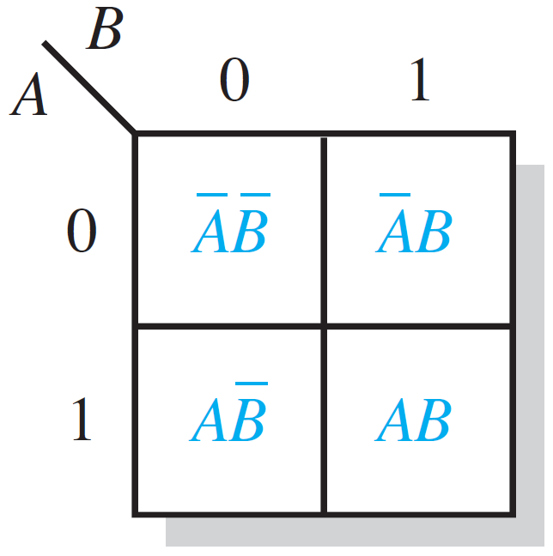
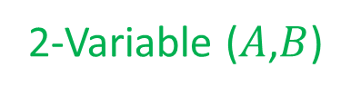
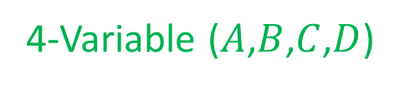
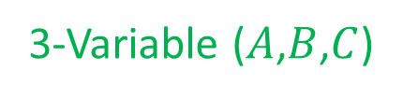
2-, 3-, and 4-Variable Karnaugh Maps
2-Variable ($A$,$B$)
3-Variable ($A$,$B$,$C$)
4-Variable ($A$,$B$,$C$,$D$)

Slide 6
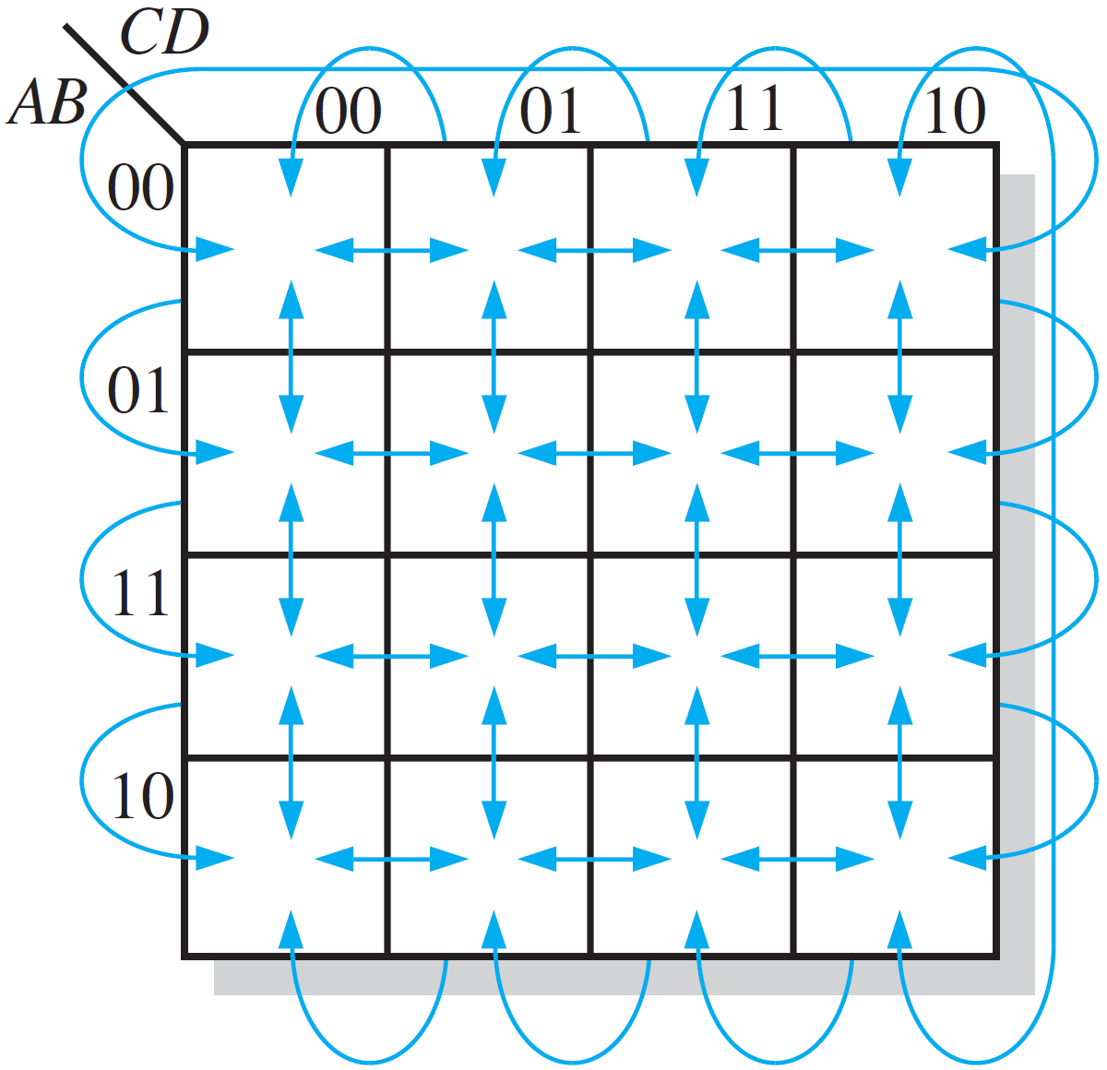
Cell Adjacency
Cells in a Karnaugh map are arranged so that there is only a single-variable change between adjacent cells.
Cells that differ by 1 variable are adjacent.
Example: 0011 & 0111, 0100 & 0110
Cells with values that differ by 2⁺ variables are not adjacent.
Example: 1101 & 0111

Slide 7
SOP Minimization Using Karnaugh Maps
Goal: Simplify a SOP expression (standard or non-standard) to its minimum form ➔ Minimum SOP!
Minimum SOP expression contains the fewest possible product terms with the fewest possible variables per term!!
Method:
Map SOP expression on a Karnaugh map.
Combine the 1’s on the map into maximum groups.
Determine minimum product term for each group, and combine minimum product terms to form a minimum SOP.

Slide 8

SOP Minimization Using Karnaugh Maps
Example (1): Standard-SOP ➔ K-Map
$X=\overline{A}\overline{B}\overline{C}+\overline{A}\overline{B}C+AB\overline{C}+A\overline{B}\overline{C}$
000
001
110
100
Map SOP expression on a Karnaugh map.
Determine binary values of product terms.
Place 1’s in corresponding cells.
1
1
1
1

Slide 9

SOP Minimization Using Karnaugh Maps
Example (1): Non-Standard-SOP ➔ K-Map
$X=\overline{A}+A\overline{B}+AB\overline{C}$
0xx
10x
110
Map SOP expression on a Karnaugh map.
Determine binary values of product terms.
Place 1’s in corresponding cells.
1
1
1
1
1
1
1

Slide 10
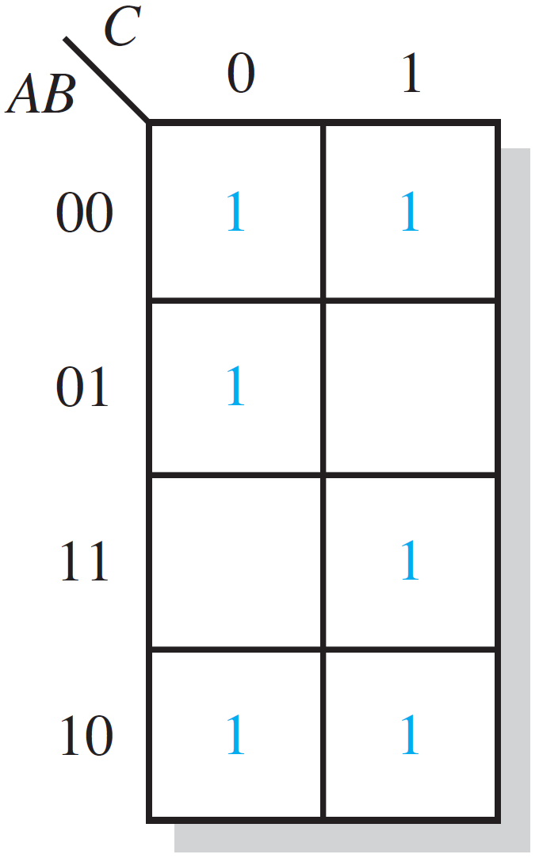
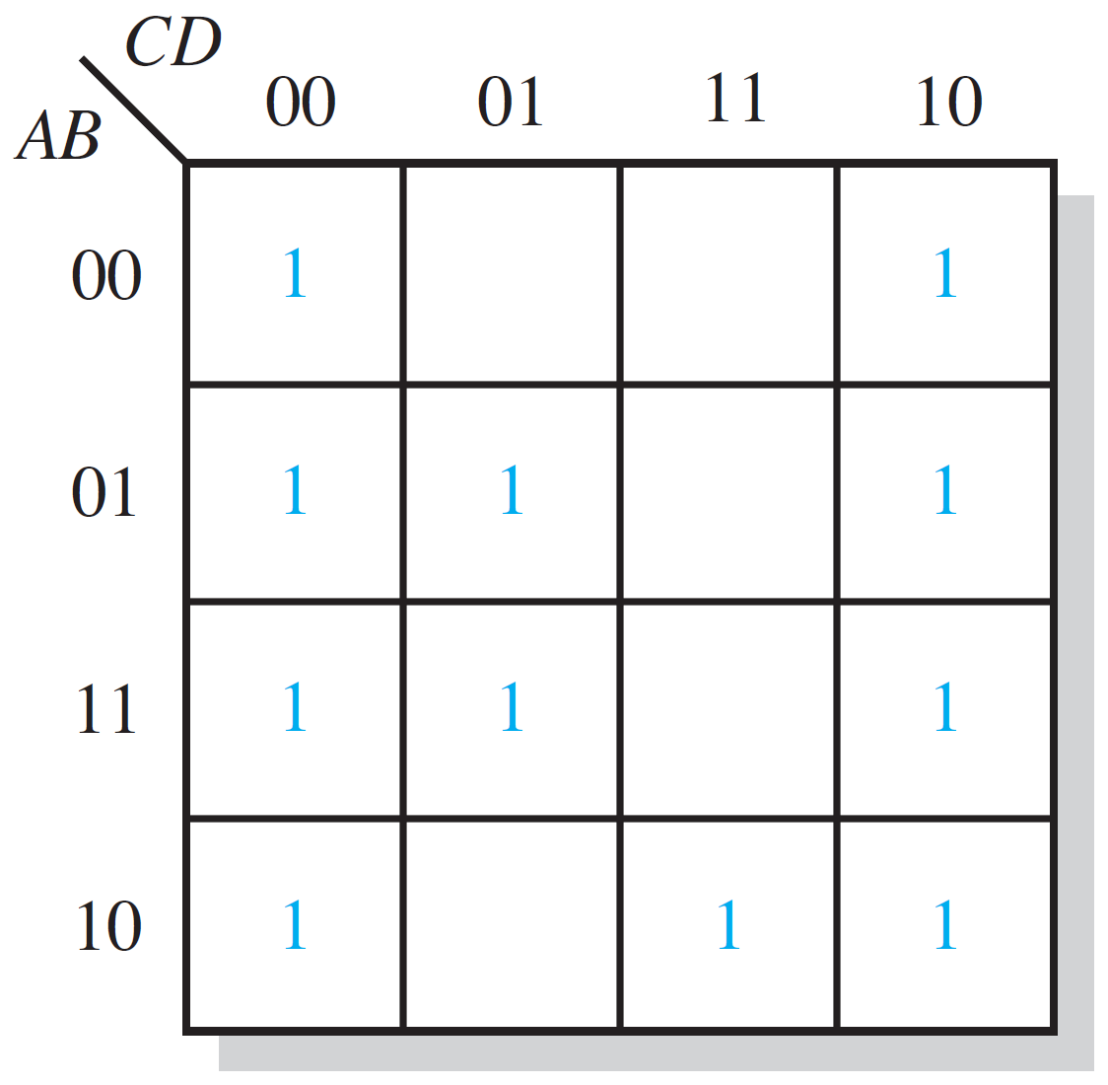
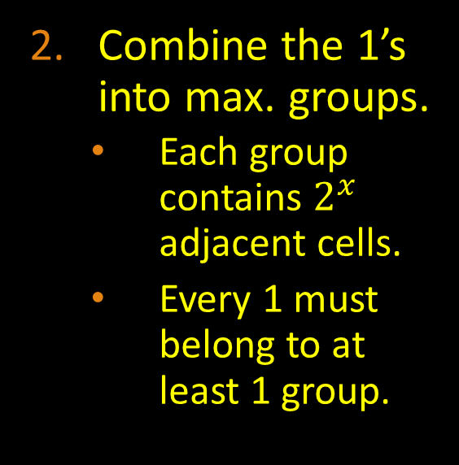
SOP Minimization Using Karnaugh Maps
Examples:
Combine the 1’s into max. groups.
Each group contains $2^{x}$ adjacent cells.
Every 1 must belong to at least 1 group.

Slide 11








SOP Minimization Using Karnaugh Maps
Examples:
$$\overline{B}$$
$$\overline{D}$$
$$\overline{A}\overline{C}$$
Determine minimum product terms (1 term per group) and combine them to form a minimum SOP.
$$AC$$
$$B\overline{C}$$
$$A\overline{B}C$$
$$X=\overline{B}+\overline{A}\overline{C}+AC$$
$$X=\overline{D}+B\overline{C}+A\overline{B}C$$

Slide 12
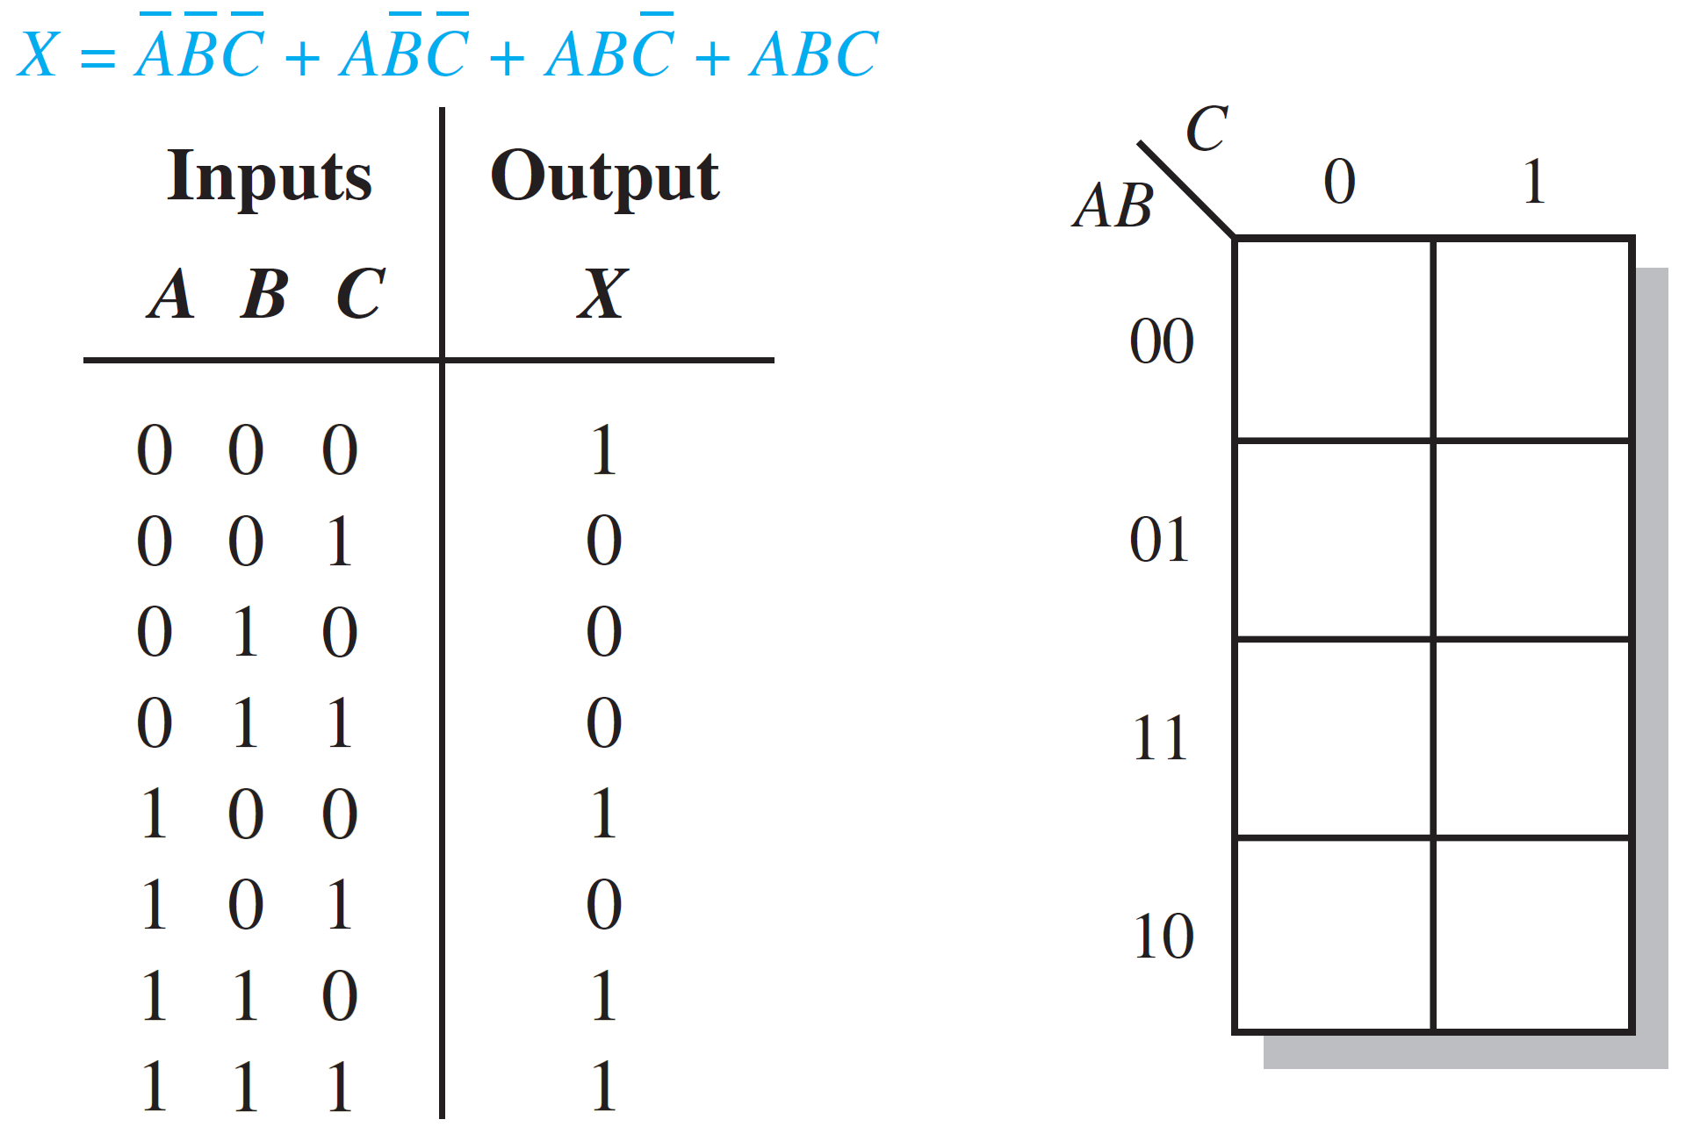
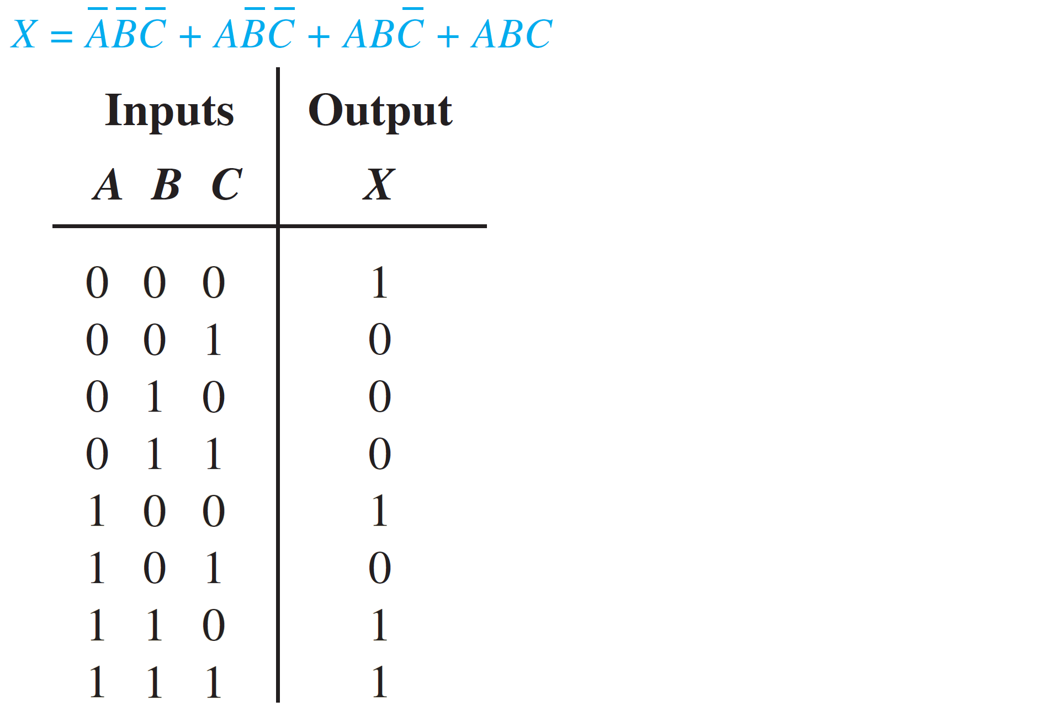
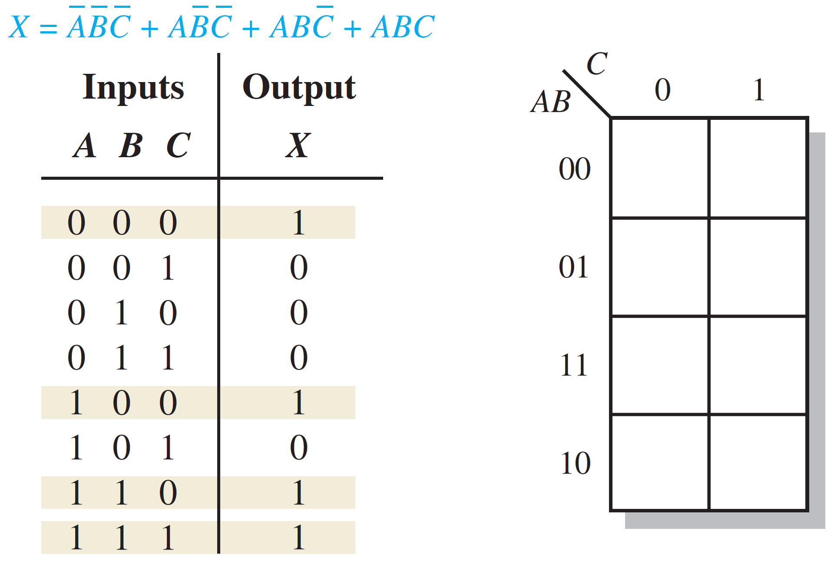
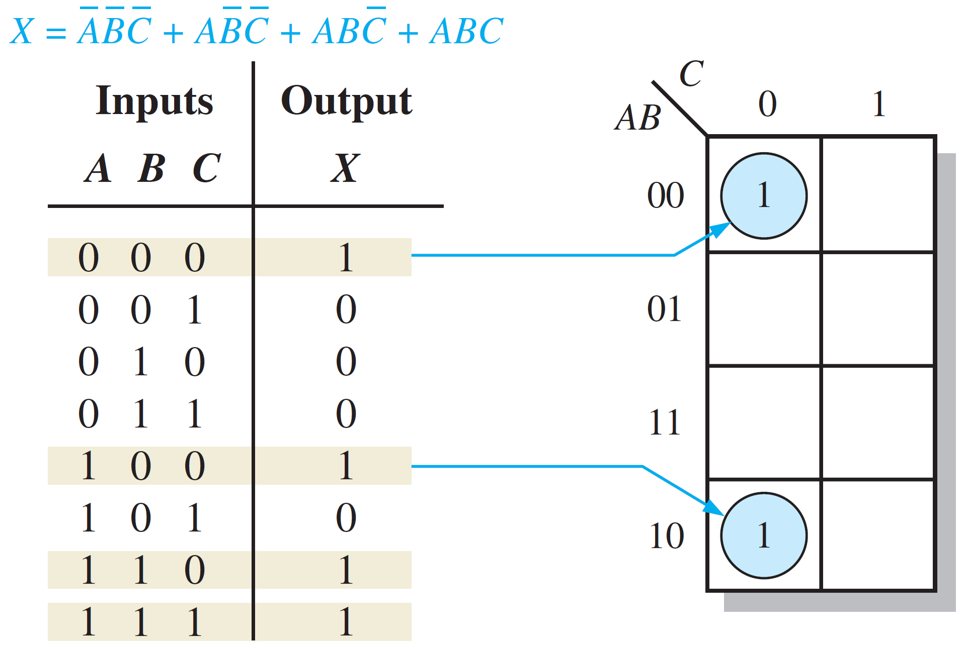
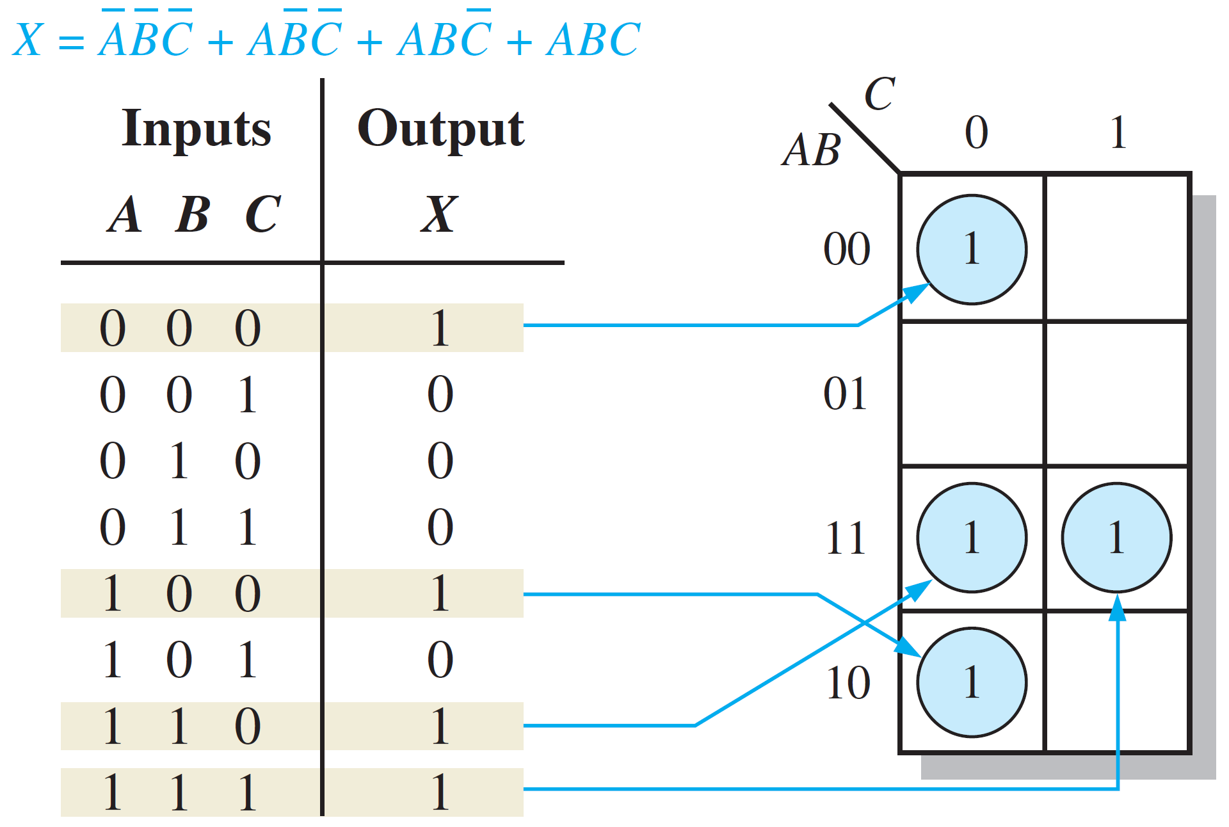
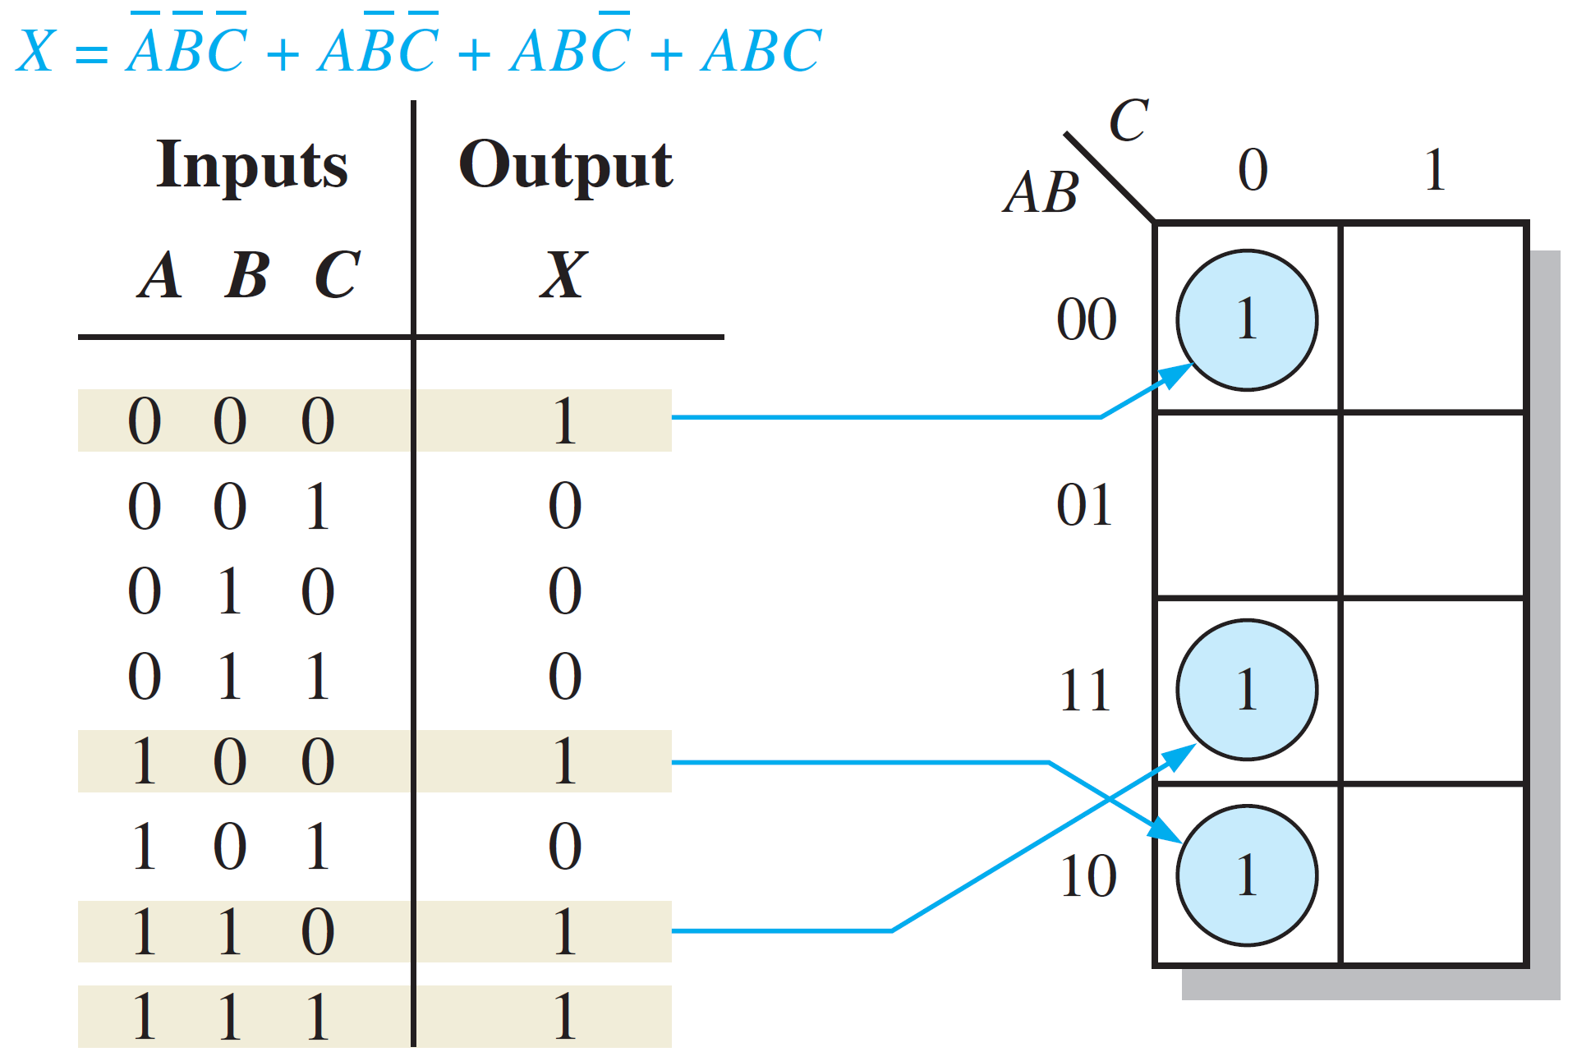
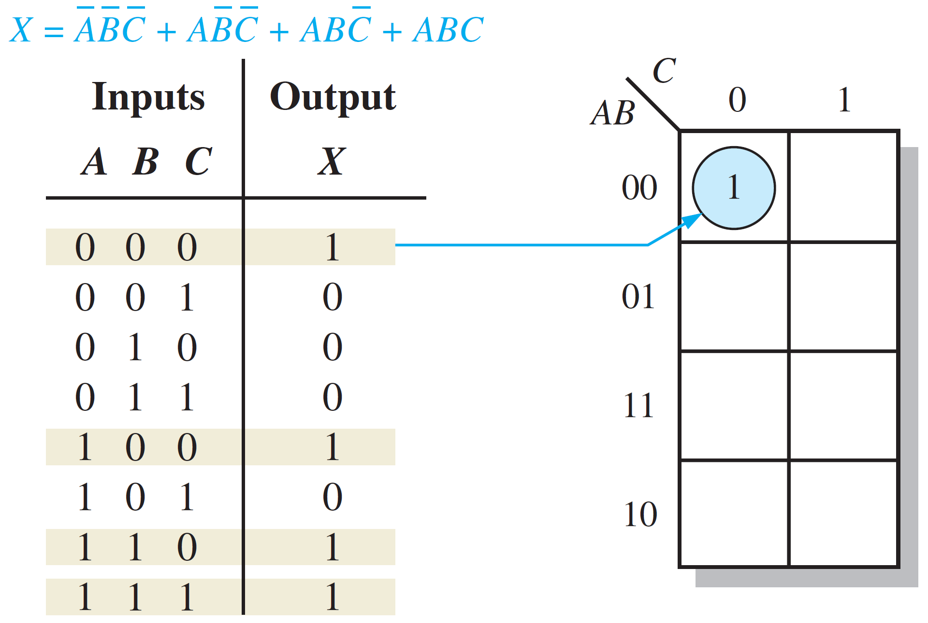
Mapping Directly from a Truth Table
Example: Truth Table ➔ K-Map
The 1’s in the output column are mapped directly into the cells corresponding to the values of the associated input variable combinations.

Slide 13

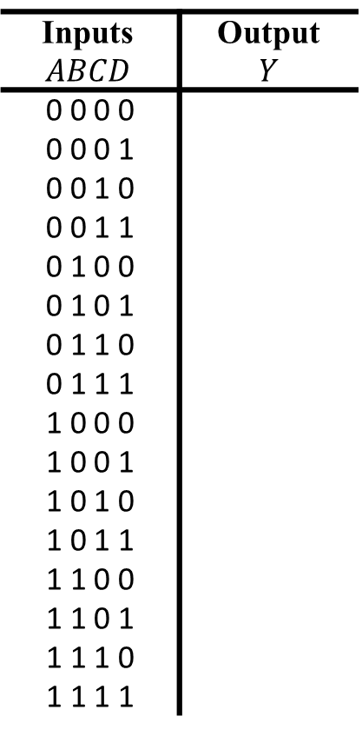

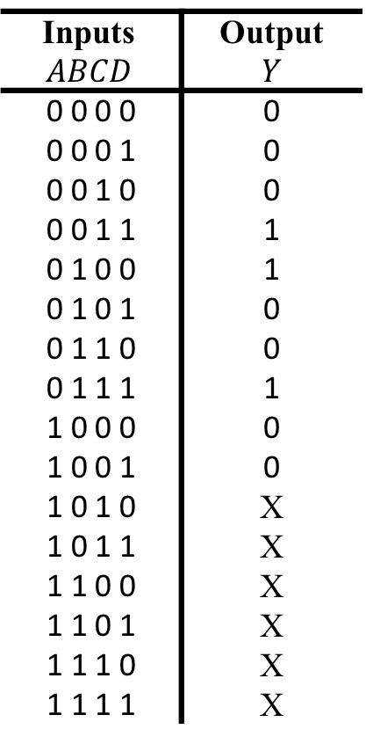
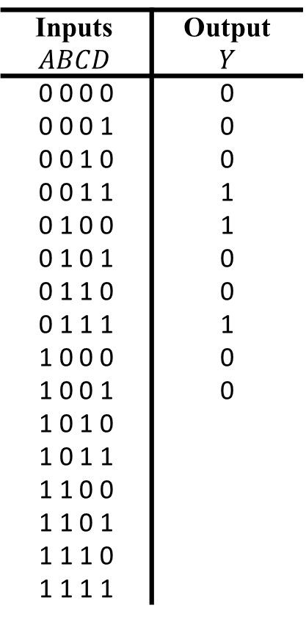
“Don’t Care” Conditions
Example:
Without Don’t cares
Inputs $$ABCD$$ | Output $$Y$$
0 0 0 0
0 0 0 1
0 0 1 0
0 0 1 1
0 1 0 0
0 1 0 1
0 1 1 0
0 1 1 1
1 0 0 0
1 0 0 1
1 0 1 0
1 0 1 1
1 1 0 0
1 1 0 1
1 1 1 0
1 1 1 1
$$Y=\overline{A}B\overline{C}\overline{D}+\overline{A}CD$$
Inputs $$ABCD$$ | Output $$Y$$
0 0 0 0 | 0
0 0 0 1 | 0
0 0 1 0 | 0
0 0 1 1 | 1
0 1 0 0 | 1
0 1 0 1 | 0
0 1 1 0 | 0
0 1 1 1 | 1
1 0 0 0 | 0
1 0 0 1 | 0
1 0 1 0
1 0 1 1
1 1 0 0
1 1 0 1
1 1 1 0
1 1 1 1
Inputs $$ABCD$$ | Output $$Y$$
0 0 0 0 | 0
0 0 0 1 | 0
0 0 1 0 | 0
0 0 1 1 | 1
0 1 0 0 | 1
0 1 0 1 | 0
0 1 1 0 | 0
0 1 1 1 | 1
1 0 0 0 | 0
1 0 0 1 | 0
1 0 1 0 | X
1 0 1 1 | X
1 1 0 0 | X
1 1 0 1 | X
1 1 1 0 | X
1 1 1 1 | X
1
If some input combinations are not allowed, we mark their corresponding output value by X’s.
“X” means we “don’t care” about the output value in this case, and hence it can be set to 0 or 1.
1
1
X
X
X
X
X
X
$$Y=B\overline{C}\overline{D}+CD$$
With Don’t cares

Slide 14
POS Minimization Using Karnaugh Maps
Goal: Simplify a POS expression (standard or non-standard) to its minimum form ➔ Minimum POS!
Minimum POS expression contains the fewest possible product terms with the fewest possible variables per term!!
Method:
Map POS expression on a Karnaugh map.
Combine the 0’s on the map into maximum groups.
Determine minimum sum term for each group, and combine minimum sum terms to form a minimum POS.

Slide 15

POS Minimization Using Karnaugh Maps
Example: POS ➔ K-Map
$X=(A+B+C)(A+B+\overline{C})(\overline{A}+B+\overline{C})$
000
001
101
Map POS expression on a Karnaugh map.
Determine binary values of sum terms.
Place 0’s in corresponding cells.
0
0
0

Slide 16
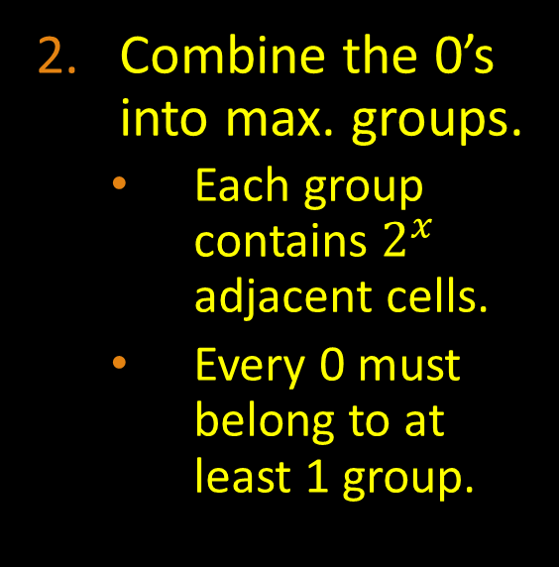

POS Minimization Using Karnaugh Maps
Example:
$X=(A+B+C)(A+B+\overline{C})(\overline{A}+B+\overline{C})$
Combine the 0’s into max. groups.
Each group contains $2^{x}$ adjacent cells.
Every 0 must belong to at least 1 group.
0
0
0

Slide 17


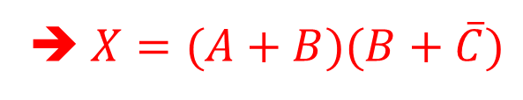
POS Minimization Using Karnaugh Maps
Example:
$X=(A+B+C)(A+B+\overline{C})(\overline{A}+B+\overline{C})$
➔ $X=(A+B)(B+\overline{C})$
Determine minimum sum terms (1 term per group) and combine them to form a minimum POS.
0
0
$$(A+B)$$
$$(B+\overline{C})$$
0

Slide 18


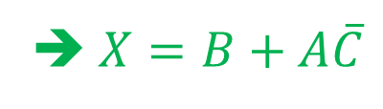

Conversion: POS ➔ SOP Using Karnaugh Maps
Example: POS ➔ SOP
$X=(A+B+C)(A+B+\overline{C})(\overline{A}+B+\overline{C})$
➔ $X=(A+B)(B+\overline{C})$
➔ $X=B+A\overline{C}$
After placing the 0’s in the map, fill the rest of the cells with 1’s and follow the steps to construct minimum SOP from K-maps.
0
0
$$B$$
$$(A+B)$$
1
1
1
1
$$(B+\overline{C})$$
$$A\overline{C}$$
1
0

Slide 19
Reading Material
Floyd, Chapter 4:
Pages 199 - 212

