Slide 1

CSE 321a
Computer Organization (1)
تنظيم الحاسبات (1)
3rd year, Computer Engineering
Fall 2017
Lecture #6
Dr. Hazem Ibrahim Shehata
Dept. of Computer & Systems Engineering
Credits to Dr. Ahmed Abdul-Monem Ahmed for the slides

Slide 2
Administrivia
Assignment #1:
Solution was posted on Saturday.
Previous exams/solutions have been posted.
Assignment #2:
To be released later on this week.
Website: http://hshehata.github.io/courses/zu/cse321a
Office hours: Sunday 1:00pm-2:00pm

Slide 3
Chapter 4. Cache Memory (Cont.)

Slide 4
Cache Memory – Design
Mapping function
Replacement algorithm
Read/Write policies
Number of caches
Addresses
Size
Block/line size

Slide 5
2. Replacement Algorithms Direct mapping
No choice.
Each block only maps to one line.
Replace that line.

Slide 6
2. Replacement Algorithms Associative and Set Associative
Hardware implemented algorithms!
Most common ones:
Least Recently Used (LRU)
Replace the block that has not been recently accessed.
First In First Out (FIFO)
Replace the oldest block.
Least Frequently Used
Replace the block which has had the fewest hits.
Random
Replace any block!

Slide 7
Cache Memory – Design
Mapping function
Replacement algorithm
Read/Write policies
Number of caches
Addresses
Size
Block/line size

Slide 8
3. Read/Write Policies Read Policy (Hit & Miss)
Reads dominate processor cache accesses.
All instructions need to be fetched ➔ reads.
Some instructions may read one or more operands.
Most instructions do not write to memory!
What if CPU wants to read a word from MM?
Read-hit policy: if read hits in cache (i.e., container block is in cache), just read word from cache!
Read-miss policy: if read misses in cache (i.e., container block is in not cache),
Read-through: read word from MM, and bring container block to cache.
No-read-through: bring container block to cache, and then read word from cache.

Slide 9
3. Read/Write Policies Write Policy (Hit)
What if CPU wants to write a word to memory?
Write-hit policy: if write hits (i.e., container block is in cache)
Write-through: write word to both cache and MM
Pros: easier to implement, MM is always consistent with cache, read miss never results in writes to MM.
Cons: Every write needs a MM access, slower writes, more MM bandwidth consumption.
Write-back: write word to cache only, do not write word to MM until cached version of container block is replaced.
In addition to tag bits, each cache line stores a “dirty bit”.
Pros: multiple writes within block require only one write to MM, faster writes, less MM bandwidth consumption.
Cons: harder to implement, MM is not always consistent with cache, reads may cause writes of dirty blocks to MM.

Slide 10
3. Read/Write Policies Write Policy (Miss)
… (Cont.)
Write-miss policy: if write misses (i.e., container block is in not cache)
Write-allocate: bring container block to cache, and then act according to write-hit policy.
No-write-allocate: write word to container block in MM, and do not bring block to cache.
Note: either write-miss policy could be used with write-through or write-back, however:
Write-back caches generally use write-allocate
Hoping that subsequent writes to block get captured by cache
Write-through caches often use no-write-allocate
since subsequent writes to block will still have to go to MM

Slide 11
3. Read/Write Policy Cache Coherency ترابط او التحام w/t Multi-CPUs
Consider a multiple-CPU organization:
Several CPUs share same MM
Each CPU has its own cache.
CPU 1
Cache 1
Main Memory
CPU 2
Cache 2
:
:
CPU n
Cache n

Slide 12
3. Read/Write Policy Cache Coherency ترابط او التحام w/t Multi-CPUs
Problem: If data is altered in one cache ➔ this invalidates this word in MM and in other caches.
This is true even if write-through is used.
Cache coherency: maintaining data in all caches consistent.
Some solutions:
Bus watching with write-through: Cache controller monitors the bus and invalidates the word in the cache if another master (e.g., CPU) updates it in MM.
Hardware transparency: Additional h/w makes sure that if one CPU updates a word in its cache, it is written to MM and updated in other caches.
Non-cacheable memory: Only a portion of MM is shared, and that portion is non-cacheable!

Slide 13
Cache Memory – Design
Mapping function
Replacement algorithm
Read/Write policies
Number of caches
Addresses
Size
Block/line size

Slide 14
4. Number of Caches Split vs. Unified & Dedicated vs. Shared
Contemporary multi-core systems use multiple caches organized in a variety of ways:
Split cache vs. unified cache
Split: one cache for instructions and another for data.
No contention between fetch unit & execute unit.
Unified: only one cache for both.
Higher hit rate than split since it balances load between instruction and data fetches.
Dedicated cache vs. shared cache
Dedicated: one cache for each CPU
No contention between CPUs
Shared: one cache shared by multiple CPUs
Better load balancing

Slide 15
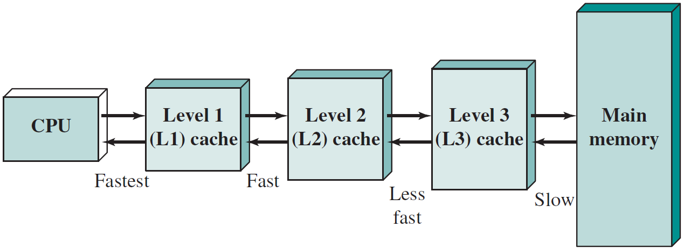
4. Number of Caches Multi-Level Caches
Three-Level Cached
Memory System
… (Cont.)
Multi-Level Caches
Multiple levels of caches located between CPU and MM.
Level 1 (L1) cache: closest to CPU, fastest, smallest.
Level 2 (L2) cache: 2nd closest to CPU, 2nd fastest, 2nd smallest.
Level 3 (L3) cache: …
Ex. - Operation of two-level cache: CPU looks for the requested word in L1 cache first. If not there, it fetches it from L2 cache. If not there, it is fetched from MM.
Higher cache levels used to be off-chip, not anymore!!

Slide 16
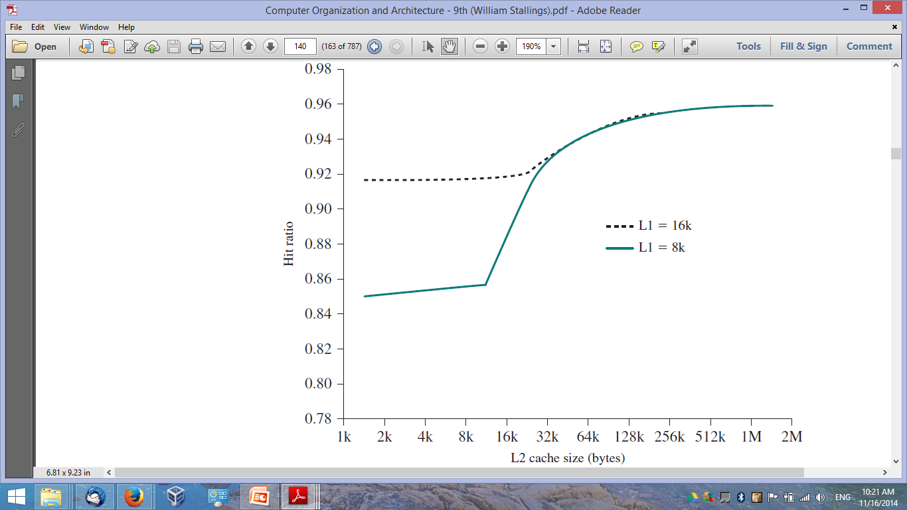
4. Number of Caches Total Hit Ratio of Two-Level Cache
Simulation: L1 and L2 caches have same line size
Trend: L2 has little effect on total number of cache hits until it is at least double L1 cache size

Slide 17
Cache Memory – Design
Mapping function
Replacement algorithm
Read/Write policies
Number of caches
Addresses
Size
Block/line size

Slide 18
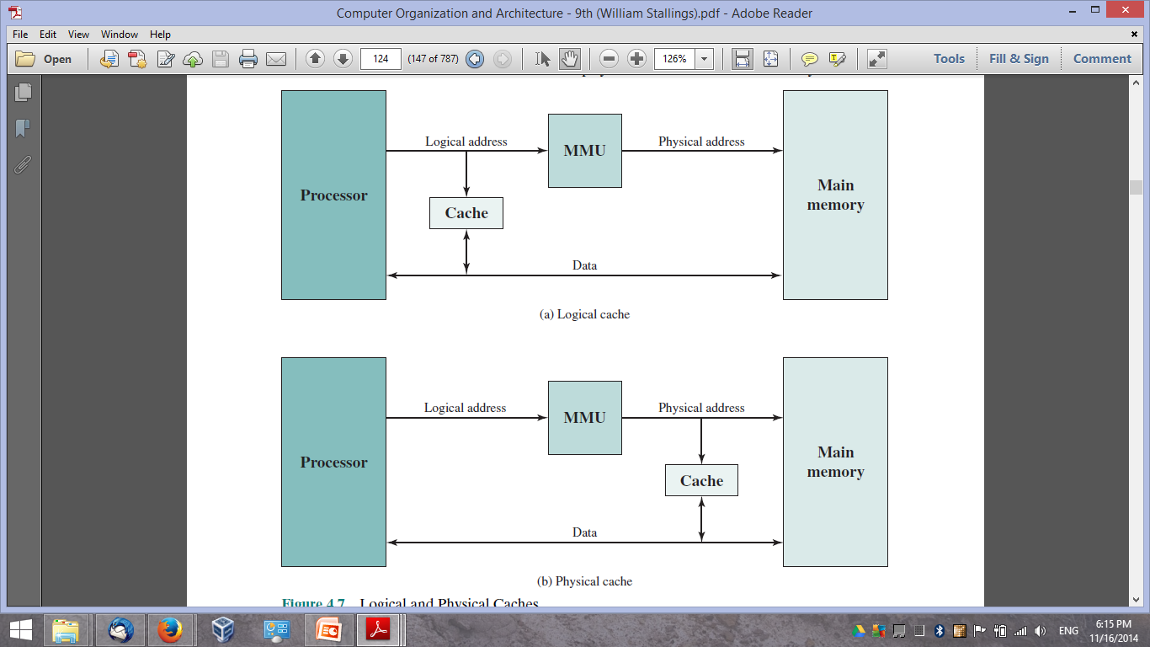
5. Cache Addressing Location relative to MMU
Where does cache sit relative to the memory management unit (MMU)?
Between CPU & MMU (MMU) ➔ Virtual (logical) Cache.
Between MMU & MM ➔ Physical Cache.

Slide 19


5. Cache Addressing Virtual vs. Physical Cache
Virtual (logical) cache
Uses virtual addresses of MM blocks in cache mapping.
CPU accesses cache directly (not through MMU).
No address translation to access cache ➔ Faster access.
Different applications have similar virtual addresses ➔ Must flush cache on each context switch.
Physical cache
Uses physical addresses of MM blocks in cache mapping.
CPU accesses cache through MMU.
Need address translation to access cache ➔ Slower access.
Different applications have different physical addresses ➔ No need to flush cache on context switch.

Slide 20
Cache Memory – Design
Mapping function
Replacement algorithm
Read/Write policies
Number of caches
Addresses
Size
Block/line size

Slide 21
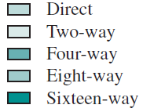
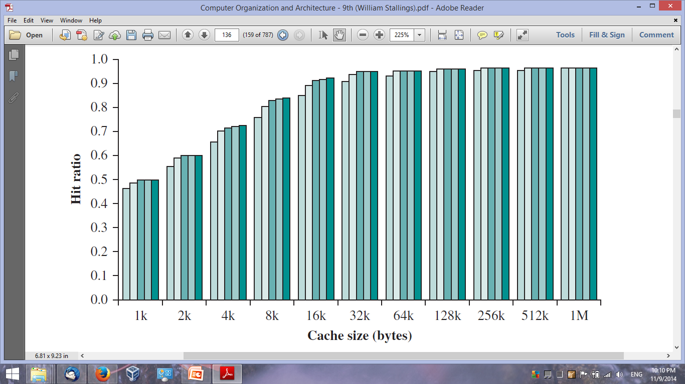
6. Cache Size Cache Size/Associativity vs. Hit ratio
Benchmark: GCC Compiler
Trend #1: bigger cache size ➔ better hit ratio
Trend #2: higher cache associativity ➔ better hit ratio

Slide 22
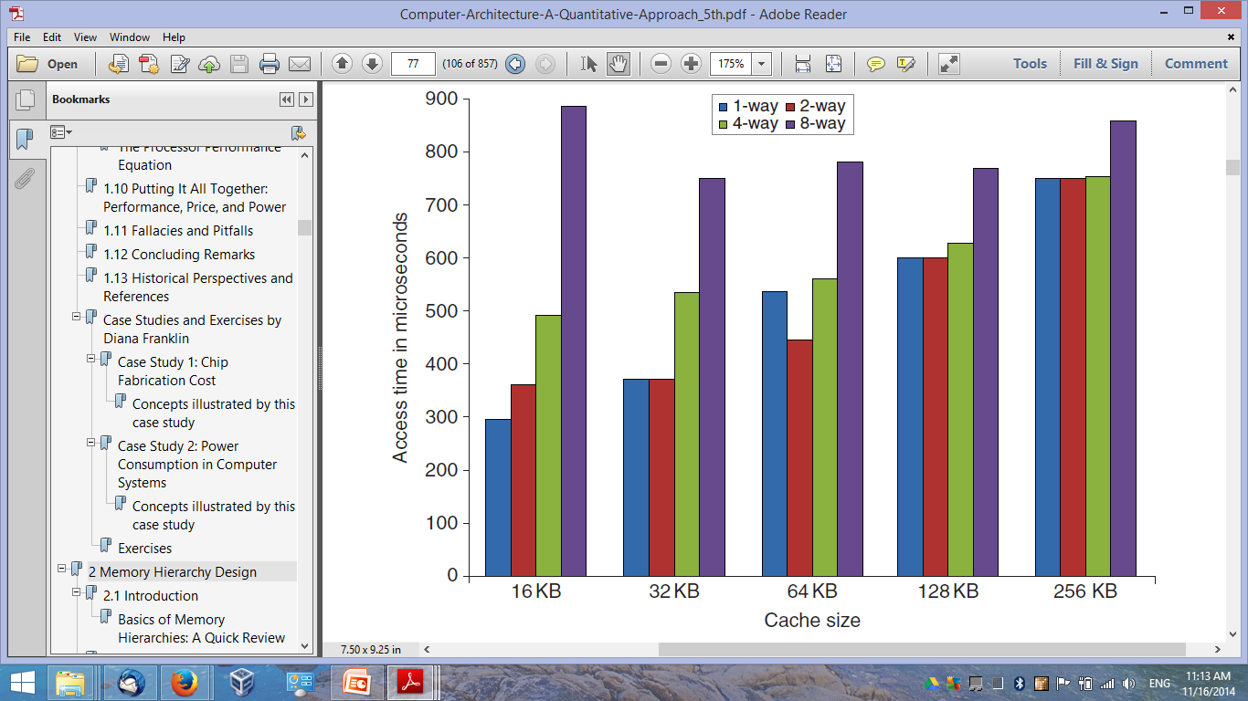
6. Cache Size Cache Size/Associativity vs. Hit Time
Cache model: CACTI, 40-nm, single-bank, 64-byte block
Trend #3: bigger cache size ➔ worse hit time
Trend #4: higher cache associativity ➔ worse hit time
Hennessey and Patterson, “Computer Architecture: A Quantitative Approach”, 5th Ed.

Slide 23
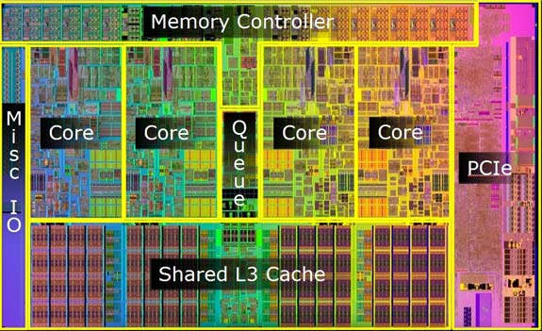
6. Cache Size Summary
Trend: Cache size ↑ ➔ Hit ratio ↑ ➔ Hit time ↑.
Motivations for bigger cache:
Better hit ratio ➔ average access time of (cache + MM) is close to cache alone.
Motivations for smaller cache:
Less gates involved in addressing ➔ faster cache.
Less cost ➔ average cost per bit of (cache + MM) is close to MM alone.
Fit the chip/board area budget.
Reality: Cache performance
depends on workload ➔ No
single “optimum” cache size exists!

Slide 24
Cache Memory – Design
Mapping function
Replacement algorithm
Read/Write policies
Number of caches
Addresses
Size
Block/line size

Slide 25
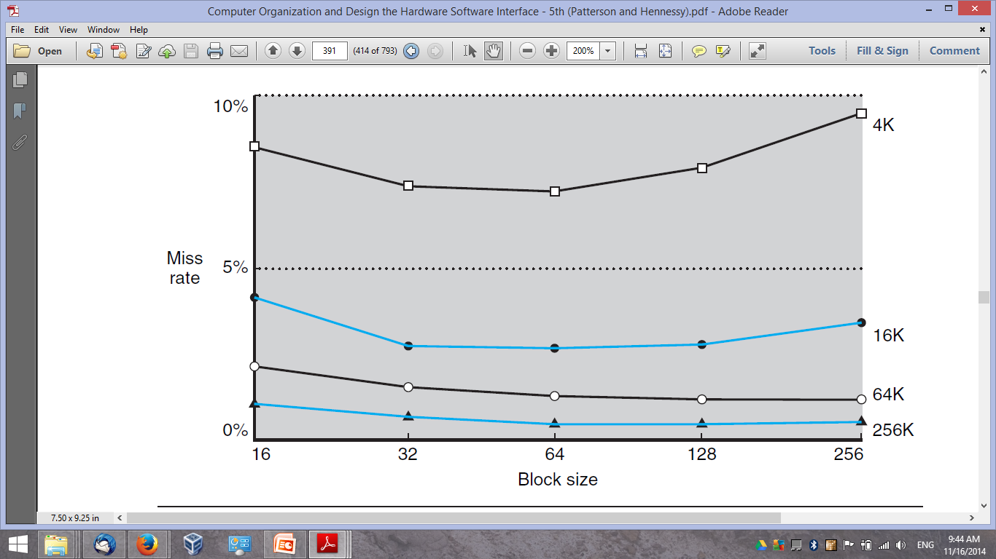
7. Block/Line Size Block Size vs. Miss Rate
Benchmark: SPEC92
System: DECstation 5000
Patterson and Hennessey, “Computer Architecture and Design: the Hardware Software Interface”, 5th Ed.

Slide 26
7. Block/Line Size Summary
Block size increases ➔ hit ratio increases at first (locality of reference).
Block becomes too big ➔ probability of using the fetched info becomes less than that of reusing info to be replaced ➔ hit ratio begins to decrease.
Two effects come into play due to larger blocks:
Less blocks could be fit into cache ➔ data gets overwritten shortly after being fetched.
More words become farther from requested ones ➔ not likely to be referenced.
Typical block size: 8-64B (PC) & 64-128B (HPC).

Slide 27
Example AMD Bulldozer Cache Organization
Three-level cache organization: L1, L2, and L3.
L1 ➔ split cache
L1 Code: 64KB, 2-way, 64B-line, shared (1 per 2 cores).
L2 Data: 16KB, 4-way, 64B-line, dedicated (1 per core).
Access Latency: 3-4 clock cycles.
L2 ➔ unified cache
1-2MB, 16-way, 64B-line, shared (1 per 2 cores).
Access Latency: 21 clock cycles.
L3 ➔ unified cache
0-8MB, 64-way, 64B-line, shared (1 per all cores).
Access Latency: 87 clock cycles.

Slide 28
Reading Material
Stallings, Chapter 4:
Pages 137 – 141

