Slide 1
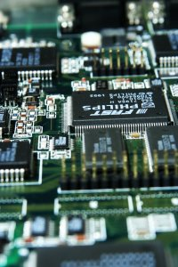
CSE 321a
Computer Organization (1)
تنظيم الحاسبات (1)
3rd year, Computer Engineering
Fall 2016
Lecture #3
Dr. Hazem Ibrahim Shehata
Dept. of Computer & Systems Engineering
Credits to Dr. Ahmed Abdul-Monem Ahmed for the slides

Slide 2
Administrivia
Lecture:
New lecture day/time: Wednesday 10:15am-12:45pm
Tutorials:
Day/Time: Sunday 2:00pm – 3:30pm
Assignment #1:
Released today.
Due on: Wednesday October 19, 2016.
Work in groups of two.
Academic integrity:
Copying assignments will not be tolerated.
Involved groups get 0 points!!
Website: http://hshehata.github.io/courses/zu/cse321a
Office hours: Sunday 12:00pm-1:00pm

Slide 3
Chapter 3. A Top-Level View of Computer Function and Interconnection (Cont.)

Slide 4
Overview
Computer Structure (Components):
CPU, Memory, I/O.
Computer Function:
Instruction Fetch/Execute.
Interrupts.
Interconnection Structure:
Transfer between mem. & proc., i/o & proc. … etc.
Bus Interconnection:
Bus structure: address, data, and control lines.
Multiple-bus hierarchies.
Elements of bus design.

Slide 5
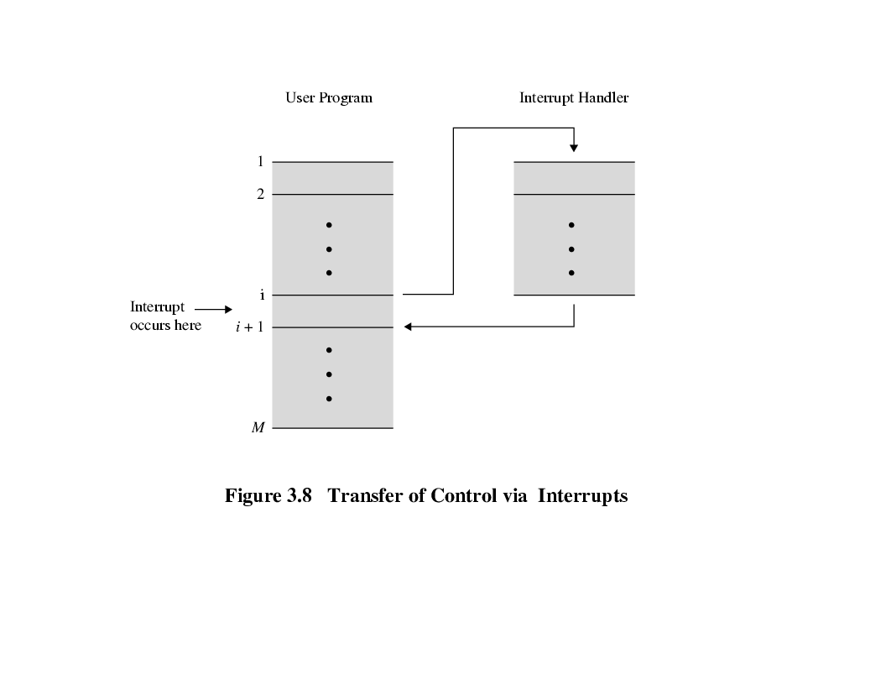
Transfer of Control via Interrupts

Slide 6
Multiple Interrupts
Disable interrupts
Processor will ignore further interrupts while processing one interrupt.
Interrupts remain pending and are checked after first interrupt has been processed.
Interrupts handled in sequence as they occur.
Define priorities
Low priority interrupts can be interrupted by higher priority interrupts.
When higher priority interrupt has been processed, processor returns to previous interrupt.

Slide 7
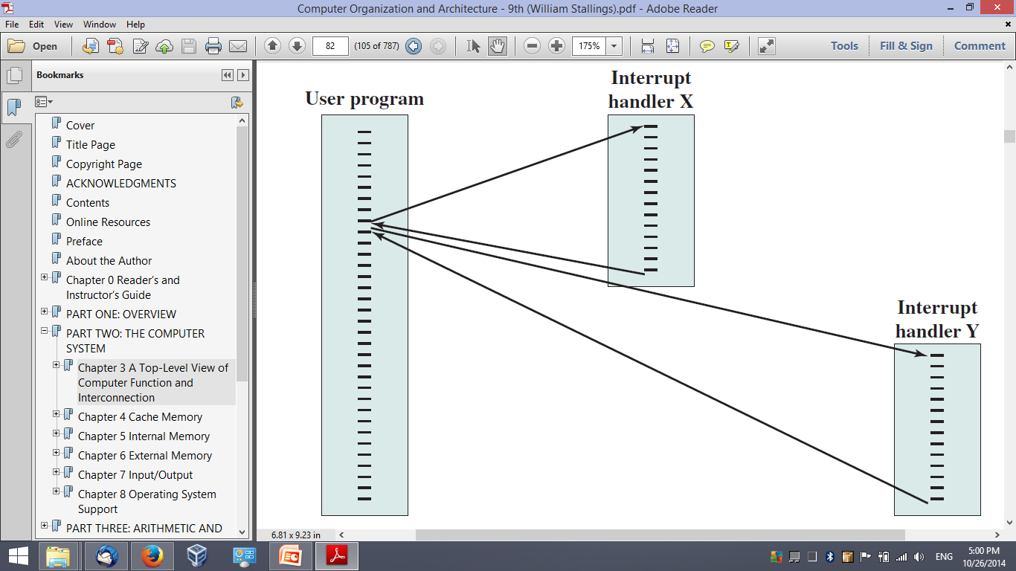
Multiple Interrupts - Sequential
Disable processing further interrupts!
Y
X
Enable processing further interrupts!

Slide 8
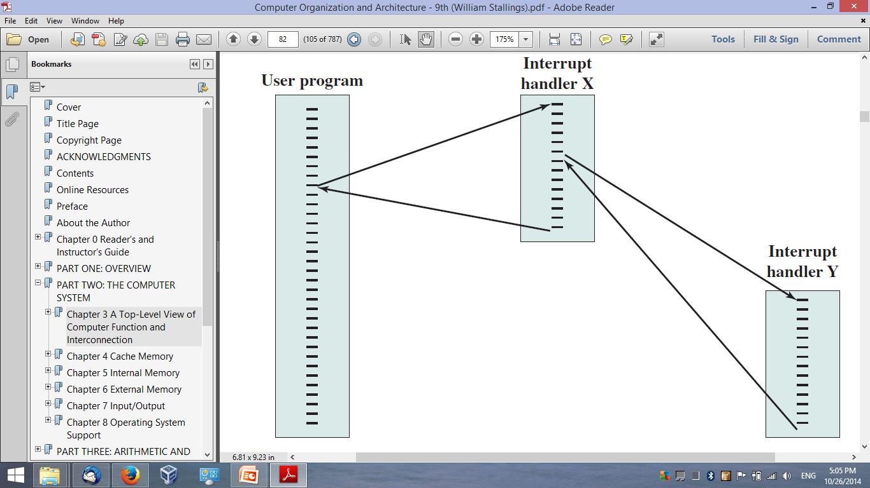
Multiple Interrupts – Nested
Y
X

Slide 9
Multiple Interrupts – Nested (example)
Interrupt priorities: Printer (P): 2, Disk (D): 4, Communication line (C): 5
ISR execution: 10 units, Interrupt scenario: P @ t=10, C @ t=15, D @ t=20
Communication ISR
_______
_______
_______
_______
_______
_______
_______
_______
User Program
Printer ISR
_______
_______
_______
_______
_______
_______
_______
_______
_______
_______
_______
_______
_______
_______
_______
_______
t = 0
_______
_______
_______
_______
_______
_______
_______
_______
D
t = 15
t = 10
C
t = 25
P
t = 40
t = 25
Disk ISR
_______
_______
_______
_______
_______
_______
_______
_______
t = 35

Slide 10
Interconnection Structures
All computer components/modules must be connected.
Collection of paths connecting various modules is called: Interconnection Structures
Different type of connection is required for different type of module.
CPU
Memory
Input/Output

Slide 11
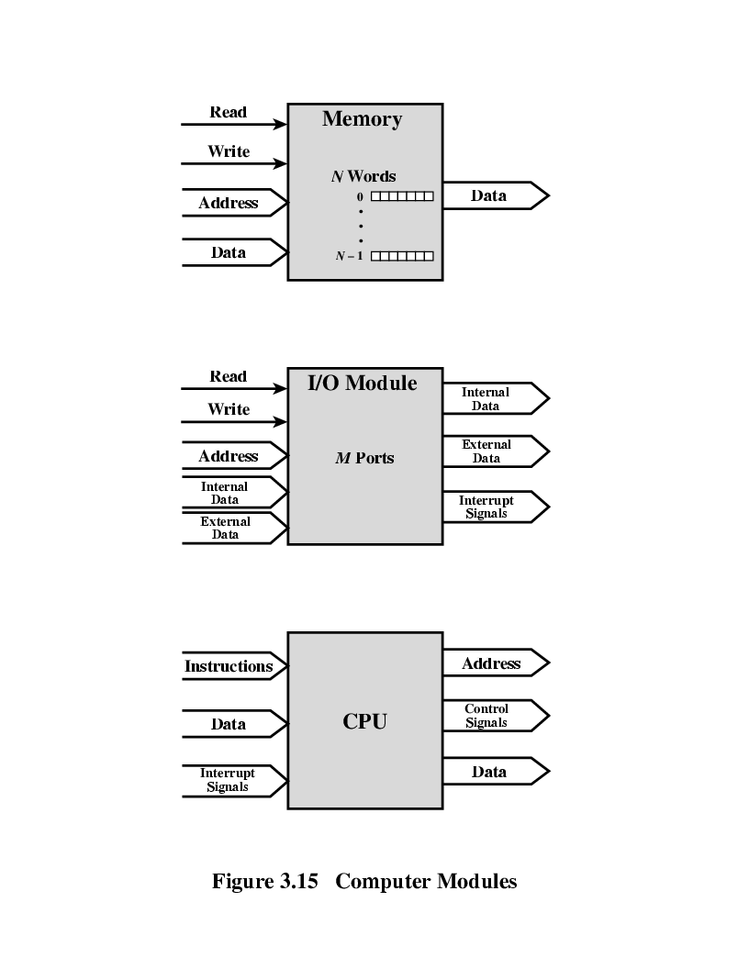
CPU Connection
Reads instructions and data
Writes out data (after processing)
Sends control signals to other units
Receives (& acts on) interrupts

Slide 12
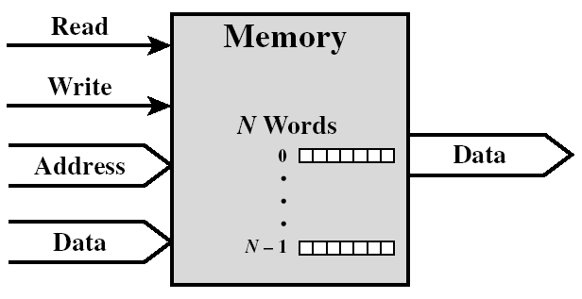

Memory Connection
Receives control signals.
Read
Write
Receives addresses (of locations).
Sends data (read operation).
Receives data (write operation).

Slide 13
I/O Connection
Similar to memory from computer’s viewpoint.
Receives control signals from computer.
e.g., read and write.
Receives addresses from computer
e.g., port no. to identify peripheral.
Output
Receives data from computer
Sends data to peripheral
Input
Receives data from peripheral
Sends data to computer
Sends control signals to peripherals.
I/o commands (e.g., spin disk).
Sends interrupt signals to computer
Read
I/O Module
M Ports
Write
Control
Signals
Address
Internal
Data
External
Data
Internal
Data
External
Data
Interrupt
Signals

Slide 14
Types of Transfers
CPU to memory.
Memory to CPU.
CPU to I/O.
I/O to CPU.
I/O to memory.
Memory to I/O.
Direct Memory Access (DMA)

Slide 15
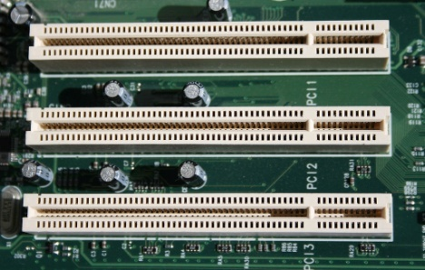
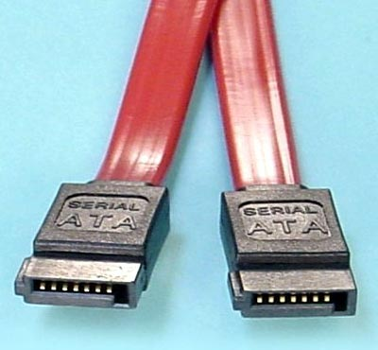
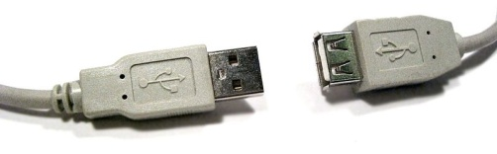
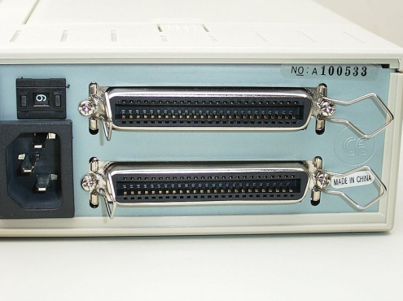
Bus Interconnection
There are a number of possible interconnection systems.
Single and multiple Bus structures are most common.
Examples of a bus:
Internal: PCI, SATA
External: USB
Internal/external: SCSI

Slide 16
What is a Bus? (1)
A communication pathway connecting two or more devices.
Usually by broadcast.
Consists of multiple lines (each carries 1 bit)
e.g. 32 lines are needed to transfer 32 bits of data in parallel.
Bus lines typically:
carry address, data, and/or control information
supply power (VCC, GND, … etc.)
Power lines may not be shown.

Slide 17
What is a Bus? (2)
Data lines
Carries data: Remember that there is no difference between “data” and “instruction” at this level!
Width is a key determinant of performance: 8, 16, 32, 64 bit.
Address lines
Identify the source or destination of data.
e.g. CPU needs to read an instruction (data) from a given location in memory.
Bus width determines maximum memory capacity of system.
e.g. 8080 has 16 bit address bus giving 64k address space.
Control lines
Control and timing information: memory read/write signal, interrupt request, clock signals

Slide 18
Bus Interconnection Scheme

Slide 19
Single Bus Problems
If great number of devices are connected to bus, performance will suffer. Why?
Greater bus length ➔ greater propagation delay ➔ more time required for device coordination
Aggregate data transfer demand approaches bus capacity ➔ bus speed becomes a bottleneck.
To overcome this problem:
Most systems use multiple buses laid out hierarchically.

Slide 20
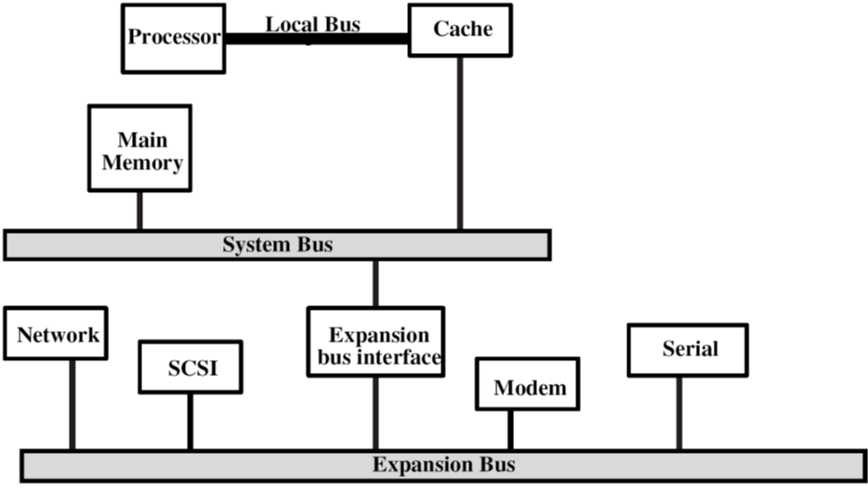
Traditional Bus Architecture

Slide 21
High Performance Bus

Slide 22
Elements of Bus Design
Bus Type
Method of Arbitration
Timing
Data Transfer Type

Slide 23
Bus Types
Dedicated
Functional: separate data & address lines.
Physical: multiple buses connecting different subsets of modules.
Multiplexed
Shared lines.
Address valid or data valid control line.
Advantages:
fewer lines.
Disadvantages
More complex control.
Lower performance.

Slide 24
Bus Arbitration (I)
More than one module controlling the bus.
e.g. CPU and DMA controller.
Only one module may control bus at a time.
Need a special h/w for arbitration.
Arbitration may be centralized or distributed.

Slide 25
Bus Arbitration (II)
Centralized Arbitration
Single hardware device controlling bus access
Bus controller or arbiter.
May be part of CPU or separate.
Distributed Arbitration
Each module may claim the bus.
Control logic on all modules.

Slide 26
Timing
Coordination of events on bus.
Synchronous
Events determined by clock signals.
Clock line belongs to the control bus.
A single 1-0 is a bus cycle.
All devices can read clock line.
Usually sync on leading edge.
Usually a single cycle for an event.
Asynchronous
Occurrence of one event on a bus follows and depends on the occurrence of a previous events.

Slide 27
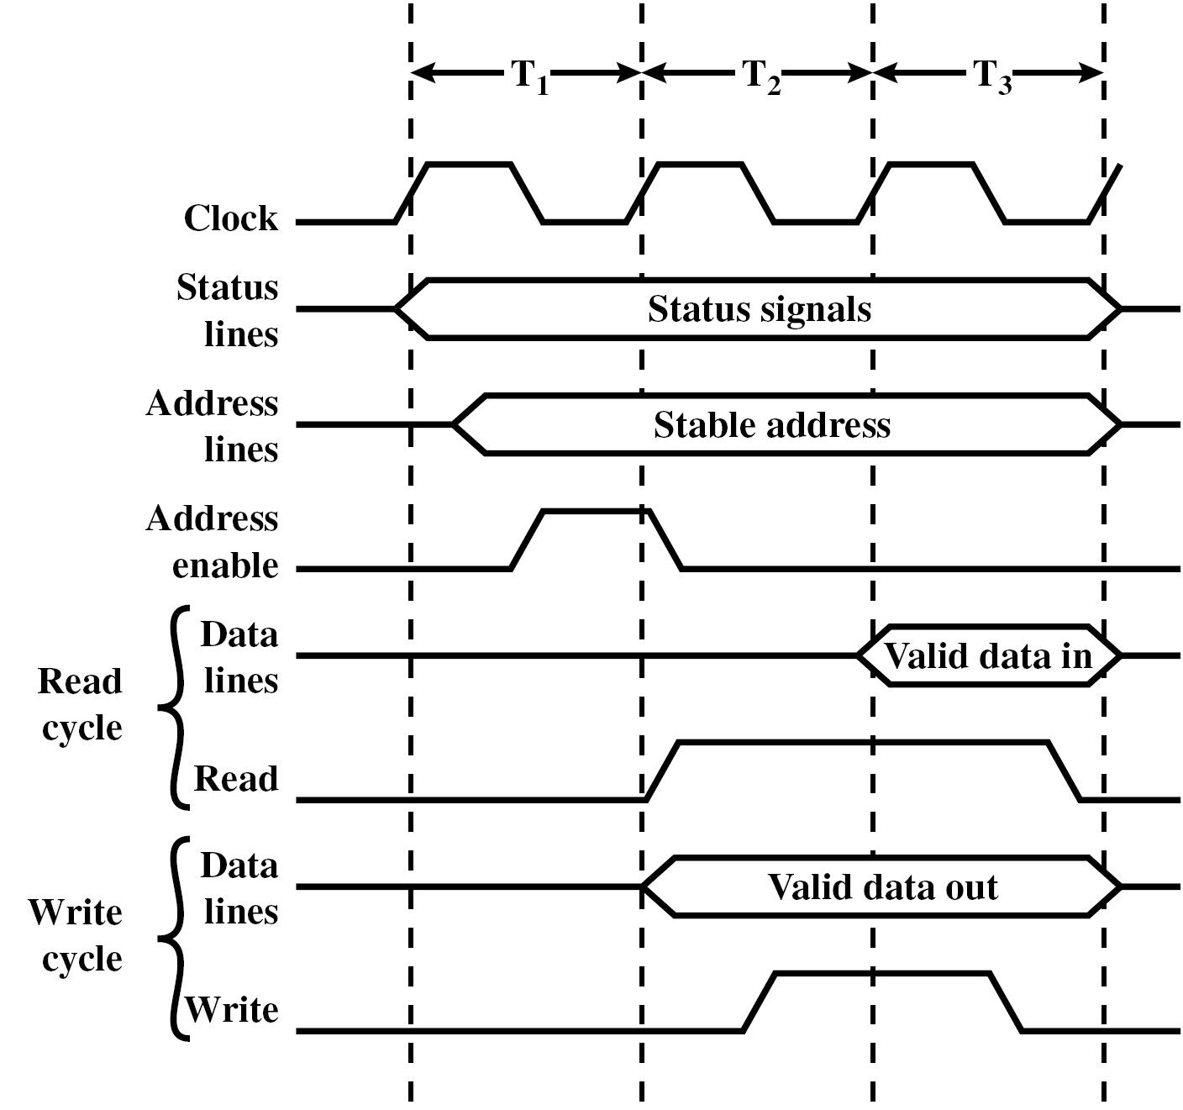
Synchronous Timing Diagram

Slide 28
Asynchronous Timing Diagram - Read

Slide 29
Asynchronous Timing Diagram - Write

Slide 30
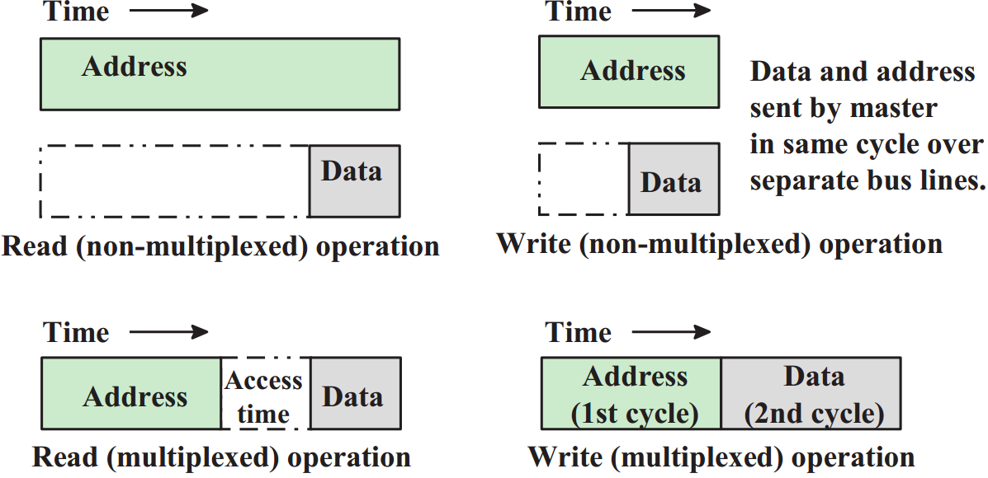
Data Transfer Type (I)

Slide 31
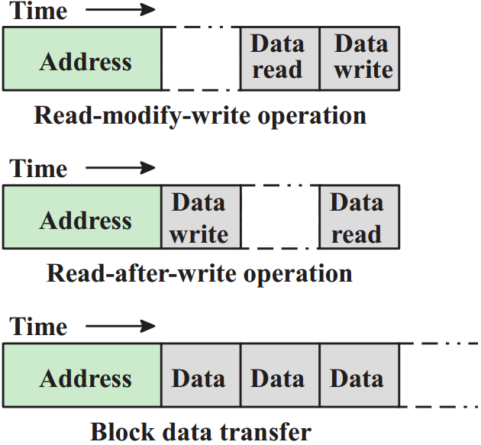
Data Transfer Type (II)

Slide 32
Reading Material
Stallings, Chapter 3:
Pages 80 – 93

