Slide 1

CSE 321b
Computer Organization (2)
تنظيم الحاسب (2)
3rd year, Computer Engineering
Winter 2017
Lecture #3
Dr. Hazem Ibrahim Shehata
Dept. of Computer & Systems Engineering
Credits to Dr. Ahmed Abdul-Monem Ahmed for the slides

Slide 2
Adminstrivia
Schedule:
Lectures: Monday 10:15am – 12:45am
Tutorials: Sunday 8:30am – 10:00am
Office hour: TBA
Assignment #1:
Released yesterday.
Due: Wednesday, Mar. 8, 2017.
Work in groups of two.
Submit one report per group.
Website: http://hshehata.github.io/courses/zu/cse321b
Office hours: TBA

Slide 3
Chapter 6. External Memory

Slide 4
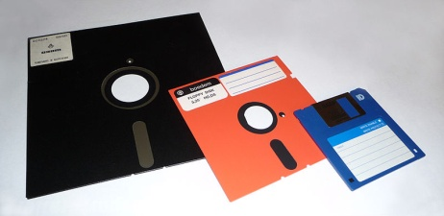
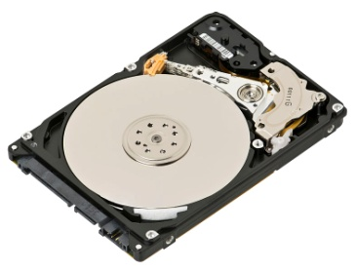
Types of External Memory
Magnetic Disk
Magnetic Read and Write Mechanisms
Data Organization and Formatting
Physical Characteristics
Disk Performance Parameters
Redundant Array of Independent Disks (RAID)
Solid-State Drive (SSD)
Optical Disk
Magnetic Tape

Slide 5
Magnetic Disk
Foundation of external memory on computers.
Disk substrate: circular platter constructed of nonmagnetic material.
Substrate coated with magnetisable material (iron oxide or cobalt oxide).
Substrate used to be aluminium or aluminium alloy. Now glass ➔ ...
Less surface defects ➔ less read/write errors.
Better uniformity of magnetic film ➔ more reliability.
Better stiffness to reduce disk dynamics.
Better shock/damage resistance.
Ability to support lower fly heights (see later).

Slide 6
Read and Write Mechanisms (1)
Head: Small device (conductive coil) that can read from or write to a portion of the platter rotating under it.
May be single read/write head or separate ones.
During read/write, head is stationary, platter rotates.
Write Operation
FACT: Current passing through coil produces a magnetic field whose direction depends on current direction.
Pulses sent to head.
Magnetic pattern recorded on surface below.

Slide 7
Read and Write Mechanisms (2)
Read Operation
Traditional - floppy and old disks
FACT: Magnetic field moving relative to a coil produces current in the coil.
Coil is the same for read and write
One read/write head.
Contemporary
Separate read head, close to write head.
Partially shielded magnetoresistive (MR) sensor.
Electrical resistance depends on direction of magnetic field.
Current passing thru MR and resistance is read as voltage.
Much greater storage densities and higher operating speeds could be achieved.

Slide 8
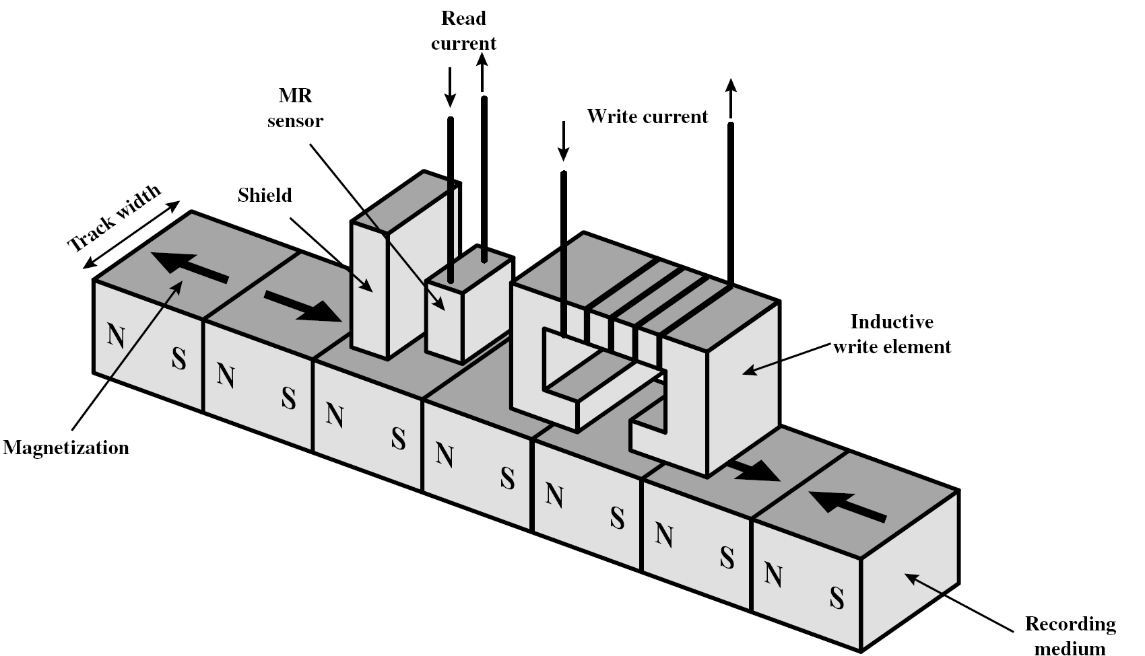
Inductive Write - MR Read Head

Slide 9
Disk Data Layout

Slide 10
Data Organization and Formatting
Tracks: concentric rings
Typically thousands per surface
Track’s width = head’s width.
Inter-track gaps between adjacent tracks ➔ prevent errors due to misalignment of the head or interference.
Sectors: tracks are divided into sectors.
Typically hundreds per track.
Fixed (512 bytes) or variable length.
Inter-sector gaps ➔ relax precision requirements
Usually data are read from or written to disks in blocks (of sectors).

Slide 11
Disk Velocity ➔ Disk Layout
Problem: bits on inner tracks pass under head slower than bits on outer tracks ➔ How can we have a constant read/write rate?!
Solution: increase spacing between bits stored on outer tracks and rotate disk at a fixed speed.
This technique is know as Constant Angular Velocity (CAV).

Slide 12
Constant Angular Velocity (CAV)
Disk rotates at constant speed
Constant angular velocity
All tracks have same capacity
Constant bits/track
Assuming constant bits/sector
Constant sectors/track
Pie-shaped sectors
Outer tracks have lower density
Variable bits/meter
Pros: Simple to locate sectors ➔ Move head to a given track and wait for a given sector.
Cons: Waste of space on outer tracks

Slide 13
Multiple Zone Recording (or Zone Bit Recording)
Tracks are grouped into zones
Within a zone, tracks have same
capacity
Constant sectors/track in each zone
Tracks in outer zones have
higher capacities
Sectors/track increase in outer zones
Pros: Higher capacity for outer tracks ➔ Greater overall storage capacities.
Cons: Harder to locate sectors ➔ more complex circuitry.

Slide 14
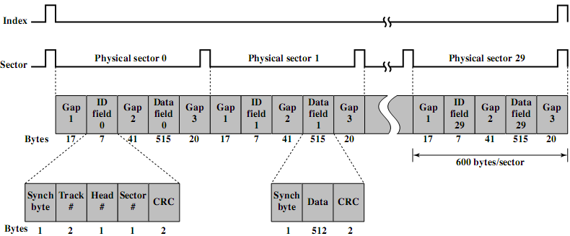
Finding Sectors
Must be able to identify start of track and sector.
Disk Format
Extra control data recorded on disk to mark tracks and sectors.
Used only by the disk drives, not accessible to the user.
Seagate ST506 format

Slide 15
Physical Characteristics
Single or double sided.
Removable or not (fixed).
Single or multiple platter.
Fixed or movable head (w.r.t. radial direction).
Head mechanism
Contact (Floppy).
Fixed gap.
Aerodynamic gap (Winchester).

Slide 16


1. Single or double sided
Single-sided
Magnetisable coating applied to one side of platter.
Low expensive disk systems (e.g., floppy disks).
Double-sided
Magnetisable coating applied to both sides of platter.
Each side has its own head.

Slide 17
2. Removable or Non-removable
Removable disk
Can be removed from drive and replaced with another disk.
e. g., floppy disks.
Provides unlimited storage capacity.
Easy data transfer between systems.
Obsoleted by CD-R and CD-R/W!
Non-removable disk
Permanently mounted in the drive.
e. g., hard disks in personal computers.

Slide 18
3. Single or Multiple Platters (1)
Multiple platters mounted on a spindle.
Multiple heads
joined and aligned
One head per side.
Aligned tracks on each platter form cylinder.
Data is striped by cylinder.
i.e., Rd/Wr cylinder by cylinder.
Advantages:
Reduces head movement.
Increases transfer rate.

Slide 19
3. Single or Multiple Platters (2)
Sector addressing methods:
Physical
Cylinder-Head-Sector (CHS)
CHS triples ➔ (0⁺,0⁺,1⁺)
Obsolete!
Logical
Logical Block Address (LBA)
Integer number ➔ 0⁺
Given sectors per track (SPT) & heads per cylinder (HPC)
Convert physical ➔ logical
LBA = ((C * HPC) + H) * SPT + S – 1
Convert logical ➔ physical
C = LBA ÷_{int} (SPT * HPC)
H = (LBA ÷_{int} SPT) mod HPC
S = (LBA mod SPT) +1

Slide 20
4. Fixed or Movable Head Disk
Fixed head
One read write head per track.
Heads mounted on fixed ridged arm.
Rare!
Movable head
One read/write head per side
Mounted on a movable arm

Slide 21
5. Head Mechanism (1)
Contact
Head comes into physical contact with storage medium during read/write.
Platter needs to be flexible.
Used in floppy disks.
Fixed gap
Head positioned a fixed distance above platter.
Used in early generations of hard disks.
Aerodynamic gap (Winchester)
<...next slide...>

Slide 22
Head Mechanism (2)
Aerodynamic gap (Winchester)
Developed by IBM in Winchester (USA)
Head rests lightly on platter surface when disk is motionless.
As disk spins, head rises (flies on a thin layer of air) due its aerodynamic design.
Allow very small head-to-surface gap
Smaller heads ➔ narrower tracks ➔ higher density
Closer head proximity ➔ greater risk of errors due to impurities ➔ Winchester heads are housed in sealed containers (free of contaminants)
Used in contemporary hard disks

Slide 23
Disk Performance Parameters
Disk operation
Disk rotates at a constant speed.
To read/write, head is positioned at the desired track and at the beginning of the desired sector on that track.
Seek time: time taken to move the disk arm (head) to the required track.
Equals: startup time + traversal time.
Average: less than 10 ms.
Disk controller waits till the desired sector rotates to line up with the head.
Rotational delay (latency): time taken for the beginning of the sector to reach the head.
Average: 1/2r, for r rpm ➔ less than 5ms if r=7200 rpm

Slide 24
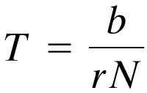
Disk Performance Parameters (2)
Access time = seek time + rotational delay
Read/write performed as the sector moves under the head.
Transfer time: time required for the transfer.
T = transfer time,
b = number of bytes to be transferred,
r = rotational speed (r.p.s.),
N = number of bytes on a track.

Slide 25
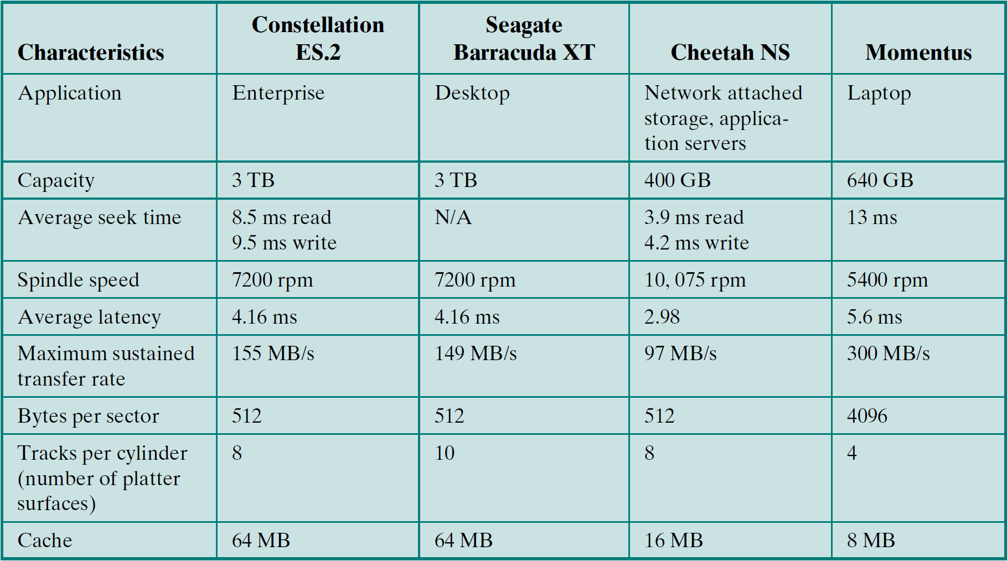
Typical Hard Disk Drive Parameters

Slide 26
Reading Material
Stallings, Chapter 6:
Pages 185 – 195

