Slide 1

CSE 321b
Computer Organization (2)
تنظيم الحاسب (2)
3rd year, Computer Engineering
Winter 2017
Lecture #9
Dr. Hazem Ibrahim Shehata
Dept. of Computer & Systems Engineering
Credits to Dr. Ahmed Abdul-Monem Ahmed for the slides

Slide 2
Adminstrivia
Midterm:
New date: Wednesday, April 26, 2017
New time: 10:30pm – 12:00pm
Location: classroom #27309
Coverage: lectures #1 ➔ #6
Assignment #2:
Final due date: Sunday, April 23, 2017
Website: http://hshehata.github.io/courses/zu/cse321b/
Office hours: TBA

Slide 3
Chapter 10. Computer Arithmetic (Cont.)

Slide 4
Outline
Integer Representation
Sign-Magnitude, Two’s Complement, Biased
Integer Arithmetic
Negation, Addition, Subtraction
Multiplication, Division
Floating-Point Representation
IEEE 754
Floating-Point Arithmetic
Addition, Subtraction
Multiplication, Division
Rounding

Slide 5
Real Numbers
Numbers with fractions.
Could be done in pure binary
1001.1010 = 2³ + 2⁰ +2⁻¹ + 2⁻³ =9.625
Where is the binary point?
Fixed?
Very large/small numbers cannot be represented.
e.g., 0.0000001, 10000000000
Fractional part of the quotient in dividing very large numbers will be lost.
Moving/floating?
How do you show where it is?
976,000,000,000,000 = 9.76 × 10¹⁴
0.0000000000000976 = 9.76 × 10^{–14}
.
0 0 1 0 1 1 0 1 0 0 1 1 1 0 1 0
Can do the same with binary numbers.
What do we need to store?

Slide 6
Floating-Point Representation
±S × 2E
Sign
Exponent
Significand (Mantissa)
The base 2 is the same for all numbers ➔ need not be stored.
Number is stored in a binary word with 3 fields:
Sign: +/–
Significand S
Exponent E
Normal number: most significant digit of the significand (mantissa) is nonzero ➔ 1 for base 2 (binary).
What number to store in the significand field?
Normal form: 1.011 × 2^{–3} ➔
There is an implicit 1 to the left of the binary point (normalized).
Exponent indicates place value (floating-point position).
0 . 0 0 1 0 1 1
Store only 011 in the significand field!

Slide 7
Floating-Point Representation Biased Exponent
±S × 2E
Biased
Exponent
Sign
Exponent
Significand (Mantissa)
?
2^{k}–1
0
?
k-bit unsigned exponent E’ ranges from to
e.g., 8-bit exponent: 0 ≤ E’ ≤ 255
The stored exponent E’ is a biased exponent
E’ = E + (2^{k–1}–1)
e.g., for 8-bit exponent, E’ = E + 127
≤ E ≤
Why?
Nonnegative floating-point numbers can be treated as unsigned integers for comparison purposes.
This is not true for 2’s comp. or sign-magnitude representations.
bias
?
?
–127
128
–127
0
128
255

Slide 8
Normalization
FP numbers are usually normalized.
i.e., exponent is adjusted so that leading bit (MSB) of mantissa is non-zero, i.e., 1.
c.f., Scientific notation where numbers are normalized to give a single digit before the decimal point, e.g. 3.123 x 10³.
Since the MSB of mantissa is always 1, there is no need to store it!

Slide 9
Floating-Point Examples
8 bits
23 bits
Biased
Exponent
Significand (Mantissa)
Sign
1717698.56
Positive ➔ sign bit = 0
E’ = E + 127 = 10100 + 1111111 = 10010011
Mantissa = 1010001 0000000000000000
1.638125 × 2²⁰
1.1010001 × 2¹⁰¹⁰⁰
0 10010011 10100010000000000000000
-1717698.56
Negative ➔ sign bit = 1
E’ = E + 127 = 10100 + 1111111 = 10010011
Mantissa = 1010001 0000000000000000
-1.638125 × 2²⁰
-1.1010001 × 2¹⁰¹⁰⁰
1 10010011 10100010000000000000000
…
Positive ➔ sign bit = 0
E’ = E + 127 = –10100 + 1111111 = 01101011
Mantissa = 1010001 0000000000000000
1.638125 × 2⁻²⁰
1.1010001 × 2⁻¹⁰¹⁰⁰
0 01101011 10100010000000000000000

Slide 10
FP Ranges (32-bit)
32-bit FP number, 8-bit exponent, 23-bit mantissa.
Largest +ve number
Largest true exponent: 128
Largest mantissa: 1 + (1 – 2^{–23})= 2 – 2^{–23}
Smallest +ve number
Smallest true exponent: –127
Smallst mantissa: 1
Smallest –ve number
Largest –ve number
Accuracy
The effect of changing LSB of mantissa.
23-bit mantissa 2⁻²³ ≈ 1.2 x 10⁻⁷
About 6 decimal places.
(2–2^{–23}) × 2¹²⁸
0.111…11
2^{–127}
– (2–2²³) × 2¹²⁸
–2^{–127}

Slide 11
Expressible Numbers (32-bit)

Slide 12
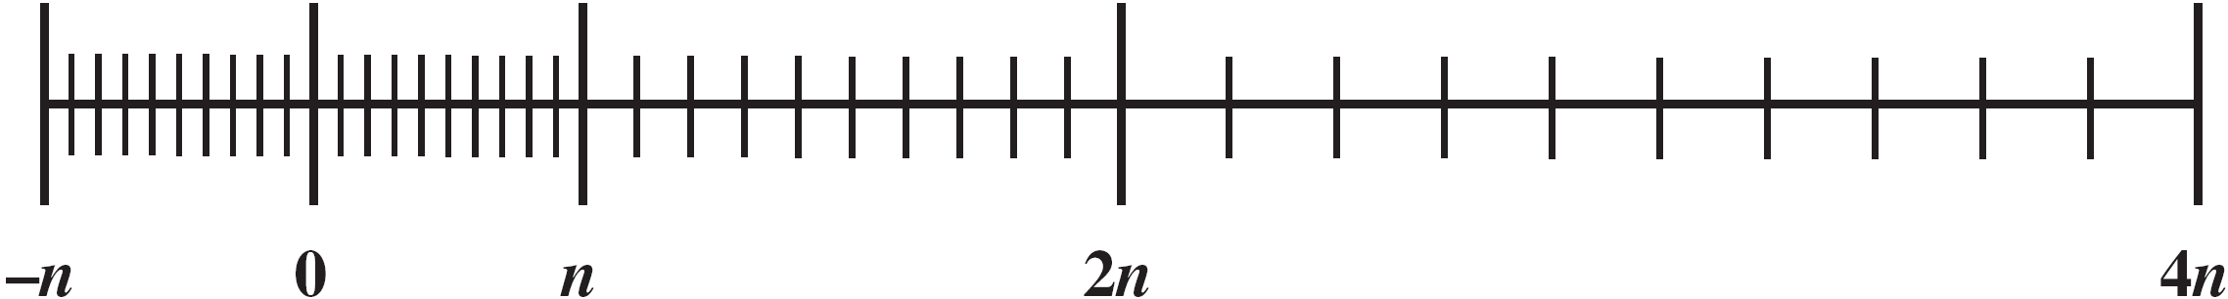
Density of Floating Point Numbers
32-bit FP number ➔ 2³² different values represented.
No more individual values are represented with floating-point numbers. Numbers are just spread out.
Numbers represented in the FP representation are not spaced evenly along the line number. Why?
Range-precision tradeoff
More bits for exponent ➔ wider range & less precision
Reason: there is a fixed number of values that can be represented!
To increase both range and precision ➔ use more bits!!!

Slide 13
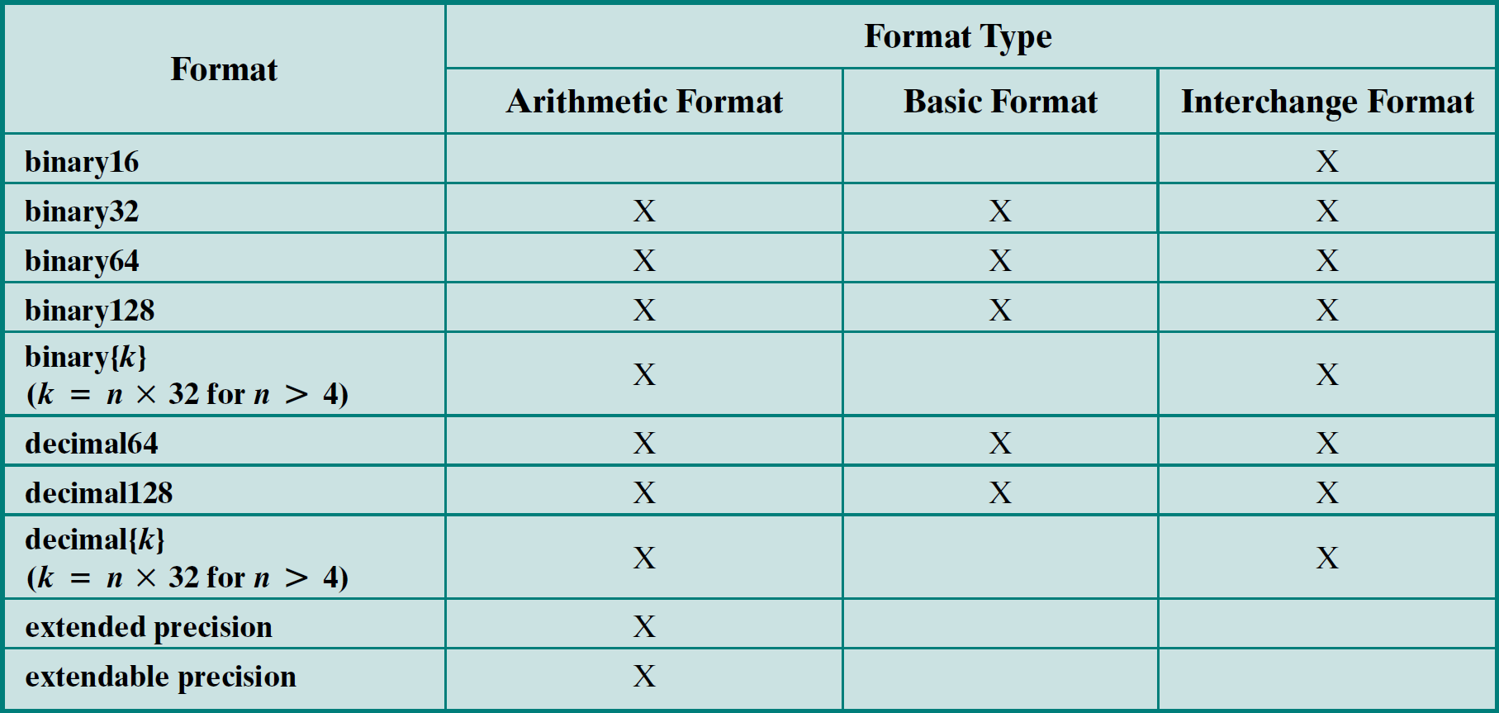
IEEE 754
Standard for floating-point representation.
Adopted 1985 and revised 2008.
IEEE 754-2008 defines many FP formats for different purposes:

Slide 14
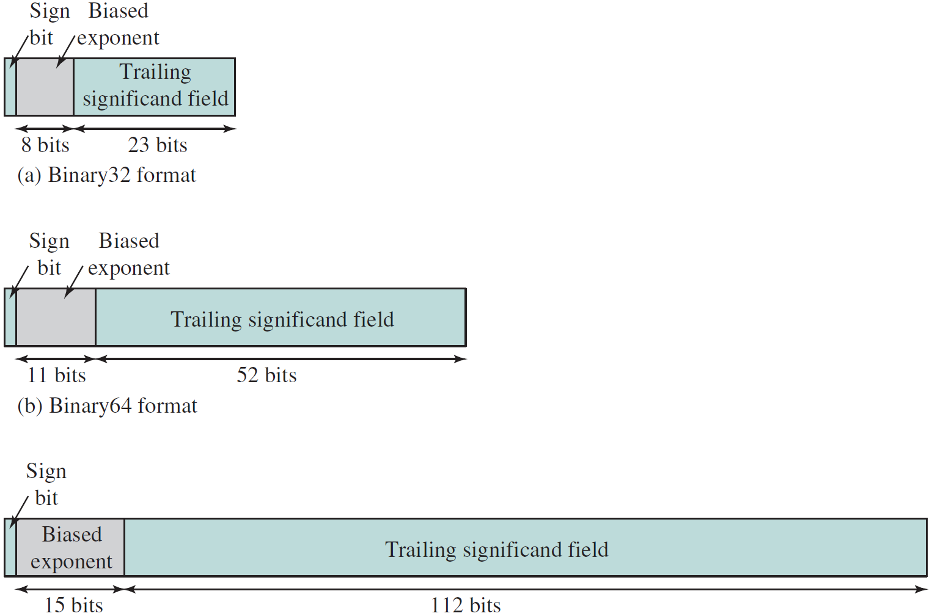
IEEE 754 - Binary32/64/128 Formats
Binary32
(Single-precision)
Binary64
(Double-precision)
Binary128
(Quadruple-precision)

Slide 15
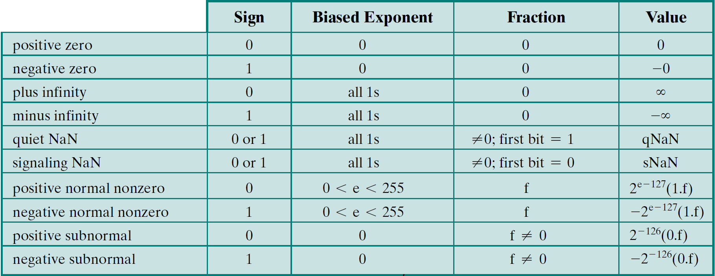
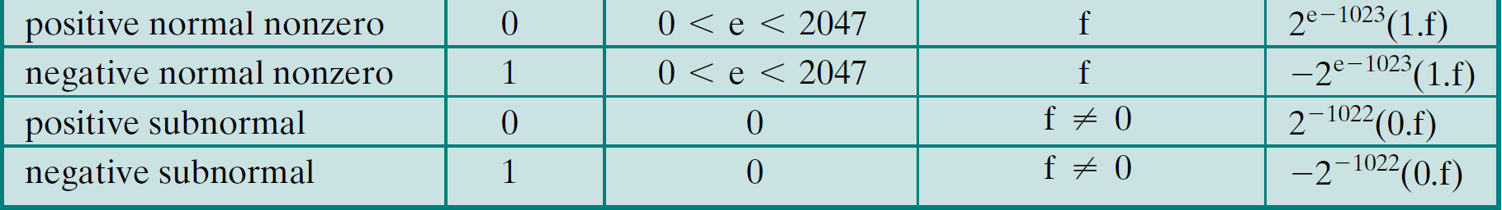
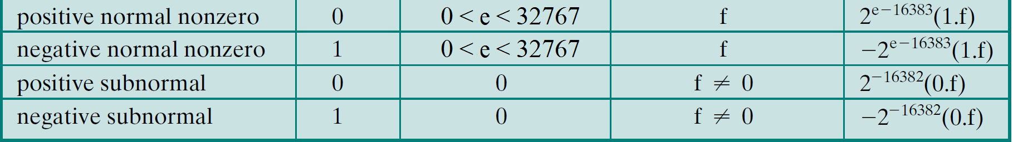
IEEE 754 - Binary32/64/128 Interpretations
32
64
128

Slide 16
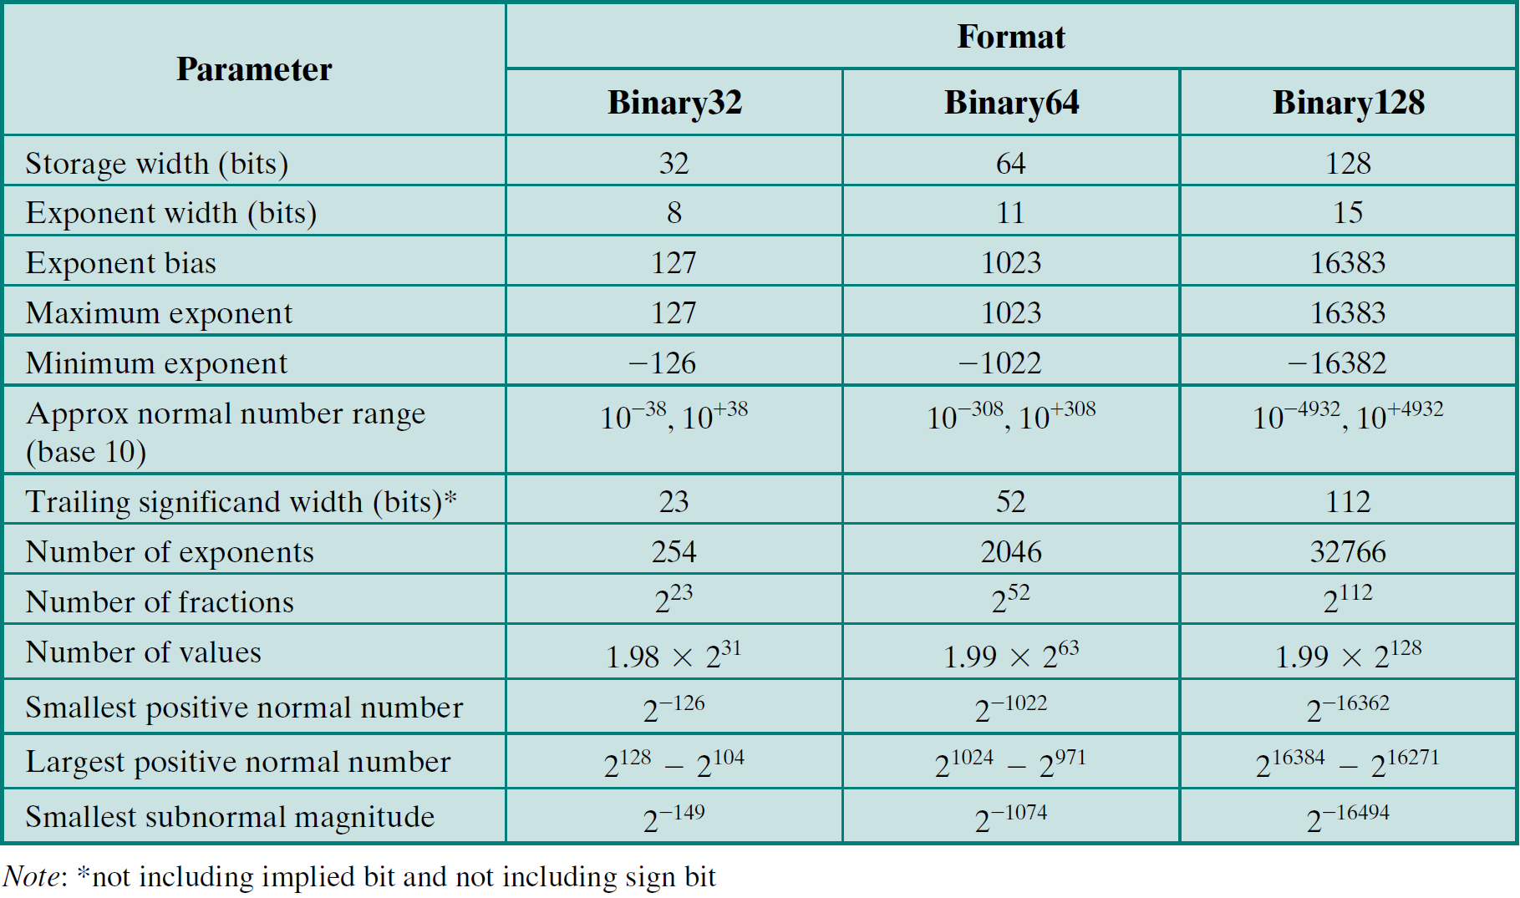
IEEE 754 - Binary32/64/128 Parameters

Slide 17
IEEE 754 - NaNs
NaN:
Symbolic entity encoded in FP format
Types: Signaling (sNaN) or Quiet (qNaN)
Both types have the same format:
F distinguishes between the two types:
F=0xxxx..xx ➔ sNaN, F=1xxxx..xx ➔ qNaN
Signaling NaN:
Signals an invalid operation exception whenever it appears as an operand. Ex.: uninitialized variables
Quite NaN:
Propagates without signaling exceptions.
S= 0 or 1 | E= 1111…11 | F ≠ 0000..00

Slide 18
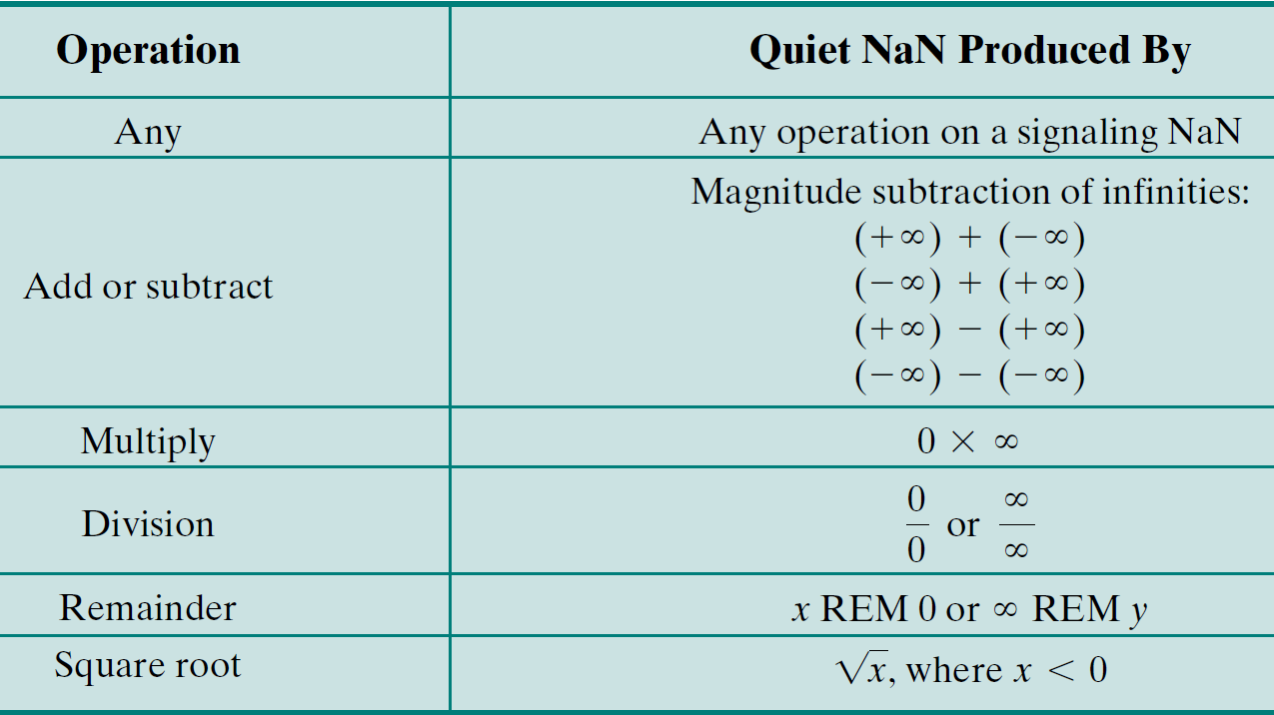
IEEE 754 - Quiet NaN

Slide 19
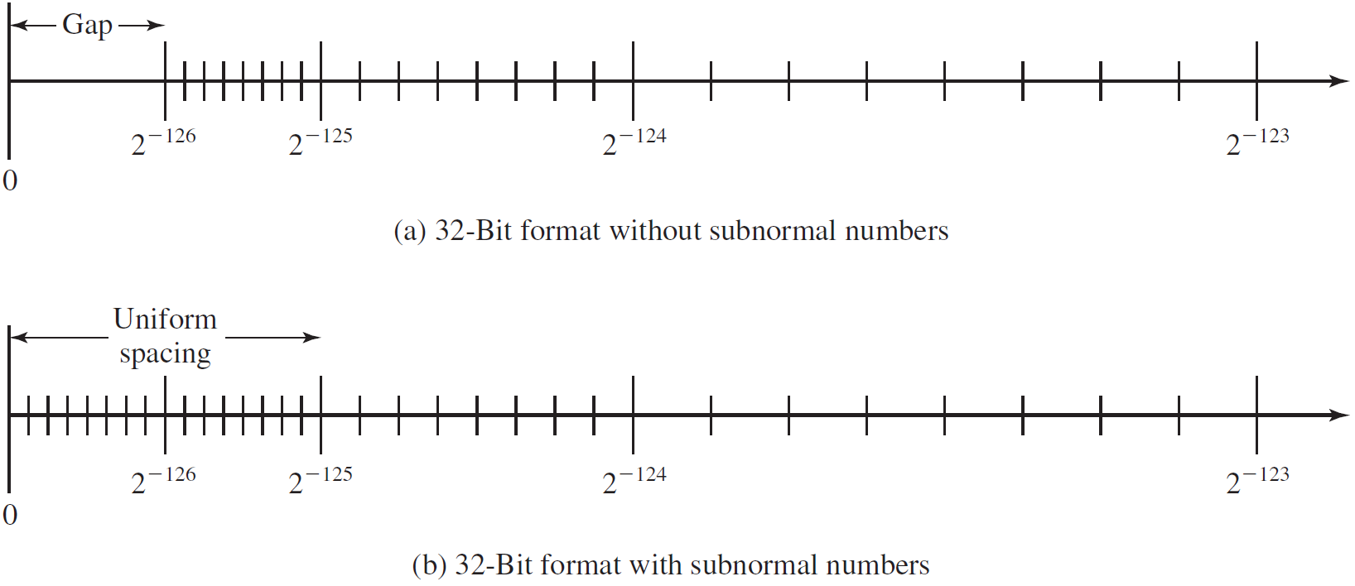
IEEE 754 - Effect of Subnormal Numbers

Slide 20
FP Arithmetic +/-
Algorithm:
Check for zeros.
Align significands (adjusting exponents).
Add or subtract significands.
Normalize result.
Round result.

Slide 21
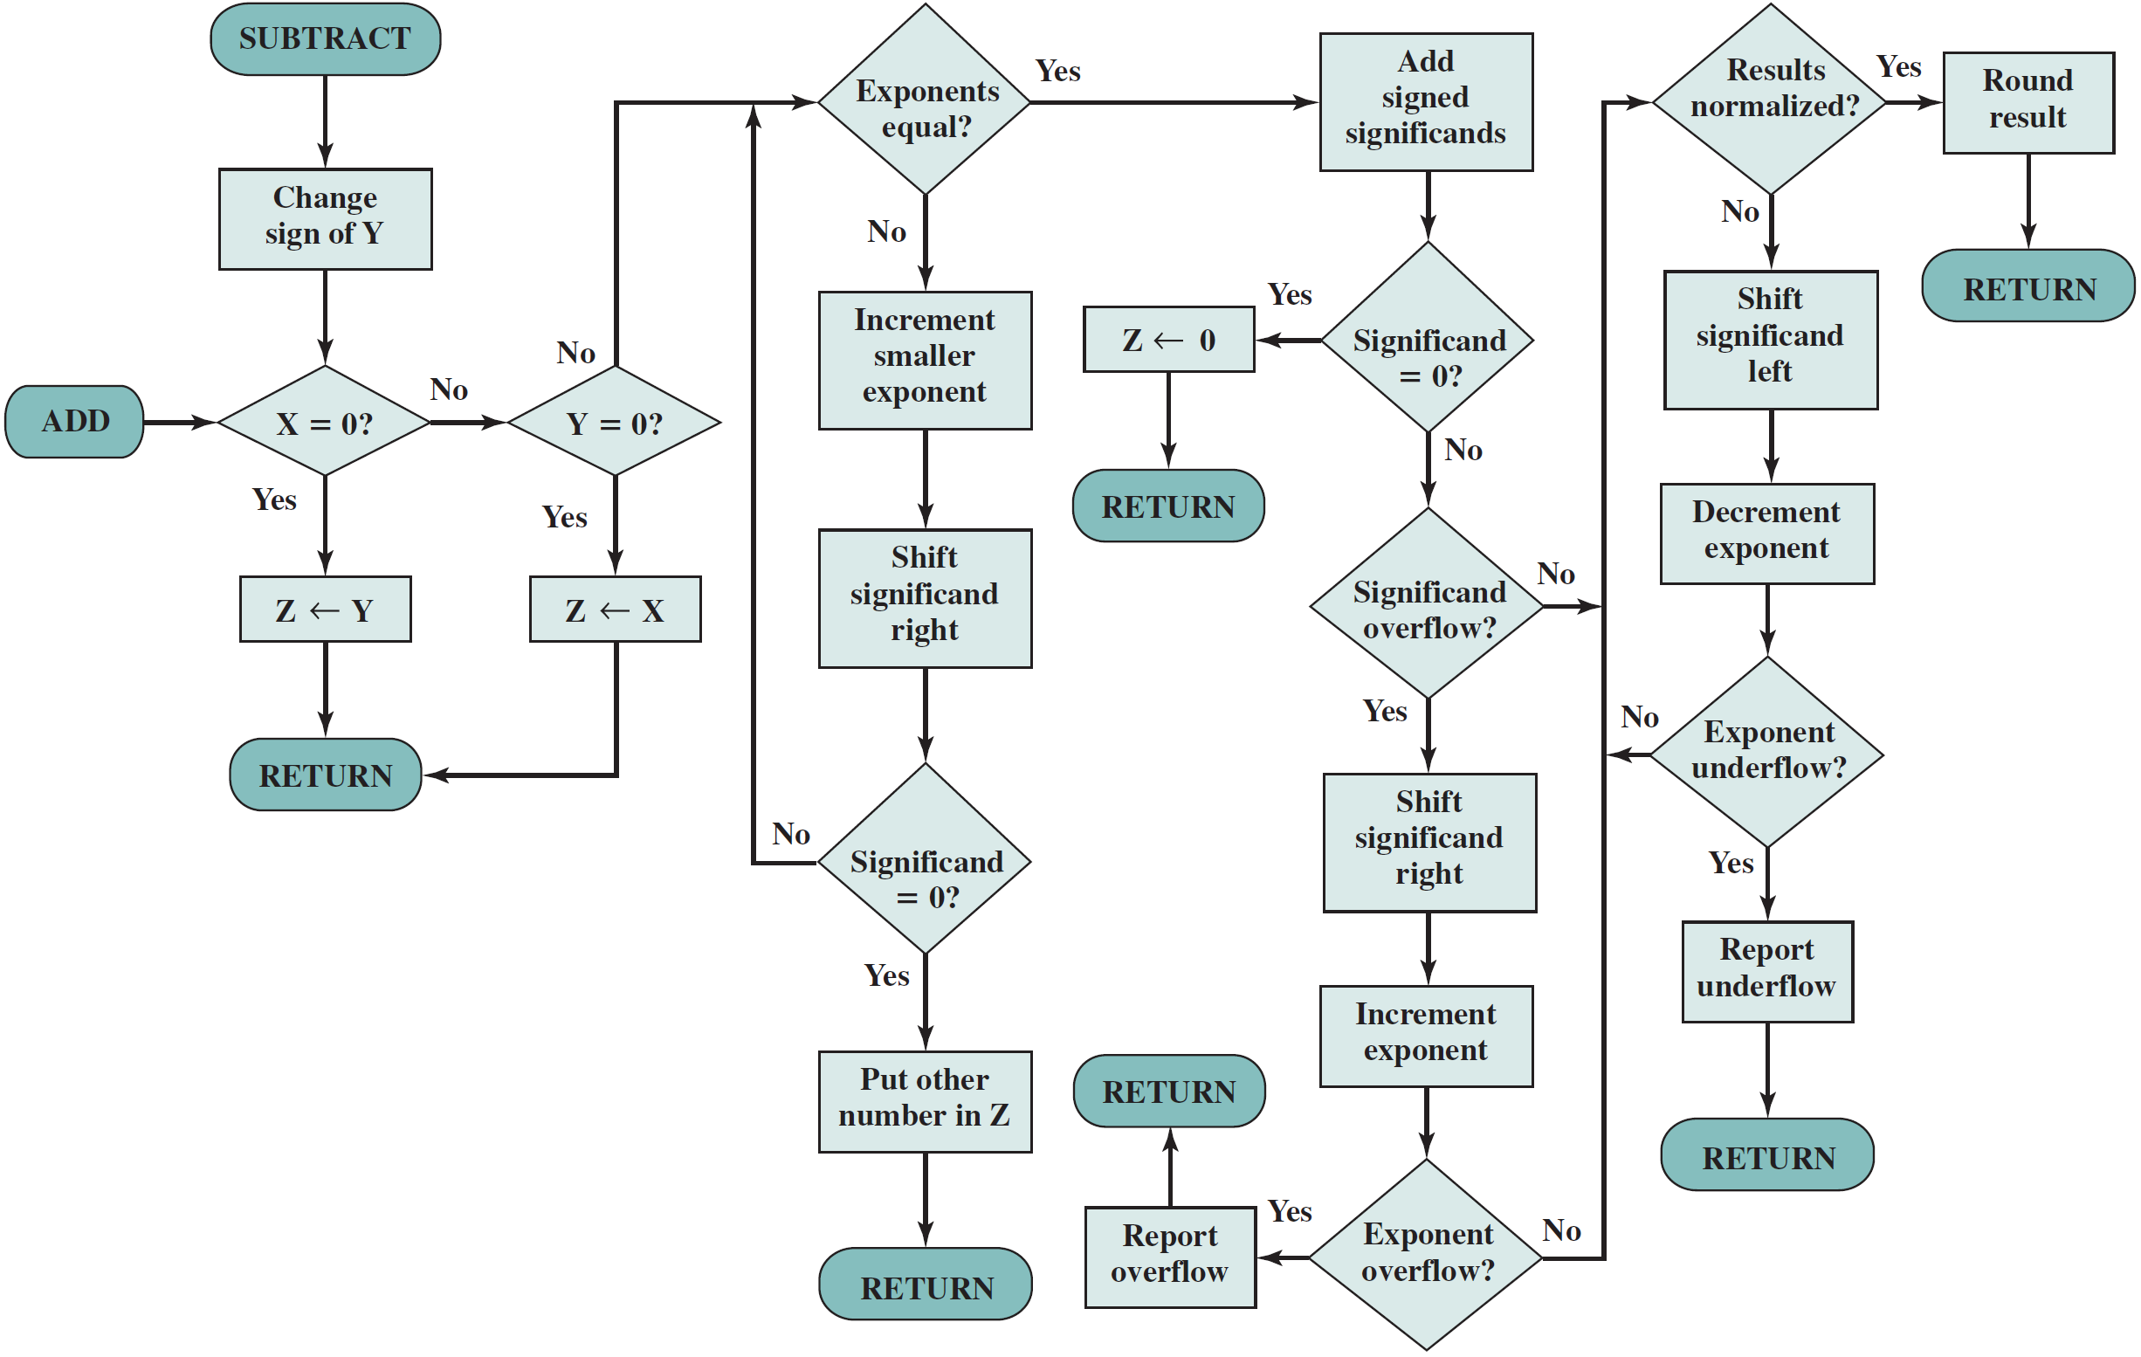
FP Addition & Subtraction Flowchart
5. Round
1. Zero Check
3. Add
4. Normalize
2. Align

Slide 22
Reading Material
Stallings, Chapter 10:
Pages 341-352
Pages 356-358

