Slide 1
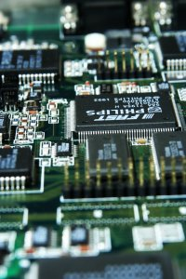
CSE 321b
Computer Organization (2)
تنظيم الحاسب (2)
3rd year, Computer Engineering
Winter 2017
Lecture #11
Dr. Hazem Ibrahim Shehata
Dept. of Computer & Systems Engineering
Credits to Dr. Ahmed Abdul-Monem Ahmed for the slides

Slide 2
Adminstrivia
Midterm:
Marks to be posted tomorrow
Assignment #3:
To be released tomorrow
Website: http://hshehata.github.io/courses/zu/cse321b/
Office hours: Sunday 11:30am – 12:30pm

Slide 3
Chapter 14. Processor Structure and Function

Slide 4
Outline
Processor organization
Register organization
Instruction cycle
Instruction pipelining
Pipelining strategy
Pipeline performance
Pipeline hazards
Dealing with branches
Intel 80486 Pipelining
The x86 Processor Family
The Arm Processor

Slide 5
Outline
Processor organization
Register organization
Instruction cycle
Instruction pipelining
Pipelining strategy
Pipeline performance
Pipeline hazards
Dealing with branches
Intel 80486 Pipelining
The x86 Processor Family
The Arm Processor

Slide 6
Pipelining Strategy
Similar to the use of an assembly line in a manufacturing plant
New inputs are accepted at one end before previously accepted inputs appear as outputs at the other end
To apply this concept to instruction execution we must recognize that an instruction has a number of stages
Notes:
38
Instruction pipelining is similar to the use of an assembly line in a manufacturing plant. An assembly line takes advantage of the fact that a product goes through various stages of production. By laying the production process out in an assembly line, products at various stages can be worked on simultaneously. This process is also referred to as pipelining, because, as in a pipeline, new inputs are accepted at one end before previously accepted inputs appear as outputs at the other end.
To apply this concept to instruction execution, we must recognize that, in fact, an instruction has a number of stages. Figures 14.5, for example, breaks the instruction cycle up into 10 tasks, which occur in sequence. Clearly, there should be some opportunity for pipelining.

Slide 7
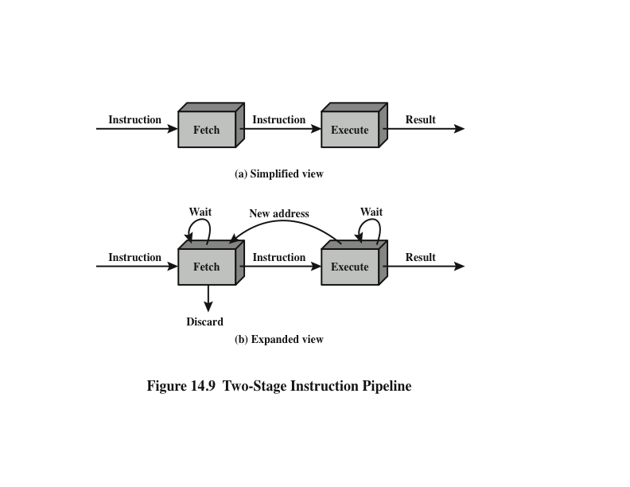
Two-Stage Instruction Pipeline
Notes:
As a simple approach, consider subdividing instruction processing into two stages: fetch instruction and execute instruction. There are times during the execution of an instruction when main memory is not being accessed. This time could be used to fetch the next instruction in parallel with the execution of the current one. Figure 14.9a depicts this approach. The pipeline has two independent stages. The first stage fetches an instruction and buffers it. When the second stage is free, the first stage passes it the buffered instruction. While the second stage is executing the instruction, the first stage takes advantage of any unused memory cycles to fetch and buffer the next instruction. This is called instruction prefetch or fetch overlap. Note that this approach, which involves instruction buffering, requires more registers. In general, pipelining requires registers to store data between stages.
It should be clear that this process will speed up instruction execution. If the fetch and execute stages were of equal duration, the instruction cycle time would be halved. However, if we look more closely at this pipeline (Figure 14.9b), we will see that this doubling of execution rate is unlikely for two reasons:
The execution time will generally be longer than the fetch time. Execution will involve reading and storing operands and the performance of some operation. Thus, the fetch stage may have to wait for some time before it can empty its buffer.
A conditional branch instruction makes the address of the next instruction to be fetched unknown. Thus, the fetch stage must wait until it receives the next instruction address from the execute stage. The execute stage may then have to wait while the next instruction is fetched.
Guessing can reduce the time loss from the second reason. A simple rule is the following: When a conditional branch instruction is passed on from the fetch to the execute stage, the fetch stage fetches the next instruction in memory after the branch instruction. Then, if the branch is not taken, no time is lost. If the branch is taken, the fetched instruction must be discarded and a new instruction fetched.

Slide 8
Additional Stages
Fetch instruction (FI)
Read the next expected instruction into a buffer
Decode instruction (DI)
Determine the opcode and the operand specifiers
Calculate operands (CO)
Calculate the effective address of each source operand
This may involve displacement, register indirect, indirect, or other forms of address calculation
Fetch operands (FO)
Fetch each operand from memory
Operands in registers need not be fetched
Execute instruction (EI)
Perform the indicated operation and store the result, if any, in the specified destination operand location
Write operand (WO)
Store the result in memory
Notes:
While these factors reduce the potential effectiveness of the two-stage pipe- line, some speedup occurs. To gain further speedup, the pipeline must have more stages. Let us consider the following decomposition of the instruction processing.
Fetch instruction (FI): Read the next expected instruction into a buffer.
Decode instruction (DI): Determine the opcode and the operand specifiers.
Calculate operands (CO): Calculate the effective address of each source operand. This may involve displacement, register indirect, indirect, or other forms of address calculation.
Fetch operands (FO): Fetch each operand from memory. Operands in registers need not be fetched.
Execute instruction (EI): Perform the indicated operation and store the result, if any, in the specified destination operand location.
Write operand (WO): Store the result in memory.
With this decomposition, the various stages will be of more nearly equal duration.

Slide 9
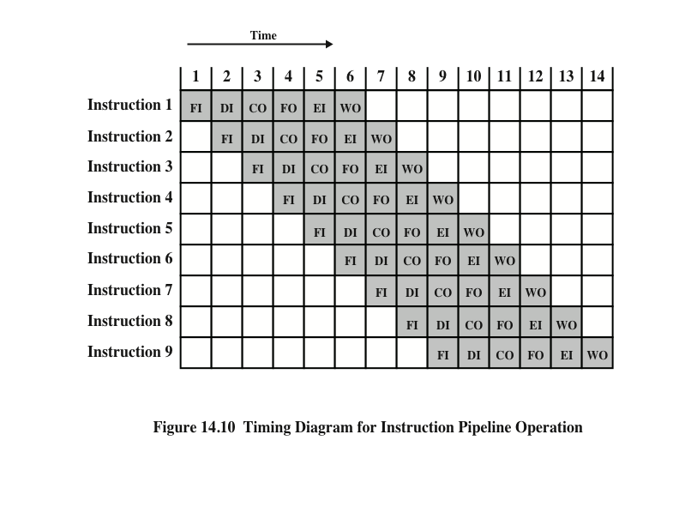
Timing Diagram for Instruction Pipeline Operation
Notes:
39
For the sake of illustration, let us assume equal duration. Using this assumption, Figure 14.10 shows that a six-stage pipeline can reduce the execution time for 9 instructions from 54 time units to 14 time units.
Several comments are in order: The diagram assumes that each instruction goes through all six stages of the pipeline. This will not always be the case. For example, a load instruction does not need the WO stage. However, to simplify the pipeline hardware, the timing is set up assuming that each instruction requires all six stages. Also, the diagram assumes that all of the stages can be performed in parallel. In particular, it is assumed that there are no memory conflicts. For example, the FI, FO, and WO stages involve a memory access. The diagram implies that all these accesses can occur simultaneously. Most memory systems will not permit that. However, the desired value may be in cache, or the FO or WO stage may be null. Thus, much of the time, memory conflicts will not slow down the pipeline.

Slide 10
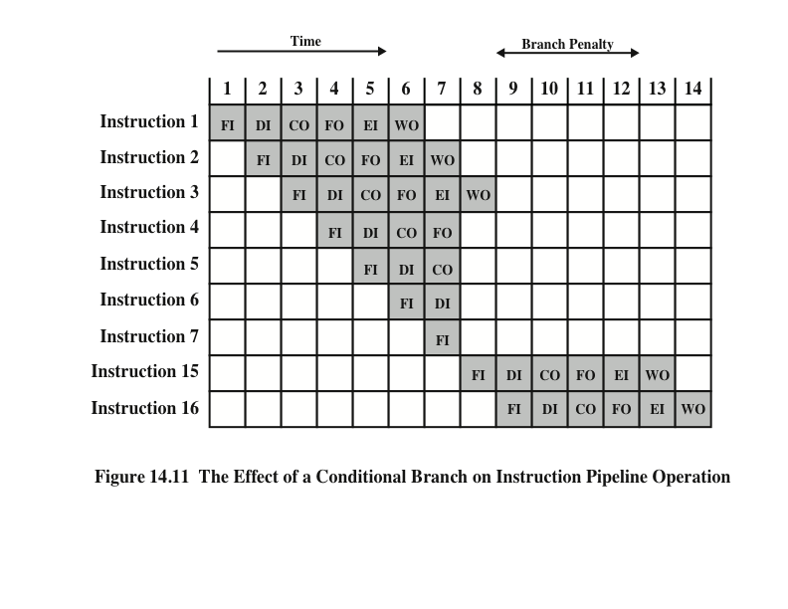
The Effect of a Conditional Branch on Instruction Pipeline Operation
Notes:
40
Several other factors serve to limit the performance enhancement. If the six stages are not of equal duration, there will be some waiting involved at various pipe- line stages, as discussed before for the two-stage pipeline. Another difficulty is the conditional branch instruction, which can invalidate several instruction fetches. A similar unpredictable event is an interrupt. Figure 14.11 illustrates the effects of the conditional branch, using the same program as Figure 14.10. Assume that instruction 3 is a conditional branch to instruction 15. Until the instruction is executed, there is no way of knowing which instruction will come next. The pipeline, in this example, simply loads the next instruction in sequence (instruction 4) and proceeds. In Figure 14.10, the branch is not taken, and we get the full performance benefit of the enhancement. In Figure 14.11, the branch is taken. This is not determined until the end of time unit 7. At this point, the pipeline must be cleared of instructions that are not useful. During time unit 8, instruction 15 enters the pipeline. No instructions complete during time units 9 through 12; this is the performance penalty incurred because we could not anticipate the branch.

Slide 11
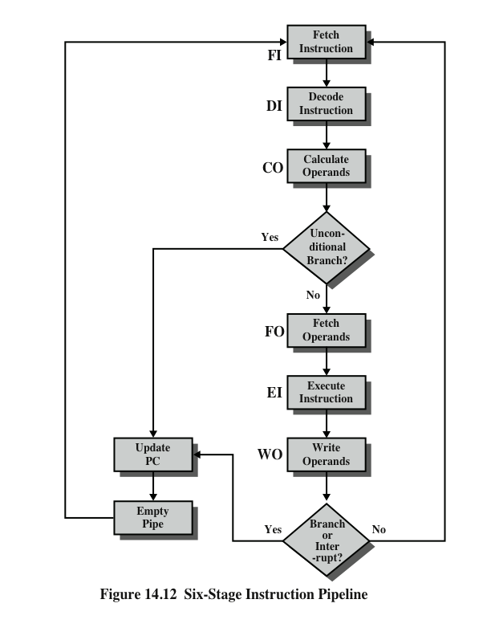
Six Stage Instruction Pipeline
Notes:
Figure 14.12 indicates the logic needed for pipelining to account for branches and interrupts.
Other problems arise that did not appear in our simple two-stage organization. The CO stage may depend on the contents of a register that could be altered by a previous instruction that is still in the pipeline. Other such register and memory conflicts could occur. The system must contain logic to account for this type of conflict.

Slide 12
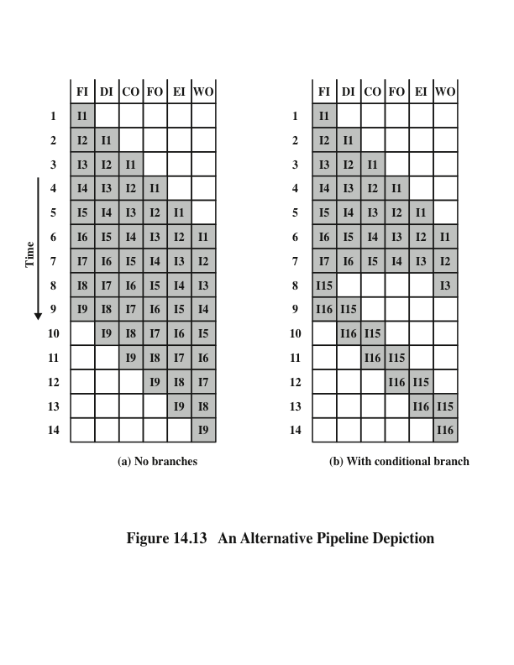
Alternative Pipeline Depiction
Notes:
To clarify pipeline operation, it might be useful to look at an alternative depiction. Figures 14.10 and 14.11 show the progression of time horizontally across the figures, with each row showing the progress of an individual instruction. Figure 14.13 shows same sequence of events, with time progressing vertically down the figure, and each row showing the state of the pipeline at a given point in time. In Figure 14.13a (which corresponds to Figure 14.10), the pipeline is full at time 6, with 6 different instructions in various stages of execution, and remains full through time 9; we assume that instruction I9 is the last instruction to be executed. In Figure 14.13b, (which corresponds to Figure 14.11), the pipeline is full at times 6 and 7. At time 7, instruction 3 is in the execute stage and executes a branch to instruction 15. At this point, instructions I4 through I7 are flushed from the pipeline, so that at time 8, only two instructions are in the pipeline, I3 and I15.

Slide 13
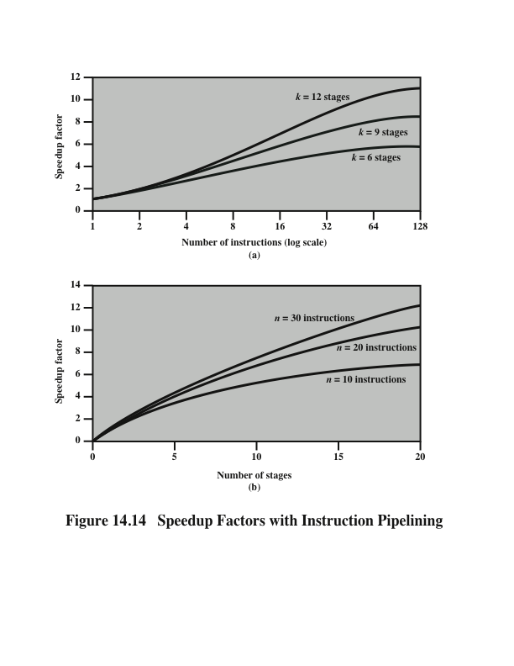
Speedup Factors with Instruction Pipelining
Notes:
Figure 14.14a plots the speedup factor as a function of the number of instructions that are executed without a branch.
Figure 14.14b shows the speedup factor as a function of the number of stages in the instruction pipeline
Thus, the larger the number of pipeline stages, the greater the potential for speedup. However, as a practical matter, the potential gains of additional pipe- line stages are countered by increases in cost, delays between stages, and the fact that branches will be encountered requiring the flushing of the pipeline.

Slide 14
Pipeline Hazards
Occur when the pipeline, or some portion of the pipeline, must stall because conditions do not permit continued execution
Also referred to as a pipeline bubble
There are three types of hazards:
Resource
Data
Control
Notes:
In the previous subsection, we mentioned some of the situations that can result in less than optimal pipeline performance. In this subsection, we examine this issue in a more systematic way. Chapter 16 revisits this issue, in more detail, after we have introduced the complexities found in superscalar pipeline organizations.
A pipeline hazard occurs when the pipeline, or some portion of the pipeline, must stall because conditions do not permit continued execution. Such a pipe- line stall is also referred to as a pipeline bubble. There are three types of hazards: resource, data, and control.

Slide 15
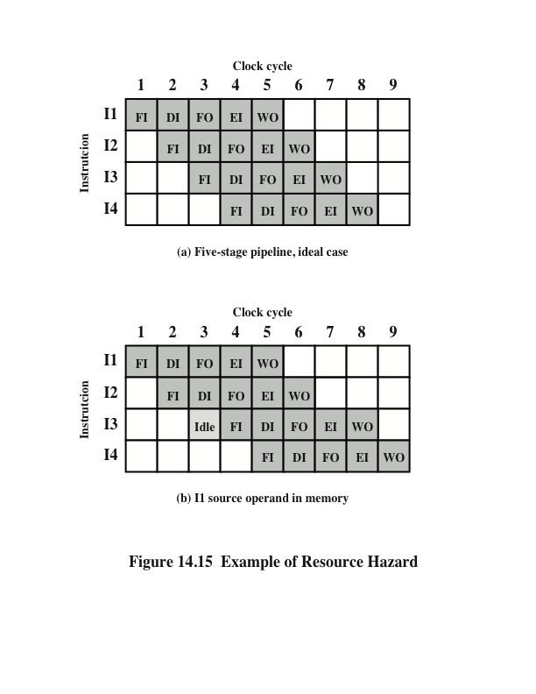
Resource Hazards
A resource hazard occurs when two or more instructions that are already in the pipeline need the same resource
The result is that the instructions must be executed in serial rather than parallel for a portion of the pipeline
A resource hazard is sometimes referred to as a structural hazard
Notes:
A resource hazard occurs when two (or more) instructions that are already in the pipeline need the same resource. The result is that the instructions must be executed in serial rather than parallel for a portion of the pipeline. A resource hazard is sometime referred to as a structural hazard.
Let us consider a simple example of a resource hazard. Assume a simplified five-stage pipeline, in which each stage takes one clock cycle. Figure 14.15a shows the ideal case, in which a new instruction enters the pipeline each clock cycle. Now assume that main memory has a single port and that all instruction fetches and data reads and writes must be performed one at a time. Further, ignore the cache. In this case, an operand read to or write from memory cannot be performed in parallel with an instruction fetch. This is illustrated in Figure 14.15b, which assumes that the source operand for instruction I1 is in memory, rather than a register. Therefore, the fetch instruction stage of the pipeline must idle for one cycle before beginning the instruction fetch for instruction I3. The figure assumes that all other operands are in registers.
Another example of a resource conflict is a situation in which multiple instructions are ready to enter the execute instruction phase and there is a single ALU. One solutions to such resource hazards is to increase available resources, such as having multiple ports into main memory and multiple ALU units.

Slide 16
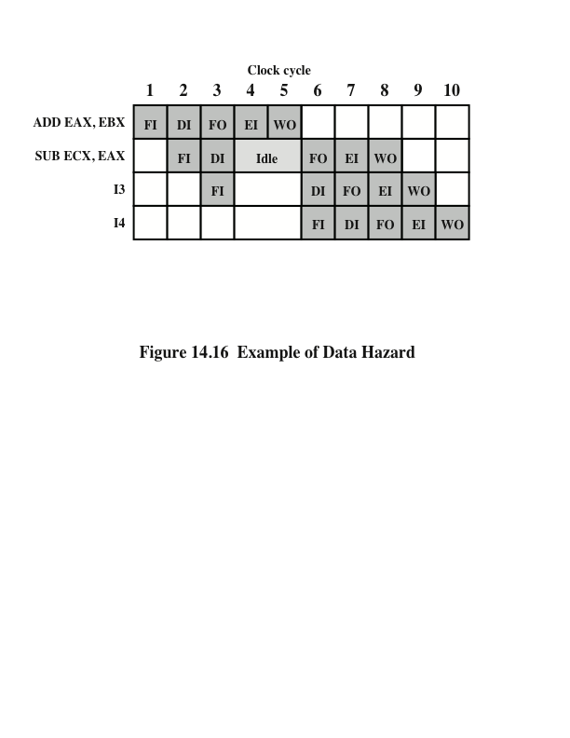
Data Hazards
RAW
Hazard
A data hazard occurs when there is a conflict in the access of an operand location
Notes:
A data hazard occurs when there is a conflict in the access of an operand location. In general terms, we can state the hazard in this form: Two instructions in a program are to be executed in sequence and both access a particular memory or register operand. If the two instructions are executed in strict sequence, no problem occurs. However, if the instructions are executed in a pipeline, then it is possible for the operand value to be updated in such a way as to produce a different result than would occur with strict sequential execution. In other words, the program produces an incorrect result because of the use of pipelining.

Slide 17
Types of Data Hazard
Read after write (RAW), or true dependency
An instruction modifies a register or memory location
Succeeding instruction reads data in memory or register location
Hazard occurs if the read takes place before write operation is complete
Write after read (WAR), or antidependency
An instruction reads a register or memory location
Succeeding instruction writes to the location
Hazard occurs if the write operation completes before the read operation takes place
Write after write (WAW), or output dependency
Two instructions both write to the same location
Hazard occurs if the write operations take place in the reverse order of the intended sequence
Notes:
There are three types of data hazards;
• Read after write (RAW), or true dependency: An instruction modifies a register or memory location and a succeeding instruction reads the data in that memory or register location. A hazard occurs if the read takes place before the write operation is complete.
• Write after read (WAR), or antidependency: An instruction reads a register or memory location and a succeeding instruction writes to the location. A hazard occurs if the write operation completes before the read operation takes place.
• Write after write (WAW), or output dependency: Two instructions both write to the same location. A hazard occurs if the write operations take place in the reverse order of the intended sequence.
The example of Figure 14.16 is a RAW hazard. The other two hazards are best discussed in the context of superscalar organization, discussed in Chapter 16.

Slide 18
Control Hazard
Also known as a branch hazard
Occurs when the pipeline makes the wrong decision on a branch prediction
Brings instructions into the pipeline that must subsequently be discarded
Dealing with Branches:
Multiple streams
Prefetch branch target
Loop buffer
Branch prediction
Delayed branch
Notes:
A control hazard, also known as a branch hazard, occurs when the pipeline makes the wrong decision on a branch prediction and therefore brings instructions into the pipeline that must subsequently be discarded. We discuss approaches to dealing with control hazards next.
One of the major problems in designing an instruction pipeline is assuring a steady flow of instructions to the initial stages of the pipeline. The primary impediment, as we have seen, is the conditional branch instruction. Until the instruction is actually executed, it is impossible to determine whether the branch will be taken or not.
A variety of approaches have been taken for dealing with conditional branches:
Multiple streams
Prefetch branch target
Loop buffer
Branch prediction
Delayed branch

Slide 19
Branch Prediction
Various techniques can be used to predict whether a branch will be taken:
Predict never taken
Predict always taken
Predict by opcode
Taken/not taken switch
Branch history table
These approaches are static
They do not depend on the execution history up to the time of the conditional branch instruction
These approaches are dynamic
They depend on the execution history
Notes:
45
Various techniques can be used to predict whether a branch will be taken. Among the more common are the following:
• • • • •
Predict never taken
Predict always taken
Predict by opcode
Taken/not taken switch
Branch history table
The first three approaches are static: they do not depend on the execution history up to the time of the conditional branch instruction. The latter two approaches are dynamic: They depend on the execution history.
The first two approaches are the simplest. These either always assume that the branch will not be taken and continue to fetch instructions in sequence, or they always assume that the branch will be taken and always fetch from the branch tar- get. The predict-never-taken approach is the most popular of all the branch prediction methods.
Studies analyzing program behavior have shown that conditional branches are taken more than 50% of the time [LILJ88], and so if the cost of prefetching from either path is the same, then always prefetching from the branch target address should give better performance than always prefetching from the sequential path. However, in a paged machine, prefetching the branch target is more likely to cause a page fault than prefetching the next instruction in sequence, and so this performance penalty should be taken into account. An avoidance mechanism may be employed to reduce this penalty.
The final static approach makes the decision based on the opcode of the branch instruction. The processor assumes that the branch will be taken for certain branch opcodes and not for others. [LILJ88] reports success rates of greater than 75% with this strategy.
Dynamic branch strategies attempt to improve the accuracy of prediction by recording the history of conditional branch instructions in a program. For example, one or more bits can be associated with each conditional branch instruction that reflect the recent history of the instruction. These bits are referred to as a taken/ not taken switch that directs the processor to make a particular decision the next time the instruction is encountered. Typically, these history bits are not associated with the instruction in main memory. Rather, they are kept in temporary high- speed storage. One possibility is to associate these bits with any conditional branch instruction that is in a cache. When the instruction is replaced in the cache, its history is lost. Another possibility is to maintain a small table for recently executed branch instructions with one or more history bits in each entry. The processor could access the table associatively, like a cache, or by using the low-order bits of the branch instruction’s address.

Slide 20
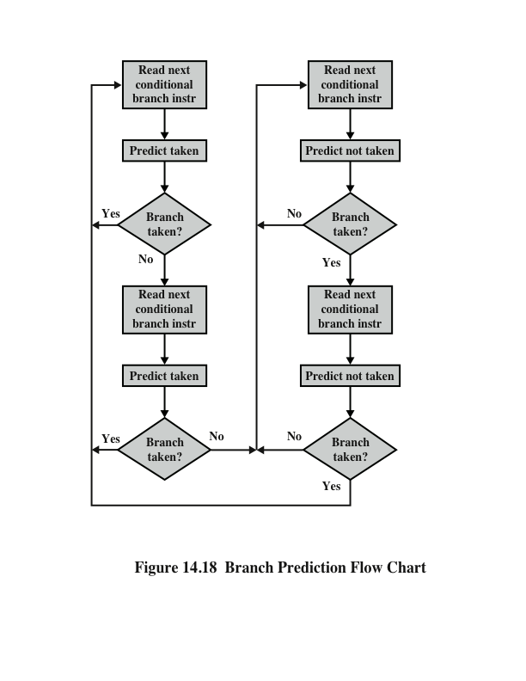
Branch Prediction Flow Chart
Notes:
With a single bit, all that can be recorded is whether the last execution of this instruction resulted in a branch or not. A shortcoming of using a single bit appears in the case of a conditional branch instruction that is almost always taken, such as a loop instruction. With only one bit of history, an error in prediction will occur twice for each use of the loop: once on entering the loop, and once on exiting.
If two bits are used, they can be used to record the result of the last two instances of the execution of the associated instruction, or to record a state in some other fashion. Figure 14.18 shows a typical approach (see Problem 14.13 for other possibilities). Assume that the algorithm starts at the upper-left-hand corner of the flowchart. As long as each succeeding conditional branch instruction that is encountered is taken, the decision process predicts that the next branch will be taken. If a single prediction is wrong, the algorithm continues to predict that the next branch is taken. Only if two successive branches are not taken does the algorithm shift to the right-hand side of the flowchart. Subsequently, the algorithm will predict that branches are not taken until two branches in a row are taken. Thus, the algorithm requires two consecutive wrong predictions to change the prediction decision.

Slide 21
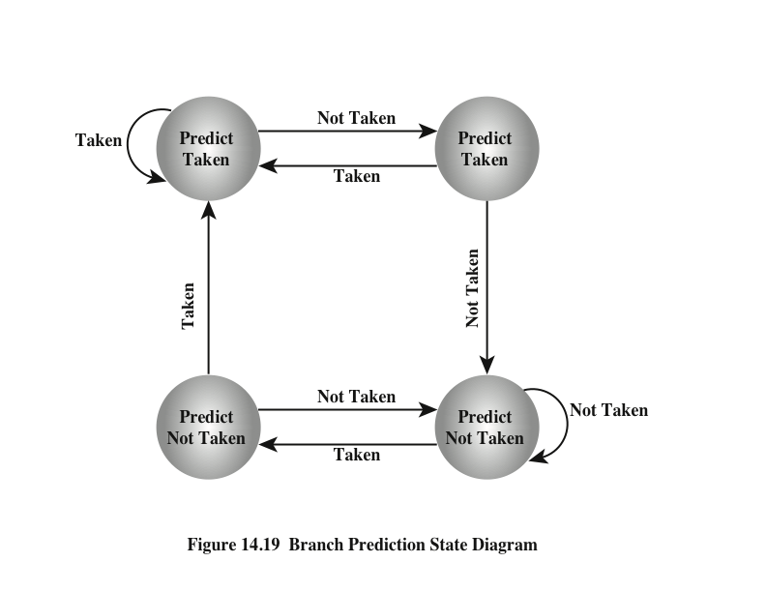
Branch Prediction State Diagram
Notes:
The decision process can be represented more compactly by a finite-state machine, shown in Figure 14.19. The finite-state machine representation is commonly used in the literature.
The use of history bits, as just described, has one drawback: If the decision is made to take the branch, the target instruction cannot be fetched until the tar- get address, which is an operand in the conditional branch instruction, is decoded. Greater efficiency could be achieved if the instruction fetch could be initiated as soon as the branch decision is made. For this purpose, more information must be saved, in what is known as a branch target buffer, or a branch history table.
The branch history table is a small cache memory associated with the instruction fetch stage of the pipeline. Each entry in the table consists of three elements: the address of a branch instruction, some number of history bits that record the state of use of that instruction, and information about the target instruction. In most proposals and implementations, this third field contains the address of the target instruction. Another possibility is for the third field to actually contain the target instruction. The trade-off is clear: Storing the target address yields a smaller table but a greater instruction fetch time compared with storing the target instruction [RECH98].

Slide 22
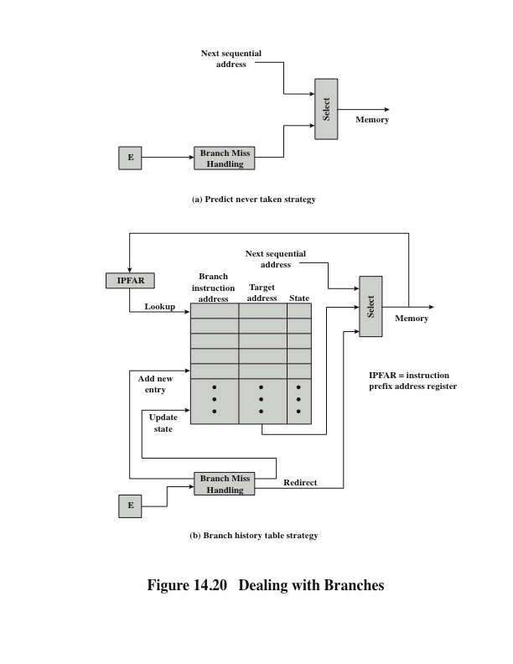
Dealing With Branches
Notes:
Figure 14.20 contrasts this scheme with a predict-never-taken strategy. With the former strategy, the instruction fetch stage always fetches the next sequential address. If a branch is taken, some logic in the processor detects this and instructs that the next instruction be fetched from the target address (in addition to flushing the pipeline). The branch history table is treated as a cache. Each prefetch triggers a lookup in the branch history table. If no match is found, the next sequential address is used for the fetch. If a match is found, a prediction is made based on the state of the instruction: Either the next sequential address or the branch target address is fed to the select logic.
When the branch instruction is executed, the execute stage signals the branch history table logic with the result. The state of the instruction is updated to reflect a correct or incorrect prediction. If the prediction is incorrect, the select logic is redirected to the correct address for the next fetch. When a conditional branch instruction is encountered that is not in the table, it is added to the table and one of the existing entries is discarded, using one of the cache replacement algorithms discussed in Chapter 4.
A refinement of the branch history approach is referred to as two-level or correlation-based branch history [YEH91]. This approach is based on the assumption that whereas in loop-closing branches, the past history of a particular branch instruction is a good predictor of future behavior, with more complex control-flow structures, the direction of a branch is frequently correlated with the direction of related branches. An example is an if-then-else or case structure. There are a number of strategies possible. Typically, recent global branch history (i.e., the history of the most recent branches not just of this branch instruction) is used in addition to the history of the current branch instruction. The general structure is defined as an (m, n) correlator, which uses the behavior of the last m branches to choose from 2^{m} n-bit branch predictors for the current branch instruction. In other words, an n-bit history is kept for a give branch for each possible combination of branches taken by the most recent m branches.

Slide 23
Reading Material
Stallings, Chapter 14:
Pages 495-504
Pages 506-510

