Slide 1
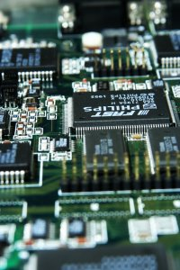
CSE 321a
Computer Organization (1)
تنظيم الحاسبات (1)
3rd year, Computer Engineering
Fall 2016
Lecture #2
Dr. Hazem Ibrahim Shehata
Dept. of Computer & Systems Engineering
Credits to Dr. Ahmed Abdul-Monem Ahmed for the slides

Slide 2
Administrivia
Website:
http://hshehata.github.io/courses/zu/cse321a/
Lecture Day/Time:
Tuesday 10:15am - 12:45am
Office Hours:
TBA!
Tutorials:
Starting next week on Sunday at 2:55pm (just once!)
Regular day/time: Thursday 10:00am – 11:30am
Assignment #1:
To be early next week.
Work in groups of two.

Slide 3
Ch. 3: A Top-Level View of Computer Function and Interconnection

Slide 4
Overview
Computer Structure (Components)
Computer Function
Instruction Fetch and Execute
Interrupts
Interconnection Structures
Bus Interconnection
Bus Structure
Multiple-Bus Hierarchies
Elements of Bus Design

Slide 5
Von Neumann (Princeton) Architecture
Almost all contemporary computer designs are based on three basic concepts introduced by John von Neumann in 1945:
Data and instructions are stored in a single read-write memory.
The contents of this memory are addressable by location, without regard to the type of data contained there.
Execution occurs in a sequential fashion (unless modified) from one instruction to the next.

Slide 6
Program Concept
Using a fixed set of logic components, there are two ways to build a system that performs a specific computation on some input data:
Special-purpose (customized) hardware:
Logic components are connected and configured specifically to perform a particular computation.
Type of computation is specified by way in which components are connected/configured → hardwired programming.
To change computation, rewire components → inflexible!
General-purpose hardware:
Logic components are connected to form a general-purpose hardware that gets configured using set of input control signals.
Type of computation (reflected by control signals values) is specified by sequence of input codes → software programming.
To change computation, change code → flexible!

Slide 7
Customized hardware
Sequence of arithmetic and logic functions
Programming in H/W
Results
Data
Instruction codes
Each code is an instruction.
A sequence of codes (or instructions) is called software program.
Programming in S/W
Instruction Interpreter
CPU
Control signals
General-purpose arithmetic and logic functions
Data
Results

Slide 8
What is a program?
A sequence of steps.
For each step, an arithmetic or logical operation could be done.
For each operation, a different set of control signals are generated.
Each operation is assigned a unique code.
e.g., ADD ➔ 9D, MOVE ➔ E3, … etc.
A hardware segment accepts the code and issues the control signals.
That’s it. We have a computer!

Slide 9
Computer Components
Each computer component takes some part in implementing the “s/w programming” approach:
Control unit (CU) acts as instruction interpreter.
Arithmetic and logic unit (ALU) implements general-purpose arithmetic and logic functions.
Both CU and ALU constitute most of central processing unit (CPU).
Data/code get into system, and results get out through input/output (I/O) units.
Data, code, and results are stored temporarily while being processed in main memory (MM) unit.

Slide 10
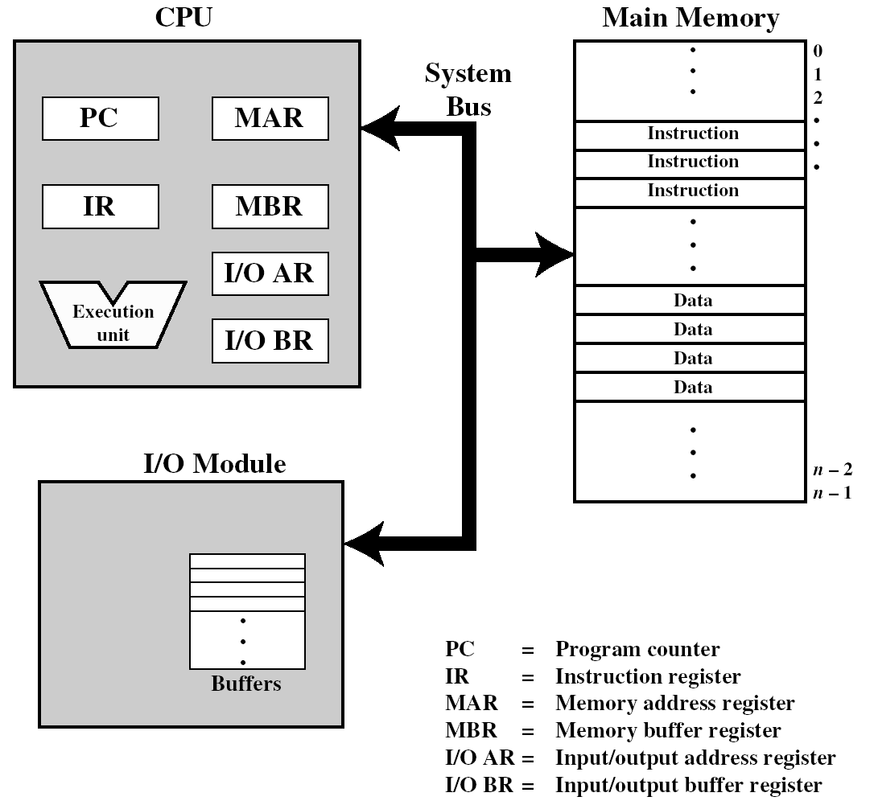


Slide 11
Overview
Computer Structure (Components)
Computer Function
Instruction Fetch and Execute
Interrupts
Interconnection Structures
Bus Interconnection
Bus Structure
Multiple-Bus Hierarchies
Elements of Bus Design

Slide 12
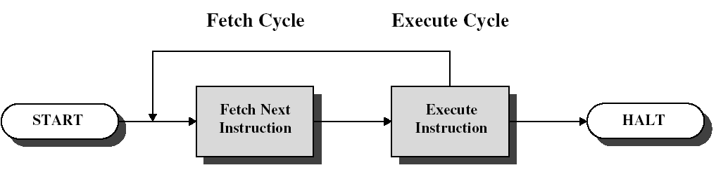
Instruction Cycle
Two steps:
Fetch: CPU reads instructions from memory, one at a time.
Execute: CPU executes instructions.

Slide 13
Fetch Cycle
Program Counter (PC) holds address of next instruction to fetch.
Processor fetches instruction from memory location pointed to by PC.
Increment PC.
Unless told otherwise
Instruction loaded into Instruction Register (IR).
Processor interprets instruction and performs required actions in execute cycle.

Slide 14
Execute Cycle
Processor-memory
Data transfer between CPU and main memory
Processor-I/O
Data transfer between CPU and I/O module
Data processing
Some arithmetic or logical operation on data
Control
Alteration of sequence of operations
e.g., jump
Combination of the above

Slide 15
Hypothetical Machine
0
3
4
15
Opcode
Address
Instruction Format
0
1
15
S
Magnitude
Integer Format
Program Counter (PC)
Instruction Register (IR)
Accumulator (AC)
0001 = Load AC from memory.
0010 = Store AC to memory.
0101 = Add to AC from memory.
CPU Registers
Partial List of Opcodes

Slide 16
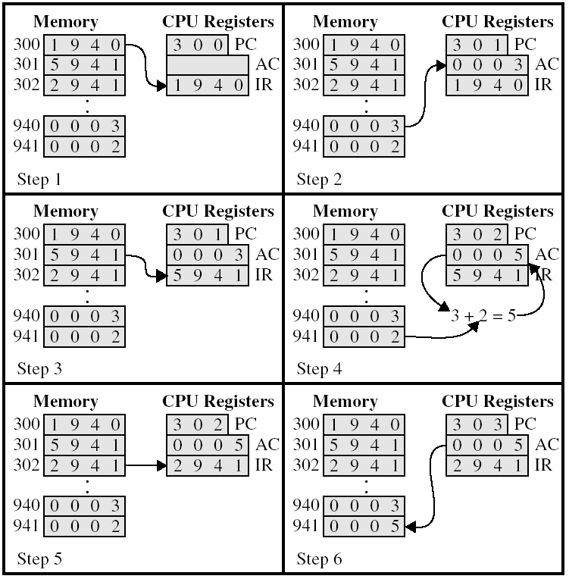
Fetch cycle
Execute cycle
First instruction
Second instruction
Third instruction

Slide 17
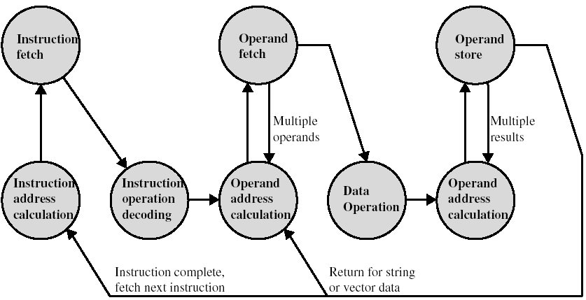
Instruction Cycle: State Diagram
CPU-memory or CPU-I/O operations
Internal CPU operations

Slide 18
Overview
Computer Structure (Components)
Computer Function
Instruction Fetch and Execute
Interrupts
Interconnection Structures
Bus Interconnection
Bus Structure
Multiple-Bus Hierarchies
Elements of Bus Design

Slide 19
Interrupts
Interrupts are provided to improve processing efficiency.
Mechanism by which other modules (e.g. I/O) may interrupt normal sequence of processing
Most common classes of interrupts:
Program
e.g. overflow, division by zero
Timer
Generated by internal processor timer
Used in pre-emptive multi-tasking (i.e., CPU time sharing).
I/O
From I/O controller
Hardware failure
e.g. memory parity error

Slide 20
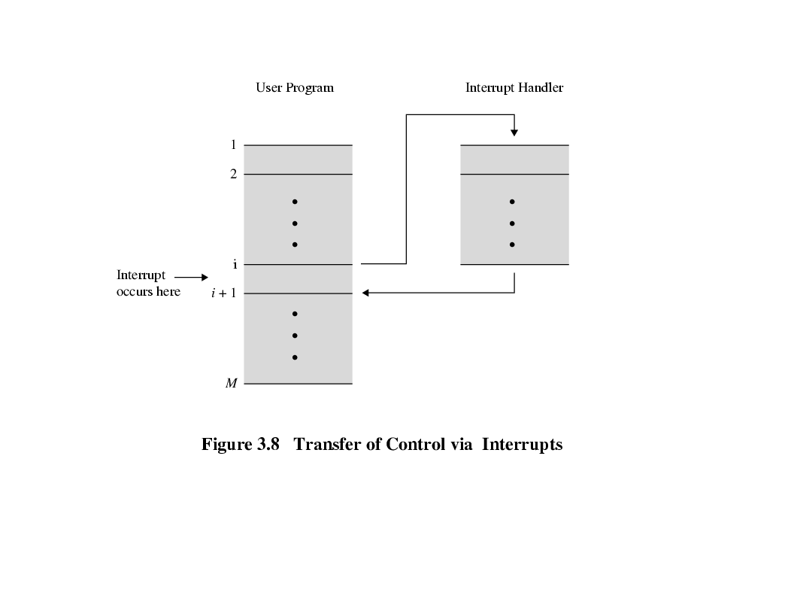
Transfer of Control via Interrupts

Slide 21
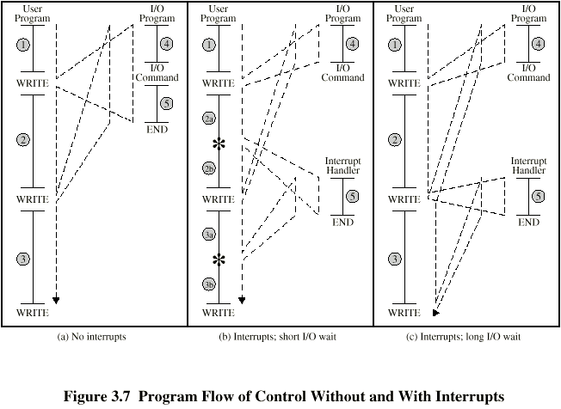
Program Flow Control

Slide 22
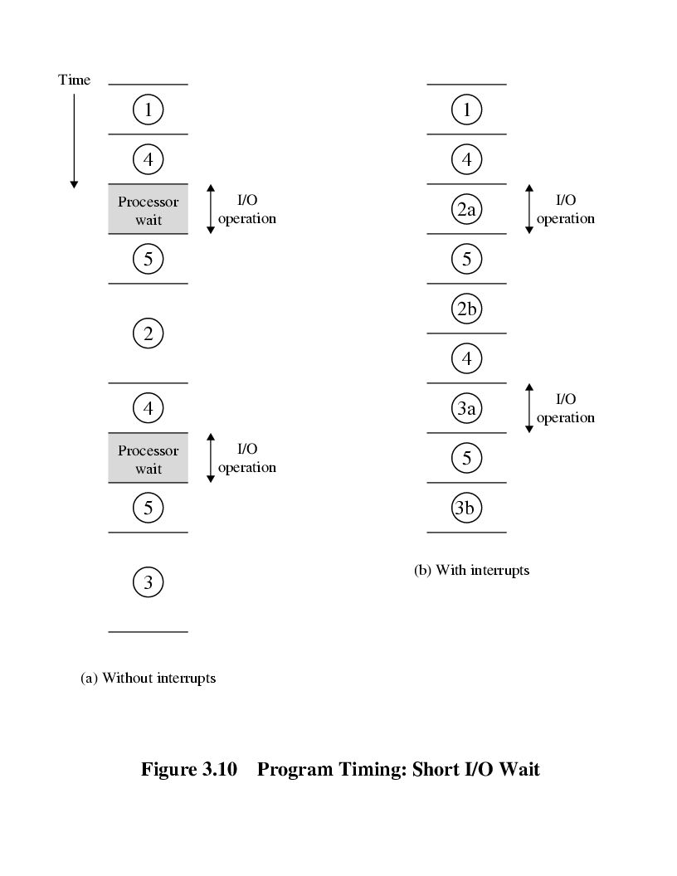
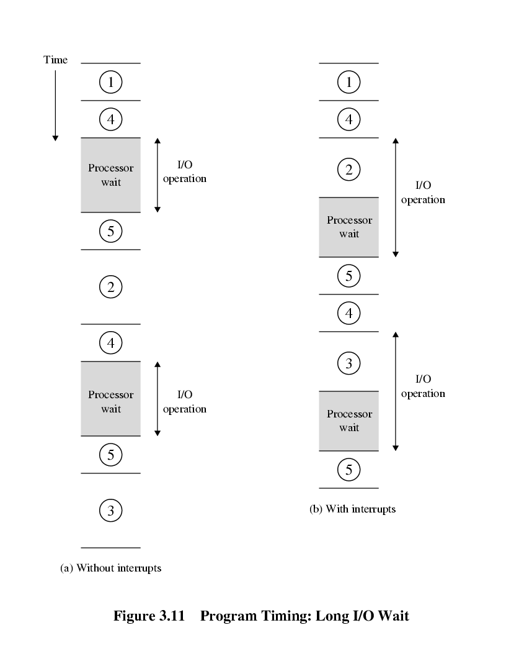
Program Timing

Slide 23
Interrupt Cycle
Added to instruction cycle.
Processor checks for interrupt
Indicated by an interrupt signal
If no interrupt:
fetch next instruction
If interrupt pending:
Suspend execution of current program.
Save context (PC & relevant data).
Set PC to start address of interrupt handler routine.
Process interrupt.
Restore context and continue interrupted program.

Slide 24
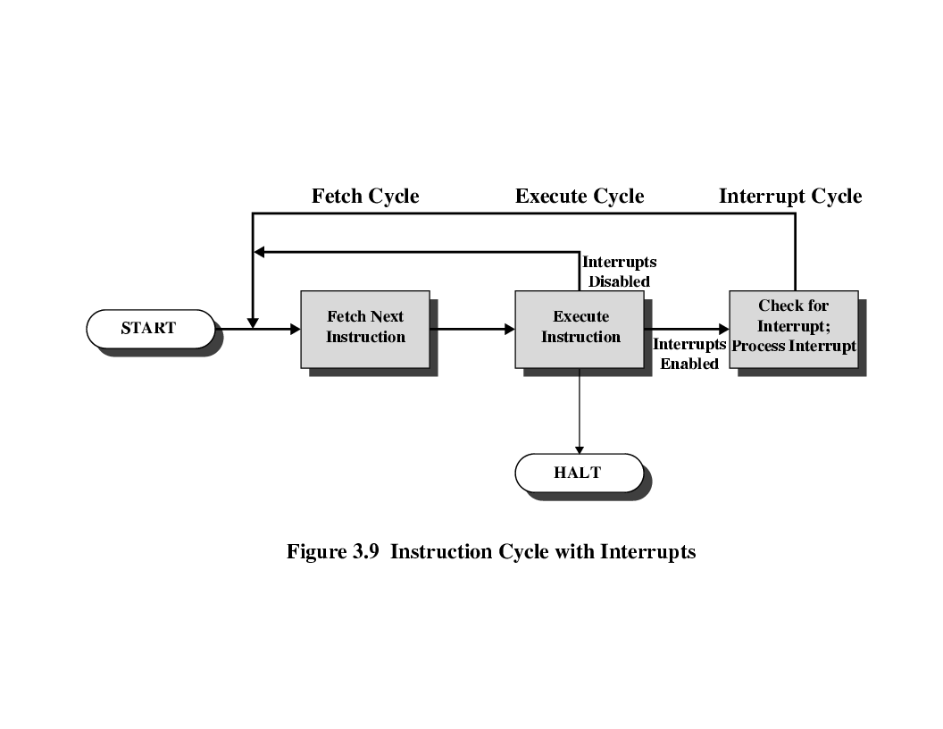
Instruction Cycle (with interrupts)

Slide 25
Instruction Cycle: State Diagram (with interrupts)

Slide 26
Reading Material
Stallings, Chapter 3:
Pages 66 – 80

