Slide 1
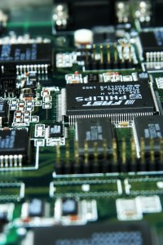
CSE 401
Computer Engineering (2)
هندسة الحاسبات (2)
4th year, Comm. Engineering
Winter 2016
Lecture #5
Dr. Hazem Ibrahim Shehata
Dept. of Computer & Systems Engineering
Credits to Dr. Ahmed Abdul-Monem Ahmed for the slides

Slide 2
Adminstrivia
Assignment #1:
  Due: Today.
  Solution will be posted soon.
Website: http://hshehata.github.io/courses/zu/cse401/
Office hours: Monday 11:30am – 12:30pm

Slide 3
Chapter 6. External Memory (Cont.)

Slide 4
Types of External Memory
Magnetic Disk
Redundant Array of Independent Disks (RAID)
Solid-State Drive (SSD)
Optical Disk
Magnetic Tape

Slide 5
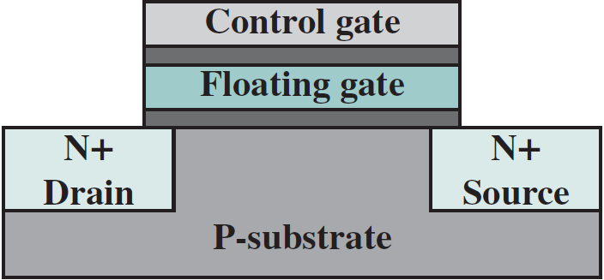
Solid-State Drive (SSD)
Purpose: complement or even replace HDDs!
The term “solid-state” refers to electronic circuitry built with semiconductors.
SSD’s store data in flash memory cells.
Each flash memory cell is built using a single transistor: floating-gate MOSFET (FG-MOSFET).
CG
FG
D
S

Slide 6
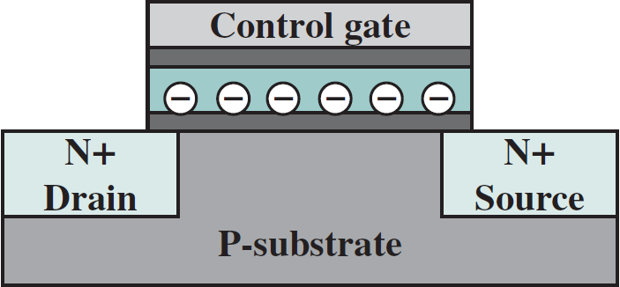
States of FG-MOSFET
I_{d}
“1”
“0”
programming
erasing
V_{T1}
V_{T0}
V_{gs}
Logic 1
No electrons trapped on the FG.
Smaller threshold voltage (V_{T1})
  Forming the channel (i.e., turning transistor on) requires applying a relatively smaller voltage to CG.
Logic 0
Electrons trapped on the FG.
Higher threshold voltage (V_{T0})
  Forming the channel (i.e., turning transistor on) requires applying a slightly higher voltage to CG.

Slide 7
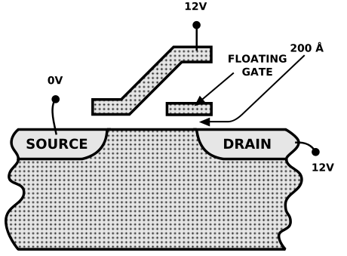
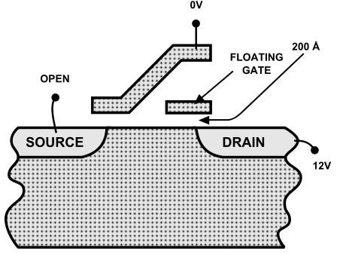
Read/Program/Erase Flash Memory Cell
I_{d}
“1”
“0”
To read:
  Apply voltage V_{r} to CG s.t. V_{T1}<V_{r}<V_{T0}.
  Measure (sense) drain current (I_{d}).
    I_{d} > 0 ➔ transistor on ➔ logic 1.
    I_{d} = 0 ➔ transistor off ➔ logic 0.
To program (write “0”):
  Apply high +ve voltage to CG & D.
  Electrons jump from channel through
  insulating layer onto FG ➔ hot-electron injection.
To erase (write “1”):
  Apply high voltage diff. between D & CG.
  Electrons pulled off FG through insul-
  ating layer to D ➔ quantum tunneling.
V_{T1}
V_{T0}
V_{gs}
V_{r}
Only Applicable to NOR flash!!

Slide 8

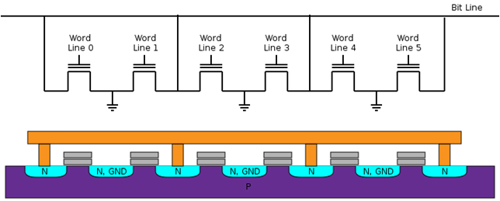

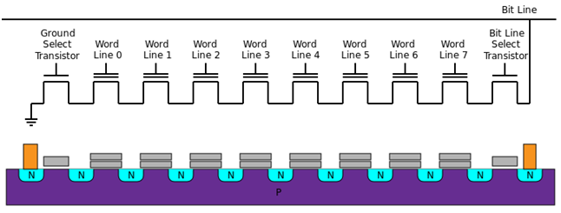

Layouts of Flash Memory
Faster read.
  Transistors directly connected to BL.
Simpler Interface.
  Random access.
Lower error rate.
Data units
  Bytes/words.
Applications
  ROM replacement.
Capacity: < 2 Gb.
NOR Flash
Faster program/erase.
Higher Density.
  Less connections to GND/BL.
Longer life span.
Data units
  Pages/blocks.
Applications
  SSDs, USB drives, SD Cards.
Capacity: < 2 Tb.
NAND Flash

Slide 9
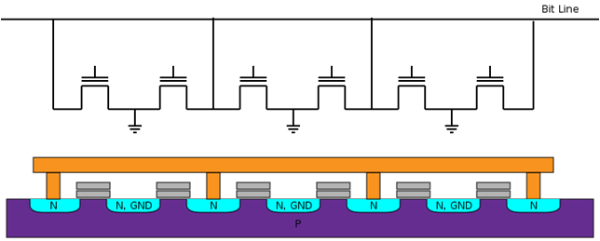
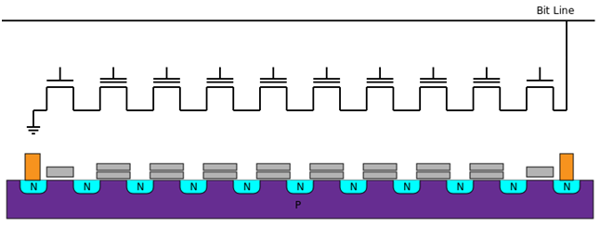
NAND/NOR Flash – Reading
NOR Flash
V_{off}
V_{r}
V_{off}
V_{off}
V_{off}
V_{off}
I_{d}
“1”
“0”
V_{T1}
V_{T0}
V_{gs}
V_{off}
V_{r}
NAND Flash
I_{d}
“1”
“0”
V_{on}
V_{on}
V_{r}
V_{on}
V_{on}
V_{on}
V_{on}
V_{on}
V_{on}
V_{on}
V_{T1}
V_{T0}
V_{gs}
V_{r}
V_{on}

Slide 10
NAND/NOR Flash – Programming (X ➔ 0)
NOR Flash
Technique:
  Hot electron injection.
Explanation:
  Electrons jump from channel to FG.
V_{high}
V_{off}
V_{high}
V_{off}
V_{off}
V_{off}
V_{off}
1
1
1
1
1
1
0
NAND Flash
Technique:
  Quantum tunneling (injection).
Explanation:
  Electrons tunnel from B to FG.
V_{high}
1
1
1
1
1
1
1
1
0

Slide 11
NAND/NOR Flash – Block Erasure (X ➔ 1)
NOR Flash
Technique:
  Quantum tunneling (ejection).
Explanation:
  Electrons tunnel from FG to S/B.
-V_{high}
-V_{high}
-V_{high}
-V_{high}
-V_{high}
-V_{high}
1
1
1
1
1
1
NAND Flash
Technique:
  Quantum tunneling (ejection).
Explanation:
  Electrons tunnel from FG to B.
-V_{high}
-V_{high}
-V_{high}
-V_{high}
-V_{high}
-V_{high}
-V_{high}
-V_{high}
1
1
1
1
1
1
1
1

Slide 12
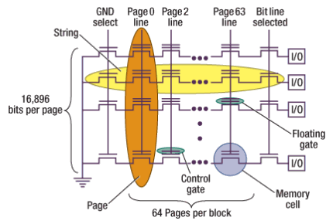
NAND Flash Block Organization
NAND flash memory is organized as a set of independent blocks. Each block has a set of pages.
Blocks are the smallest erasable units.
Pages are the smallest programmable units.
  Partial pages can be programmed in some devices!
** The numbers of bits-per-page and pages-per-block here are typical for a 2Gb NAND flash device **

Slide 13
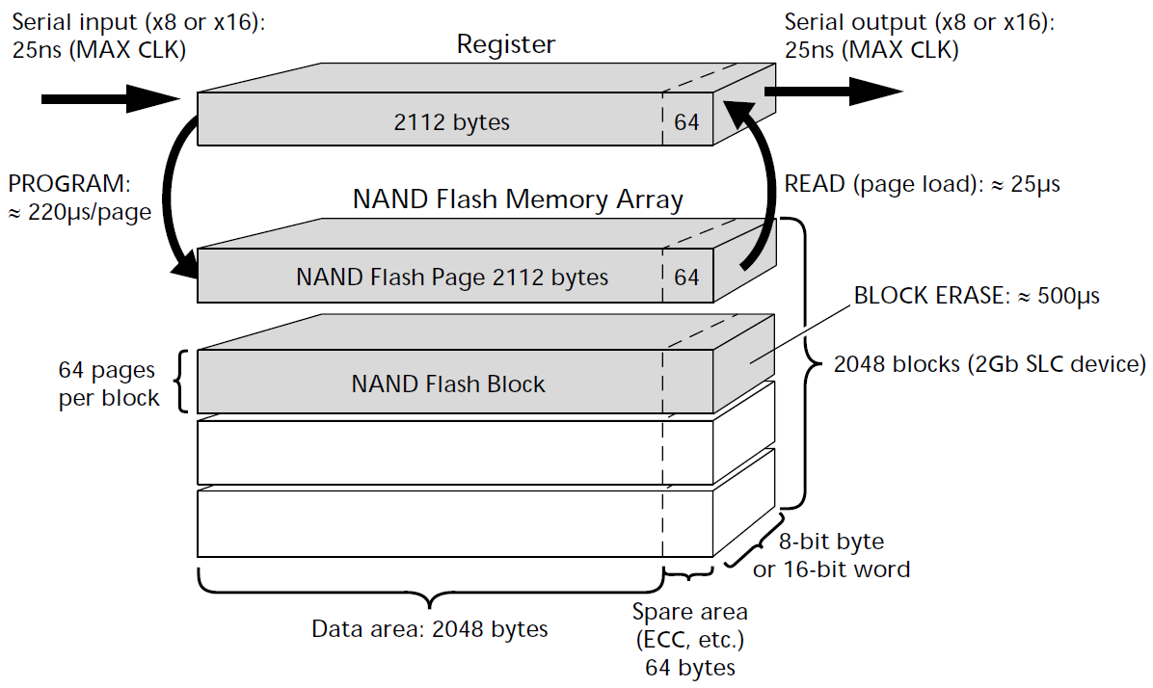
NAND Flash Memory Architecture

Slide 14
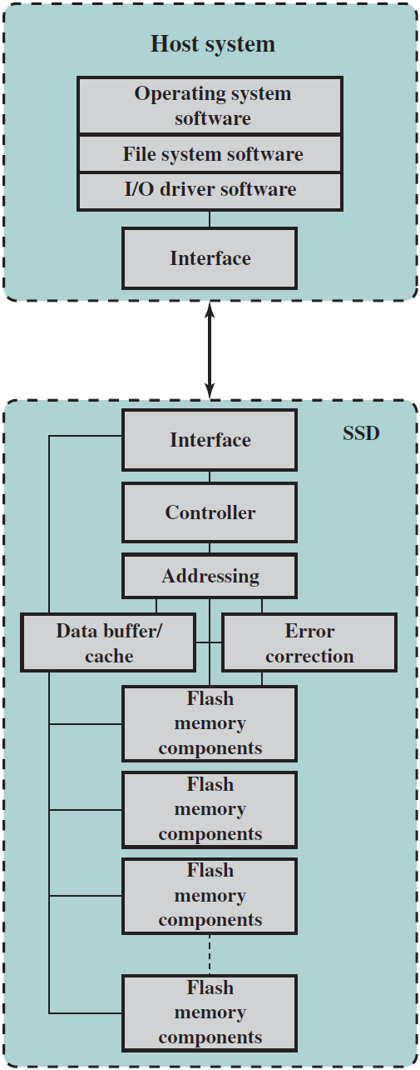
SSD Architecture
Controller: provides SSD device level interfacing & firmware execution.
Addressing: logic to select one of the flash memory components.
Data buffer/cache: High-speed RAM for speed matching and increasing data throughput.
Error correction: Logic for error detection and correction.
Flash memory components: Individual NAND flash chips.

Slide 15
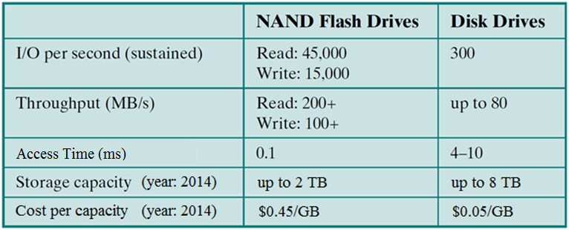
SSD vs. HDD
SSDs have the following advantages over HDDs:
  Higher input/output operations per second (IOPS)
  Longer lifespan: no mechanical wear.
  Lower power consumption.
  Quieter and cooler running capabilities.
  Lower access times & latency rates: >10x faster.

Slide 16
Optical Storage - History
1983 CD (Compact Disk, audio CD)
CD-ROM
.........
1996 DVD-ROM
DVD-R
.........
2002 Blu-ray
.........

Slide 17
CD-ROM
Same technology used for audio (CD).
  Difference: CD-ROM drives support error-correction.
Capacity
  Data: 650-700MB, or Audio: 74-80 minute.
Material
  Polycarbonate coated with highly reflective coat, usually aluminium.
Data stored as sequence of pits engraved along a spiral track on top of polycarbonate layer.
Read by reflecting laser.
Constant packing density ➔ Constant Linear Velocity (CLV) ➔ variable angular velocity.

Slide 18
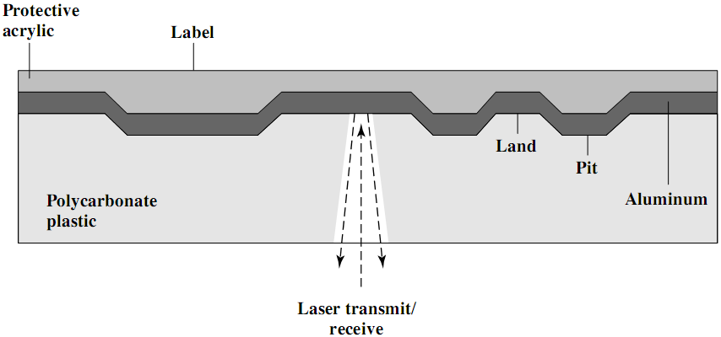
CD-ROM - Fabrication
(3)
(4)
(1)
(2)
Master disk: Info printed as pits on the polycarbonate surface using a high-intensity laser.
Master is used to make a die to stamp out copies.
Pitted surface coated with a reflective material (Aluminium).
Coat of acrylic to protect against dust and scratches.

Slide 19
CD-ROM - Operation
CD drive transmits a low-power laser beam towards disk.
  beam falls on a pit (rough surface) ➔ low intensity reflected.
  beam falls on a land (smooth surface) ➔ high intensity reflected.
Photo-sensor senses surface at regular intervals.
  Change in elevation ➔ logic 1, otherwise ➔ logic 0.

Slide 20
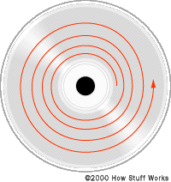
CD-ROM Drive Speeds
Audio is single speed (1x=150kB/s)
  Constant linear velocity
  1.2 m/s
  Track (spiral) is 5.27km long
  Gives 4391 seconds = 73.2 minutes
Other speeds are quoted as multiples.
  e.g. 24x (24x150kB/s=3.6MB/s)
Quoted figure is maximum drive can achieve.

Slide 21
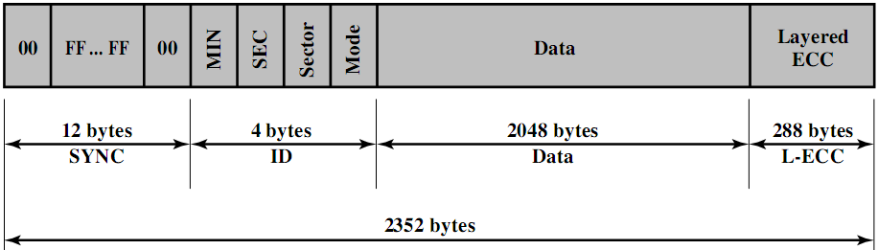
CD-ROM Block/Sector Format
Mode 0=blank data field
Mode 1=2048 byte data+error correction
Mode 2=2336 byte data
Mag. disks: ID(track, sector, head, CRC), Data(512+2)
CD: ID(minute, second, sector, mode), Data(2048+288)

Slide 22
Access on CD-ROM
Difficult!!
  Move head to a rough position.
  Set correct speed.
  Read address.
  Adjust to required location.

Slide 23
CD-ROM For & Against
Pros:
  Large capacity (cf. floppy disks).
  Easy to mass produce (cf. magnetic disks).
  Removable (cf. magnetic disks).
  Robust.
Cons:
  Expensive for small quantities.
  Slow (access time ≈ 0.5 sec).
  Read only.

Slide 24
Other Optical Storage
CD-Recordable (CD-R)
  Write Once Read Many (WORM).
  Quite affordable.
  Compatible with CD-ROM drives.
  Medium includes a dye layer. Reflectivity is activated by a high-intensity laser.
CD-ReWritable (CD-RW)
  Erasable.
  Inexpensive.
  Mostly CD-ROM drive compatible.
  Phase change by a laser beam
    Material has two different reflectivity’s in two different phase states (crystalline or amorphous).
    Eventually, the material loses its desirable properties (500000~1000000 erase cycles).

Slide 25
DVD
Digital Video Disk
  Used to indicate a player for movies
    Only plays video disks.
Digital Versatile Disk
  Used to indicate a computer drive
    Will read computer disks and play video disks.
Very high capacity (4.7G per layer).
  Small spacing between spiral loops (tracks). Pits too. Shorter wavelength.
  Double layer: Semi-reflective layer on top of the reflective layer. Read by adjusting focus.
  Double sided.
Full length movie on single disk (MPEG compression).

Slide 26
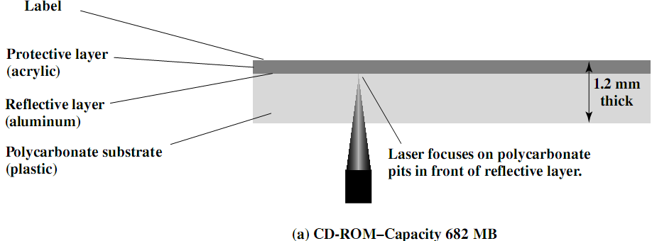
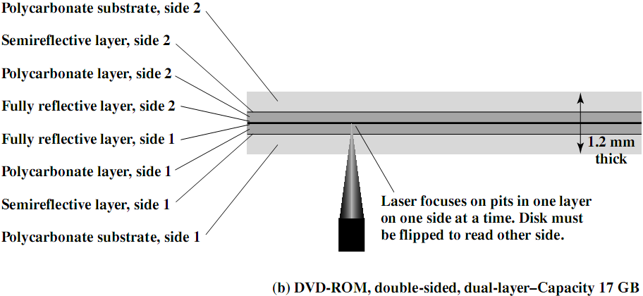
CD vs. DVD

Slide 27
Optical Storage - Types
Optical Disk
CD DVD
Capacity 650M~750MB 4.7G~17GB
Drive Compatibility Incomp. with DVD Comp. with CD
Structure One 1.2mm base Two 0.6mm bases
Gap Track gap=1.6µm 0.74µm
Pit gap=0.834µm 0.4µm
Side & layer Single layer/side Double layer/side
Products CD --
CD-ROM DVD-ROM
CD-R DVD-R
CD-RW DVD-RW

Slide 28
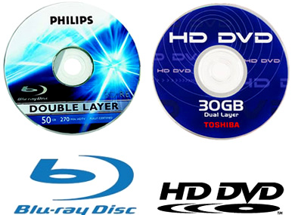
High-Definition Optical Disks
Designed for high-definition (HD) videos
  Resolution>standard-definition (SD) videos.
    e.g., 1280 x 720 pixels or 1920 x 1080 pixels.
Much higher capacity than DVD
  Shorter wavelength laser in the blue-violet range.
  Smaller pits ➔ higher bit density.
HD-DVD
  15GB single side single layer.
Blu-ray Disk (BD)
  25GB single side single layer.
  Data layer closer to laser.
    Tighter focus, less distortion, smaller pits.
  Types: BD-ROM (read only), BD-R (recordable), and BD-RE (re-recordable).

Slide 29
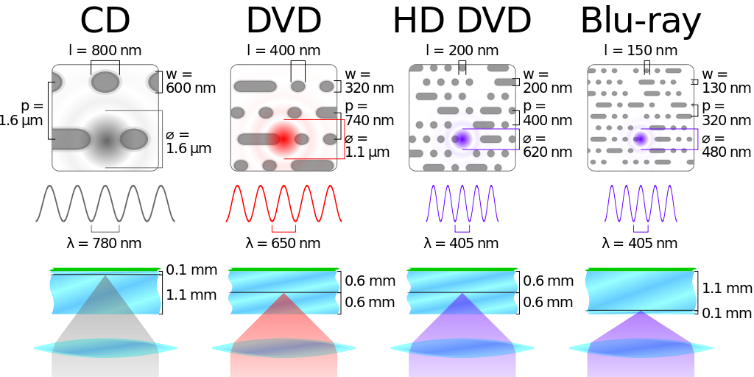
Optical Memory Characteristics
Land
Pit
Track
Beam Spot

Slide 30
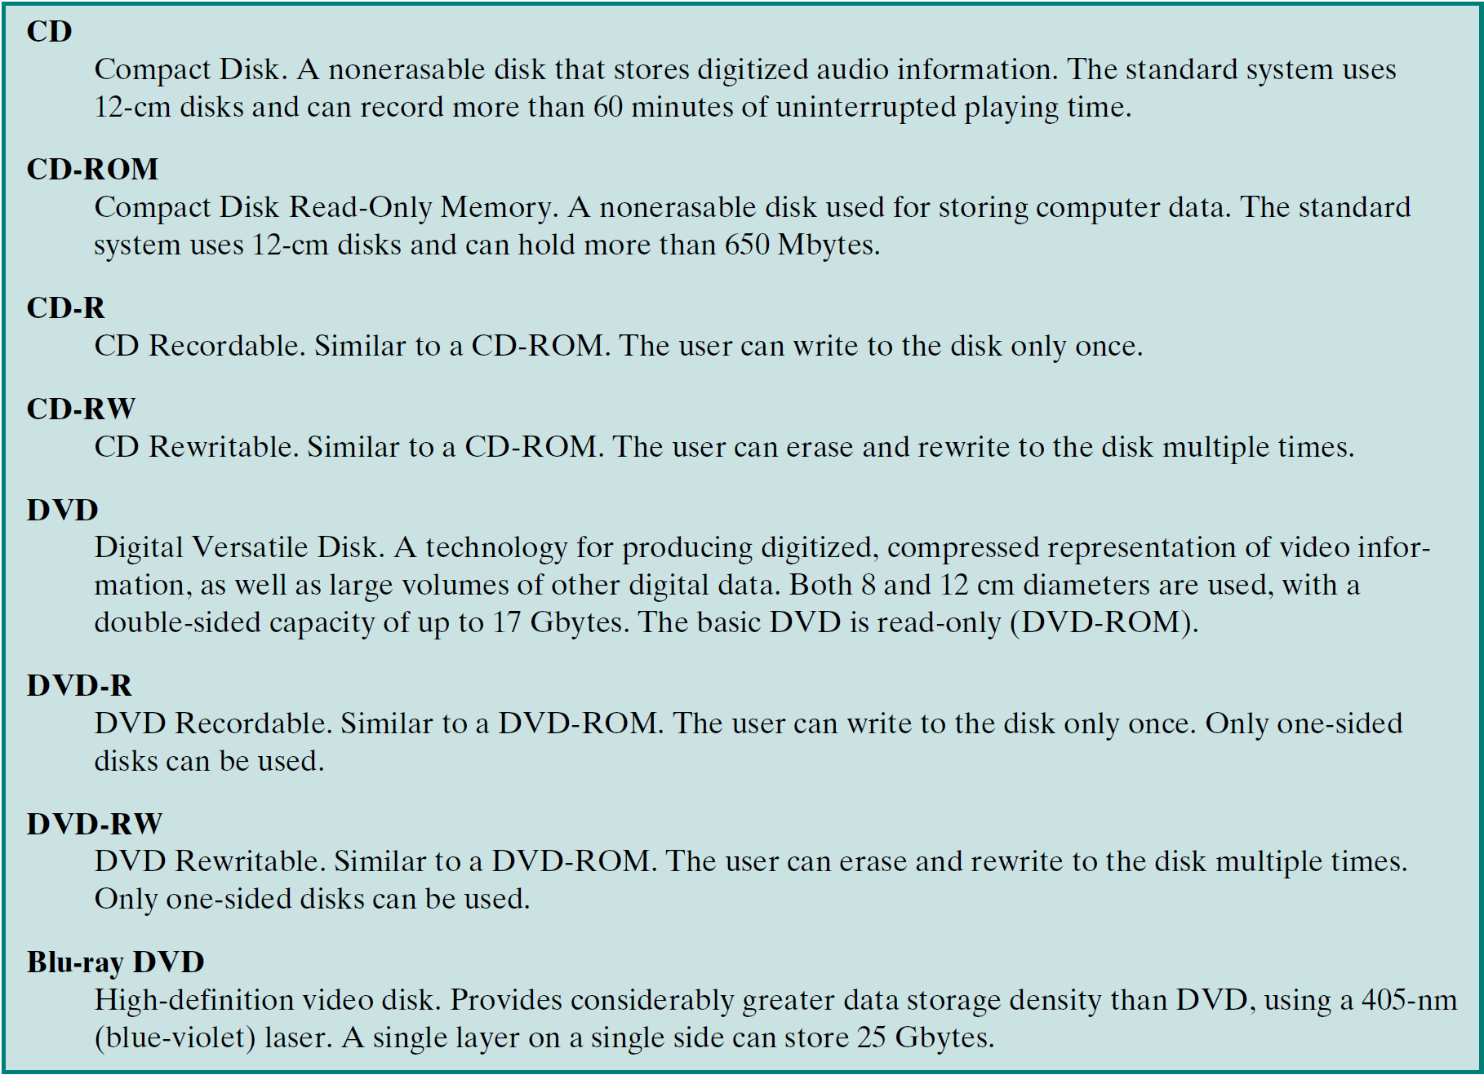
Summary of Optical Disks

Slide 31
Reading Material
Stallings, Chapter 6:
  Pages 205 – 215

