Slide 1

CSE 321b
Computer Organization (2)
تنظيم الحاسب (2)
3rd year, Computer Engineering
Winter 2015
Lecture #3
Dr. Hazem Ibrahim Shehata
Dept. of Computer & Systems Engineering
Credits to Dr. Ahmed Abdul-Monem Ahmed for the slides

Slide 2
Adminstrivia
Schedule:
  Lectures: Monday 9:00am – 11:30am
  Tutorials: Sunday 10:00am – 11:30am
  Office hour: TBA
Assignment #1:
  To be released later on this week.
  Due by the end of next week.
  Work in groups of two.
  Submit one report per group.
Website: http://www.bit.do/hshehata-courses-zu-cse321b
Office hours: TBA

Slide 3
Chapter 6. External Memory

Slide 4
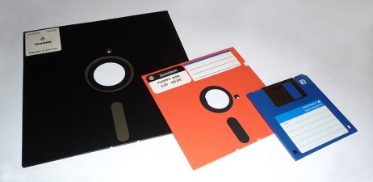
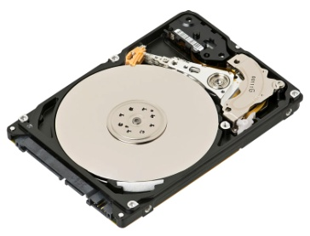
Types of External Memory
Magnetic Disk
  Magnetic Read and Write Mechanisms
  Data Organization and Formatting
  Physical Characteristics
  Disk Performance Parameters
Redundant Array of Independent Disks (RAID)
Solid-State Drive (SSD)
Optical Disk
Magnetic Tape

Slide 5
Magnetic Disk
Foundation of external memory on computers.
Disk substrate: circular platter constructed of nonmagnetic material.
Substrate coated with magnetisable material (iron oxide or cobalt oxide).
Substrate used to be aluminium or aluminium alloy. Now glass ➔ ...
  Less surface defects ➔ less read/write errors.
  Better uniformity of magnetic film ➔ more reliability.
  Better stiffness to reduce disk dynamics.
  Better shock/damage resistance.
  Ability to support lower fly heights (see later).

Slide 6
Read and Write Mechanisms (1)
Head: Small device (conductive coil) that can read from or write to a portion of the platter rotating under it.
  May be single read/write head or separate ones.
  During read/write, head is stationary, platter rotates.
Write Operation
  FACT: Current passing through coil produces a magnetic field whose direction depends on current direction.
  Pulses sent to head.
  Magnetic pattern recorded on surface below.

Slide 7
Read and Write Mechanisms (2)
Read Operation
  Traditional - floppy and old disks
    FACT: Magnetic field moving relative to a coil produces current in the coil.
    Coil is the same for read and write
    One read/write head.
  Contemporary
    Separate read head, close to write head.
    Partially shielded magnetoresistive (MR) sensor.
    Electrical resistance depends on direction of magnetic field.
    Current passing thru MR and resistance is read as voltage.
    Much greater storage densities and higher operating speeds could be achieved.

Slide 8
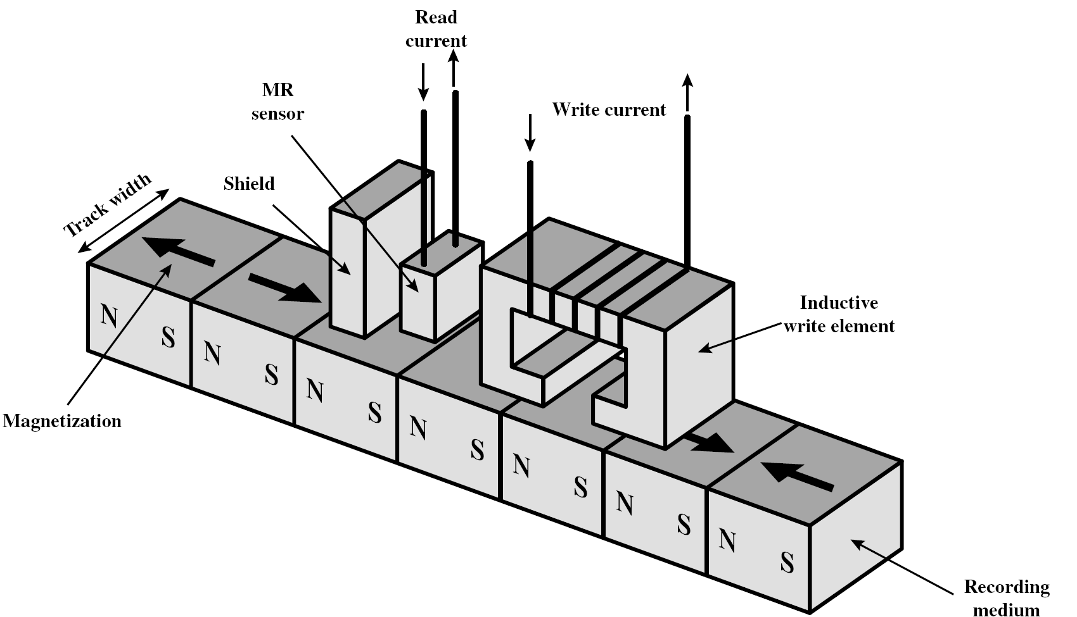
Inductive Write - MR Read Head

Slide 9
Disk Data Layout

Slide 10
Data Organization and Formatting
Tracks: concentric rings
  Typically thousands per surface
  Track’s width = head’s width.
  Inter-track gaps between adjacent tracks ➔ prevent errors due to misalignment of the head or interference.
Sectors: tracks are divided into sectors.
  Typically hundreds per track.
  Fixed (512 bytes) or variable length.
  Inter-sector gaps ➔ relax precision requirements
  Usually data are read from or written to disks in blocks (of sectors).

Slide 11
Disk Velocity ➔ Disk Layout
Problem: bits on inner tracks pass under head slower than bits on outer tracks ➔ How can we have a constant read/write rate?!
Solution: increase spacing between bits stored on outer tracks and rotate disk at a fixed speed.
  This technique is know as Constant Angular Velocity (CAV).

Slide 12
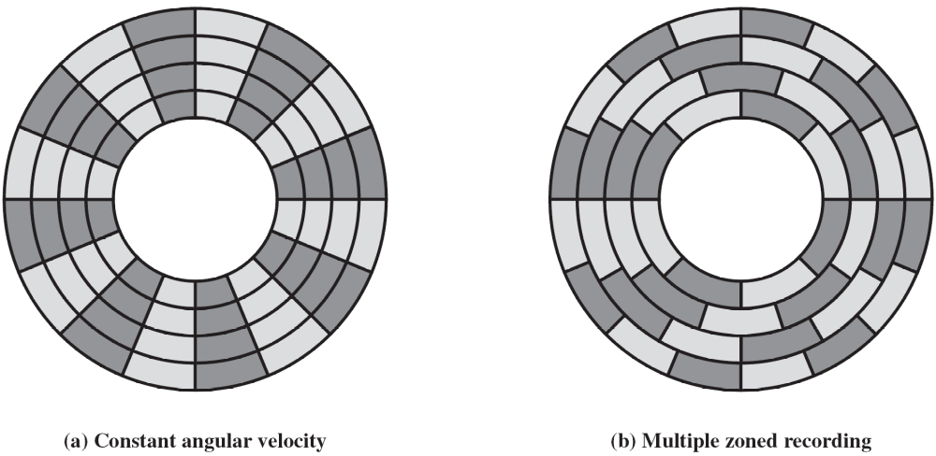
Constant Angular Velocity (CAV)
Disk rotates at constant speed
  Constant angular velocity
All tracks have same capacity
  Constant bits/track
  Assuming constant bits/sector
    Constant sectors/track
    Pie-shaped sectors
Outer tracks have lower density
  Variable bits/meter
Pros: Simple to locate sectors ➔ Move head to a given track and wait for a given sector.
Cons: Waste of space on outer tracks

Slide 13
Multiple Zone Recording (or Zone Bit Recording)
Tracks are grouped into zones
Within a zone, tracks have same
capacity
  Constant sectors/track in each zone
Tracks in outer zones have
higher capacities
  Sectors/track increase in outer zones
Pros: Higher capacity for outer tracks ➔ Greater overall storage capacities.
Cons: Harder to locate sectors ➔ more complex circuitry.

Slide 14
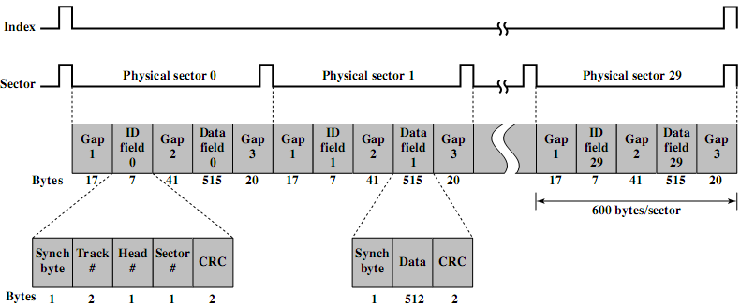
Finding Sectors
Must be able to identify start of track and sector.
Disk Format
  Extra control data recorded on disk to mark tracks and sectors.
  Used only by the disk drives, not accessible to the user.
Seagate ST506 format

Slide 15
Physical Characteristics
Single or double sided.
Removable or not (fixed).
Single or multiple platter.
Fixed or movable head (w.r.t. radial direction).
Head mechanism
  Contact (Floppy).
  Fixed gap.
  Aerodynamic gap (Winchester).

Slide 16


1. Single or double sided
Single-sided
  Magnetisable coating applied to one side of platter.
  Low expensive disk systems (e.g., floppy disks).
Double-sided
  Magnetisable coating applied to both sides of platter.
  Each side has its own head.

Slide 17
2. Removable or Non-removable
Removable disk
  Can be removed from drive and replaced with another disk.
  e. g., floppy disks.
  Provides unlimited storage capacity.
  Easy data transfer between systems.
  Obsoleted by CD-R and CD-R/W!
Non-removable disk
  Permanently mounted in the drive.
  e. g., hard disks in personal computers.

Slide 18
3. Single or Multiple Platters (1)
Multiple platters mounted on a spindle.
Multiple heads
  joined and aligned
  One head per side.
Aligned tracks on each platter form cylinder.
Data is striped by cylinder.
  i.e., Rd/Wr cylinder by cylinder.
  Advantages:
    Reduces head movement.
    Increases transfer rate.

Slide 19
3. Single or Multiple Platters (2)
Sector addressing methods:
  Physical
    Cylinder-Head-Sector (CHS)
    CHS triples ➔ (0⁺,0⁺,1⁺)
    Obsolete!
  Logical
    Logical Block Address (LBA)
    Integer number ➔ 0⁺
Given sectors per track (SPT) & heads per cylinder (HPC)
  Convert physical ➔ logical
  LBA = ((C * HPC) + H) * SPT + S – 1
  Convert logical ➔ physical
  C = LBA ÷_{int} (SPT * HPC)
  H = (LBA ÷_{int} SPT) mod HPC
  S = (LBA mod SPT) +1

Slide 20
4. Fixed or Movable Head Disk
Fixed head
  One read write head per track.
  Heads mounted on fixed ridged arm.
  Rare!
Movable head
  One read/write head per side
  Mounted on a movable arm

Slide 21
5. Head Mechanism (1)
Contact
  Head comes into physical contact with storage medium during read/write.
  Platter needs to be flexible.
  Used in floppy disks.
Fixed gap
  Head positioned a fixed distance above platter.
  Used in early generations of hard disks.
Aerodynamic gap (Winchester)
  <...next slide...>

Slide 22
Head Mechanism (2)
Aerodynamic gap (Winchester)
  Developed by IBM in Winchester (USA)
  Head rests lightly on platter surface when disk is motionless.
  As disk spins, head rises (flies on a thin layer of air) due its aerodynamic design.
  Allow very small head-to-surface gap
    Smaller heads ➔ narrower tracks ➔ higher density
    Closer head proximity ➔ greater risk of errors due to impurities ➔ Winchester heads are housed in sealed containers (free of contaminants)
  Used in contemporary hard disks

Slide 23
Disk Performance Parameters
Disk operation
  Disk rotates at a constant speed.
  To read/write, head is positioned at the desired track and at the beginning of the desired sector on that track.
Seek time: time taken to move the disk arm (head) to the required track.
  Equals: startup time + traversal time.
  Average: less than 10 ms.
Disk controller waits till the desired sector rotates to line up with the head.
Rotational delay (latency): time taken for the beginning of the sector to reach the head.
  Average: 1/2r, for r rpm ➔ less than 5ms if r=7200 rpm

Slide 24
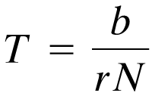
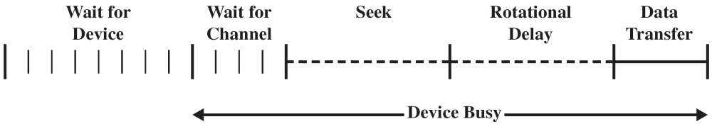
Disk Performance Parameters (2)
  Access time = seek time + rotational delay
Read/write performed as the sector moves under the head.
Transfer time: time required for the transfer.
  T = transfer time,
  b = number of bytes to be transferred,
  r = rotational speed (r.p.s.),
  N = number of bytes on a track.

Slide 25
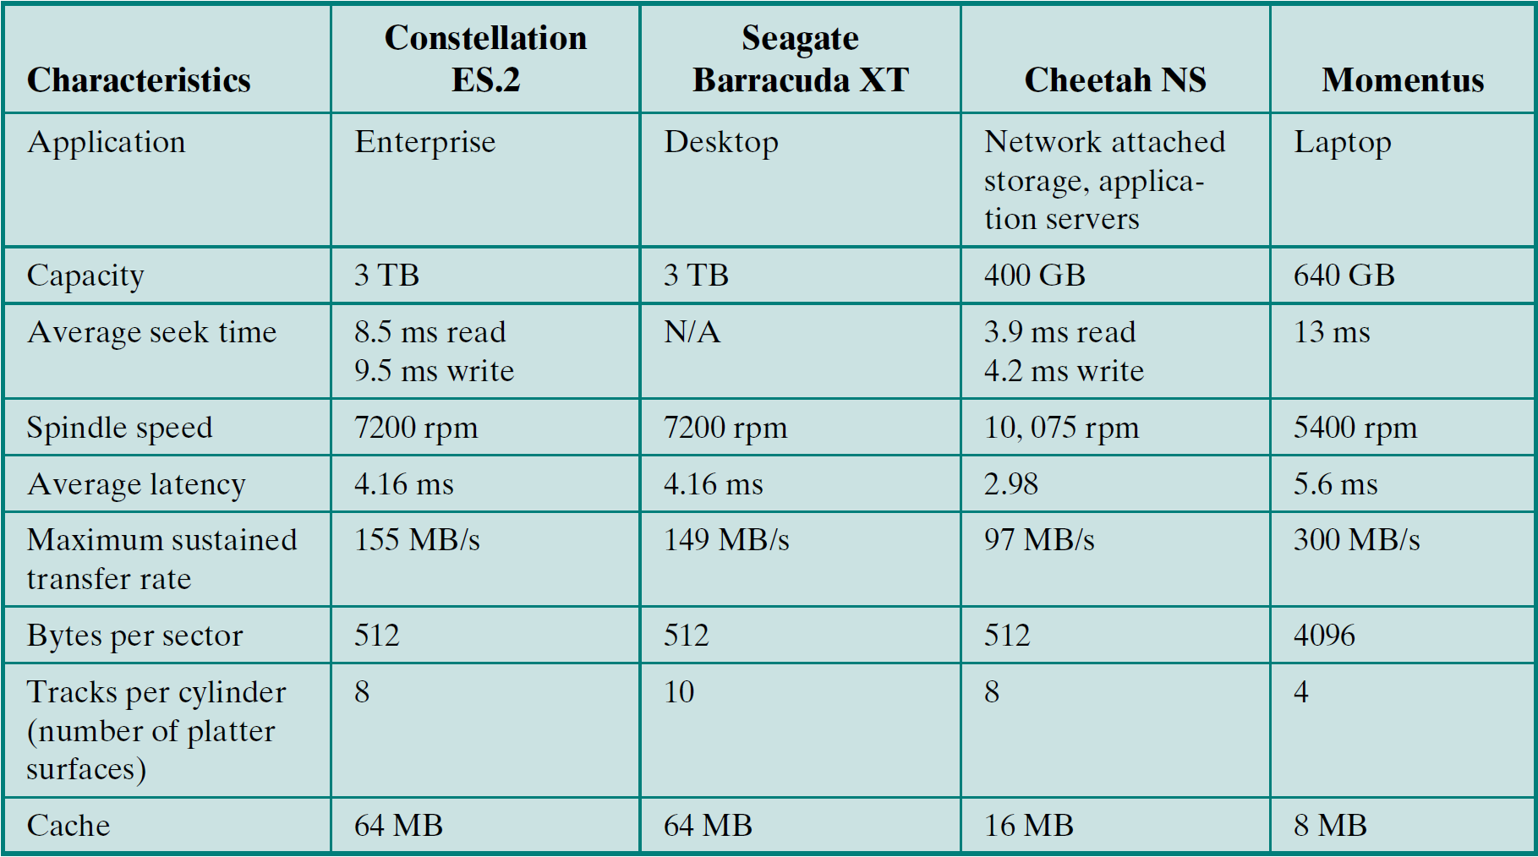
Typical Hard Disk Drive Parameters

Slide 26
Reading Material
Stallings, Chapter 6:
  Pages 185 – 195

