Slide 1
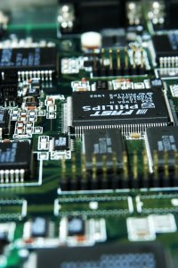
CSE 401
Computer Engineering (2)
هندسة الحاسبات (2)
4th year, Comm. Engineering
Winter 2016
Lecture #1
Dr. Hazem Ibrahim Shehata
Dept. of Computer & Systems Engineering
Credits to Dr. Ahmed Abdul-Monem Ahmed for the slides

Slide 2
Teaching Staff
Instructor:
  Hazem Ibrahim Shehata
  Email: hshehata@uwaterloo.ca
  Lectures: Sunday 9:00am-11:30am
  Office Hours: TBA
Teaching Assistants:
  Mohamed Eissa (Tutorials)
    Email: em3issaa@gmail.com
    Tutorials: TBA
  Sanaa Fekry (Labs)
    Email: sanaafekry2003@yahoo.com
    Labs: TBA

Slide 3
Course Info
Course website:
  http://www.bit.do/hshehata-courses-zu-cse401
  http://www.googledrive.com/host/0B9ExmUsPoGjSWUpOQ05XT3loYUE
Textbook:
  “Computer Organization and Architecture: Designing for Performance”, William Stallings, 9th Edition, 2013, www.williamstallings.com/ComputerOrganization

Slide 4
Course Info (Cont.)
Grading:
Course work | Grade distribution
Participation | 3pt | 30
Assignments | 12pt
Midterm Exam | 15pt
Labs | 16pt | 30
Oral Exam | 14pt
Final Exam | 90pt
Total Points | 150

Slide 5
Course Overview
Ch. 5: Internal Memory Technology
  Semiconductor MM, error correction, …, etc.
Ch. 6: External Memory
  Magnetic disks, optical disks, magnetic tapes, … etc.
Ch. 7: Input / Output
  Programmed i/o, interrupt-driven i/o, DMA, …, etc.
Ch. 10: Computer Arithmetic
  Integer representation, Integer arithmetic , FP representation, FP arithmetic, …, etc.
Ch. 14: Processor Structure and Function
  Processor organization, register organization, Instruction pipelining, ..., etc.

Slide 6
Ch 5: Internal Memory Technology

Slide 7
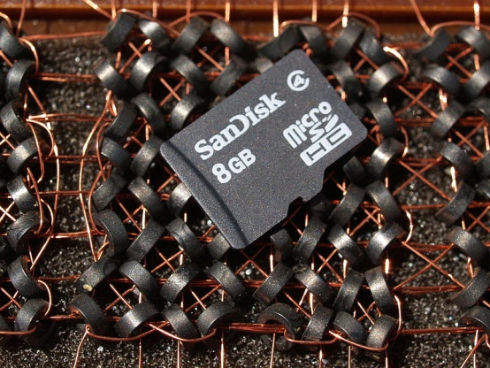
Memory Cell
Semiconductor memory: electronic memory implemented on a semiconductor-based IC.
Memory cell: basic element of a semiconductor memory.
  Holds one bit.
  Properties
    Two stable states to represent 0 and 1 ➔ bi-stable!
    Can be written into to set the state.
    Can be read to sense the state.
Semiconductor Memory
vs.
Magnetic-core Memory

Slide 8
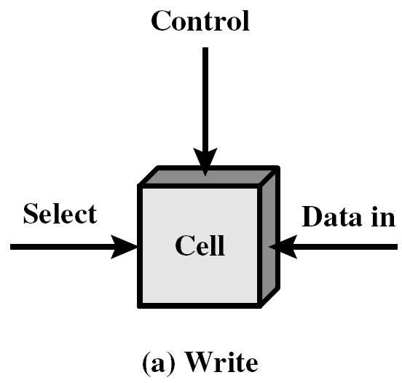
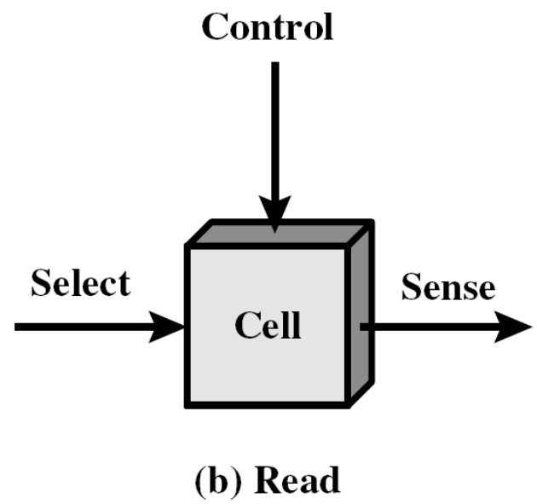
Conceptual Operation of a Memory Cell
Three terminals: select, control, data in/sense.
  Select: select a memory cell for read/write.
  Control: indicate required operation: read or write.
  Data in/sense:
    Read: Output the state of the cell.
    Write: electrical signal that sets the state to 0 or 1.

Slide 9
Semiconductor Memory Types
Volatile
  Random Access Memory (RAM)
    Dynamic RAM (DRAM)
    Static RAM (SRAM)
Non-volatile
  Read-Only Memory (ROM)
  Programmable ROM (PROM)
  Erasable Programmable ROM (EPROM)
  Electrically Erasable Programmable ROM (EEPROM)
  Flash Memory

Slide 10
RAM
Individual words of memory are directly accessed through wired-in addressing logic.
Misnamed!! All semiconductor memories are random access!!
Read/Write: by electrical signals.
Volatile: must be provided with a constant power supply ➔ temporary storage.
Dynamic or static.

Slide 11
Dynamic RAM (DRAM)
Bits are stored as charge on capacitors.
  Charge ➔ 1, no charge ➔ 0.
Capacitors discharge ➔ DRAM needs periodic charge refreshing even when powered.
Analog device: capacitor can store any charge value within a range ➔ a threshold value is used.
Pros
  Simpler construction.
  Smaller per bit.
  Less expensive.
Cons
  Need refresh circuits.
  Slower.
Most common usage: main memory.

Slide 12
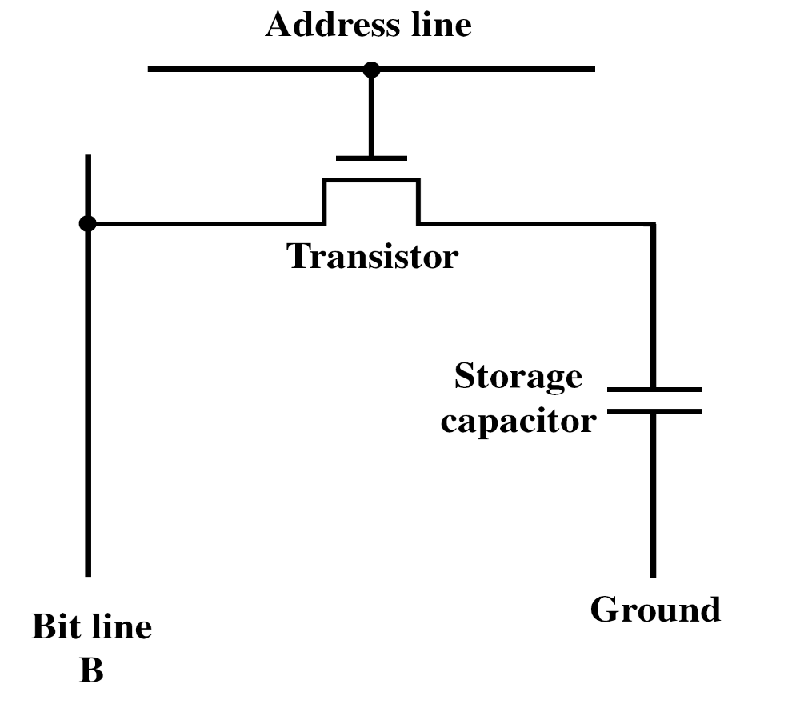
DRAM Structure

Slide 13
DRAM Operation
Address line active when bit read or written.
  Transistor switch closed (current flows).
Write
  Voltage to bit line
    High for 1 low for 0.
  Then signal address line
    Transfers charge to capacitor.
Read
  Address line selected
    transistor turns on.
  Charge from capacitor fed via bit line to a sense amplifier
    Compares with threshold/reference value to determine 0 or 1.
  Readout discharges capacitor ➔ charge must be restored

Slide 14
Static RAM (SRAM)
Bits stored as on/off switches.
Digital device: uses flip-flops.
No charges to leak.
No refreshing needed.
Pros
  Does not need refresh circuits.
  Faster.
Cons
  More complex construction.
  Larger per bit.
  More expensive.
Most common usage: cache memory.

Slide 15
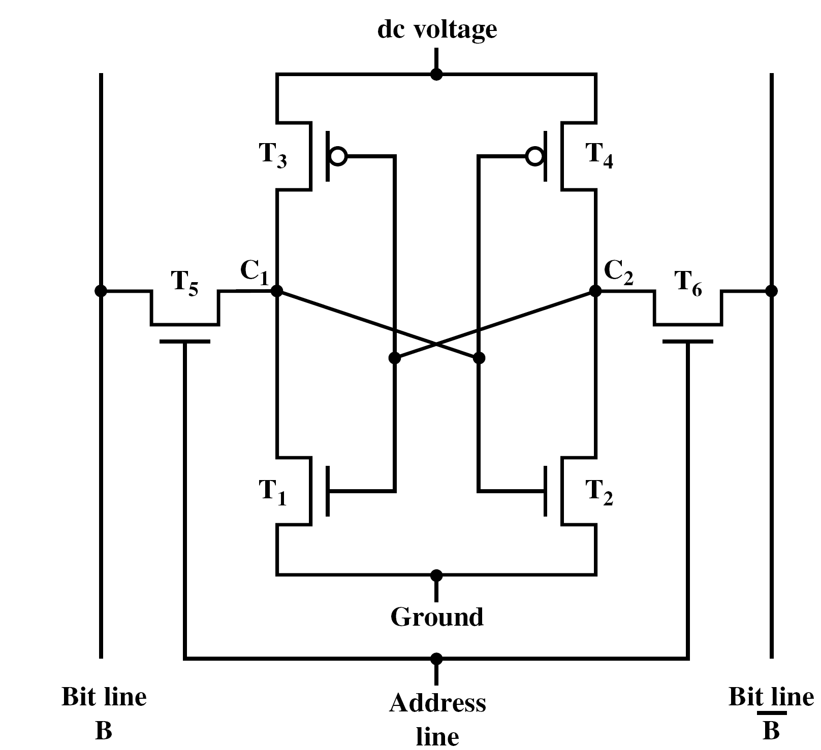
SRAM Structure

Slide 16
SRAM Operation
Transistor arrangement
gives stable logic state.
C₁ and C₂: diff. states
State 1
  C₁ high, C₂ low
  T₂ on, T₄ off
  T₁ off, T₃ on
State 0
  C₁ low, C₂ high
  T₂ off, T₄ on
  T₁ on, T₃ off
Address line transistors T₅ T₆ are switches.
Write – apply value to B & compliment to B.
Read – value is on line B.
ON
OFF
ON
OFF
High
Low
High
Low
OFF
ON
ON
OFF

Slide 17
DRAM vs SRAM
Both volatile
  Power needed to preserve data.
Dynamic cell
  Simpler to build, smaller.
  More dense: more cells per unit area.
  Less expensive.
  Needs refreshment.
  Fixed cost of refreshment circuitry ➔ use large memory units to benefit from the small cell cost.
  Used in main memory.
Static cell
  Faster
  Used in cache memory.

Slide 18
Read Only Memory (ROM)
Permanent storage that cannot be changed.
  Nonvolatile.
Can read stored data, cannot write new data.
Written during fabrication
  Large fixed cost of data insertion ➔ expensive for small number of copies.
  No room for error. One bit error ➔ throw the whole batch of ROMs.
Why useful?
  Data or program is permanently in main memory and need never be loaded from a secondary storage device.
Applications
  Microprogramming.
  Library subroutines.
  System programs (BIOS).

Slide 19
Programmable ROM (PROM)
Nonvolatile.
Can be written into only once.
Writing (or programming):
  Performed electrically using a special equipment.
    Writing one ➔ do nothing! (all cells store one by default).
    Writing zero ➔ blow a fuse (or melt an anti-fuse) in the cell.
  Performed by supplier or customer (after fabrication).
Useful when a small number of ROMs with a particular memory content is needed.
Flexible and convenient.
ROM is good for high-volume production.

Slide 20
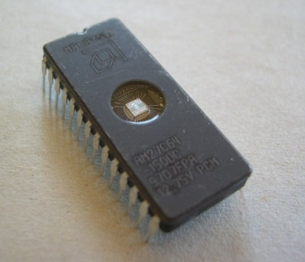
Erasable Programmable ROM (EPROM)
Nonvolatile.
Read-mostly memory: read operations are far more than write operations.
Read and written electrically.
  Before a write operation, all cells must be optically erased to the same initial state.
Erasure
  Done optically by exposure of the packaged chip to ultraviolet radiation.
  Takes up to 20 minutes.
  Can be done repeatedly.
One transistor per bit ➔ dense.
More expensive than PROM, but can do multiple updates.

Slide 21
Electrically Erasable Programmable ROM (EEPROM)
Nonvolatile.
Read-mostly memory.
Can be written into without erasing prior contents
  Only the byte/bytes addressed are updated.
Write operation takes longer than read.
Flexible: updatable in place using ordinaly bus lines.
More expensive than EPROM.
Less dense than EPROM: fewer bits per chip.

Slide 22
Flash Memory
Nonvolatile.
Read-mostly memory.
First introduced in the mid-1980s.
Intermediate between EPROM and EEPROM in cost and functionality
  Like EEPROM, it uses electrical erasing technology.
  Entire flash memory can be erased in a few seconds ➔ much faster than EPROM.
  Only a block of memory can be erased.
  No byte-level erasure.
  Like EPROM, one transistor per bit ➔ higher density than EEPROM.

Slide 23
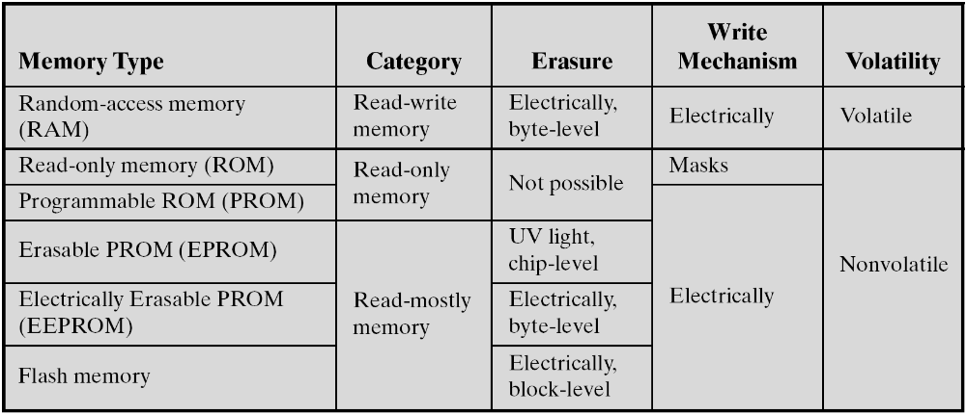
Semiconductor Memory Types - Summary

Slide 24
Chip Logic
Semiconductor memory comes in packaged chips.
Each mem. chip contains an array of memory cells.
Design issue: number of bits of data that maybe read/written at a time.
  One extreme: 1-word-per-chip organization: physical arrangement of cells in the array is the same as logical arrangement of words in memory.
    EX.: 1Mx16 memory = One 1Mx16 chip.
  Other extreme: 1-bit-per-chip organization: data is read/written 1 bit at a time.
    Ex.: 1Mx16 memory = sixteen 1Mx1 chips s.t. chip #1 holds bit #1 of each word, chip #2 holds bit #2 of each word, and so on.

Slide 25
Typical 16 Mb DRAM (4Mx4)
Logically, 4 square arrays of 2048 x 2048 elements.
Each horizontal line connects to the Select terminal of each cell in its row.
Each vertical line connects to the Data in/Sense terminal of each cell in its column.
Reduces number of address pins
  Multiplex row address and column address
  11 pins to address (2¹¹=2048)
  Adding one more pin doubles range of values so x4 capacity

Slide 26
Refreshing
Refresh circuit included on chip.
Disable chip.
Count through rows.
Data is read out and written back into the same location ➔ each cell is refreshed.
Takes time.
Slows down apparent performance.

Slide 27
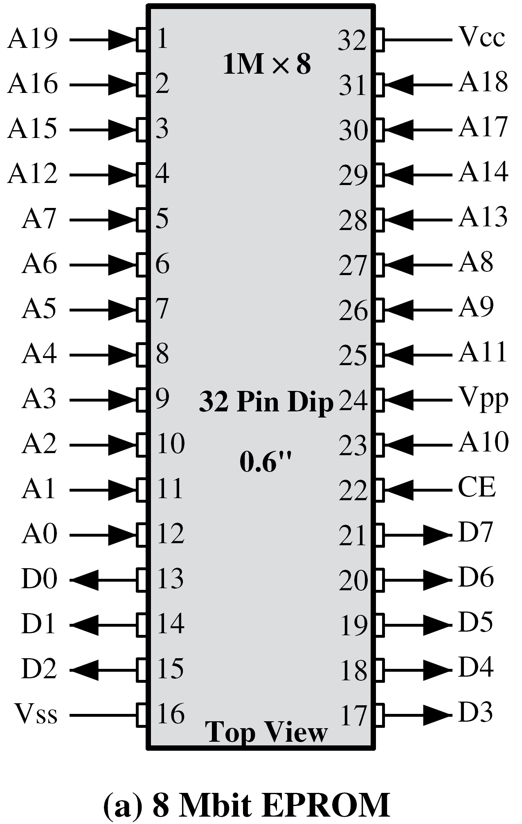
Chip Packaging
8-Mbit EPROM chip, 1M x 8.
One-word-per-chip package.
Address: A0-A19, Data: D0-D7
Vcc; power, Vss: ground, CE: chip enable, Vpp: programming voltage.
16-Mbit DRAM, 4M x 4.
Updatable ➔ data pins in/out.
WE: Write Enable
OE: Output Enable
NC: No Connect ➔ even # of pins

Slide 28
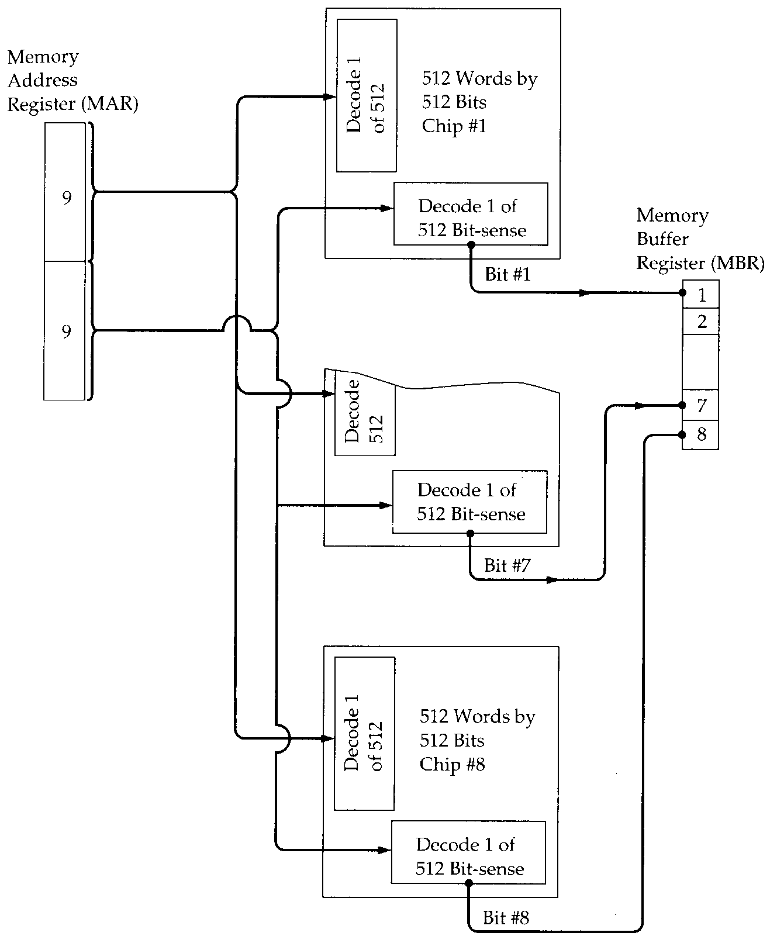
Module
Organization
Available: 256k x 1 chips
256k x 8 memory

Slide 29
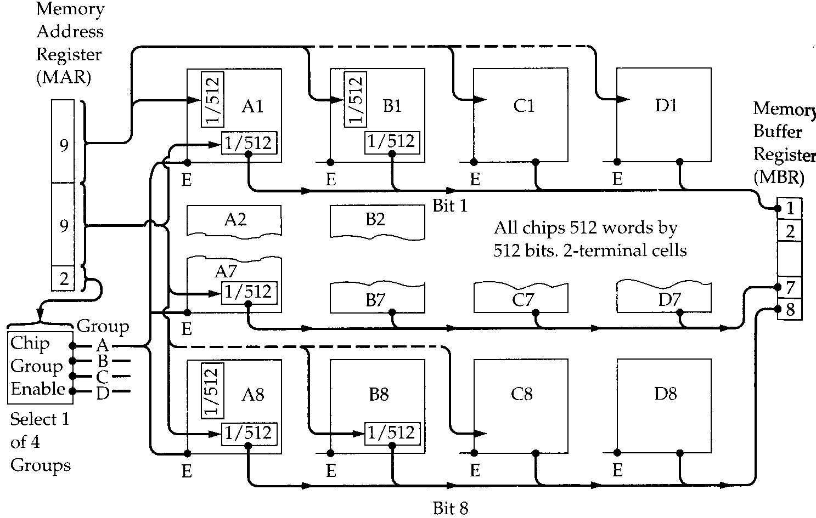
Module Organization (2)
Available: 256k x 1-bit chips
1M x 8 memory

Slide 30
Reading Material
Stallings, Chapter 5:
  Pages 159 – 169

