Slide 1

CSE 401
Computer Engineering (2)
هندسة الحاسبات (2)
4th year, Comm. Engineering
Winter 2016
Lecture #2
Dr. Hazem Ibrahim Shehata
Dept. of Computer & Systems Engineering
Credits to Dr. Ahmed Abdul-Monem Ahmed for the slides

Slide 2
Adminstrivia
Schedule:
  Lectures: Sunday 9:00am – 11:30am
  Tutorials: Monday 8:30am – 10:00am
  Labs: ???
  Office hour: TBA
Assignment #1:
  To be released next week
Website: http://www.bit.do/hshehata-courses-zu-cse401
Office hours: TBA

Slide 3
Ch 5: Internal Memory (Cont.)

Slide 4
Error Correction
Semiconductor memory is subject to errors
  Rate: 1 error/hour to 1 error/century in a 1GB memory!
  Types: hard and soft.
Hard Failure
  Permanent physical defect.
  Mem. cells can’t store data: stuck at 0 or 1, or switching.
  Caused by harsh environments, manufacturing defects, or wear.
Soft Error
  Random, non-destructive event that alters contents of one or more memory cells.
  No permanent damage to memory.
  Caused by power supply problems or alpha particles.
Detected/corrected using Hamming error correcting code.

Slide 5
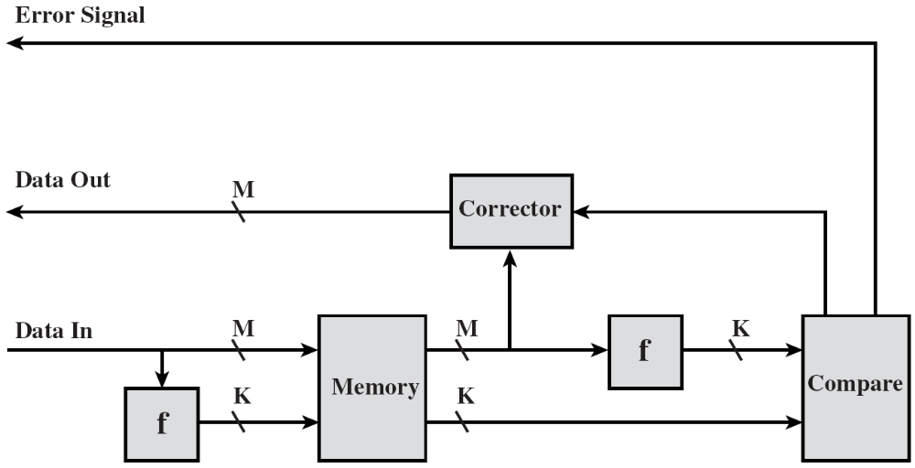
Error-Correcting Code Function

Slide 6
Hamming Error-Correcting Code
Data bits: 1110
B
A
1
1
0
1
0
0
1
Discrepancies
0
C
Parity bits
Chosen so that total number of 1s in each circle is even.
By checking the parity bits, discrepancies are found ➔ error can be easily found and corrected.

Slide 7
Error-Correcting Codes
A codeword consists of N bits split into M data bits and K check (redundant) bits
  N = M + K.
Hamming distance: Number of bit-positions in which two codewords differ.
  Ex.: 11001001, 10100001 → Hamming distance = 3 → 3 bit errors are needed to convert one into the other.
Note: in a code, not all 2^{N} codewords are legal.
Hamming distance of the whole code: minimum Hamming distance between 2 legal codewords.
A distance d code can:
  Detect: d – 1 errors.
  Correct: (d – 1)/2 errors if d is odd, or (d/2) – 1 errors if d is even.

Slide 8
Error Detection/Correction
Detection: parity bit.
  Distance = 2 → can detect up to 1 bit error.
  Ex.: data=1011010 → codeword=10110100 → any codeword with a distance = 1 (such as: 10100100) is considered illegal → single-bit errors are detectable.
Correction: Consider a code with 4 valid codewords:
0000000000, 0000011111, 1111100000, 1111111111
  Distance = 5 → can correct up to 2 bit errors.
  If 0000000111 arrives, → 0000011111
  If 0000000000 becomes 0000000111 due to 3 errors → cannot be corrected properly.

Slide 9
Single Bit Error Correction
Design a code to correct all single bit errors.
M = data bits, K = check bits
N = M + K
Rule: Choose K s.t. M + K + 1 ≤ 2^{K}
Justification:
  Each of the 2^{M} legal words has N illegal codewords at distance 1.
  Thus, each of the 2^{M} legal words requires (N + 1) bit patterns dedicated to it.
  (N + 1) 2^{M} ≤ 2^{N} → M + K + 1 ≤ 2^{K}

Slide 10
Hamming Code
2^{K} - 1 ≥ M + K
➔ 2^{K} ≥ 9+K
➔ K = 4
1
0
0
1
1
0
1
0
Data bits
12
11
10
9
8
7
6
5
4
3
2
1
1
0
0
1
0
1
1
1
?
1
0
1
?
0
?
?
0
1
1
1
0
?
0
0
1
0
=
Bit position 1: 1
Bit position 2: 1
Bit position 4: 1
Bit position 1
Bit position 8: 0
Bit position 2
Bit position 4
Bit position 8

Slide 11
Hamming Code (2)
12
11
10
9
8
7
6
5
4
3
2
1
1
0
0
1
0
?
1
0
1
1
?
0
1
?
1
0
?
Assume error in bit 9.
Recompute the check bits.
Bit 1 = 0 (error).
Bit 2 = 1.
Bit 4 = 1.
Bit 8 = 1 (error).
Error is in bit position = 1 + 8 = 9 → flip it (correction).

Slide 12
Hamming SEC-DED Code
Wrong!!!
A
B
1
0
1
0
0
1
1
1
0
Fix error
0
Discrepancies
C

Slide 13
Hamming SEC-DED Code (2)
A
B
1
0
1
0
0
1
1
1
0
Fix error
0
Discrepancies
×
1
1
C

Slide 14
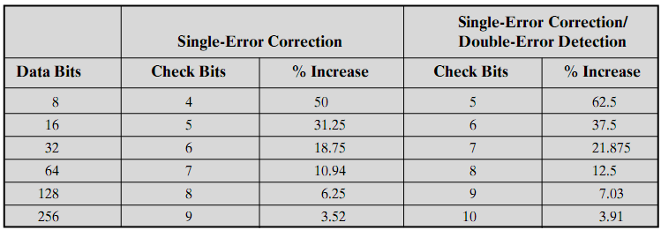
Increase in Word Length with Error Correction

Slide 15
Advanced DRAM Organization
Interface to MM is a system bottleneck.
DRAM chip is the main building block of MM.
Basic DRAM architecture same since 1970s!
Enhancements to basic DRAM architecture
  Synchronous DRAM (SDRAM)
    DDR-SDRAM, DDR2-SDRAM, DDR3-SDRAM
  Rambus DRAM (RDRAM)
  Cache DRAM (CDRAM)

Slide 16
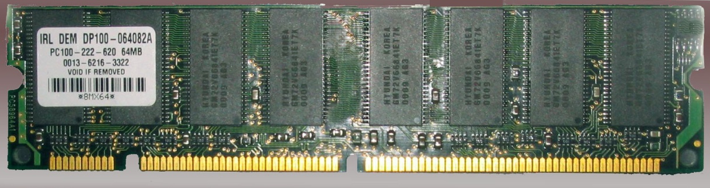
Synchronous DRAM (SDRAM)
Unlike traditional DRAM (which is asynchronous), SDRAM exchanges data with CPU synchronized to an external clock (system bus).
No wait states!
  SDRAM moves data in/out under control of system clock.
  CPU issues command and address.
  Latched by the SDRAM.
  SDRAM responds after a number of clock cycles.
  Meanwhile, CPU can do other tasks ➔ no waits.

Slide 17
Synchronous DRAM (SDRAM) (2)
Burst mode: a series of data bits can be clocked out rapidly after the first bit has been accessed.
Eliminates row and column address setup time.
Useful when the required bits are in sequence and in the same row of the array as the initial access.
Multiple-bank internal architecture improves opportunities for parallelism.
Mode Register (MR)
  Specifies burst length.
  Allows programmer to adjust latency between read request and data transfer.

Slide 18
IBM 64Mb SDRAM

Slide 19
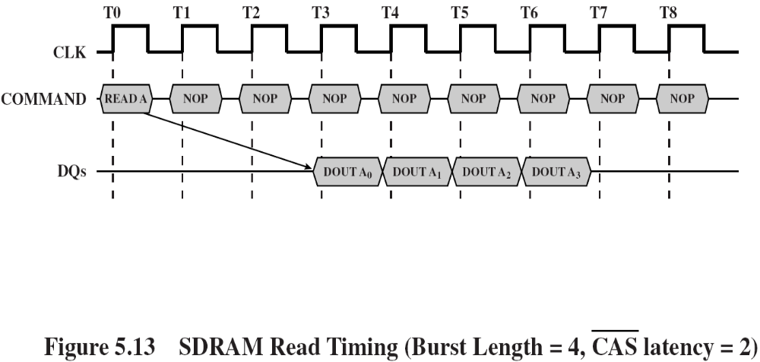
SDRAM Operation
Burst type, length and latency are set in mode reg.
  Type: interleaved or sequential
  In the example: length=4 and latency=3
Burst read command is initiated.
  At the rising edge of the clock: CS & CAS ➔ low, and RAS & WE ➔ high.
Address inputs determine starting column for burst.

Slide 20
Enhanced versions of SDRAM
Double Data Rate (DDR-SDRAM)
  produces two words of data every memory cycle
  sends data to CPU twice per clock cycle (at leading & trailing edges of the clock)
  2x data rate of SDRAM (with same cell speed)
DDR2-SDRAM
  produces four words of data every memory cycle
  2x bus speed & data rate of DDR (with same cell speed)
DDR3-SDRAM
  produces eight words of data every memory cycle
  2x bus speed & data rate of DDR2 (with same cell speed)

Slide 21
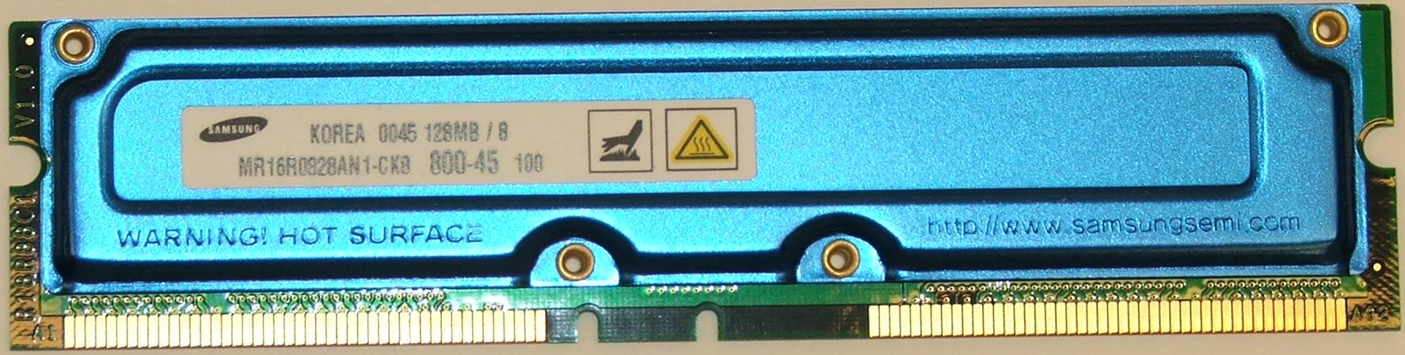
Rambus DRAM (RDRAM) (1)
Adopted by Intel for Pentium & Itanium in late 90s.
Was main competitor to SDRAM.
Chips are vertical packages – all pins on one side.
Data exchange over 28 wires < 12 cm long.
Bus can address up to 32 RDRAM chips and is rated at 1.6 GBps.

Slide 22
Rambus DRAM (RDRAM) (2)
Asynchronous block-oriented protocol
  Initial 480 ns access time.
  Then 1.6 GB/s.
What makes this speed possible is the bus itself, which defines impedances, clocking, and signals very precisely.
RDRAM gets a memory request over the high-speed bus (unlike conventional DRAMs controlled by RAS, CAS, R/W, and CE).
This request contains address, operation, number of bytes.

Slide 23
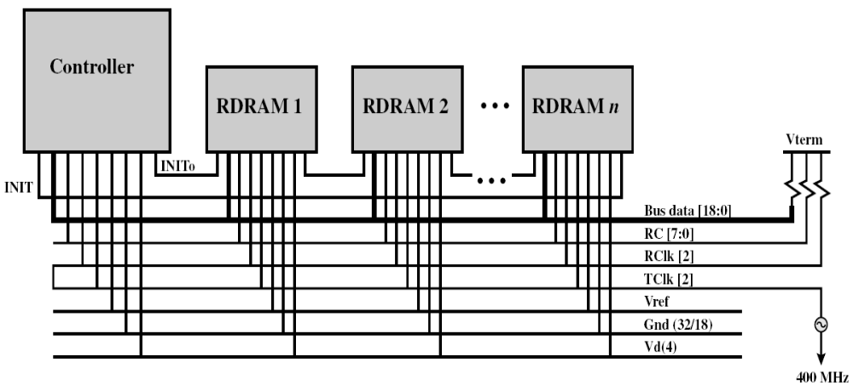
RDRAM Diagram
Bus Data [17:0]
Controller and a number of RDRAM modules connected via a common bus.
Bus: 18 data lines, cycling at twice the clock rate ➔ 800 Mbps per line.
Address and control signals: 8 lines (RC)
Clock starts at the far end from the controller, propagates to the controller end, then loops back.
Module sends data to the controller synchronously to the clock to master.
Controller sends data to a module synchronously with the clock in the opposite direction.

Slide 24
Cache DRAM (CDRAM)
CDRAM integrates a small SRAM cache (16 kb) onto a generic DRAM chip.
CDRAM can be used in two ways:
  As a true cache with 64-bit lines.
  As a buffer to support serial access of a data block.
    e. g., to refresh a bit-mapped screen, the CDRAM can prefetch the data from the DRAM into the SRAM buffer. Subsequent accesses to the chip results in accesses to the SRAM only.

Slide 25
Reading Material
Stallings, Chapter 5:
  Pages 170 – 180

