Slide 1

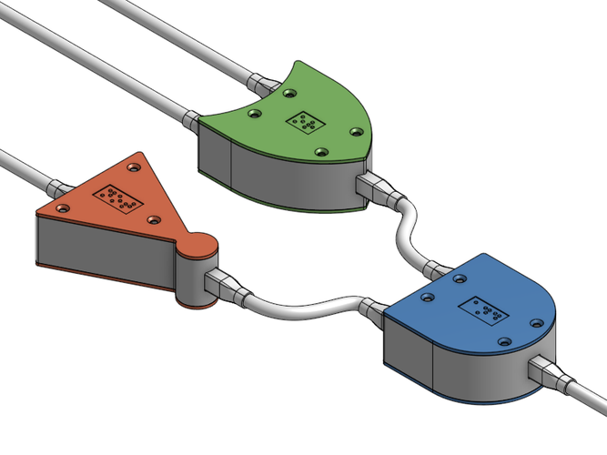
CS 211 - Digital Logic Design 211 عال - تصميم المنطق الرقمي First Term - 1439/1440 Lecture #7
Dr. Hazem Ibrahim Shehata
Assistant Professor
College of Computing and Information Technology

Slide 2
Administrivia
Midterm #1:
Date: Wednesday, October 24, 2018.
Time: 8:30am - 9:30am
Scope: Chapters 2 and 3 (Lectures 1, 2, 3, 4, 5, and first part of 6).
Tutorial:
There will be no tutorial this Sunday!
Instead, there will be a review tutorial on Monday at 12:30pm.
Website: http://hshehata.github.io/courses/su/cs211

Slide 3

Chapter 4: Boolean Algebra ... (... Continuing …)

Slide 4
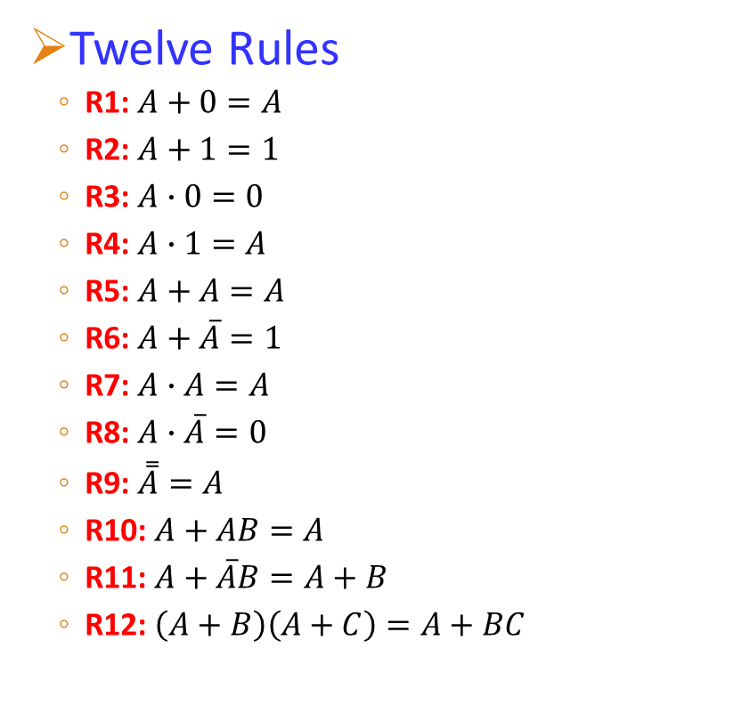

Laws and Rules of Boolean Algebra
Five Laws
CL1: $A+B=B+A$
CL2: $AB=BA$
AL1: $A+(B+C)=(A+B)+C$
AL2: $A(BC)=(AB)C$
DL: $A(B+C)=AB+AC$
Twelve Rules
R1: $A+0=A$
R2: $A+1=1$
R3: $A∙0=0$
R4: $A∙1=A$
R5: $A+A=A$
R6: $A+\overline{A}=1$
R7: $A∙A=A$
R8: $A∙\overline{A}=0$
R9: $\overset{̿}{A}=A$
R10: $A+AB=A$
R11: $A+\overline{A}B=A+B$
R12: $\left(A+B\right)\left(A+C\right)=A+BC$

Slide 5
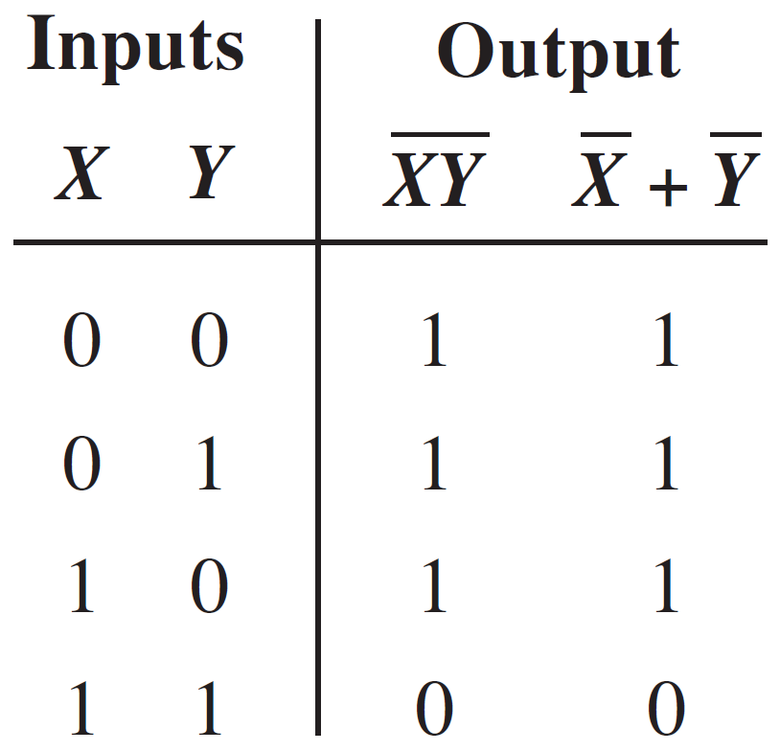
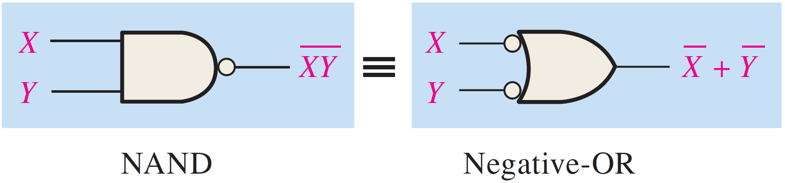

DeMorgan’s Theorems
DeMorgan’s First Theorem:
States that: “The complement of a product of variables is equal to the sum of the complements of the variables”.
$$\overline{XY}=\overline{X}+\overline{Y}$$

Slide 6
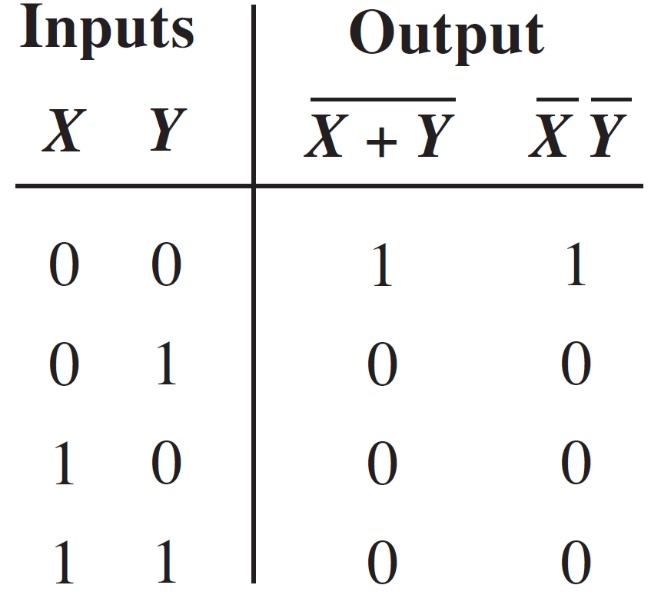
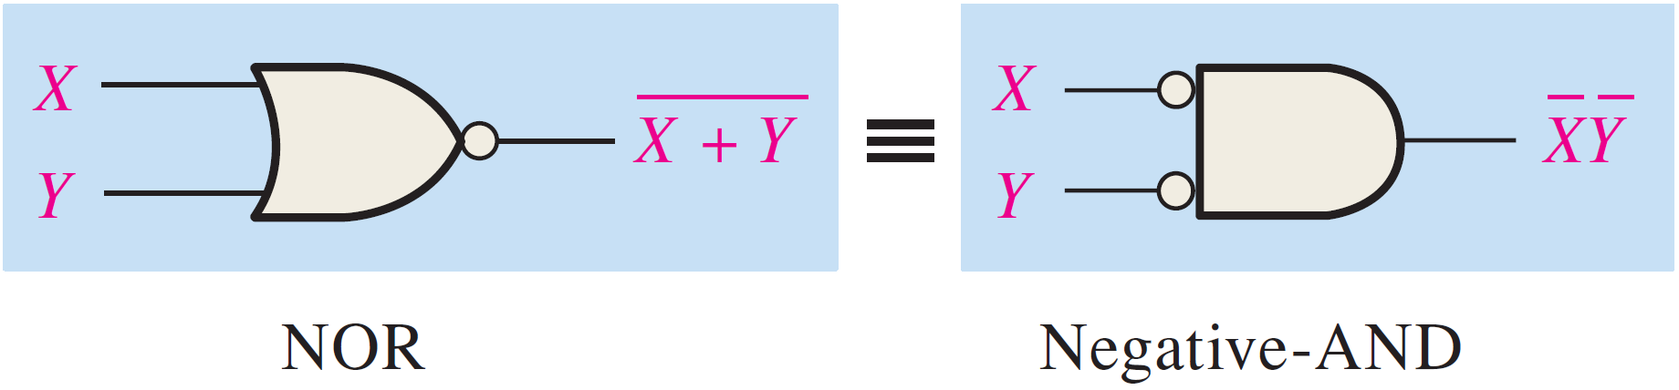

DeMorgan’s Theorems (DMT)
DeMorgan’s Second Theorem:
States that: “The complement of a sum of variables is equal to the product of the complements of the variables”.
$$\overline{X+Y}=\overline{X}\overline{Y}$$

Slide 7
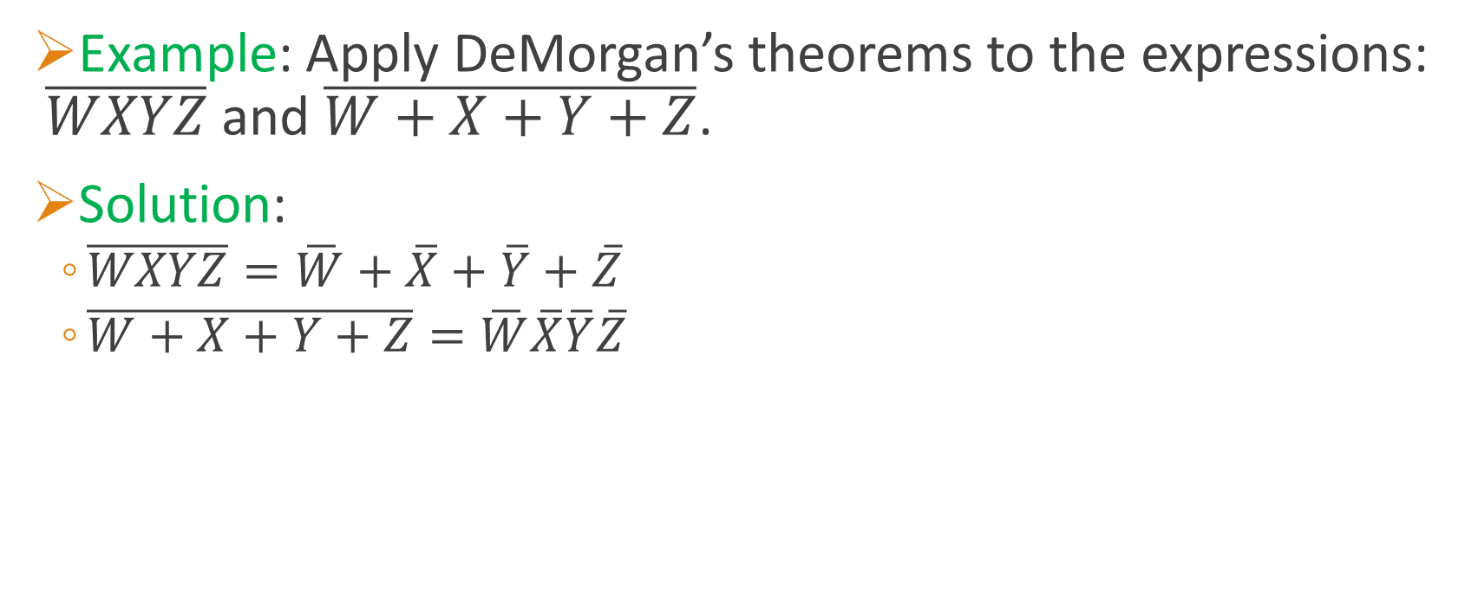
Applying DeMorgan’s Theorems
Example: Apply DeMorgan’s theorems to the expressions: $\overline{WXYZ}$ and $\overline{W+X+Y+Z}$.
Solution:
$\overline{WXYZ}=\overline{W}+\overline{X}+\overline{Y}+\overline{Z}$
$\overline{W+X+Y+Z}=\overline{W}\overline{X}\overline{Y}\overline{Z}$

Slide 8
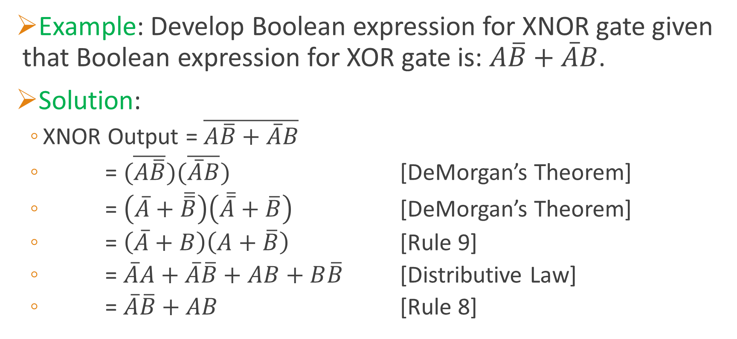
Applying DeMorgan’s Theorems
Example: Develop Boolean expression for XNOR gate given that Boolean expression for XOR gate is: $A\overline{B}+\overline{A}B$.
Solution:
XNOR Output = $\overline{A\overline{B}+\overline{A}B}$
= $(\overline{A\overline{B}})(\overline{\overline{A}B})$ [DeMorgan’s Theorem]
= $\left(\overline{A}+\overline{\overline{B}}\right)\left(\overline{\overline{A}}+\overline{B}\right)$ [DeMorgan’s Theorem]
= $\left(\overline{A}+B\right)\left(A+\overline{B}\right)$ [Rule 9]
= $\overline{A}A+\overline{A}\overline{B}+AB+B\overline{B}$ [Distributive Law]
= $\overline{A}\overline{B}+AB$ [Rule 8]

Slide 9
Boolean Analysis of Logic Circuits
Goal: Given a logic circuit, can we construct a truth table for its output?!
Method:
Derive Boolean expression for the logic circuit (i.e., output).
Evaluate Boolean expression (know what inputs make it 1).
Put evaluation results in a truth table format.

Slide 10
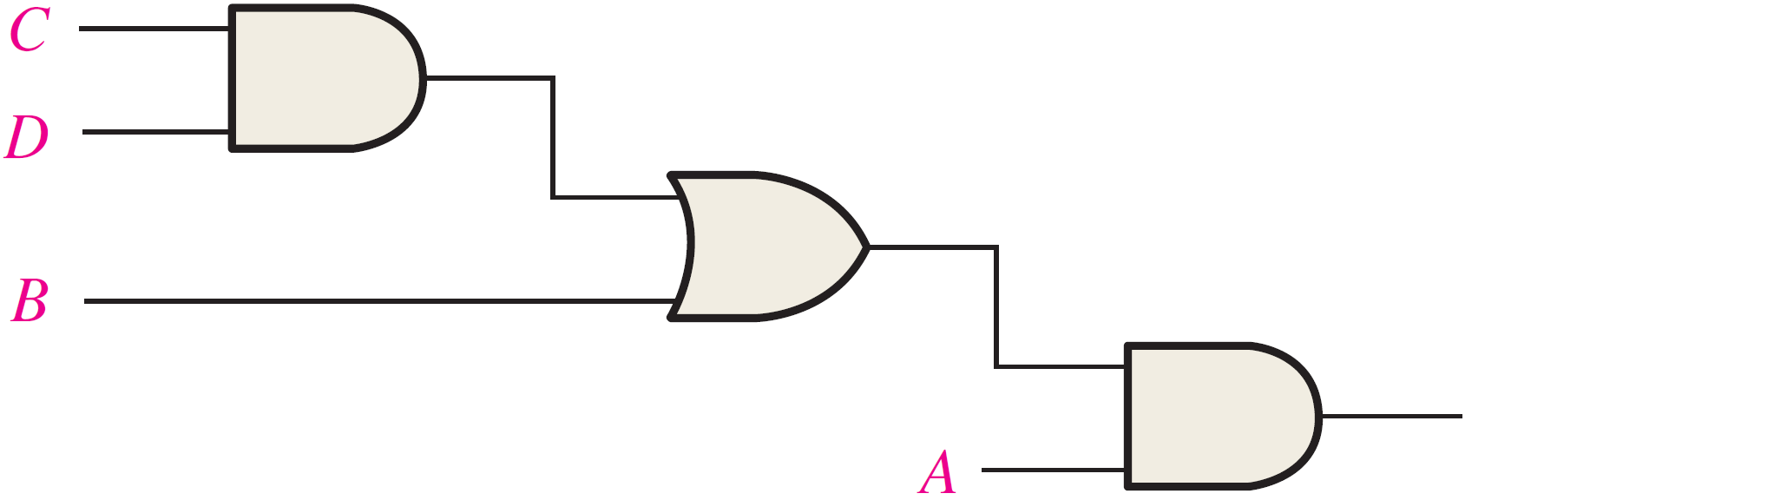
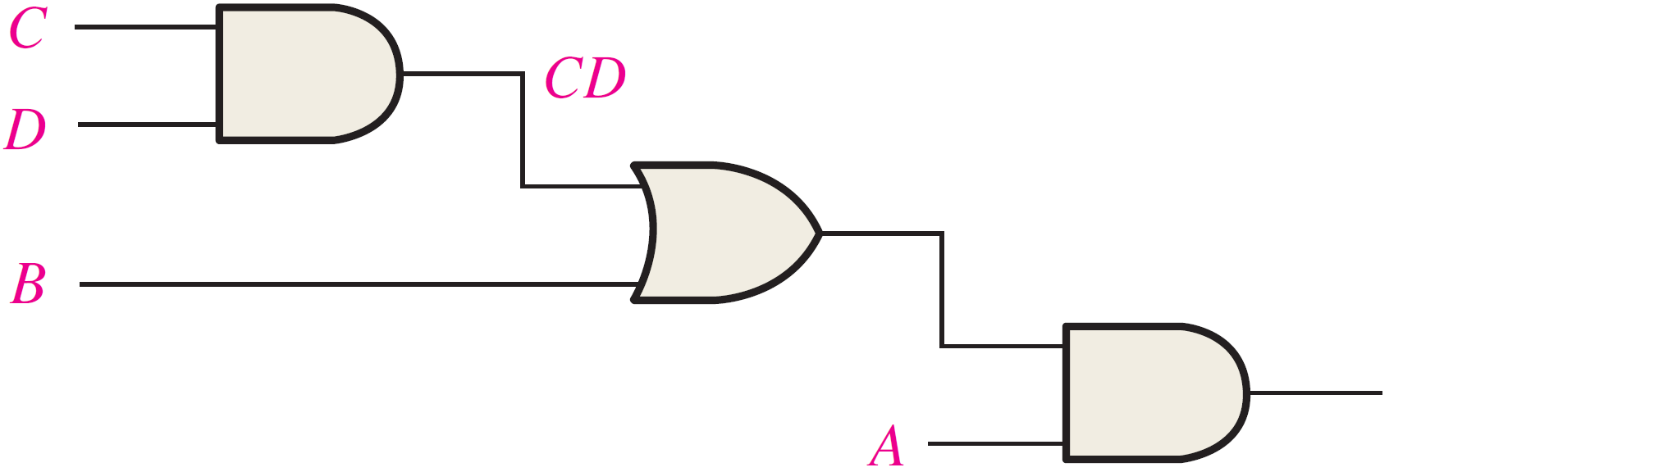
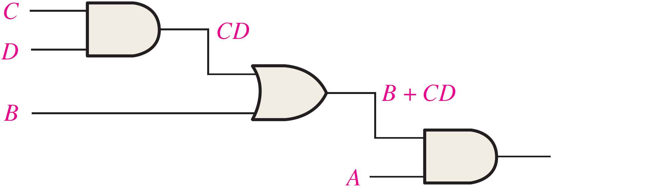
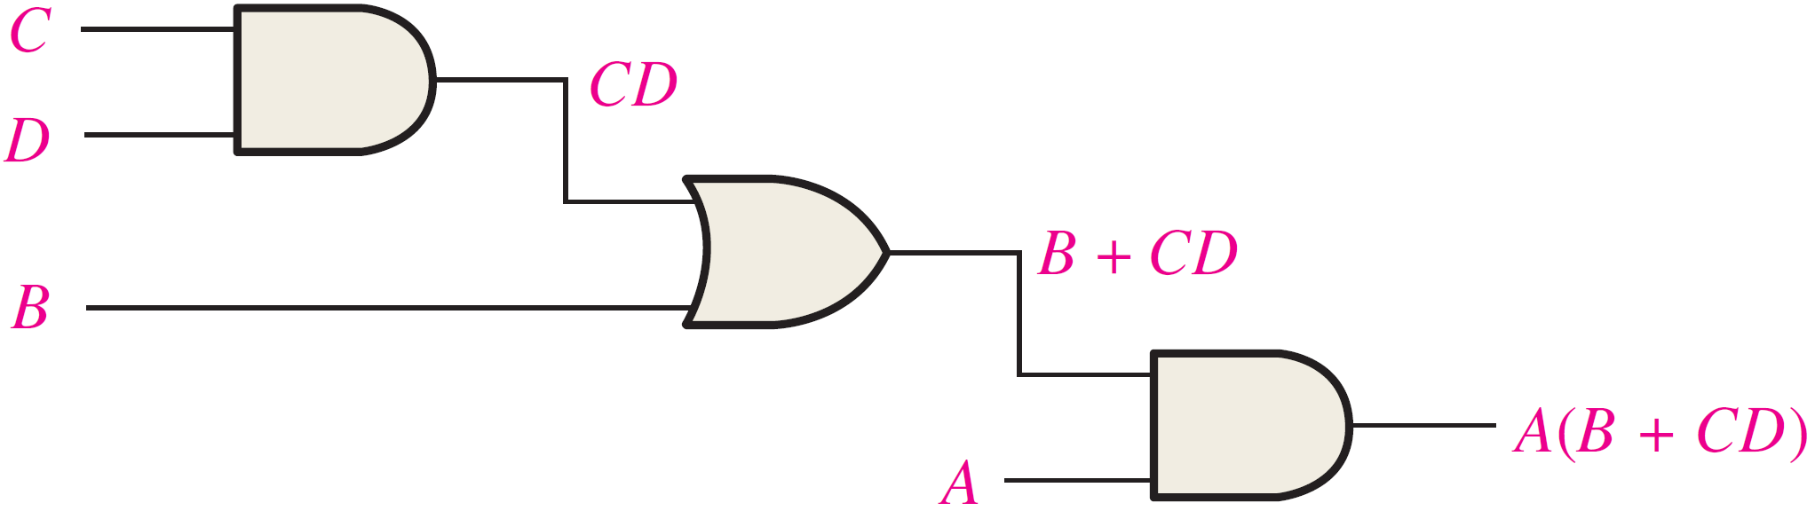
Boolean Analysis of Logic Circuits
Example:
1
2
Derive Boolean Expression for Logic Circuit
Begin at left-most inputs and work toward final output, writing expression for each gate.
3

Slide 11
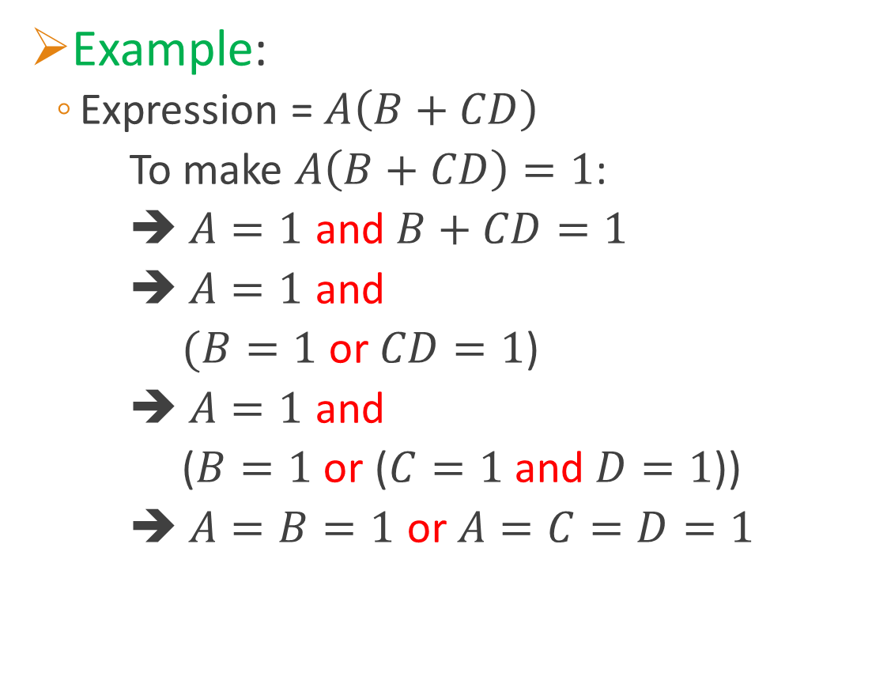
Boolean Analysis of Logic Circuits
Example:
Expression = $A\left(B+CD\right)$
To make $A\left(B+CD\right)=1$:
➔ $A=1$ and $B+CD=1$
➔ $A=1$ and
$(B=1$ or $CD=1$)
➔ $A=1$ and
($B=1$ or ($C=1$ and $D=1$))
➔ $A=B=1$ or $A=C=D=1$
Evaluate Expression
Find the values of the variables that make the expression equal to 1!

Slide 12
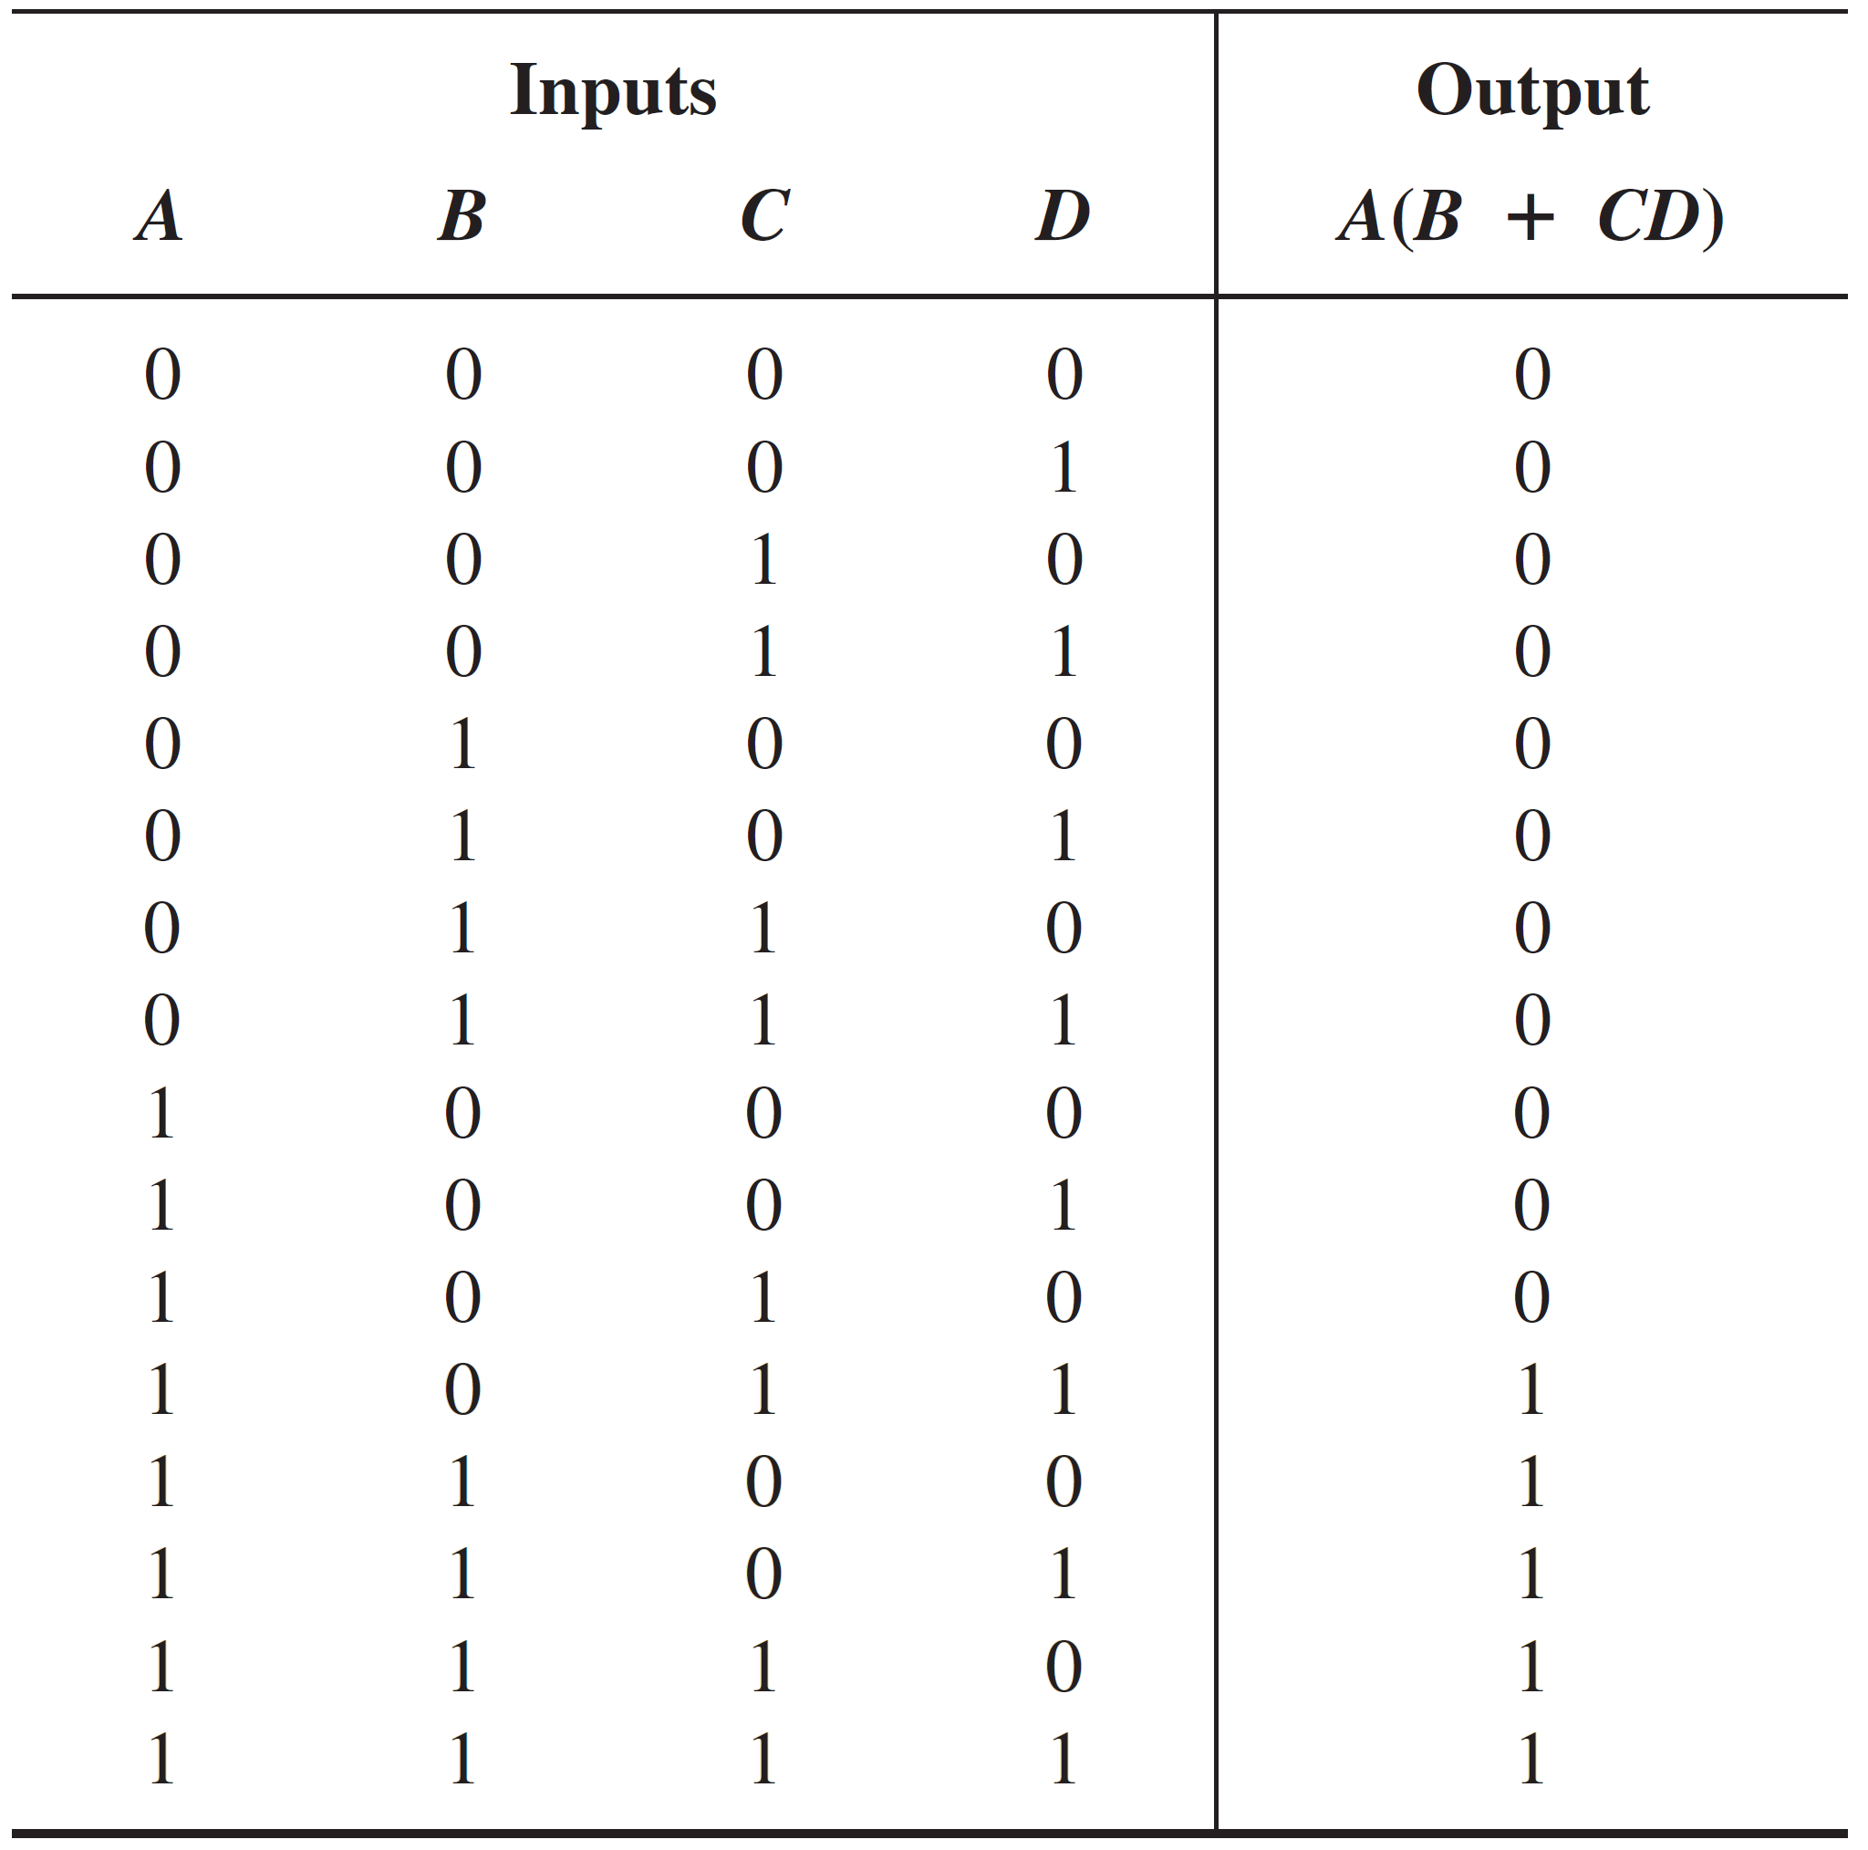
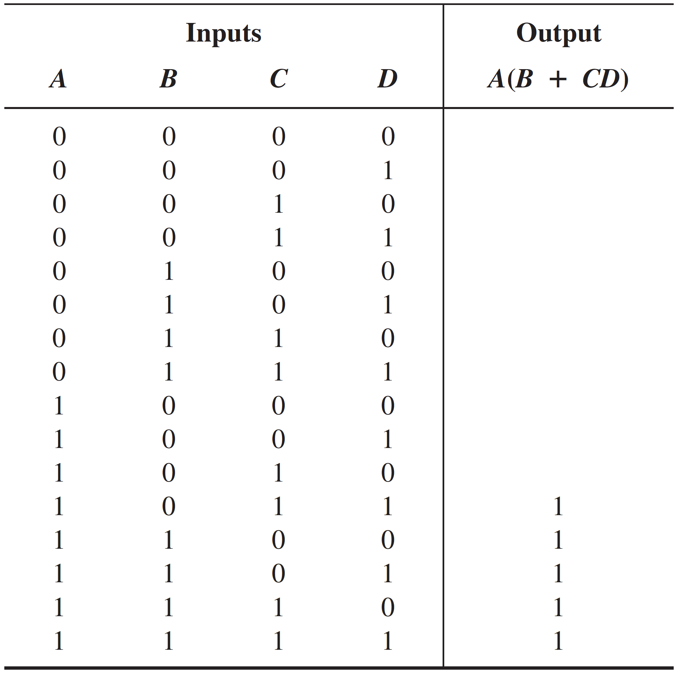
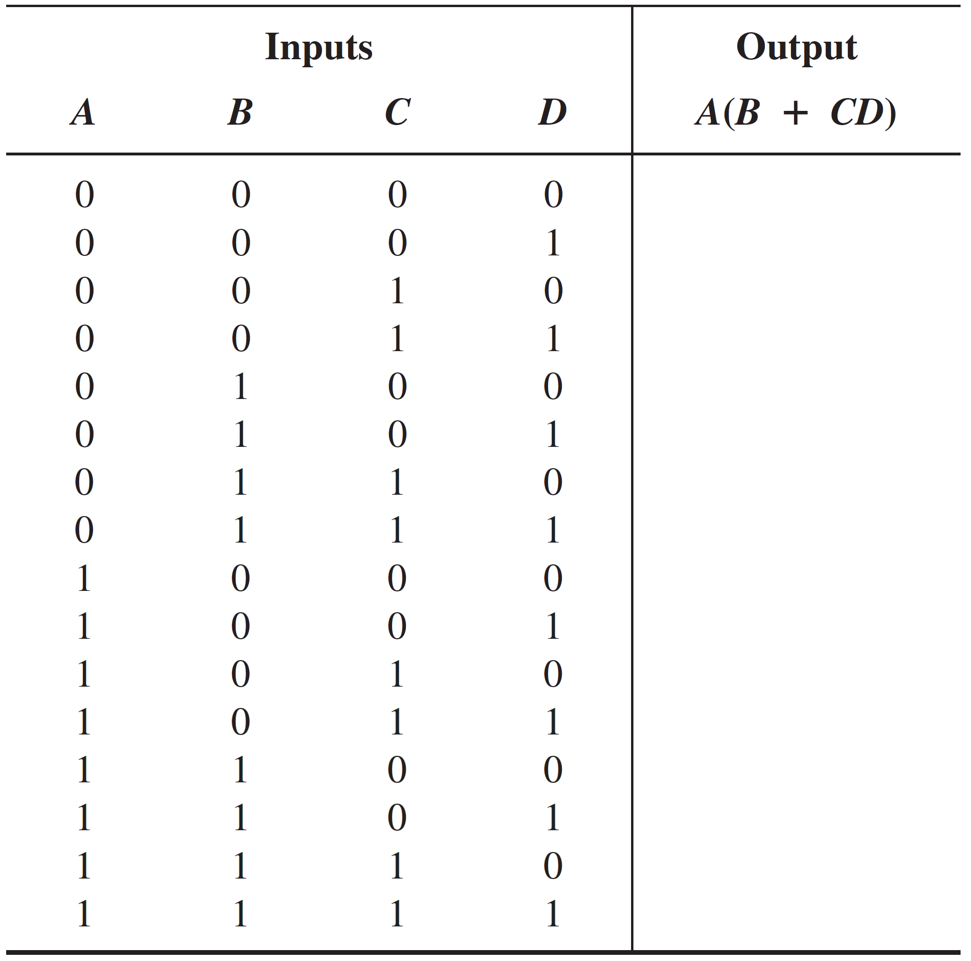
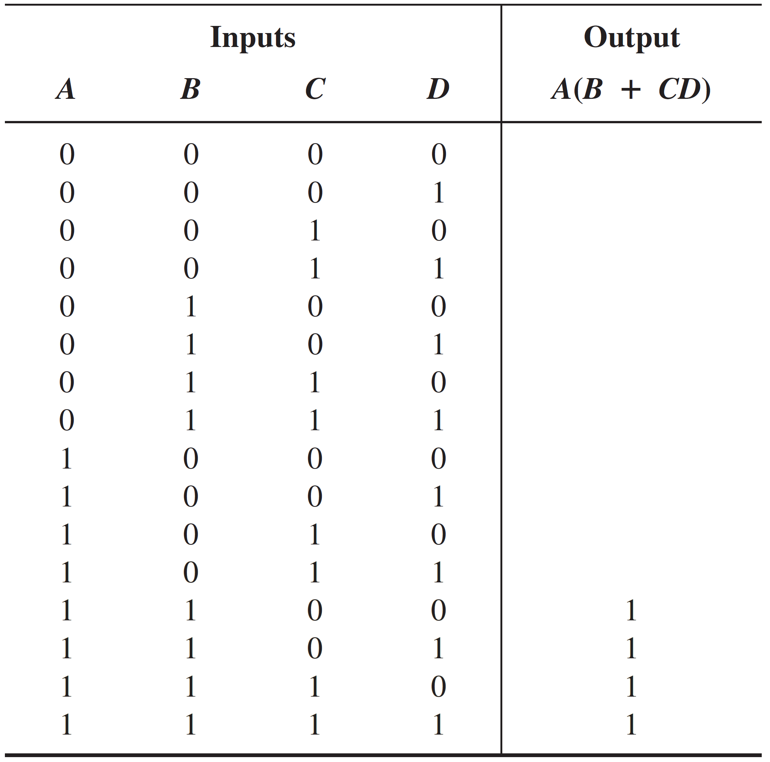
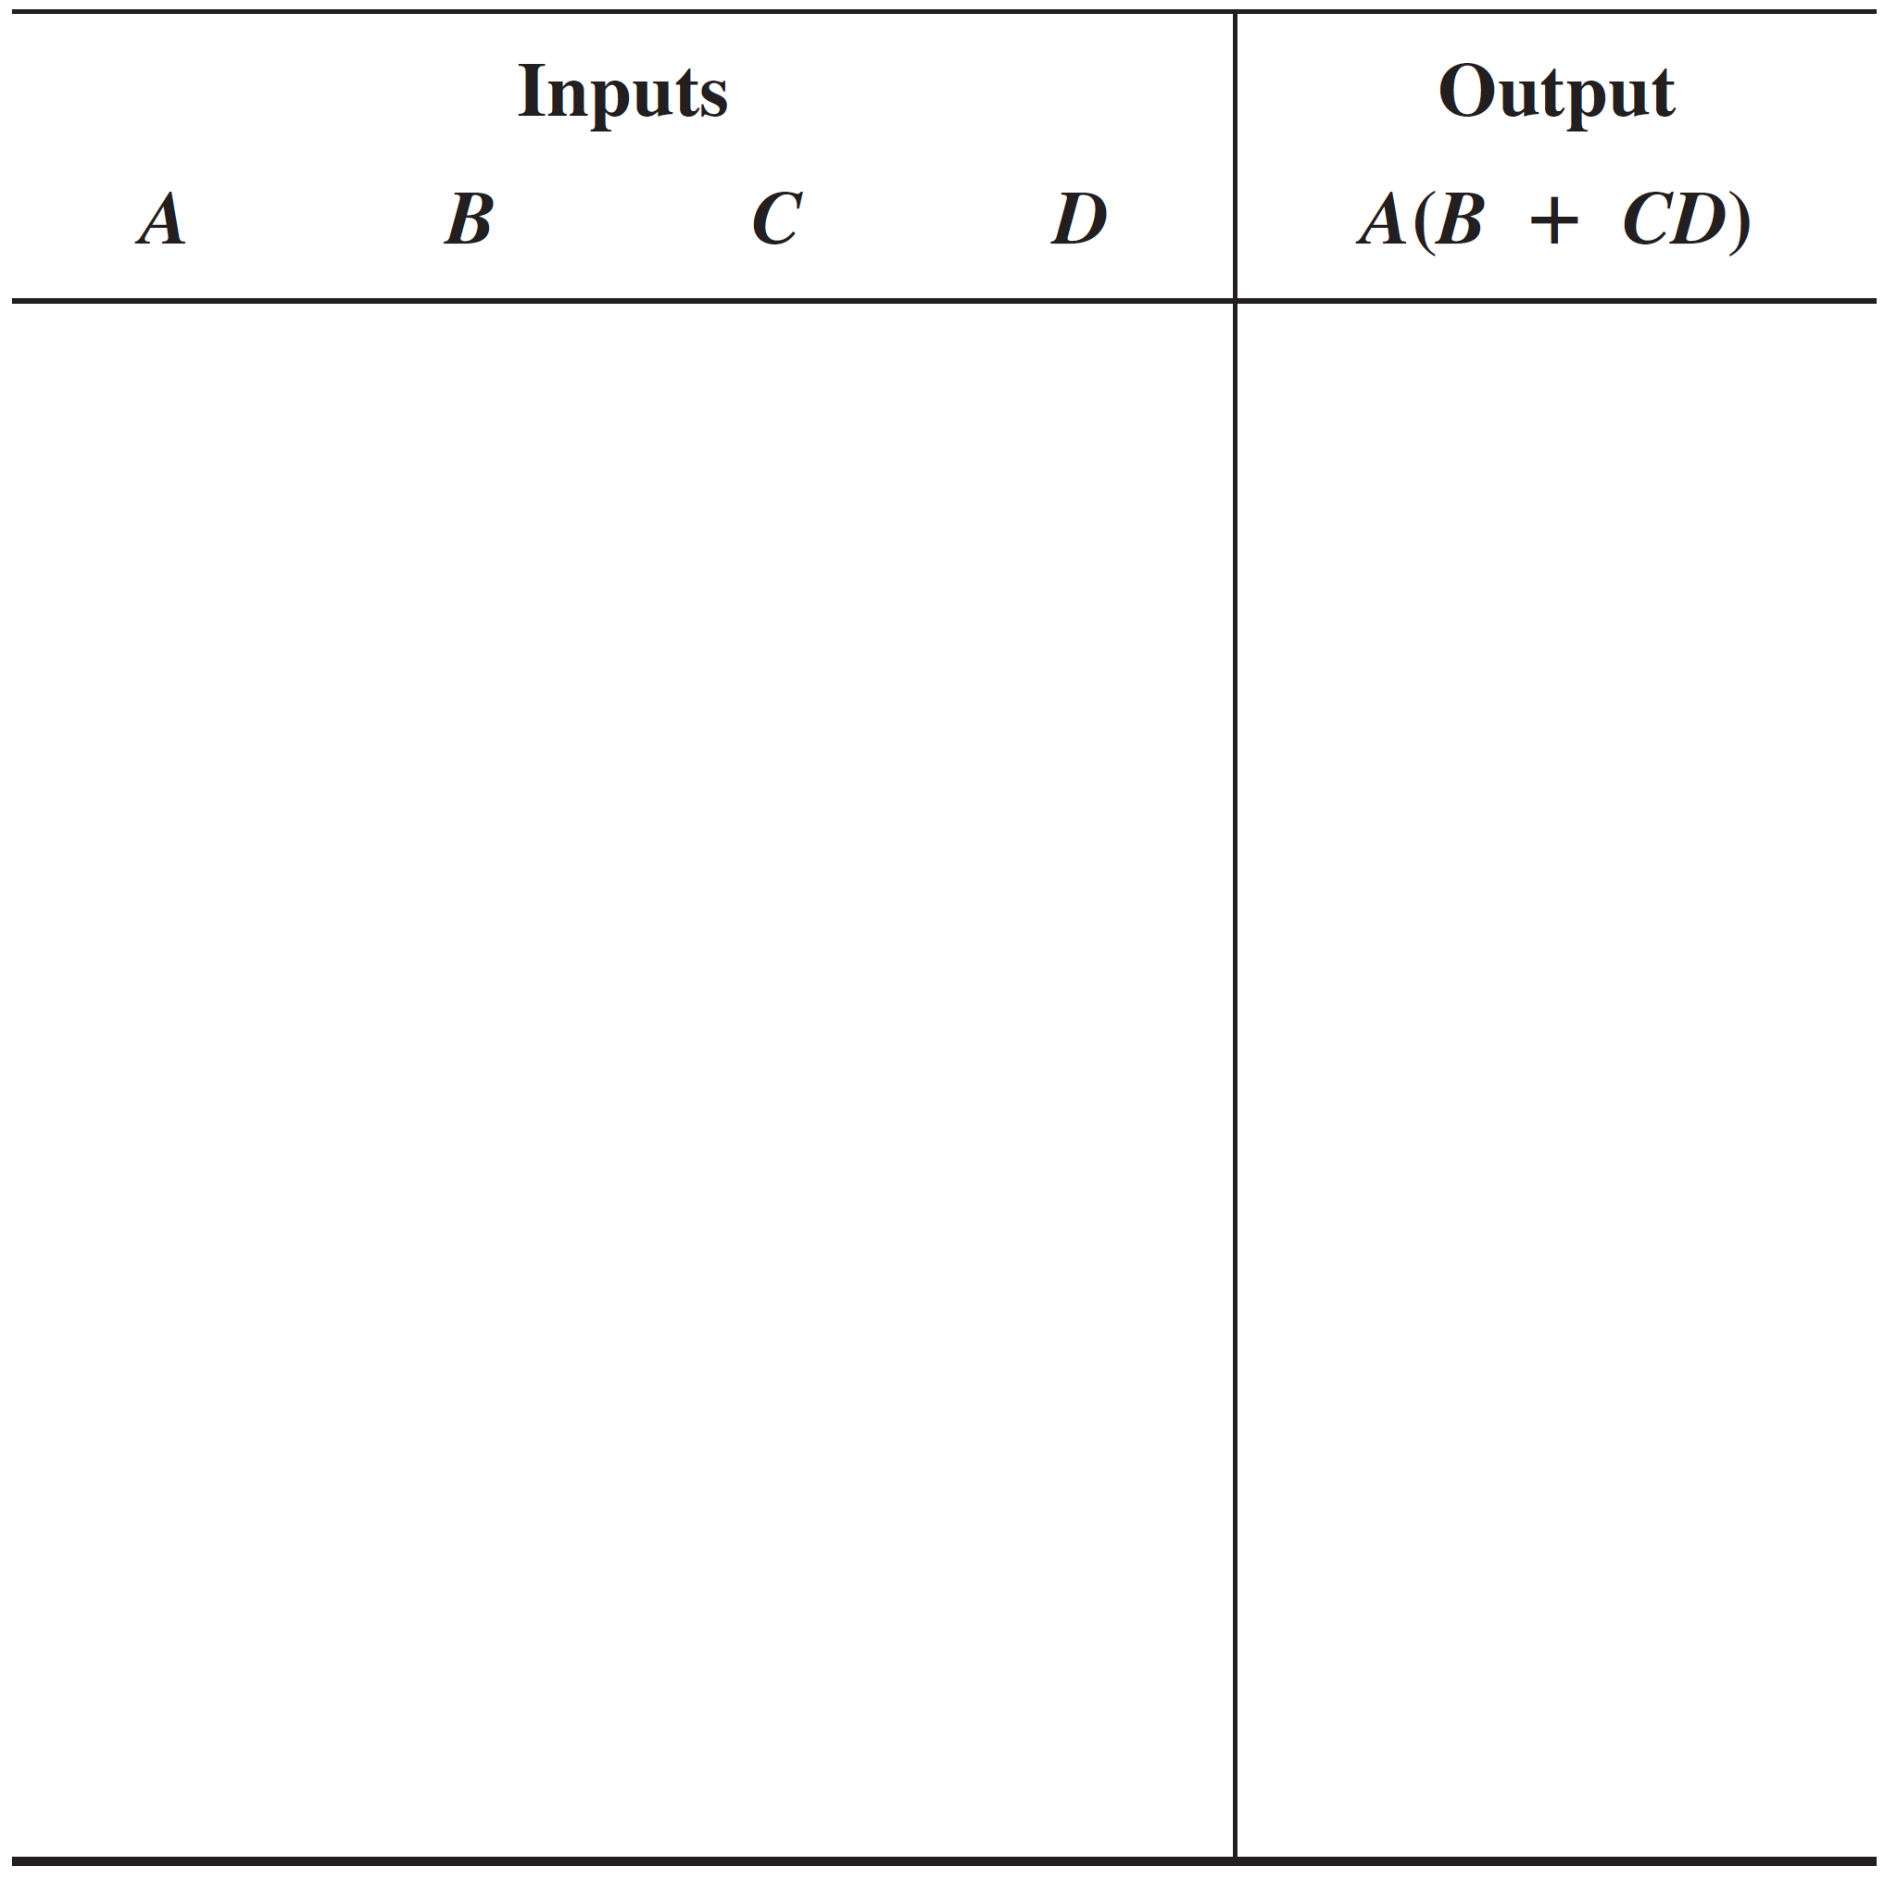


Boolean Analysis of Logic Circuits
Example:
Put Results in Truth Table Format
Place a 1 in output column for each combination of input variables determined in the evaluation.
$$A=C=D=1$$
$$A=B=1$$

Slide 13
Logic Simplification Using Boolean Algebra
Goal: Given a logic circuit, can we construct an equivalent circuit with fewer number of gates?!
“Equivalent” means “has the same Truth Table”.
Method:
Derive Boolean expression for the logic circuit (i.e., output).
Simplify Boolean expression (using laws, rules, and theorems).
Construct logic circuit from the simplified Boolean Expression.

Slide 14
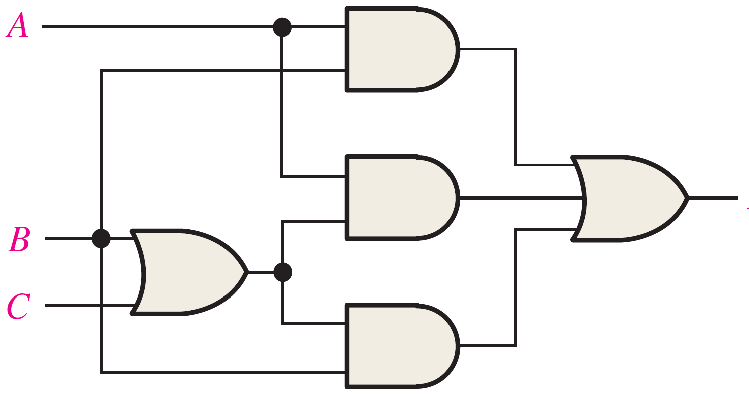






Logic Simplification Using Boolean Algebra
Example:
$$AB$$
$$A(B+C)$$
Derive Boolean expression for logic circuit.
$$X$$
$$B+C$$
$$B(B+C)$$
$$X=AB+A\left(B+C\right)+B(B+C)$$

Slide 15
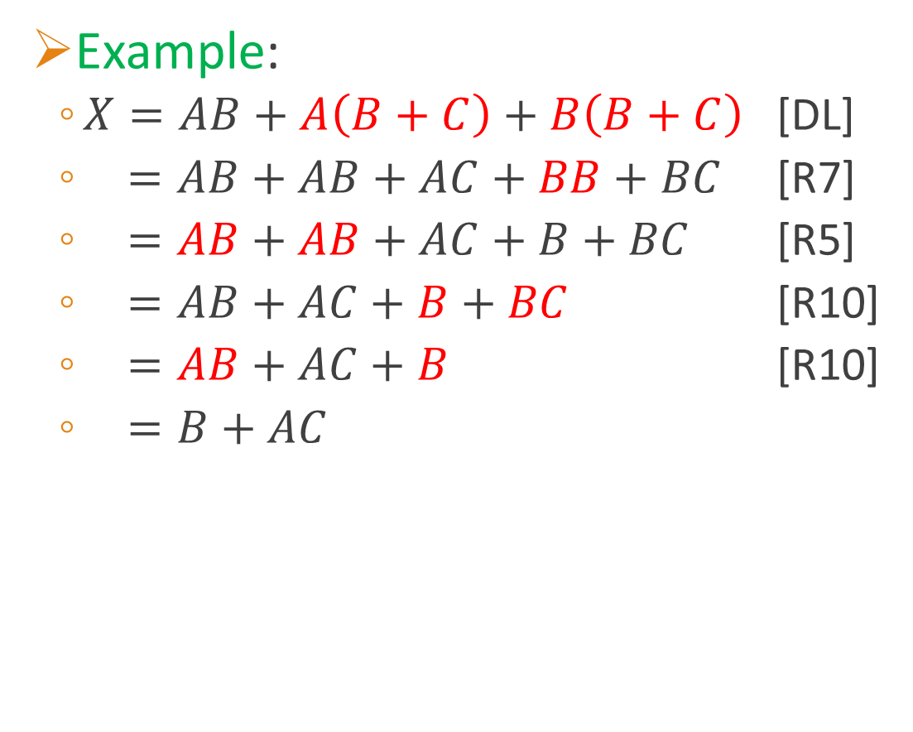
Logic Simplification Using Boolean Algebra
Example:
$X=AB+A\left(B+C\right)+B\left(B+C\right)$ [DL]
$=AB+AB+AC+BB+BC$ [R7]
$=AB+AB+AC+B+BC$ [R5]
$=AB+AC+B+BC$ [R10]
$=AB+AC+B$ [R10]
$=B+AC$
Simplify Boolean expression.

Slide 16
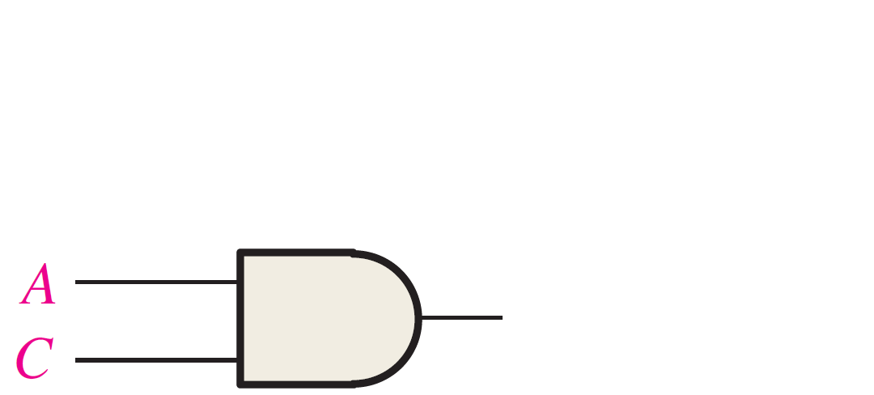
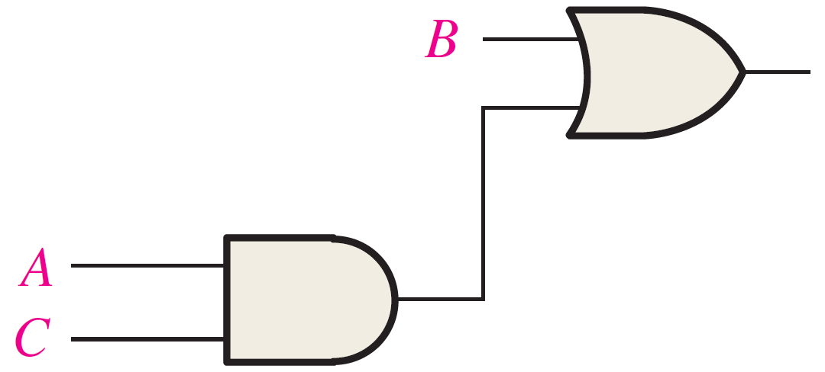



Logic Simplification Using Boolean Algebra
Example:
$$X=B+AC$$
Construct logic circuit from simplified Boolean Expression
$$B+AC$$
$$AC$$

Slide 17
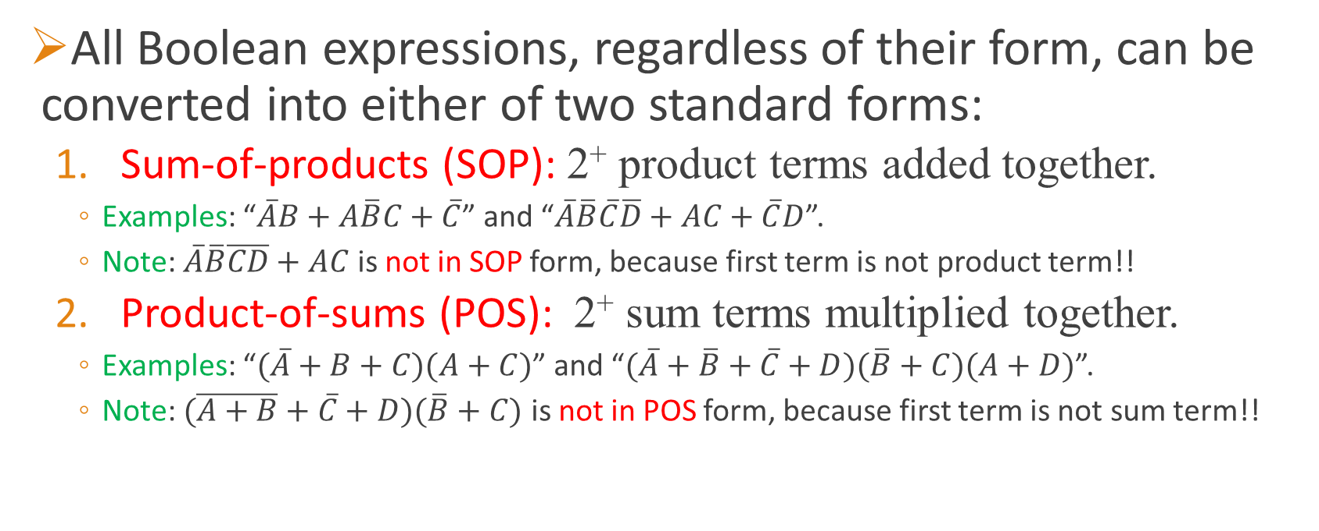
Standard Forms of Boolean Expressions
All Boolean expressions, regardless of their form, can be converted into either of two standard forms:
Sum-of-products (SOP): 2⁺ product terms added together.
Examples: “$\overline{A}B+A\overline{B}C+\overline{C}$” and “$\overline{A}\overline{B}\overline{C}\overline{D}+AC+\overline{C}D$”.
Note: $\overline{A}\overline{B}\overline{CD}+AC$ is not in SOP form, because first term is not product term!!
Product-of-sums (POS): 2⁺ sum terms multiplied together.
Examples: “$(\overline{A}+B+C)(A+C)$” and “$(\overline{A}+\overline{B}+\overline{C}+D)(\overline{B}+C)(A+D)$”.
Note: $(\overline{A+B}+\overline{C}+D)(\overline{B}+C)$ is not in POS form, because first term is not sum term!!

Slide 18

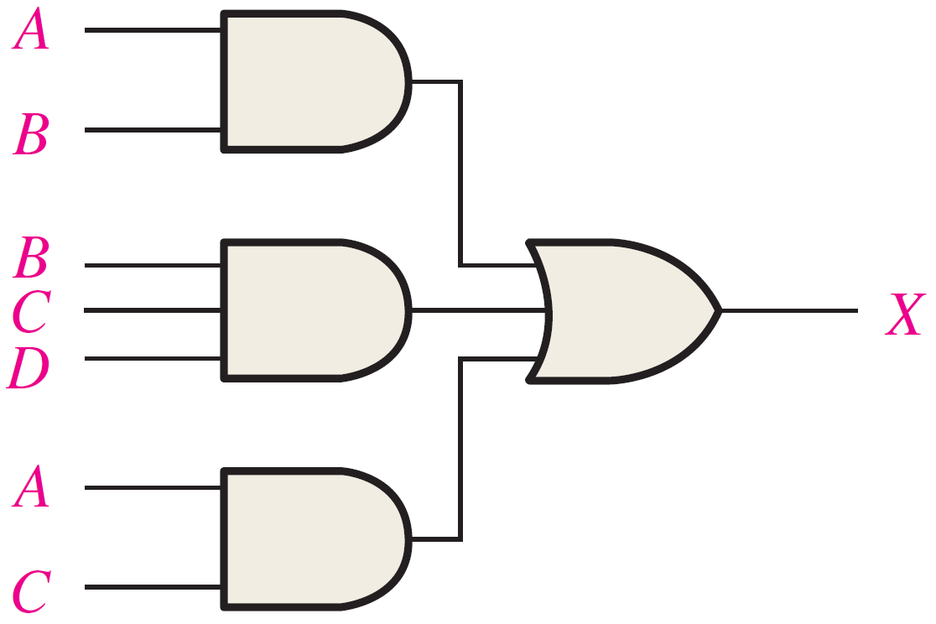
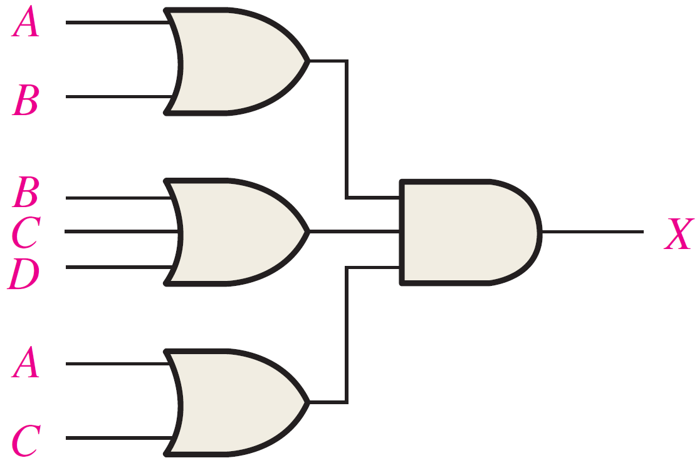
Implementing SOP & POS Expressions
Implementing SOP Expressions
Implementing POS Expressions
ORing outputs of 2⁺ AND gates
Example:
ANDing outputs of 2⁺ OR gates
Example:

Slide 19
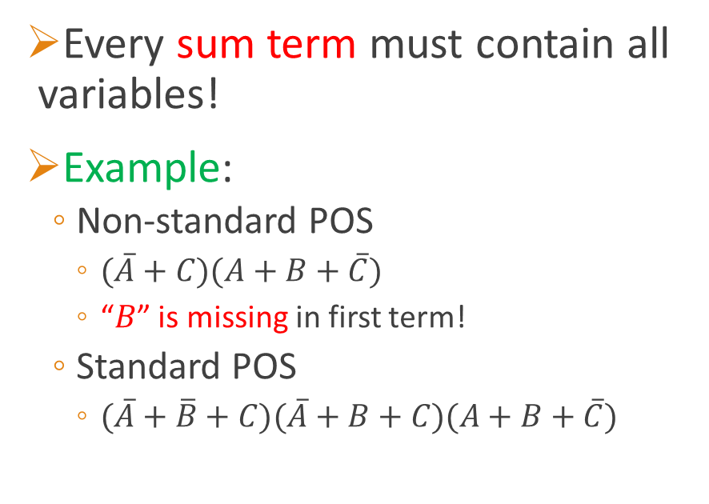
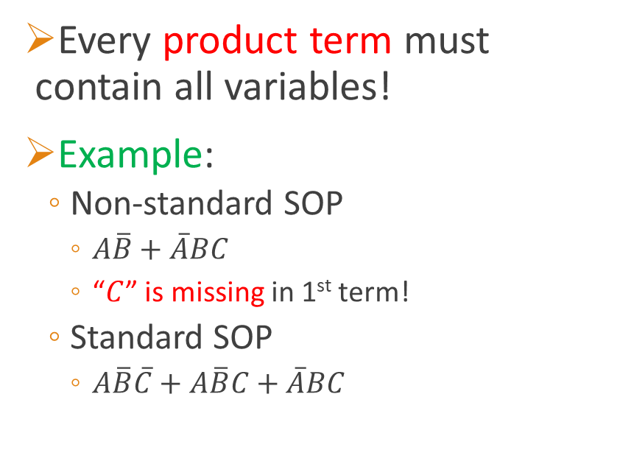
Standard SOP & POS Expression
Standard SOP expression
Standard POS Expression
Every product term must contain all variables!
Example:
Non-standard SOP
$A\overline{B}+\overline{A}BC$
“$C$” is missing in 1st term!
Standard SOP
$A\overline{B}\overline{C}+A\overline{B}C+\overline{A}BC$
Every sum term must contain all variables!
Example:
Non-standard POS
$(\overline{A}+C)(A+B+\overline{C})$
“$B$” is missing in first term!
Standard POS
$(\overline{A}+\overline{B}+C)(\overline{A}+B+C)(A+B+\overline{C})$

Slide 20
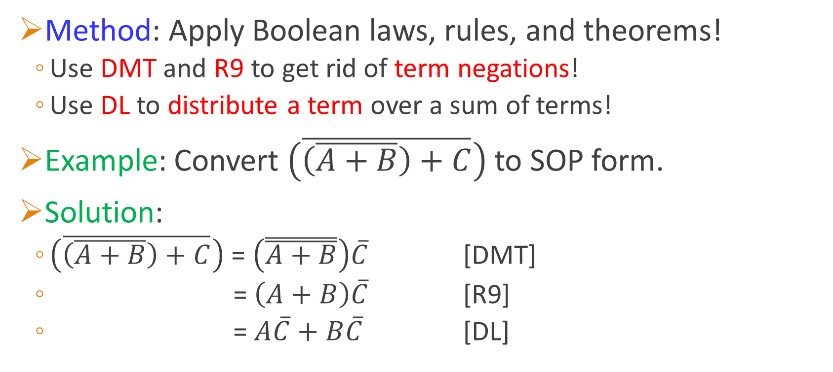
Conversion: General Expression ➔ SOP
Method: Apply Boolean laws, rules, and theorems!
Use DMT and R9 to get rid of term negations!
Use DL to distribute a term over a sum of terms!
Example: Convert $\left(\overline{\left(\overline{A+B}\right)+C}\right)$ to SOP form.
Solution:
$\left(\overline{\left(\overline{A+B}\right)+C}\right)$ = $\left(\overset{̿}{A+B}\right)\overline{C}$ [DMT]
= $\left(A+B\right)\overline{C}$ [R9]
= $A\overline{C}+B\overline{C}$ [DL]

Slide 21
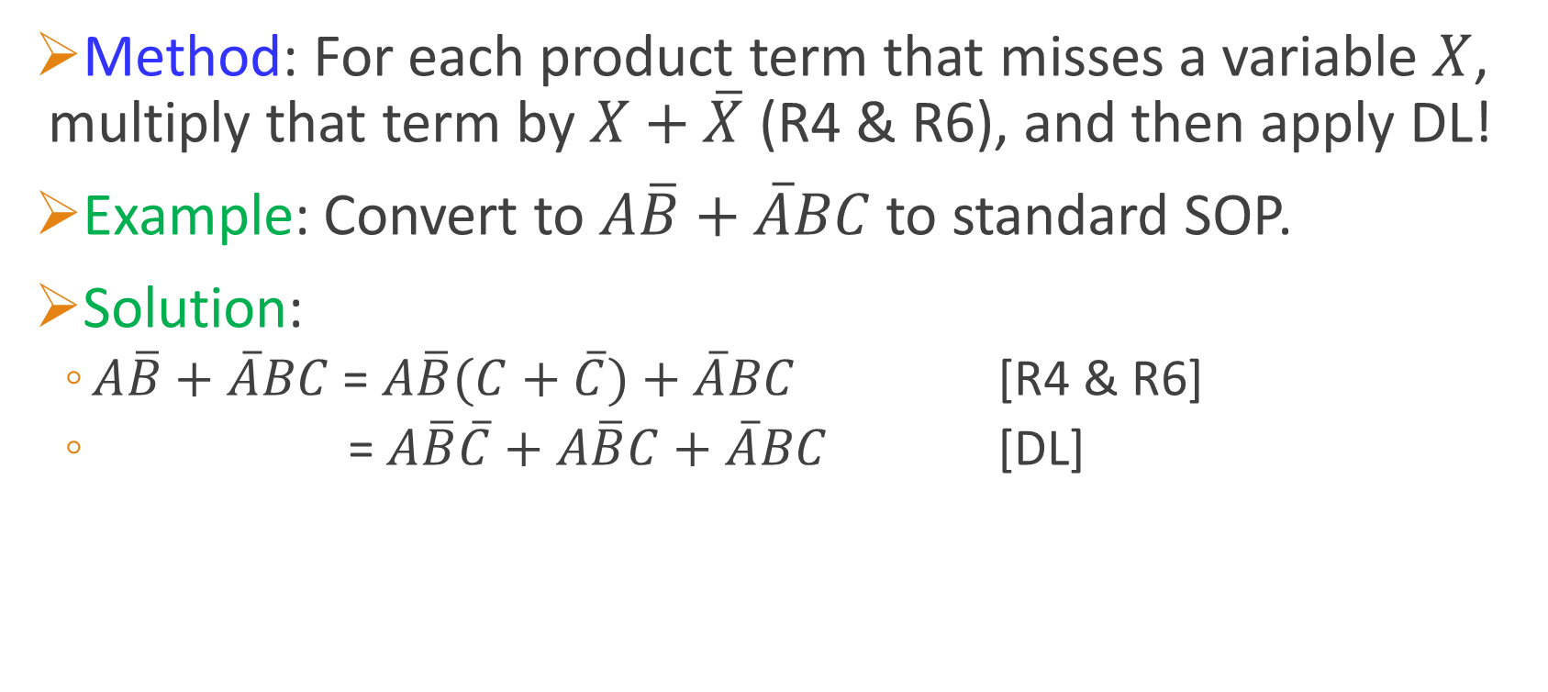
Conversion: SOP ➔ Standard SOP
Method: For each product term that misses a variable $X$, multiply that term by $X+\overline{X}$ (R4 & R6), and then apply DL!
Example: Convert to $A\overline{B}+\overline{A}BC$ to standard SOP.
Solution:
$A\overline{B}+\overline{A}BC$ = $A\overline{B}(C+\overline{C})+\overline{A}BC$ [R4 & R6]
= $A\overline{B}\overline{C}+A\overline{B}C+\overline{A}BC$ [DL]

Slide 22
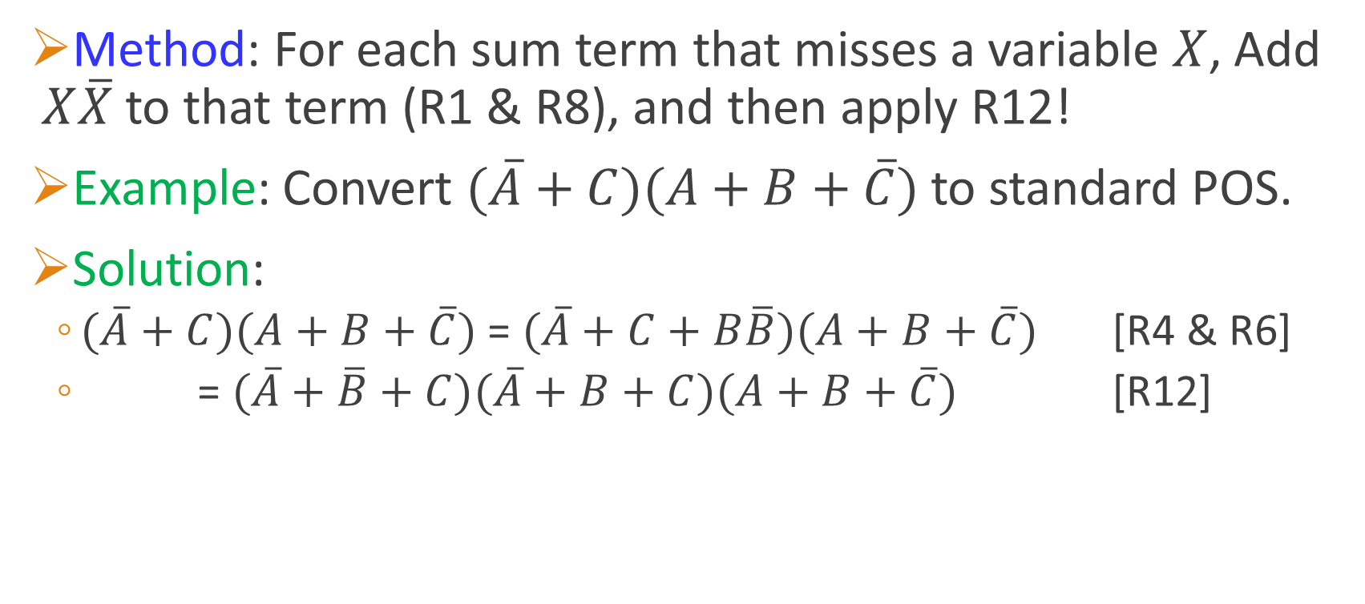
Conversion: POS ➔ Standard POS
Method: For each sum term that misses a variable $X$, Add $X\overline{X}$ to that term (R1 & R8), and then apply R12!
Example: Convert $(\overline{A}+C)(A+B+\overline{C})$ to standard POS.
Solution:
$(\overline{A}+C)(A+B+\overline{C})$ = $(\overline{A}+C+B\overline{B})(A+B+\overline{C})$ [R4 & R6]
= $(\overline{A}+\overline{B}+C)(\overline{A}+B+C)(A+B+\overline{C})$ [R12]

Slide 23
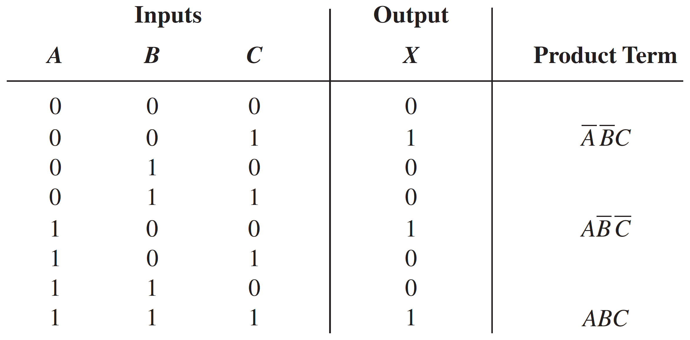
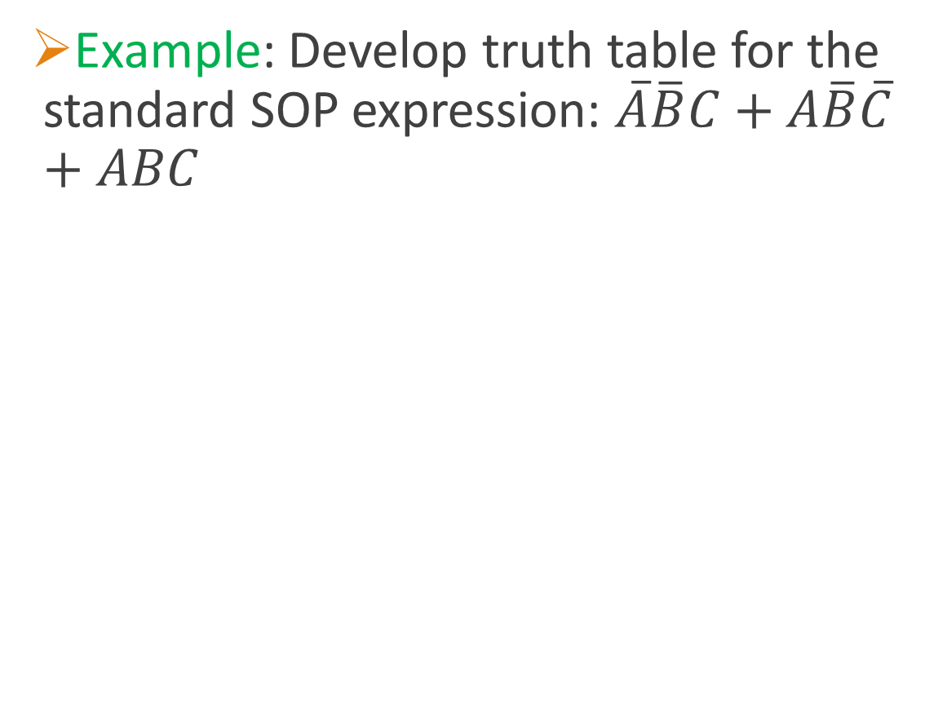
Conversion: Standard SOP ➔ Truth Table
Example: Develop truth table for the standard SOP expression: $\overline{A}\overline{B}C+A\overline{B}\overline{C}+ABC$
Method: For each product term, determine binary value of inputs that makes it 1, and then place a 1 in output column at corresponding row. Place 0’s in all remaining rows.

Slide 24
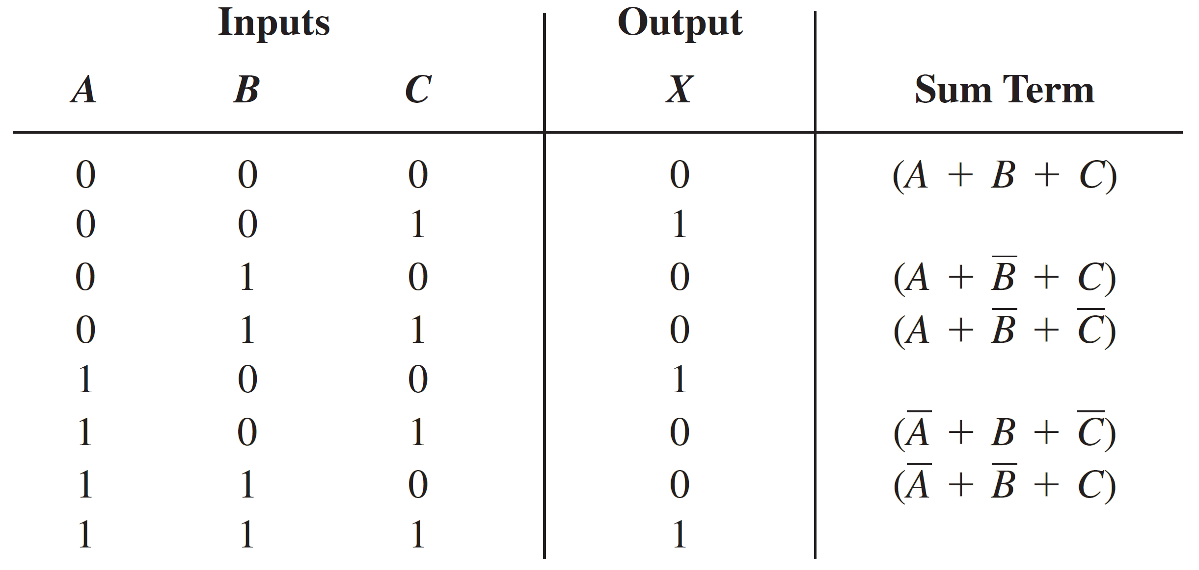
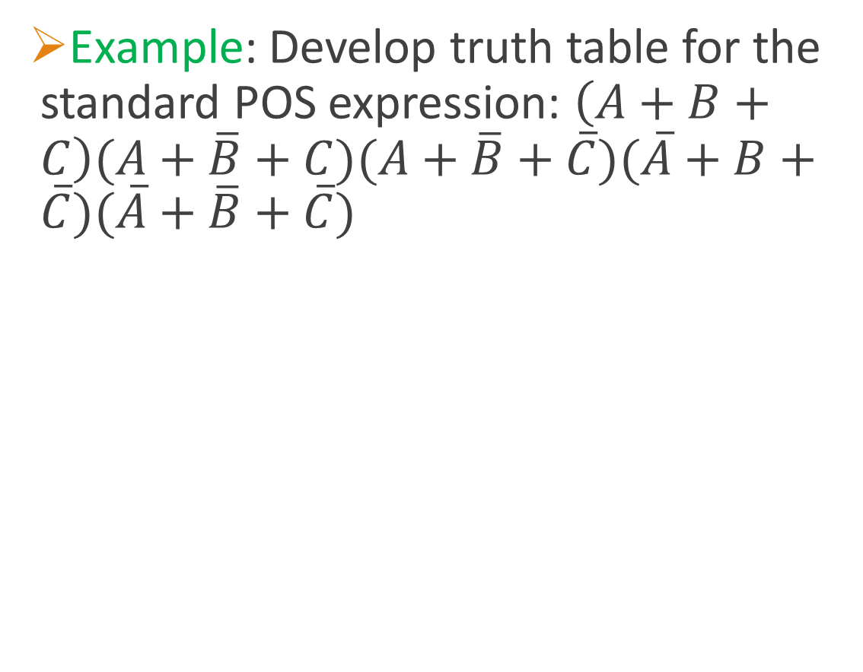
Conversion: Standard POS ➔ Truth Table
Example: Develop truth table for the standard POS expression: $\left(A+B+C\right)(A+\overline{B}+C)(A+\overline{B}+\overline{C})(\overline{A}+B+\overline{C})(\overline{A}+\overline{B}+\overline{C})$
Method: For each sum term, determine binary value of inputs that makes it 0, and then place a 0 in output column at corresponding row. Place 1’s in all remaining rows.

Slide 25
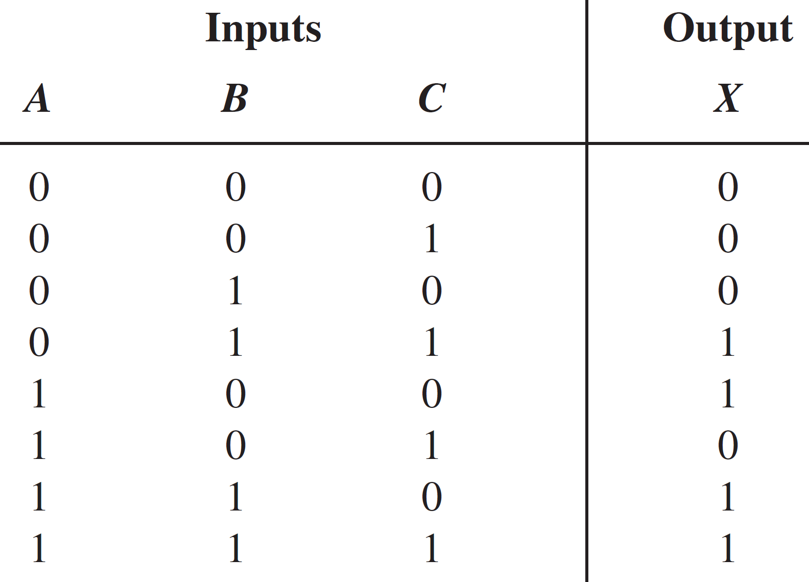





Conversion: Truth Table ➔ Standard SOP
Example: Construct standard SOP expression from following truth table:
Method: Identify binary values of inputs that make output = 1. Convert each binary value to a product term replacing each 1 with corresponding var. and 0 with corresponding var. complement
$$\overline{A}BC$$
$$A\overline{B}\overline{C}$$
$$+$$
$$AB\overline{C}$$
$$ABC$$
$$X=\overline{A}BC+A\overline{B}\overline{C}+AB\overline{C}+ABC$$

Slide 26
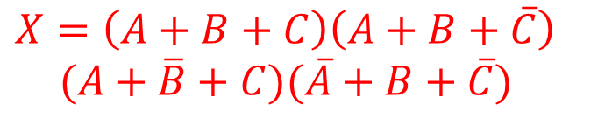





Conversion: Truth Table ➔ Standard POS
Example: Construct standard POS expression from following truth table:
$$A+B+C$$
Method: Identify binary values of inputs that make output = 0. Convert each binary value to a sum term replacing each 0 with corresponding var. and 1 with corresponding var. complement.
$$A+B+\overline{C}$$
$$A+\overline{B}+C$$
$$∙$$
$$\overline{A}+B+\overline{C}$$
$$X=\left(A+B+C\right)\left(A+B+\overline{C}\right)$$
$$(A+\overline{B}+C)(\overline{A}+B+\overline{C})$$

Slide 27
Conversion: Stand. POS ⬅➔ Stand. SOP
Standard SOP ➔ Standard POS:
Method:
Standard SOP ➔ truth table
Truth table ➔ standard POS
Standard POS ➔ Standard SOP:
Method:
Standard POS ➔ truth table
Truth table ➔ standard SOP

Slide 28
Reading Material
Floyd, Chapter 4:
Pages 179 - 199

