Slide 1

CSE 321a
Computer Organization (1)
تنظيم الحاسبات (1)
3rd year, Computer Engineering
Fall 2017
Lecture #5
Dr. Hazem Ibrahim Shehata
Dept. of Computer & Systems Engineering
Credits to Dr. Ahmed Abdul-Monem Ahmed for the slides

Slide 2
Administrivia
Lecture:
Day/Time: Tuesday, 9:00am – 11:30am
Tutorial:
Day/Time: Tuesday, 12:00pm – 1:30pm
Assignment #1:
Deadline extended to upcoming Thursday.
Website: http://hshehata.github.io/courses/zu/cse321a
Office hours: Sunday 1:00pm-2:00pm

Slide 3
Chapter 4. Cache Memory (cont.)

Slide 4
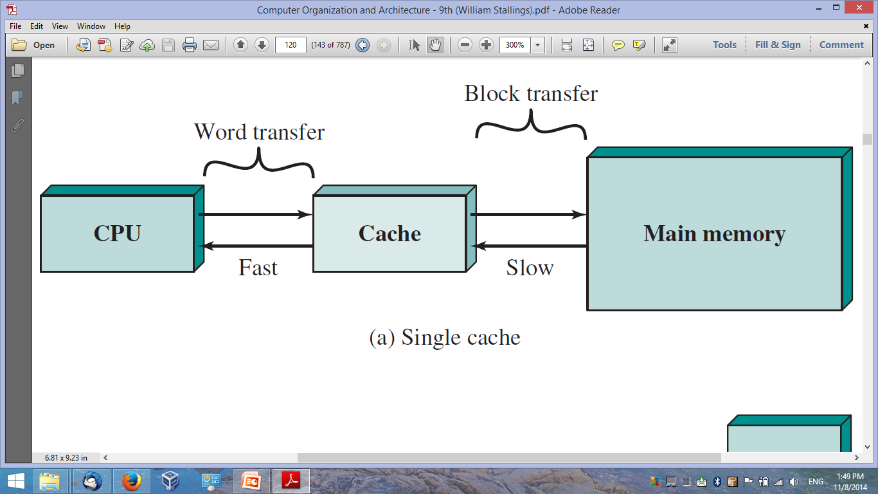
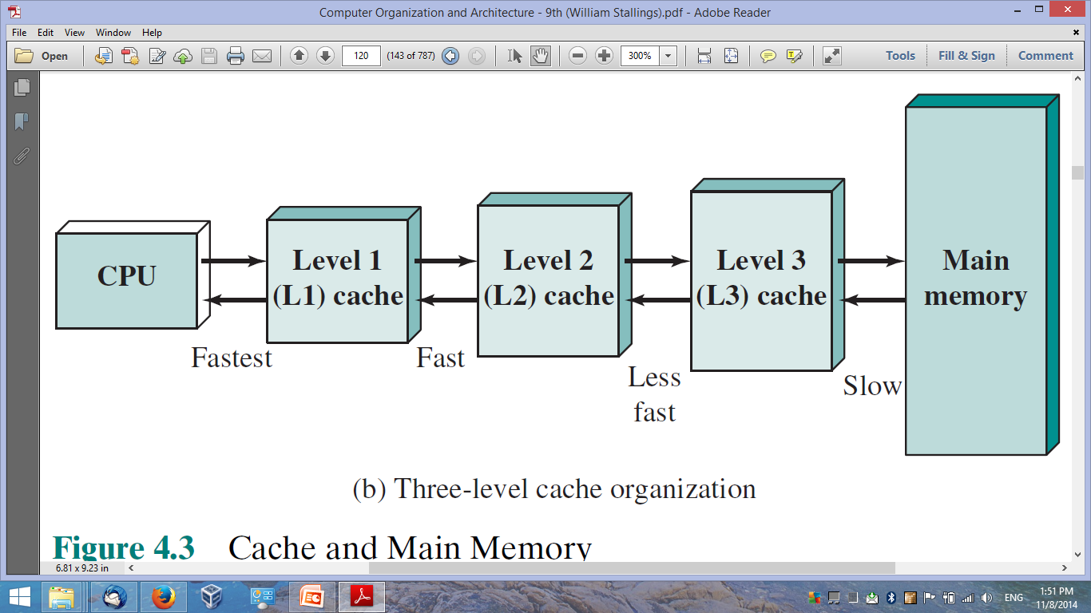
Cache Memory - Concept
One-Level Cached
Memory System
Three-Level Cached
Memory System

Slide 5
Cache Memory – Design
Mapping function
Replacement algorithm
Read/Write policies
Number of caches
Addresses
Size
Block/line size

Slide 6
Cache Memory – Design
Mapping function
Replacement algorithm
Read/Write policies
Number of caches
Addresses
Size
Block/line size

Slide 7
(I) Direct Mapping
Main Memory
Block 0
Block 1
Block 2
Cache Memory
. . .
. . .
Line 0
Block m-1
Line 1
Block m
Line 2
Block m+1
Block m+2
. . .
. . .
Block 2m-1
. . .
. . .
. . .
Line m-1
Block M-m
Each MM block maps to only one cache line.
Block #b maps to line #(b modulo m).
If a block is in cache, it must be in one specific place.
Block M-m+1
Block M-m+2
. . .
. . .
Block M-1

Slide 8
(I) Direct Mapping Cache Line Table
Number of MM blocks = M
Number of cache lines = m
Cache line # (b modulo m) | MM block # (b)
0
⬅
0, m, 2m, 3m, …, M-m
1
⬅
1,m+1, 2m+1, …, M-m+1
2
⬅
2,m+2, 2m+2, …, M-m+2
……
⬅
………………………….
m-1
⬅
m-1, 2m-1, 3m-1, …, M-1

Slide 9
(I) Direct Mapping Tiny Example
Main memory:
1 Location ≡ 1 word ≡ 1 byte
32 byte
Length of address = log₂ 32 = 5
4-byte blocks
# of blocks (M) = 32 / 4 = 8
Cache:
16 byte
4-bytes lines
# of lines (m) = 16 / 4 = 4

Slide 10
(I) Direct Mapping Tiny Example
Main Memory
 | 00000
 | 00001
 | 00010
 | 00011
 | 00100
 | 00101
 | 00110
 | 00111
 | 01000
 | 01001
 | 01010
 | 01011
 | 01100
 | 01101
 | 01110
 | 01111
 | 10000
 | 10001
 | 10010
 | 10011
 | 10100
 | 10101
 | 10110
 | 10111
 | 11000
 | 11001
 | 11010
 | 11011
 | 11100
 | 11101
 | 11110
 | 11111
B0
B1
Cache Memory
001➔ tag=0, line=01
L0
B2
010➔ tag=0, line=10
L1
B3
L2
B4
101➔ tag=1, line=01
L3
B5
110: tag=1, line=10
B6
Block # |  | Word #
1 | 01 | 10
Tag # | Line #
B7

Slide 11
(I) Direct Mapping Address Format
Memory address is split (based on block size) into:
Least significant w bits ➔ identify word in block.
w = log₂ (# of words in block).
Most significant s bits ➔ identify block in MM.
s = log₂ (# of blocks in MM).
The s bits are split (based on cache size) into:
Least significant r bits ➔ identify cache line.
r = log₂ (# of lines in cache).
Most significant s – r bits ➔ tag (identify group).
In the “tiny example”: w=2, s=3, r=2, s-r=1.
Block # (s bits)
Word #
(w bits)
Tag # (s-r bits)
Line # (r bits)

Slide 12
(I) Direct Mapping Big Example
Main memory:
1 Location ≡ 1 word ≡ 1 byte
16M byte
Length of address = log₂ 16M = 24
4-byte blocks
# of blocks (M) = 16M / 4 = 4M
Cache:
64K byte
4-bytes lines
# of lines (m) = 64K / 4 = 16K

Slide 13
(I) Direct Mapping Big Example – Address Format
22
Block # (s bits)
Word #
(w bits)
Tag # (s-r bits)
Line # (r bits)
2
8
14
24-bit address
s + w = (s-r) + r + w = 24
4-byte block ➔ 4M-block MM
w = log₂ 4 = 2 bits
s = 24 – w = 22 bits (Another way: s = log₂ 4M = 22 bits)
64K-byte Cache ➔ 16K-line Cache
r = log₂ 16K = 14 bits
s-r = 22 – 14 = 8 bits
Notes:
No 2 blocks that map to the same line have the same tag field
Check contents of cache by finding line and checking tag

Slide 14
(I) Direct Mapping Address Format Summary
Address length = (s + w) bits.
Number of addressable units = 2^{s+w} words.
Block size = line size = 2^{w} words.
w = log₂ (# of words in block).
Number of blocks in MM = M = 2^{s+w}/2^{w} = 2^{s}.
s = log₂ (# of words in MM / # of words in block)
Number of lines in cache = m = 2^{r}.
r = log₂ (# of words in cache / # of words in line).
Size of tag = (s – r) bits.
(s-r) = log₂ (# of words in MM / # of words in cache)

Slide 15
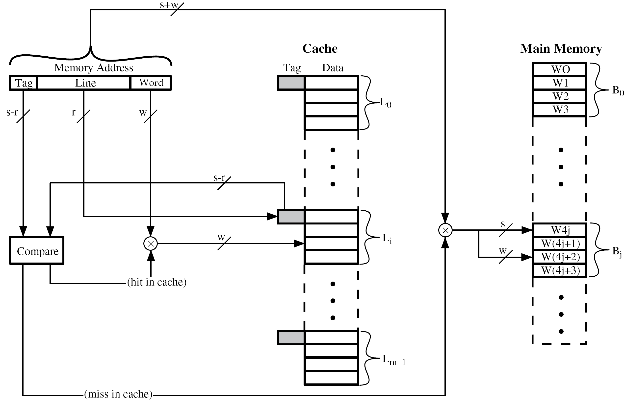
(I) Direct Mapping Cache Organization

Slide 16
(I) Direct Mapping Big Example – Search
Tag
Line
word
(16339C)₁₆ =
0001 0110 0011 0011 1001 1100
0CE7
Main memory size = 16 MB
Cache size = 64 kB
Block size = 4 bytes
w = 2, r = 14, s-r = 8

Slide 17
(I) Direct Mapping Pros & Cons
Simple.
Inexpensive.
Fixed location for given block.
If a program accesses 2 blocks that map to the same line repeatedly, cache misses are very high.

Slide 18
(II) (Fully-)Associative Mapping
A main memory block can load into any line of cache.
Memory address is interpreted as tag and word.
Tag uniquely identifies block of memory.
Every line’s tag is examined for a match.
Cache searching gets expensive.

Slide 19
(II) Associative Mapping Tiny Example
Main memory:
1 Location ≡ 1 word ≡ 1 byte
32 byte
Length of address = log₂ 32 = 5
4-byte blocks
# of blocks (M) = 32 / 4 = 8
Cache:
16 byte
4-bytes lines
# of lines (m) = 16 / 4 = 4

Slide 20
(II) Associative Mapping Tiny Example
Main Memory
 | 00000
 | 00001
 | 00010
 | 00011
 | 00100
 | 00101
 | 00110
 | 00111
 | 01000
 | 01001
 | 01010
 | 01011
 | 01100
 | 01101
 | 01110
 | 01111
 | 10000
 | 10001
 | 10010
 | 10011
 | 10100
 | 10101
 | 10110
 | 10111
 | 11000
 | 11001
 | 11010
 | 11011
 | 11100
 | 11101
 | 11110
 | 11111
B0
000 ➔ tag=000
B1
Cache Memory
L0
B2
L1
B3
L2
101 ➔tag=101
B4
L3
B5
111 ➔tag=111
B6
Block # | Word #
101 | 10
Tag #
B7

Slide 21
(II) Associative Mapping Address Format
Memory address is split (based on block size) into:
Least significant w bits ➔ identify word in block.
w = log₂ (# of words in block).
Most significant s bits ➔ identify block in MM, and used as a tag.
s = log₂ (# of blocks in MM).
In the “tiny example”: w=2, s=3.
Tag #
(s bits)
Word #
(w bits)

Slide 22
(II) Associative Mapping Big Example
Main memory:
1 Location ≡ 1 word ≡ 1 byte
16M byte
Length of address = log₂ 16M = 24
4-byte blocks
# of blocks (M) = 16M / 4 = 4M
Cache:
64K byte
4-bytes lines
# of lines (m) = 64K / 4 = 16K

Slide 23
(II) Associative Mapping Big Example – Address Format
Tag #
(s bits)
Word #
(w bits)
22
2
24-bit address
s + w = (s-r) + r + w = 24
4-byte block ➔ 4M-block cache
w = log₂ 4 = 2 bits
s = 24 – w = 22 bits (Another way: s = log₂ 4M = 22 bits)
Note:
Each cache line can store a 4-byte block and a 22-bit tag (identifying that block).
To find a block in cache, compare the address tag field (s) against all cache line tags until hit!!

Slide 24
(II) Associative Mapping Address Format Summary
Address length = (s + w) bits.
Number of addressable units = 2^{s+w} words.
Block size = line size = 2^{w} words.
w = log₂ (# of words in block).
Number of blocks in MM = M = 2^{s+w}/2^{w} = 2^{s}.
s = log₂ (# of words in MM / # of words in block)
Number of lines in cache = m ➔ unknown!
Size of tag = s.

Slide 25
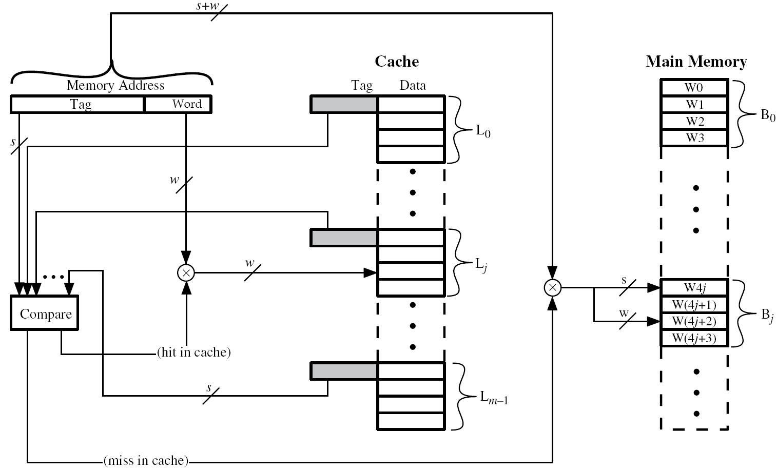
(II) Associative Mapping Cache Organization

Slide 26
(II) Associative Mapping Big Example – Search
Tag
word
(16339C)₁₆ =
0001 0110 0011 0011 1001 1100
058CE7
Main memory size = 16 MB
Cache size = 64 kB
Block size = 4 bytes
w = 2, s = 22

Slide 27
(III) Set-Associative Mapping
Cache is divided into a number of sets (v) of equal size.
Each set contains a number of lines (k).
k-way set-associative mapping!
A block b could map to any line in a set i if and only if i = b modulo v.

Slide 28
(III) Set-Associative Mapping
Main Memory
Block 0
Block 1
Block 2
Cache Memory
. . .
. . .
Set 0
Block v-1
Block v
Set 1
Block v+1
4-way set associative mapping
Block v+2
Set 2
. . .
. . .
Block 2v-1
. . .
. . .
. . .
………….......
………….......
………….......
Block M-v
Block M-v+1
Block M-v+2
Set v-1
. . .
. . .
Block M-1

Slide 29
(III) Set-Associative Mapping Tiny Example
Main memory:
1 Location ≡ 1 word ≡ 1 byte
32 byte
Length of address = log₂ 32 = 5
4-byte blocks
# of blocks (M) = 32 / 4 = 8
Cache:
16 byte
4-bytes lines
# of lines (m) = 16 / 4 = 4
2-line sets ➔ k=2 ➔ 2-way set-associative
# of sets (v) = 4 / 2 = 2

Slide 30
(III) Set-Associative Mapping Tiny Example
Main Memory
 | 00000
 | 00001
 | 00010
 | 00011
 | 00100
 | 00101
 | 00110
 | 00111
 | 01000
 | 01001
 | 01010
 | 01011
 | 01100
 | 01101
 | 01110
 | 01111
 | 10000
 | 10001
 | 10010
 | 10011
 | 10100
 | 10101
 | 10110
 | 10111
 | 11000
 | 11001
 | 11010
 | 11011
 | 11100
 | 11101
 | 11110
 | 11111
B0
B1
Cache Memory
001➔ tag= 00, set=1
L0
S0
B2
L1
B3
011➔ tag= 01, set=1
L2
S1
B4
L3
101➔ tag= 10, set= 1
B5
B6
Block # |  | Word #
10 | 1 | 10
Tag # | Set #
111➔ tag=11, set=1
B7

Slide 31
(III) Set-Associative Mapping Address Format
Memory address is split (based on block size) into:
Least significant w bits ➔ identify word in block.
w = log₂ (# of words in block).
Most significant s bits ➔ identify block in MM.
s = log₂ (# of blocks in MM).
The s bits are split (based on cache size) into:
Least significant d bits ➔ identify cache set.
d= log₂ (# of sets in cache).
Most significant s – d bits ➔ tag (identify group).
In the “tiny example”: w=2, s=3, d=1, s-d=2.
Block # (s bits)
Word #
(w bits)
Tag # (s-d bits)
Set # (d bits)

Slide 32
(III) Set-Associative Mapping Big Example
Main memory:
1 Location ≡ 1 word ≡ 1 byte
16M byte
Length of address = log₂ 16M = 24
4-byte blocks
# of blocks (M) = 16M / 4 = 4M
Cache:
64K byte
4-bytes lines
# of lines (m) = 64K / 4 = 16K
2-line sets ➔ k=2 ➔ 2-way set-associative
# of sets (v) = 16K / 2 = 8K

Slide 33
(III) Set-Associative Mapping Big Example – Address Format
22
Block # (s bits)
Word #
(w bits)
Tag # (s-d bits)
Set # (d bits)
2
9
13
24-bit address
s + w = (s-r) + r + w = 24
4-byte block
w = log₂ 4 = 2 bits
s = 24 – w = 22 bits
64K-byte Cache ➔ 16K-line Cache ➔ 8K-set Cache
d = log₂ 8K = 13 bits
s-r = 22 – 13 = 9 bits

Slide 34
(III) Set-Associative Mapping Address Format Summary
Address length = (s + w) bits.
Number of addressable units = 2^{s+w} words.
Block size = line size = 2^{w} words.
w = log₂ (# of words in block).
Number of blocks in MM = M = 2^{s+w}/2^{w} = 2^{s}.
s = log₂ (# of words in MM / # of words in block)
Number of lines in set = k ➔ k-way set-associative
Number of sets = v = 2^{d}.
Number of lines in cache = m = k * v = k * 2^{d}.
d = log₂ (# of words in cache / # of words in set).
Size of tag = (s – d) bits.
(s-d) = log₂ (# of blocks in MM / # of sets in cache).

Slide 35
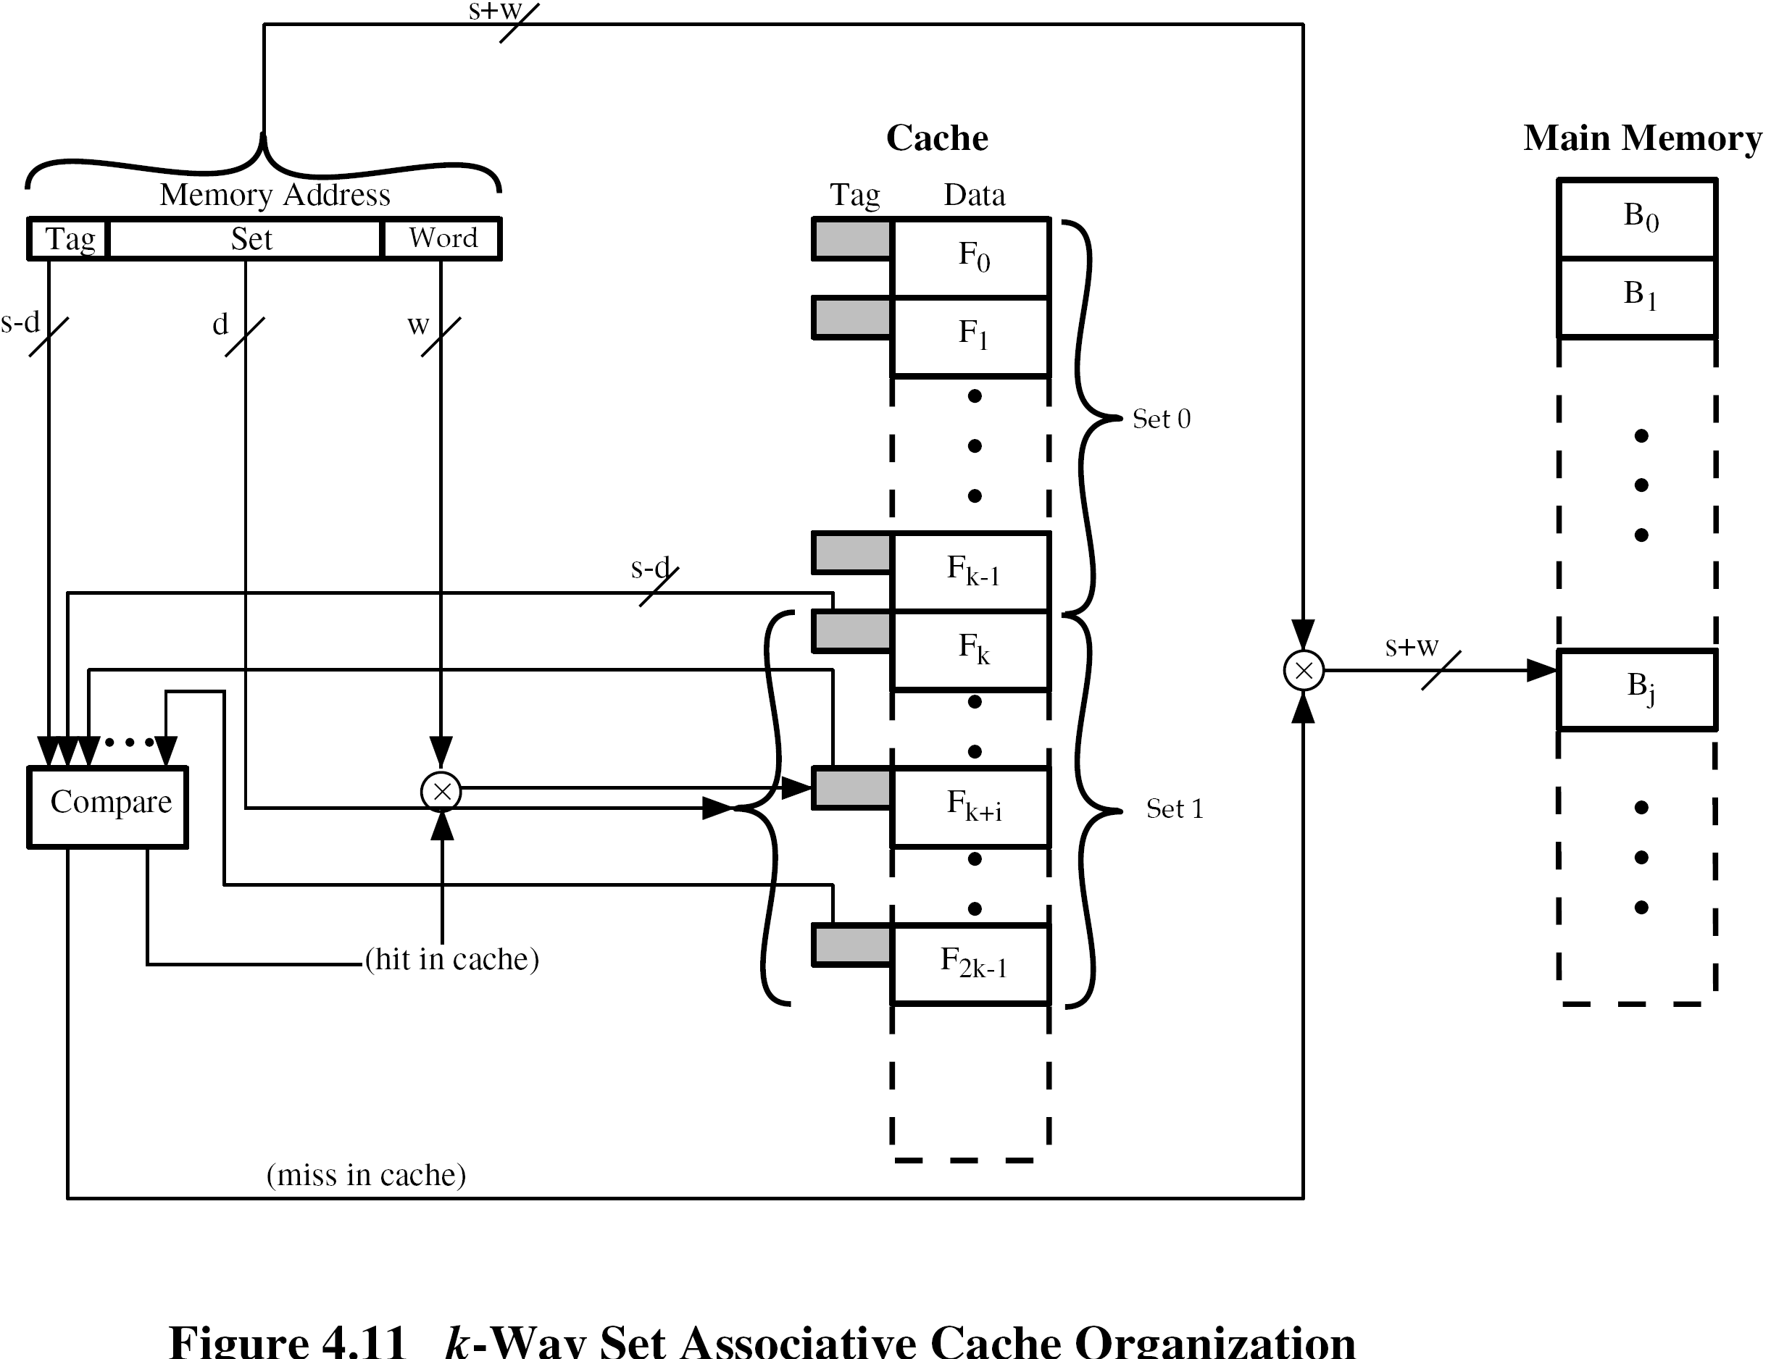
(III) Set-Associative Mapping Cache Organization (k-way)
s+w

Slide 36
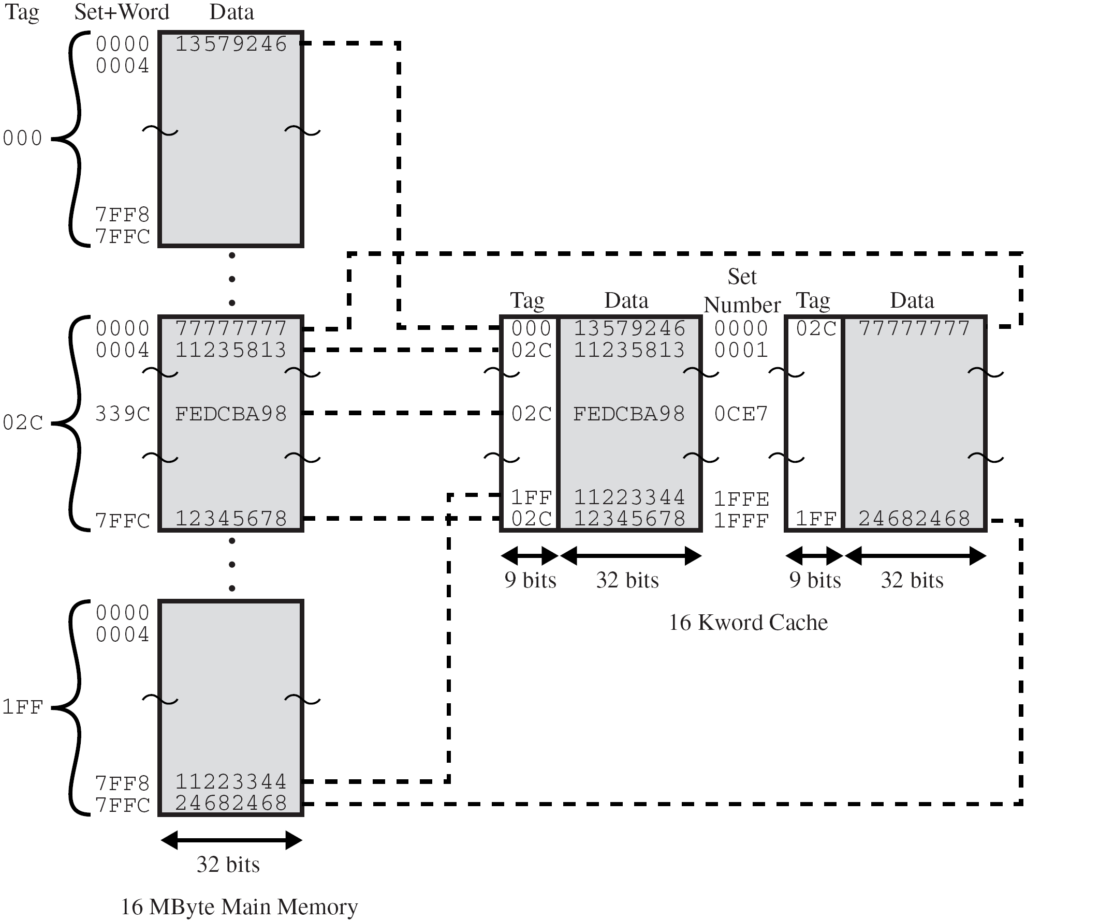
(III) Set-Associative Mapping Big Example – Search
Main memory size = 16 MB
Cache size = 64 kB
Block size = 4 bytes
2-way set-associative mapping
w = 2, d = 13, s-d = 9

Slide 37
Reading Material
Stallings, Chapter 4:
Pages 123 – 136

