Slide 1

CSE 321b
Computer Organization (2)
تنظيم الحاسب (2)
3rd year, Computer Engineering
Winter 2017
Lecture #4
Dr. Hazem Ibrahim Shehata
Dept. of Computer & Systems Engineering
Credits to Dr. Ahmed Abdul-Monem Ahmed for the slides

Slide 2
Adminstrivia
Assignment #1:
Released last week.
Due: Wednesday, March 15, 2017.
Website: http://hshehata.github.io/courses/zu/cse321b
Office hours: TBA

Slide 3
Chapter 6. External Memory (Cont.)

Slide 4
Types of External Memory
Magnetic Disk
Redundant Array of Independent Disks (RAID)
Optical Disk
Solid-State Drive (SSD)
Magnetic Tape

Slide 5
RAID
Problem: Improvement rate in secondary storage < rate for CPU and MM.
Solution: Can’t improve one-disk perf. ➔ use multiple in parallel!
Array of disks
Operate independently and in parallel.
Single I/O request can be handled in parallel if the block is distributed across multiple disks.
Separate I/O requests can be handled in parallel.
Performance metrics: depend on request patterns & data layout.
I/O data transfer rate.
I/O request rate (response time).
Recovery from errors & disk failure.
RAID: Redundant Array of Independent Disks.
7 levels in common use, not a hierarchy.
Set of physical disks viewed by OS as single logical drive.
Data distributed across physical drives.
Can use redundant capacity to store parity information.

Slide 6
RAID 0 - Stripping without Mirroring or Parity
Stripe
No disks dedicated for redundancy or parity!
Data is striped and distributed across disks.
Strip: physical block, sector, or another unit.
Strips are mapped round robin to consecutive disks.
Stripe: Set of logically consecutive strips that maps exactly one strip to each array member.

Slide 7
RAID 0 - Performance
RAID 0 for high I/O data transfer rate
System is configured s. t. each (single) I/O request can be processed by multiple disks in parallel ➔ Less tr. time ➔ Higher tr. rate!
Two requirements (to experience high data transfer rate):
High transfer capacity between memory and disks (internal controller buses, I/O buses, memory buses, etc.).
Small strip ➔ Higher chance that any single I/O request requires data from multiple strips located on different disks.
RAID 0 for high I/O request rate
System configured s. t. multiple I/O requests can be processed by multiple disks in parallel ➔ Higher I/O req. rate!
There are typically hundreds of I/O requests per second by multiple independent applications, or single one.
Balance I/O load across multiple disks ➔ Achieve high I/O req. rate.
Large strip ➔ few seeks/disk per request ➔ less I/O queuing time.

Slide 8
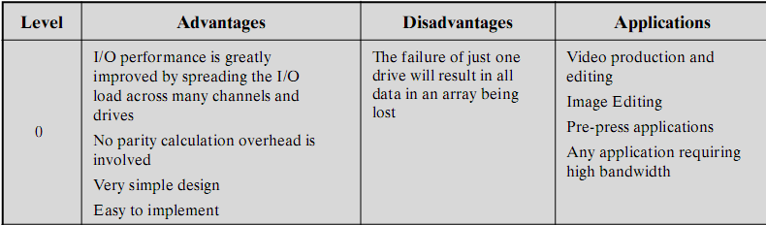
RAID 0 - Pros and Cons

Slide 9

RAID 1 - Mirroring without Stripping or Parity
Duplicate data (without striping) ➔ mirrored disks.
2 copies of each block on separate disks.
Read from either disk (the one with min. access time).
Write to both (in parallel) ➔ Time = larger access time.
Recovery is simple: swap faulty disk & re-mirror.
Expensive ➔ used to store system S/W & critical files.
I/O transfer rate
read: > single disk, write: ≈ single disk.
I/O request rate
read: ≈ 2x single disk, write: ≈ single disk.
block a₀
block b₀
block c₀
block d₀
block a₀
block b₀
block c₀
block d₀
block a₁
block b₁
block c₁
block d₁
block a₁
block b₁
block c₁
block d₁
block a₂
block b₂
block c₂
block d₂
block a₂
block b₂
block c₂
block d₂
block a₃
block b₃
block c₃
block d₃
block a₃
block b₃
block c₃
block d₃

Slide 10
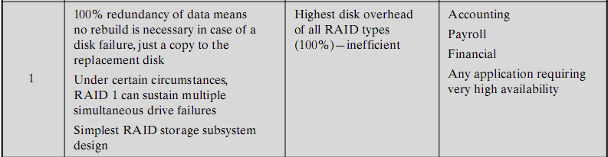
RAID 1 - Pros and Cons
block a₀
block b₀
block c₀
block d₀
block a₀
block b₀
block c₀
block d₀
block a₁
block b₁
block c₁
block d₁
block a₁
block b₁
block c₁
block d₁
block a₂
block b₂
block c₂
block d₂
block a₂
block b₂
block c₂
block d₂
block a₃
block b₃
block c₃
block d₃
block a₃
block b₃
block c₃
block d₃

Slide 11
RAID 2 - Bit-Level Stripping with Hamming ECC
Parallel access: all disks participate in every I/O request.
Disks are synchronized: all heads in same position at any given time.
Bit-level stripping: Very small strips ➔ single-bit strips!
Error correction calculated across corresponding bits on disks.
Multiple parity disks store Hamming code in corresponding bit positions.
Number of redundant disks is proportional to log number of data disks.
Read: data & parity delivered to controller ➔ error corrected instantly.
Write: all data and parity disks accessed.
Contemporary disks are highly reliable ➔ RAID 2 not used in practice!!
I/O transfer rate: very high due to small strip size.
I/O request rate: only one at a time ➔ ≈ single disk!

Slide 12
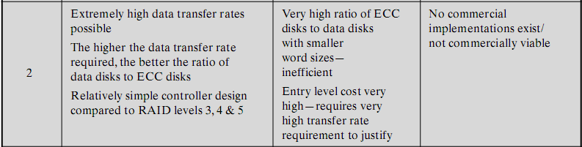
RAID 2 - Pros and Cons

Slide 13
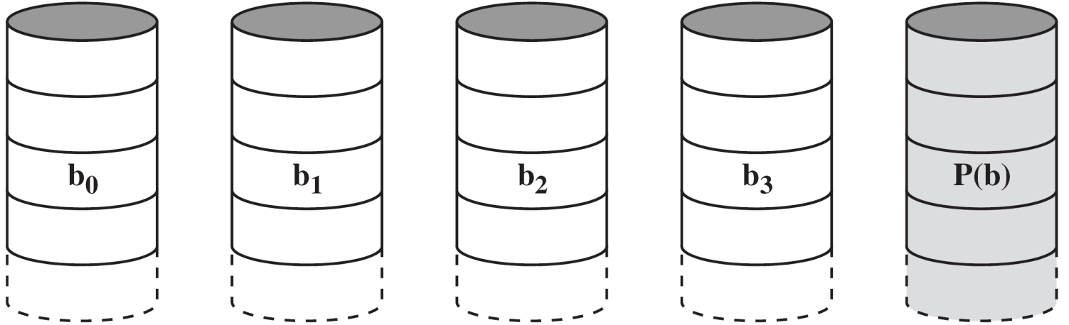
RAID 3 - Byte-Level Stripping with Parity
Similar to RAID 2: synchronized disks, small strips. Byte-level stripping ➔ single-byte strips.
Only 1 redundant disk, no matter how large the array.
Simple parity bit for each set of corresponding bits.
Drive fails ➔ replace it and reconstruct data from surviving disks and parity info. For instance, in a 5-disk array:
Disk #1 fails ➔ X1(i) = X4(i) ⊕ X3(i) ⊕ X2(i) ⊕ X0(i)
I/O transfer rate: very high due to small strip size.
I/O request rate: only one at a time ➔ ≈ single disk.

Slide 14
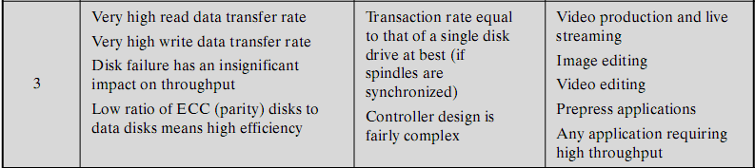
RAID 3 - Pros and Cons

Slide 15
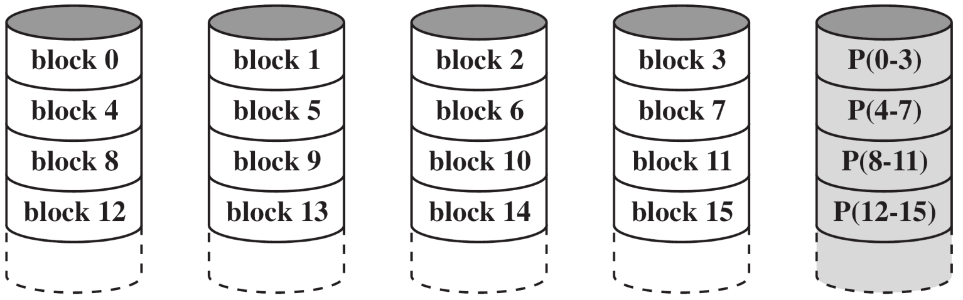
RAID 4 - Block-Level Stripping with Parity
Independent access: each disk operates independently (not synchronized) ➔ separate I/O requests in parallel.
Relatively large strips (block-level).
Bit-by-bit parity calculated across strips on each disk.
Parity stored on parity disk.
Write: read old data and old parity, update both.
Write to disk #1 ➔ X4’(i) = X4(i) ⊕ X1(i) ⊕ X1’(i)
Not the case in RAID 2 and RAID 3 due to parallel access.
I/O transfer rate: read: ≈ RAID 0, write: < single disk.
I/O request rate: read: ≈ RAID 0, write: < single disk.

Slide 16
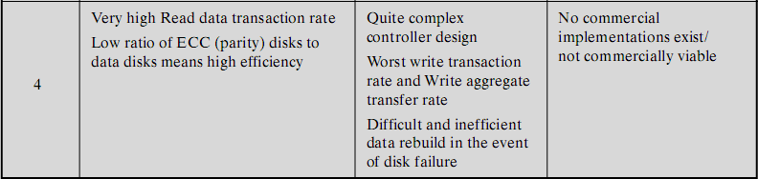
RAID 4 - Pros and Cons

Slide 17
RAID 5 - Block-Level Stripping with Distributed Parity
Independent access, relatively large strips (block-level).
Like RAID 4, except parity distributed across all disks.
Round robin allocation for parity strips.
n-disk array: parity strip is on a different disk for the first n stripes, and the pattern repeats.
Avoids RAID 4 bottleneck at parity disk.
Commonly used in network servers.
N.B. Does not mean 5 disks!
I/O transfer rate: read: ≈ RAID 0, write: < single disk.
I/O request rate: read: ≈ RAID 0, write: < single disk.

Slide 18
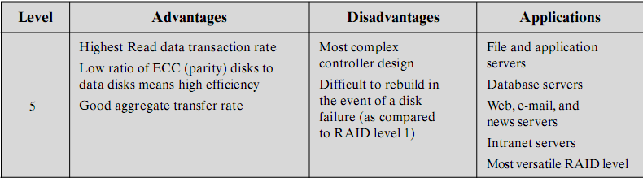
RAID 5 - Pros and Cons

Slide 19
RAID 6 - Block-level striping with double distributed parity
Independent access, relatively large strips (block-level).
Two parity calculations.
P and Q are two different data check algorithms.
Stored in separate blocks on different disks.
N data disks ➔ N+2 disks required to build the array.
High data availability
Three disks need to fail for data loss.
Significant write penalty.
I/O transfer rate: read: ≈ RAID 0, write: < RAID 5.
I/O request rate: read: ≈ RAID 0, write: < RAID 5.

Slide 20
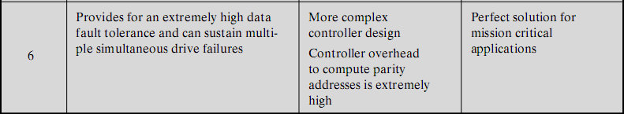
RAID 6 - Pros and Cons

Slide 21
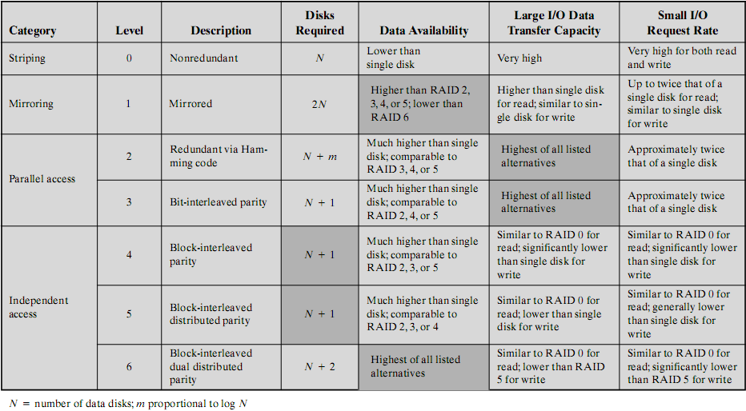
RAID Levels - Summary
Similar to single disk
Similar to single disk
* N = number of data disks. N must be greater than 1 in all RAID configurations except RAID 1 where N could be equal to 1.
* m = number of ECC disks. N is proportional to log m.

Slide 22
Optical Storage - History
1983 CD (Compact Disk, audio CD)
CD-ROM
.........
1996 DVD-ROM
DVD-R
.........
2002 Blu-ray
.........

Slide 23
CD-ROM
Same technology used for audio (CD).
Difference: CD-ROM drives support error-correction.
Capacity
Data: 650-700MB, or Audio: 74-80 minute.
Material
Polycarbonate coated with highly reflective coat, usually aluminium.
Data stored as sequence of pits engraved along a spiral track on top of polycarbonate layer.
Read by reflecting laser.
Constant packing density ➔ Constant Linear Velocity (CLV) ➔ variable angular velocity.

Slide 24
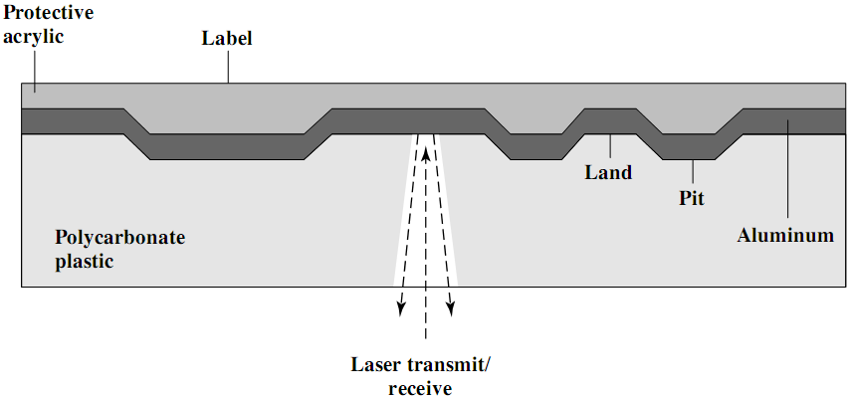
CD-ROM - Fabrication
(3)
(4)
(1)
(2)
Master disk: Info printed as pits on the polycarbonate surface using a high-intensity laser.
Master is used to make a die to stamp out copies.
Pitted surface coated with a reflective material (Aluminium).
Coat of acrylic to protect against dust and scratches.

Slide 25
CD-ROM - Operation
CD drive transmits a low-power laser beam towards disk.
beam falls on a pit (rough surface) ➔ low intensity reflected.
beam falls on a land (smooth surface) ➔ high intensity reflected.
Photo-sensor senses surface at regular intervals.
Change in elevation ➔ logic 1, otherwise ➔ logic 0.

Slide 26
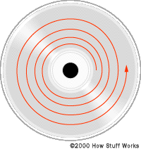
CD-ROM Drive Speeds
Audio is single speed (1x=150kB/s)
Constant linear velocity
1.2 m/s
Track (spiral) is 5.27km long
Gives 4391 seconds = 73.2 minutes
Other speeds are quoted as multiples.
e.g. 24x (24x150kB/s=3.6MB/s)
Quoted figure is maximum drive can achieve.

Slide 27
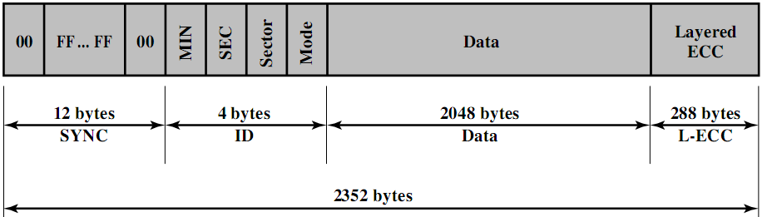
CD-ROM Block/Sector Format
Mode 0=blank data field
Mode 1=2048 byte data+error correction
Mode 2=2336 byte data
Mag. disks: ID(track, sector, head, CRC), Data(512+2)
CD: ID(minute, second, sector, mode), Data(2048+288)

Slide 28
Access on CD-ROM
Difficult!!
Move head to a rough position.
Set correct speed.
Read address.
Adjust to required location.

Slide 29
CD-ROM For & Against
Pros:
Large capacity (cf. floppy disks).
Easy to mass produce (cf. magnetic disks).
Removable (cf. magnetic disks).
Robust.
Cons:
Expensive for small quantities.
Slow (access time ≈ 0.5 sec).
Read only.

Slide 30
Other Optical Storage
CD-Recordable (CD-R)
Write Once Read Many (WORM).
Quite affordable.
Compatible with CD-ROM drives.
Medium includes a dye layer. Reflectivity is activated by a high-intensity laser.
CD-ReWritable (CD-RW)
Erasable.
Inexpensive.
Mostly CD-ROM drive compatible.
Phase change by a laser beam
Material has two different reflectivity’s in two different phase states (crystalline or amorphous).
Eventually, the material loses its desirable properties (500000~1000000 erase cycles).

Slide 31
DVD
Digital Video Disk
Used to indicate a player for movies
Only plays video disks.
Digital Versatile Disk
Used to indicate a computer drive
Will read computer disks and play video disks.
Very high capacity (4.7G per layer).
Small spacing between spiral loops (tracks). Pits too. Shorter wavelength.
Double layer: Semi-reflective layer on top of the reflective layer. Read by adjusting focus.
Double sided.
Full length movie on single disk (MPEG compression).

Slide 32
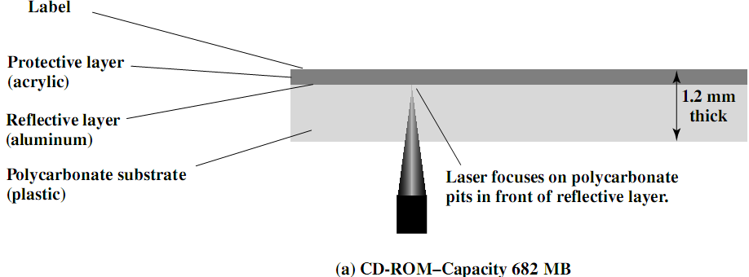
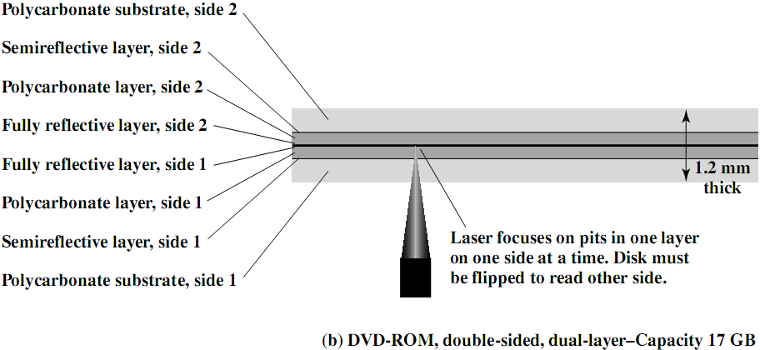
CD vs. DVD

Slide 33
Optical Storage - Types
Optical Disk
CD DVD
Capacity 650M~750MB 4.7G~17GB
Drive Compatibility Incomp. with DVD Comp. with CD
Structure One 1.2mm base Two 0.6mm bases
Gap Track gap=1.6µm 0.74µm
Pit gap=0.834µm 0.4µm
Side & layer Single layer/side Double layer/side
Products CD --
CD-ROM DVD-ROM
CD-R DVD-R
CD-RW DVD-RW

Slide 34
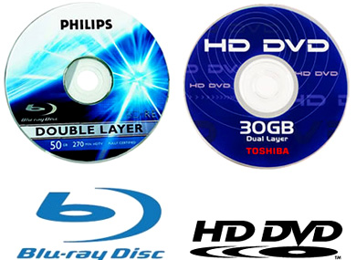
High-Definition Optical Disks
Designed for high-definition (HD) videos
Resolution>standard-definition (SD) videos.
e.g., 1280 x 720 pixels or 1920 x 1080 pixels.
Much higher capacity than DVD
Shorter wavelength laser in the blue-violet range.
Smaller pits ➔ higher bit density.
HD-DVD
15GB single side single layer.
Blu-ray Disk (BD)
25GB single side single layer.
Data layer closer to laser.
Tighter focus, less distortion, smaller pits.
Types: BD-ROM (read only), BD-R (recordable), and BD-RE (re-recordable).

Slide 35
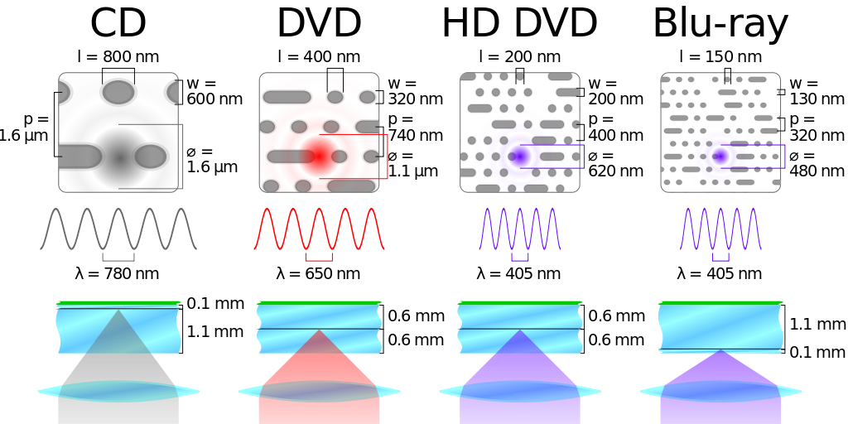
Optical Memory Characteristics
Land
Pit
Track
Beam Spot

Slide 36
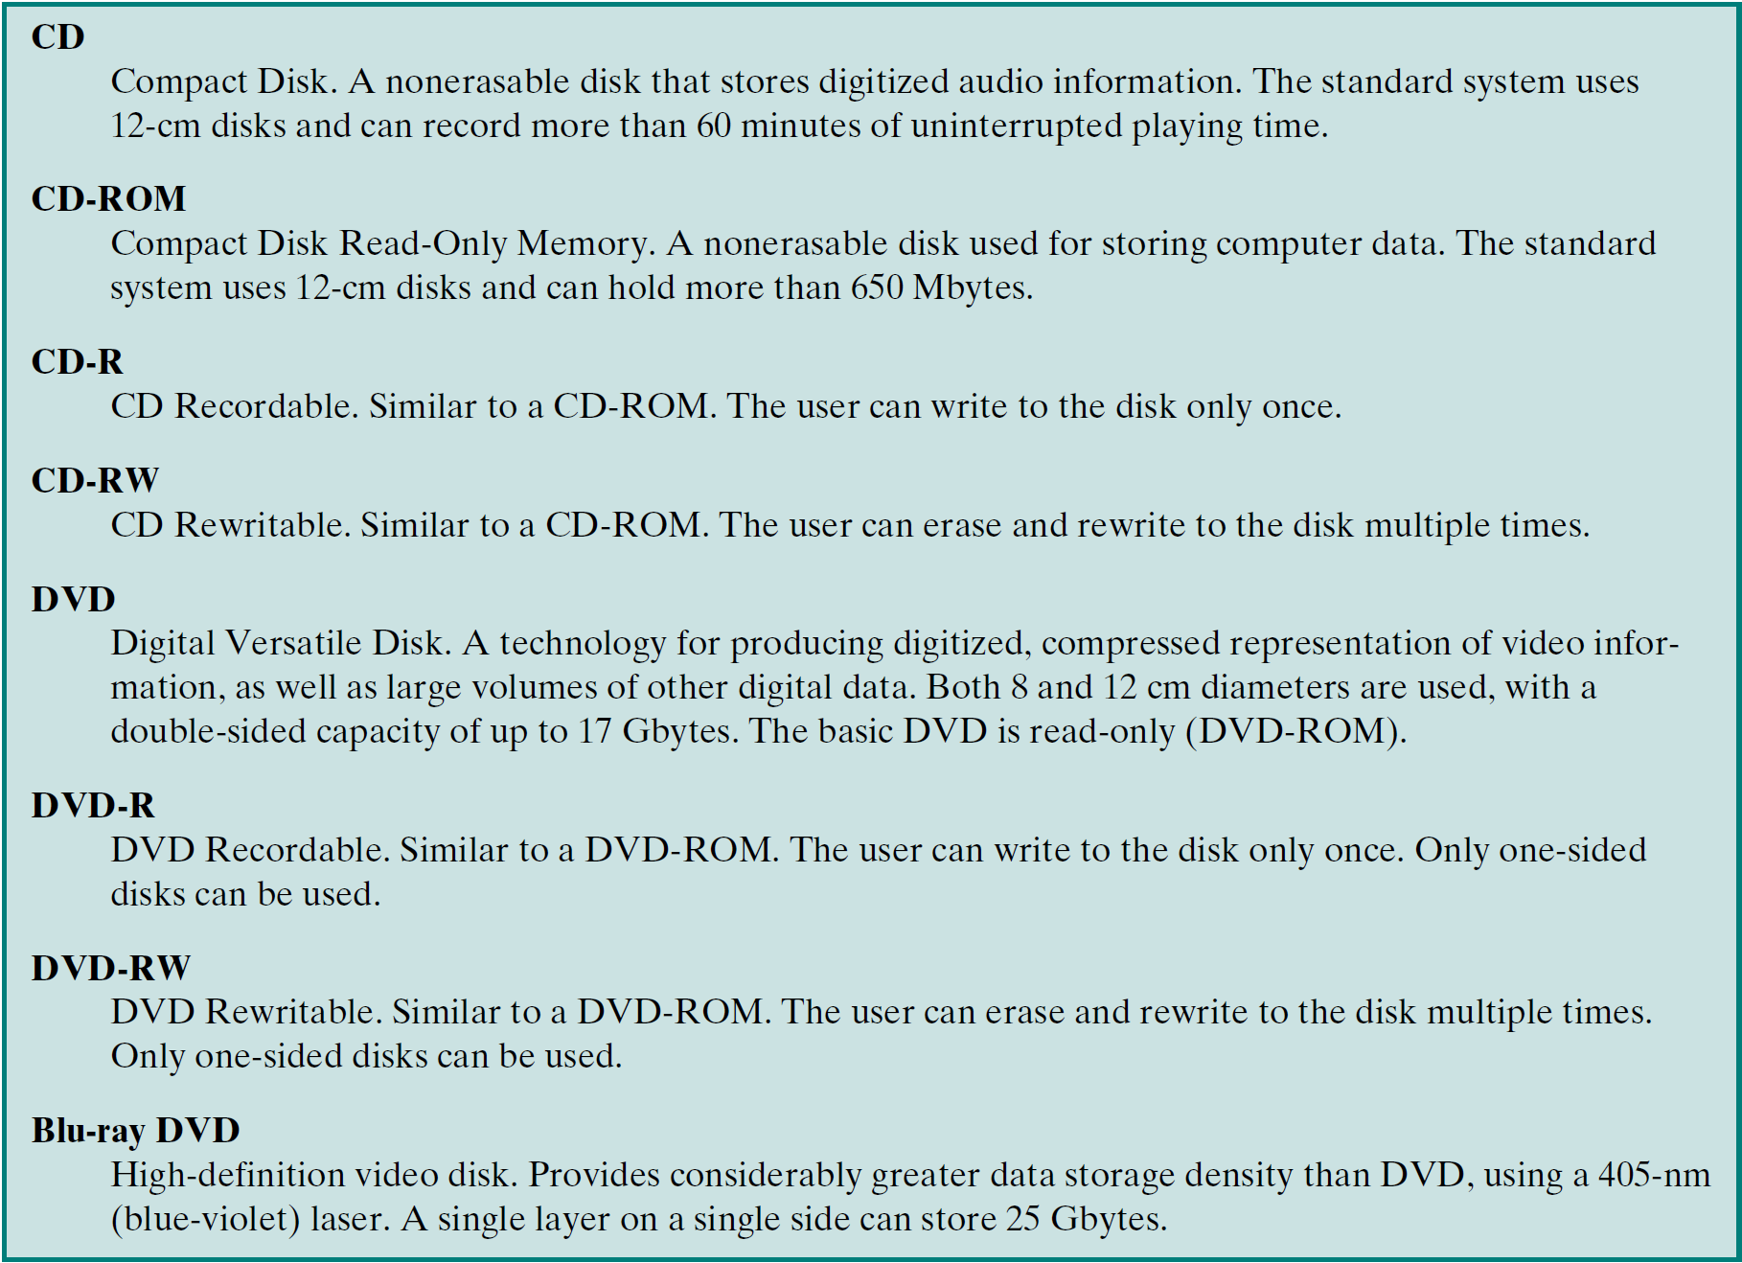
Summary of Optical Disks

Slide 37
Reading Material
Stallings, Chapter 6:
Pages 195 – 205
Pages 210 – 215

