Slide 1
Applications of Regular Expressions
Regular expressions in Java and Perl
Regular expressions in compiler generators (JavaCC)
Using FSAs to build Moore and Mealy machines

Slide 2
Finite State Transducers
DFA with no accept states
As the DFA “runs”, it produces output
Moore machine: Produces output upon (re)entering state
Mealy machine: Produces output upon following transition
Theoretically equivalent on power
Can be used to specify the behavior of things as disparate as soda machines and CPUs
See JFLAP examples

Slide 3
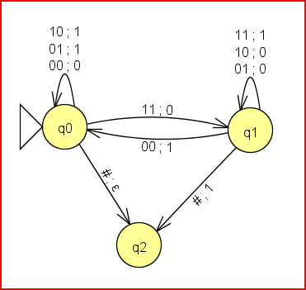
Mealy Machine Adder
Input: Successive pairs of bits to be added, low-order bits first. Terminate with #.

Slide 4
Proofs
Prove that if two languages L1 and L2 over {0,1} are regular, then the set of all binary strings that belong to neither L1 nor L2 is also regular.
Since L1 and L2 are regular, their UNION is regular. Since this intersection is regular, its complement is regular. The complement is the set of all binary strings that belong to neither L1 nor L2.
Prove that the complement of a non-regular language must itself be a non-regular language.
Let L be non-regular. Assume that its complement L’ is regular. This implies (by a closure property) that L is regular, which is a contradiction. Therefore our assumption is wrong and L’ is non-regular.

Slide 5
Proofs
Explain what is wrong with the following "proof" that the language of the RE 0*1* is not regular:
Suppose L were regular. Then it would be accepted by a DFA with no more than k states, where k is even. Consider the string z = 0^{k/2}1^{k/2}. Split z = uvw with u=0^{k/2-1}, v = 01, and w=1^{k/2-1}. Then uv²w = 0^{k/2-1}01011^{k/2-1} is not in L. This is a contradiction of the Pumping Lemma, and so our supposition is false.
The Pumping Lemma says that there must exist a substring in the first k symbols that is pumpable. This proof only shows that one particular substring is not pumpable.

Slide 6
Context-Free Grammars
S → 0 S 1
S → ε
Symbols that appear on a left-hand side are called non-terminals: {S}
Alphabet symbols that appear on a right-hand side are called terminals: {0,1}
Each rule is called a production
One non-terminal is designated as a start symbol
The language defined by a CFG is the set of all strings of non-terminals that can be derived from the start symbol. Here’s an example derivation:
S ➔ 0 S 1 ➔ 0 0 S 1 1 ➔ 0 0 0 S 1 1 1 ➔ 0 0 0 1 1 1
This CFG describes the language 0^{n}1^{n}

Slide 7
More Context-Free Grammars
All palindromes over alphabet {a,b}
S → a S a
S → b S b
S → a
S → b
S → ε
All binary strings with an even number of 1’s
S → Z 1 Z 1 S
S → Z
Z → 0 Z
Z → ε

Slide 8
More Context-Free Grammars
Expressions in Java (numbers, binary arithmetic operators, parens)
E → E + E
E → E - E
E → E * E
E → E / E
E → ( E )
E → #

Slide 9
Derivations
S → Z 1 Z 1 S
S → Z
Z → 0 Z
Z → ε
Derivation: Sequence of steps that leads from one string to another, with one non-terminal being replaced at each step with its LHS:
S ➔ Z 1 Z 1 S ➔ Z 1 Z 1 Z ➔ 0 Z 1 Z 1 Z ➔ 0 0 Z 1 Z 1 Z ➔ 0 0 Z 1 1 Z ➔ 0 0 1 1 Z ➔ 0011
We say that S ➔* 0 0 1 1, or “S yields 0011”
Leftmost derivation: Derivation where each replacement is of the leftmost nonterminal:
S ➔ Z 1 Z 1 S ➔ 0 Z 1 Z 1 S ➔ 0 0 Z 1 Z 1 S ➔ 0 0 1 Z 1 S ➔ 0 0 1 1 S ➔ 0 0 1 1 Z ➔ 0011

Slide 10
Ambiguous Grammars
A grammar is ambiguous if there is more than one leftmost derivation for some string in the language. Is this grammar ambiguous?
S → Z 1 Z 1 S
S → Z
Z → 0 Z
Z → ε
No.
How about this one?
E → E + E
E → E - E
E → E * E
E → E / E
E → ( E )
E → #
E ➔ E + E ➔ E * E + E ➔ # * E + E ➔ # * # + E ➔ # * # + #
E ➔ E * E ➔ # * E ➔ # * E + E ➔ # * # + E ➔ # * # + #

Slide 11
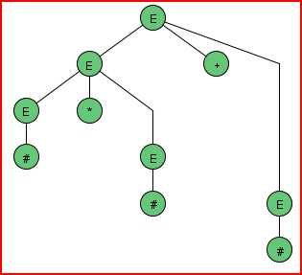
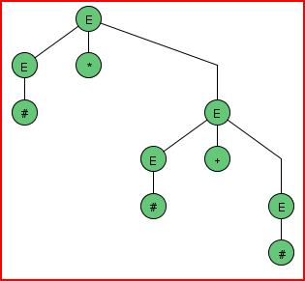
Derivation Trees
Does ambiguity matter? No if we are using a grammar to describe a language, but possibly yes if we are using a grammar to process a language. Here are two leftmost derivation trees for the expression grammar:
E → E + E
E → E - E
E → E * E
E → E / E
E → ( E )
E → #

Slide 12
Unambiguous Grammars
Sometimes an ambiguous grammar can be replaced with an unambiguous one:
E → E + E
E → E - E
E → E * E
E → E / E
E → ( E )
E → #
E → E + T
E → E – T
E → T
T → T * F
T → T / F
T → F
F → ( E )
F → #

