Slide 1
Keep the Big Picture in Mind
A language is a set of (say, binary) strings.
The set of all strings is infinite and is both regular and context-free.
But not every subset of the set of all strings is regular or context-free.
Why is it interesting to talk about sets of binary strings?
Suppose L₁ = set of all prime numbers. What would it mean if it were regular? Context free? Computable?
Suppose L₂ = set of all Java methods that take no parameters, read no input, and always return when they are executed. What would it mean if it were regular? Context free? Computable?

Slide 2
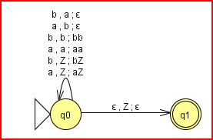
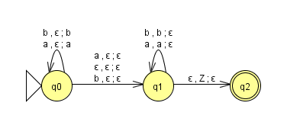
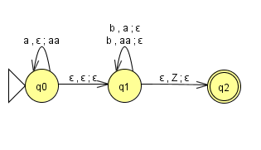
More Examples
Strings of equal numbers of a’s and b’s
Strings of a’s and b’s that are palindromes
The language {a^{n}b^{m} : n ≤ m ≤ 2n}

