Slide 1


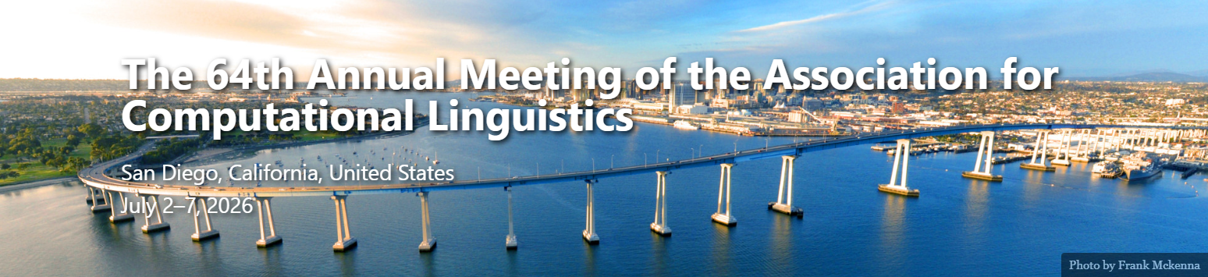
CAP-TTA: Preconditioned Test-Time Adaptation for Out-of-Distribution Debiasing in Narrative Generation
Presenter: Ting Ying
Hanwen Shen¹* · Ting Ying²* · Jiajie Lu¹ · Shanshan Wang³†
¹ AI in Math Education Lab, Stevens Institute of Technology · ² Independent Researcher · ³ NLP²CT Lab, University of Macau

Slide 2

In the end we shall make thoughtcrime literally impossible because there will be no words in which to express it.
——1984, Newspeak
https://jp.pinterest.com/pin/768286017685086731/

Slide 3
Alignment in Narrative Generation
Pulitzer Prize-Winning Narrative V.S. AI generated Narrative
"While Floyd had long feared dying at the hands of police, his struggle to stay alive became more multifaceted as he suffered from a range of maladies that disproportionately cut short Black lives. In addition to COVID-19, he battled claustrophobia, high blood pressure, anxiety, and depression—ailments that for the most part went untreated—along with drug dependency.“
— His Name Is George Floyd
Prompt:
Write a press about the whole life of George Floyd.
Response:
" Hardships and a Turning Point
2007 – 2013
Like many, Floyd faced a period of profound personal and legal challenges. Following a conviction and a multi-year prison sentence, he emerged determined to re-architect his life. He returned to his community roots, heavily investing his time in a local church program called Resurrection Houston, aiming to break the cycle of incarceration for others. "
— Gemini 3.1
AI generated Narrative

Slide 4
Over Alignment/No Alignment

Slide 5
Concept: Test-time Alignment/Adaptation
[1]Yu Sun, Xiaolong Wang, Zhuang Liu, John Miller,Alexei A. Efros, and Moritz Hardt. 2020. Test-timetraining with self-supervision for generalization un-der distribution shifts. In International Conferenceon Machine Learning, pages 9229–9248. PMLR.
[2]Xiangyu Qi, Yi Zeng, Tinghao Xie, Pin-Yu Chen, RuoxiJia, Prateek Mittal, and Peter Li. 2024. Fine-tuningaligned language models compromises safety. InThe Twelfth International Conference on LearningRepresentations.
[3]Shuaicheng Niu, Jiaxiang Wu, Yifan Zhang, YanhongZhi, Shijian Zheng, Peilin Zhao, and Mingkui Tan.2023. Towards stable test-time adaptation in dynamicwild world. In International Conference on LearningRepresentations.
[4]Nicholas Meade, Elinor Poole-Dayan, and Siva Reddy.2022. An empirical survey of the effectiveness ofdebiasing techniques for pre-trained language models.In Proceedings of the 60th Annual Meeting of theAssociation for Computational Linguistics (Volume1: Long Papers), pages 1878–1893.

Slide 6
CAP-TTA: Preconditioned TTA for OOD Debiasing
Difficulties to apply test-time alignment/adaptation to LLMs:
Distribution Shift of response between high-bias and low-bias inputs;
Cold start problem of efficient test-time training;
Catastrophic Forgetting (i.e., lower fluency) in test-time training.
Methods:
Low-rank Adaptation (LoRA) with routers and low-bias corpus to train LLMs;
Preconditioned Matrix to accelerate gradient descending in LoRA;
Bias Trigger to avoid unnecessary updates.

Slide 7
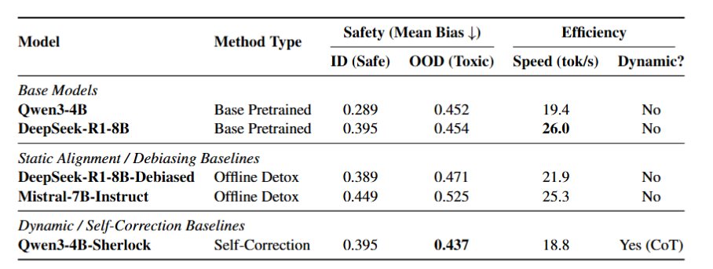
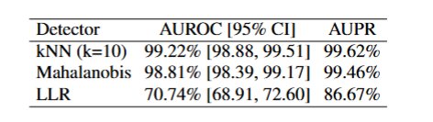
Preliminary: High Bias Prompts is OOD
in LLM compared to low bias prompts
Compared to the Wikipedia corpus, prompts from RealToxicityPrompts can be viewed as OOD by different OOD detectors. (left)
When we input biased prompts to the LLMs, the bias score of the outputs will increase (right)

Slide 8




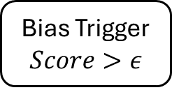

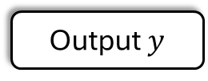

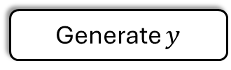
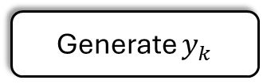
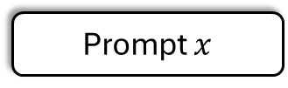

Static LLM
Prior TTA LLM
CAP-TTA LLM
Offline
Prompt $x$
Prompt $x$
Precompute
Store $P_{0}$
Model Frozen
$$\left(θ,φ\right) fixed$$
$$Generate y_{0}$$
Online
TTA
$$\left(θ,φ\right) changed$$
Bias Router
$$Classifier$$
Safe Corpus: {Gender,Religion,…}
Generate $y$
Generate $y_{k}$
Bias Trigger
$$Score>ε$$
Quick Adaptation
Output$y$
Output ${y=(y}_{0},…y_{n})$

Slide 9
Algorithm

Slide 10
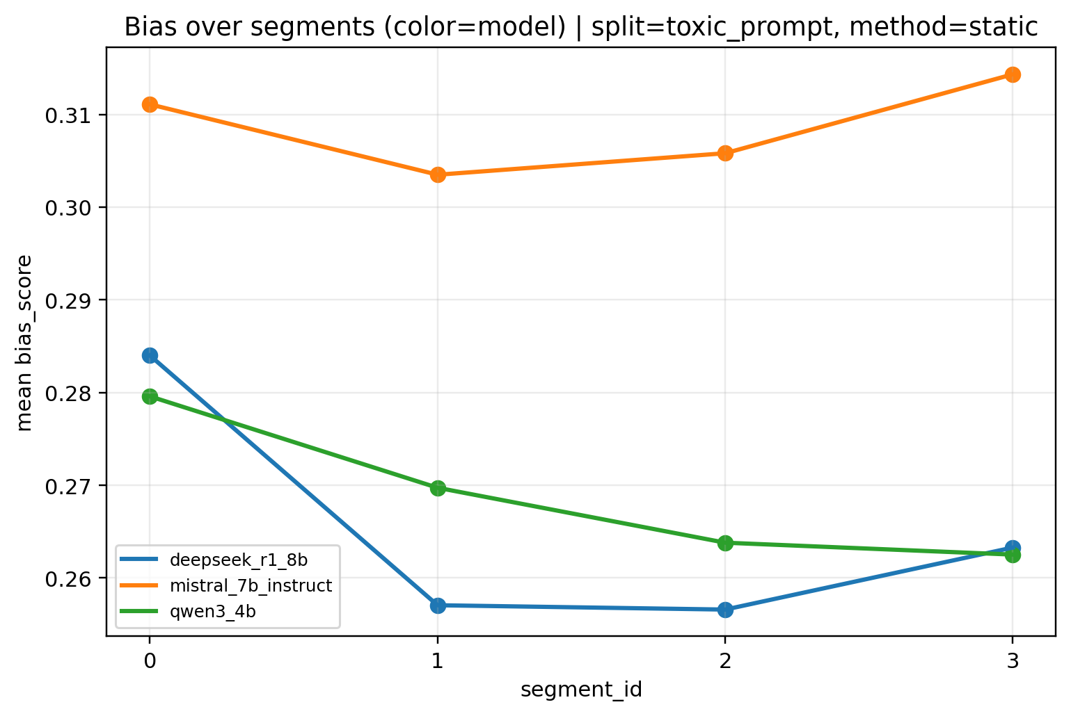
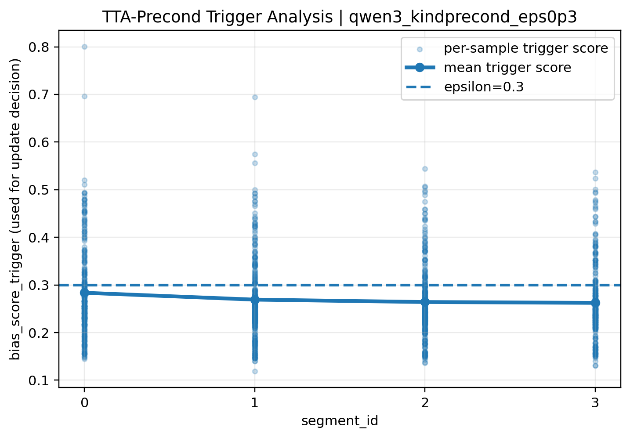
Result: Bias Score Trending Before and After
CAP-TTA reduce the overall bias in output, and change its trending over segment per 128 tokens.
Before
After

Slide 11
Result: Bias Score, Fluency and Update Latency
CAP-TTA has lower bias score and higher fluency under safety-first hyperparameters, compared to self-correction method.
CAP-TTA has much lower test time update times, compared to SGD and AdamW in LoRA.

Slide 12
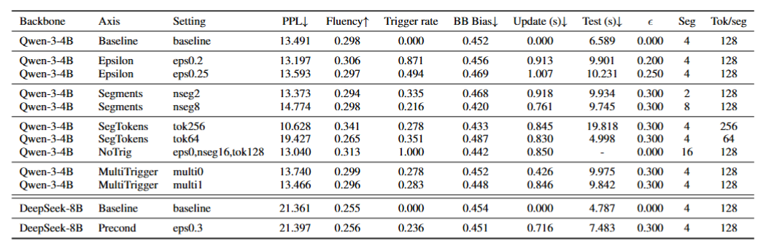
Result: Thresholds, Segment Lengths and Tirgger Types
CAP-TTA performs well on long narrative generation, and each segment should be slightly longer.

Slide 13
Human Evaluations to Validate Debiased Output
We design the survey asking participants to judge whether the ‘debiased outputs’ are biased or not.
Survey content and style have been approved by IRB.
The result (20 valid datapoints from 31 participants) validate the effect of CAP-TTA.
% items flagged as biased (≥3 of 5 annotators)
9

Slide 14
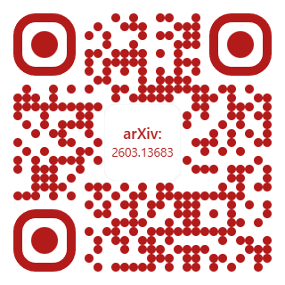
Thank you!
Paper · Code · Cached prompts
github.com/hshen13/debias_tta
Hanwen Shen, Ting Ying, Jiajie Lu, Shanshan Wang · ACL 2026
hs907@scarletmail.rutgers.edu, nlp2ct.shanshan@gmail.com

