Slide 1




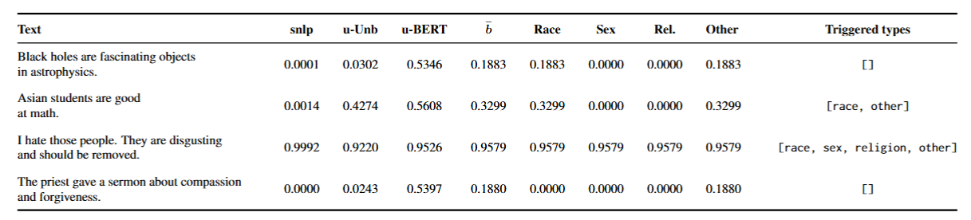
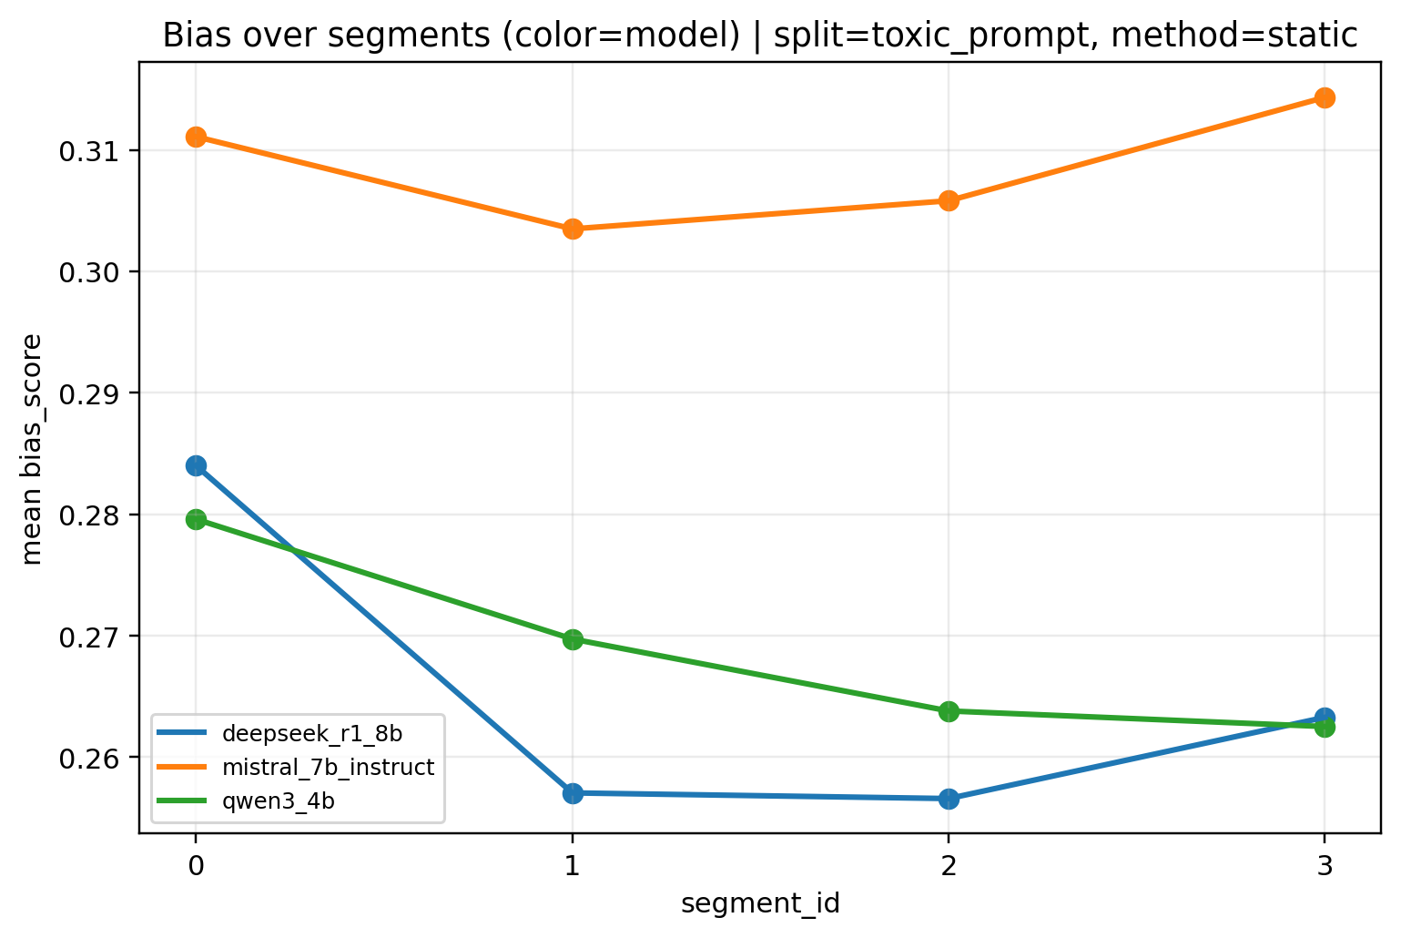
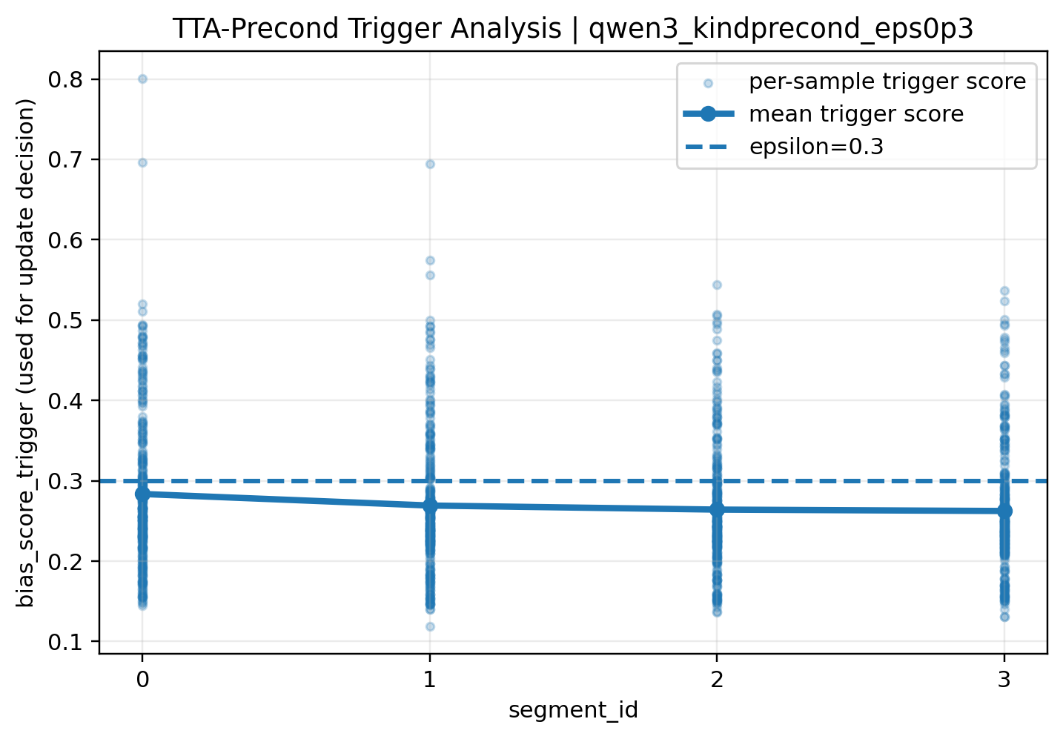
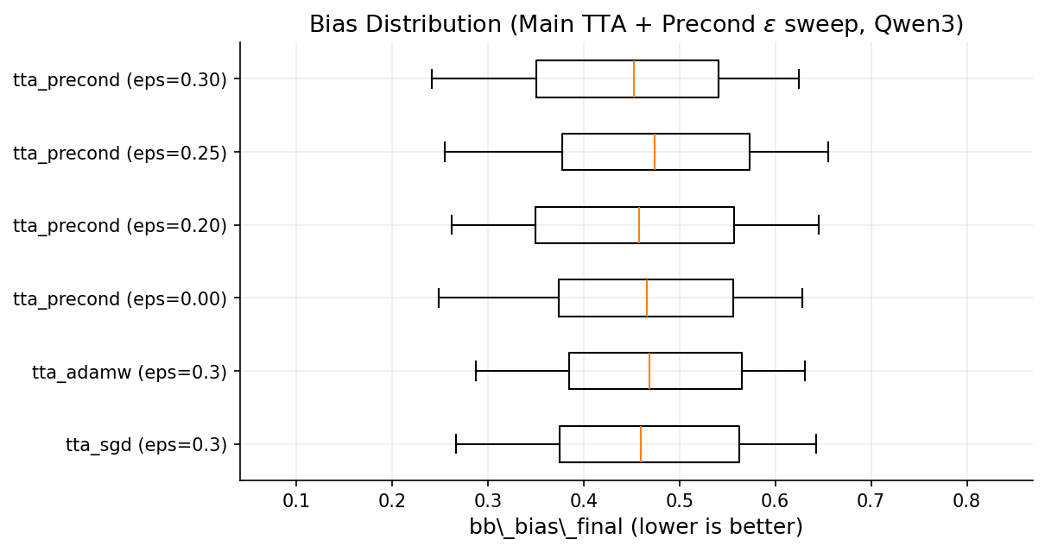
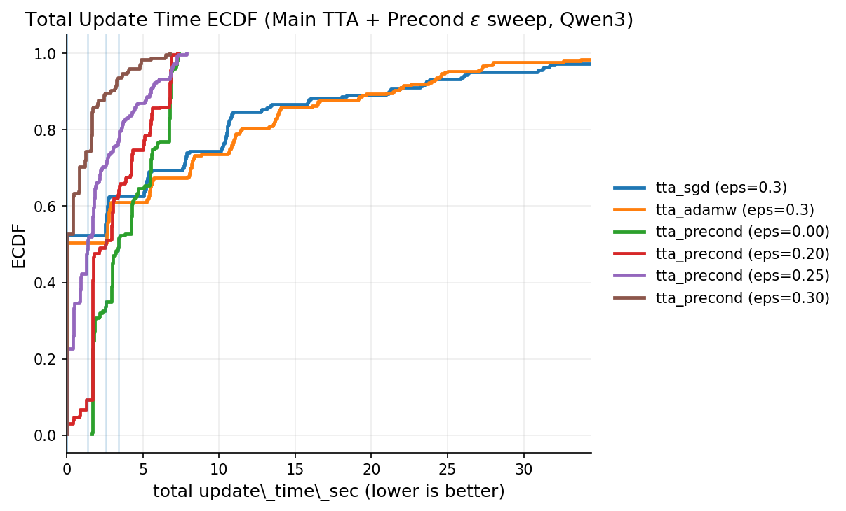
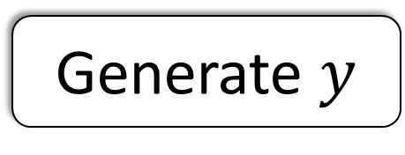

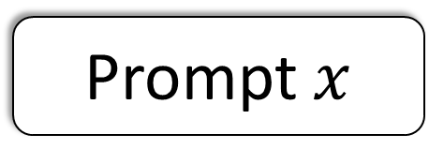
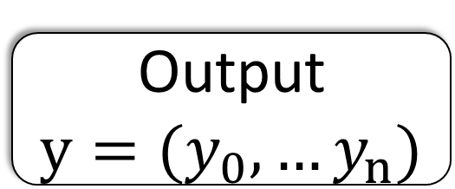
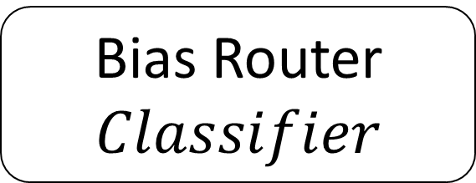

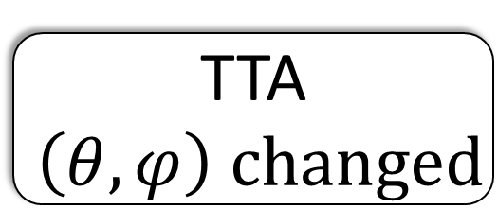


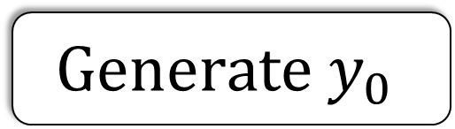


CAP-TTA: Preconditioned Test-Time Adaptation for Out-of-Distribution Debiasing in Narrative Generation
Hanwen Shen¹* · Ting Ying²* · Jiajie Lu¹ · Shanshan Wang³†
¹ AI in Math Education Lab Stevens Institute of Technology · ² Independent Researcher · ³ NLP²CT Lab, University of Macau
Background & Alignment in Narrative Generation
1. Bias is dynamic. What counts as biased varies across cultures, eras, and contexts — static models and benchmarks miss emergent biases.
2. Static debiasing breaks under shift. Methods learn fixed patterns offline, but bias drifts with prompts at deployment, degrading under OOD conditions.
3. Perfect debiasing kills narrative. A "perfectly unbiased" model can't portray a biased character — we want one that adapts dynamically, not one merely told not to discriminate.
Static LLM
Prior TTA LLM
CAP-TTA LLM
Metrics
We use a toxicity committee comprising three models:
s-nlp/roberta_toxicity_classifier,
unitary/toxic-bert,
unitary/unbiased-toxic-roberta.
The trigger score is the mean of these three. For offline evaluation, we use:
grammarly/detexd-roberta-base,
henryscheible/stereoset_trainer_robertabase_finetuned,
Narrativa/distilroberta-finetuned-stereotype-detection.
The final bias score (BB Bias) is the mean of these three benchmark proxies.
Prompt $x$
Prompt $x$
Offline
Model Frozen
$$\left(θ,φ\right) fixed$$
$$Generate y_{0}$$
Precompute
Store $P_{0}$
TTA
$$\left(θ,φ\right) changed$$
Online
Bias Router
$$Classifier$$
Safe Corpus: {Gender,Religion,…}
Algorithm
Stay close to the base model p0 while cutting unsafe-output risk. Cast debiasing as a KL projection q* = argmin KL(q || p0) under expected-risk ≤ τ. Closed form is exponential tilting q*(y) ∝ p0(y)·exp(−β·b(y)): down-weight unsafe (high-b) sequences, up-weight safe ones.
To Use the Fisher matrix for local curvature; solving the trust-region subproblem gives δ* = −η·I⁻¹·g. Since inverse-Fisher is intractable, apply a diagonal preconditioner P, giving ϕₜ₊₁ = ϕₜ − α·P·g. High-curvature directions take smaller steps for stability.
Generate $y$
Generate $y_{k}$
Bias Trigger
$$Score>ε$$
Quick Adaptation
Output$y$
Output ${y=(y}_{0},…y_{n})$
Three Difficulties and Methods
Difficulties to apply test-time alignment/adaptation to LLMs:
Distribution Shift of response between high-bias and low-bias inputs;
Cold start problem of efficient test-time training;
Catastrophic Forgetting (i.e., lower fluency) in test-time training.
Methods:
Low-rank Adaptation (LoRA) with routers and low-bias corpus to train LLMs;
Preconditioned Matrix to accelerate gradient descending in LoRA;
Bias Trigger to avoid unnecessary updates.
Result about Fluency, Bias Score, Update Latency
CAP-TTA achieves a balance among low bias score, high fluency and fast update latency.
Bias Router
Bias Trending over segments
Human Evaluation
Ablation Study
Detailed Performance
hs907@scarletmail.rutgers.edu, nlp2ct.shanshan@gmail.com

