Slide 1


Ensemble Inference for Diffusion Model-based Speech Enhancement
Hao Shi, Naoyuki Kamo, Marc Delcroix, Tomohiro Nakatani, Shoko Araki NTT Corporation, Japan

Slide 2




Speech Signal Received in Real Scenarios
$$y=x\left(t\right)+v(t)$$
$$y: microphone received signal$$
$$x\left(t\right): desiresed speech signal$$
$$v\left(t\right):interference signal$$
Additive noise / interference speakers
Denoising
Target Speaker Extraction
Speech Enhancement: Recover $x\left(t\right)$ from $y$

Slide 3
Types of Speech Enhancement
Traditional speech enhancement:
Spectral subtraction
Minimum mean squared error (MMSE)
Weiner filtering
Drawbacks:
Based on assumption
Often fail to track non-stationary noise
Introduce “music noise”
Supervised speech enhancement:
Neural networks
No or few assumptions
Data driven
Supervised methods (data driven) outperform Traditional methods

Slide 4
Supervised Speech Enhancement
Deterministic approaches
Learn optimal deterministic mapping from noisy speech to clean speech
Mapping / Masking methods [1],[2],[3]
Probabilistic approaches
Capture the target distribution, either implicitly or explicitly
Generative adversarial network
Diffusion models
References:
[1] Y. Xu, J. Du, L.-R. Dai, and C.-H. Lee, “A Regression Approach to Speech Enhancement Based on Deep Neural Networks,” IEEE/ACM TASLP, vol. 23, no. 1, pp. 7–19, 2015.
[2] Y. Luo and N. Mesgarani, “Conv-tasnet: Surpassing ideal time–frequency magnitude masking for speech separation,” IEEE/ACM TASLP, vol. 27, no. 8, pp. 1256–1266, 2019.
[3] A. Li, C. Zheng, L. Zhang, and X. Li, “Glance and gaze: A collaborative learning framework for single-channel speech enhancement,” Applied Acoustics, vol. 187, pp. 108499, 2022.

Slide 5
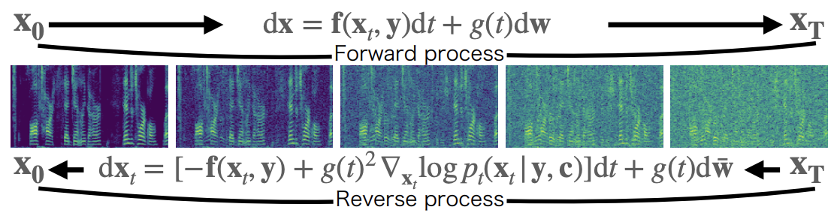




Score-based Diffusion Models
Conditions for score model
Denoising
$$p_{t}\left(x_{t} | y\right)$$
Target Speaker Extraction (TSE)
$$p_{t}\left(x_{t} | y, c\right)$$
$c$: speaker clue
Forward process: gradually transformed into noise
Forward stochastic differential equation (SDE)
Reverse process: invert the progressive noise-adding process
The reverse SDE can be expressed using the score model
: a standard Wiener process
: drift
: diffusion coefficient functions
$$s_{θ}$$
: score model (neural network)

Slide 6


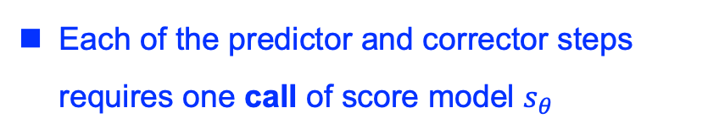
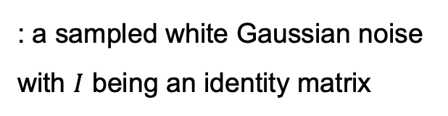
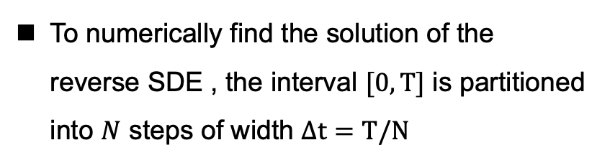
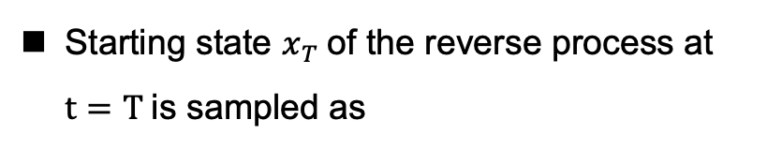

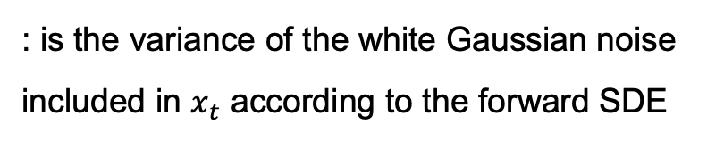
Score-based Diffusion Models
Training Objective
Inference
Starting state $x_{T}$of the reverse process at $t=T$is sampled as
$$x_{T}∼𝒩_{𝒸}\left(x_{T};y,σ{\left(T\right)}^{2}I\right)$$
To numerically find the solution of the reverse SDE , the interval $[0, T]$ is partitioned into $N$ steps of width $Δt=T/N$
: a sampled white Gaussian noise with $I$ being an identity matrix
For each step, the current state is determined using both predictor and corrector (PC solver)
$$σ{\left(t\right)}^{2}$$
: is the variance of the white Gaussian noise included in $x_{t}$ according to the forward SDE
Each of the predictor and corrector steps requires one call of score model $s_{θ}$
Call: Number of solver used

Slide 7
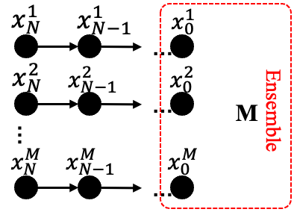




Ensemble Inference and Its Drawbacks
The inference is stochastic: running the inference process with different random seeds leads to different enhanced signals sampled
Exploited this property to improve the estimation by performing ensemble inference and obtained enhanced speech by averaging multiple generated samples
Results of TSE (LibriMix2spk)
Model | SI-SDR
Mixture | 0.03
Diff-TSE-MT | 9.40
+ Ensemble | 11.28
Single SDE process
Call: $N$ times
Following $N$ SDE processes
Call: Number of solver used
Call: M$✕ N$ times
Significantly increasing the call: time-consuming
References:
N. Kamo, M. Delcroix, and T. Nakatani, “Target Speech Extraction with Conditional Diffusion Model,” in Proc. Interspeech, 2023, pp. 176–180

Slide 8
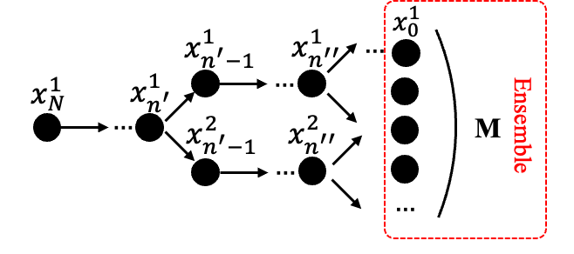



SplitTree Ensemble Inference (Proposed)
Ensemble
SplitTree Ensemble
Following $N$ SDE processes
Following single SDE process
Sampling different initial states
Sampling at intermediate steps
Call: M$✕ N$ times
Call: $N+\left(n+1\right)∗(M−1)$ times
Split $M$ branches at a single split point $n (<N)$
Much smaller when using $n≪N$ in comparison with $M∗N$
Using sufficiently diverse samples is crucial for ensemble inference:
The sample diversity will decrease at the latter inference process since the variance of the added noise decreases in the latter stages.

Slide 9
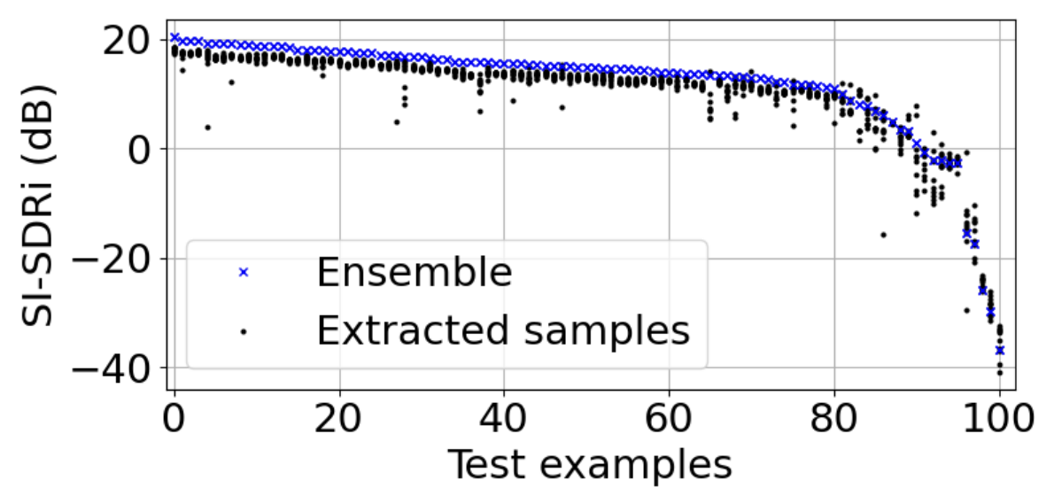
Outlier Removal
Outlier detection
Some samples generated have extremely poor quality [1] (TSE, Libri2Mix dataset)
Outlier is detected as an outlier when distance $D\left[m\right]>η$
Distance:
Deviation:
Sample variance:
In preliminary experiments, the outliers tended to occur whining a relatively short time segment
References:
[1] N. Kamo, M. Delcroix, and T. Nakatani, “Target Speech Extraction with Conditional Diffusion Model,” in Proc. Interspeech, 2023, pp. 176–180

Slide 10
Experimental Settings: Dataset
Denoising
We synthesized the WSJ0-CHiME3 dataset
Each observed signal was created by randomly selecting a noise file and combining it with clean utterance.
Every utterance was employed only once, and the Signal-to-Noise Ratio (SNR) was uniformly sampled within a range of 0 to 20 dB for the training, validation, and test sets.
Target Speaker Extraction
Performed experiments using the openly available LibriMix-2spk dataset
We used the 100-hours version of the data and followed the openly available recipe¹ that defines the enrollment utterances used for each mixture in the test set.
¹ https://github.com/butspeechfit/speakerbeam

Slide 11
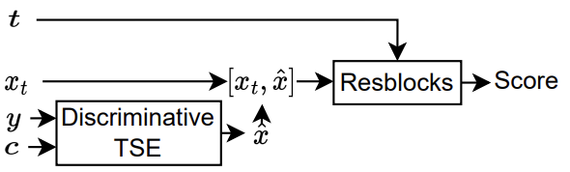
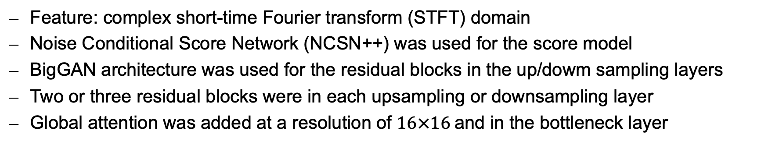
Experimental Settings: Networks
Common Settings
The network architecture and training strategies were consistent with those of SGMSE+ for both the denoising and TSE tasks
Feature: complex short-time Fourier transform (STFT) domain
Noise Conditional Score Network (NCSN++) was used for the score model
BigGAN architecture was used for the residual blocks in the up/dowm sampling layers
Two or three residual blocks were in each upsampling or downsampling layer
Global attention was added at a resolution of $16×16$and in the bottleneck layer
Special Settings for TSE
Combining diffusion model and conventional deterministic TSE model

Slide 12
Ensemble Analysis
Model | PESQ | ESTOI | SI-SDR | SI-SIR | SI-SAR
Denoising
1 sample | 2.84 | 91.93 | 16.52 | 33.53 | 16.61
En. 2 | 3.01 | 92.97 | 17.32 | 33.54 | 17.43
En. 4 | 3.11 | 93.49 | 17.82 | 33.57 | 17.95
En. 8 | 3.16 | 93.79 | 18.10 | 33.56 | 18.24
En. 10 | 3.17 | 93.86 | 18.16 | 33.57 | 18.30
TSE
1 sample | 2.79 | 77.26 | 9.40 | 44.31 | 9.40
En. 2 | 2.94 | 79.17 | 10.46 | 44.48 | 10.45
En. 4 | 3.04 | 80.26 | 11.16 | 44.60 | 11.15
En. 8 | 3.08 | 80.89 | 11.58 | 44.68 | 11.57
En. 10 | 3.10 | 81.04 | 11.67 | 44.69 | 11.66

Slide 13
Ensemble Analysis
Model | PESQ | ESTOI | SI-SDR | SI-SIR | SI-SAR
Denoising
1 sample | 2.84 | 91.93 | 16.52 | 33.53 | 16.61
En. 2 | 3.01 | 92.97 | 17.32 | 33.54 | 17.43
En. 4 | 3.11 | 93.49 | 17.82 | 33.57 | 17.95
En. 8 | 3.16 | 93.79 | 18.10 | 33.56 | 18.24
En. 10 | 3.17 | 93.86 | 18.16 | 33.57 | 18.30
TSE
1 sample | 2.79 | 77.26 | 9.40 | 44.31 | 9.40
En. 2 | 2.94 | 79.17 | 10.46 | 44.48 | 10.45
En. 4 | 3.04 | 80.26 | 11.16 | 44.60 | 11.15
En. 8 | 3.08 | 80.89 | 11.58 | 44.68 | 11.57
En. 10 | 3.10 | 81.04 | 11.67 | 44.69 | 11.66
Ensemble inference was effective for both tasks
Ensemble inference was effective even when using just two samples
The performance further improved with up to eight samples
After that, the improvement became less significant

Slide 14
Ensemble Analysis
Model | PESQ | ESTOI | SI-SDR | SI-SIR | SI-SAR
Denoising
1 sample | 2.84 | 91.93 | 16.52 | 33.53 | 16.61
En. 2 | 3.01 | 92.97 | 17.32 | 33.54 | 17.43
En. 4 | 3.11 | 93.49 | 17.82 | 33.57 | 17.95
En. 8 | 3.16 | 93.79 | 18.10 | 33.56 | 18.24
En. 10 | 3.17 | 93.86 | 18.16 | 33.57 | 18.30
TSE
1 sample | 2.79 | 77.26 | 9.40 | 44.31 | 9.40
En. 2 | 2.94 | 79.17 | 10.46 | 44.48 | 10.45
En. 4 | 3.04 | 80.26 | 11.16 | 44.60 | 11.15
En. 8 | 3.08 | 80.89 | 11.58 | 44.68 | 11.57
En. 10 | 3.10 | 81.04 | 11.67 | 44.69 | 11.66
Ensemble method primarily reduces signal distortion and artifacts
Less impact on reducing interference

Slide 15
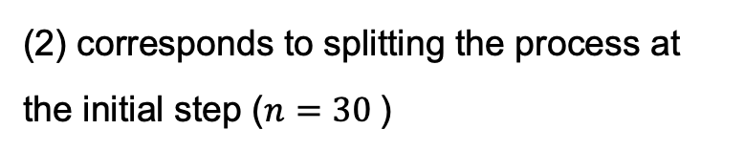
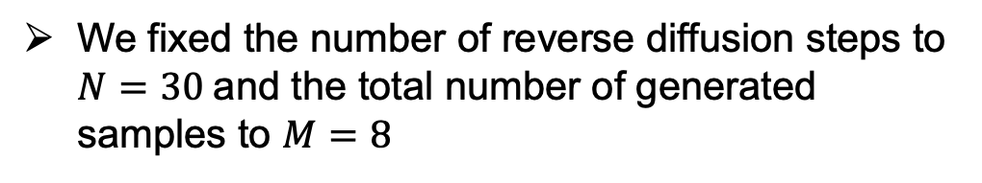
Evaluation of SplitTree
We fixed the number of reverse diffusion steps to $N=30$and the total number of generated samples to $M=8$
 | Split Points | #Splits | #Calls | PESQ | SI-SDR
(1) | - | 1 | 30 | 2.84 | 16.52
(2) | 30 | 8 | 240 | 3.16 | 18.10
(3) | 21 | 8 | 177 | 3.14 | 18.10
(4) | 11 | 8 | 107 | 3.05 | 17.73
(5) | 30, 21 | 2, 4 | 186 | 3.15 | 18.08
(6) | 30, 21, 11 | 2, 2, 2 | 146 | 3.13 | 18.06
(2) corresponds to splitting the process at the initial step ($n=30$)

Slide 16
Evaluation of SplitTree
We fixed the number of reverse diffusion steps to $N=30$and the total number of generated samples to $M=8$
 | Split Points | #Splits | #Calls | PESQ | SI-SDR
(1) | - | 1 | 30 | 2.84 | 16.52
(2) | 30 | 8 | 240 | 3.16 | 18.10
(3) | 21 | 8 | 177 | 3.14 | 18.10
(4) | 11 | 8 | 107 | 3.05 | 17.73
(5) | 30, 21 | 2, 4 | 186 | 3.15 | 18.08
(6) | 30, 21, 11 | 2, 2, 2 | 146 | 3.13 | 18.06
Comparing experiments (2) and (3):
splitting the SDE process at an intermediate step was also very effective

Slide 17
Evaluation of SplitTree
We fixed the number of reverse diffusion steps to $N=30$and the total number of generated samples to $M=8$
 | Split Points | #Splits | #Calls | PESQ | SI-SDR
(1) | - | 1 | 30 | 2.84 | 16.52
(2) | 30 | 8 | 240 | 3.16 | 18.10
(3) | 21 | 8 | 177 | 3.14 | 18.10
(4) | 11 | 8 | 107 | 3.05 | 17.73
(5) | 30, 21 | 2, 4 | 186 | 3.15 | 18.08
(6) | 30, 21, 11 | 2, 2, 2 | 146 | 3.13 | 18.06
Comparing experiments (3) and (4):
splitting at a smaller n reduced the number of calls but also lowered the performance.
This observation indicates that when n is too small, the added noise power is unable to generate enough variation in the generated samples.

Slide 18
Evaluation of SplitTree
We fixed the number of reverse diffusion steps to $N=30$and the total number of generated samples to $M=8$
 | Split Points | #Splits | #Calls | PESQ | SI-SDR
(1) | - | 1 | 30 | 2.84 | 16.52
(2) | 30 | 8 | 240 | 3.16 | 18.10
(3) | 21 | 8 | 177 | 3.14 | 18.10
(4) | 11 | 8 | 107 | 3.05 | 17.73
(5) | 30, 21 | 2, 4 | 186 | 3.15 | 18.08
(6) | 30, 21, 11 | 2, 2, 2 | 146 | 3.13 | 18.06
Performing splitting at different steps (i.e., experiments (5) and (6)) can further reduce the number of calls by up to 40% while maintaining performance.

Slide 19
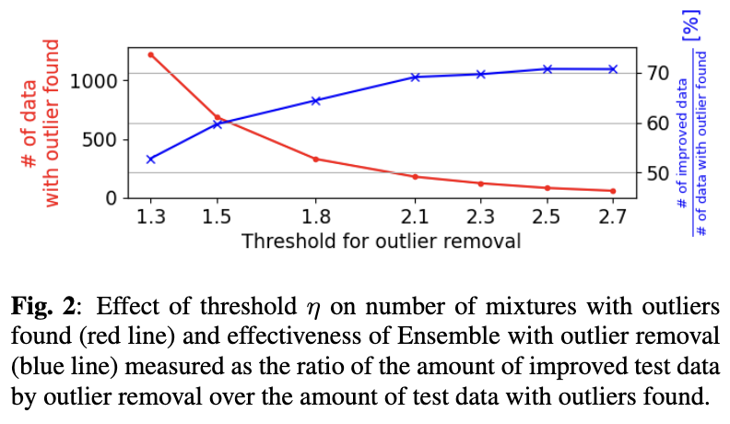
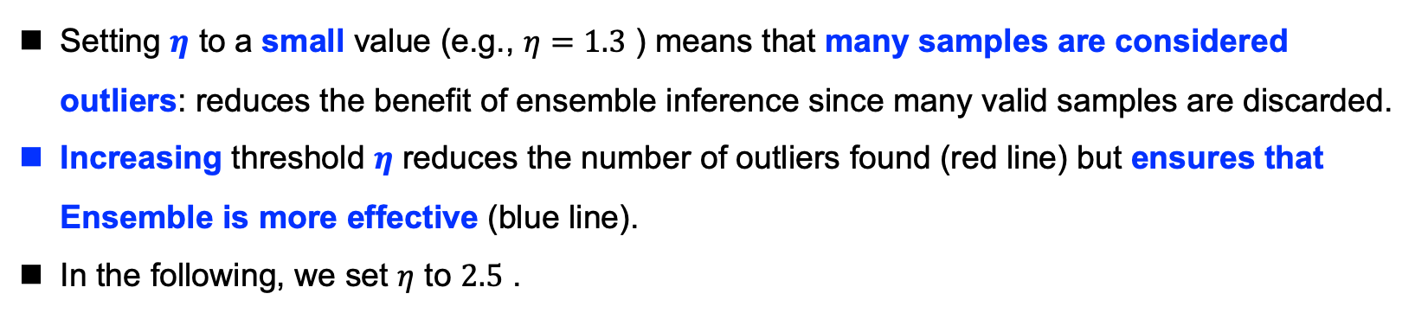
Evaluation of Outlier Removal
Setting $η$ to a small value (e.g., $η=1.3$ ) means that many samples are considered outliers: reduces the benefit of ensemble inference since many valid samples are discarded.
Increasing threshold $η$ reduces the number of outliers found (red line) but ensures that Ensemble is more effective (blue line).
In the following, we set $η$ to $2.5$ .

Slide 20
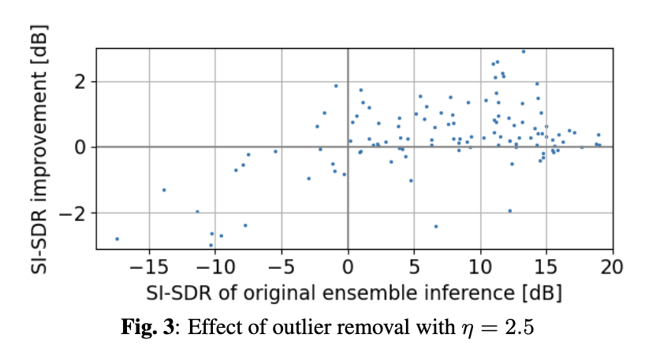
Evaluation of Outlier Removal
Outlier removal successfully improved the SI-SDR in most cases.
Note that the test data with low SI-SDR values, e.g., below 0 dB, are degraded. These data points constitute extraction failures for which the target speaker was not correctly identified in the mixture for most samples. In such cases, our proposed outlier removal naturally cannot improve the performance as most of the samples correspond to the interference and not the target speaker.

Slide 21
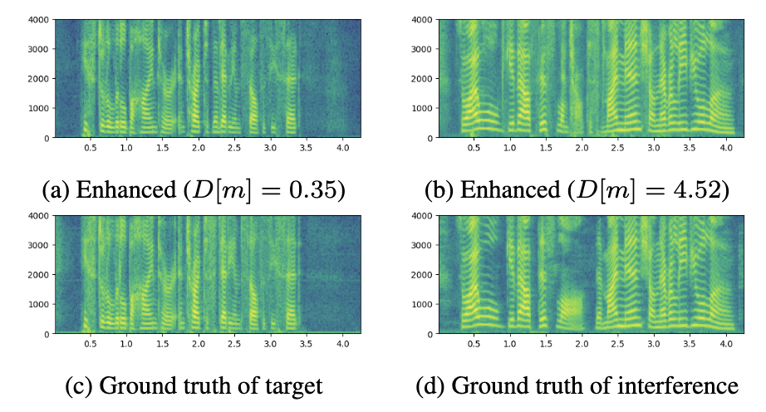
Evaluation of Outlier Removal
With a threshold value of $η=2.5$ , the proposed method identified sample (b) as an outlier, which is indeed an extraction failure since its spectrogram resembles the interference.

Slide 22
Evaluation of Outlier Removal
Outlier removal for the denoising task did not get any improvement because the identification failure for a target speaker cannot happen with it.

Slide 23
Conclusions
We investigated ensemble inference for diffusion model-based TSE and denoising tasks and proposed two extensions: outlier removal to improve its effectiveness and SplitTree to raise its computational efficiency.
Experimental results showed that ensemble inference was effective for both the denoising and TSE tasks and primarily contributed to reducing the artifacts.
We also showed that our proposed outlier removal procedure could improve TSE performance and that ensemble inference's efficiency was raised by up to 40% using the proposed SplitTree approach.

Slide 24
Reporter: Hao Shi

