Slide 1

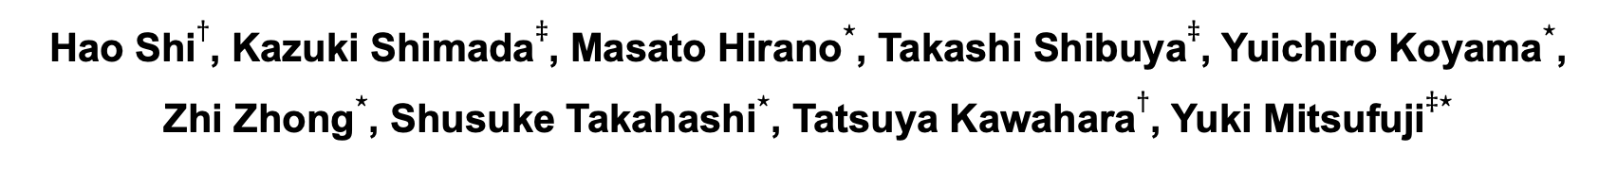

Diffusion-Based Speech Enhancement with Joint Generative and Predictive Decoders
Hao Shi$†$, Kazuki Shimada$‡$, Masato Hirano$⋆$, Takashi Shibuya$‡$, Yuichiro Koyama$⋆$, Zhi Zhong$⋆$, Shusuke Takahashi$⋆$, Tatsuya Kawahara$†$, Yuki Mitsufuji$‡⋆$
$†$Graduate School of Informatics, Kyoto University, Kyoto, Japan
$‡$Sony AI, Tokyo, Japan
$⋆$Sony Group Corporation, Tokyo, Japan

Slide 2




Speech Signal Received in Real Scenarios
$$y=x\left(t\right)+v(t)$$
$$y: microphone received signal$$
$$x\left(t\right): desiresed speech signal$$
$$v\left(t\right):interference signal$$
Additive noise / interference speakers
Denoising
Speech Enhancement: Recover $x\left(t\right)$ from $y$

Slide 3
Types of Speech Enhancement
Traditional speech enhancement:
Spectral subtraction
Minimum mean squared error (MMSE)
Weiner filtering
Drawbacks:
Based on assumption
Often fail to track non-stationary noise
Introduce “music noise”
Supervised speech enhancement:
Neural networks
No or few assumptions
Data driven
Supervised methods (data driven) outperform Traditional methods

Slide 4
Supervised Speech Enhancement
Deterministic (Predictive) approaches
Learn optimal deterministic mapping from noisy speech to clean speech
Mapping / Masking methods [1],[2],[3]
Probabilistic (Generative) approaches
Capture the target distribution, either implicitly or explicitly
Generative adversarial network
Diffusion models
References:
[1] Y. Xu, J. Du, L.-R. Dai, and C.-H. Lee, “A Regression Approach to Speech Enhancement Based on Deep Neural Networks,” IEEE/ACM TASLP, vol. 23, no. 1, pp. 7–19, 2015.
[2] Y. Luo and N. Mesgarani, “Conv-tasnet: Surpassing ideal time–frequency magnitude masking for speech separation,” IEEE/ACM TASLP, vol. 27, no. 8, pp. 1256–1266, 2019.
[3] A. Li, C. Zheng, L. Zhang, and X. Li, “Glance and gaze: A collaborative learning framework for single-channel speech enhancement,” Applied Acoustics, vol. 187, pp. 108499, 2022.

Slide 5
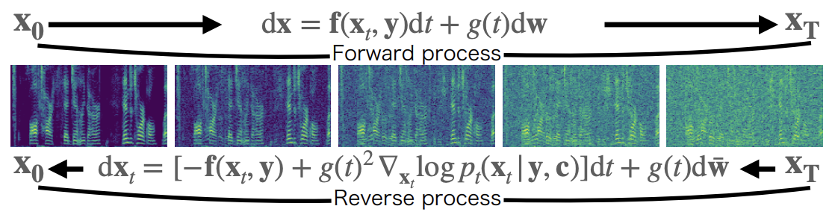

Score-based Diffusion Models
Forward process: gradually transformed into noise
Forward stochastic differential equation (SDE)
Reverse process: invert the progressive noise-adding process
The reverse SDE can be expressed using the score model
: a standard Wiener process
: drift
: diffusion coefficient functions
$$s_{θ}$$
: score model (neural network)

Slide 6


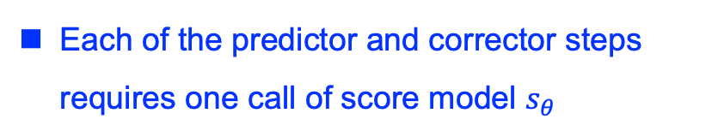
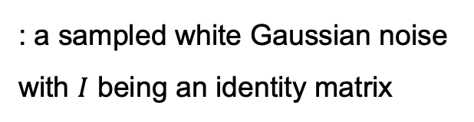
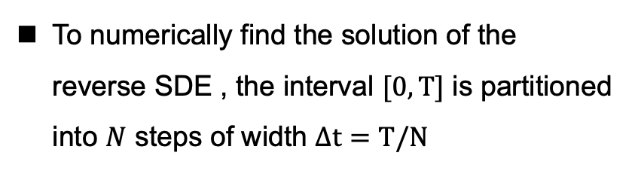
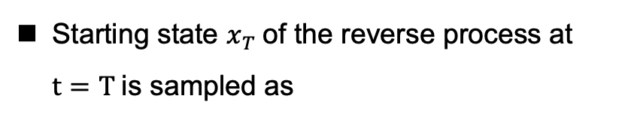

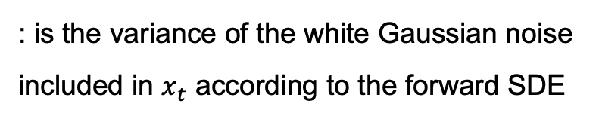
Score-based Diffusion Models
Training Objective
Inference
Starting state $x_{T}$of the reverse process at $t=T$is sampled as
$$x_{T}∼𝒩_{𝒸}\left(x_{T};y,σ{\left(T\right)}^{2}I\right)$$
To numerically find the solution of the reverse SDE , the interval $[0, T]$ is partitioned into $N$ steps of width $Δt=T/N$
: a sampled white Gaussian noise with $I$ being an identity matrix
For each step, the current state is determined using both predictor and corrector (PC solver)
$$σ{\left(t\right)}^{2}$$
: is the variance of the white Gaussian noise included in $x_{t}$ according to the forward SDE
Each of the predictor and corrector steps requires one call of score model $s_{θ}$

Slide 7
Drawbacks of Diffusion Model for SE
The reverse diffusion process of the diffusion models is very time-consuming
StoRM [1]:
The predictive model is only used as the initialization for the diffusion model
reduce the number of reverse diffusion steps significantly
shown that the generative and predictive models have different distortion
UNIVERSE [2]:
Adding predictive information to the decoder of the diffusion model helps diffusion score estimation
The previous systems limits the system's ability to fully exploit the complementarity between predictive and diffusion SE.
Reference:
[1] J.-M. Lemercier, J. Richter, S. Welker, and T. Gerkmann, “Storm: A diffusion-based stochastic regeneration model for speech enhancement and dereverberation,” IEEE/ACM TASLP, vol. 31, pp. 2724–2737, 2023
[2] J. Serr`a, S. Pascual, J. Pons, R. O. Araz, and D. Scaini, “Universal Speech Enhancement with Score-based Diffusion.” arXiv, 2022

Slide 8
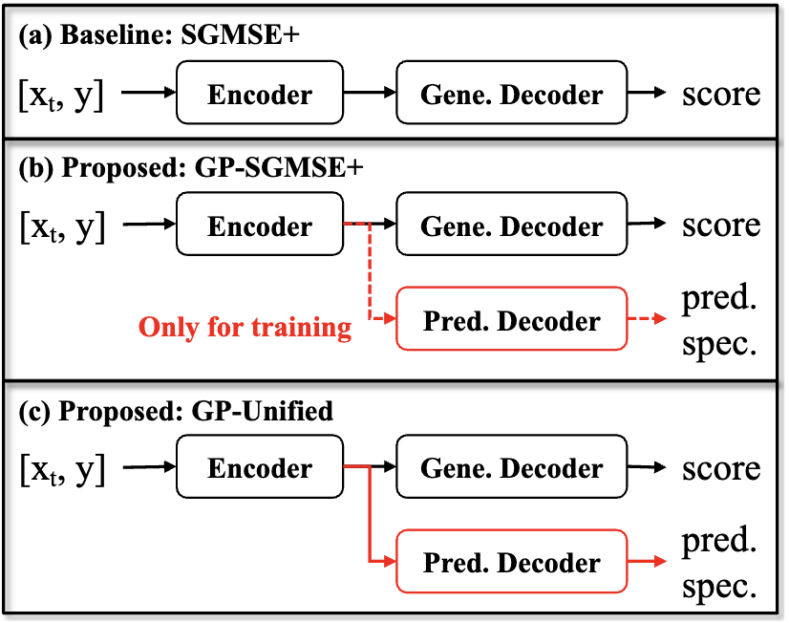
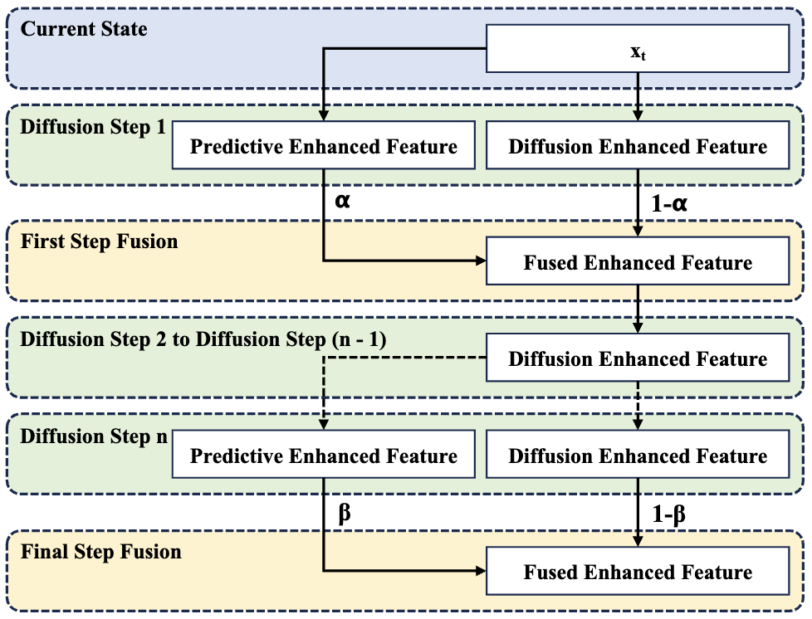
Unified SE System: Integrate the Generative and Predictive SE
Fuse them in the first and final diffusion steps:
The first step fusion: utilizes the predicted feature to initialize the subsequent diffusion processes
The final step fusion: to leverage the complementarity between the generative and predictive enhanced feature.
Shares one encoder
Contains predictive and generative decoders

Slide 9
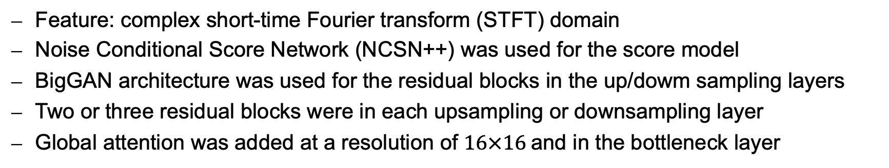
Experimental Settings
Dataset
Voicebank-DEMAND
16kHz
Neural Network
Feature: complex short-time Fourier transform (STFT) domain
Noise Conditional Score Network (NCSN++) was used for the score model
BigGAN architecture was used for the residual blocks in the up/dowm sampling layers
Two or three residual blocks were in each upsampling or downsampling layer
Global attention was added at a resolution of $16×16$and in the bottleneck layer

Slide 10
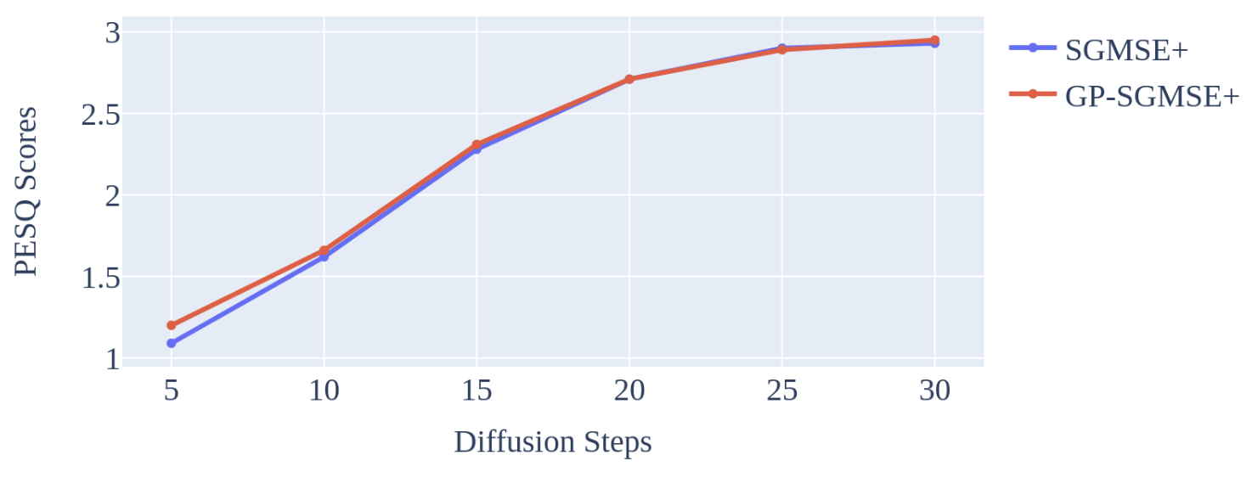
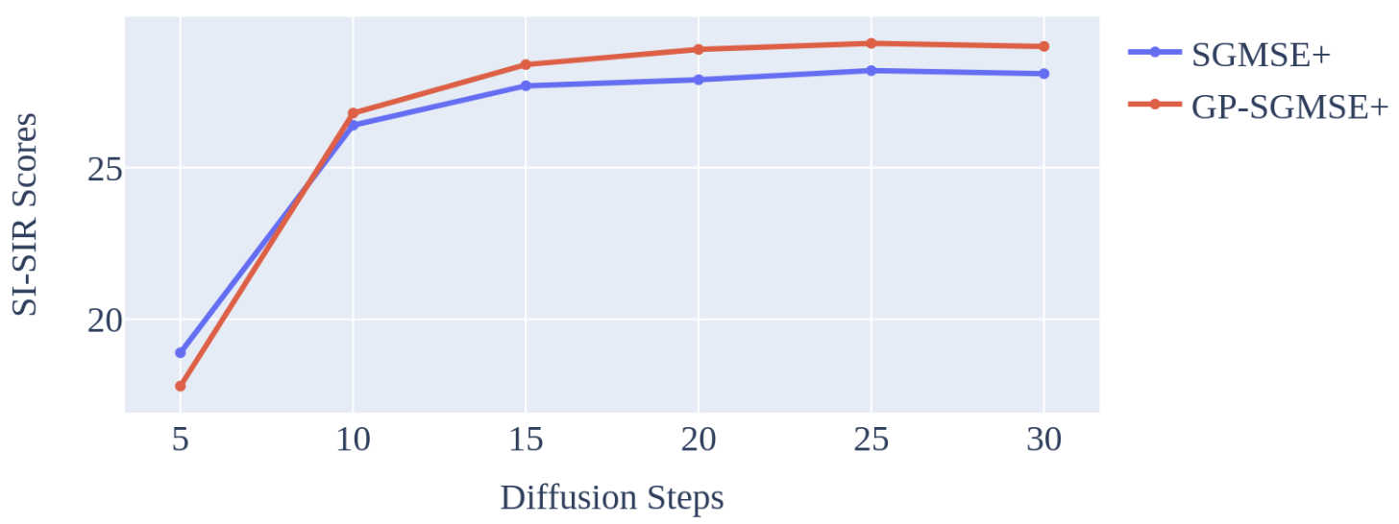
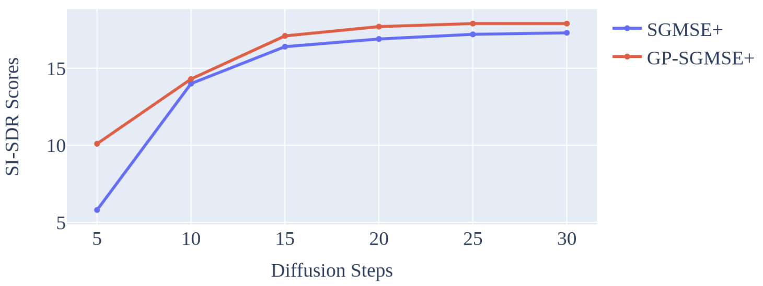
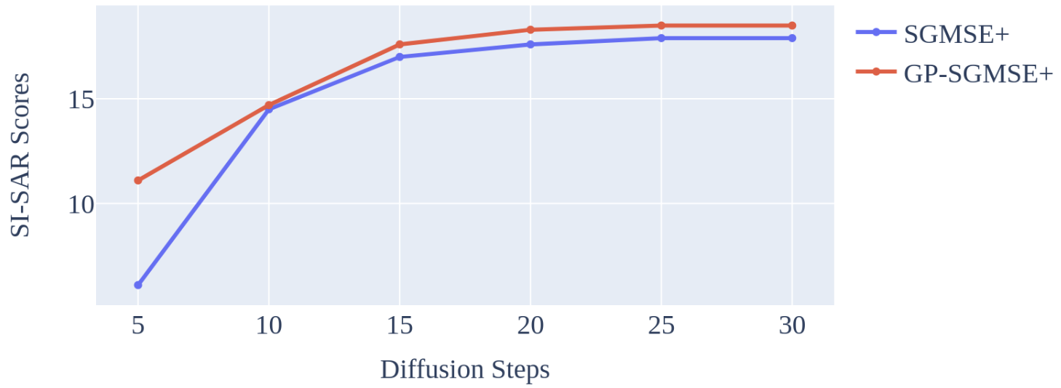
Effect of Incorporating Predictive Loss
Introducing a predictive loss function into the diffusion model can effectively reduce speech distortion, reduce noise, and reduce artificial noise.
However, the predictive information has a minor effect on the PESQ

Slide 11
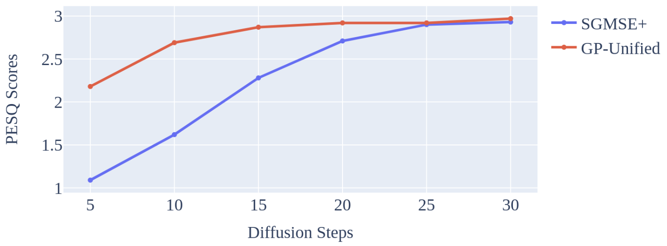
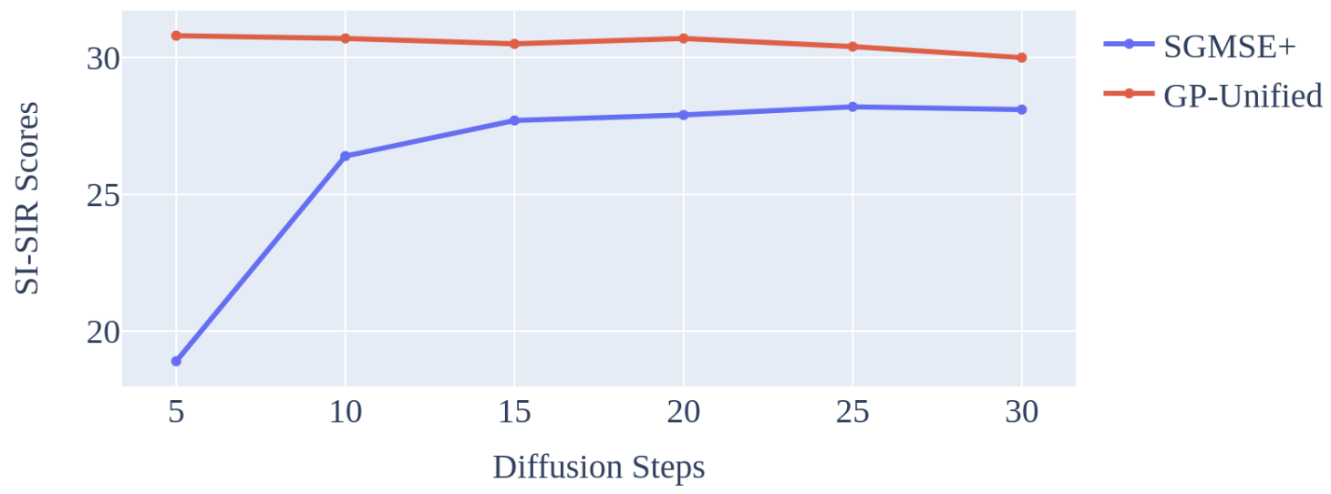
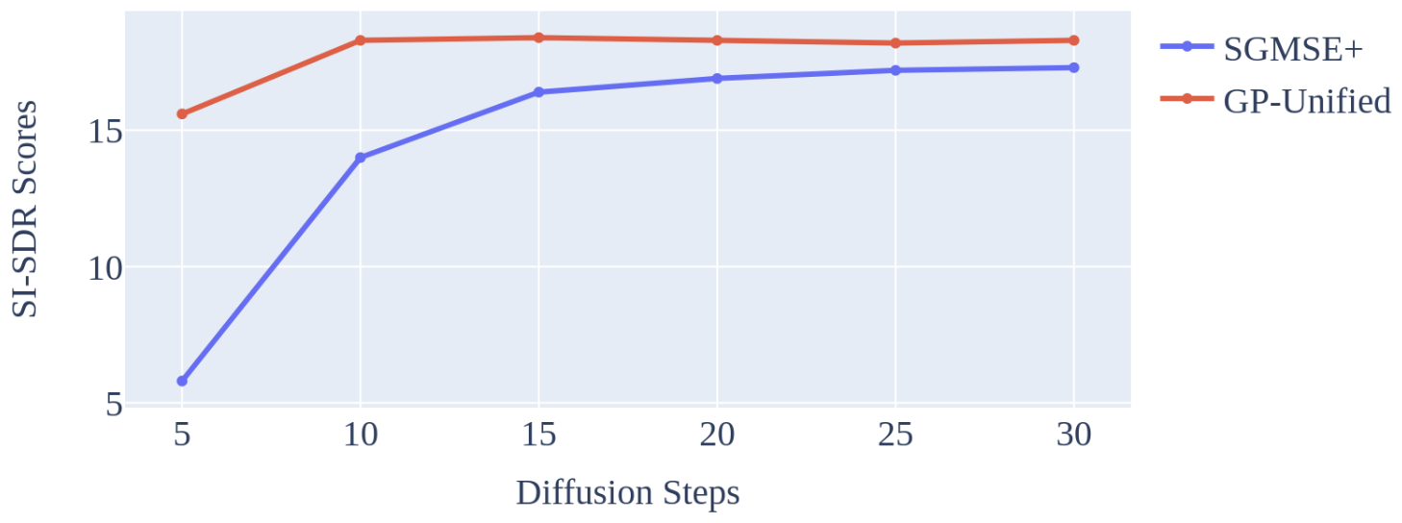

Effect of the Proposed Method
The proposed system can combine the characteristics of predictive and generative SE and fully use the predictive complex spectrograms even when the number of diffusion steps is small
When the diffusion steps increase, the complementarity between the generative and predicted complex spectrograms is manifested.
Through the fusion, PESQ and SI-SDR can be further improved

Slide 12
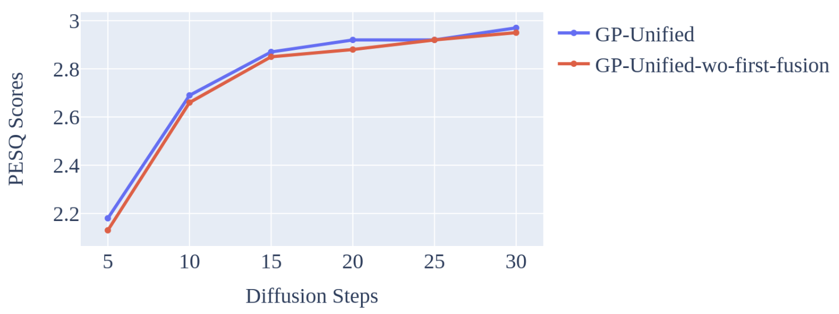
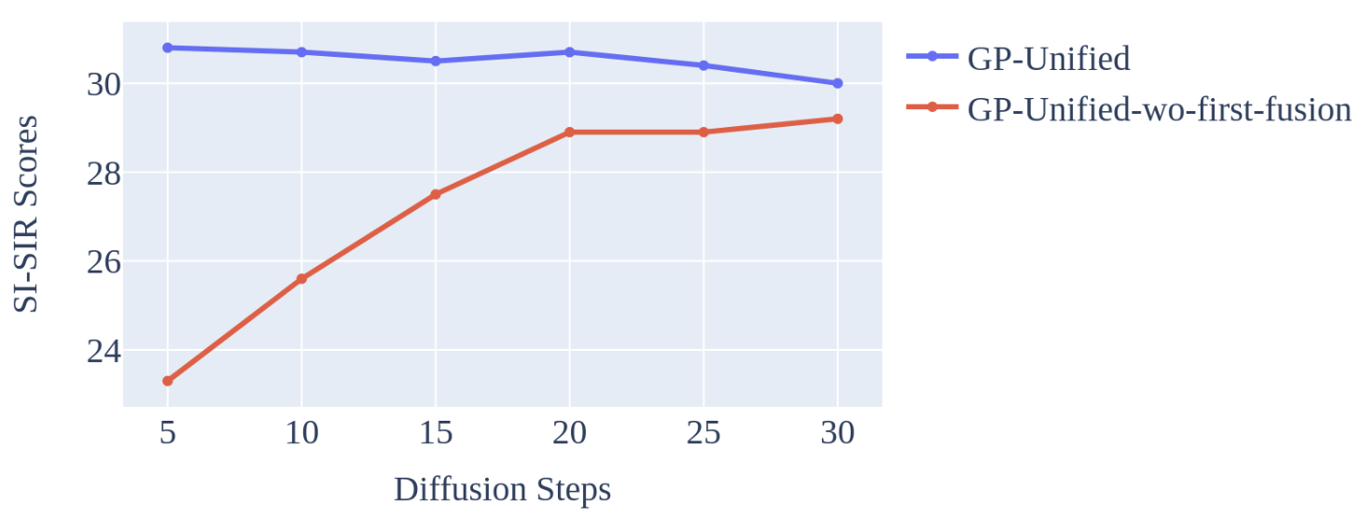
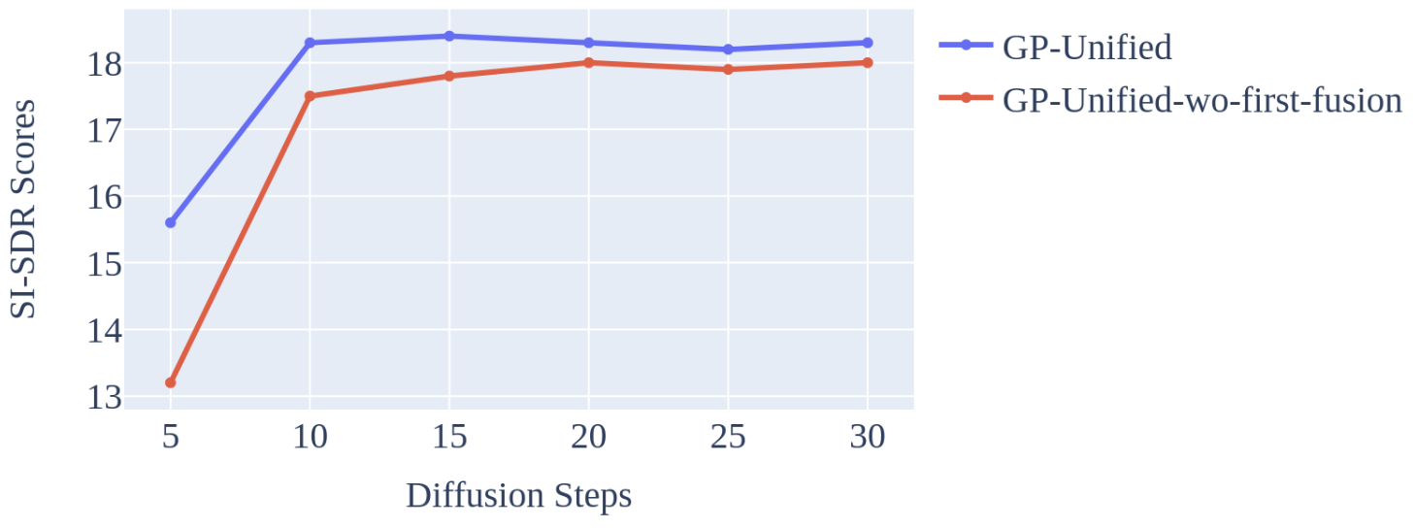
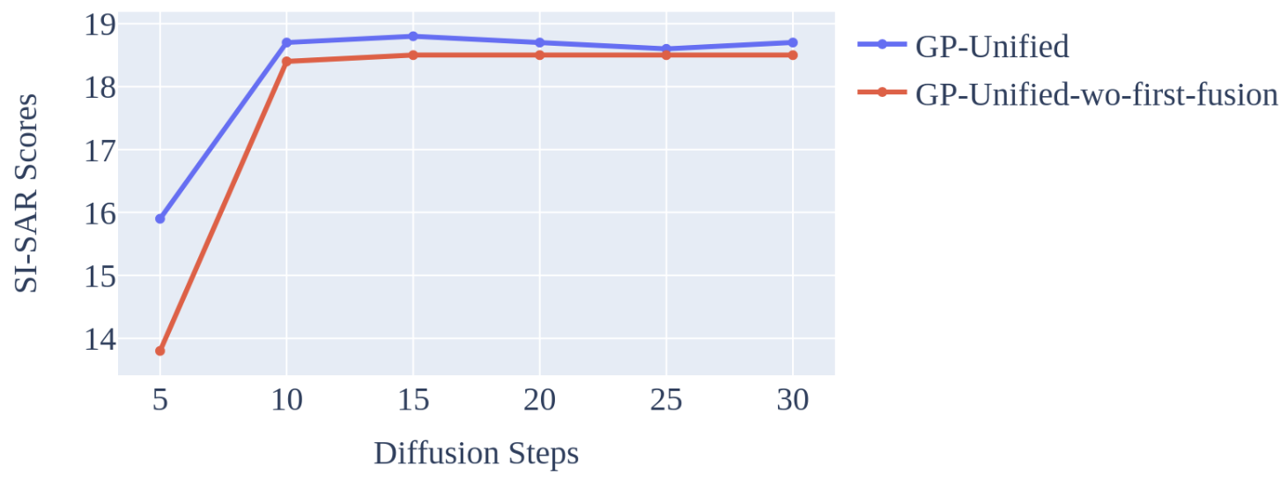
Effect of the First Fusion
The first step fusion mainly affects the diffusion speed
The first step fusion not only plays the role of initialization but also compensates for some speech distortion caused by diffusion.

Slide 13
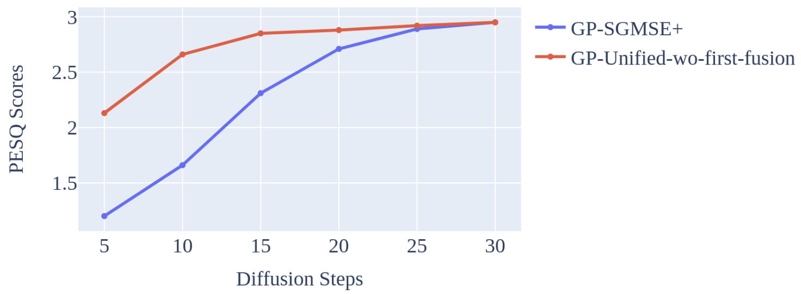
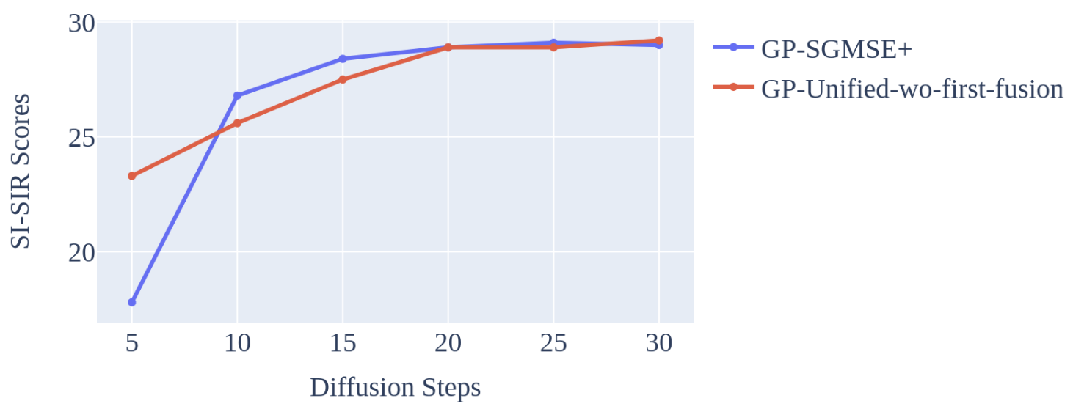
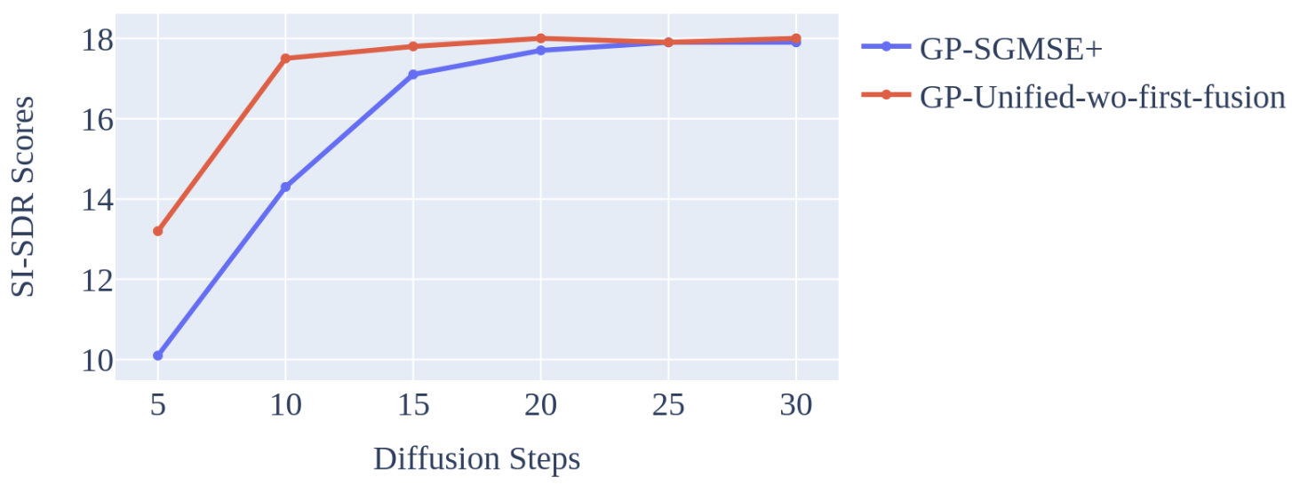
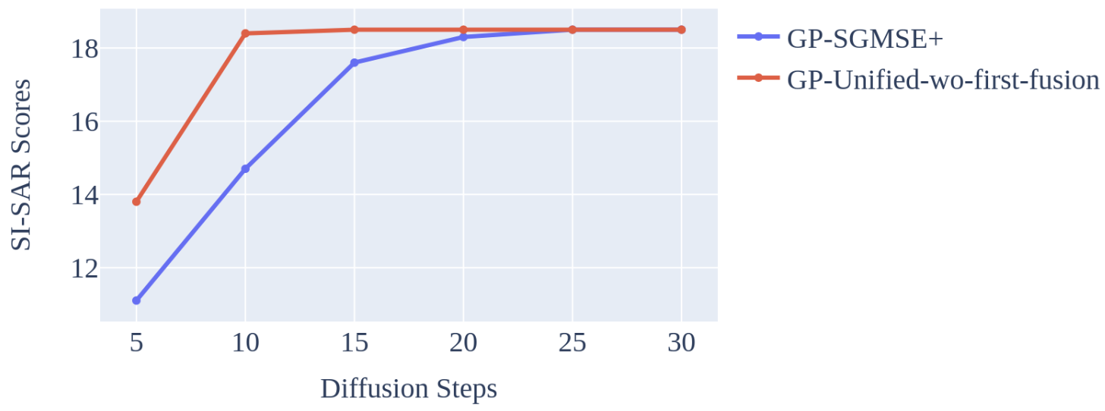
Effect of the Final Fusion
The final fusion step gives a significant PESQ improvement, especially when the number of diffusion steps is small
The final step fusion can significantly reduce speech distortion and artificial noise when the number of steps is small
The effect is not obvious for noise suppression

Slide 14
Performance of the Predictive Output
The performance of the predictive output at different diffusion steps
Diffusion Steps | 5 | 10 | 15 | 20 | 25 | 30
PESQ | 2.16 | 2.67 | 2.85 | 2.91 | 2.93 | 2.95
The performance improves as the iteration steps increases.

Slide 15
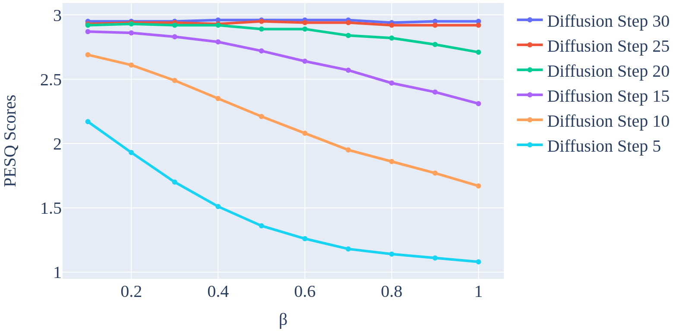
Effect of Fusion Hyperparameter
A more significant impact on smaller diffusion steps, and the advantages of the fusion are mainly reflected for smaller diffusion steps, especially in steps 5, 10, and 15.
In step 5, the main performance improvement comes from predictive information.
In steps 10, 15, and 20, it mainly comes from the feature fusion: the performance of ``GP-Unified'' was improved compared to the generative (``GP-SGMSE+'') and the predictive model.

Slide 16
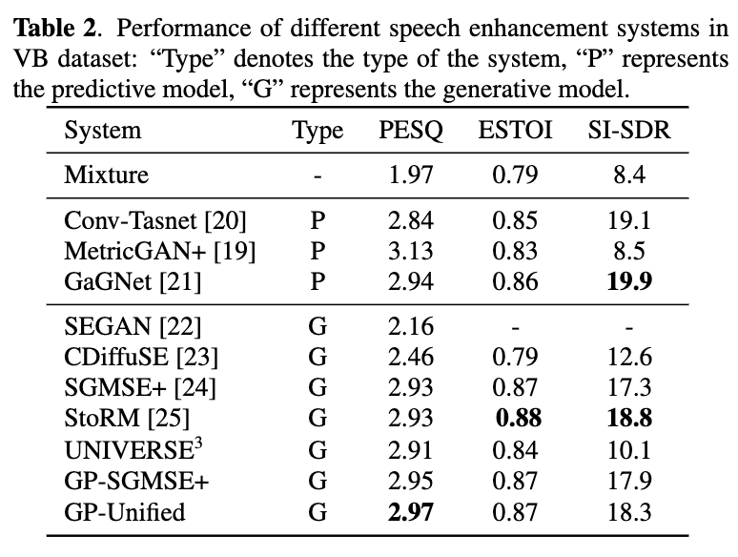
Comparasion with Other Methods

Slide 17
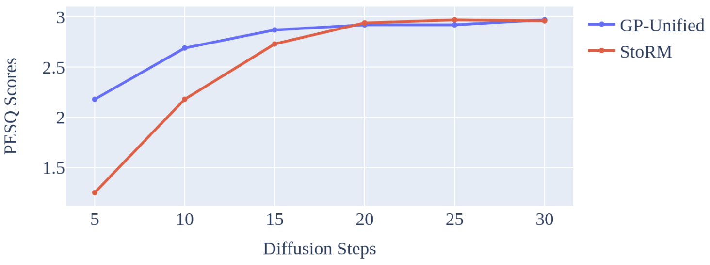
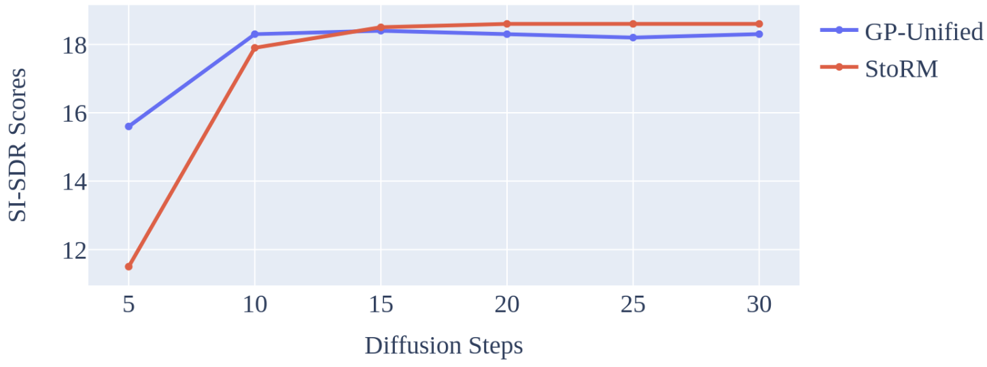
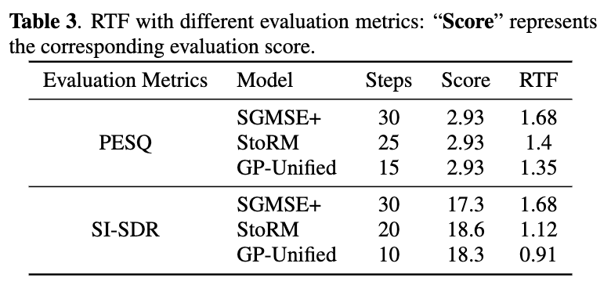
Comparison with StoRM
In comparison to "SGMSE+", "GP-Unified" achieves a substantial reduction in diffusion steps, resulting in improved RTF performance.

Slide 18
Conclusions
We have proposed a unified generative and predictive speech enhancement model (GP-Unified).
The model encodes both generative and predictive information and applies the generative and predictive decoders separately, whose results are fused.
The predictive information helps the model to reduce speech distortion, noise, and artifacts.
The two systems are fused in the first and final steps.
The information fusion can speed up the diffusion process by reducing the number of diffusion steps by about 50\%, which leads better RTF.
Besides, information fusion can lead to better performance with the complementary between the predictive and generative SE.

Slide 19
Reporter: Hao Shi

