Slide 1
Bird Songs Analysis
Zhengyuan Wen, Ming Pei, Haoyue Shi

Slide 2
Outline
Introduction
Data Preprocessing
What we did on CHTC
Our classification model
Future Prospects and drawbacks

Slide 3

Introduction
Our goal: Identify the bird specie given its song
Our final data set: 12GB audio files of 13 different bird species
Our Result: A model with an accuracy 49.14% on test data sets, which is larger than a random guess
(7.7%) among 13 bird species

Slide 4
Data Preprocessing
In this part, we tried to change audio files to a “dataframe”, which can be directly used by the classification model

Slide 5
Data Preprocessing
Step 1
Goal: Remove the background noises. The high frequency is usually the sound of birds, and the low frequency is usually some environmental noise.
Method: FIR(Finite Impulse Response filter). We manually set a frequency baseline 1500Hz by listening to different birdsongs of 13 bird species. And remove the amplitudes whose frequency are smaller than 1500Hz.

Slide 6
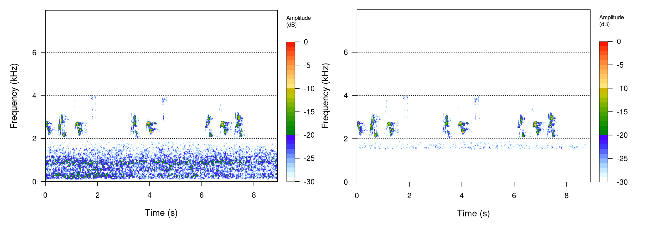
Data Preprocessing
Step 1
Results:

Slide 7
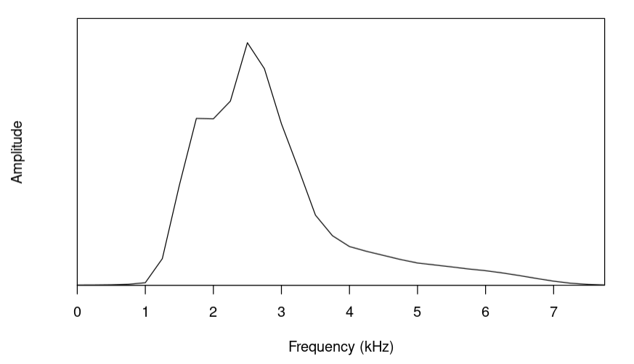
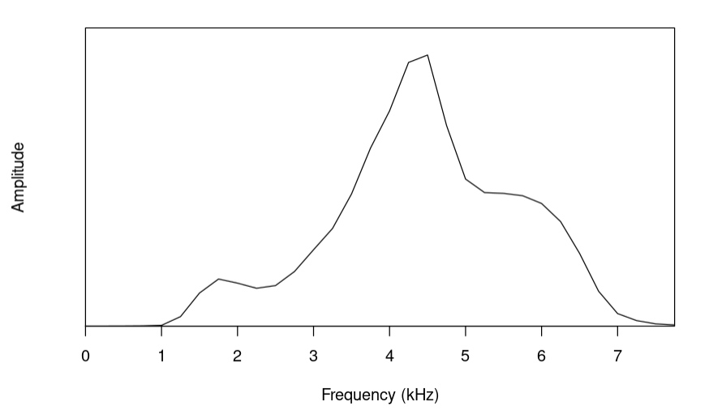
Data Preprocessing
Step 2
Goal: Extract features from audio files
Method: Extract the mean relative amplitude of the frequency distribution using STFT(Short-time Fourier Transformation)
Results: We got 32 features extracted from an audio file
amerob
barswa

Slide 8
What we did on CHTC
We used CHTC to do the data preprocessing jobs
The total number of samples is 6727. We used sample() function in R to obtain 30 groups of samples and deployed on 30 CHTC machines.
Each group contains roughly 225 files and each of their sizes is about 350MB. Since FIR requires large amount of memories, each procedure we requested 1CPU (Used 1), 2GB of Disk Space (Used roughly 1.3GB) and 8GB of memories (Used roughly 6GB).
A single job can be completed in 14 minutes. The total 30 parallel jobs were completed in 1 hour, saving us a lot of time.

Slide 9
Classification Model
Model introduction
For training part, we used Single Hidden-Layer Neural Network with skip layer connection for prediction.
We tried several parameter options for size of the hidden layer, and ended up choosing 8 knots in hidden layer as our final choice. Larger ones (16 and 12) showed worse results than the 8 because of overfitting problem.
The total parameters (weights) we need to estimate are 797 (32×8+8×13+32×13+13+8=797).

Slide 10
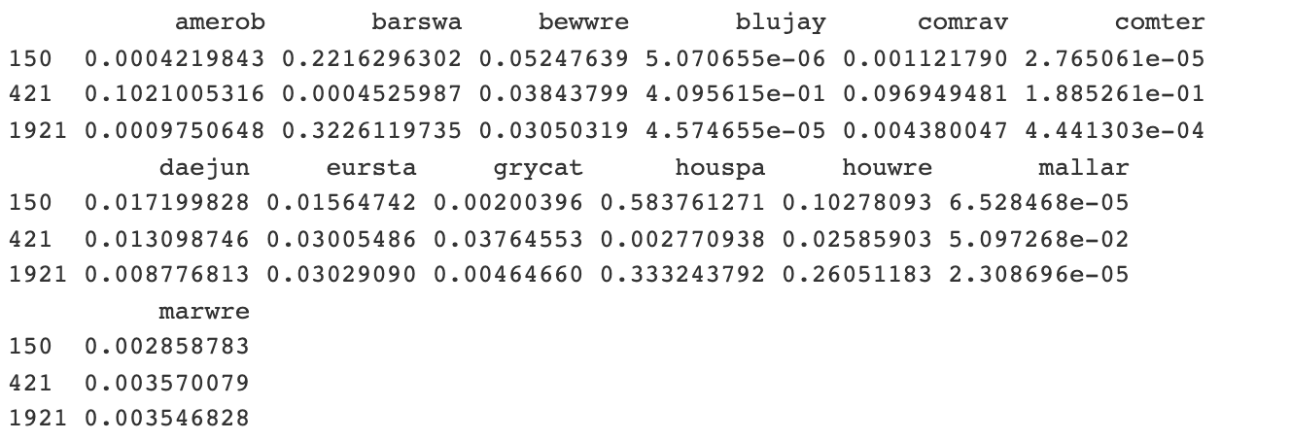
Classification Model
Predict example
Sample 150’s true label is houspa, Sample 421 is blujay and 1921 is houwre.

Slide 11
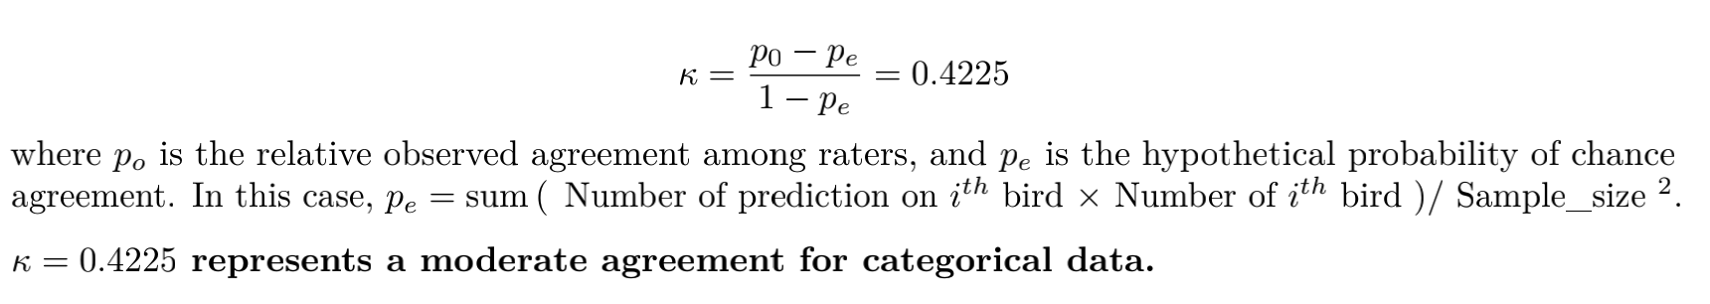
Classification Model
Model result
The test accuracy is 49.14% similar to training accuracy (51.40%). We say there is no obvious
overfitting problem. (Training data: Group 4-30 / Testing data: Group 1-3)
As for multiple class prediction task, we often use Cohen’s Kappa Coefficients to measure good or bad of a model.

Slide 12
Future prospects and drawbacks
Hard to distinguish the bird songs whose frequency is lower than 1500 Hz as we didn’t have those birds in training set after selections
The accuracy of model can be improved by using Convolutional Neural Network and MFCC
We didn’t deal with the data imbalance issue. (The larges number of samples of certain bird species is 1206 and the samllest is 223)

