Slide 1

Machine Learning
Group 4
2019.6.4

Slide 2
6,000
Machine Learning
标题数字等都可以通过点击和重新输入进行更改，顶部“开始”面板中可以对字体、字号、颜色、行距等进行修改。
Liu Yang

Slide 3
Machine Learning
Data preprocessing (2-3 Days)
Prediction (5-6 Days)
Data cleaning(pandas),Dimensionality reduction(PCA)
sklearn,tenserflow,knn(predicting deaths)
neural network(predict the probability of an accident)
Analyze data (3-4 Days)
Provide data interface(2-3 Days)
pandas,matplotlib,provide data needed for front-end visualization
python,pandas,csv to json

Slide 4
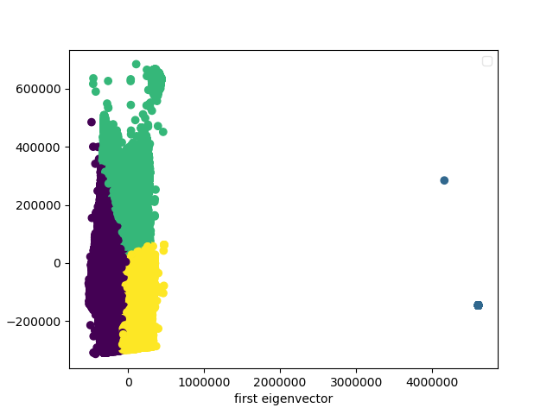
Data preprocessing
Use Pandas and PCA to process data
Delete items with invalid data and delete the lowest importance features
The data used in machine learning predictions is listed:
[3.11120375e+03 2.36503033e+03 4.04432189e+02 4.25192094e+00
2.80610463e+00 2.68095011e+00 1.98375673e+00 1.71485234e+00
1.43409583e+00 1.03324731e+00 8.79413888e-01 6.33758201e-01
5.03127567e-01 3.79278372e-01 3.67916953e-01 2.53786654e-01]
'lum', 'int', 'atm','col', 'catr', 'circ', 'nbv', 'vosp','prof', 'plan', 'lartpc', 'larrout', 'surf', 'infra', 'situ', 'env1'

Slide 5
Prediction
Predicting deaths (20/5 - 22/5)
Classification
DecisionTreeClassifier()
Predict the possibility of an accident(23/5 - 24/5)
Regression
svm.SVR()

Slide 6
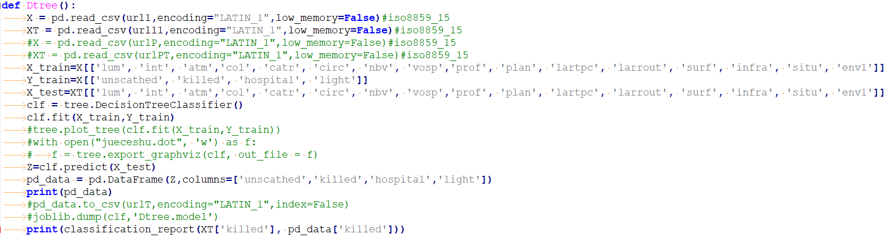
Predicting deaths
Predicting the number of unscathed, killed, hospitalized wounded and light injury in an accident by decision tree classification
Train:200,000 datas Test:40,000 datas

Slide 7
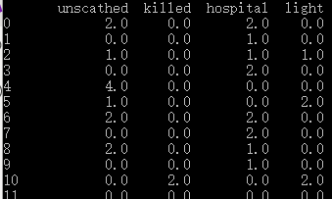
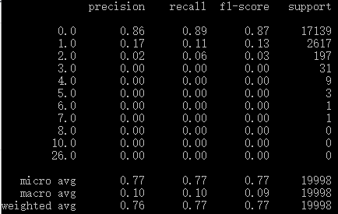
Predicting deaths
Predicting the number of unscathed, killed, hospitalized wounded and light injury in an accident by decision tree classification
Model prediction accuracy

Slide 8
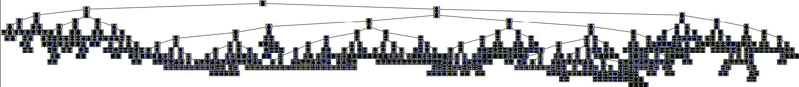
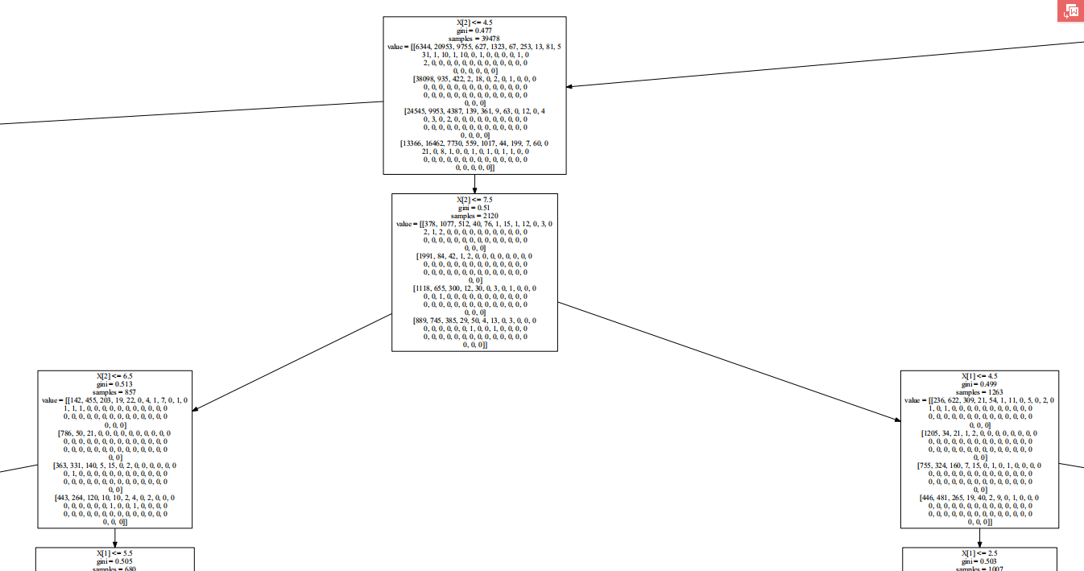
Decision Tree

Slide 9
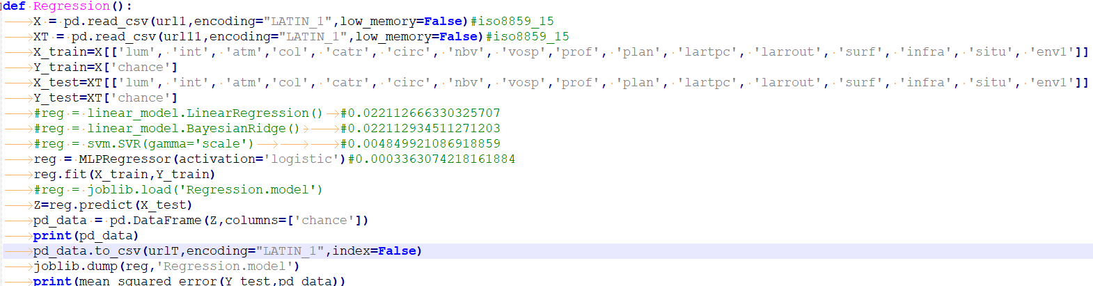
Predict the possibility of an accident
Predict the possibility of an accident under certain conditions by SVR
Mark the present datas as having an occurrence probability of 1
And randomly generate new data marked the probability in 0

Slide 10
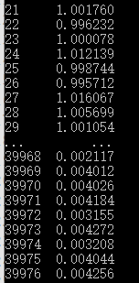
Predict the possibility of an accident
Predict the possibility of an accident under certain conditions by SVR
MSE Error：

Slide 11
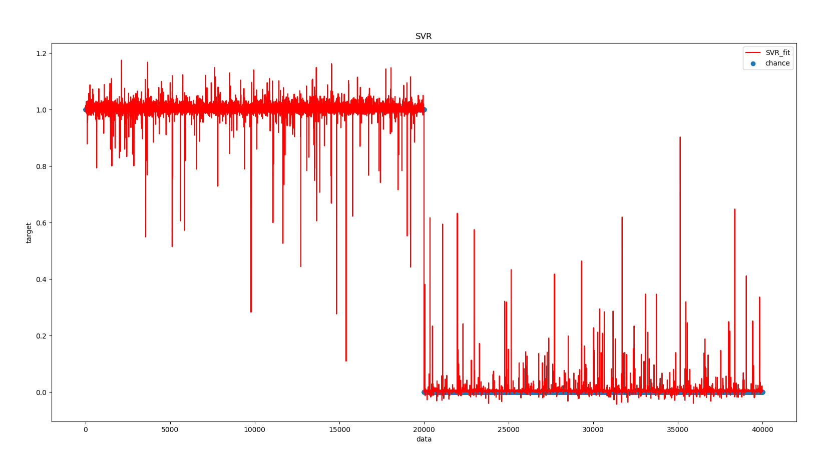
Predict the probability of an accident

Slide 12
THANK YOU
Group 4
2019.5.14
2019

