Slide 1

Accidents Analysis & Prediction
Group 4
2019.5.6

Slide 2

Accidents happens every day , every hour ,even every minute.
Millions of people got injured even died because of accidents.
What can we do?
Analysis......
Prediction......
With data mining and machine learning, We plan to do this project……
Background
6,000
标题数字等都可以通过点击和重新输入进行更改，顶部“开始”面板中可以对字体、字号、颜色、行距等进行修改。
标题数字等都可以通过点击和重新输入进行更改，顶部“开始”面板中可以对字体、字号、颜色、行距等进行修改。

Slide 3
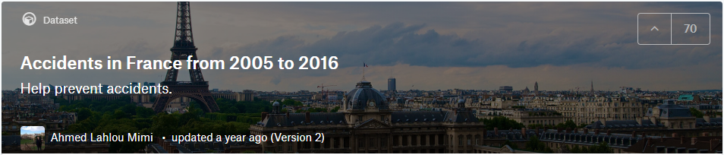
Our Dataset
6,000
标题数字等都可以通过点击和重新输入进行更改，顶部“开始”面板中可以对字体、字号、颜色、行距等进行修改。
标题数字等都可以通过点击和重新输入进行更改，顶部“开始”面板中可以对字体、字号、颜色、行距等进行修改。

Slide 4
Data Attributes in Our Dataset
Characteristics of the accidents
Places
date, lighting conditions, localisation,
Atmospheric conditions, type of collision, GPS coding...
category of road, Road Number, Traffic regime, Total number of traffic lanes, Drawing in plan, surface condition...
We have about 50 valid attributes.
Users
Vehicles
User category, Severity of the accident, Sex of the user, Reason for traveling at the time of the accident,
On pavement, Action of the pedestrian...
GP Flow direction, CATV Category of vehicle.

Slide 5
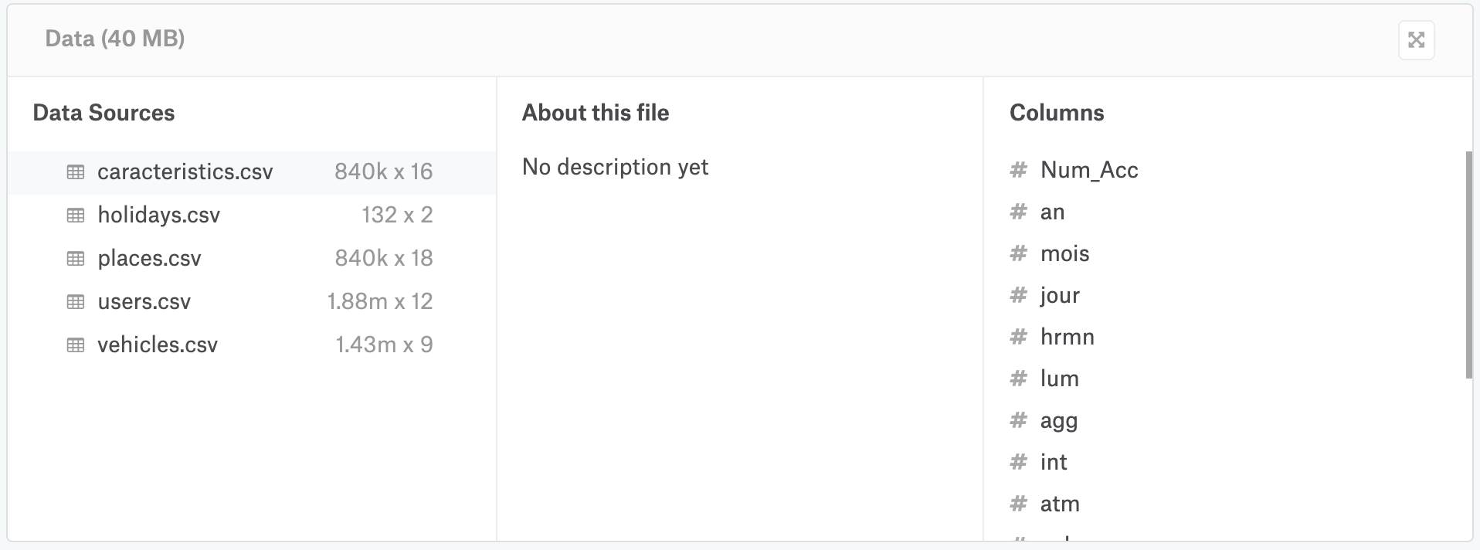
Besides, We have 300,000+ valid data items.

Slide 6
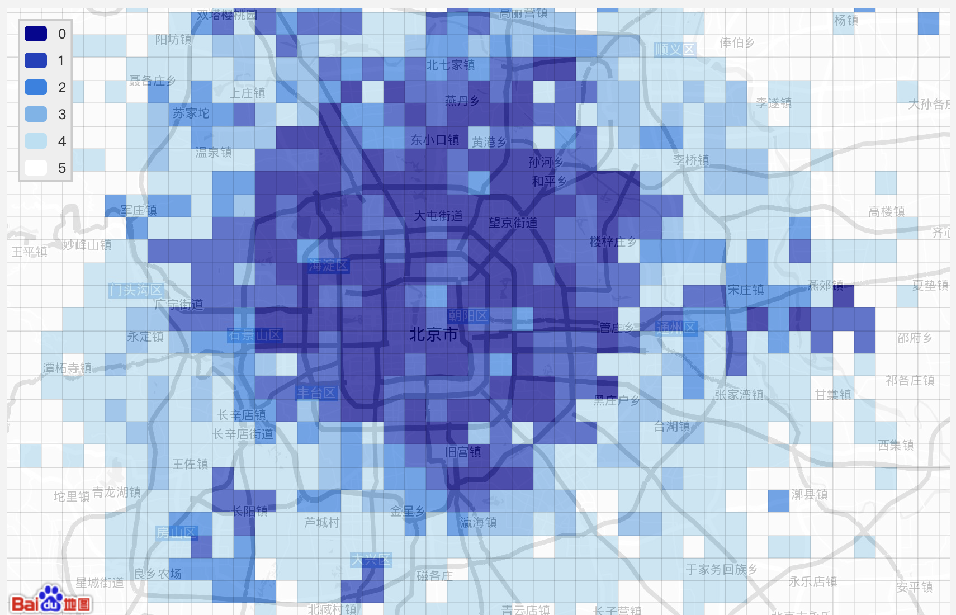
Description - Contact / Scenarios
Our software is aimed at the Ministry of Transport. Powered by Machine Learning and Data Mining technology, our system is going to figure out the possibility of accidents in certain conditions. At the same time, our system will tell users the predicted level of these accidents, such as how many people get injured.
What's more, it's easy and convenient for users to visualize the data. For instance, we provide a map to show all the accidents at a certain time. Move and click, and then you will get the detailed information about the accident you click. Furthermore, we can find statistics plots about weather, types of roads, types of vehicles and so on.
By the way, users can uploads new accidents into the database.
B/S framwork
smartphone and PC
Three languages

Slide 7
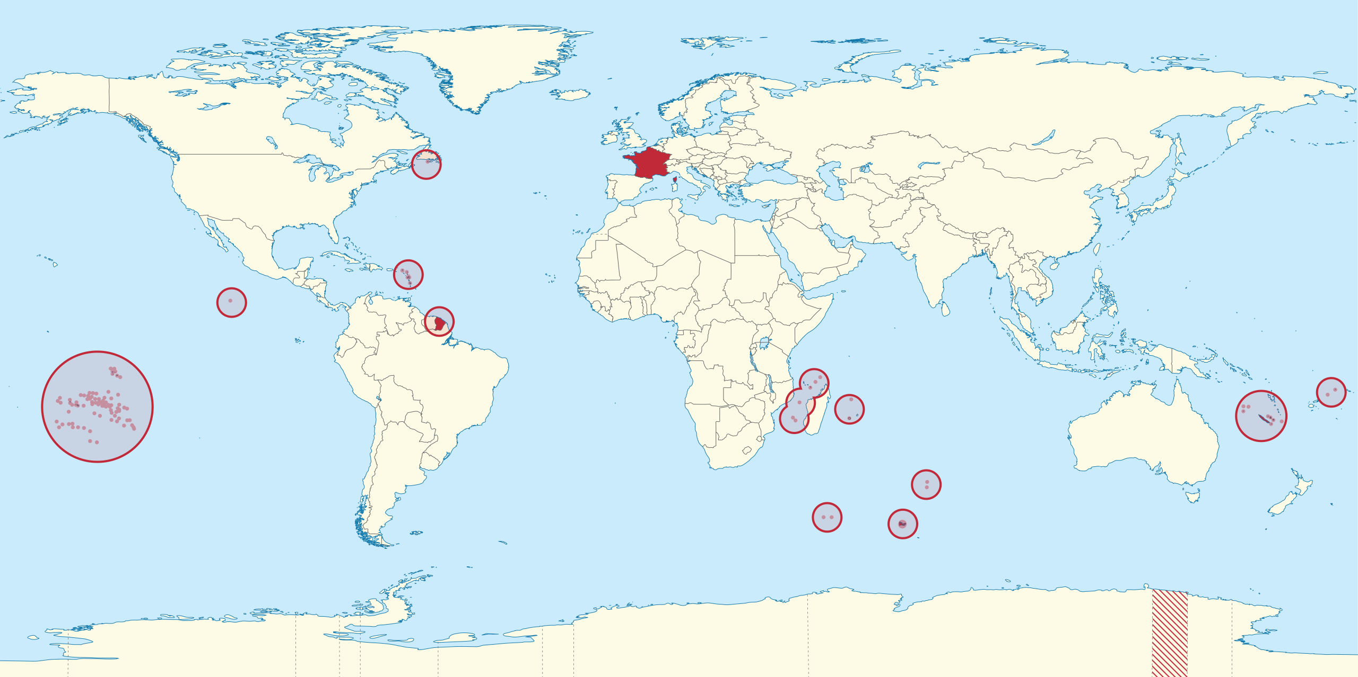
Description - Contact / Scenarios
Our system is based on B/S framwork, so officers can use it accessibly by both smartphone and PC.
In order to be international, our system will support 3 languages: French, English and Chinese.

Slide 8
Description - Difficulties
It is difficult to find out a proper model for machine learning to fit our project.
Our dataset has so many attributes and data items that it is hard for us to classify and clean them. It may cost a lot of time.
We have a lot of knowledge which may be used later to learn before coding and analyzing.
B/S framwork
smartphone and PC
Three languages

Slide 9
Description – Goals of the application
Provide users with the prediction of accidents at certain conditions.
Provide convenient tools to visualize data.
Provide interactive forms to uploads latest accidents.
B/S framwork
smartphone and PC
Three languages

Slide 10
Use Case Diagram

Slide 11
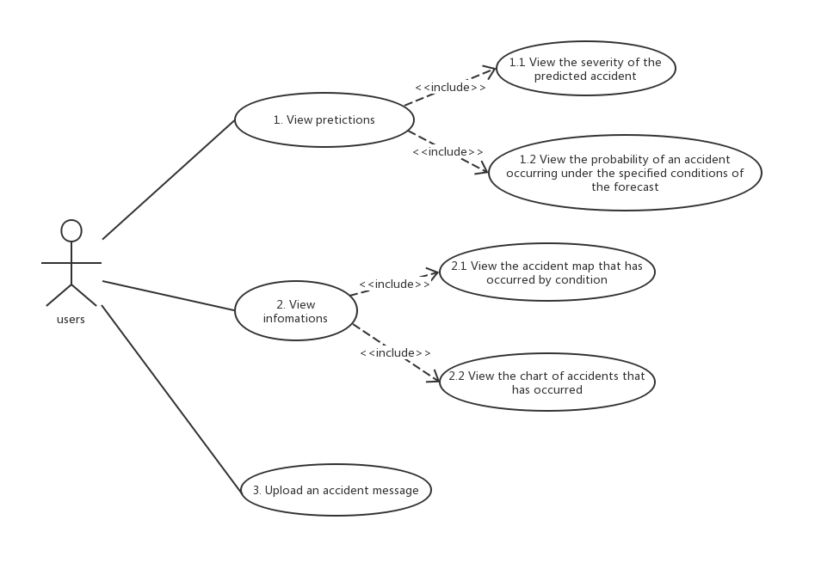

Slide 12
Class Diagram

Slide 13
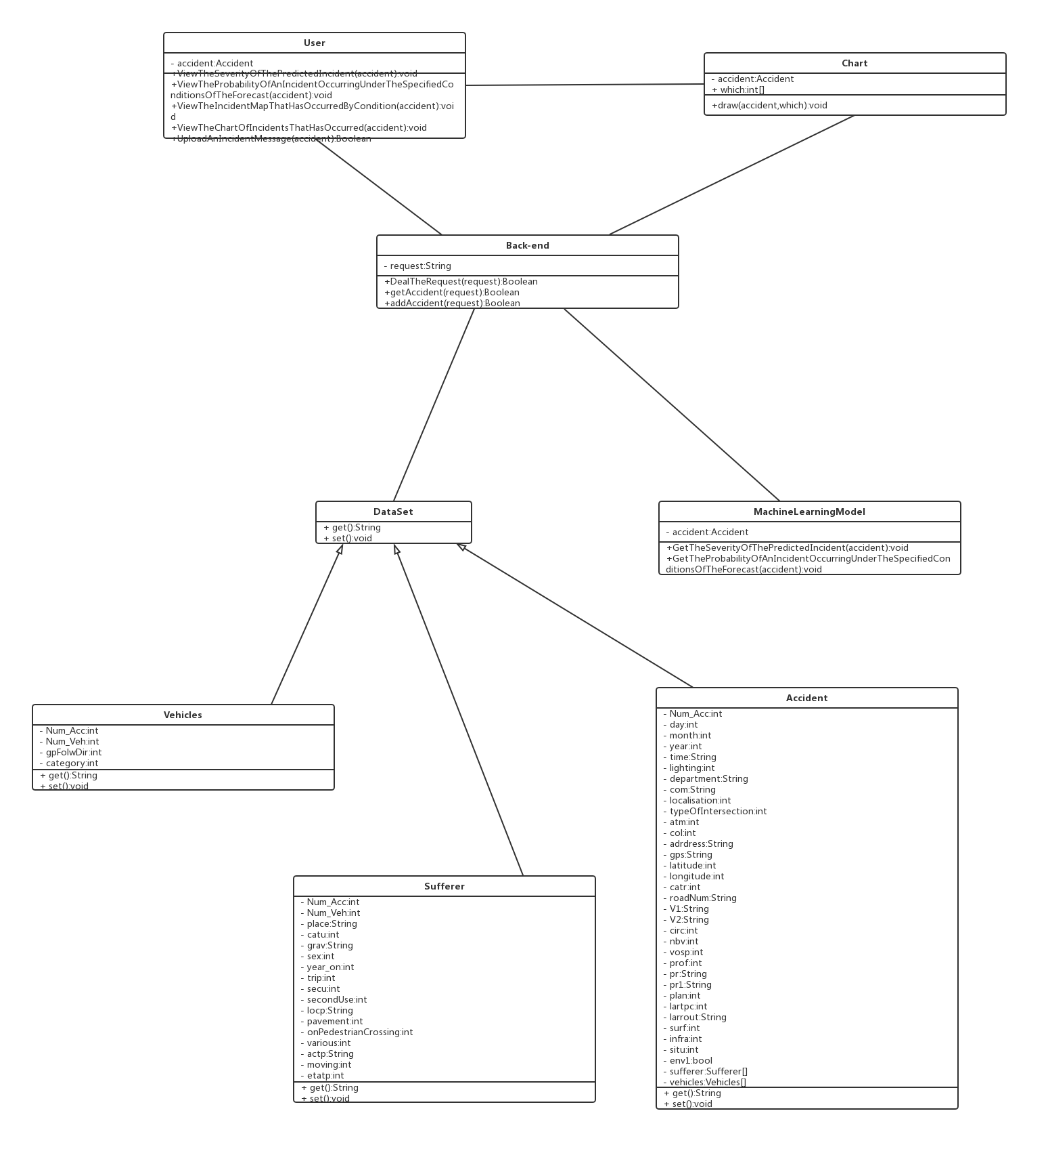
The Whole Class
·User, Chart
·Back-end
·MachineLearningModel
·DataSet

Slide 14
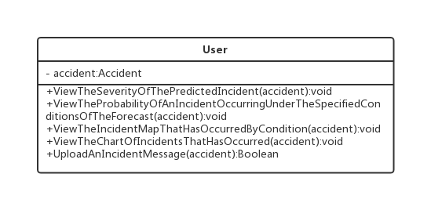
User
Users who use our products.

Slide 15
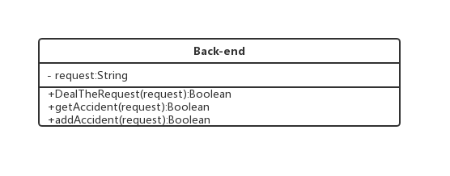
Back-end
The back end in our B/S Architecture.

Slide 16
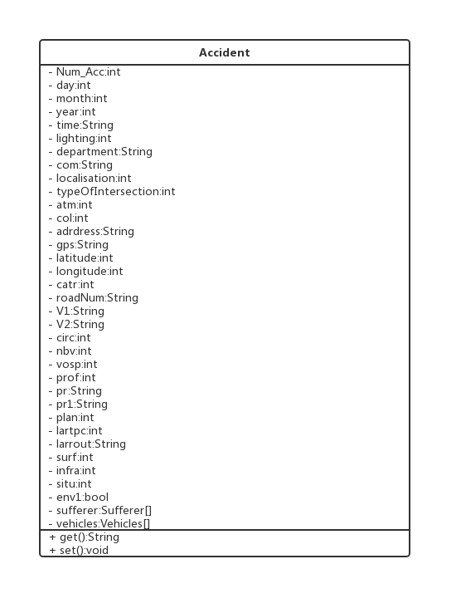
Accident
Specific information about the accident.

Slide 17
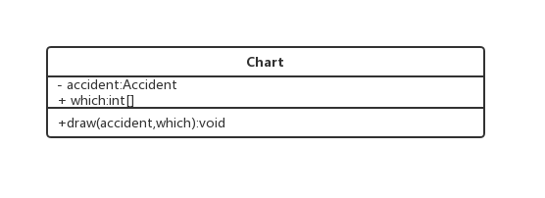
Chart
To present visual results.

Slide 18
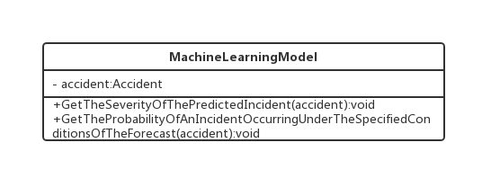
MachineLearningModel
A Machine Learn Model is going to predict the severity of an incident and the probability of an accident occurring under specified conditions.

Slide 19
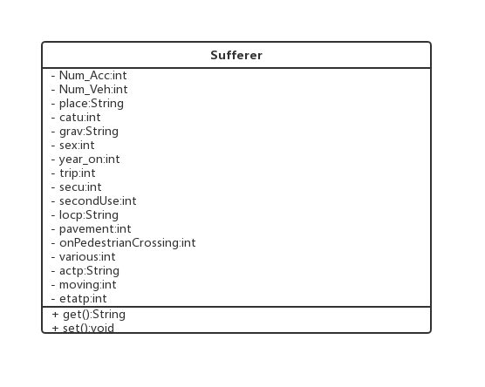
Sufferer
The person in accident.

Slide 20
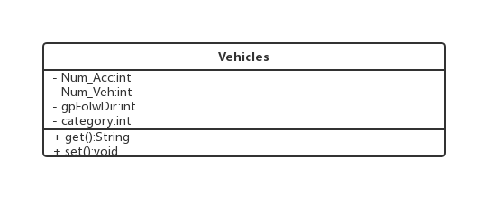
Vehicles
The vehicles in accident.

Slide 21
Sequence Diagram

Slide 22
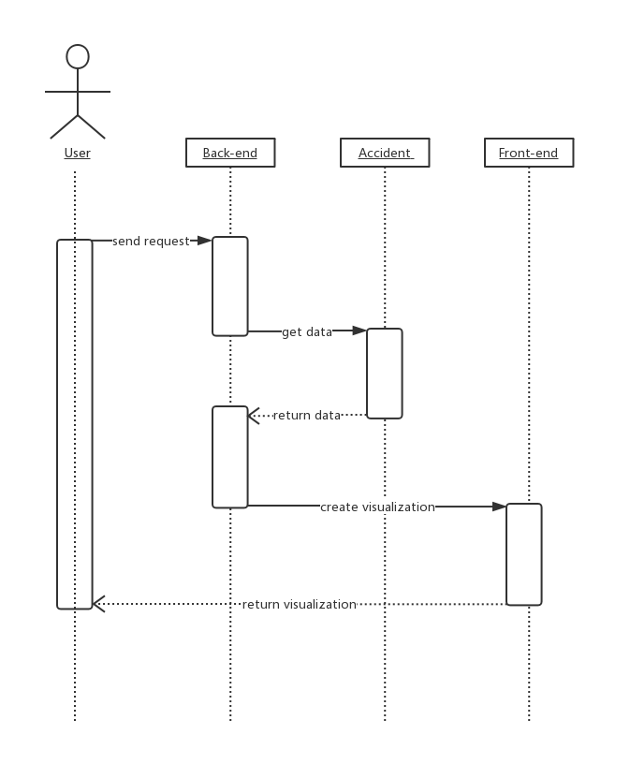
Visualize
Users can query the specified range of accidents, then get a visual map.

Slide 23
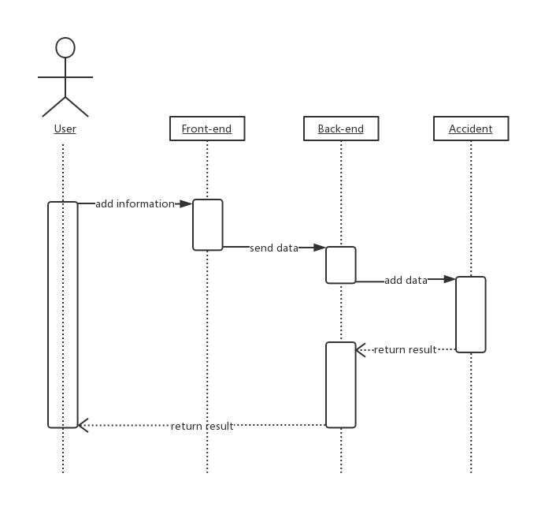
Upload
Users can upload accidents through our system.

Slide 24
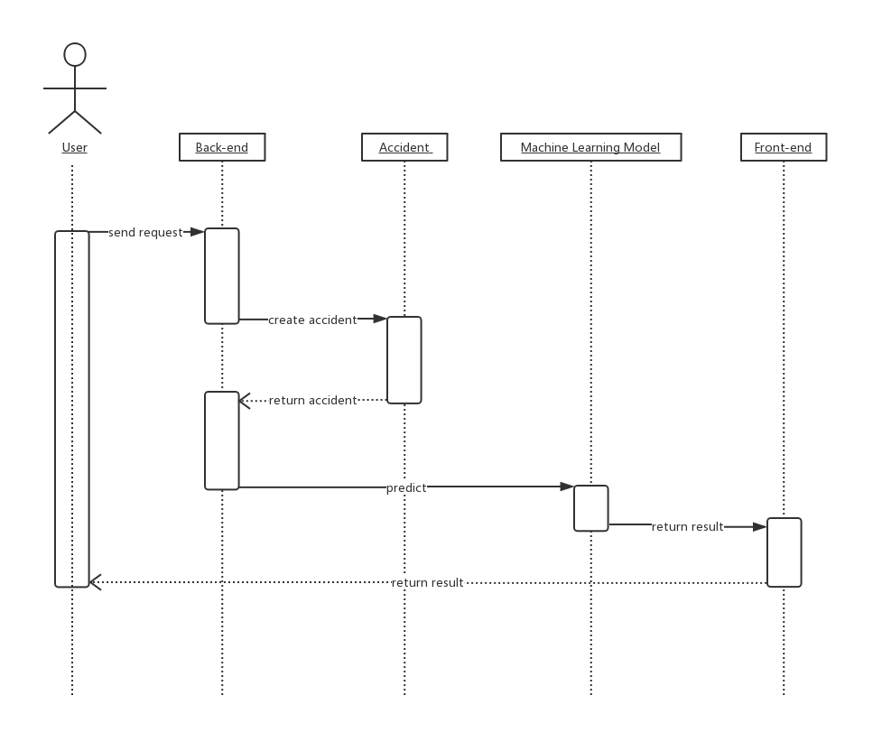
Predict
·Predict the probability of an accident occurring under specified conditions
·Predict the severity of an incident.

Slide 25
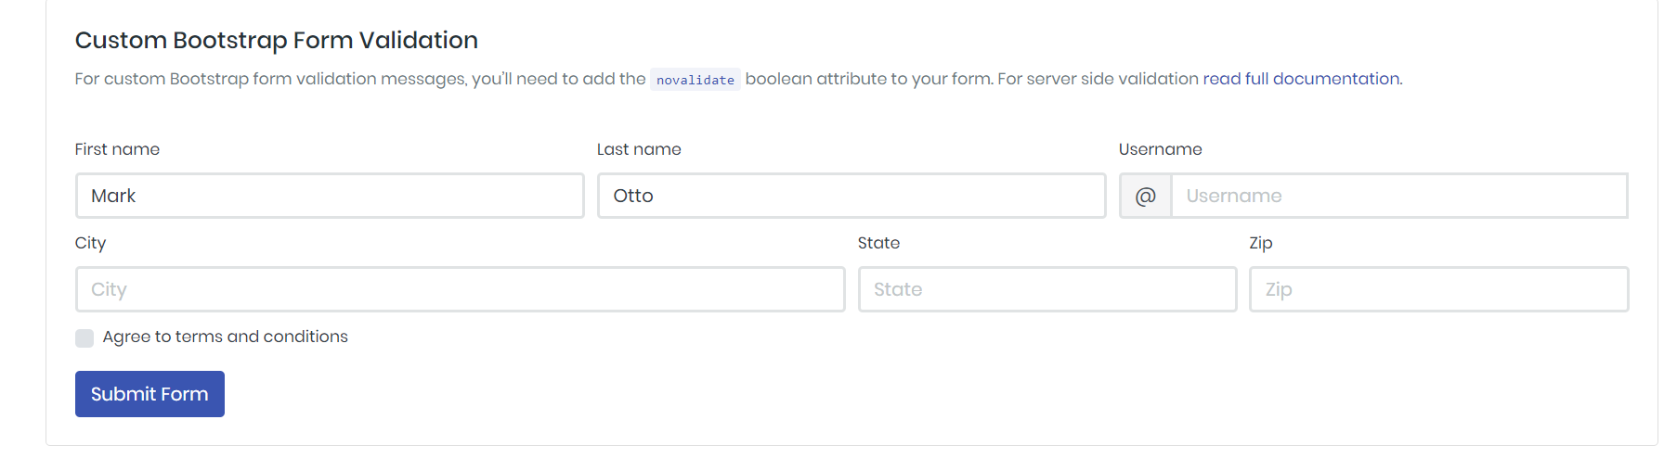
GUI - Example
Upload Accidents
B/S framwork
smartphone and PC
Three languages

Slide 26
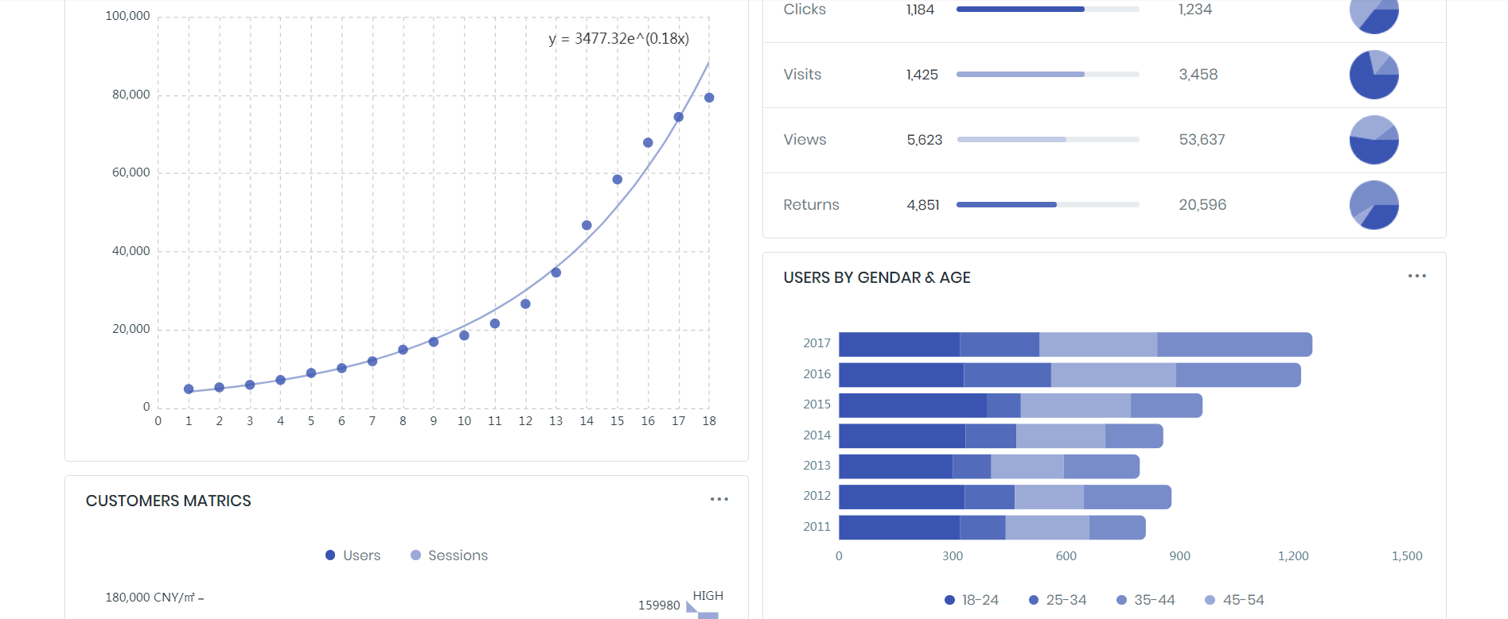
GUI - Example
Quary Accidents
B/S framwork
smartphone and PC
Three languages

Slide 27

GUI - Example
Accident Map
B/S framwork
smartphone and PC
Three languages

Slide 28
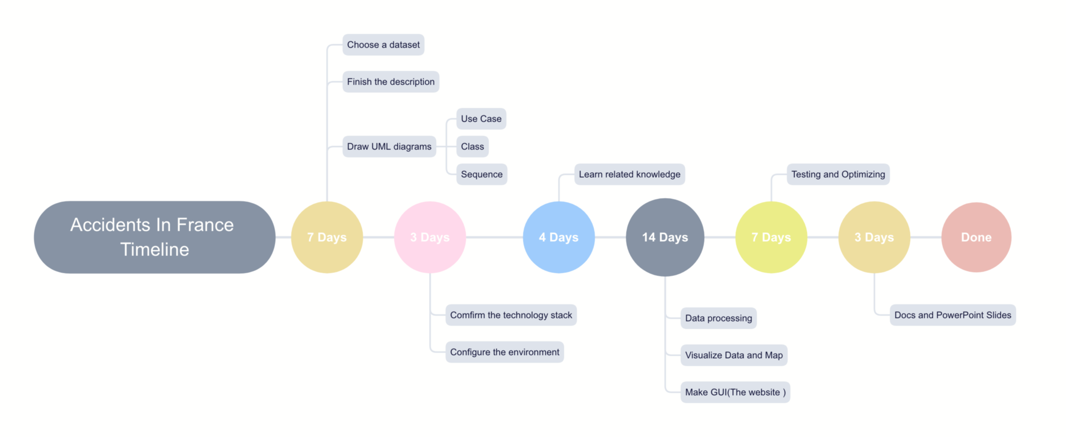
Timeline

Slide 29
THANK YOU
Group 4
2019.5.6
2019

