Slide 1
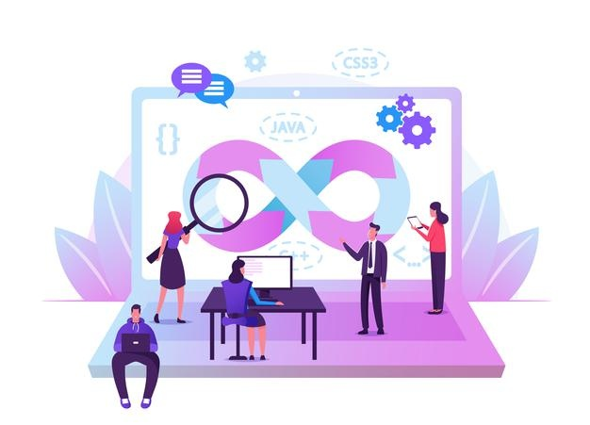

INTRODUCTION TO DEVOPS & HANDS-ON STARTUP

Slide 2
CONTENTS OF THIS LECTURE
Introduction to DevOps.
Jira & Git
Agile Methodology
Scrum
Sprint
Scrum roles in detail
Jira tool
Version control system (CVCS/DVCS)
(GIT Github GitLAB Bitbucket)

Slide 3
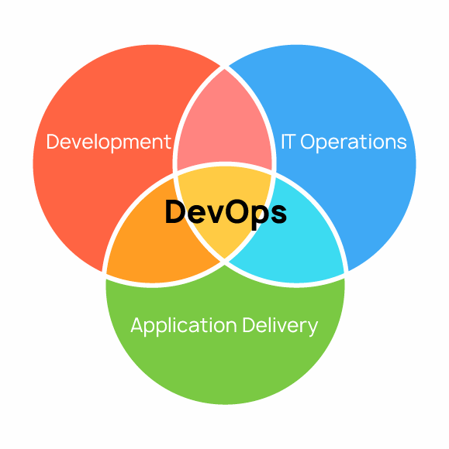
DevOps Architecture
Why do we need to have a single unified pipeline architecture?
A simple representation of the word DevOps:

Slide 4
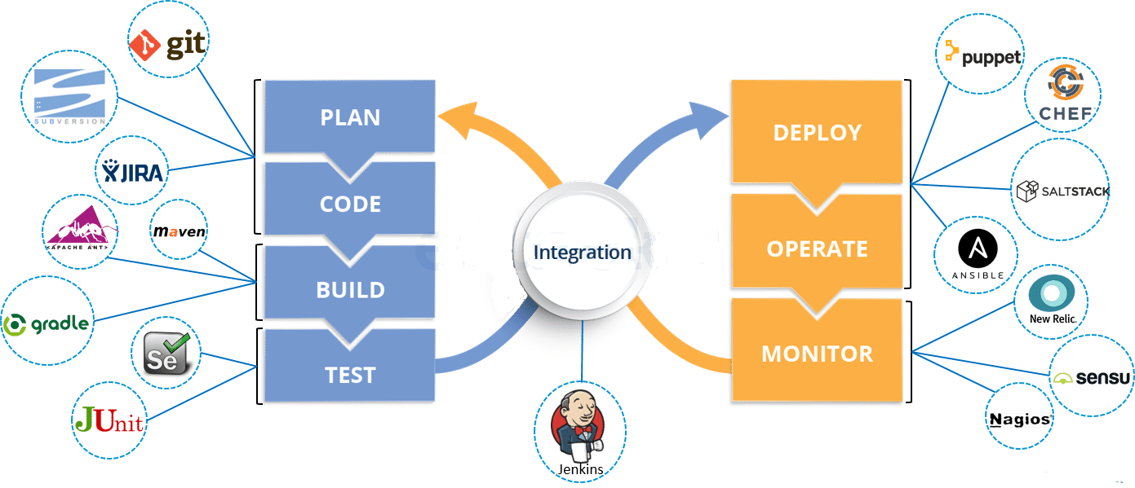
DevOps Architecture
A complete representation of the word DevOps:

Slide 5
AGILE METHODOLOGY
Why do we need project management and what impact will it have on our project?
Agile methodology is a type of project management process, which was first described in 2001.
Agile is a response to a sequential style of software development where the business states its requirements, and IT delivers software to meet them.
Here collaborative effort of developer and customer will enable a service to fulfill its demands and provide solutions to any shortcomings.
It encourages frequent inspection and adaptation.
In short, agile favors speed of delivery, testing, and continuous feedback.

Slide 6
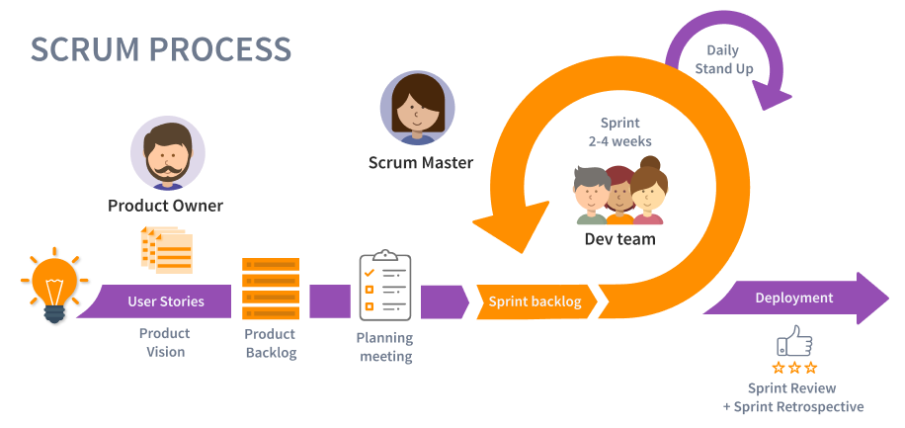
SCRUM
Scrum is an agile project management framework. It describes a set of meetings, tools, and roles that work in concert to help teams structure and manage their work.
The term is borrowed from rugby, where a scrum is a formation of players. The term scrum was chosen because it emphasizes teamwork.

Slide 7
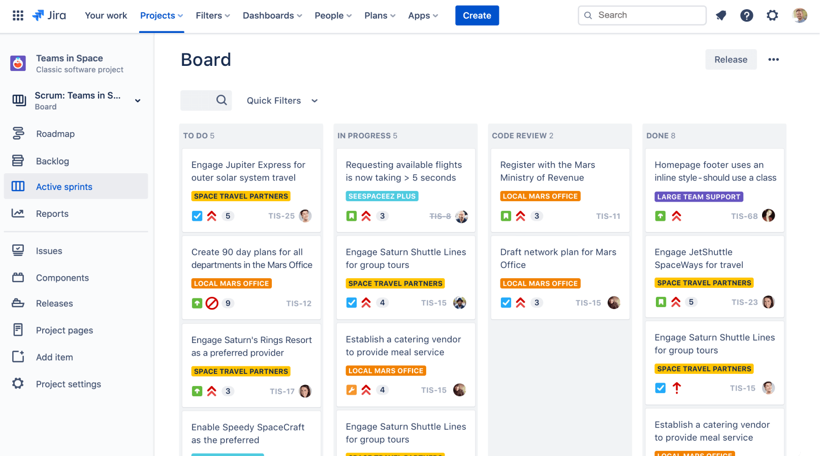
JIRA
WHAT IS JIRA AND WHY DO WE NEED IT?
It is a PLAN and TRACK tool used for management and road map of a team or an organization.
Easy integration helps improved workflow.
Notes:
Plan = requirements
Track= sprint helps us in this

Slide 8
Important aspects:
Collect requirements by RE team.
Setup Requirements/Issues.
Prioritizing the requirements.
Roles :
Product Owner
Project Manager
Team lead
Scrum Master
Developers
Sprint- creating a timeline for each requirement and the whole project.
BACKLOG

Slide 9
VERSION CONTROL SYSTEM (VCS)
A version control system helps the developer team to efficiently communicate and manage(track) all the changes made to the source code by telling who made changes and what change have been made.
Benefits include:
Traceability.
Document History.
Branching And Merging.
Identity.
Reduction Of Duplication And Errors.
Management Overview.
Open Channels Of Communication.
Famous examples include:
GitHub , Beanstalk, AWS Code Commit , SVN- (subversion)- needs separate server
and client
Notes:
Implementing Jira + version control means less jumping in and out of different interfaces, which can impact development productivity.

Slide 10
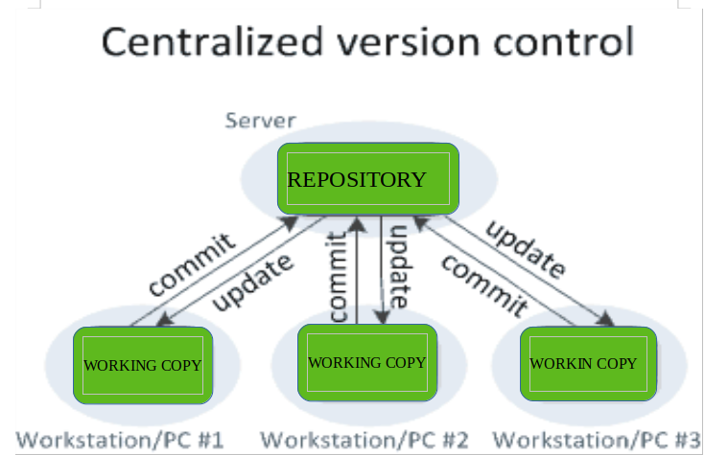
Types of VCS
Local Version Control Systems:
It is one of the simplest forms and has a database that kept all the changes to files under revision control. RCS is an example, by updating directory(patch).
Centralized Version Control Systems: (CVCS)
Two things are required to make your changes:
You commit
They update
It allows administrators to control over
who can do what.
Distributed Version Control Systems: (DVCS)
Created to overcome single point of failure.
Each user has their own repository and working copy.
To make your changes visible to others, 4 things are required:
You commit
You push
They pull
They update

Slide 11
GIT & GITHUB & GITLAB & BITBUCKET
As discussed before it is a DVCS, but all 3 of these have different roles in doing so.
Simply put, Git is a version control system that lets you manage and keep track of your source code history.
GitHub is a cloud-based hosting service that lets you manage Git repositories. If you have open-source projects that use Git, then GitHub is designed to help you better manage them.
GitLab is more focused on offering a features-based system with a centralized, integrated platform for web developers.
Git is a distributed version control system while Bitbucket is a web-based version control repository hosting service for development projects that use Git or Mercurial

