Slide 1

MetaFeature‑Orchestrator
Automated Evaluation and Agentic Prompt Orchestration for Large‑Scale AI
Jane Huang
01/26/2026
Notes:
Today I want to talk about something many AI teams might underestimate — that is how to scale evaluation.
Not just score models. Not just run benchmarks.
But how to make evaluation scale across hundreds of features, languages, and evolving models.

Slide 2

Executive Summary
Scale and autonomy make manual and ad-hoc AI evaluation untenable.
Evaluation must be treated as governed platform infrastructure, not a QA process.
Metadata-driven orchestration enables auditability and cross-feature consistency.
Responsible AI requirements are enforced structurally to scale innovation without eroding trust.
Notes:
“Let me summarize the core idea. Scale and autonomy make manual evaluation impossible.
If every feature team:
Writes their own prompts
Chooses their own metrics
Applies Responsible AI checks slightly differently
You lose consistency. You lose comparability. You lose trust.
So I treat evaluation as governed platform infrastructure.
But governance alone isn’t enough.
The key is metadata-driven orchestration.
That’s what makes it scalable.
And Responsible AI isn’t a checklist — it’s structurally enforced inside the orchestration layer.”

Slide 3

Problem Statement
Manual, feature-specific evaluation cannot scale to Apple’s global, fast-moving AI ecosystem.
At this scale, evaluation must be treated as core platform infrastructure rather than downstream QA.
LLM-as-judge improves throughput but fails without prompt governance, leading to drift and inconsistency.
The true bottleneck is the absence of a governed evaluation layer, not a lack of evaluators.
Notes:
“At large scale, evaluation fails in four ways:
Feature-specific evaluation doesn’t generalize.
LLM-as-judge increases throughput but introduces drift.
Prompts evolve informally over time.
Risk enforcement becomes inconsistent across teams.
The deeper issue is this:
Evaluation today is treated as content — but it should be treated as code.
Without a governed evaluation layer, you cannot:
Compare scores across time
Compare scores across features
Or ensure consistent RAI enforcement
The bottleneck is architectural, not human.”

Slide 4

Feature Taxonomy and Category
Quality is task- and risk-specific, requiring taxonomy-driven evaluation.
Taxonomy governs valid metrics, risks, and evaluation semantics.
Metrics evolve under human governance with controlled versioning.
Category | Representative Features | Primary Evaluation Focus
Summarization | Email summaries, article digests | Faithfulness, coverage, hallucination avoidance
Auto‑Reply & Writing Assistance | Smart Reply, Writing Tools | Relevance, tone, privacy, social appropriateness
Translation | Live translation, message translation | Semantic equivalence, fluency, cultural alignment
Assistant & Reasoning | Task planning, shortcuts | Correctness, grounding, reasoning validity
Creative Generation | Image Playground, Genmoji | Safety, bias, policy compliance
Canonical Feature Categories
Notes:
“Scalability starts with abstraction.
Quality is not universal.
A summarization model fails differently from a creative generator. A translation feature fails differently from a personal assistant.
So instead of writing evaluation logic per feature, I define canonical feature categories.
Each category defines:
What metrics are valid
What risks are dominant
What Responsible AI gates are required
For example:
Summarization , we focus Faithfulness, coverage & hallucination avoidance Translation, we focus Semantic equivalence & cultural alignment This taxonomy becomes the foundation for reuse.
When a new feature launches, we don’t invent evaluation from scratch — we map it to a category and inherit its evaluation contract.” Be noted that we also need to provide a controlled custom category for novel or emerging feature types. Features assigned to this category must explicitly declare their evaluation metrics and are subject to mandatory Responsible AI enforcement, ensuring that innovation does not bypass.

Slide 5

System Design Principles
Auditability & traceability
Structural Responsible AI enforcement
Cost‑aware orchestration
Notes:
“There are three principles that make this scalable in practice.
First: Auditability and traceability.
Every evaluation prompt is versioned. Every metric is explicitly defined. Every output is structured JSON.
This makes evaluation reproducible.
Second: Structural Responsible AI enforcement.
Safety, privacy, and bias are not optional scoring dimensions. They are hard gates embedded in the template.
Third: Cost-aware orchestration.
Scalability is not just technical — it’s economic.
If every evaluation requires multi-step agent reasoning, cost becomes the bottleneck.
So we separate deterministic and agentic modes.”

Slide 6


Dual‑Mode Architecture
Template Mode – Canonical & reproducible
Agentic Mode – Novel & complex features
Aspect | Template Mode | AI Agent Mode
Framework | Pure Python | Microsoft Agent Framework
Planning | Hard-coded workflow | Dynamic LLM reasoning
Tool Use | None | 9 tools via @ai_function
Memory | Stateless | Thread-based conversation
Decision Making | Deterministic code paths | LLM-driven decisions
Speed | Instant | Requires API calls
Cost | Free | API costs
Best For | Simple, well-defined features | Complex, novel features
Notes:
This is the core architectural decision.
We intentionally built two modes.
Template Mode is pure Python. It’s deterministic. No dynamic reasoning. It’s fast, predictable, and essentially free to run at scale.
Agent Mode is built on the Microsoft Agent Framework. It can use tools. It has memory. It makes dynamic decisions.
So why do we need both?
Because scalability has two dimensions.
Operational scale — handling massive volume — that’s Template Mode. Complexity scale — handling novel, ambiguous tasks — that’s Agent Mode.
Template Mode handles volume. Agent Mode handles novelty.
Determinism protects the system. Agent autonomy improves the system.
And any real production system evolves over time. We start with these two modes, monitor performance and feedback, and let data guide how each one expands or replace.
Stability is the foundation. Intelligence is the accelerator.

Slide 7


Template Mode: Prompt Orchestration Flow
1. Feature metadata
2. Category & locale resolution
3. Metric selection
4. RAI injection
5. Template instantiation
6. JSON‑structured output
Each generated prompt includes:
Template Structure
Section | Purpose
1. Evaluator Role & Task | Clear role definition and task description
2. Hard FAIL Gates | Safety, Privacy, Toxicity, Legal gates with automatic override
3. Primary Metrics | Metric definitions with weights and 1-5 scoring scale
4. Second-Order Signals | Fluency, linguistic naturalness, localization quality, regional compliance
5. Evaluation Protocol | Step-by-step evaluation process
6. Responsible AI Checklist | Locale-specific RAI checks
7. Output Format | Structured JSON schema
Category-Specific Hard Gates
Template | Hard Gates
Generic | Safety, Privacy, Toxicity, Legal
Summarization | Hallucination, Safety, Privacy, Factual
Translation | Meaning, Offensive, Safety, Legal
Auto-Reply | Relevance, Safety, Privacy, Tone
Personal Assistant | Privacy, Consent, Safety, Medical, Financial
Notes:
“This slide shows how scalability becomes mechanical.
We don’t manually write prompts.
We assemble them based on:
Feature metadata
Category & locale resolution
Metric selection
RAI injection
JSON output enforcement
Each template has a fixed structure:
Evaluator role
Hard fail gates
Primary metrics with weights
Second-order signals
Evaluation protocol
Responsible AI checklist
Structured output format
Hard gates override scoring.
If privacy or safety fails, the feature fails — regardless of metric averages.
This makes risk enforcement scalable and consistent.”

Slide 8
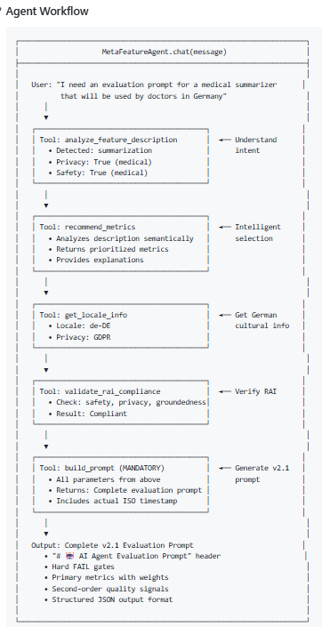

Agent Mode
An AI agent built on Microsoft Agent Framework that uses LLMs to make dynamic decisions about metric selection, RAI compliance, and prompt generation.
What’s an AI agent:
An AI agent is a system that reasons, takes actions using tools, and adapts over time to achieve a goal.
Advantage of AI agent:
Goal-directed autonomy
Reasoning + action loop
Tool use (beyond text generation)
State and memory
Feedback-driven adaptation
Tool | Purpose
lookup_metrics | Find metrics for a category
suggest_metrics | Get recommendations for additional metrics
recommend_metrics | Intelligent metric selection with architecture detection
get_locale_info | Get cultural/regulatory info for a locale
validate_rai_compliance | Check if metrics meet RAI requirements
build_prompt | Generate the v2.2 evaluation prompt with additive metric policy
get_code_metrics | Get programmatic metrics sample
analyze_feature_description | Extract attributes from natural language
Notes:
When a feature is new or ambiguous, deterministic rules aren’t enough.
Agent mode introduces goal-directed reasoning.
The agent can:
Look up relevant metrics
Suggest additional ones
Detect architecture type
Retrieve locale regulatory info
Validate RAI compliance
Construct updated evaluation prompts
But importantly: It uses tools. It doesn’t hallucinate structure.
This makes it adaptive but still governed.”

Slide 9
Case Study: Prompt Comparison
Dimension | AI Agent–Generated Prompt | Deterministic Template Prompt
Source | AI agent–generated | Human-authored deterministic template
Primary goal | Deep, feature-specific agentic evaluation | Stable, repeatable quality & compliance contract
Design philosophy | Maximalist, adaptive, research-grade | Minimalist, conservative, production-grade
Reasoning transparency | Required and scored | Partial / indirect
Temporal reasoning depth | Very high (temporal accuracy emphasized) | Medium
Privacy model | Dynamic (over-inference, modality leakage) | Static (PII, consent, minimization)
Responsible AI framing | Embedded throughout metrics | Checklist-driven
Metric count | Very high (≈20+ primary metrics) | Moderate
Scoring granularity | Fine-grained, weighted | Coarser, simpler
Evaluator cognitive load | High | Low–medium
Automation readiness | Medium | High
Best suited for | Research, red-teaming, pre-launch deep dives | Production QA, compliance, large-scale evals
Core strength | Insight, coverage, agent failure detection | Stability, consistency, operational clarity
Core limitation | Complexity, evaluator fatigue | Blind spots for agentic failures
Bottom-line role | Improves the system | Protects the system
Sample Prompt
Sample Prompt
Notes:
This comparison makes the tradeoff very clear.
With the agent-generated prompt, you get:
20+ evaluation metrics
Very fine-grained reasoning
High transparency
But it also comes with higher cognitive load.
It’s ideal for research, deep diagnostics, and red-teaming — where you want maximum insight.
With the template prompt, you get:
A focused set of core metrics
Stable, repeatable outputs
Clear operational logic
Strong automation readiness
So the right choice depends on the scenario.
If you need stability and high volume — use the template. If you need depth and adaptability — use the agent.
And in many real-world systems, the best solution is hybrid — let the template handle the bulk automation, and let the agent step in when human judgment or deeper reasoning is required.
It’s not either-or. It’s about designing the right balance.

Slide 10
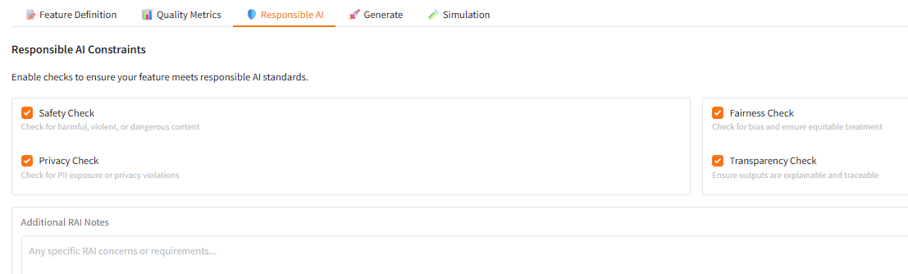
Responsible AI by Construction
Privacy protection
Bias & safety enforcement
Hallucination detection
Notes:
“This is where governance meets scalability.
Responsible AI exists at three structural layers:
Privacy protection Bias & safety enforcement Hallucination detection
These are not advisory — they are embedded.
For example: If a translation leaks PII → automatic fail. If a summarization invents medical advice → automatic fail.
As the product expands to new markets, locale-specific RAI requirements are injected automatically.
Trust scales with product growth.”

Slide 11

Demo
Notes:
I will demo the meta feature orchestrator web app that I build by myself in another video with tons of examples.

Slide 12

Key Takeaways
Elevates AI evaluation into governed platform infrastructure aligned with Apple’s quality and ethical standards.
Encodes human judgment into deterministic systems to enable safe, scalable innovation with accountability.
Provides a future-proof foundation for agentic AI through real-time, adversarial, and trajectory-level evaluation.
Notes:
“Let me close with three points.
First: Evaluation must scale horizontally across features and locales.
Second: It must scale vertically across complexity — including agentic systems.
Third: It must scale economically and operationally across teams.
MetaFeature-Orchestrator turns evaluation from a manual bottleneck into governed, scalable infrastructure.
Because as AI systems become more autonomous, evaluation must become more architectural.”
Thanks for watching

