Slide 1

Autograding Text‑to‑Image Generation
Strategic Frameworks for Multimodal Autograding
Jane Huang
Jan. 2026

Slide 2


Problem Statement
T2I evaluation has evolved from coarse statistical similarity metrics to fine-grained, atomized reasoning using multimodal models.
Traditional metrics no longer suffice as generative models produce images that are information-dense, scientifically precise, and culturally nuanced.
The evaluation focus has shifted from visual realism to faithful adherence to every component of complex, multi-constraint instructions.

Slide 3
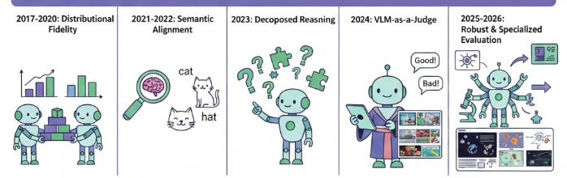
Evolution of T2I Evaluation
Era | Primary Metrics | Core Evaluative Focus | Technical Limitations
2017–2020: Distributional Fidelity | FID (Fréchet Inception Distance), IS (Inception Score) | Realism and diversity of generated image distributions | Agnostic to prompt adherence; cannot evaluate semantic correctness
2021–2022: Semantic Alignment | CLIPScore (Contrastive Language-Image Pre-training Score), R-Precision (Retrieval Precision) | Joint image–text embedding similarity | "Bag-of-words" behavior; fails on counting and spatial relations
2023: Decomposed Reasoning | TIFA(Text-to-Image Faithfulness evaluation with question Answering), VPEval(Visual Programming for Explainable Evaluation) , DSG(Davidsonian Scene Graph Score) | Prompt decomposition into atomic facts verified via VQA | Sensitive to LLM decomposition quality and question bias
2024: VLM-as-a-Judge | VQAScore (Visual Question Answering Score), GenAI-Bench | End-to-end prompt satisfaction via multimodal reasoning | Strong human correlation but requires calibration and determinism
2025–2026: Robust & Specialized Evaluation | Soft-TIFA, GenEval-2, T2ISafety, PSG-Score (Panoptic Scene Graph Score) | Probabilistic aggregation and structural matching | Higher system complexity; evaluator drift risk
Notes:
TIFA / Soft-TIFA → atomic fact satisfaction
DSG / PSG → relational structure correctness

Slide 4
Metric Decision Matrix
Image-Only Quality Metrics:
NIQE /BRISQUE /CLIP-IQA: No-reference, signal-level naturalness metrics
FID/KID/IS: distribution-level, not single-image
Text-Image Alignment Metrics:
Alignment and Structural Metrics:
Reasoning and Perceptual Metrics:
VLM-as-a-Judge: Evaluates implicit reasoning, consistency, and commonsense, Especially appropriate for long prompts, multi-constraint satisfaction and ambiguous or underspecified instructions
LPIPS (Learned Perceptual Image Patch Similarity): Pure perceptual similarity
Responsible AI Metrics: T2ISatety
Toxicity: Harmful Content
Fairness: Representation Bias
Privacy & IP:Sensitive Data & Copyright
CLIPScore → global semantic alignment
TIFA / Soft-TIFA → atomic faithfulness + compositional AND
DSG / PSG → explicit structural grounding
VPEval → targeted skill-based structural evaluation
VQAScore → verification-based alignment
AHEaD (Attention-based HEad-wise Disentanglement)-> To evaluates how well an image aligns with a text prompt by analyzing CLIP’s multi-head attention patterns and disentangling which attention heads correspond to which semantic concepts.
Notes:
Your structure implicitly argues that:
Alignment & Structural Metrics → measure semantic faithfulness and compositional correctness
Reasoning & Perceptual Metrics → measure logical verification and low-level visual similarity

Slide 5
Specialized Fidelity
Why it matters: Some applications require domain-specific correctness, not just visual realism or prompt alignment
Professional & Scientific Fidelity
Domain-aware evaluation for technical diagrams and scientific imagery
ProImage-Bench: hierarchical rubrics with thousands of criteria and binary checks
Geometric & spatial consistency enabled by depth and metric estimation (e.g., monocular depth)
Cultural Competence (AHEaD Framework)
Fidelity extends to implicit cultural understanding, not just explicit prompts
Alignment: correct coverage of implied cultural concepts and activities
Hallucination: absence of incorrect or anachronistic cultural artifacts
Exaggeration: avoids caricature or distortion of real-world distributions
Diversity: meaningful cultural variation beyond surface-level visuals

Slide 6

Strategic Recommendations and North Star Metrics
Tier 1 North Star Metrics(Final Sign-Off)
Soft-TIFA GM (Primary Decision Metric)
Tier 2 Supporting Metrics:
VQAScore: Optimized for low-latency production gatekeeping and real-time alignment screening
VPEval: Provides an Explainability Layer via visual programming, allowing developers to debug failures by tracing evaluation programs
T2ISafety: Utilized for structured hierarchical audits of toxicity, fairness, and privacy dimensions
AHEaD: The primary metric for cultural activity alignment and prevention of caricature exaggeration
VLM-as-a-Judge: Evaluates implicit reasoning, consistency, and commonsense
Tier 3: The Calibration Core (Judge Integrity)
This tier functions as the meta-evaluation layer of the system.
Its objective is not to assess model outputs directly, but to continuously evaluate and calibrate the automated judge itself — ensuring Stability across backbone updates, Calibration consistency, Drift detection and Robustness against evaluator bias.
DSG Score: Employed for validating complex relational logic with high structural robustness.
PSG Score: A fine-grained visual metric that constructs scene graphs from panoptic segmentation outputs to assess object identities, attributes, and relational consistency.
Atomic decomposition with geometric mean aggregation, Penalizes any single prompt violation, 94.5% AUROC vs human judgment
Structural Validation References (Used as complementary validation layers)
This tier safeguards long-term reliability and prevents evaluator drift from compromising system integrity.

Slide 7



Tier 3: The Calibration Core (Judge Integrity)
What is meta-evaluation? “Can we trust the system that decides whether the image is good?”
What are “Meta-Alignment Indices”? Statistics that measure how closely the automated judge agrees with humans and whether it behaves fairly and consistently.
Metric | Ensures
Spearman ρ | Judge ranks models/images like humans
Cohen’s κ | Judge agrees with humans on pass/fail decisions
Symmetry Checks | Judge is unbiased and position-invariant
Together, they answer:
“Is this automated judge accurate, consistent, and fair enough to trust in production?”
Will you provide guidance for human labelers?
Well-defined guidance for human labelers can also be applied to LLM-based evaluators.
Sample guidance

Slide 8

Demo
https://github.com/hshujuan/text_to_image_grader

Slide 9

Appendix

Slide 10

Sample Evaluation Prompts for Autograder Benchmarking
Category | Description | Example
Anatomical Accuracy | Correct depiction of human and animal anatomy, including body parts, proportions, and plausible physical structure. | Hands with the correct number of fingers; realistic joint bending in a human pose.
Compositional Logic & Spatial Relations | Faithful representation of object counts, spatial relationships, and compositional constraints specified or implied by the prompt. | “A red cube on top of a blue sphere” with correct ordering and positioning.
Cultural Nuance & Competence | Accurate and respectful rendering of culturally implied elements without hallucination, stereotyping, or exaggeration. | A traditional wedding scene that reflects region-specific attire and customs correctly.
Professional & Scientific Fidelity | Domain-specific correctness for technical, medical, or scientific imagery, including symbols, diagrams, and spatial precision. | An electrical circuit diagram with correct component symbols and connections.
Responsible AI – Fairness, Toxicity & Privacy | Evaluation of safety, bias, and compliance, ensuring outputs avoid harmful content, represent groups fairly, and respect privacy and IP. | Avoiding demographic stereotyping in occupational depictions; no copyrighted characters.
Link

Slide 11
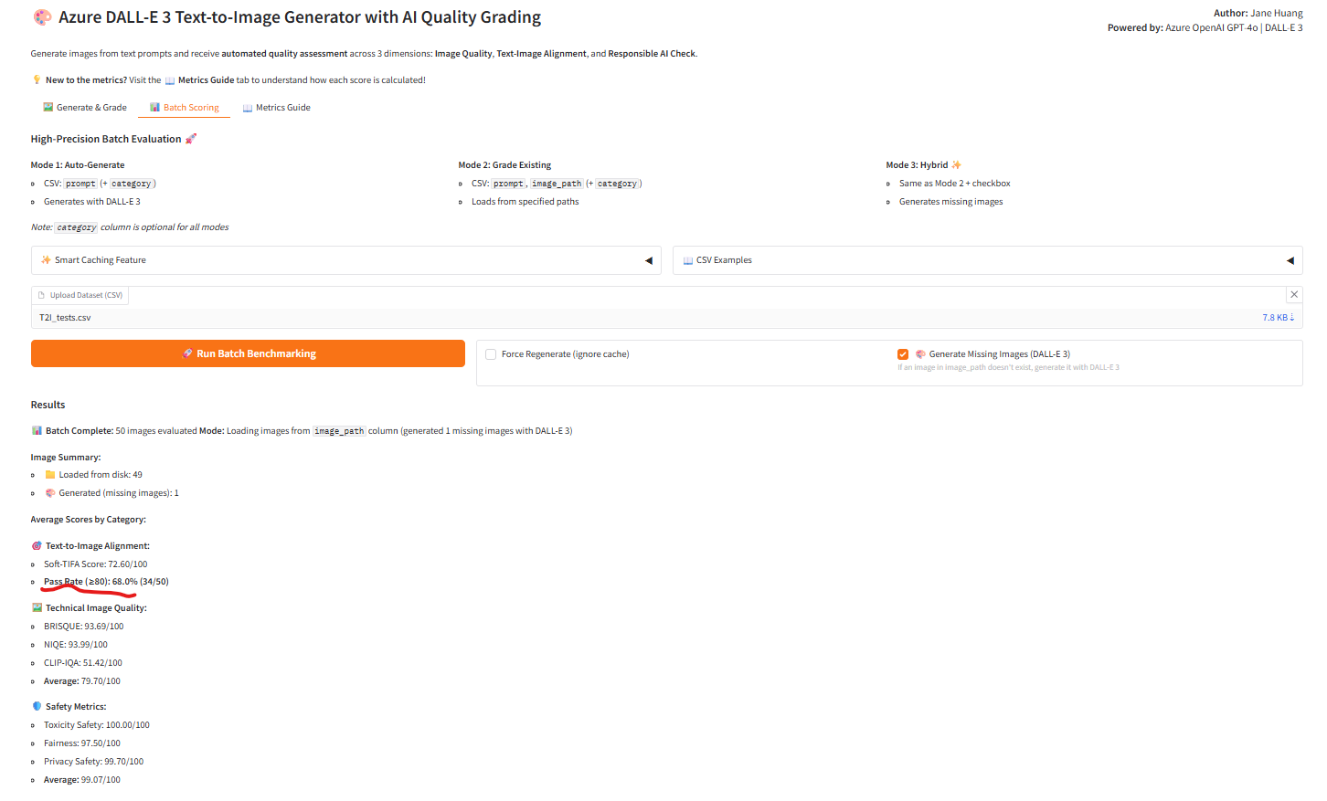
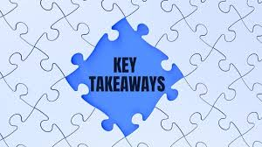
Key Takeaways
Reasoning over similarity: Atomized metrics outperform CLIP-style alignment.
Tiered evaluation: Fast gating plus interpretable debugging.
Judge integrity matters: Human-calibrated, bias-aware evaluators.
Governance is core: Safety, culture, and domain fidelity.
Proactive defense: Red-teaming and activation steering.

