Slide 1


Ball In One Manual
Team BagelGongChae2

Slide 2
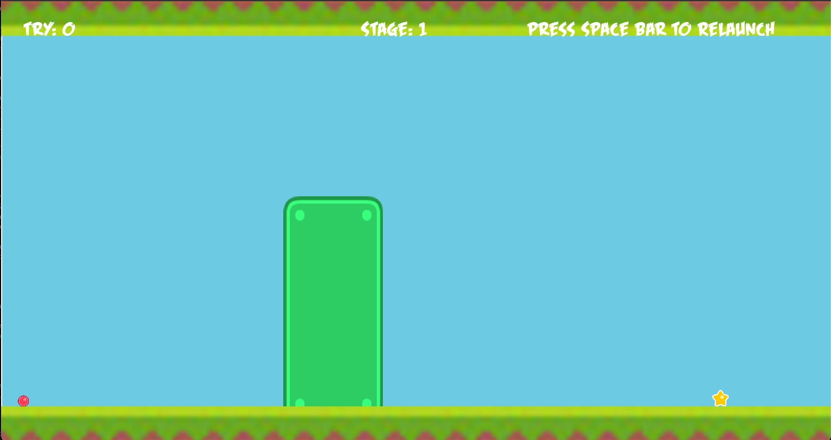
The Goal of the Game
Accomplish “Ball In One” for each stage
“Ball In One” : Hit the target in Only One shot
Try # will be increased if the player miss the shot

Slide 3

The Goal of the Game
Player can control the direction & velocity of the ball using mouse
Goes to the next stage when the target is hit
Obstacles migth be helpful
Realease
Drag
Left click

Slide 4


The Goal of the Game
When the player misses the shot, press space bar to restart the stage
The total number of tries will be counted

Slide 5
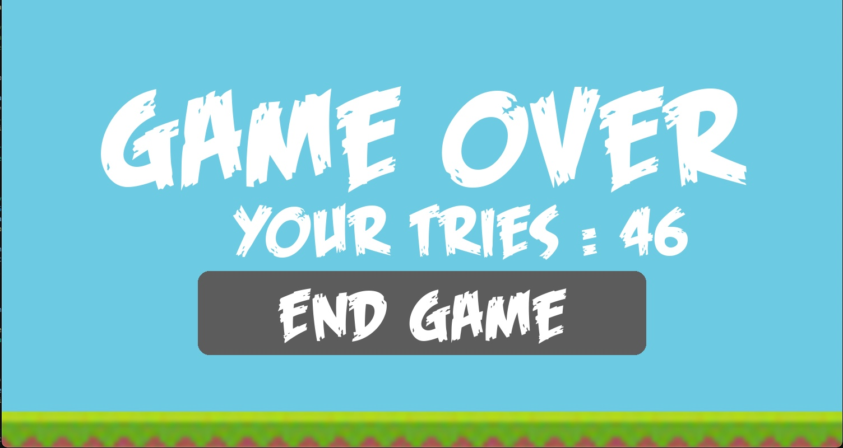
The Goal of the Game
“Ball In One” in a row, get the Perfect Score 8
Your goal is to get the perfect score!!

Slide 6
Enjoy!

