Slide 1


Human System Integration 101
Dr. Dimitri Masson
incose.org

Slide 2


HSI 101.
Dimitri Masson
Co-chair – Sector 2
A brief introduction to HSI
Assistant Professor in HSI
Incose TLI cohort 8
Grace Kennedy
Chair – Sector 4
Principal Consultant HF & SE @ Acmena

Slide 3




INCOSE HSI Wg
Firstname Lastname
Firstname Lastname
Firstname Lastname
Firstname Lastname
Co Chair – Sector 1
Chief Technologist Autonomous Systems
@ Collins Aerospace
Co-chair – Sector 1
Flight Deck Lead Engineer
@ Boeing
Co-chair – Sector 2
CEO, @ end to end Systems
Co-chair – Sector 3 Asia-Oceania)
COULD THIS BE YOU?

Slide 4
HSI Relevance
Vision 2035
  “Approaching 2035, socio-technical systems will be increasingly autonomous, incorporating more AI, will be massively interconnected, and must be collaborative, safe, secure and trusted.
  Analyzing and predicting system behavior will become more challenging, but systems engineers will be expected to analyze, design, and evaluate these systems with human and natural principles in mind. Systems engineering practice will include HSI methods for evaluating human factors and usability, identifying emergent behaviors, and detecting and managing unanticipated behaviors.
  Improvements in HSI methods, human behavioral simulation and human-in-the-loop simulation capabilities will help power the next generation of systems engineering practices and tools, allowing the systems engineer to better understand possible non-deterministic outcomes and cope with uncertainty.
  Research in HSI will be infused into systems engineering practice and become a core competency of the systems engineer.”
IS2026
  Best Paper : 246 - Human-in-the-Loop Safety for ADAS: Blending Kansei, HSI, and AI to Reduce False-Positive Interventions

Slide 5
Starter for 10…
Q1. What does HSI stand for?
A. Human Systems International
B. Human Systems Interaction
C. Human Systems Integration
D. Human Systems Intersection
You can type your answer in the chat

Slide 6
Starter for 10…
A. What does HSI stand for?
A. Human Systems International
B. Human Systems Interaction
C. Human Systems Integration
D. Human Systems Intersection

Slide 7
For 500 points
Q2. Who does HSI?
A. Systems Engineering People
B. Human Factors Practitioners People
C. Human Computer Interaction People
D. Operational Research People
You can type your answer in the chat

Slide 8
For 500 points
A. Who does HSI?
A. Systems Engineering People
B. Human Factors People
C. Human Computer Interaction People
D. Operational Research People
TRICK QUESTION!
It’s all of the above.

Slide 9
The Finale… for 1000 points
Q3. What is being integrated?
A. Humans and Technological Systems
B. Humans into Systems Design
C. HF and SE Approaches
D. Teams of HF and SE
You can type your answer in the chat

Slide 10
The Finale… for 1000 points
A. What is being integrated?
A. Humans into Technological Systems
B. Humans into Systems Design
C. HF and SE Approaches
D. Teams of HF and SE
IT DEPENDS ON YOUR PERSPECTIVE
Notes:
Something out of the matrix
Isn’t the human part of the system?

Slide 11
What is Human Systems Integration?
Also known as Human Factors Integration
Short Definition: “Human Systems Integration (HSI) is defined as an approach of systems engineering (SE) that integrates technology, organizations and people effectively.”
What it is
“HSI is the transdisciplinary sociotechnical and management PROCESS used to ensure that the human elements of a system are appropriately addressed and integrated within the wider systems engineering lifecycle and management approach to a project. HSI involves analyzing, designing and evaluating technological, organizational and human systems. “ INCOSE SE Handbook (5th Edition, 2023)
When
What activities are being done?
Involving what?

Slide 12
Value Proposition for HSI
Performance
HSI activities support the development of systems to ensure:
Meet the required capability
Consider human possibilities, limitations and necessities
Optimise the sociotechnical system performance
Cost
Reduce program costs (see program risk)
Reduce and optimise project costs over the whole systems lifecycle.
Time
Reduce risk of programmatic time overruns
Improve efficiency of effort and reduction of rework
Risk
Manage program risk:
Earlier in the lifecycle
Reducing costs to rectify defects if they were discovered later
Control risks throughout the lifecycle:
Safety during operations and maintenance
Long term damage to health or wellbeing
Loss of life
Organisation
Improve integration during projects, reducing silos
Develops the skills of the SE and HF workforce
Used across project portfolios
Notes:
Performance Optimise the whole sociotechnical system — not just the hardware or software.
Risk Catch human-related issues early. Safety incidents, health damage, and loss of life are all HSI failures with legal, ethical, and financial consequences.
Cost Reduce lifecycle costs. Rework and operational failures are expensive. Early HSI investment pays back.
Time Reduce programme time overruns. Fewer surprises during test and operations.
The Three Levels of HSI Cost
HSI is commonly seen as an added expense because developers don’t always reap the operational benefits.
The adoption gap is real. Making the value visible early is part of the HSI practitioner’s job.
Cost of employing skilled HSI practitioners
Cost of implementing their recommendations during development
Cost of operations once recommendations are — or are not — in place
HSI Is Also an Ethical Commitment
“Whatever notions or methods are implemented in a specific project, the final objective of HSI is to design and to operate systems that allow humans to be humans.”
— HSI Primer Vol. 1

Slide 13
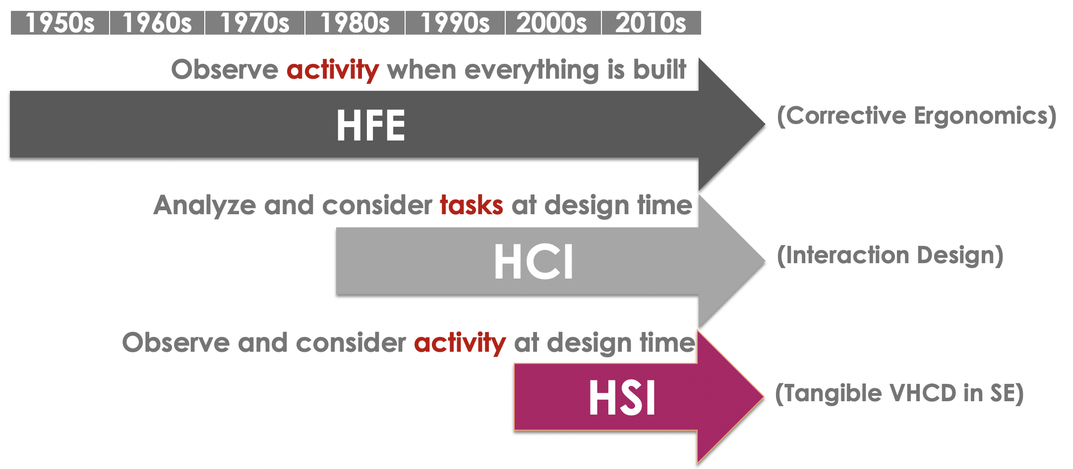
History of HSI
From Guy Andre Boy (2020). Human-Systems Integration: From Virtual to Tangible.

Slide 14
History of HSI
Pre-1980s
1980s
Modern Day
From…
Technology-centred product design and development
Focussed on training of personnel once the system development was almost complete.
Then…
HSI borne out of US Army efforts to formalise whole of system processes.
MANPRINT (Manpower and Personnel Integration) program 1986 sought to address the integration of the human aspects into the SE activities
Bringing in HF analyses earlier into the development
Limited to the users of the operational system
Now
Not just defence domains
All humans and organisations at any stage of the system lifecycle
Human-in-the-loop simulation in virtual engineering
Human-centred design that allows the human
to “be human”
Fitting the human to the technology
Fitting the technology to human needs

Slide 15
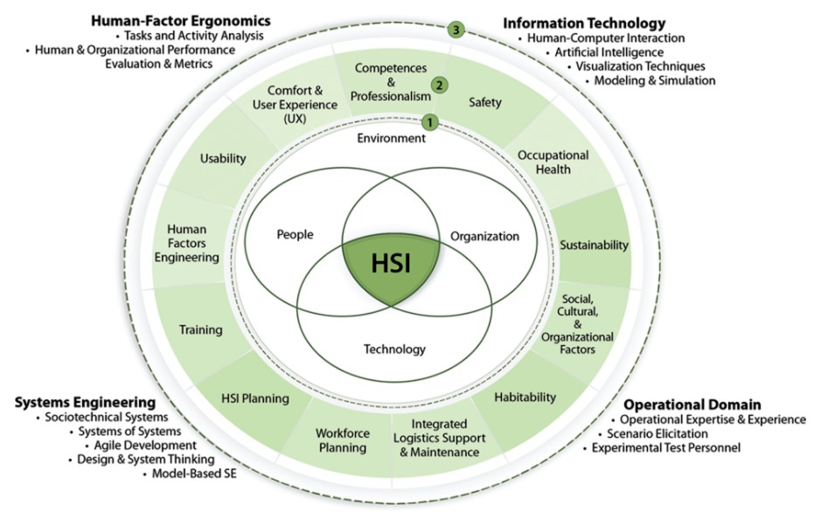
The Scope of HSI
[Scope of HSI from the INCOSE Systems Engineering Handbook: a guide for systems lifecycle processes and activities, 2023]

Slide 16
NB: Roles, not job titles!
Who’s Involved in HSI?
Comfort / UX
Systems Engineering Team
Environment & Sustainability
HUMAN SYSTEMS INTEGRATOR(S)
Habitability
Usability
Integrated Logistics Support
Human Factors Engineering
Workforce / Manpower
HSI Planning
Safety
Organisational & Social Factors
Competencies / Personnel
Occupational Health
Training

Slide 17
Where do HSI Practitioners Come From?
Niches of niches
Human Factors/Ergonomics
Systems Engineering
Social Sciences: Psychology, Physical Sciences, Cognitive Sciences, OHS, etc
Not many specialist tertiary degrees
in HF or SE
Engineering Disciplines:
Civil, Mechanical, Electrical, etc
Experience doing HSI or working in cross-disciplinary teams
HF/E Professionals
Systems Engineering Practitioner
Non-traditional routes
Non-traditional routes
Specialism in HSI

Slide 18
From INCOSE HSI Primer Vol 1, 2023
Notes:
PhaseKey HSI Activities
ConceptIdentify users & impacts · HF requirements · CONOPS · baseline performance
DevelopmentTask & activity analysis · HITL simulation · function allocation · risk mitigation
ManufacturingUsability & acceptance testing · workforce recruitment & training · org. change prep

Slide 19
Tailoring HSI
Not One Size Fits All
Scale your HSI effort to:
  Complexity of human interaction with the system
  Novelty of the system and degree of automation
  Level of risk and safety criticality
  Degree of organisational change
  Resources available and mandated standards
HSI must coordinate with SE activities throughout the lifecycle — not sit alongside them as an optional add-on.

Slide 20




HSI Examples
Unmanned Oil Rigs – Designing a Control Room

Slide 21

Introduction
Oil Rigs are remote locations, with harsh conditions for human operators.
Design production facility that can be operated without human on site during a long period
Robotic operations are a game changer
The study aims at defining the emerging human functions when introducing robotics in operations.

Slide 22
Redesign of the organization of the platforms
Operating room next to the existing control room, which would also become remote.
No need for continuous human presence.
From the operating room, remote supervision and coordination of the robots by the operators. The robots would autonomously perform the activities that field operators used to do on the installations: routine tasks, maintenance, emergency operations.
Human interventions limited to short-term maintenance campaigns.
Objectives:
To study the impact of the introduction of robotics in the management of operations, which will be carried out from the remote control room and operating room of the site.
Specify the organization of the new "operating room" entity and identify the skills that the operators of this room must have.
Facilities operated by robots, which would be controlled remotely via the operating room.

Slide 23

Project objectives
Can you develop a control room for a fleet of robots before the robots exists ?
What will be the impacts of controlling such a fleet on the overall organization ?
Can we apply the PRODEC methodology from the MMT project to another case study ?

Slide 24
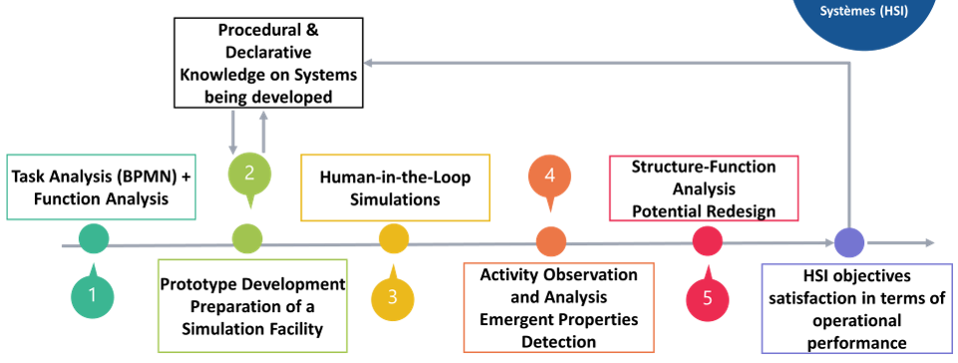
How do we go about
There is too many activities to cover them all
Select a pool of scenarios of increasing complexity.
Model one scenario
Identify necessary functions for each agents
Create one or several new allocation of these functions
Simulate these processes, analyse and add these to the pool of processes

Slide 25
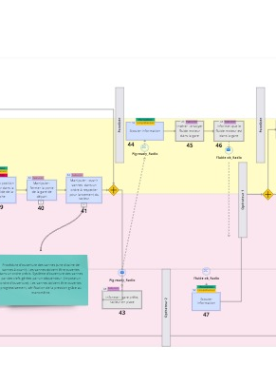
Modelling
BPMN Modelisation :
  Multi-agents modelling
  Multi-level modelling
  Cross validation with the experts
https://miro.com/app/board/uXjVMj0x6cc=/

Slide 26

Functional Analysis
Function are attributed to the different agents
Ontological approach to generalize functions
Classification according to
  Situational Awareness Level (Endsley, 1995)
    Situation Awareness (S)
    Decision making (D)
    Action (A)
  Rasmussen levels of functions (Rasmussen, 1983).
    Skills based (1)
    Rules based (2)
    Knowledge based (3)

Slide 27

New task allocations
Based on As-is scenario
Functional Analysis
  e.g. verification and inspection task are kept on human
  Listening and informing become receiving and sending information
Predicted functional capabilities of the robots
  We can predict from the analysis some capabilities (carrying, identifying valves etc..)
Prescribed organisation of the oil rig (
  separation control room (process ) / operation room (robot fleet)
  Iterative process involving experts and creative sessions
  Several concurrent scenario have been proposed and discussed for the simulations

Slide 28
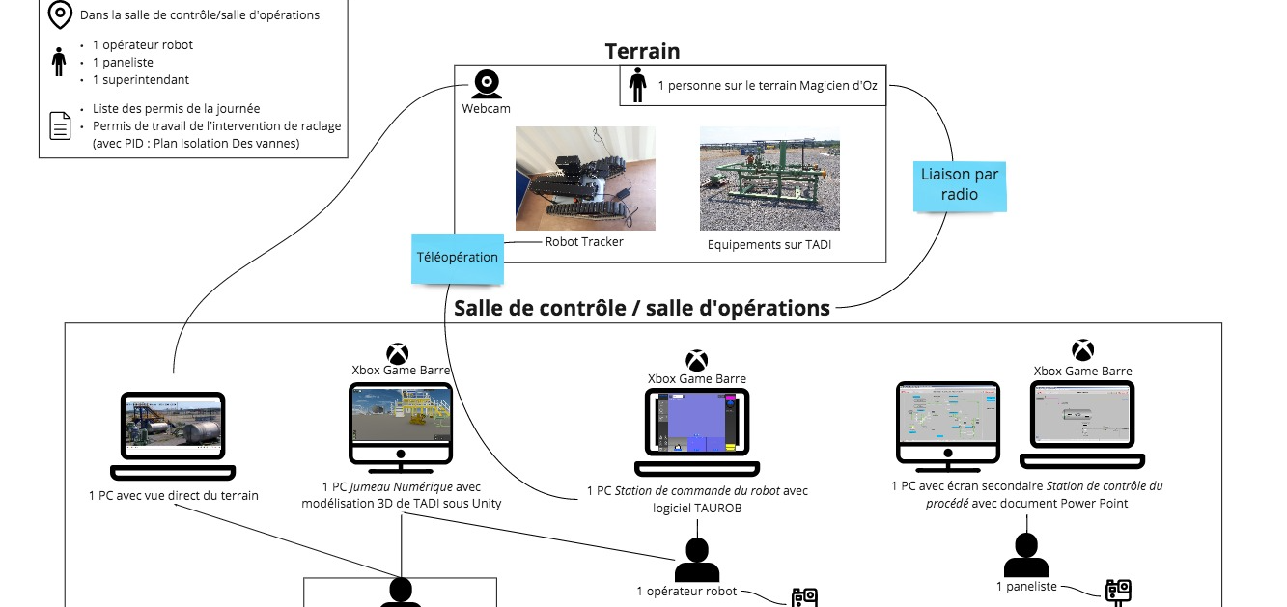
Human in the loop simulations
Wizard of Oz

Slide 29
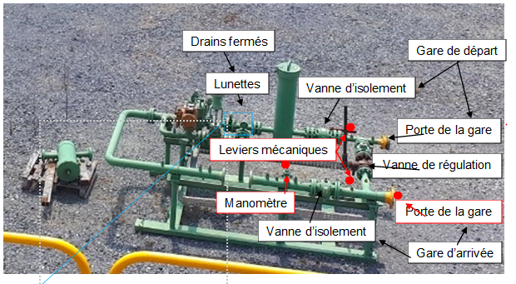
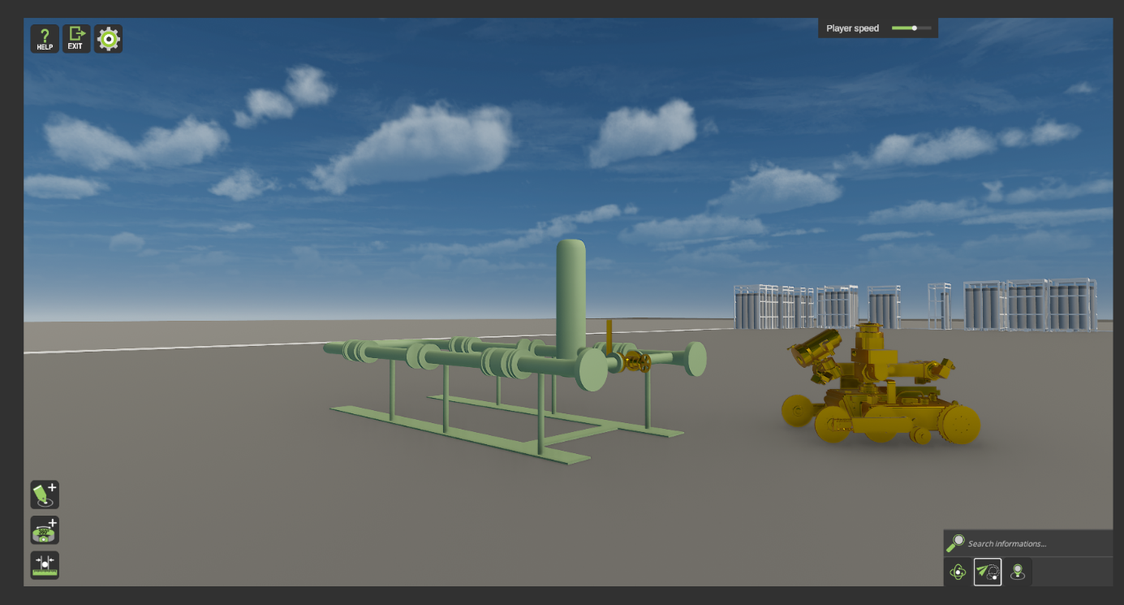
Human in the loop simulations
Physical and digital twin
Fake equipement to simulate a pig launcher
Digital twin of the equipement and robot

Slide 30
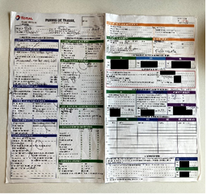
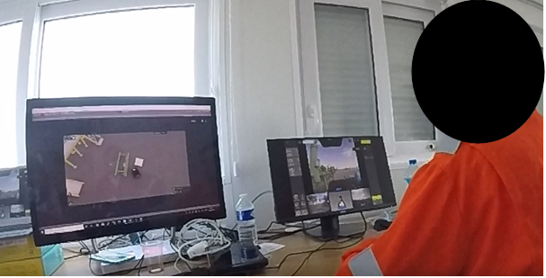
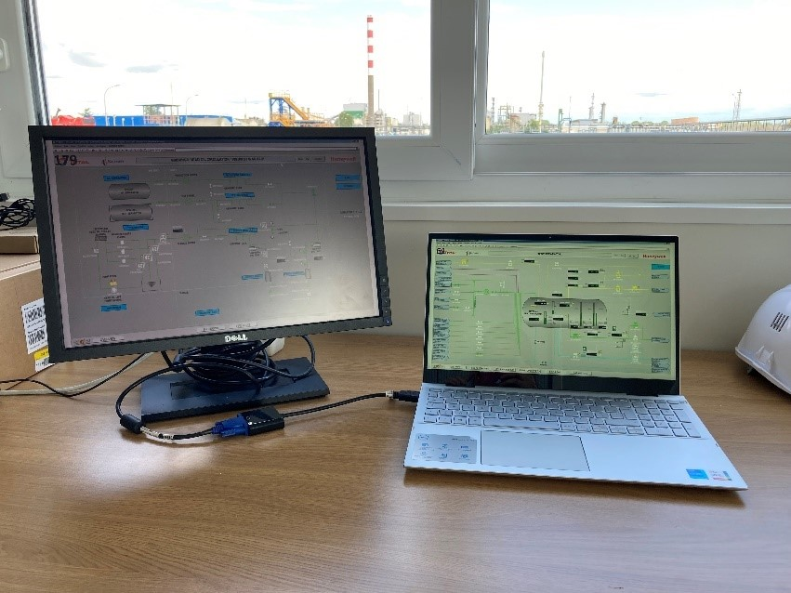
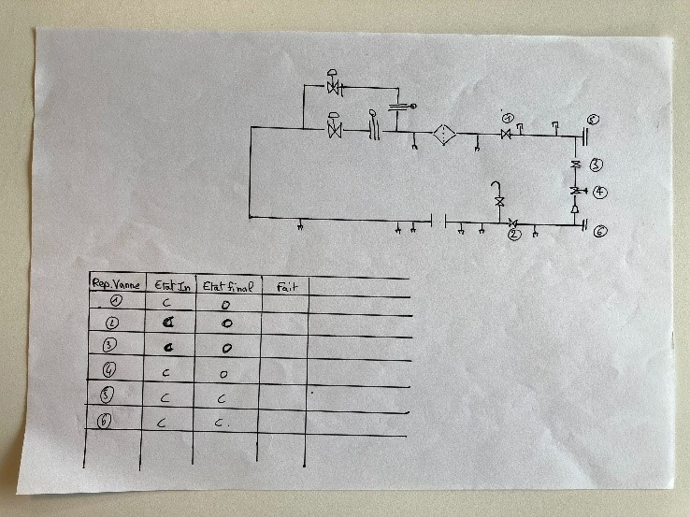
Human in the loop simulations
User interfaces and resources
Operation room :
Digital twin (left)
robot remote controler (right)
Control room :
Process controler (powerpointware left)
Work permits (right top)
Process Description (right bottom)

Slide 31
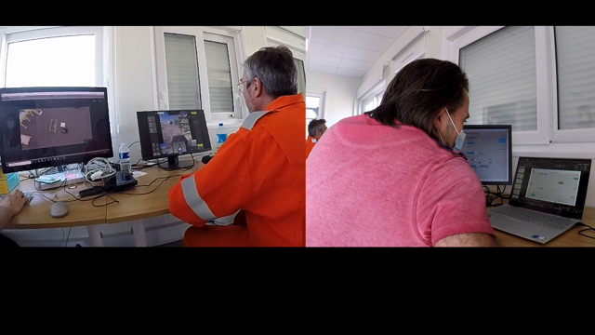
Human in the loop analysis
Interaction analysis : Type and direction of the interaction.
    Efficiency (time)
    Efficacy (repetition)
    Feedback
User assement
    Situation awareness evaluation : SART (Taylor, 1990)
    Individual Cognitive task load : NASA-TLX (Hart 1988)
  Group Cognitive task load : TWLQ (Sellers, 2013)
  User engagement (Shah 2010)
  User interface utilisabilité de l’interface: SUS
BPMN Modelisation

Slide 32







Additionnal Resources
2 min
2 hour
2 week
2 month
INCOSE Systems Engineering Handbook
INCOSE HSI Wg – Human System Integration Primer Vol. 1
Nasa – Human System Integration Handbook
Braude University - Human System Integration Mooc
Estia HSI Course

Slide 33



About the
INCOSE
HSI Working Group
incose.org | 33

Slide 34
HSI WG
Mission and Aims
Our mission is to ensure all design and engineering disciplines include human and socio-technical interaction and integration to enable system performance.
The HSI WG aims to demonstrate the value of HSI as an integral part of the Systems Engineering effort and to develop associated practices, resources, organizations, and training to support the Systems Engineering community’s adoption of HSI by:
Staying at the forefront of evolving SE practices to ensure that the presence of humans is integrated into the engineering in order to deliver successful sociotechnical systems across their life cycle.
Fostering a community of practitioners from the contributing disciplines (System Engineering, Human Factors/Ergonomics, Information Technology, and Operational Domains) and develop a common framework.
sdfsdfs

Slide 35
INCOSE HSI WG
~500 members from various INCOSE chapters worldwide
Academia, Government and Industry
Covering aerospace, space, defence, automotive, academia, telecoms, transportation, infrastructure
Sector 3
Sector 1
Sector 2

Slide 36
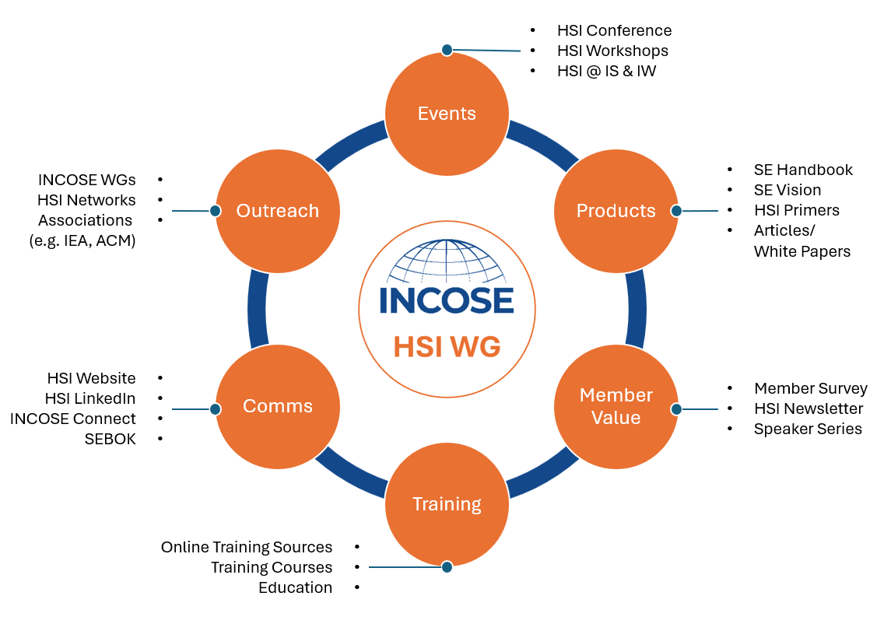
What does the HSI WG do?

Slide 37




INCOSE HSI WG Events
US
EMEA
ASIA-OCEANIA
VIRTUAL
TORRANCE, US
JEJU, ROK
1st HSI International Conference
2nd HSI International Conference
HSI WG Regional Workshops
4th HSI WG International Workshop
4th HSI WG International Conference
2019
2021
2023
2025
2027
2020
2022
2024
2026
1st HSI WG International Workshop
2nd HSI WG International Workshop
3rd HSI International Conference
HSI WG Regional Workshops
BIARRITZ, FR
VIRTUAL
US
EMEA
ASIA-OCEANIA
VIRTUAL
LONDON, UK

Slide 38



Coming up…
HSI WG General Meetings 3rd Wednesday of every other month (July, Sept, Nov)

Slide 39




Let’s
connect
Follow our HSI WG Linked In Page:
https://www.linkedin.com/company/
incose-hsi
Email us on:
hsi@incose.net
Join the HSI Community:
https://connect.incose.org/home
Meeting Recordings:
http://youtube.com/
@INCOSE_HSI_WG

Slide 40

Thank you

