Slide 1
CVSD Final Project
Team 26
B08502092廖偉富 B08901062張家翔

Slide 2
Algorithm

Slide 3
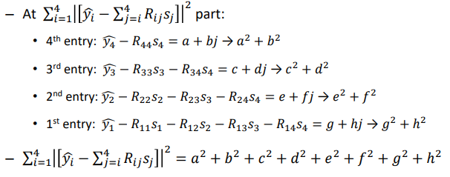
K-Best Algorithm
Intuition:
If 4th entry is large, than this s4 is not the solution
If 3rd entry is large, than this (s3, s4) is not the solution
……

Slide 4
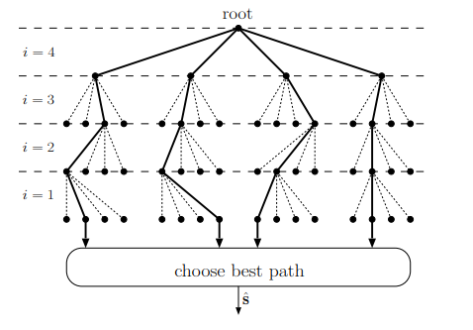
K-Best Algorithm
i = 4, calculate all conditions
i = 3, select 1 best condition
i = 2, select 1 best condition
i = 1, select 1 best condition

Slide 5
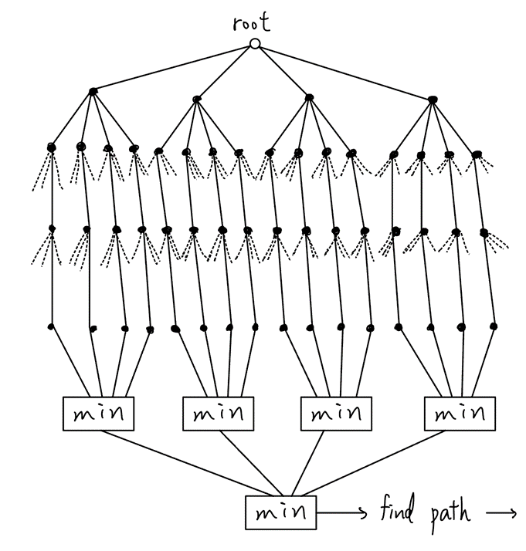


Step 1
At root, Initialize all L to 0
Calculate

Slide 6

Step 2
Calculate

Slide 7
Step 3
Calculate

Slide 8
Step 4
Calculate
where m is determined in step 3

Slide 9
Step 5
Compare the 16 results, choose the smallest
Determine hard-bits by path, without calculating LLR

Slide 10
Pros and Cons
Pros
No need to calculate LLR, avoid unnecessary calculation
Only need to store 4 L values
Cons
Error rate increases
Unbalanced calculation in each cycle

Slide 11

Calculation of Distance
Using L1-norm (Manhattan distance) to replace L2-norm
The error rate doesn’t change

Slide 12
Hardware Implementation

Slide 13
Computation of y – Rs
y – Rs → y/s – R
Only calculate y/s1 because s is symmetrical on complex plane

Slide 14
Quantization
R: 8-bit (S2-5)
s: 2-bit (1-1，ignore sign bit)
y: 6-bit (S1-3)

Slide 15
Output buffer
Total: 136 bits register
……
Store index
Output index

Slide 16
Other optimization
Resource sharing
Reuse multiplier and adder
Retiming
Decrease the length of critical path
Clock gating
Use auto-CG instead of manual-CG

Slide 17
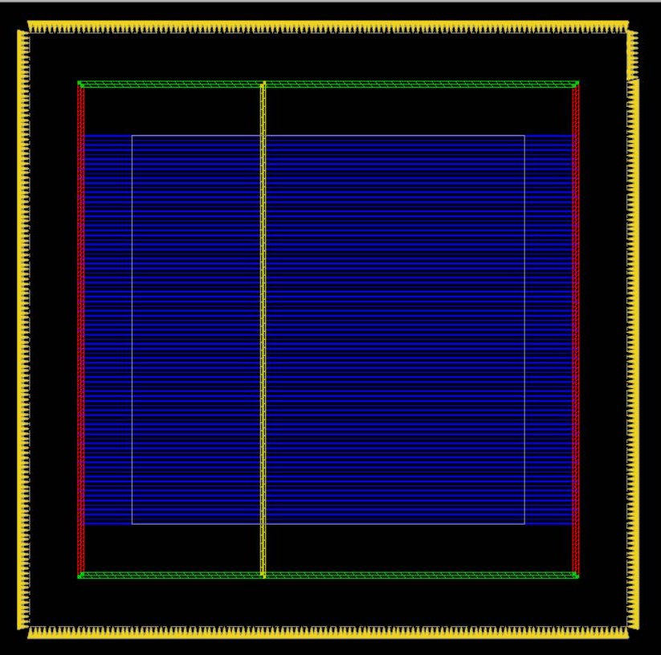
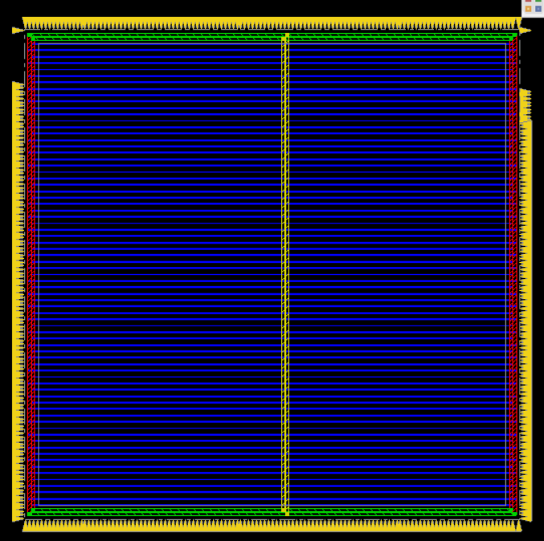
APR
Decrease margin
Decrease the distance between core and die boundary
Decrease die area
Increase core utilization

Slide 18
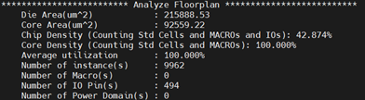
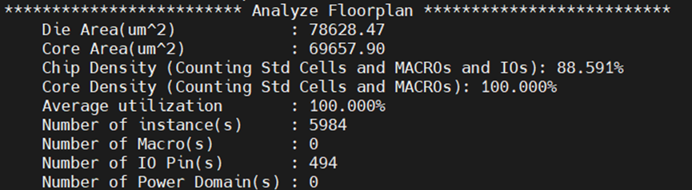
APR - Effect of decreasing margin

Slide 19
Performance

Slide 20
A-T-P
Die Area: 78628.47 (um^2)
Cycle time: 28 (ns)
Power: 0.5337 (mW)

Slide 21

Data error rate vs. SNR

Slide 22
Reference

Slide 23
Reference
[1] L. G. Barbero and J. S. Thompson, "A Fixed-Complexity MIMO Detector Based on the Complex Sphere Decoder," 2006 IEEE 7th Workshop on Signal Processing Advances in Wireless Communications, Cannes, France, 2006, pp. 1-5
[2] Zhan Guo and P. Nilsson, "Algorithm and implementation of the K-best sphere decoding for MIMO detection," in IEEE Journal on Selected Areas in Communications, vol. 24, no. 3, pp. 491-503, March 2006, doi: 10.1109/JSAC.2005.862402.

