Slide 1
Final Project Presentation
Group 9
電機三 王建翔
電機三 黃于瑄
電機三 朱凱麟

Slide 2
Outline
Baseline
Extension
Assembly
L2cache
Conclusion

Slide 3
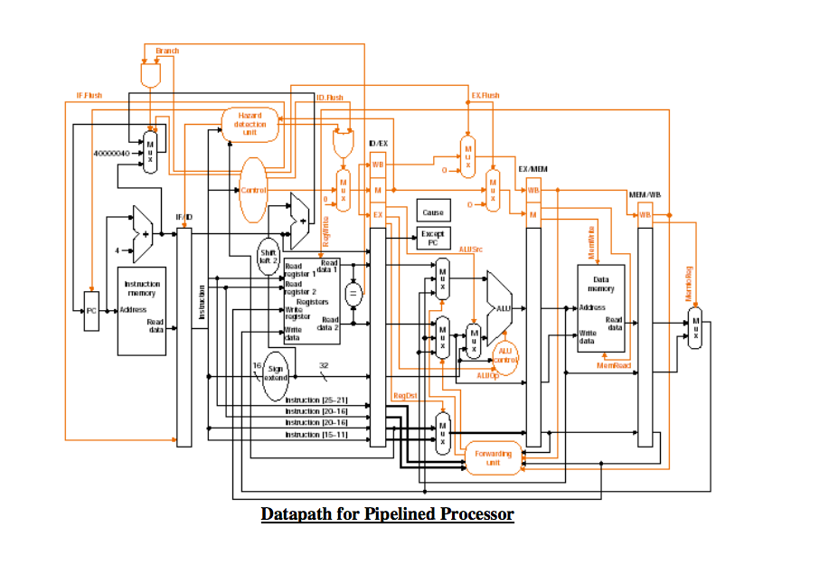
Baseline
Single Cycle Mips (HW3)
L1CACHE (HW5)
Combine them !
Add some modules !

Slide 4
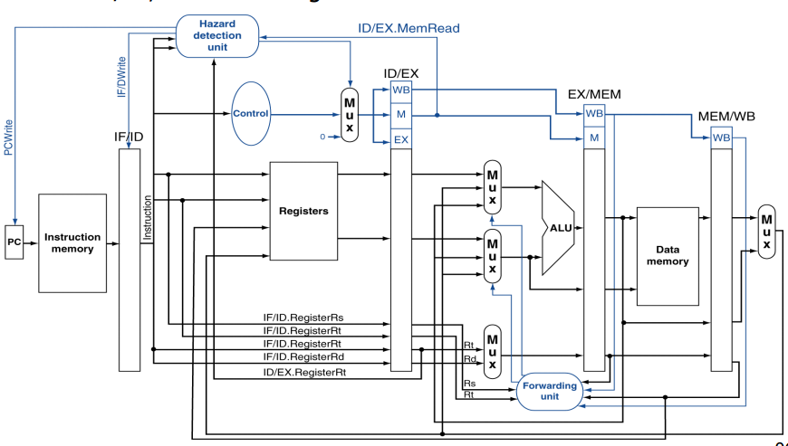
pipeline
All :stall_both_zero、PC_plus_four
IR & IR_next:PC_write
IF/ID:IF_Flush

Slide 5
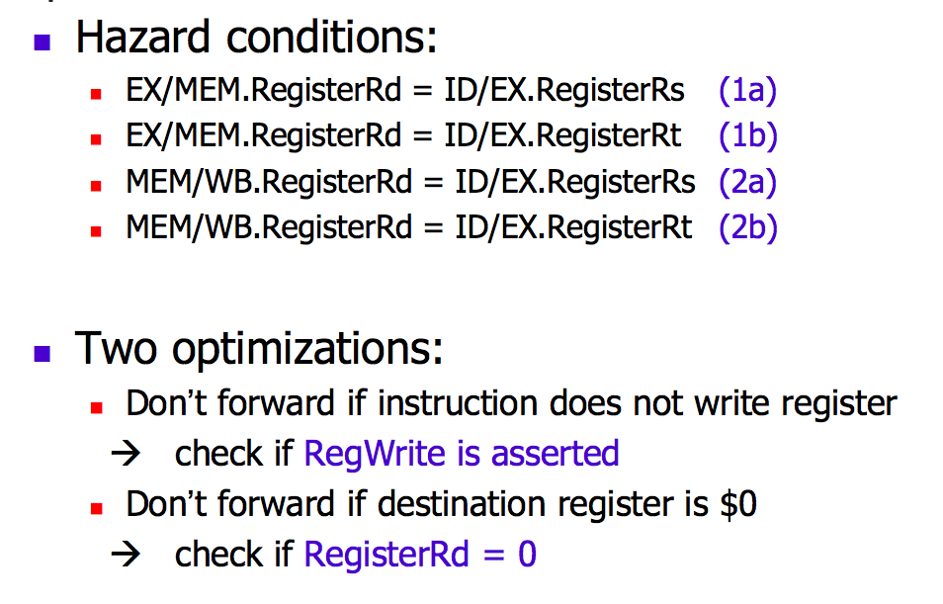
Fowarding Unit
Forward_A=10 Forward_B=00
Forward_A=00 Forward_B=10
Forward_A=01 Forward_B=00
Forward_A=00 Forward_B=01

Slide 6
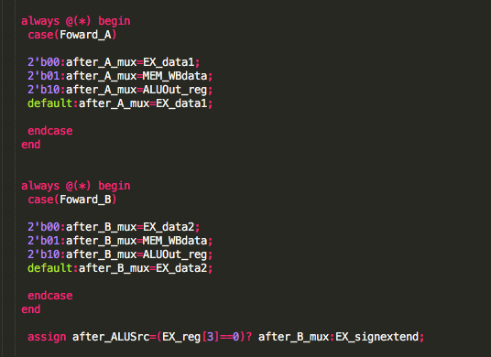
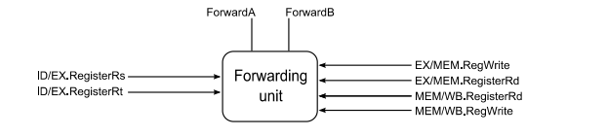

Slide 7
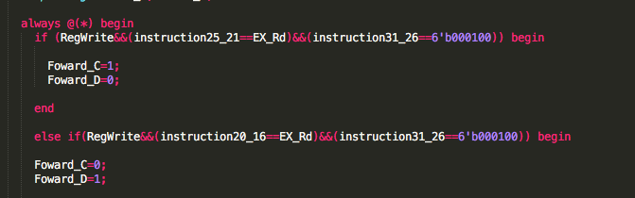
Beq_foward
Beq_equal determine in ID
IF in EX stage’s Rd == ID_Rs or EX stage’s Rd==ID_Rt ➔Hazard！！！
Need Fowarding Unit～～！

Slide 8
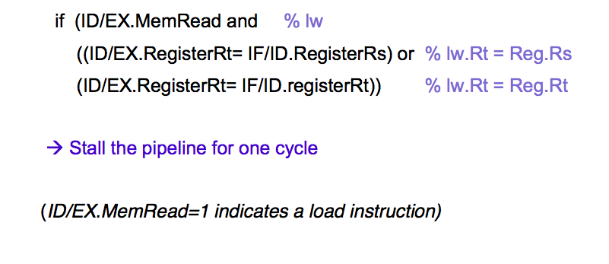
Load Stall
PCWrite=0 IF_Flush=0
HazMux=0

Slide 9
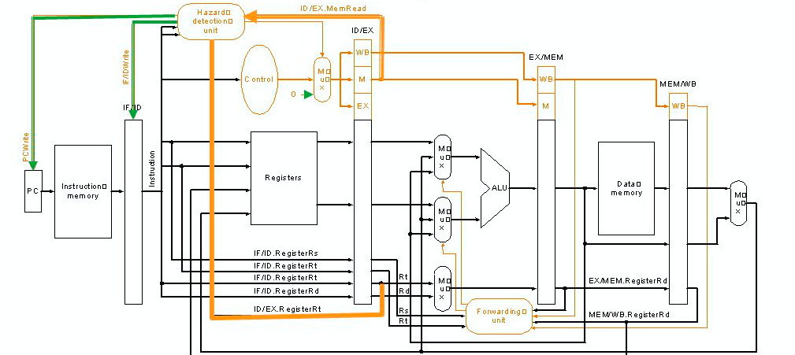
Hazard Detection

Slide 10
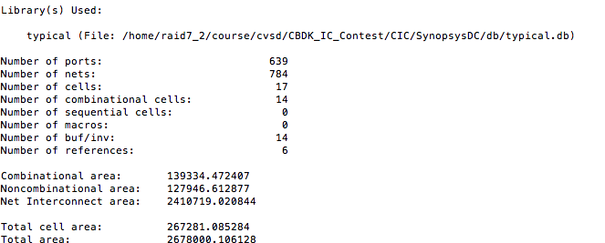

report

Slide 11
Outline
Baseline
Extension
Assembly
L2cache
Conclusion

Slide 12
Outline
Baseline
Extension
Assembly
L2cache
Conclusion

Slide 13
L2cache
write
write
Read from mem
Read from mem
finish
finish
Data
instruction
設計構想：
與其使用許許多多的控制訊號，來決定現在是要執行Data cache還是inst. cache，我們採用了state來做為區分。

Slide 14
Outline
Baseline
Extension
Assembly
L2cache
Conclusion

Slide 15
Conclusion

