Slide 1

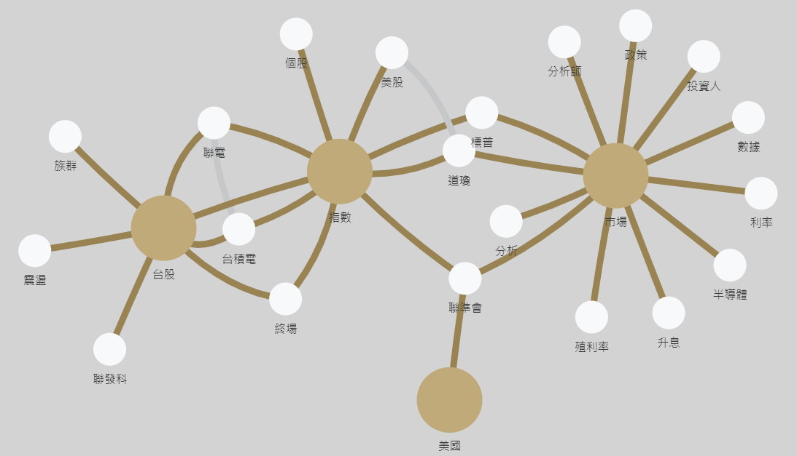

Slide 4
BERT

Slide 16
CATEGORYS
TOP PERSONS
TW WESTERN CHINA
5 10 15 20
FREQ
GRAPH
TW
WESTERN
CHINA
7
3
1

Slide 17
FREQ
TW
WESTERN
CHINA
7
3
1

Slide 18
GOOD
NEWS
!!!

Slide 19
GOOD
NEWS
!!!

Slide 20
Apriori

Slide 21
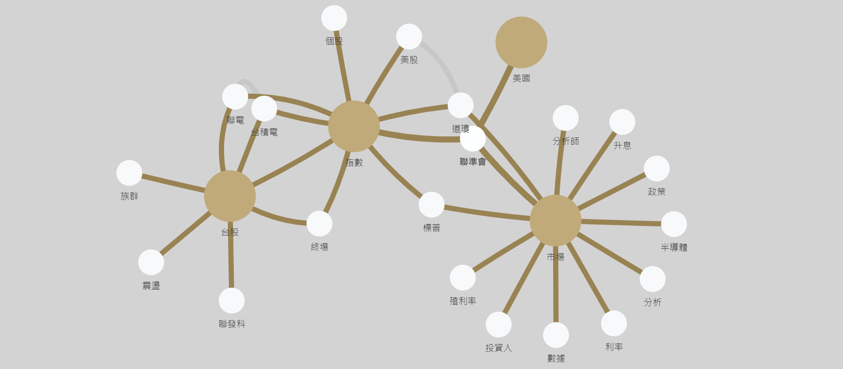
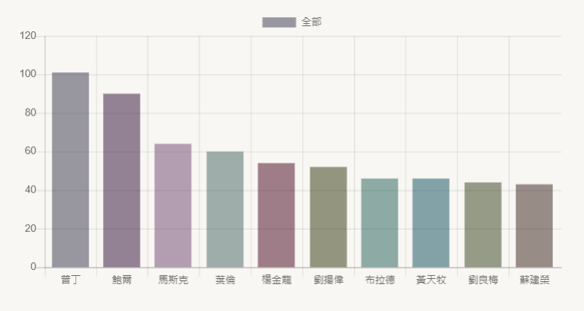

Slide 22
