Slide 1
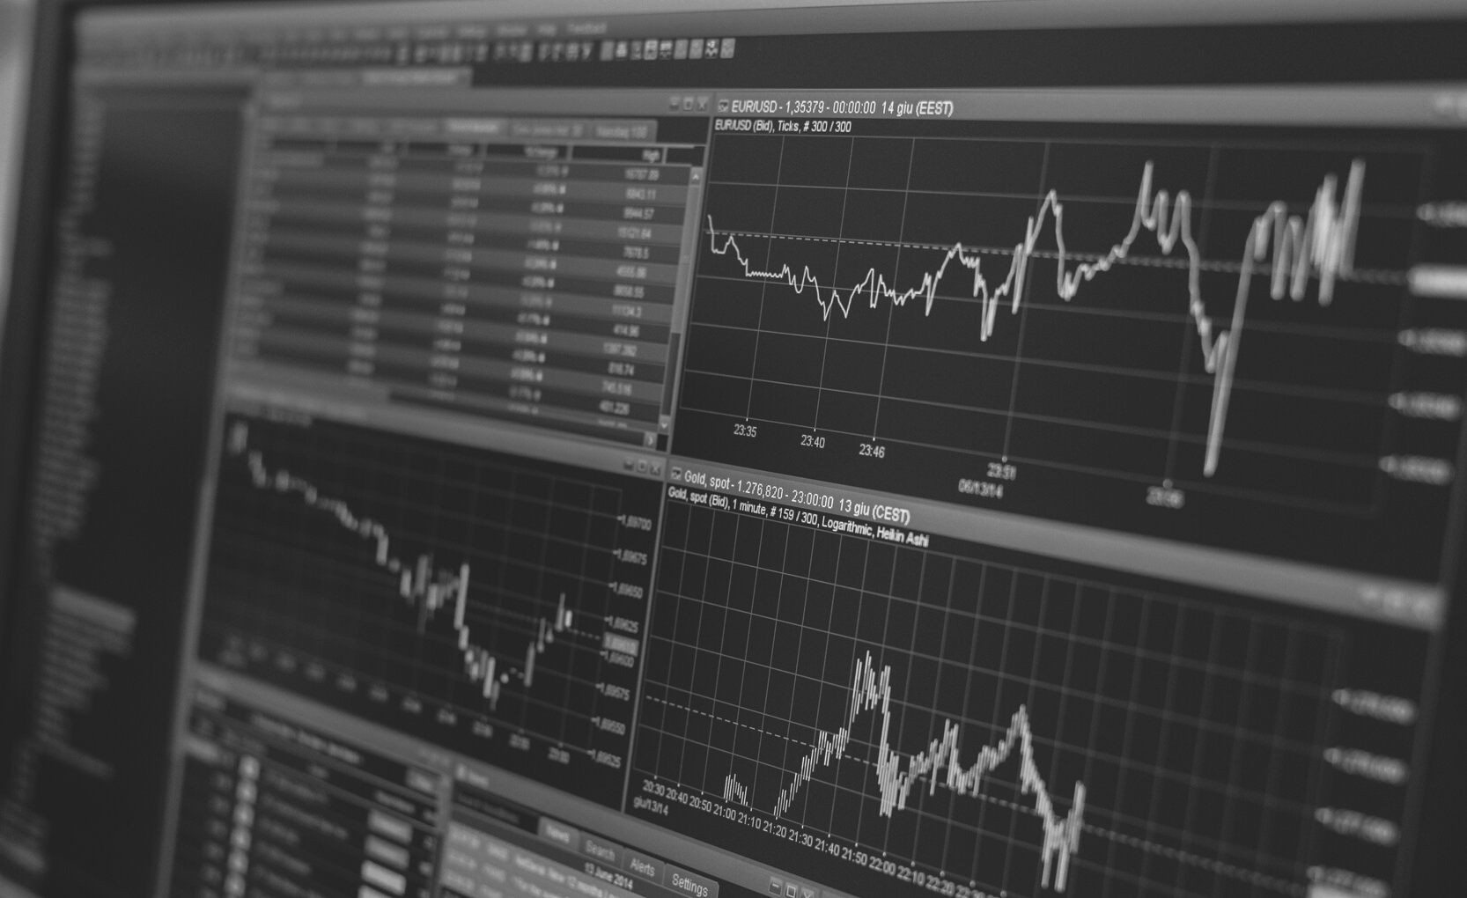
OOP Final Project
Stock Analyze
Introduction by 鄔仁迪、程愷元、翁武鱗、林敬原、危湘妤

Slide 2
Outline of topics
Catalog
- Motivation
- What source we use
- How to Analyze
- Demo
- Conclusion

Slide 3
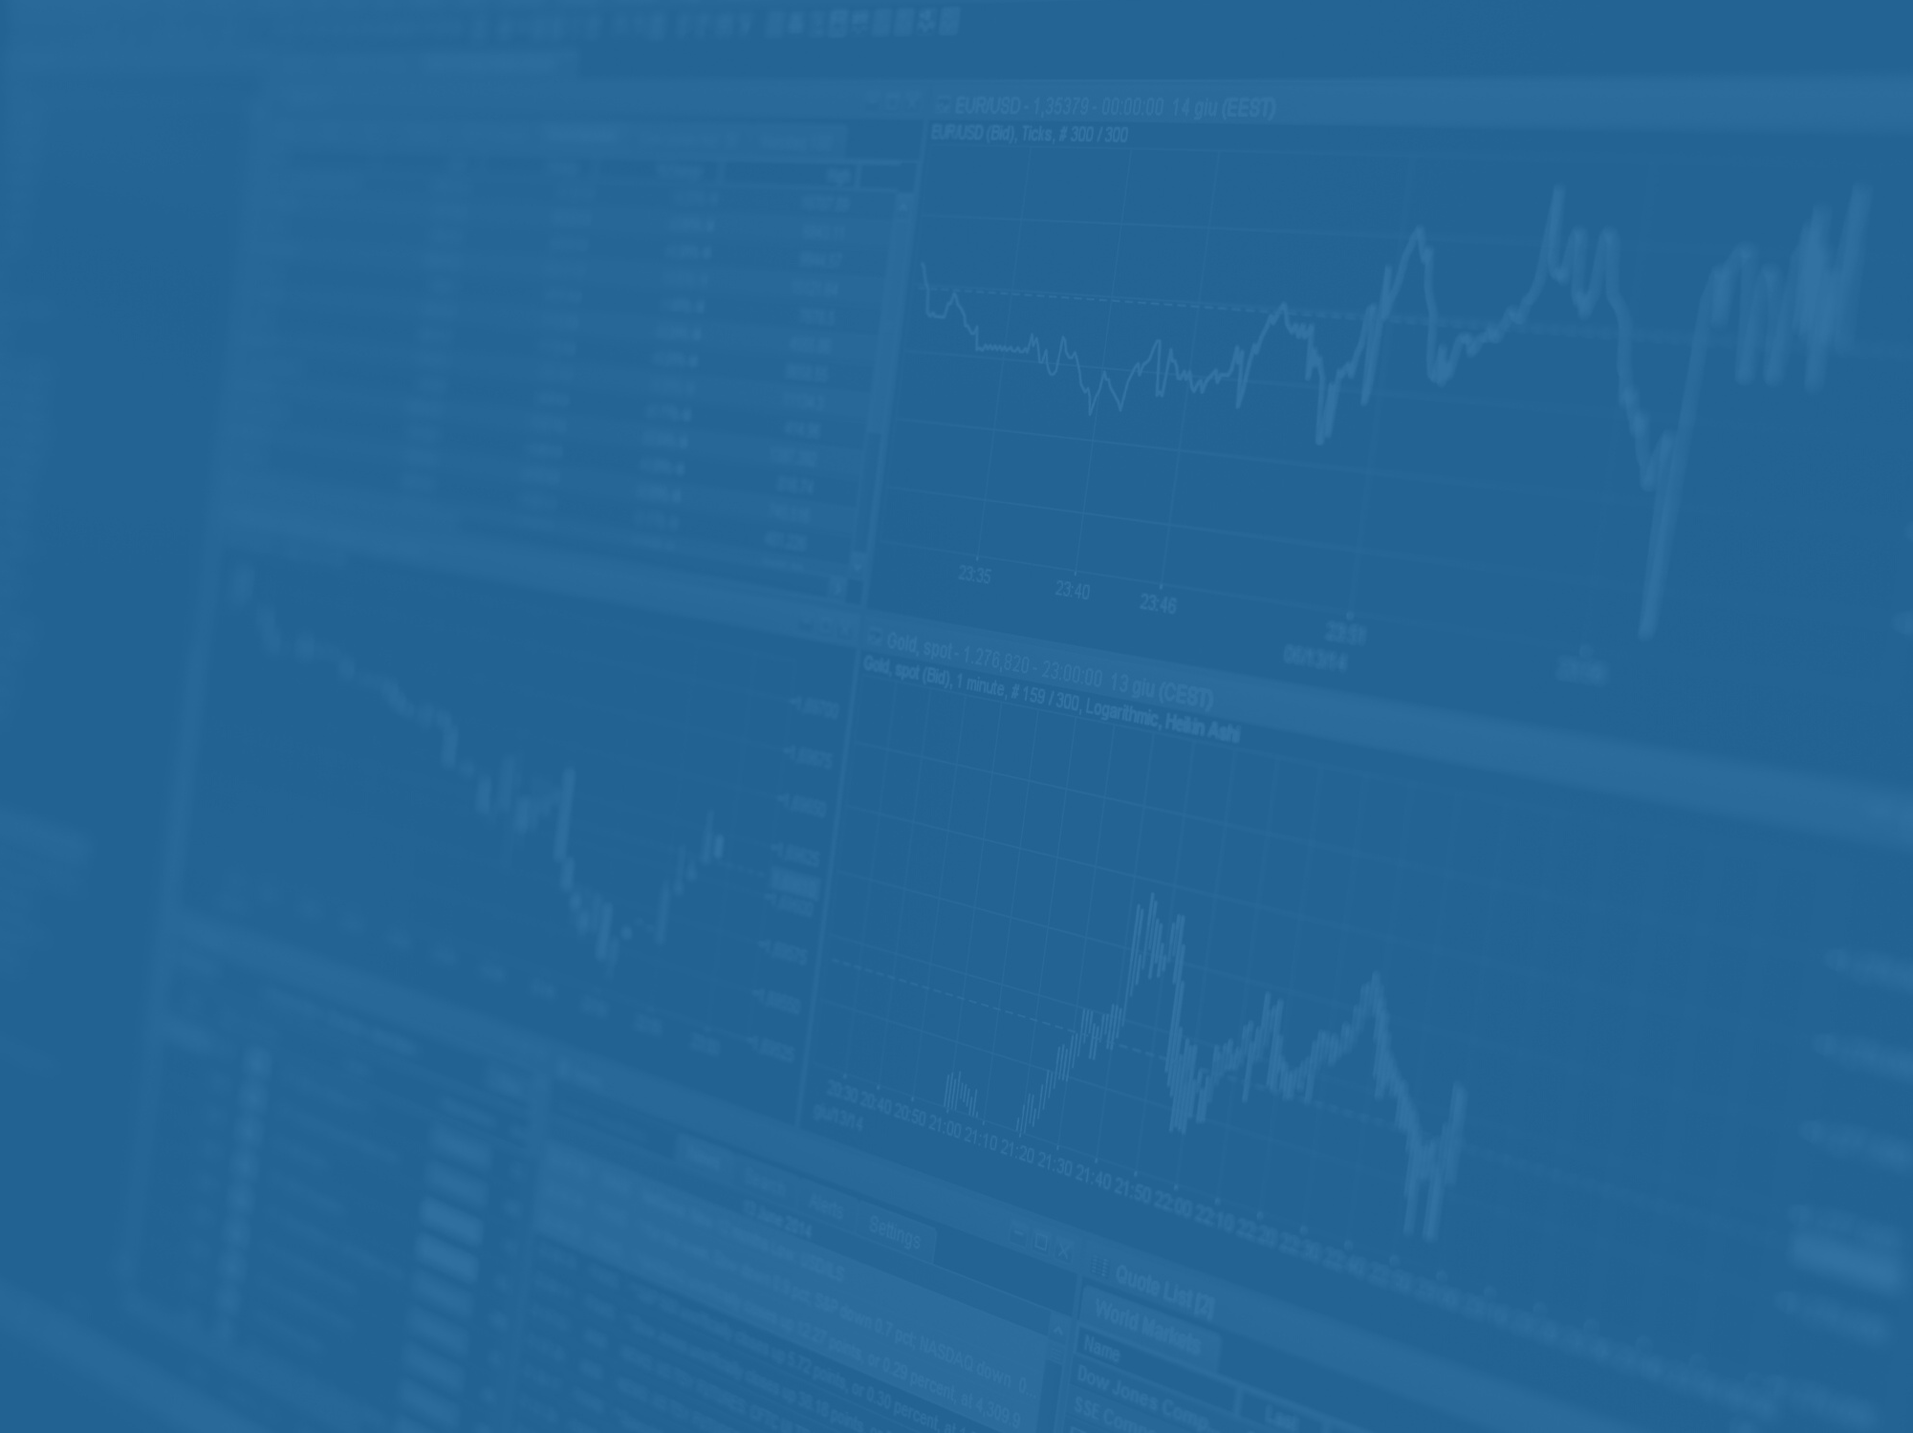

Money doesn’t grow on trees.
But...
Originated in the late 19th

Slide 4
Money does grow on code.
Originated in the early 21st

Slide 5
Money isn't everything but the more the better.
Motivation
Stock market is an attractive field, what if we can learn more about it...

Slide 6
Data Fetch
yfinance
Create data plot
matplotlib
mplfinance
seaborn
What source we use
Deal with the data
pandas
Machine Learning
prophet

Slide 7
Golden Cross
Where price will raise
Dead Cross
Where price will drop
Bollinger Bands
HOW TO ANALYZE
Use statistic to analyze
Machine Learning
Predict future trends

Slide 8
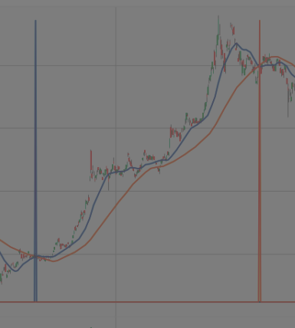
Cross

Slide 9
Short term
Long term
The period day common set is 20
The short-term is more close to the real price
The period day common set is 60
The long-term more stable than short-term

Slide 10
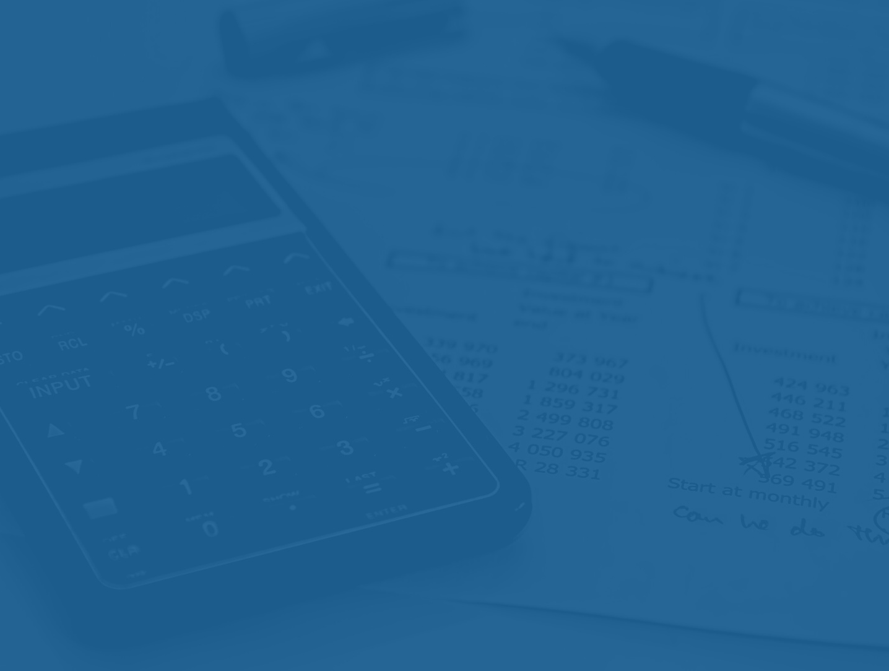
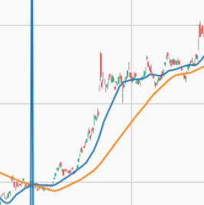
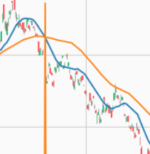
Golden
Cross
Death
Cross
If the short term day mean is greater than long term day mean after cross,
Price Will Rise
If the short term day mean is lesser than long term day mean after cross,
Price Will Drop

Slide 11
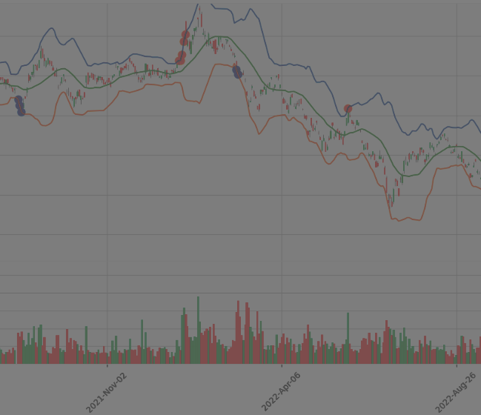
Bollinger Bands

Slide 12
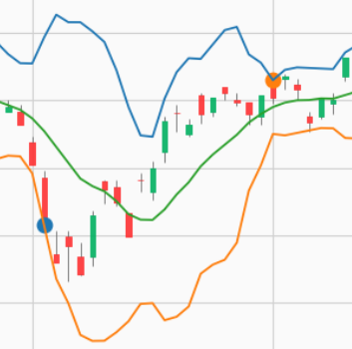
UPPER BAND
SMA + z-score * standard deviations.
BOLLINGER
BANDS
SMA
Simple Moving Average
LOWER BAND
SMA - z-score * standard deviations

Slide 13
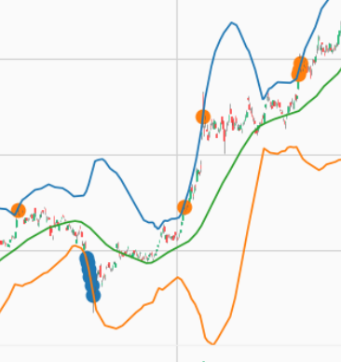
Bollinger Bands
Bands Tighten
raise the probability to start a trending move
Bands Separate
raise the probability to end a trending move
Price exceed Band
raise the probability to a strong trend

Slide 14
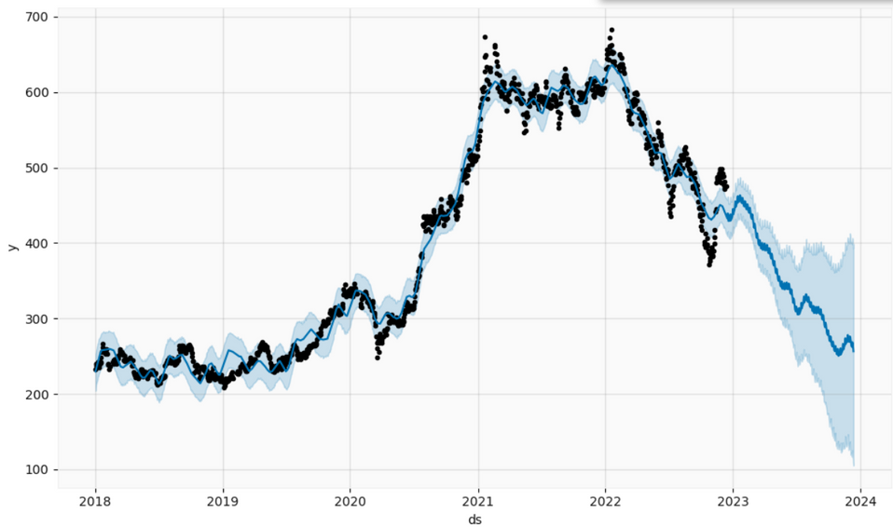
Machine
Learning
Predict Value and Interval
Fit the data to training module, then predict the price in the future.

Slide 15
Data
Dealing with time Series data
Feature
Prophet
Non-linear fit with daily, weekly and yearly, seasonality, plus holiday effects
typically handles outliers well
Easy to use
Prophet is open source software released by Facebook’s Core Data Science team . Which mean it is free and easy to use.

Slide 16
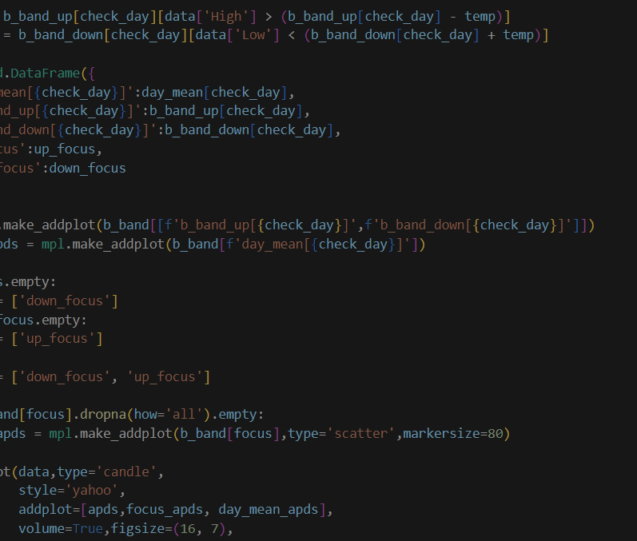
Demo

Slide 17
Even though it may not work every time, these tools still provides us a way to analyze the stock market more efficiently and not from our instinct.
Conclusion

Slide 18
What are your expectations
for this?
Share your question to us.

Slide 19
Bollinger Bands
https://www.fidelity.com/learning-center/trading-investing/technical-analysis/technical-indicator-guide/bollinger-bands
Prophet
https://facebook.github.io/prophet/
Reference

