Slide 1
Distribution
Collab
Genre
See All Video
Jan
Feb
Mar
Apr
May
Jun
Jul
Aug
Sep
Oct
Nov
Dec
2026
0
2025
15
2024
0
2023
0

Slide 2
Distribution

Slide 3
第一眼沒辦法知道功能
Jan
Feb
Mar
Apr
May
Jun
Jul
Aug
Sep
Oct
Nov
Dec
2026
0
2025
15
2024
0
2023
0

Slide 4
有手機板沒辦法用的問題
Jan
Feb
Mar
Apr
May
Jun
Jul
Aug
Sep
Oct
Nov
Dec
2026
0
2 Streams
2025
15
2024
0
2023
0

Slide 5
Jan
Feb
Mar
Apr
May
Jun
Jul
Aug
Sep
Oct
Nov
Dec
2026
0
2 Streams
Click!
2025
15
2024
0
2023
0
Jan
Feb
Mar
Apr
May
Jun
Jul
Aug
Sep
Oct
Nov
Dec
2026
0
2 Streams
2025
2025.06.06
2025.06.17
Street Fighter™ 6
Overwatch
15
2024
0
2023
0

Slide 6
Genre

Slide 8
Collab

Slide 10
See All Video

Slide 11
Distribution
Collab
Genre
See All Video
Click!
Jan
Feb
Mar
Apr
May
Jun
Jul
Aug
Sep
Oct
Nov
Dec
2026
0
2025
15
2024
0
2023
0

Slide 12
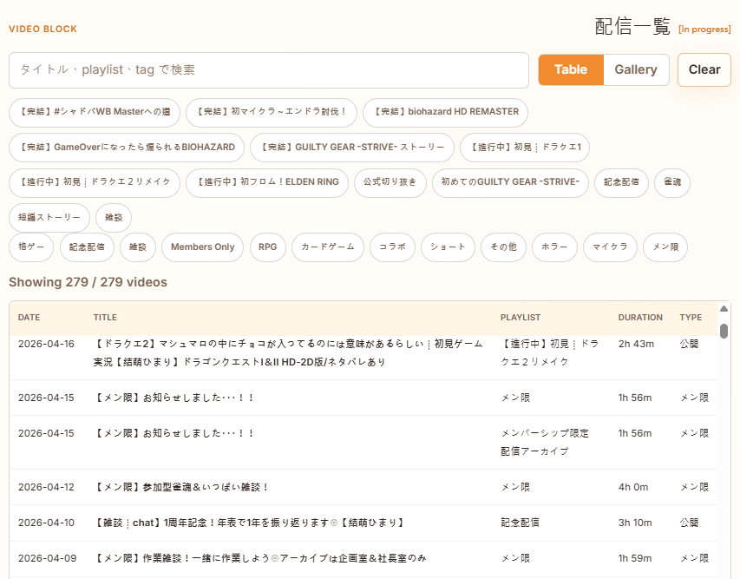
Distribution
Collab
Genre
See All Video
Jan
Feb
Mar
Apr
May
Jun
Jul
Aug
Sep
Oct
Nov
Dec
2026
0
2025
15
2024
0
2023
0

