Slide 1

How to bring in more profit and reduce delinquency rate
AuroraBank

Slide 2
Problem Statement
“We are acquiring customers, but portfolio risk and profitability trends are worrying. Can you build a unified view of our card and personal loan customers to identify: which segments are driving delinquencies and fraud, which segments are profitable and engaged, and what early behavioral signals predict future risk or inactivity, so we can adjust our underwriting, credit limits, and marketing strategies?”

Slide 3
Introduction
- Objective: Investigate the relationship between customer segments, their behaviour to the bank’s profit and delinquency rate.
- Key Factors: Analyse factors that influences profit and delinquency rate.
- Analysis: Examine customer data from different regions with the product types, Credit Card and Personal Loan to identify patterns on profit for the bank and delinquency rate.
- Outcome: Recommend next steps to optimize profit for the bank and reduce delinquency rate.

Slide 4
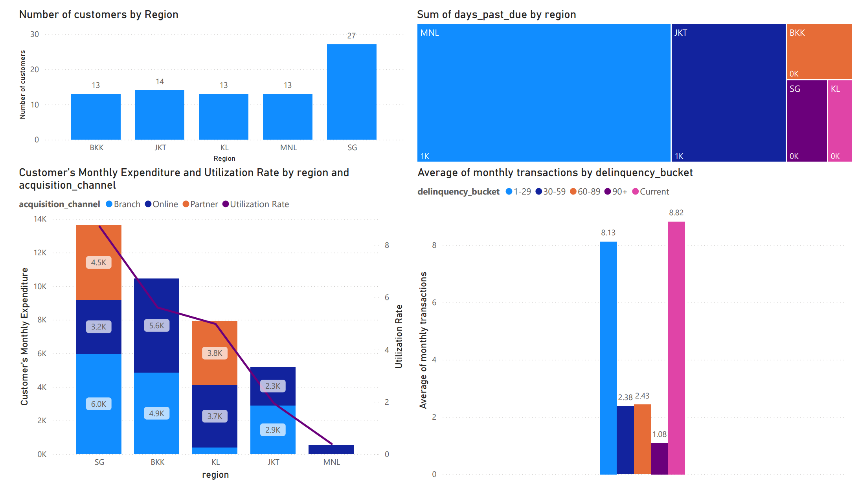
Customer Profile Analysis Report

Slide 5
Recommendations
- Focus marketing efforts: AuroraBank can focus marketing efforts on Singapore Credit Card customers acquired from branches as they are the ones that will spend more, bringing in more profit for the bank.
- Early intervention strategies: AuroraBank can implement strategies to identify customers that make 1-3 transactions month on month and put up measures to prevent them from being delinquent. Additionally, they can focus this effort on the region with the most delinquents, Manila.

Slide 6
Thank you

