Slide 1
Deep and Collective Entity Resolution in Parallel
Ting Deng Wenfei Fan Ping Lu Xiaomeng Luo Xiaoke Zhu Wanhe An
Beihang University
University of Edinburgh
Shenzhen Institute of Computing Sciences
Notes:
Hello, my name is Ting. I’d like to introduce our work “Deep and Collective Entity Resolution in Parallel”.
It is a joint work with Wenfei, Ping, Xiaoment, Xiaoke and Wanhe.

Slide 2
Deep and Collective Entity resolution (ER)
Identify whether two tuples in a dataset refer to the same real-world entity
It has been a longstanding challenge to improve the accuracy of ER
Deep and collective ER by unifying logic rules and ML models
Deep ER (Recursion)
Collective ER
Unifying Logic and ML
Identify new matches
by making use of matches deduced earlier
+
Collectively correlate information across multiple tables
+
Benefit from both and improve the accuracy by unifying the two methods
Notes:
Entity resolution, is to identify whether two tuples in a dataset refer to the same real-world entity.
In this work, we present model and algorithms to deep and collective entity resolution, by unifying logic rules and machine learning models, to improve the accuracy of entity resolution.
So we can identify new matches by making use of matches deduced earlier, and by collectively correlating information across multiple tables.
Also, it can benefit from both logic and machine learning models to improve the accuracy.

Slide 3
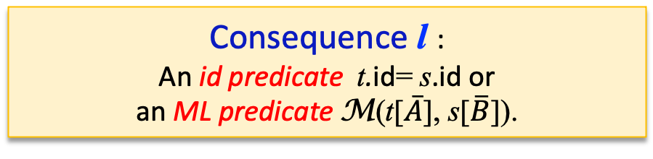
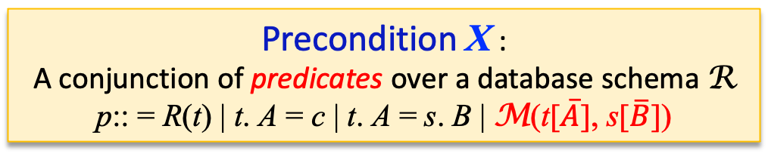
Matching Rules with mL (MRLs)
MRL $φ$: X $⟶$ l
Precondition X :
A conjunction of predicates over a database schema R
p:: = R(t) | t. A = c | t. A = s. B | M(t[$\overline{A}$], s[$\overline{B}$])
Consequence l :
An id predicate t.id= s.id or
an ML predicate M(t[$\overline{A}$], s[$\overline{B}$]).
Extend matching dependencies by embedding with well-trained ML classifiers as ML predicates
t.id = s. id : the entities represented by t and s match, then refer to the same entity
Deep and Collective ER
Deduces a set $Γ$ of matches and validated ML predications by applying MRLs in $Σ$
Modeled as an extension of the chase with MRLs, with the Church-Rosser property
Decision problem | Number of relations | id predicates in the Prec.
Deep and Collective ER | Unbounded | Yes | NP-complete
Collective ER (not Deep) | Unbounded | No | NP-complete
Deep ER (not collective) | Fixed | Yes | PTIME
Parallel fixpoint model
Notes:
We extend matching dependencies by embedding well-trained ML classifiers as predicates. We call our rules MRL, for short.
Based on the MRLs, Deep and Collective entity resolution is to deduce a set of matches and validated ML predications by applying MRLs.
The deduction is modeled as an extension of the chase with MRLs, with the church-rosser property.
That is, It always converges at the same set of matches no matter what MRLs are used and in what order they are applied.
However, since the decision problem is intractable, we present a parallel fixp-point model to reduce the computation cost and communication cost.

Slide 4

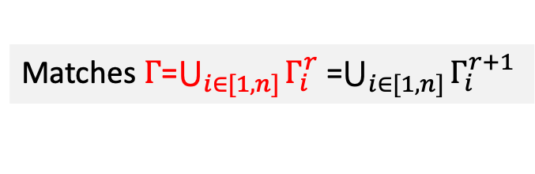

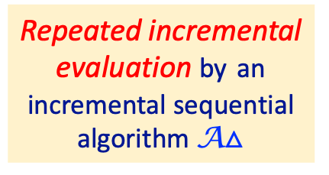





Updated-driven Parallel fixpoint model under BSP model
Partitioned dataset D= (W₁, …, W_{n}), distributed to workers P₁, …, P_{n}
Worker P₁
…
Worker P_{n}
Partial evaluation by a sequential algorithm A
$Γ_{1}^{0}$ = A($Σ$, W_{i})
$Γ_{n}^{0}$ = A($Σ$, W_{i})
Local matches
Master P₀
Data partitioning strategy
$Γ_{1}^{1}$ = A$△$( $Σ$, W_{i} , $∆Γ_{1}^{0}$ )
$Γ_{n}^{1}$ = A$△$( $Σ$, W_{i} , $∆Γ_{n}^{0}$ )
$∆Γ_{1}^{0}$
$∆Γ_{n}^{0}$
New matches
Repeated incremental evaluation by an incremental sequential algorithm A$△$
Worker P₁
Worker P_{n}
Parallel deduction algorithm
…
Updates
$∆Γ_{i}^{r}=∅$, i$∈$[1, n]
Matches $Γ$=$\bigcup_{i∈[1, n]}{Γ_{i}^{r}}$ =$\bigcup_{i∈[1, n]}{Γ_{i}^{r+1}}$
Update-driven fixpoint computation: no communication of raw data
Notes:
The parallel model conducts updated-driven fixpoint computation under BSP model.
It has two phases, including partial evaluation and repeated incremental evaluation.
In the first step, All workers first deduces its local matches in parallel, and send their local matches to the master.
After receiving local matches from all the workers, the master routes the new matches to relevant workers as updates.
Then each worker incrementally deduce the new matches by an incremental sequential algorithm and send them to the master.
The process iterates until no more new matches can be deduced and the master returns the union of all matches it receives.
Note that, there is no communication of raw data between the master and the workers.
So we develop a data partitioning strategy and parallel deduction algorithms to implement the fix-point computation.

Slide 5


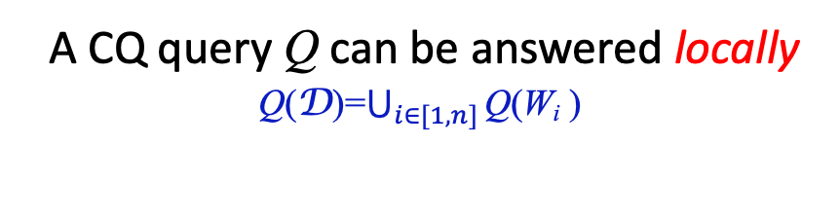

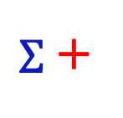
Data partitioning for parallel fixpoint computation
Extend Hypercube (HC) to handle a set of MRLs with multiple query optimization (MQO)
Hypercube
D
H=[n₁]$×…×\text{[}\text{n}\text{l}\text{]}$
HyPart
$Σ$ +
D
H=[n₁]$×…×\text{[}\text{n}\text{l}\text{]}$
Q +
MQO
W₁
W₂
…
W_{n}
W₁
W₂
…
W_{n}
A CQ query Q can be answered locally
Q(D)=$\bigcup_{i∈[1,n]}{\text{Q}\text{(}\text{W}\text{i}}$ )
D $⊨$ $Σ$ can be verified locally
D $⊨$ $Σ$ iff $\text{W}\text{i}$ $⊨$ $Σ$, i $∈$[1, n]
Partition the data with the minimum hash function computation (NP-complete)
An heuristic partitioning algorithm HyPart /A strategy to assign the hash functions
Reduce the computation cost
Reduce the communication cost
Improve the performance
Reuse the hash function computations as much as possible
Send a tuple with the same hash functions to the same worker for different rules
Using MQO to find the common predicates of MRLs
Notes:
For the data partitioning, We extend the Hypercube algorithm to handle a set of MRLs with multiple query optimization, instead of applying it to the dataset for each MRL, to avoid multiple accesses to the dataset.
That is, we want to partition the dataset with the minimum hash function computation.
However, it is intractable.
So we develop an heuristic partitioning algorithm to assign the hash functions.
It can reduce the computation cost and also reduce the communication cost, that is we reuse the hash function computations as much as possible, and send a tuple with the same hash functions to the same worker for different rules.
The algorithm also guarrentees it can be verified locally whether the dataset satisfies all the MRLs, and then support the parallel fixpoint model

Slide 6



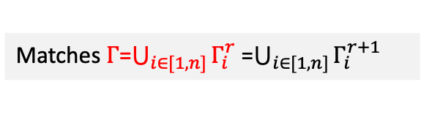



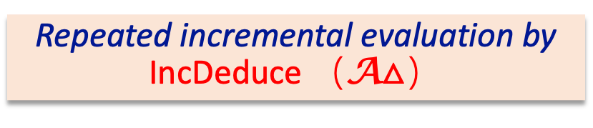


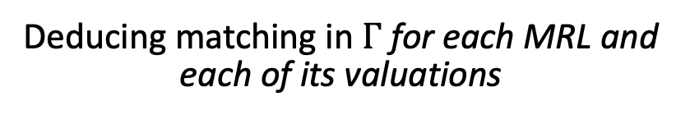
A Parallel scalable deduction algorithm
Partial evaluation by Deduce（A）
Worker P₁
…
Worker P_{n}
Deducing matching in $Γ$ for each MRL and each of its valuations
$Γ_{1}^{0}$ = A($Σ$, W_{i})
$Γ_{n}^{0}$ = A($Σ$, W_{i})
Local matches
Master P₀
Repeated incremental evaluation by IncDeduce （A$△$）
$Γ_{1}^{1}$ = A$△$( $Σ$, W_{i} , $∆Γ_{0}^{0}$ )
$Γ_{n}^{1}$ = A$△$( $Σ$, W_{i} , $∆Γ_{n}^{0}$ )
$∆Γ_{1}^{0}$
$∆Γ_{n}^{0}$
New matches
Incrementally expand $Γ$ by using an update-driven strategy
Worker P₁
…
Worker P_{n}
Updates
$∆Γ_{i}^{r}=∅$, i$∈$[1, n]
Optimization to speed up the process
Matches $Γ$=$\bigcup_{i∈[1, n]}{Γ_{i}^{r}}$ =$\bigcup_{i∈[1, n]}{Γ_{i}^{r+1}}$
Avoid to store all intermediate results and reduce the repeated valuations
Parallelly scalable: the more processors are used, the faster the algorithms run
Notes:
Finally, We develop algorithms to implement the partial evaluation and incremental evaluation in the parallel fix-point model,
with optimizations to avoid to store all intermediate results and reduce the repeated valuations
Our algorithm is parallelly scalable., that is, the more processors are used, the faster the algorithm run

Slide 7
Experimental results
Using five real-life Datasets and synthetic datasets, compared with eight state-of-the-art baselines
Accuracy
23% and 38% more accurate than ML and logical methods for ER, resp.
outperforms deep ER and collective ER by 21% and 32%, resp.
Efficiency
505s on datasets of 30M tuples using 16 machines.
faster than 7 out of 8 state-of-the-art ER baselines.
Scalability
Parallelly scalable with the number n of processors used: 3.56 times faster when n increases from 4 to 32
Models and Algorithms for Deep and Collective ER by unifying logic and ML
Notes:
The experimental results show that our algorithm outperforms the machine learning models and logical methods on accuracy, and it also outperforms deep entity resolution and collective entity resolution.
Also, Our algorithm scales well with large datasets, and is parallelly scalable with the number of processors used.

Slide 8
Conclusion
Deep and collective ER with MRLs that may embed ML predicates
Complexity analysis and parallel fixpoint model
Data partitioning strategy and parallel scalable algorithm underlying a fix point model
Notes:
In summary, We have studied deep and collective ER with MRLs that
may embed ML predicates, to improve the accuracy of entity resolution.
We have settled its complexity, modeled it as a fix-point computation, and
provided techniques underlying the fix-point model, including a data partitioning strategy and an algorithm with provable parallel scalability.
That’s all for the talk, Thanks!

