Slide 1
CSCI 576 Final Project Analysis of Egocentric Videos
Instructor: Parag Havaldar
Student: Chien-Wei Yeh
Yi-Wen Wang
Hsiao-Lun Wang

Slide 2
Project Description
Simple player to play video and audio at frame rate
Egocentric Video Summarization
Indexing into Egocentric Videos
Correcting for better video quality

Slide 3
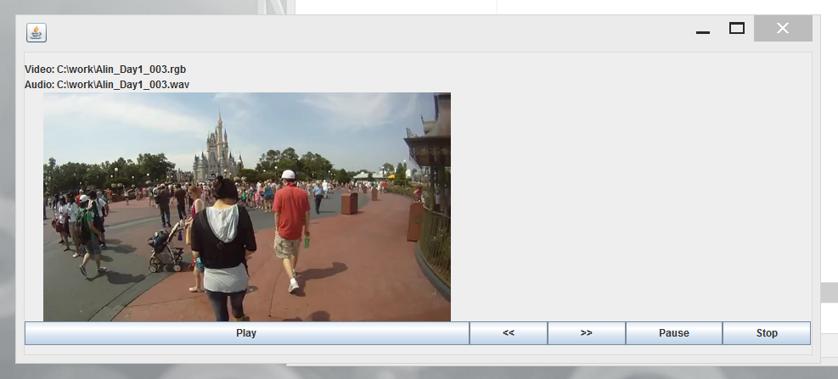
Simple Video Player (Avplayer.java)
Play: wait for (66.67 ms- processing time), read one frame and repaint.
Pause: Stop reading frame data
Stop: Stop reading frame
Bonus:2X forward speed(>>): wait for (33.38ms- processing time), read one frame and repaint
Bonus:2X backward speed(<<):Use class FileChannel to specify position
Capture the event of each button and set parameters

Slide 4
Simple Video Player (PlaySound.java)
Sound
Inherit and Start another thread with Play sound class. public class PlaySound extends Thread
Apply Clip class to jump to the specific position of wav file audioClip.setMicrosecondPosition(indx*66); This function can help us jump to the forwarding, backwarding and pause (jump to position zero)
Stop : set parameter in PlaySound class, in function run() checking “bIfStop” to stop

Slide 5
Summarization
To divide original video into different shots
To calculate each frame’s mean of RGB and entropy
To calculate difference of mean and entropy between current frame and previous frame
When frame’s mean and entropy both higher than average of mean’s difference and average of entropy’s difference, the will be assigned to a new shot
If the length of shot is lower than 15, it will be combined to next shot

Slide 6
Summarization (cont’d)
To calculate the importance of each shot
Mean and standard difference
Entropy
Motion vector
Audio
To pick up shot by it’s importance, while computing the whole length. Let the time of summary_video is about 90 seconds.

Slide 7
Indexing
Subsample, resize the Query image to the same size as video
Find the distribution of image pixels in the Query image
Compare the image pixels distribution
of each frame to the distribution of image. Calculate the SAD (Sum of abs. difference)

Slide 8
Indexing (cont’d)
Find motion compensation of central 10*10 block between targeted frame and query image. Get the residual.
If MAD (means absolute difference) is smaller than 20, then the frame is similar to Query image
Generate about 5 second video closet to the Query image
Also, cut the sound of targeted time from our class WavFile.java

Slide 9
Correcting for better quality
Separate the video into fast motion area and slow motion area using the motion vector detecting function in the summarization process to determent the motion speed.
For the slow motion area, calculate the motion vectors of all the points which surrounding the entire frame to find out the motion direction and range.

Slide 10
Correcting for better quality (cont’d)
Cut each frame from original frame size to a smaller new size to have enough space for correcting.
Correct the movement to the opposite direction.

Slide 11
Thank you

