Slide 1

NM2207 Computational Media Literacy
Lonce Wyse
National University of Singapore

Slide 2



About
Course is for non-programmers
Literacy through making stuff
Learning with web technologies

Slide 3
About
Course is for non-programmers
Literacy through making stuff
Learning with web technologies

Slide 4
About
Course is for non-programmers
Literacy through making stuff
Learning with web technologies

Slide 5
About
Course is for non-programmers
Literacy through making stuff
Learning with web technologies

Slide 6
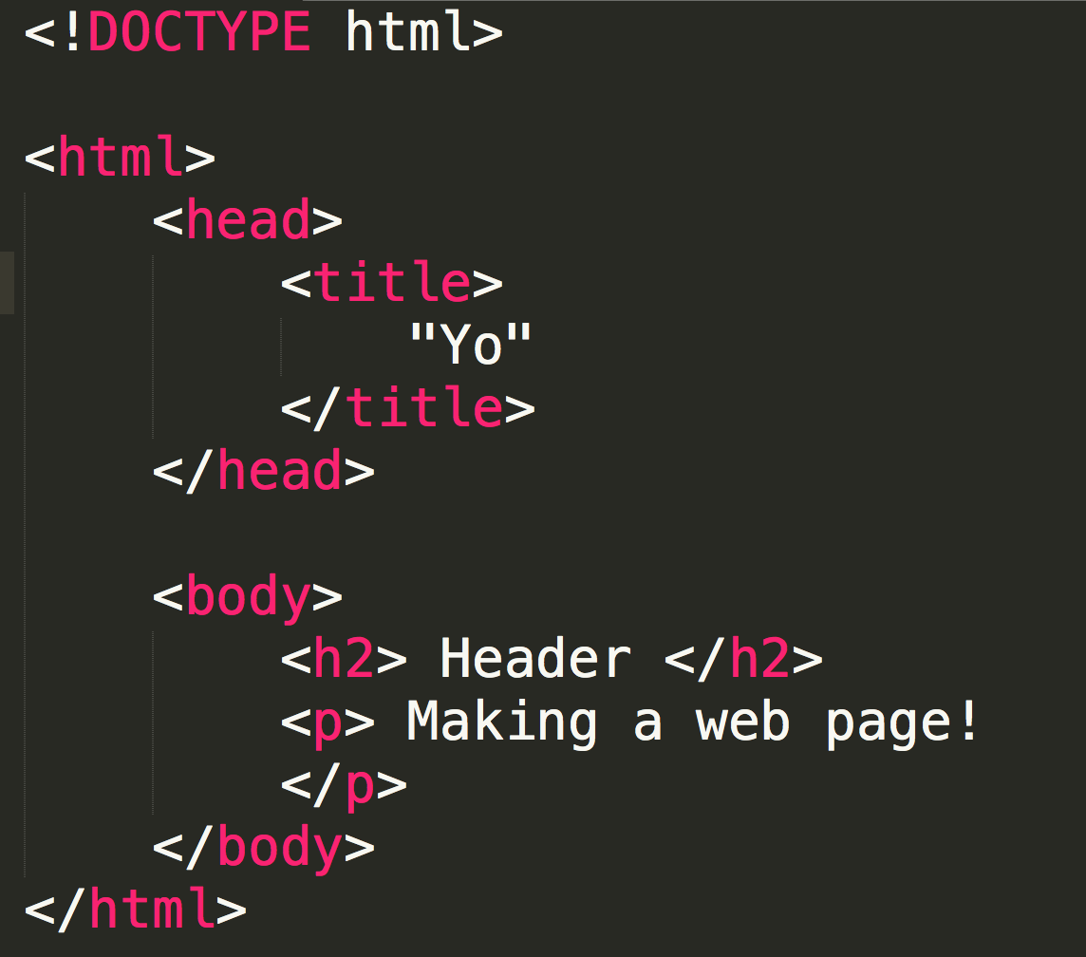
HTML

Slide 7
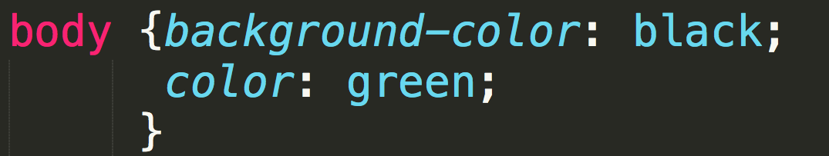
CSS

Slide 8
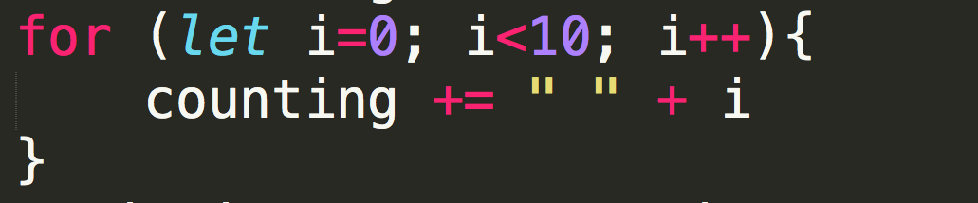
JavaScript

Slide 9
Computational Literacy
What and why?
What will you be able to do by the end of this course?

Slide 10
Background
one of the early computationally oriented at FASS (New Media, Data Science)
pre-NUS Computational Thinking - alternative to GEM (more CS and no coding)
Early “blended” course
Interns
13 f2f hours

Slide 11
Course Structure
4-MC, Workload: 10 hours
Video “lectures” (avg 2.5 hrs)
Introduce concepts
Code along (template files provided)
Classroom “challenge” sessions (3 hrs)
Groups of 2 or 3 (no one codes alone)
Questions (vids, homeworks, challenges)
Homeworks (4.5 hrs)
Upload to your website

Slide 12
Grading
Challenges (Attendance/Participation)
Just show TA by end of class, 100%
Class day midnight uploaded (notify TA), 50%
Weekly Homework
Sunday midnight uploaded to website 100%
Tuesday midnight uploaded (notify TA) 50%
2 quizzes
Final Project

Slide 13

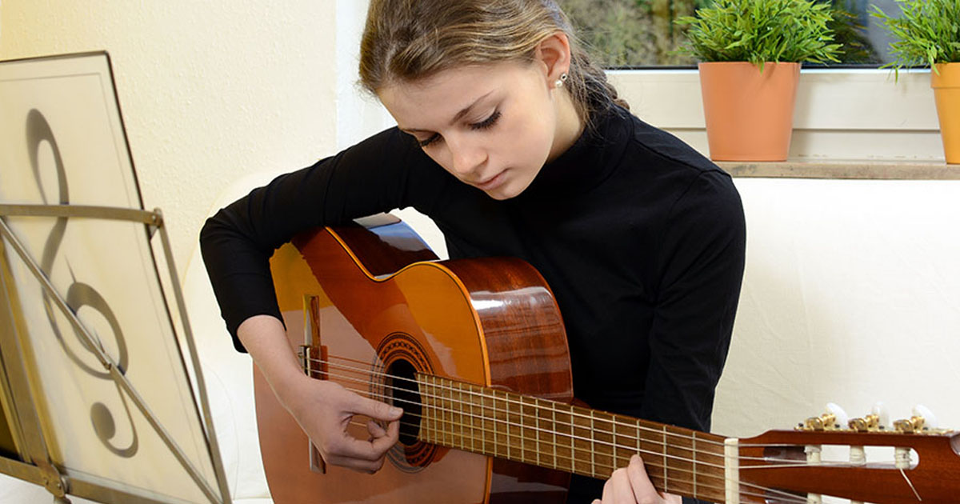
How to do well?
Practice regularly
Google window (eg w3schools)
Work with a friend
Rip, mash, modify
Practice regularly

Slide 14


Please choose, a or b:

Slide 15
Home: lonce.org
Email: lonce.wyse@nus.edu.sg
Teaching Assistants
Dennis
Brandon
Ha
Anh
Yi Wei

Slide 16
Tutorial group & challenges
First 7 rows
Divide into 6 groups
Introduce yourself to each person in your group. You’ll be working with them!
Download challenges from LumiNUS
Step through each challenge
Sign your TA’s sheet (name and matric)

