Slide 1
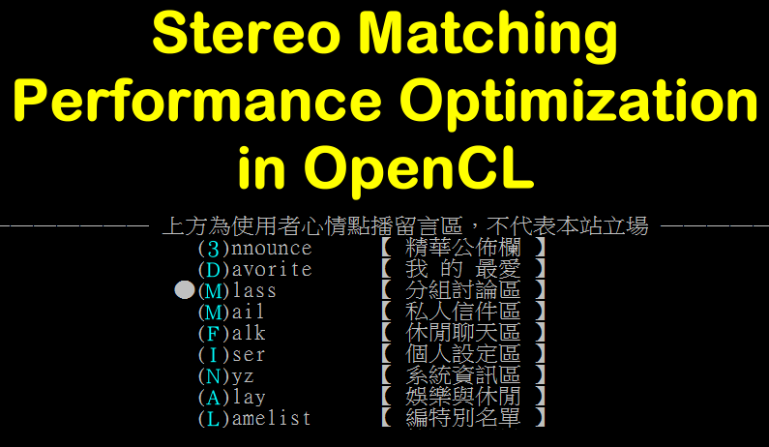

Slide 2
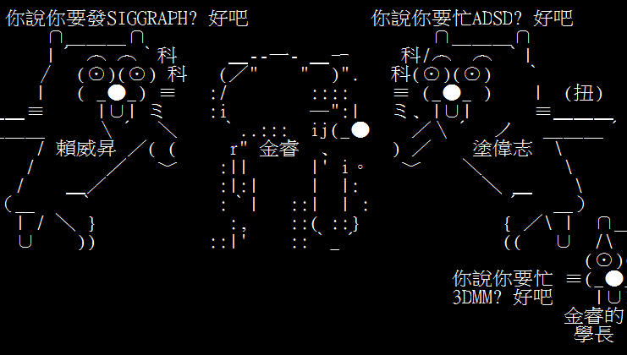
看板《Three Bears》

Slide 3

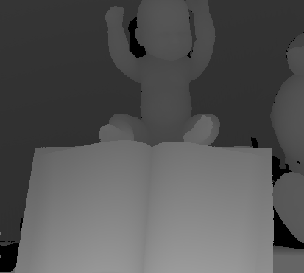
看板《Stereo Matching》

Slide 4
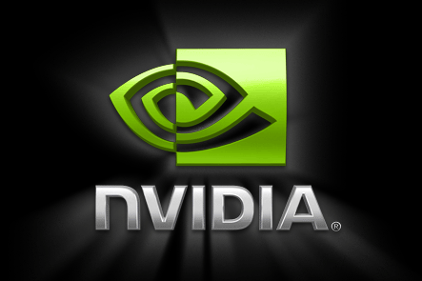
看板《nVidia》

Slide 5
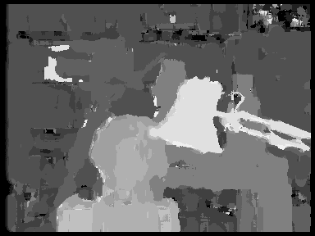
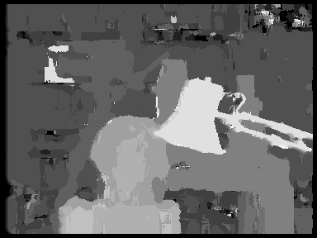
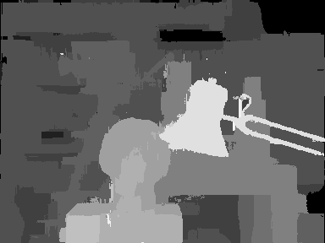
看板《Result》
Adaptve Weight – CPU version
Adaptve Weight – OpenCL version
Cross-based – CPU version
Cross-based – OpenCL version

Slide 6
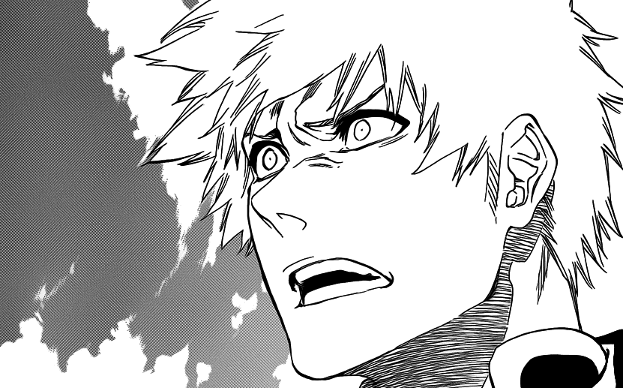

Slide 7
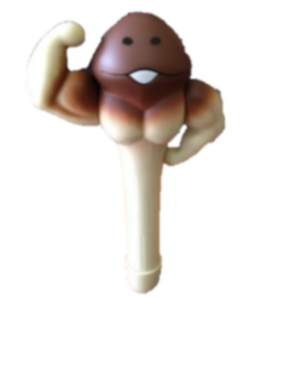
看板《Mushroom Pen》
30+ X

Slide 8
看板《Optimization》
Performance Optimization

Slide 9
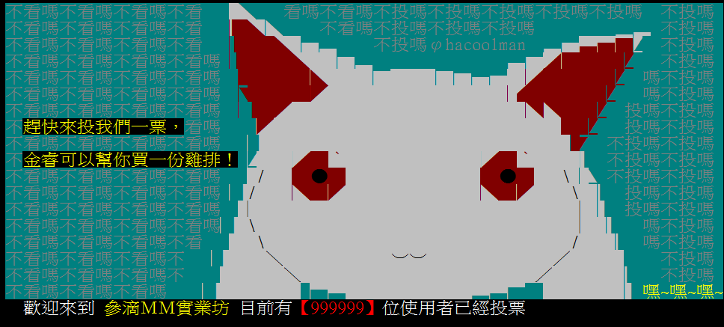
看板《QB》

