Slide 1

KA IOT Cloud Platform
David Hsia
© 2015 KeyASIC, Inc.

Slide 2
Agenda
Solutions
Deliveries
Schedule(s)
Technologies
To Do

Slide 3
Deliveries
KA Cloud Services:
AAA, Mass Storage, Saas (file transfer, control msg)
KA Client Services:
API – C library kaclient.a, JAVA kaclient.jar
Klono APP – GUI for end user and operation
Kdrive and Kcard – consumer devices

Slide 4
Schedule(s)
Phase I
10/31/2015 –Server side, Complete Relay mode file transfer functions and UID key authentication
10/31/2015 – Client side, Complete API to use Relay mode file transfer functions
10/31/2015– Client side, Complete Klono APP including network configuration and file operation
Phase II
05/31/2016 – Server side, Complete P2P mode file transfer functions and user authentication Server side
05/31/2016 – Server side,- Add SHA2 encryption in communication and MQ functionality
10/31/2016 – Client side, Complete Klono APP to fully use KA Cloud services, P2P and data encryption

Slide 5


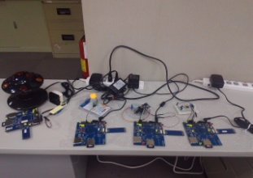
Technologies
Firewall hole punching
NAT
NATs

Slide 6
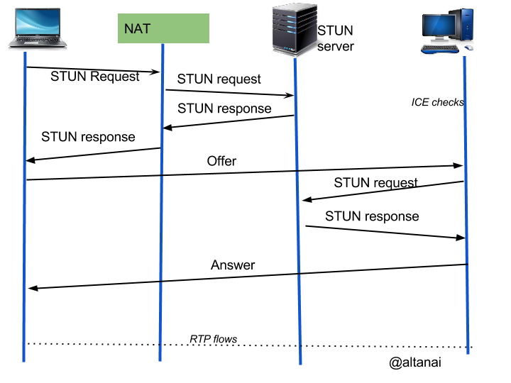
What is STUN?

Slide 7
What Issues
Type of NAT
Full Cone NAT | Static NAT
Restricted Cone NAT (Dynamic NAT) | must first have sent packets to IP X before it can receive packages from X
Port Restricted Cone NAT (Dynamic NAT) | same as Restricted Cone NAT but applies restrictions to port also
Symmetric NAT | Port change in each connection
Solutions
ICE (Interactive Connectivity Establishment ) RFC 5245, Apr 2010
STUN (Session Traversal Utilities for NAT) RFC 5389, Dec 2008
TURN (Traversal Using Relays around NAT) RFC 5766 , Apr 2010

Slide 8
KA IOT Cloud Solutions
Relay mode
Cloud Service
MySql
Mobile Device APP
NAT
TURN
NAT
Kdrive
P2P mode
Cloud Service
MySql
NAT
Mobile Device APP
STUN
NAT
Kdrive

Slide 9
Server/Client Diagram
KeyAsic Cloud Service
FindPort Server (5000)*
Auth Server (6000)*
MySql (3306)
3
NAT
STUN/TURN server (3478)
CLI (5766)
NAT
2
Relay(32355-65535)
Mobile APP
UID
4
1
UID
KDrive
Tomcat (8080)
5
For flow mark number:
Kdrive init connection to Turnserver with UID. It could be rejected if it is disabled.(?)
APP sends UID to FindPortServer to locate Kdrive relay port via UID. Also could be rejected
*APP also can use REST interface to authenticate id/password directly again MySQL
3. Turnsever provides CLI port 5766 to return the mapped port for findportserver
After APP gets mapped address, it can connect to Kdrive and starts to do file transfer
App also can use REST to send other command to directly check user credentical data from MySQL

Slide 10
Software Components
Device (KDrive/arm926 series) – HTTP CGI script and C socket API
AAA
Busybox HTTP/CGI
Socket/TLS
App Client – Android/IOS – Java and 3rd part SDK
AAA
UI & I/O
Response parser
3rd party SDK
Apache Commons Net™
Socket/TLS

Slide 11
Software Components (cont.)
KeyASIC Cloud Server
Google P2P Coturn 3.2.5.9 (STUN/TURN)
Database - MySQL
Tomcat container server
Message Queue and other 3rd Party SDK
AAA
Tomcat container
MySQL API
3rd party SDK
STUN/TURN server
Socket/TLS

Slide 12
Software Components (cont.)
P2P server is adapted from open source STUN/TURN server
AAA – Accounting, Authentication, Authorization
*We use a dedicated Auth server with MySQL for AAA
3. MySQL – is used for persistence data and AAA service
4. Tomcat server provides DAO service with RESTful API for APP
5. 3rd party SD to support MQTT, OPENSSL, Crypto…etc
6. Socket with TLS protocol provides security and low level networking service

Slide 13
Use Cases I
Kdrive device driver init connection to Kcloud service
Kdrive
Auth Server
Ping turnserver
After kdrive connected to Internet
Send UID to register
Verify UID using MySQL
UID created in manufacture and printed as QR code on shell
When user plug in Kdrive, client will send UID to server for verification

Slide 14
Use Case II
APP use UID to connect to Kdrive (after UID registered)
APP
FindPortServer
Authserver
Keyasic Turnserver
Kdrive
UID
Validate UID
reject connection
If bad UID
Get relay port
Return relay port
Return relay port
Establish connection uses relay port

Slide 15
Use Case III
APP sends list folder command
APP
Keyasic Turnserver(relay)
Kdrive
Select ‘ls folder”
Relay port to connect to Kdrive
Return success
Return files list of folder

Slide 16
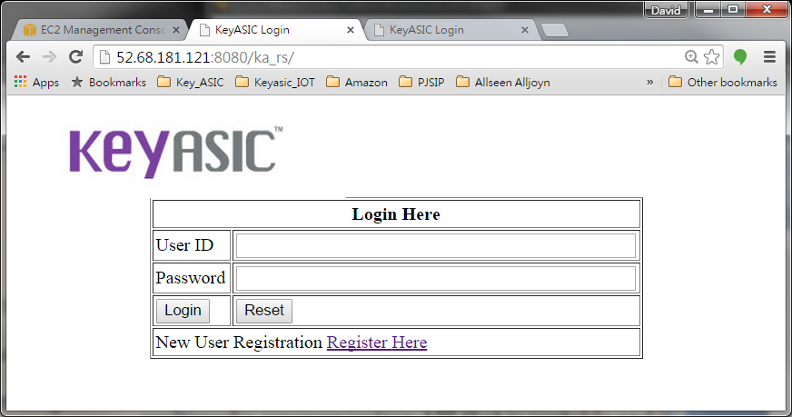
Rest Web Service on AWS

Slide 17
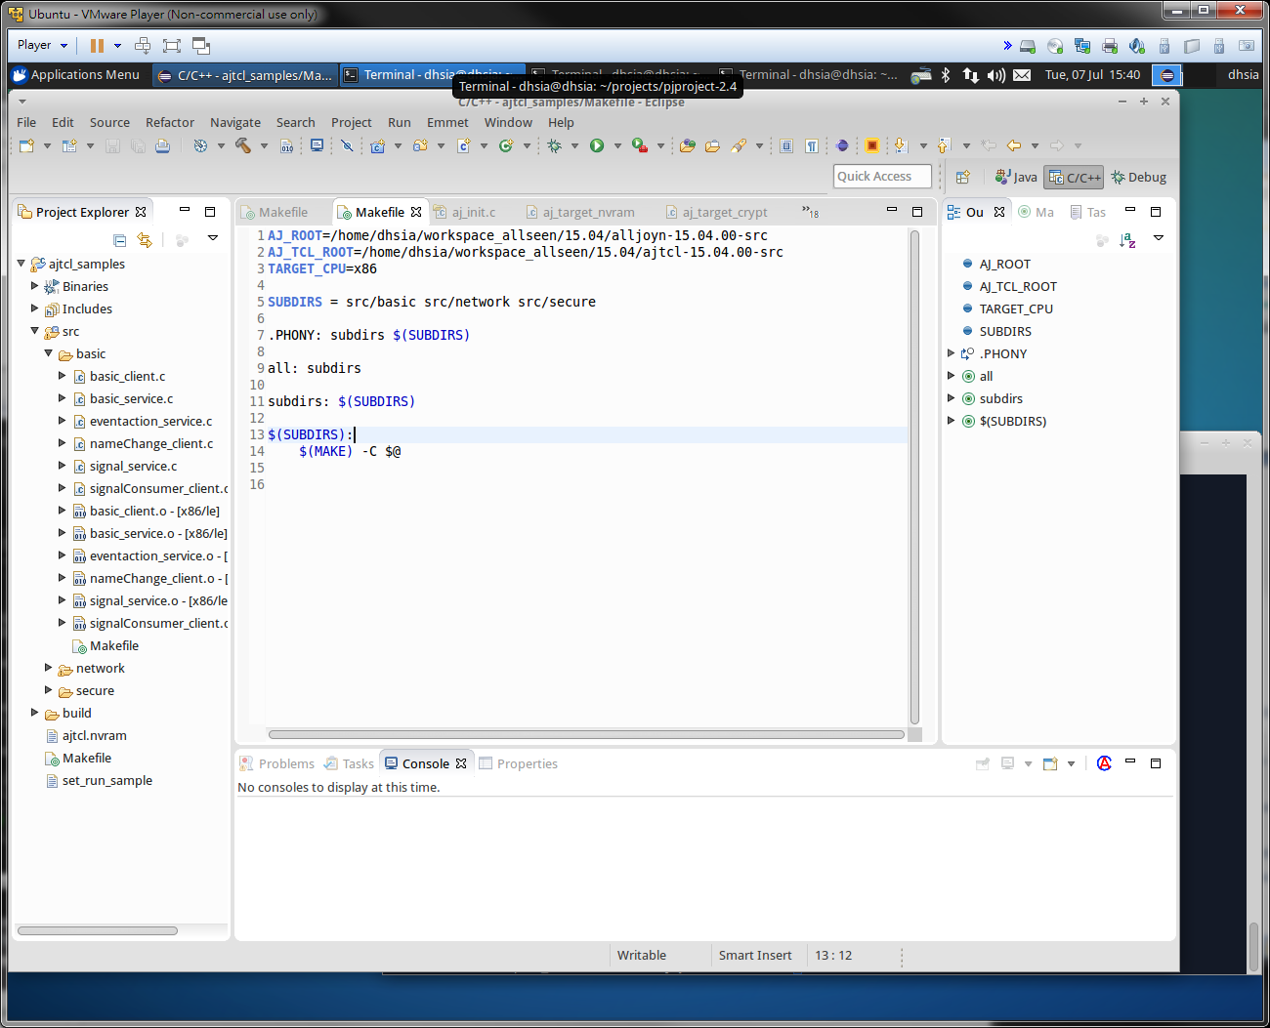
Eclipse IDE – my work ENV

Slide 18
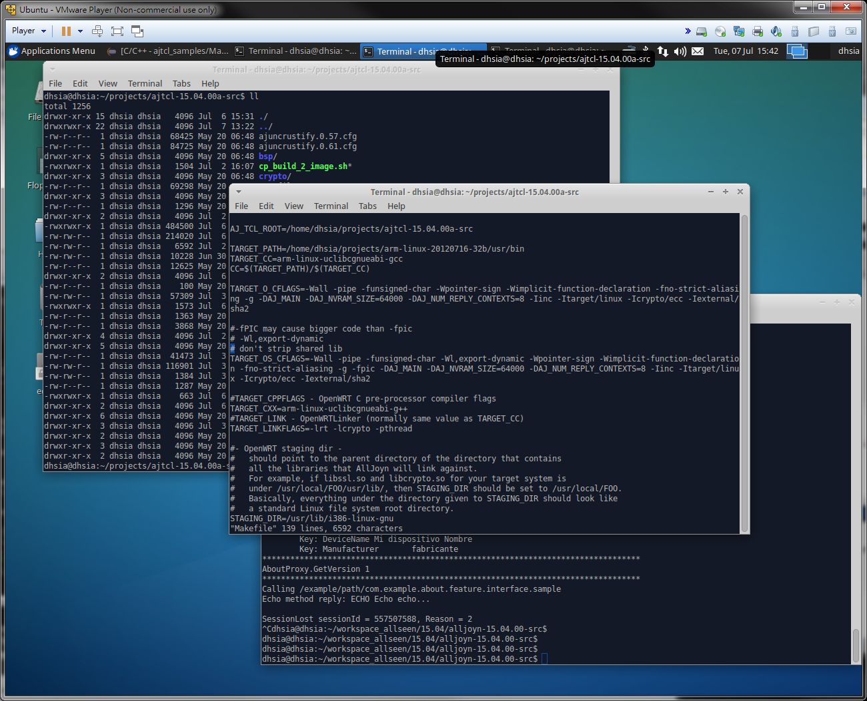
Test on EVB: cross compile, Copy source code to build project

Slide 19
The Challenges
Understand STUN protocol to insert our requests
Integrate Turnserver’s security with KeyASIC’s security system
Data encryption library will need bigger space in Kdrive
KA Cloud deployment requires more AWS power and space for China solution

Slide 21
TO DO List (on progress)
Use Eclipse IDE to trace codes
Removing dependency on libcryto.so and libstdc++.so.6
Fully Test new code on EVB to Knolo
Compare to TUK library’s size and performace

Slide 22
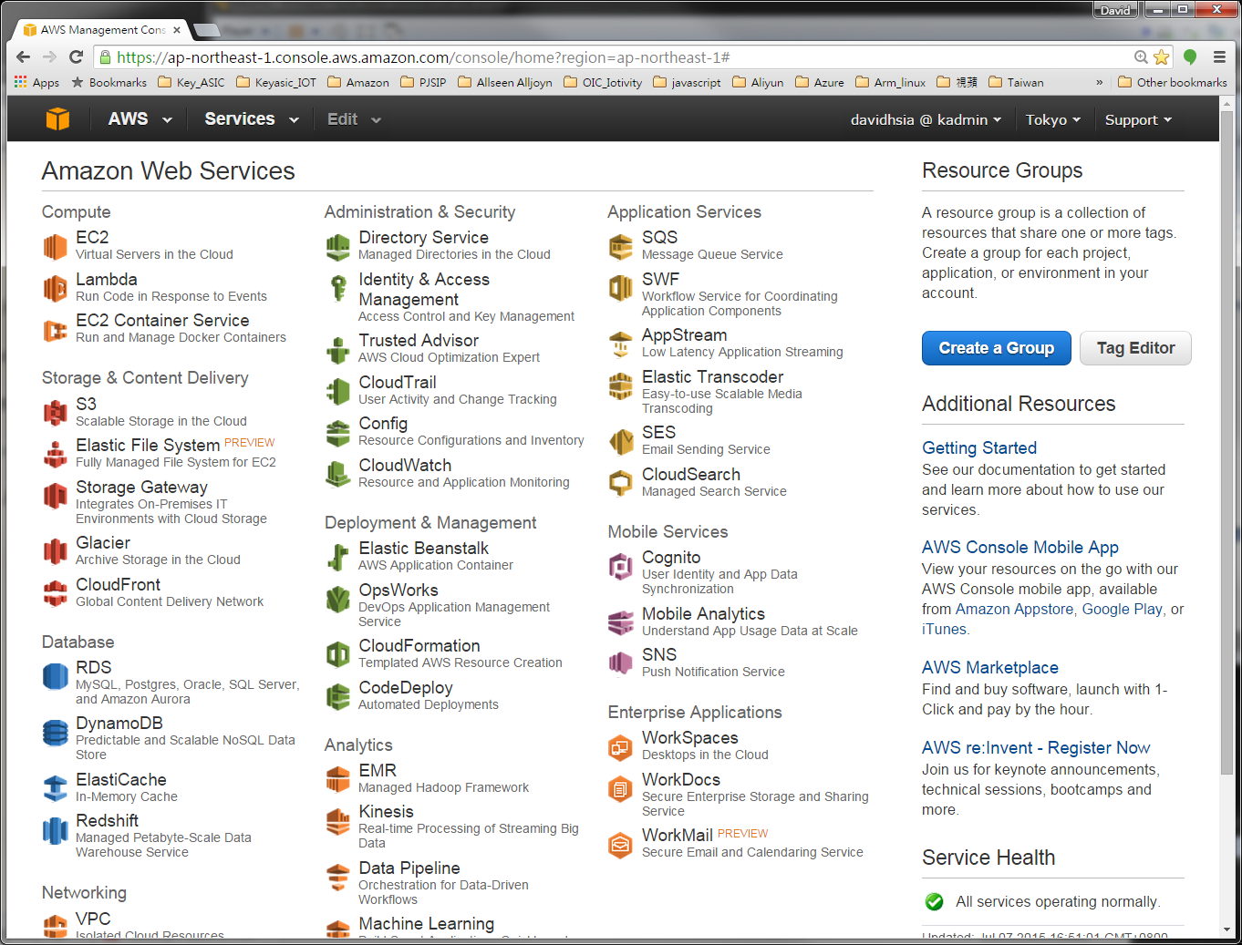
Amazon’s AWS

Slide 23
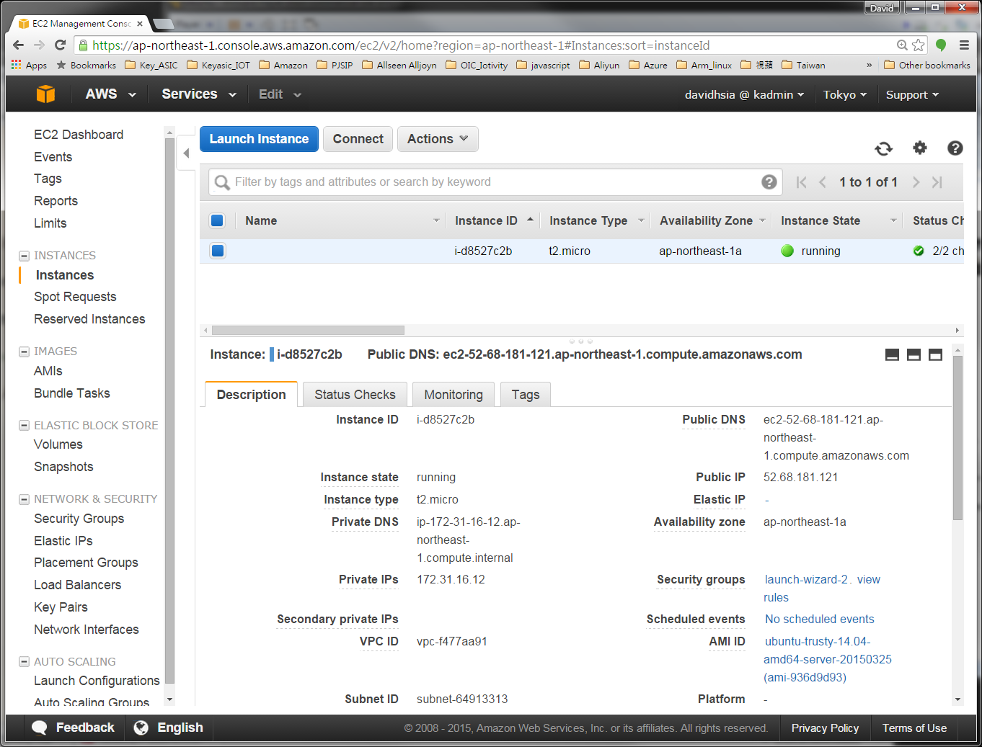
EC2 Tokyo region Tomcat7 & MySQL

Slide 24
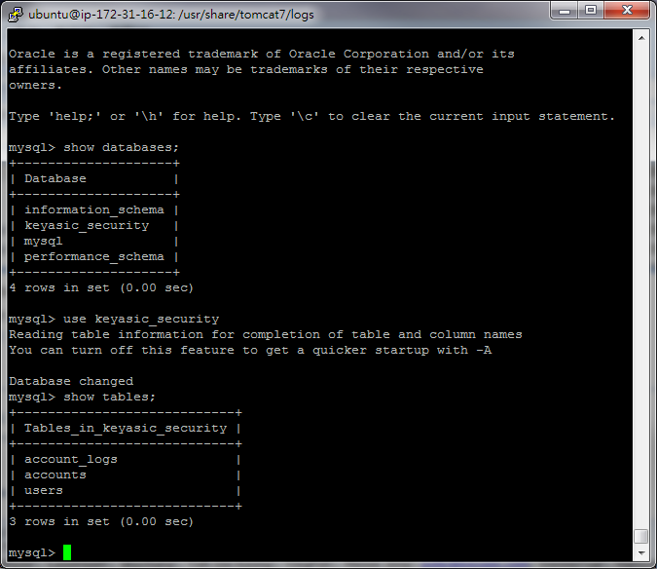
MySQL on AWS

Slide 25
Thanks
Q & A

