Slide 1
SOA, REST & JSON
Hannah Siegel & Andreas Vogt
2015-03-20

Slide 2
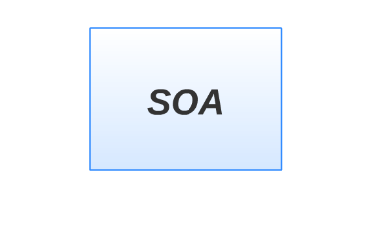

Slide 3
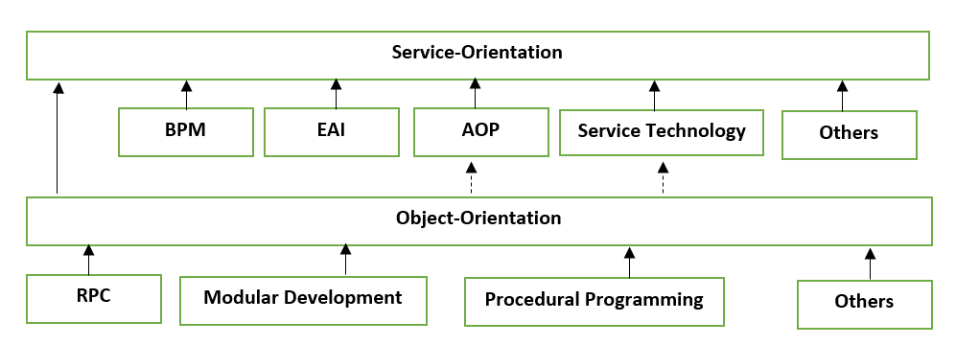
Service Oriented Architecture
Service – Orientation
Service Oriented Computing
Actors
Platforms
Success Formula
Contributors

Slide 4
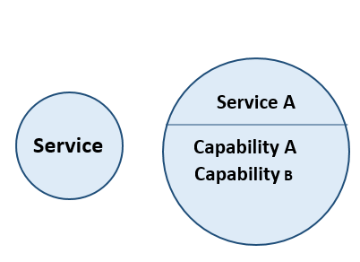
Service
Unit of logic
SOA Design Principles Applied
Clearly defined function
Description of the functionality

Slide 5
Problems?
Resistant to change
Communication and data transmission
Vendor dependency
Not enough support to BPM

Slide 6
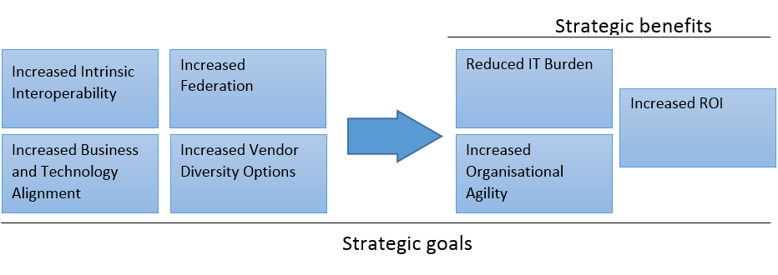
Solution

Slide 7
SOA Manifesto
Business value over technical strategy
Strategic goals over project-specific benefits
Intrinsic interoperability over custom integration
Shared services over specific-purpose implementations
Flexibility over optimization
Evolutionary refinement over pursuit of initial perfection

Slide 8
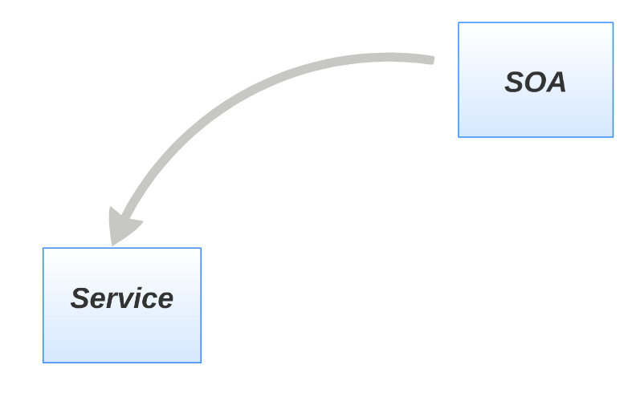

Slide 9
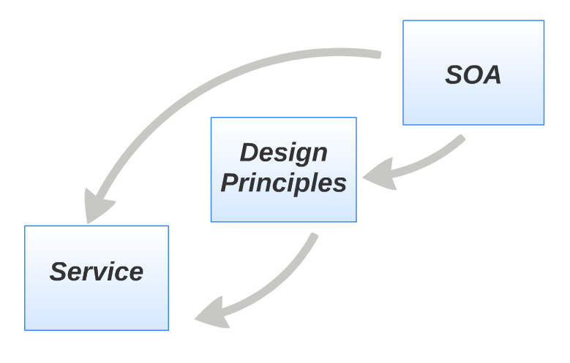

Slide 10
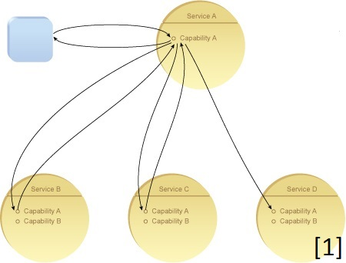
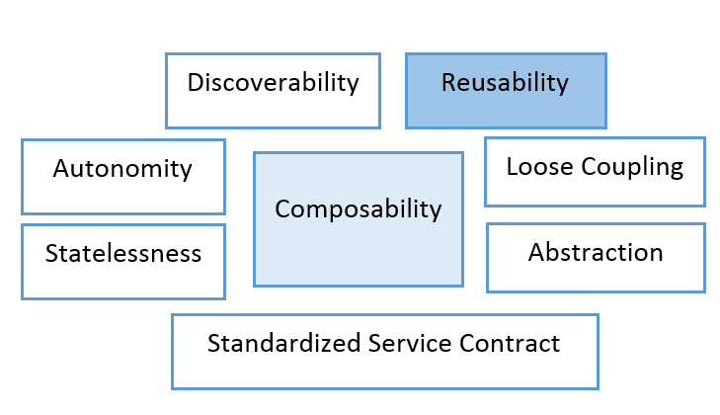
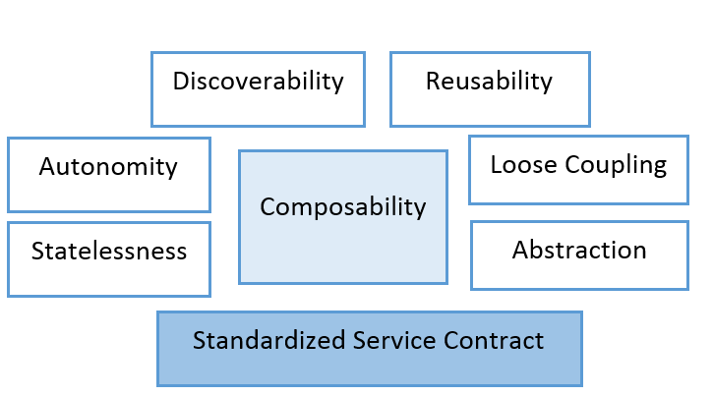
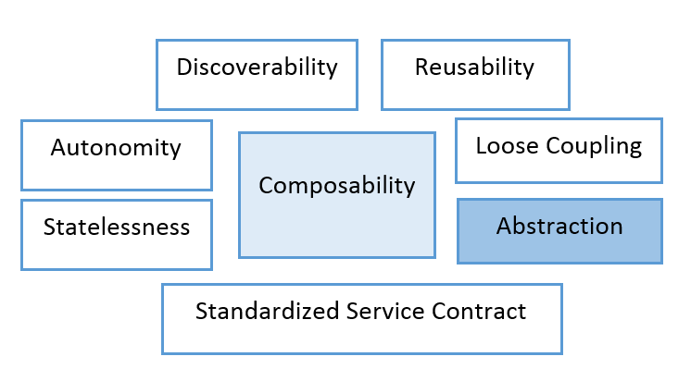
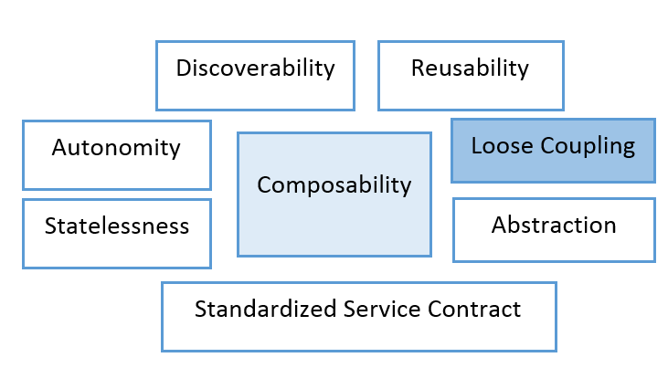
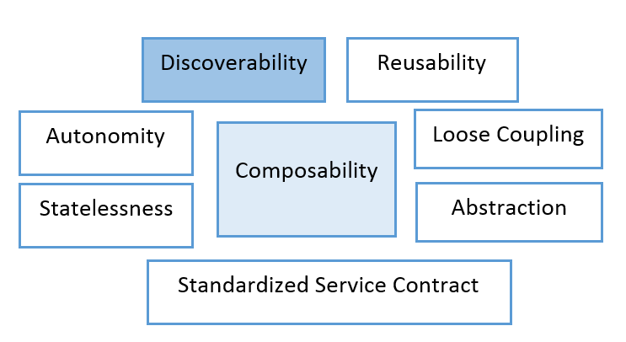
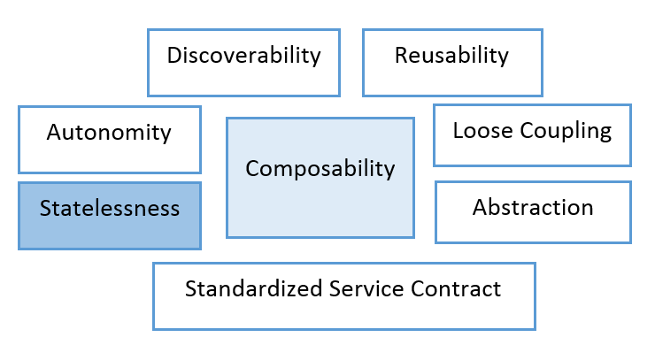
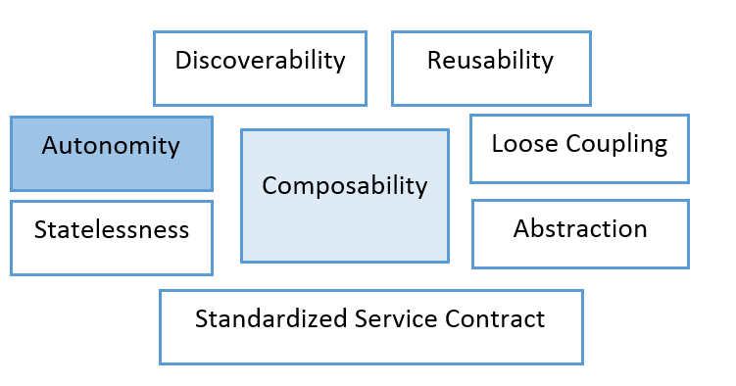
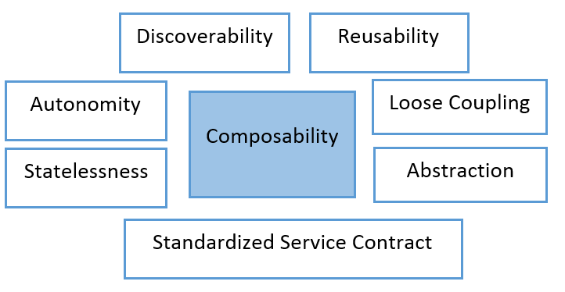
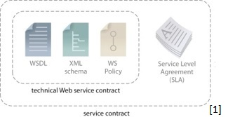
Design Principles

Slide 11
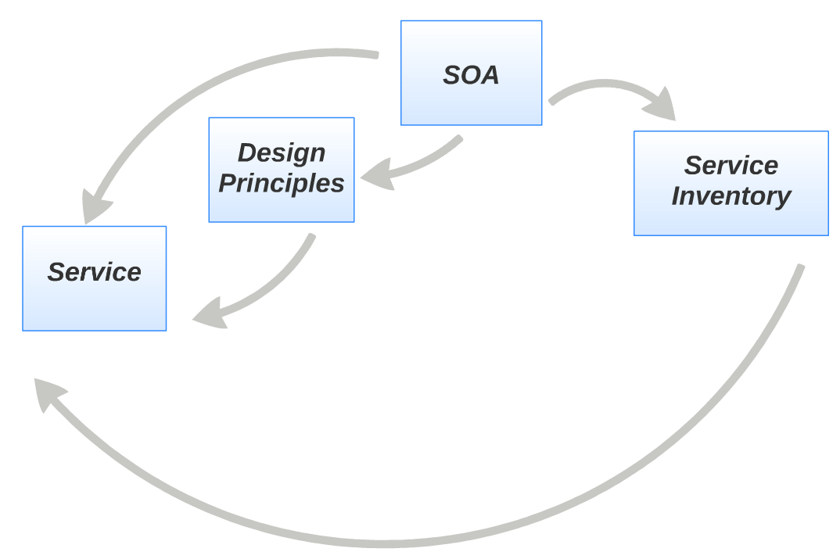

Slide 12
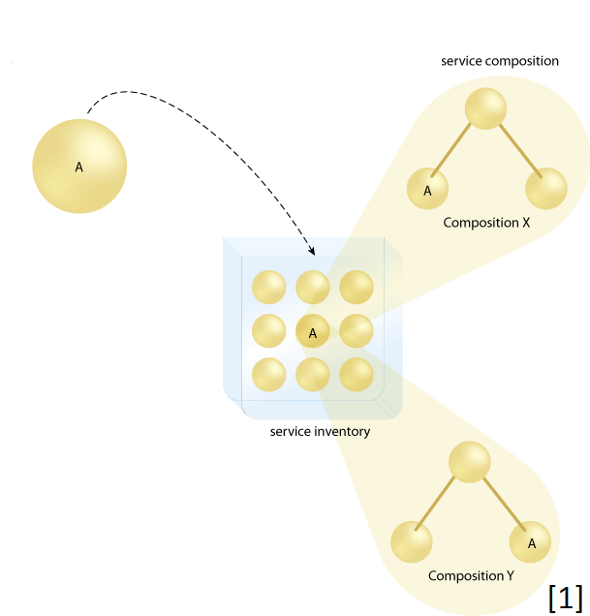

Slide 13
Orchestration
BPEL
Graphically composing services from a very business process view
Generating new processes without coding
Generating compositions
Power of SOA

Slide 14
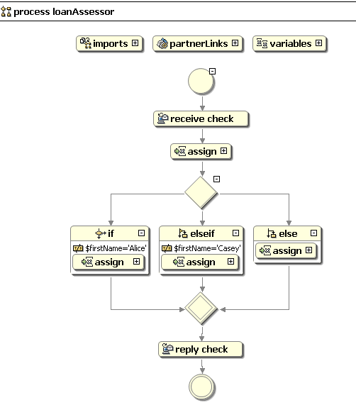
BPEL
[3]

Slide 15
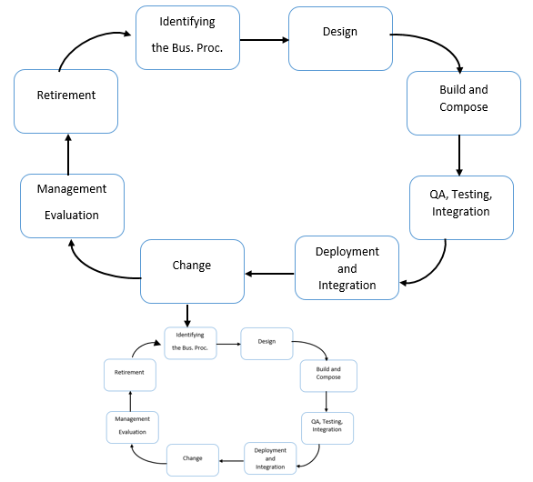
Lifecycle
Normal Lifcycle + Service Lifecycle
Differences from normal software development:
Identifying the Business Process
Build and compose
Change
Retirement

Slide 16
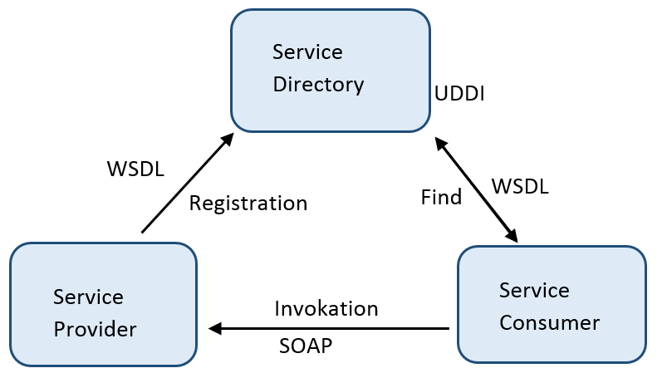
SOA Triangle

Slide 17
SOAP
SOAP is an XML based protocol for accessing Web Services
Originally shortcut for "Simple Object Access Protocol“
Stand for itself now
Ordinary XML document

Slide 18
SOAP Message Information
An Envelope element that identifies the XML document as a SOAP message
A Header element that contains header information
A Body element that contains call and response information
A Fault element containing errors and status information"

Slide 19
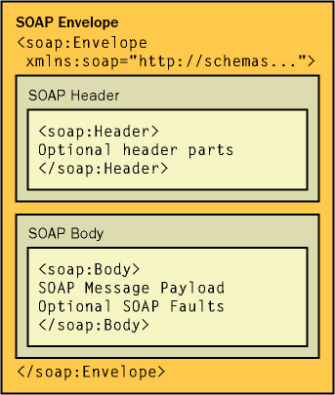
[5]

Slide 20
Request
<soap:Envelopexmlns:soap="http://www.w3.org/2001/12/soap-envelope"soap:encodingStyle="http://www.w3.org/2001/12/soap-encoding">
<soap:Body xmlns:m="http://www.example.org/stock">
<m:GetStockPrice>
<m:StockName>IBM</m:StockName>
</m:GetStockPrice>
</soap:Body>
</soap:Envelope>

Slide 21
Response
<soap:Envelopexmlns:soap="http://www.w3.org/2001/12/soap-envelope"soap:encodingStyle="http://www.w3.org/2001/12/soap-encoding">
<soap:Body xmlns:m="http://www.example.org/stock"> <m:GetStockPriceResponse>
<m:Price>34.5</m:Price>
</m:GetStockPriceResponse>
</soap:Body>
</soap:Envelope>

Slide 22
WSDL
Web Service Description Language
XML based Interface description language
Used to describe web services which are called by SOAP-Messages
Specifies location and operations the service exposes

Slide 23
WSDL File Contents
Definition : Defines web-service name
Message : Describes data being exchanges (in-ouput)
Type : Define data types
Port Type : Combines message elements to one operation
Binding : How Port Type will be transmitted
Port : Where the service can be accessed
Service: What Ports support the web service

Slide 24
UDDI
Universal Description, Discovery and Integration
Businesses can register and search for Web services
Communicates via SOAP
Uses WSDL to describe interfaces to web services
Tools : Apache: jUDDI, INFRAVIO X-Registry Platform

Slide 25
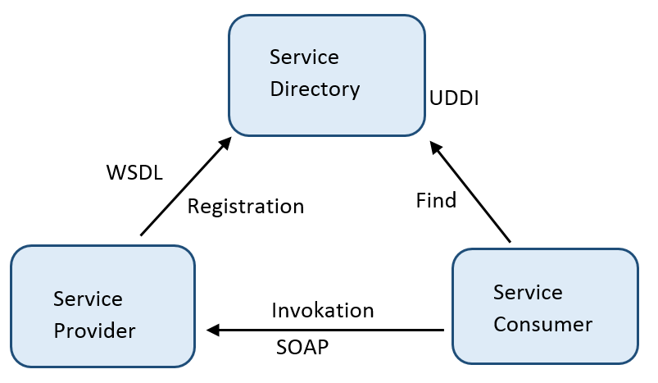
SOA Triangle

Slide 26
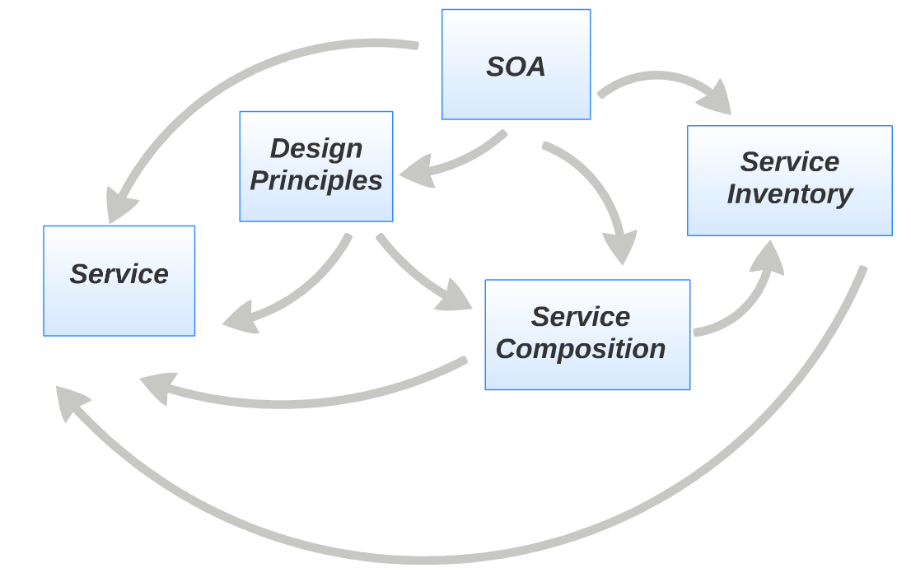

Slide 27
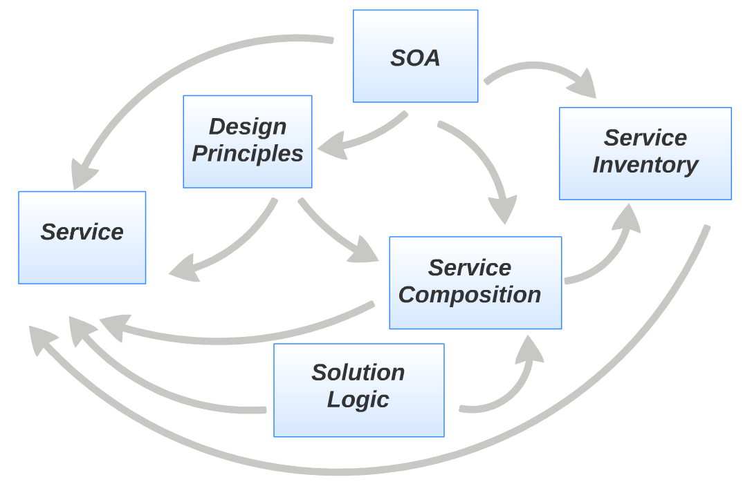

Slide 28
Migration of Legacy Systems
50% applications designed SOA
Rarely start from scratch
Existing legacy systems -> Services
Already achieved different domains

Slide 29
REST
REpresentational State Transfer
Guidelines and best practices For Creating Web-Services
Work with HTTP-Protocol
Rest is basically using HTTP Requests

Slide 30
HTTP Requests
GET : used to get a representation of a resource (READ)
PUT : is most-often utilized for update capabilities(UPDATE)
POST :most-often utilized for creation of new resources(CREATE)
DELETE : It is used to delete a resource identified by a URI(DELETE)

Slide 31
RESTful Web-Services
Restful applications use HTTP requests
HTTP Requests GET,PUT,POST,DELETE
To access Recoures use URI
(Uniform Resource Identifiers)
Exchange of representations of resources

Slide 32
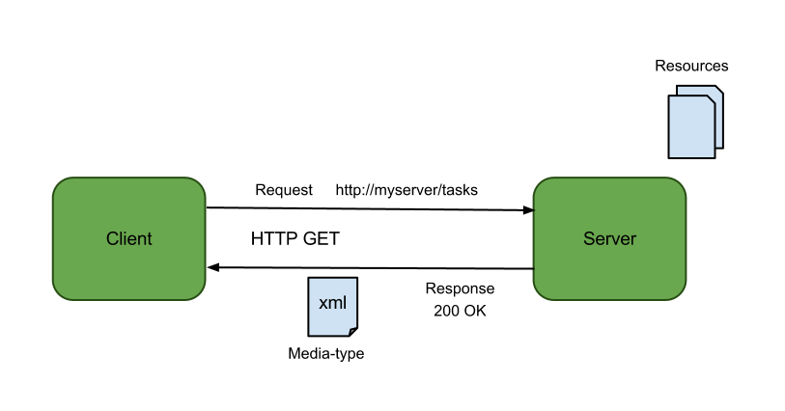
[4]

Slide 33
XML
EXtensible Markup Language
Designed to describe data
Software- and hardware-independent tool for carrying information
Nearly all other standards originate from XML

Slide 34
XML Example
<employees> <employee> <firstName>John</firstName> <lastName>Doe</lastName> </employee> <employee> <firstName>Anna</firstName> <lastName>Smith</lastName> </employee> <employee> <firstName>Peter</firstName> <lastName>Jones</lastName> </employee> </employees>

Slide 35
JSON
JavaScript Object Notation
Lightweight data-interchange format
does not support name spaces and schemed based validation
Easier to understand than XML

Slide 36
JSON Example
{{"employees:[ {"firstName":"John", "lastName":"Doe"}, {"firstName":"Anna", "lastName":"Smith"}, {"firstName":"Peter", "lastName":"Jones"}]}

Slide 37

REST EXAMPLE
[6]

Slide 38
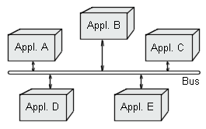
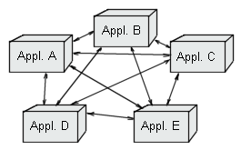
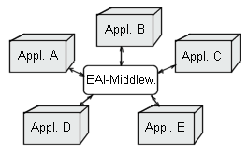
Enterprise Service Bus
Distribute information
Routing
Mask differences among underlying platforms
Ensure information delivery
Re-route, log, and enrich information
[2]

Slide 39
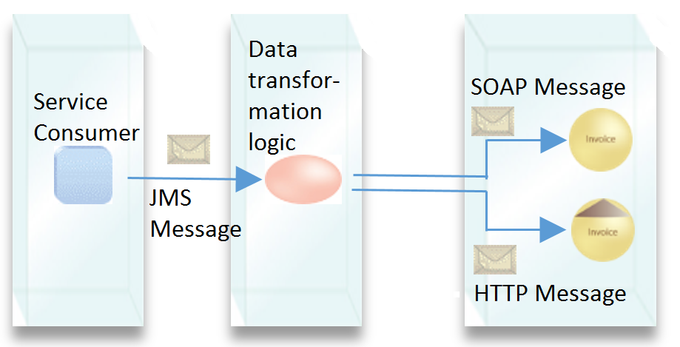
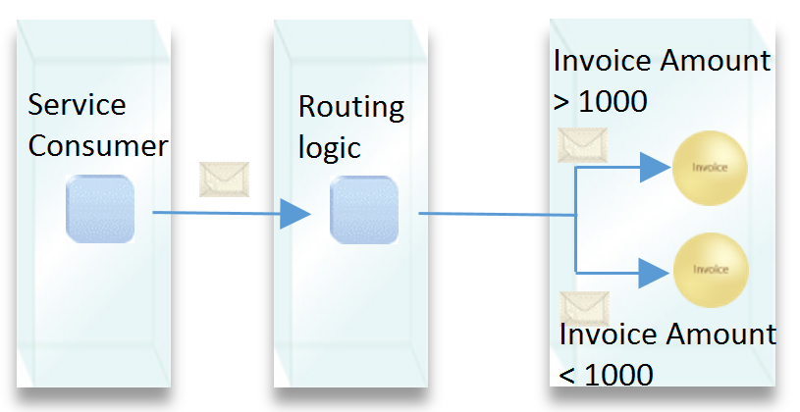
Enterprise Service Bus

Slide 40
Summary & Conclusion

Slide 41
Thank you for your attention! Any Questions?

Slide 42
Sources
[1] SOA Principles of Service Design, (c) Prentice Hall/PearsonPTR - http://serviceorientation.com
[2] EAI Enterprise Application Integration,Thorsten Horn
http://www.torsten-horn.de/techdocs/eai.htm
last used : 28.02.2014, 20:25
[3] http://documentation.progress.com/infocenter/sonic/8.5/index.jsp
[4] http://prideparrot.com/blog/archive/2012/3/creating_a_rest_service_using_asp_net_web_api
[5] http://flylib.com/books/en/2.439.1.22/1/
[6] https://spring.io/guides/gs/rest-service/

