Slide 1
REST
REpresentational State Transfer
Guidelines and best practices For Creating Web-Services
Work with HTTP-Protocol
Rest is basicly using HTTP Requests

Slide 2
HTTP Methods
GET : used to a representation of a resource (READ)
PUT : is most-often utilized for update capabilities(UPDATE)
POST :most-often utilized for creation of new resources(CREATE)
DELTE : It is used to delete a resource identified by a URI(DELETE)

Slide 3
RESTful Web-Services
Restful applications use HTTP requests
HTTP Requests GET,PUT,POST,DELETE
To access Recoures use URI
(Uniform Resource Identifiers)
Exchange of representations of resources

Slide 4
Migration of Legacy Systems
50% applications designed SOA
Rarely start from scratch
Existing legacy systems -> Services
Already achieved different domains

Slide 5
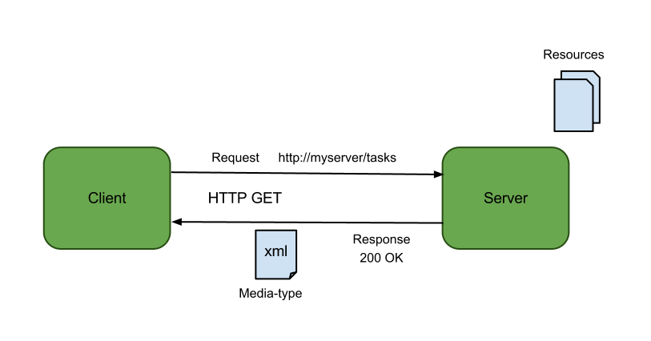

Slide 6
XML
EXtensible Markup Language
Designed to describe data
Software- and hardware-independent tool for carrying information
Nearly all other standards originate from XML

Slide 7
JSON
JavaScript Object Notation
Lightweight data-interchange format
Easier to understand than XML
text format that is completely language independent

Slide 8
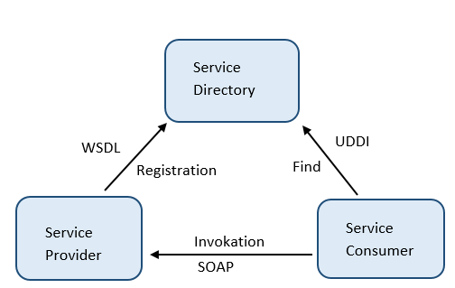
SOA-Triangle
Würde gerne nach-
dem du das erklärt
Hast SOAP WSDL und
UDDI machen falls du
Das Dreieck am schluss
Erklären willst

Slide 9
SOAP
SOAP is an XML based protocol for accessing Web Services
Originally shortcut for "Simple Object Access Protocol“
Stand for itself now
Ordinary XML document

Slide 10
SOAP Message Information
An Envelope element that identifies the XML document as a SOAP message
A Header element that contains header information
A Body element that contains call and response information
A Fault element containing errors and status information"

Slide 11
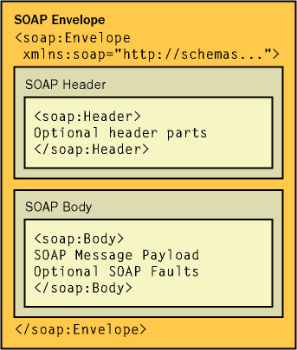

Slide 12
Response
<soap:Envelopexmlns:soap="http://www.w3.org/2001/12/soap-envelope"soap:encodingStyle="http://www.w3.org/2001/12/soap-encoding">
<soap:Body xmlns:m="http://www.example.org/stock"> <m:GetStockPriceResponse>
<m:Price>34.5</m:Price>
</m:GetStockPriceResponse>
</soap:Body>
</soap:Envelope>

Slide 13
Request
<soap:Envelopexmlns:soap="http://www.w3.org/2001/12/soap-envelope"soap:encodingStyle="http://www.w3.org/2001/12/soap-encoding">
<soap:Body xmlns:m="http://www.example.org/stock">
<m:GetStockPrice>
<m:StockName>IBM</m:StockName>
</m:GetStockPrice>
</soap:Body>
</soap:Envelope>

Slide 14
WSDL
Web Service Description Language
XML based Interface communicationinterface description language
Used to describe web services which are called by SOAP-Messages
Specifies location and operations the service exposes

Slide 15
WSDL File Contents
Definition : Defines servicename
Message : Describes data being exchanges (in-ouput)
Type : Define data types
Port Type : Combines message elements to one operation
Binding : How Port Type will be transmitted
Port : Where the service can be accessed
Service: What Ports support the web service

Slide 16
UDDI
Universal Description, Discovery and Integration
Businesses can register and search for Web services
Communicates via SOAP
Uses WSDL to describe interfaces to web services
Tools : Apache: jUDDI, INFRAVIO X-Registry Platform

Slide 17

REST EXAMPLE

