Slide 1
SOA, REST & JSON
Siegel, Vogt
2015-03-20

Slide 2
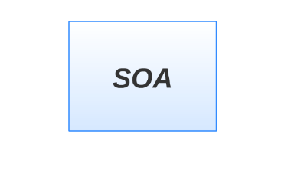

Slide 3
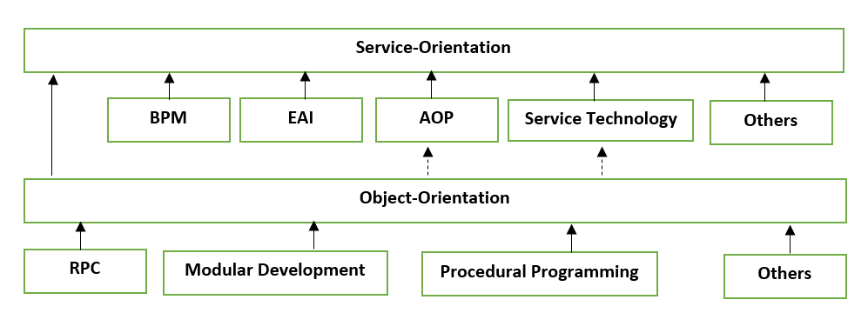
Service Oriented Architecture
Service – Orientation
Service Orientated Computing
Actors
Platforms
Sucess Formula
Contributors

Slide 4
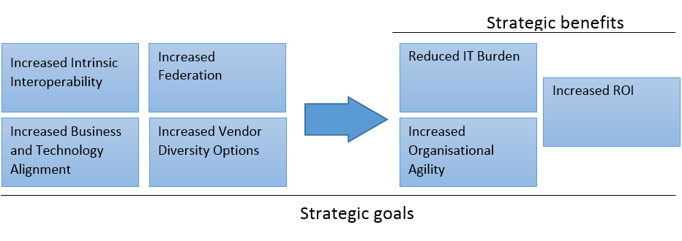
Why SOA?
Resistant to change
Communication and data transmission
Vendor dependency
Not enough support to BPM

Slide 5
SOA Manifesto
Business value over technical strategy
Strategic goals over project-specific benefits
Intrinsic interoperability over custom integration
Shared services over specific-purpose implementations
Flexibility over optimization
Evolutionary refinement over pursuit of initial perfection

Slide 6
SOA Lifecycle
TODO? Hier?

Slide 7
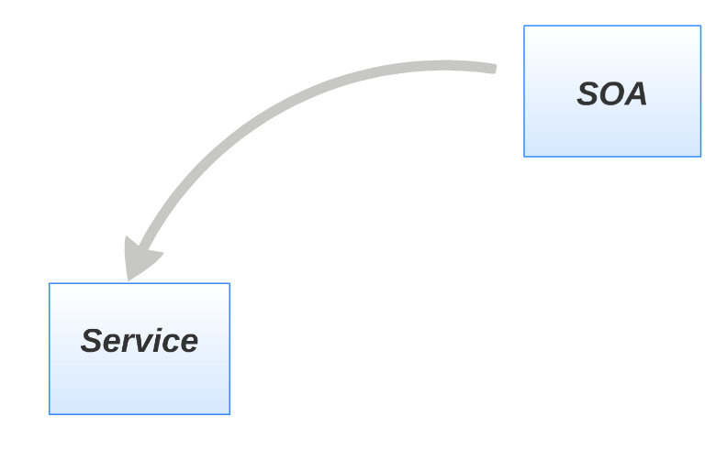

Slide 8
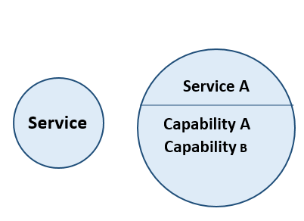
Service
Unit of logic
SOA Design Principles Applied
Clearly defined function
Description of the functionality

Slide 9
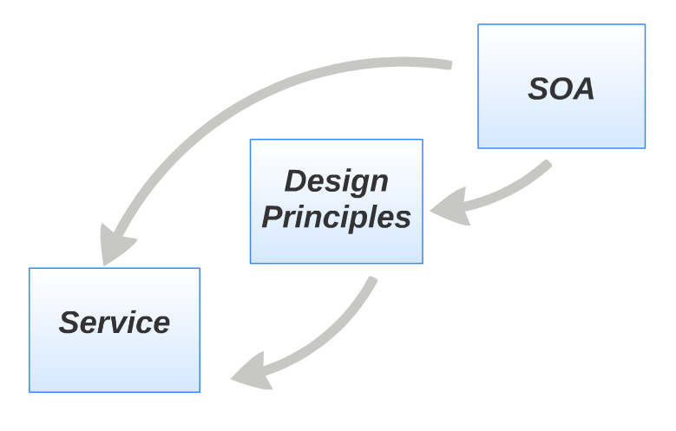

Slide 10
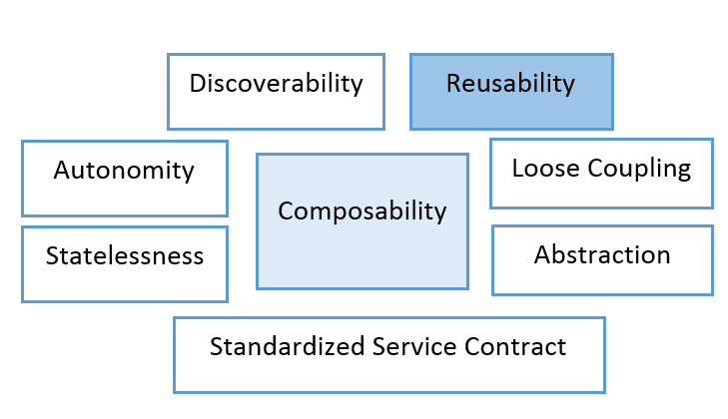
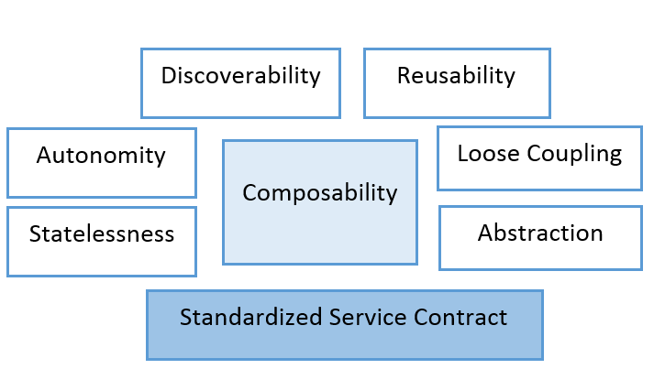
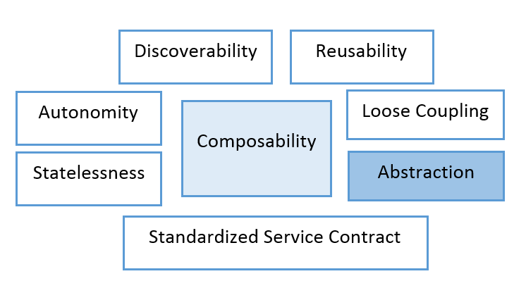
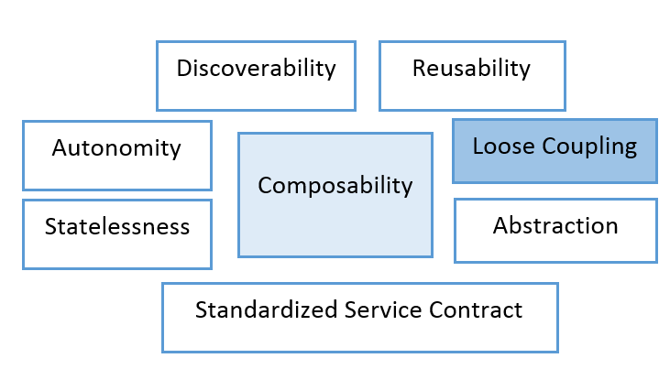
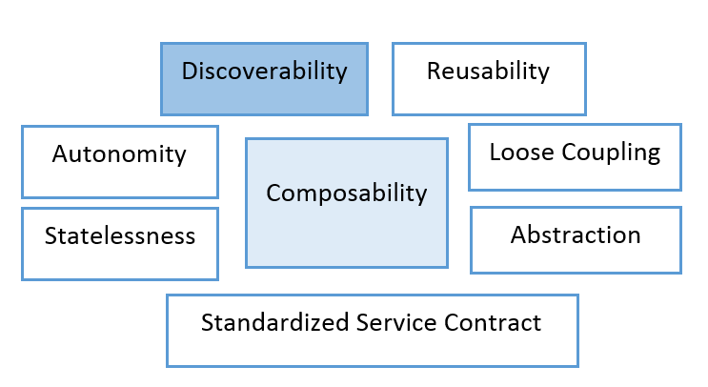
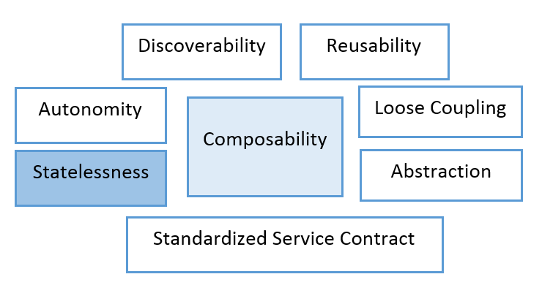
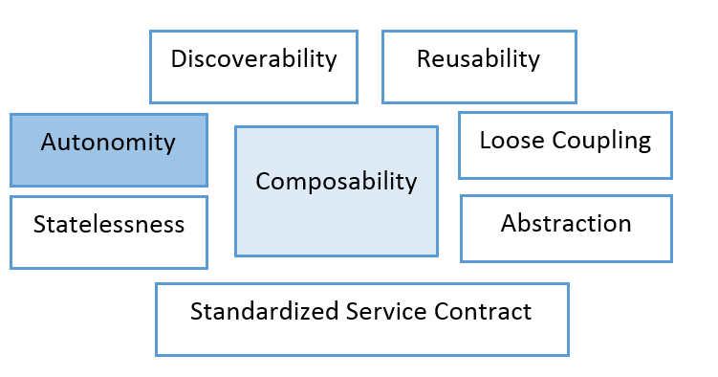
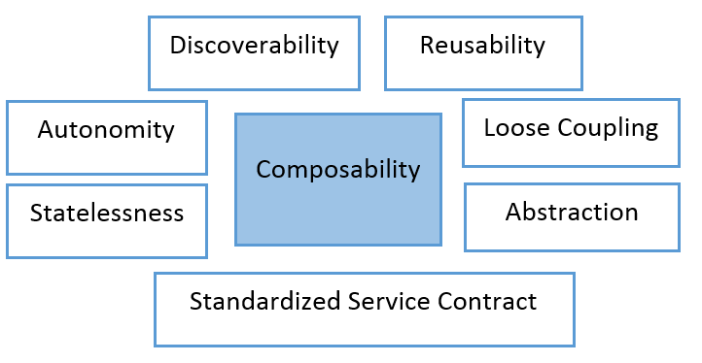
Design Principles

Slide 11
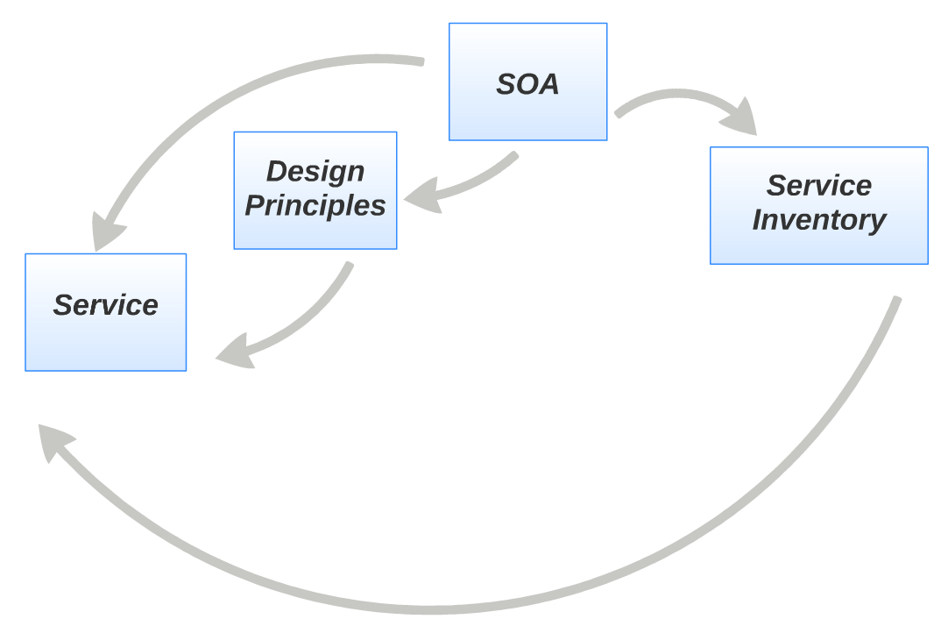

Slide 12
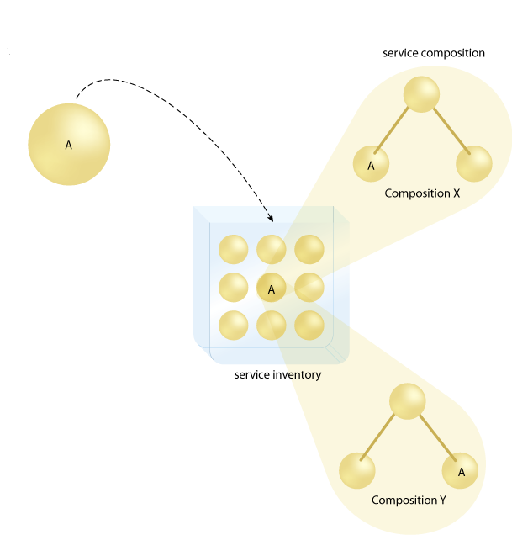

Slide 13
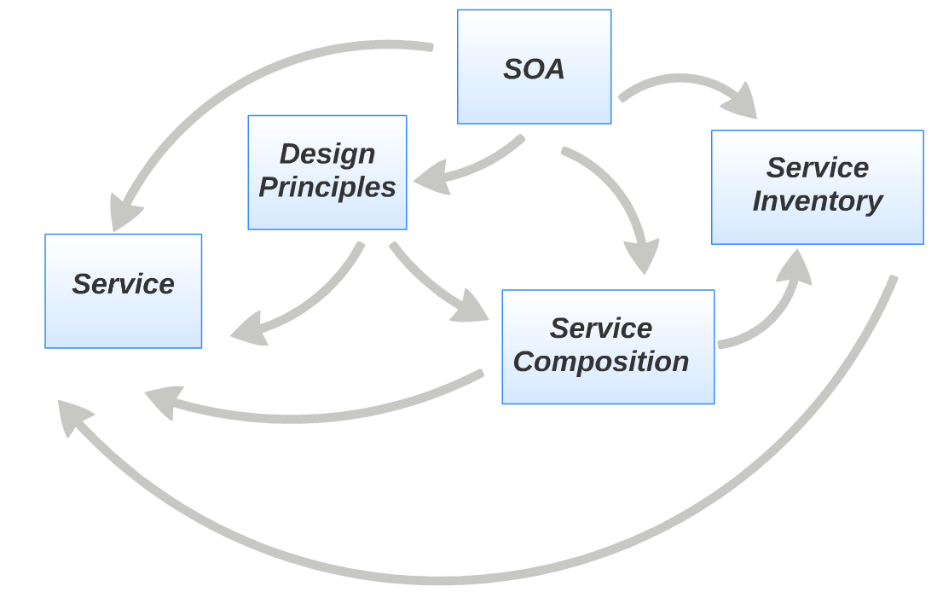

Slide 14
Orchestration
Todo

Slide 15
BPEL
TODO

Slide 16
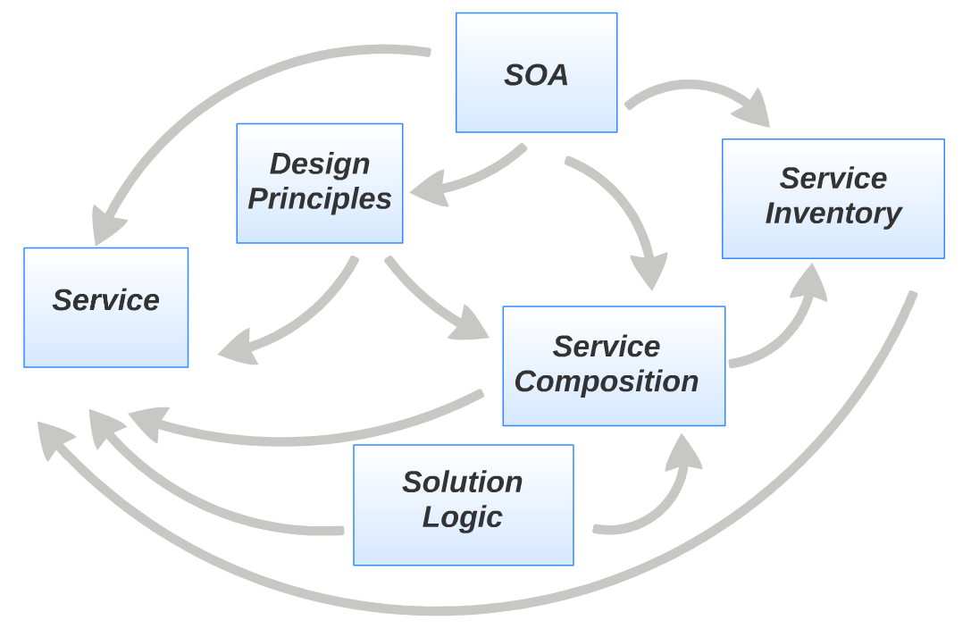

Slide 17
BPM

