Slide 1
SOA, REST & JSON
Hannah Siegel & Andreas Vogt
2015-03-20

Slide 2
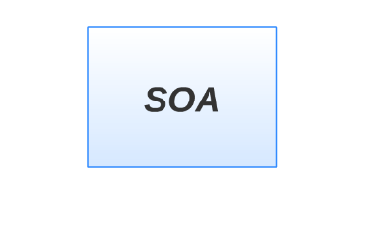

Slide 3
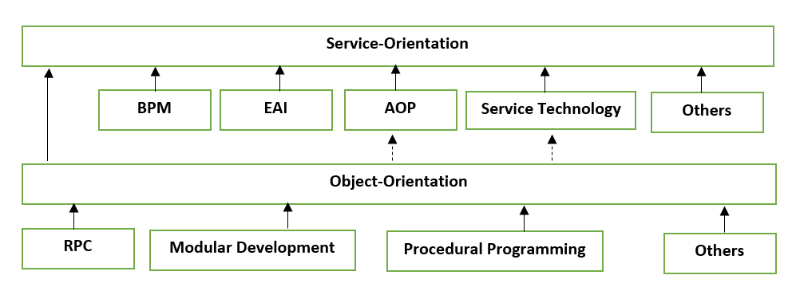
Service Oriented Architecture
Service – Orientation
Service Orientated Computing
Actors
Platforms
Sucess Formula
Contributors

Slide 4
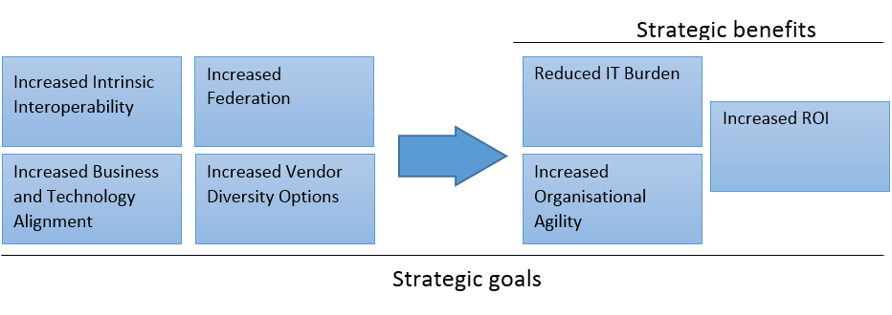
Why SOA?
Resistant to change
Communication and data transmission
Vendor dependency
Not enough support to BPM

Slide 5
SOA Manifesto
Business value over technical strategy
Strategic goals over project-specific benefits
Intrinsic interoperability over custom integration
Shared services over specific-purpose implementations
Flexibility over optimization
Evolutionary refinement over pursuit of initial perfection

Slide 6
SOA Lifecycle
TODO? Hier?

Slide 7
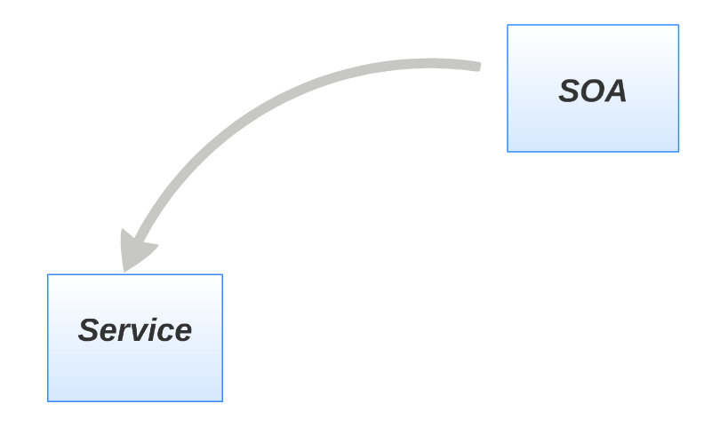

Slide 8
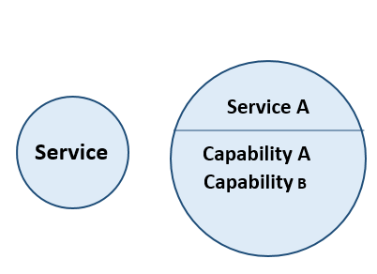
Service
Unit of logic
SOA Design Principles Applied
Clearly defined function
Description of the functionality

Slide 9
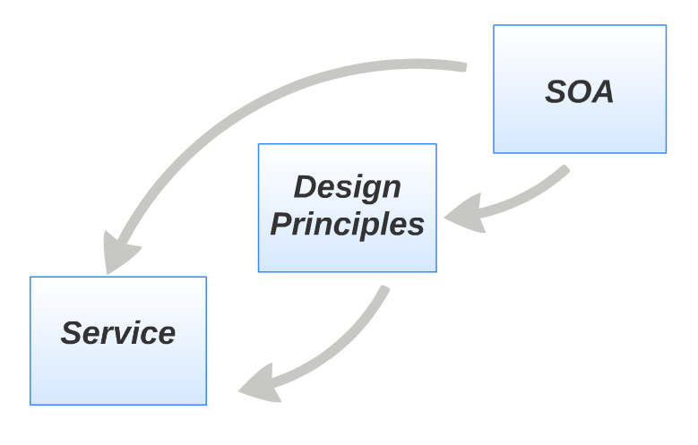

Slide 10
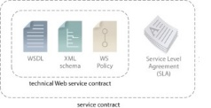
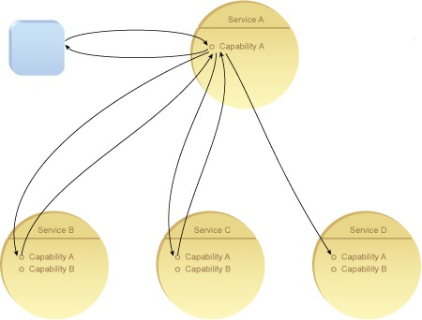
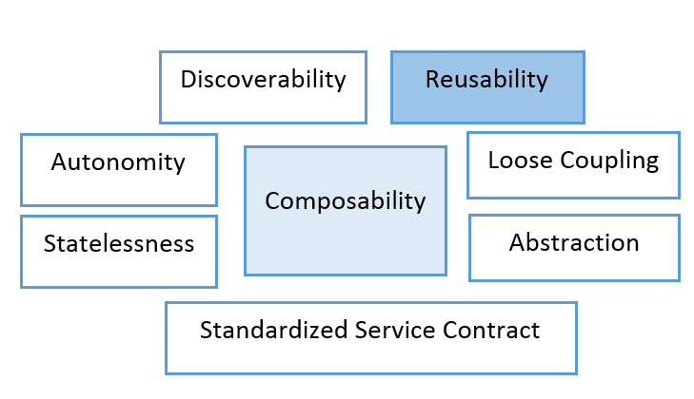
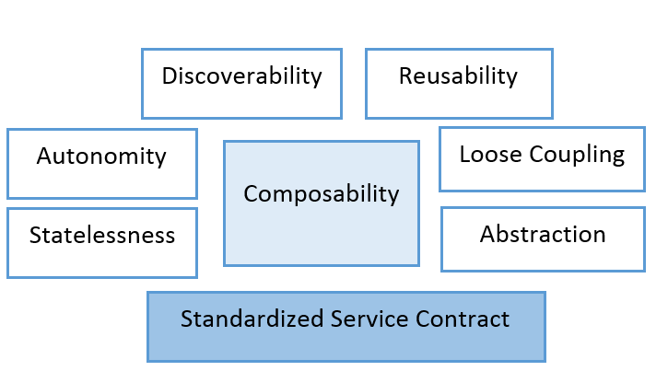
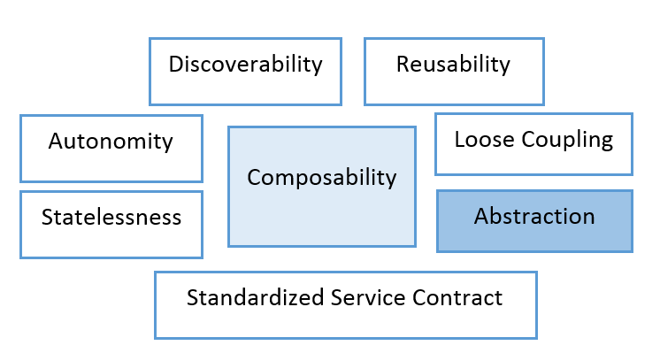
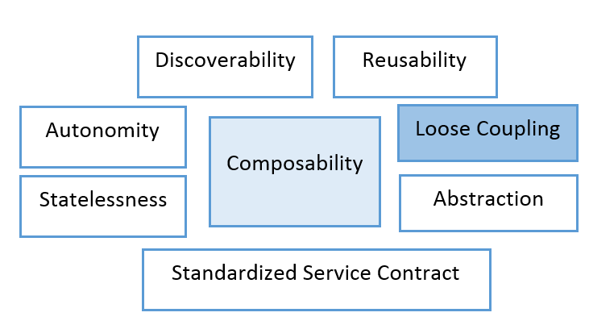
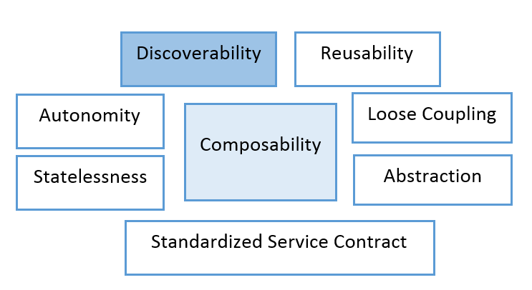
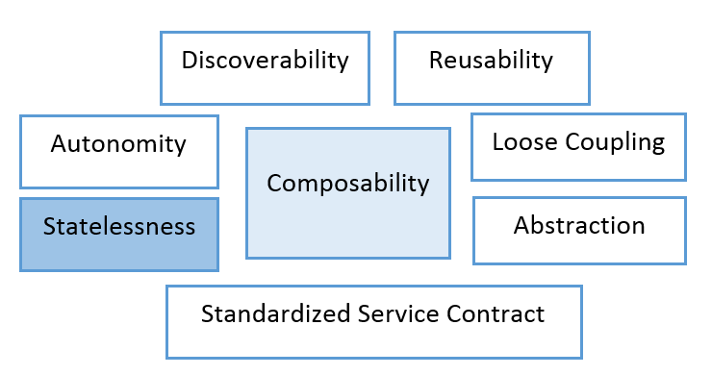
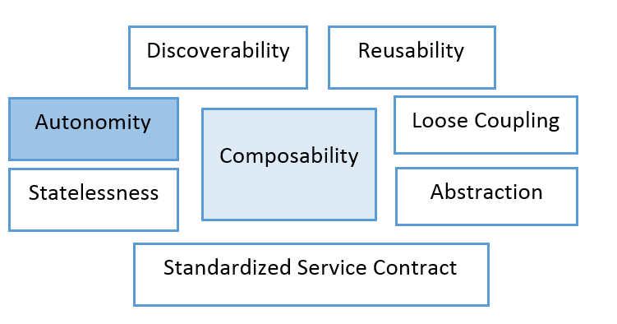
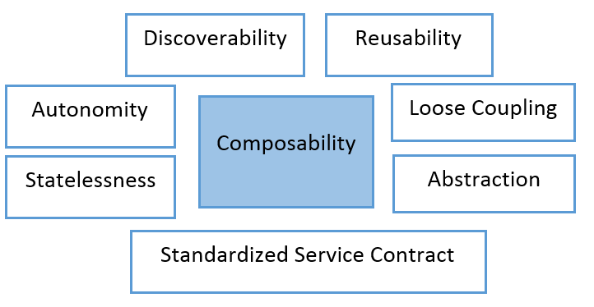
Design Principles

Slide 11
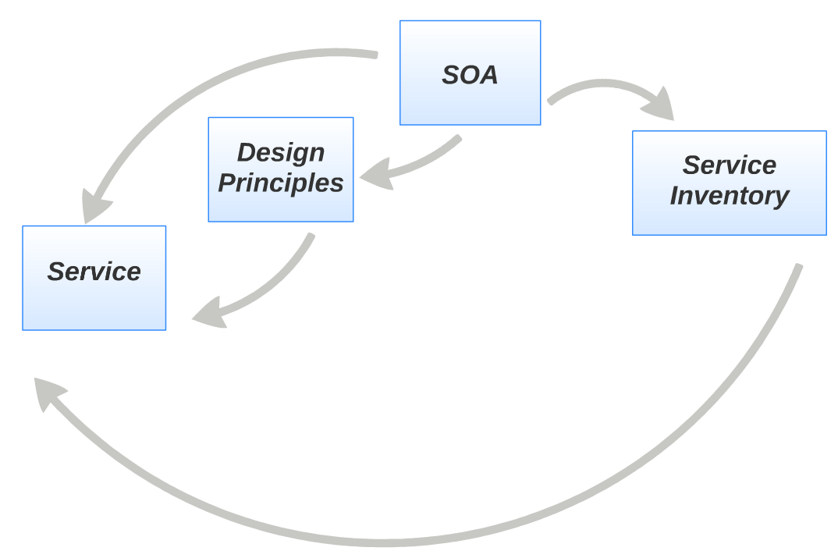

Slide 12
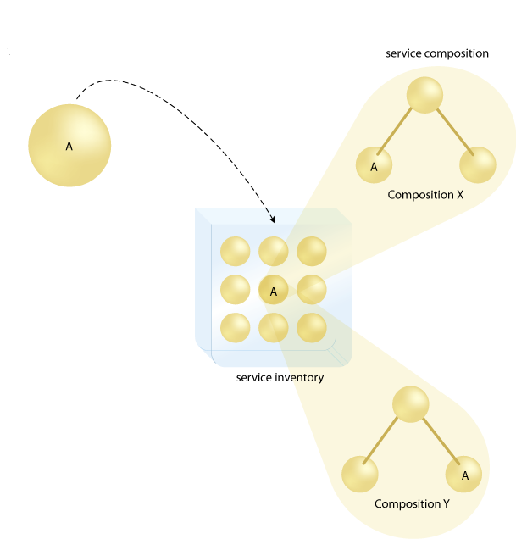

Slide 13
BPM

Slide 14
BPEL

Slide 15
Orchestration

Slide 16
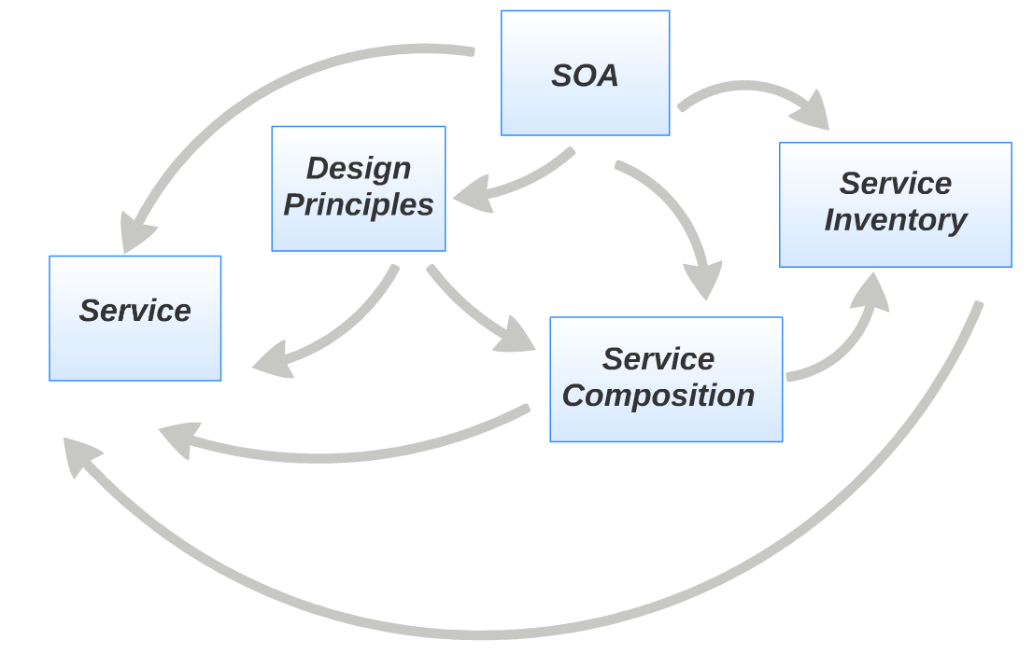

Slide 17
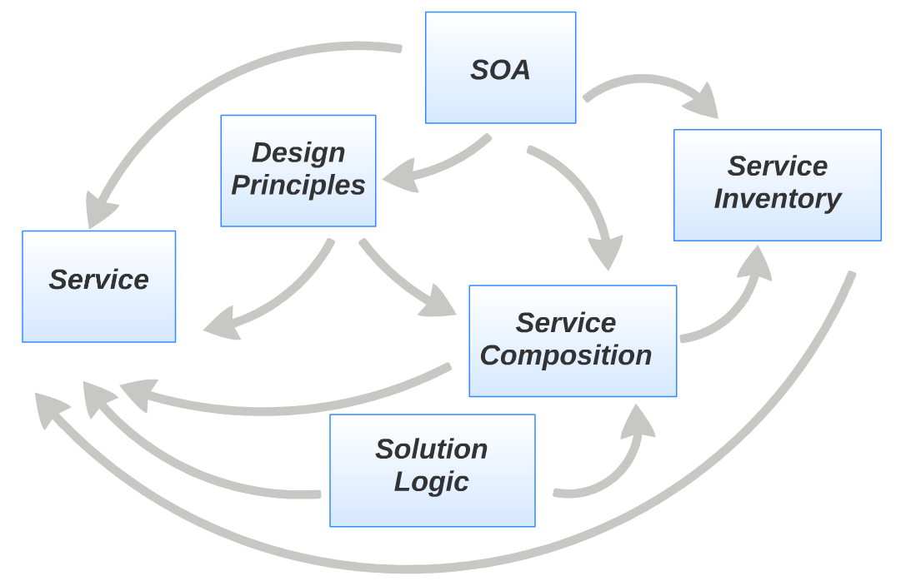

Slide 18
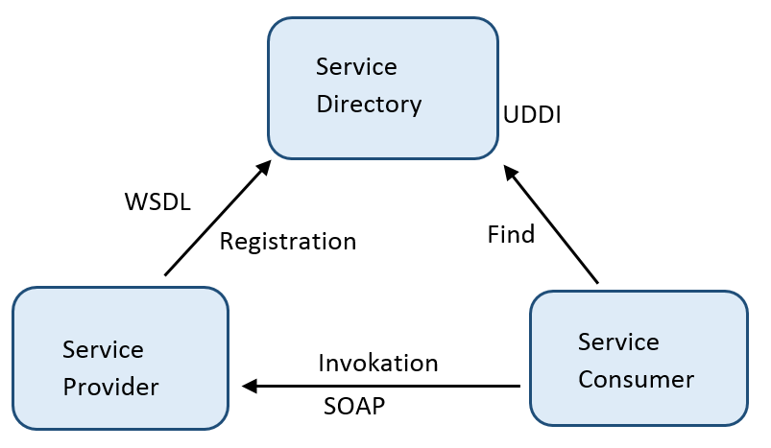
SOA Triangle

Slide 19
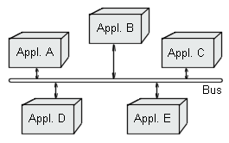
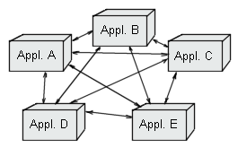
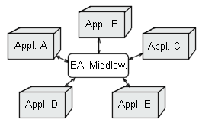
Enterprise Service Bus
Distribute information
Routing
Mask differences among underlying platforms
Ensure information delivery
Re-route, log, and enrich information

Slide 20
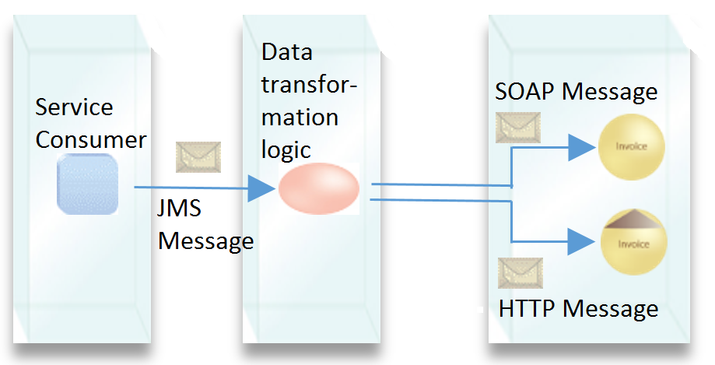
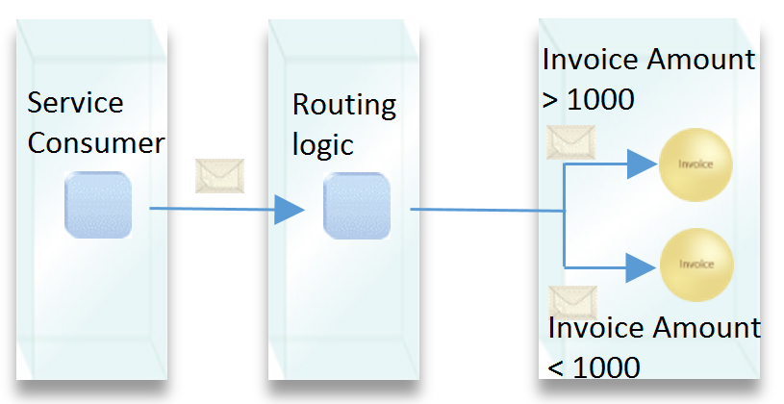
Enterprise Service Bus

