Slide 1
ctDNA Radiogenomics

Slide 2
ctDNA-Radiogenomics
Timepoint | t1 | t2
Non-Responders | 3 | 3
Responders | 10 | 10
13 subjects
First two timepoints (t1 and t2) subject to analysis
Manual segmentation performed on the series of the highest resolution
Extracted radiomic features within the delineated tumor using PyRadiomics
Survival analysis
Semi-automatic tumor segmentation
Notes:
Features not normalized prior to extraction.
Parameters:
{'distances': [1], 'additionalInfo': True, 'enableCExtensions': True, 'force2D': False, 'interpolator': 'sitkBSpline', 'resampledPixelSpacing': None, 'label': 1, 'normalizeScale': 1, 'normalize': False, 'force2Ddimension': 0, 'removeOutliers': None, 'minimumROISize': None, 'minimumROIDimensions': 1, 'resegmentRange': None, 'padDistance': 5}

Slide 3
PyRadiomics
First Order Statistics (19 features)
Shape-based (16 features)
Gray Level Cooccurence Matrix (23 features)
Gray Level Run Length Matrix (16 features)
Gray Level Size Zone Matrix (16 features)
Neigbouring Gray Tone Difference Matrix (5 features)
Gray Level Dependence Matrix (14 features)
http://pyradiomics.readthedocs.io/en/latest/features.html

Slide 4
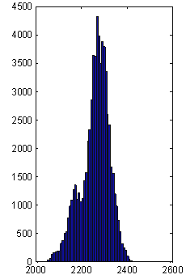
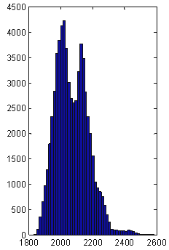
First-order Features
Common statistics extracted from the intensity histogram of the image
min intensity
max intensity
mean intensity
standard deviation
90th percentile
10th percentile
Sum intensity
Entropy
skewness
Kurtosis
…more…
Amadasun et al. IEEE Trans Syst Man Cybern 1989, Materka et al. COST B11 Report 1998

Slide 5
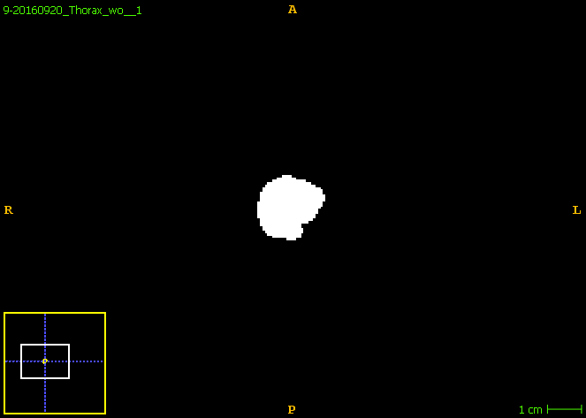
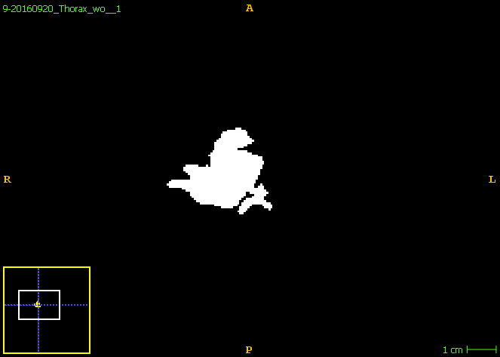
Shape Features
Max Diameters
Compactness
Sphericity
Major/Minor Axis
Elongation
Surface Area
Surface Volume Ratio
Flatness
…more…

Slide 6
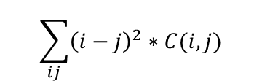
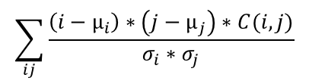
Gray-level Co-occurrence Features
Spatial relationship among gray levels in specified directions
$$\sum_{ij}{\frac{\left(i−µ_{i}\right)∗\left(j−µ_{j}\right)∗C(i,j)}{σ_{i}{∗σ}_{j}}}$$
$$\sum_{ij}{{\left(i−j\right)}^{2}∗C(i,j)}$$
0^{O}
45^{O}
90^{O}
135^{O}
Low contrast
2 | 0 | 0
1 | 1 | 1
3 | 1 | 1
0.17 | 0 | 0 | 0
0 | 0.5 | 0 | 0
0.17 | 0 | 0 | 0
0 | 0.17 | 0 | 0
0 | 0.33 | 0 | 0
0 | 0.33 | 0 | 0.17
0 | 0.17 | 0 | 0
0 | 0 | 0 | 0
3x3 image
with 4 possible gray levels
Gray-level co-occurrence
matrix (C) for 0^{O}
Gray-level co-occurrence
Matrix (C) for 90^{O}
High contrast
(For simplicity, symmetry is not considered here.)
Haralick et al. IEEE Trans Syst Man Cybern 1973

Slide 7
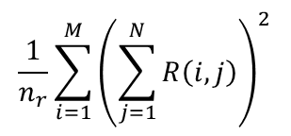
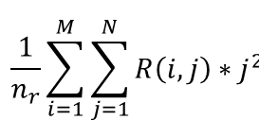
Gray-level Run-length Features
Texture coarseness in specified directions
0^{O}
45^{O}
90^{O}
135^{O}
$$\frac{1}{n_{r}}{\sum_{i=1}^{M}{\left(\sum_{j=1}^{N}{R\left(i,j\right)}\right)}}^{2}$$
2 | 0 | 0
1 | 1 | 1
3 | 1 | 1
1 | 0
1 | 1
0 | 0
0 | 0
0 | 0
2 | 0
0 | 0
0 | 0
$$\frac{1}{n_{r}}\sum_{i=1}^{M}{\sum_{j=1}^{N}{R\left(i,j\right)∗j^{2}}}$$
Run-length
matrix (R) for 0^{O}
Run-length
matrix (R) for 90^{O}
3x3 image
with 4 possible gray levels
(For simplicity, symmetry is not considered here.)
Galloway et al. Comput Graphics Image Process 1975, Chu et al. Pattern Recognit Lett 1990

Slide 8
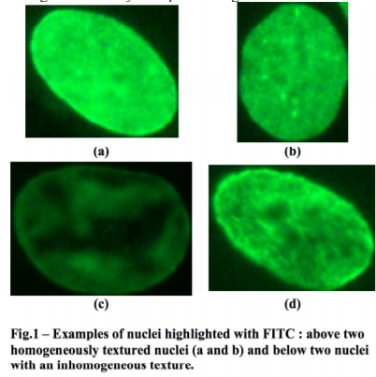
Gray-level Size Zone Features
Texture homogeneity in a region
2 | 0 | 0
1 | 1 | 1
3 | 1 | 1
0 | 1 | 0 | 0 | 0
0 | 0 | 0 | 0 | 1
1 | 0 | 0 | 0 | 0
1 | 0 | 0 | 0 | 0
3x3 image
with 4 possible gray levels
(Rotational invariant)
Guillaume Thibault et. al. “Texture Indexes and Gray Level Size Zone Matrix. Application to Cell Nuclei Classification”. Pattern Recognition and Information Processing 2009.

Slide 9
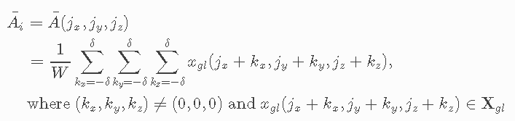
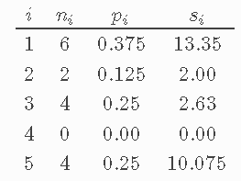
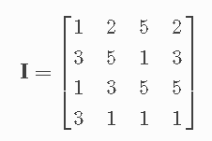
Neigboring Gray Tone Difference Features
quantifies the difference between a gray value and the average gray value of its neighbors within distance δ. The sum of absolute differences for gray level i is stored in the matrix.
Amadasun M, King R; Textural features corresponding to textural properties; Systems, Man and Cybernetics, IEEE Transactions 1989.

Slide 10
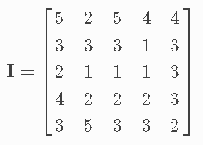
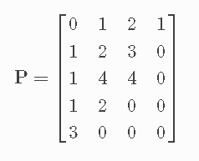
Gray Level Dependence Matrix Features
quantifies gray level dependencies in an image. A gray level dependency is defined as a the number of connected voxels within distance δ that are dependent on the center voxel. A neighboring voxel with gray level j is considered dependent on center voxel with gray level i if |i−j|≤α. In a gray level dependence matrix P(i,j) the (i,j)th element describes the number of times a voxel with gray level i with j dependent voxels in its neighborhood appears in image.
α = 0 and δ = 1
Amadasun M, King R; Textural features corresponding to textural properties; Systems, Man and Cybernetics, IEEE Transactions 1989.

Slide 11
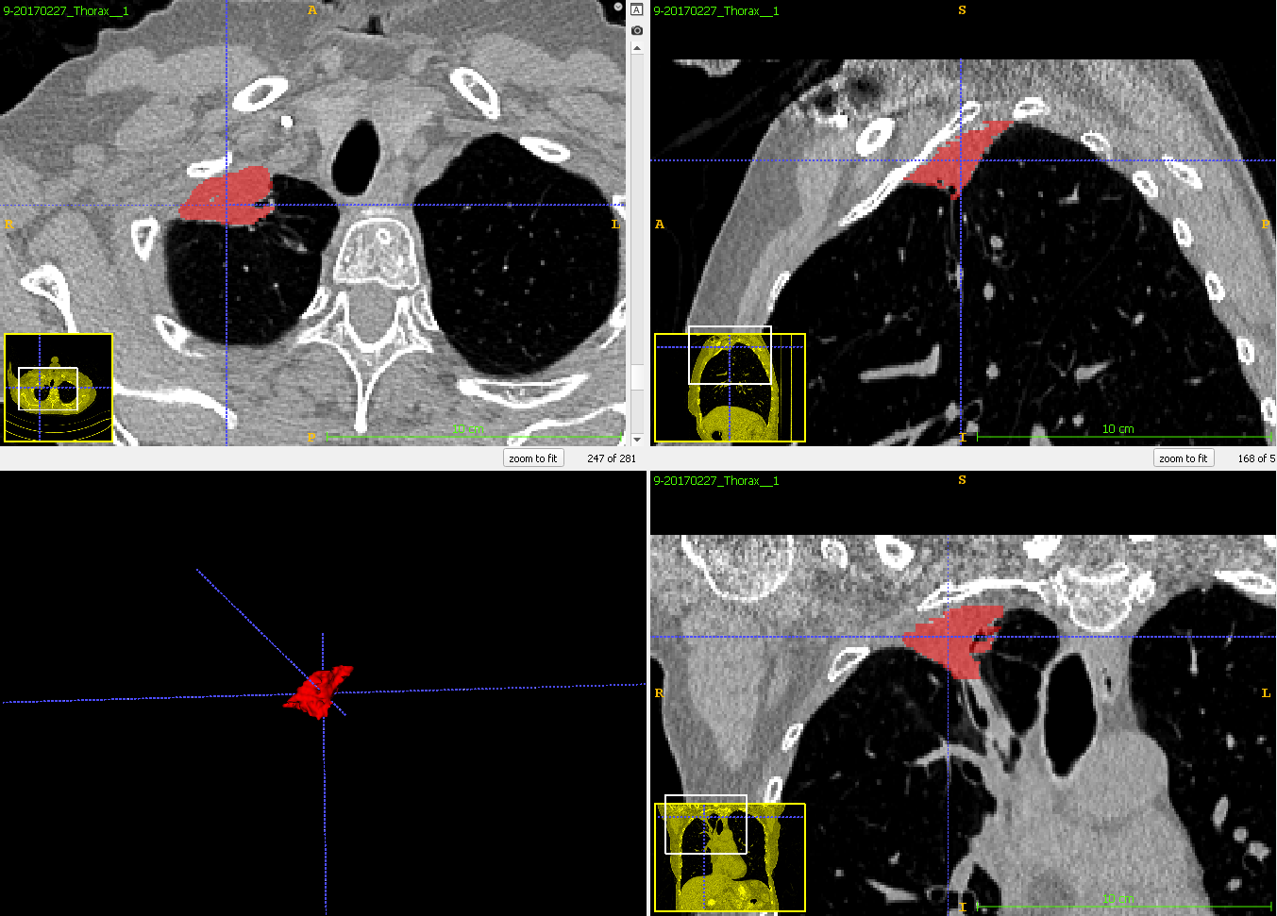
Case 9:
First follow-up (t2)
RECIST:
Responder
(Partial)

Slide 12
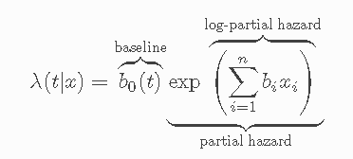
Survival Analysis
Important risk factors included:
Age
Number of metastatic sites
% T790M AF (allelic fraction)
1st principle component for each radiomic feature family
7 PC features total
Using the first timepoint t1 data
Cox’s Proportional Hazard model
With L2 penalty of 0.1 (emperical)

Slide 13
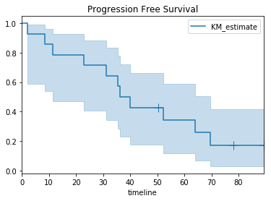
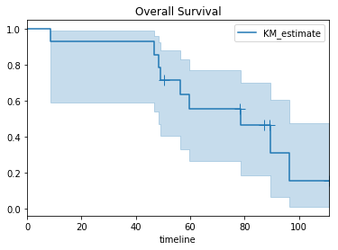
Survival Analysis

Slide 14
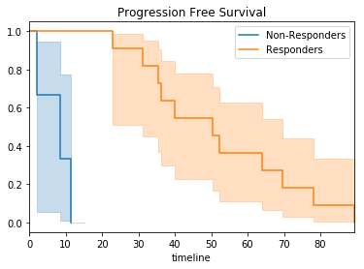
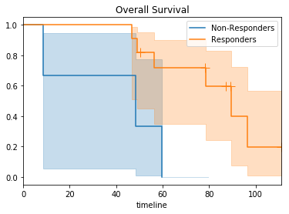
Survival Analysis

Slide 15
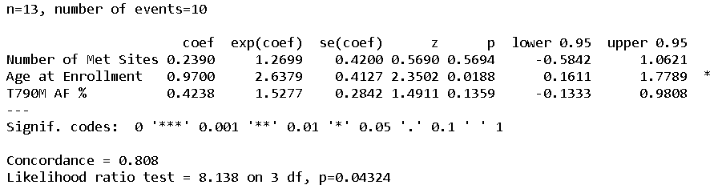
Baseline model
Just the risk factors:
Age, Number of metastatic sites, % T790M AF (allelic fraction)
Modeling Progression

Slide 16
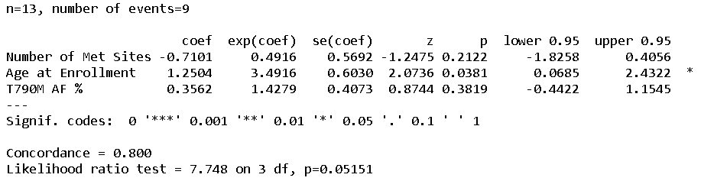
Baseline model
Just the risk factors:
Age, Number of metastatic sites, % T790M AF (allelic fraction)
Modeling Death

Slide 17
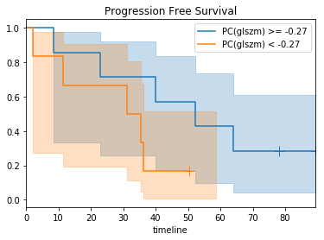
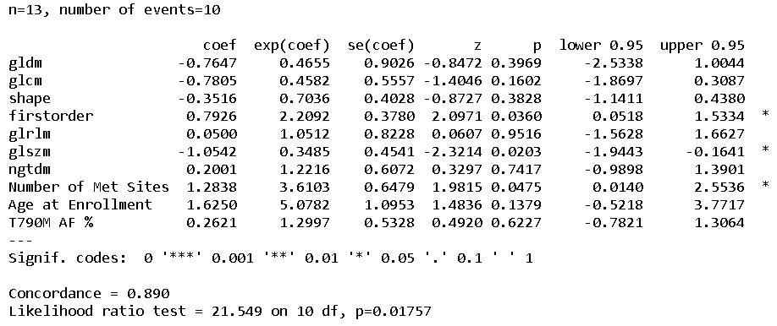
Baseline + radiomic features
Modeling Progression

Slide 18
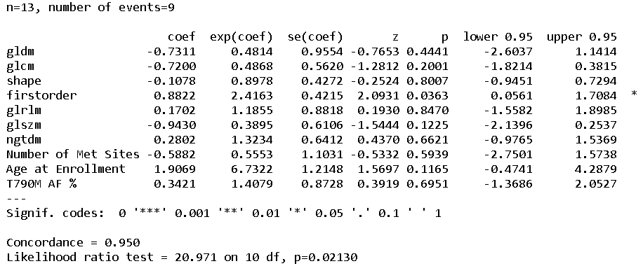
Baseline + radiomic features
Modeling Death

Slide 19
Permutation
To see if the covariates are overfitted to a random survival outcome whatsoever
Survival outcome permuted 1000 times

Slide 20
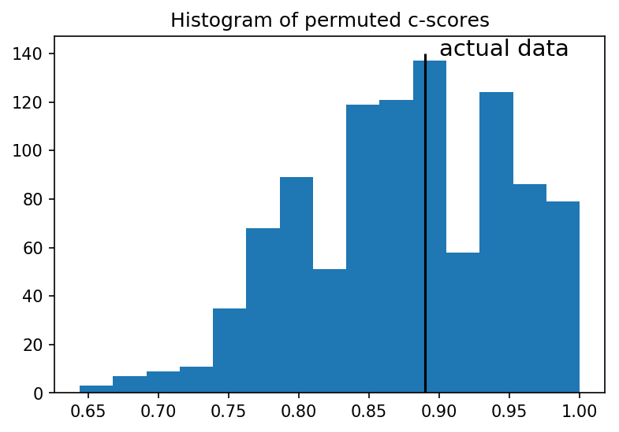
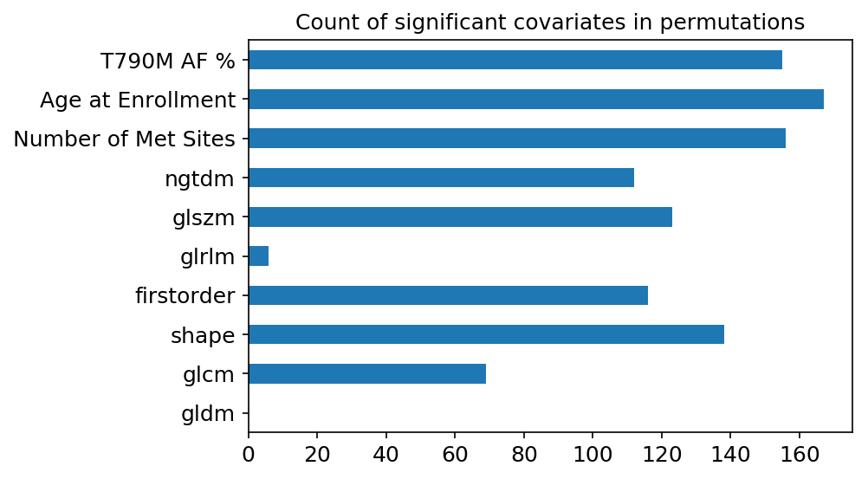
Permutation: Progression Free Survival

Slide 21
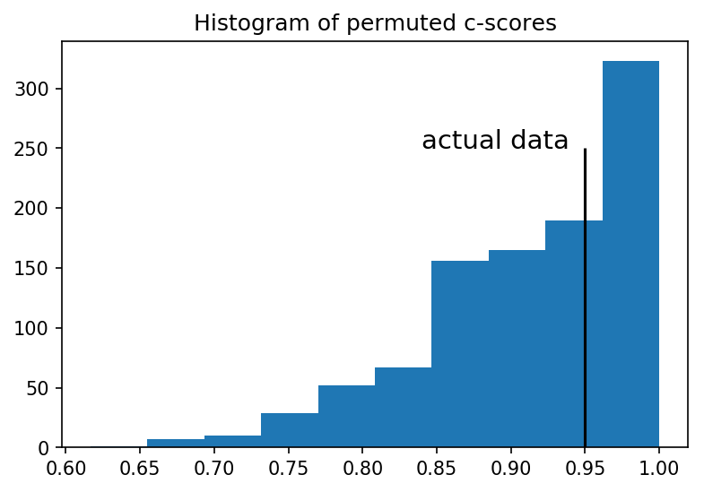
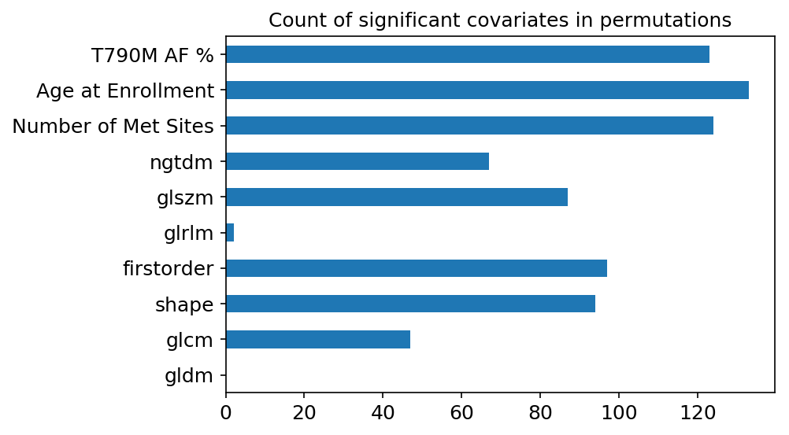
Permutation: Overall Survival

Slide 22
Conclusion
Overfitting??
More data

Slide 23
Semi-automatic tumor segmentation
Active contour with ITK SNAP
Need seed point
Notes:
Dice:
9 T1 0.720

Slide 24
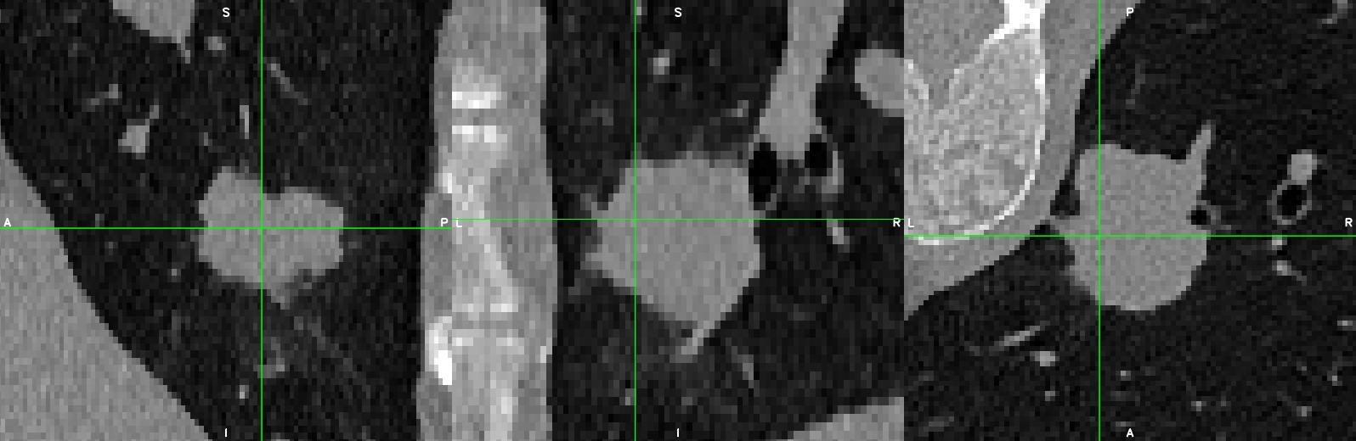
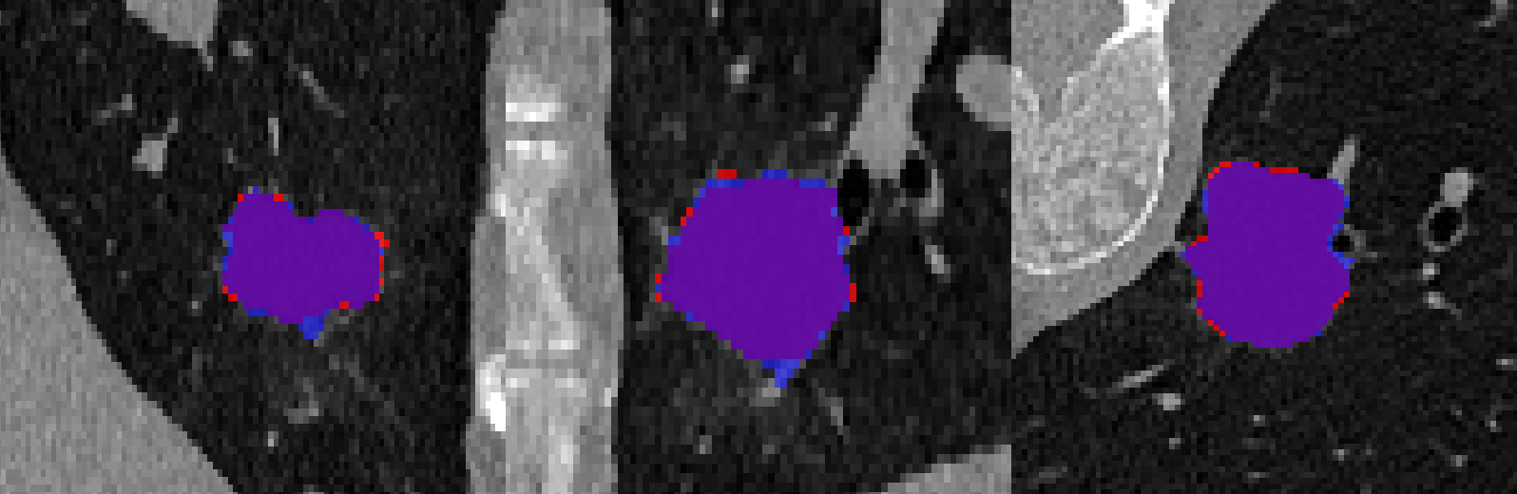
Patient 349 Baseline
Blue: semi-automatic
Red: manual
Notes:
Case 9 T1

Slide 25
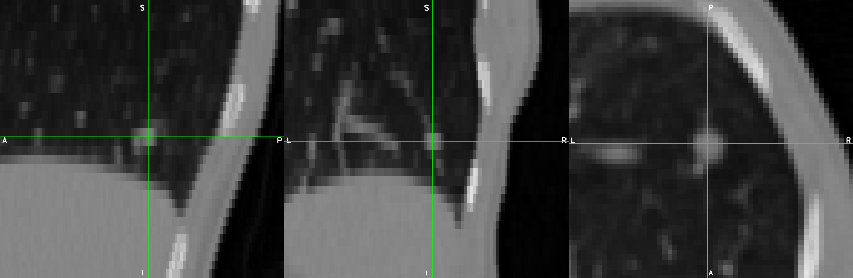
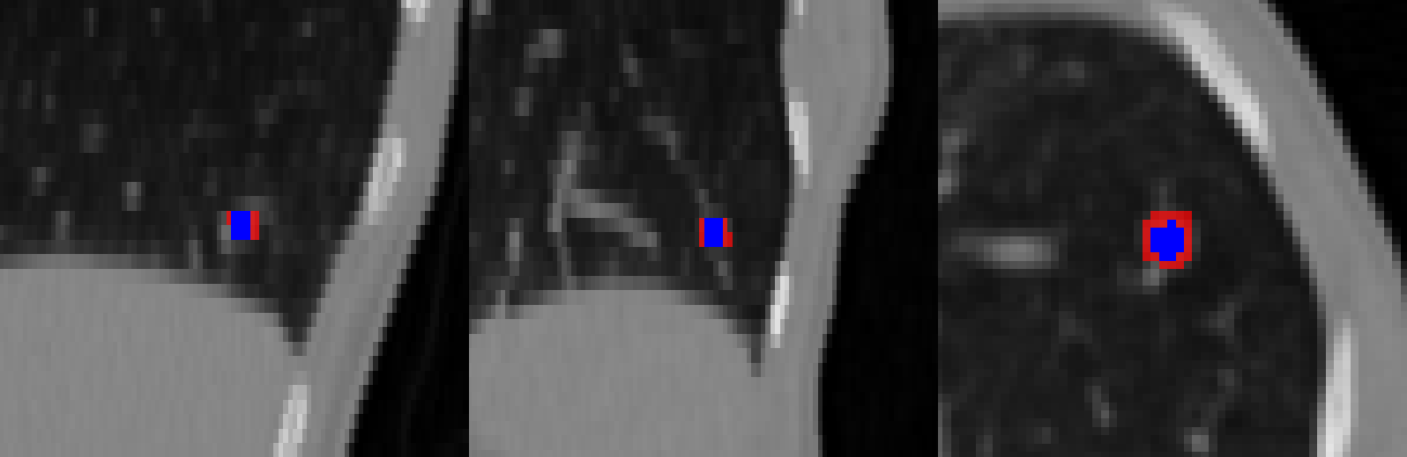
Patient 166 Baseline
Blue: semi-automatic
Red: manual
Notes:
Case 9 T1

Slide 26
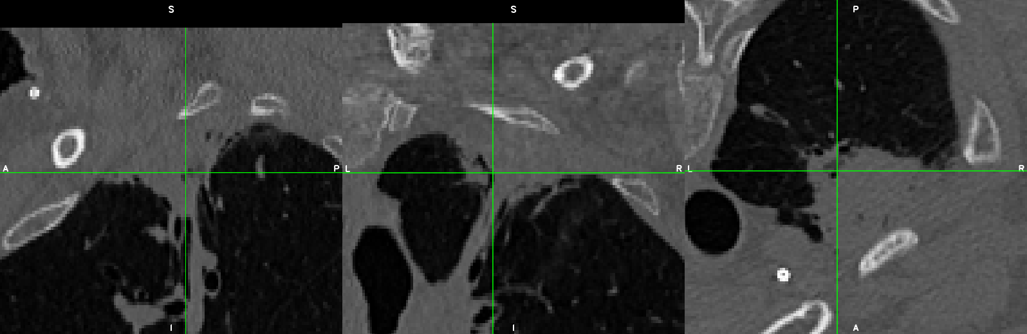
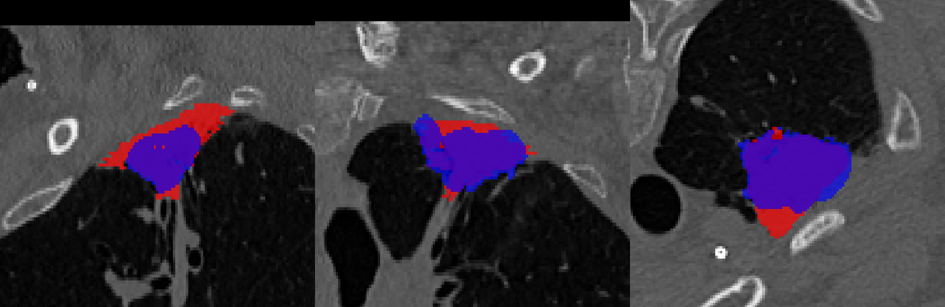
Patient
9
Baseline
Blue: semi-automatic
Red: manual
Notes:
Case 9 T1

Slide 27
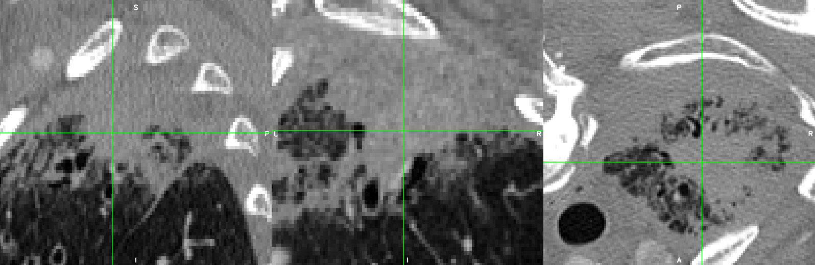
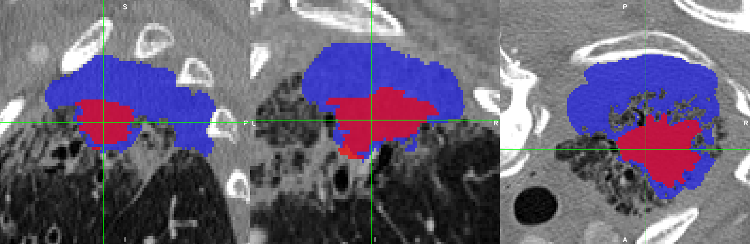
Patient 166 Baseline
Blue: semi-automatic
Red: manual
Notes:
Case 9 T1

Slide 28
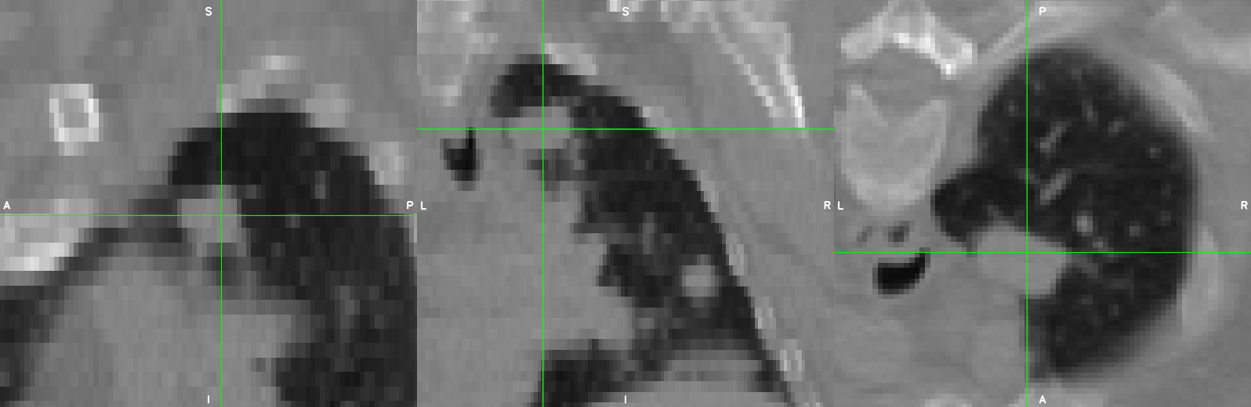
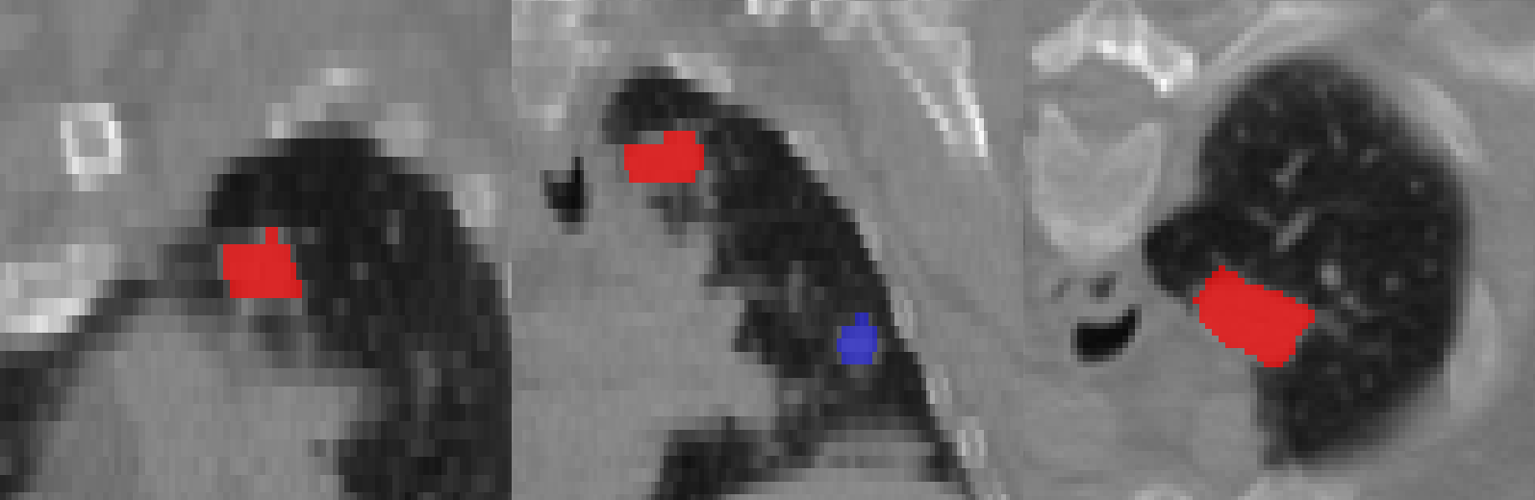
Patient 268 Baseline
Notes:
Case 9 T1

