Slide 1
LITMUS - Reddit:
A Study of Misinformation on Reddit for the COVID-19 Vaccine
CS6365 SPRING 2021
Eric Hsieh, Dongsuk Lim
April 20th, 2021

Slide 2
Introduction and Background
COVID-19 is the first pandemic where technology and social media were used to spread information
With an overabundance of information, there are attempts to spread wrong information
Disinformation can cost lives and worsen the pandemic
We aim to analyze the facts and opinions on the COVID-19 vaccines on Reddit to study the spread of disinformation

Slide 3
Goal
Binary classification of Reddit Post Titles regarding the Covid-19 Vaccine
Misinformation or Not Misinformation
Project modeled after LITMUS
Similar goal and pipeline
Aim to solve misinformation problem in LITMUS
Integrate a potential source of data

Slide 4
Motivation
Lots of misinformation online, especially Reddit
Polarizing discussions on Covid-19 Vaccine
Reddit is a good subject:
Large user base
Lots of discussion and varying opinions
Contains a lot of textual data, good source for NLP

Slide 5

Milestones Achieved
Three major milestones
M1: Accurate data collection from Reddit and preprocessing
M2: Accurate model selection, we aim to train a model for our NLP task
The model should be able to discern accurate facts and disinformation regarding the COVID-19 vaccine
M3: Development of working frontend and backend to show our results

Slide 6
Architecture, Data, and Analysis

Slide 7
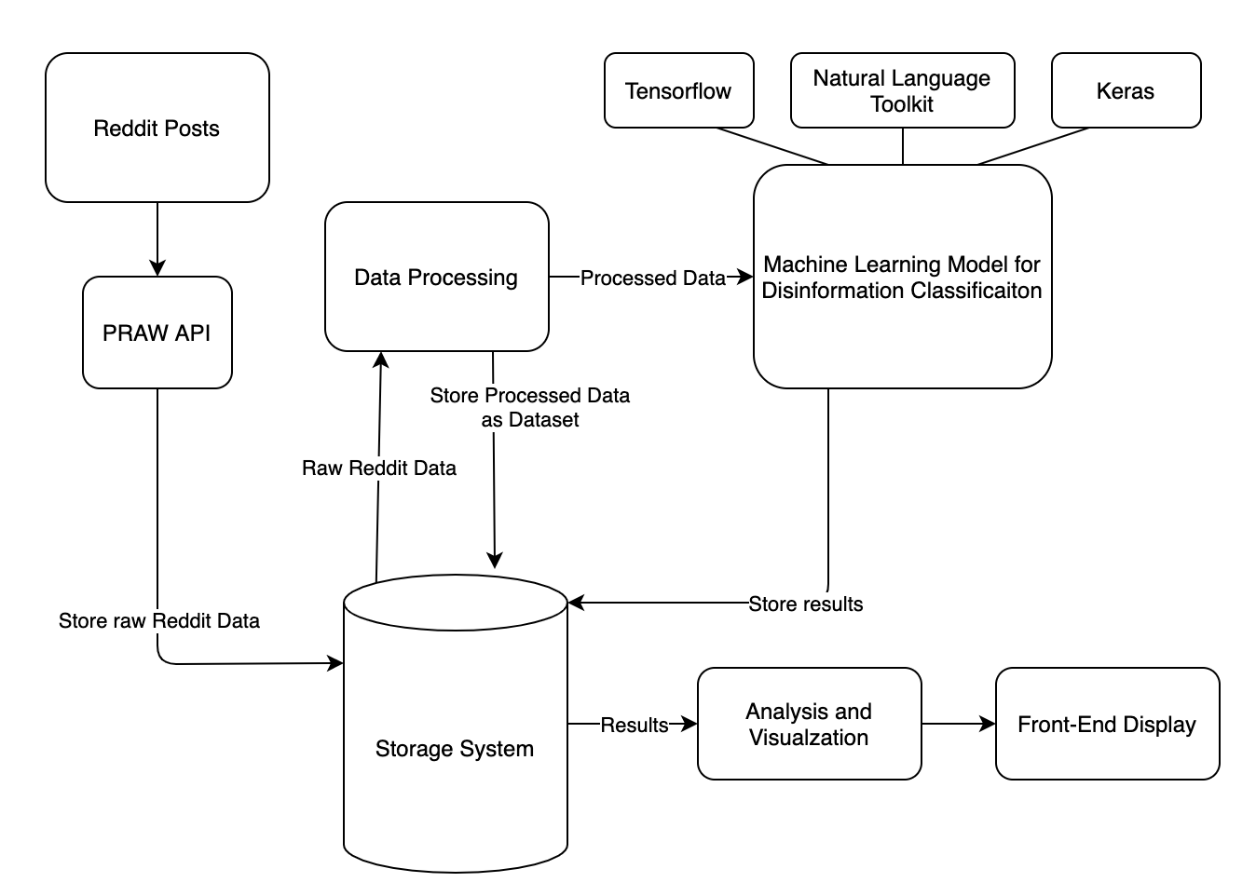
General Architecture

Slide 8
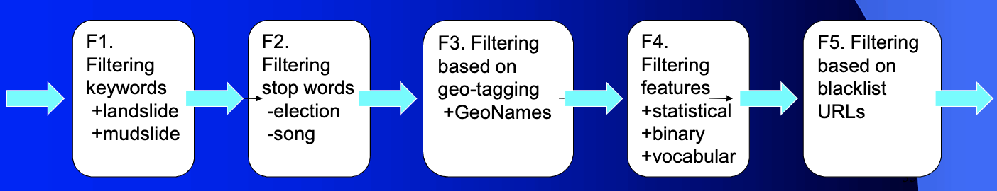
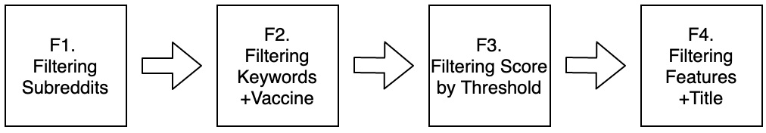
LITMUS-Inspired Social Filtering Pipeline

Slide 9
Data
PRAW Reddit API for collection
~2,500 submissions that pertain to the Covid-19 Vaccine
4 main Subreddits:
Coronavirus
COVID19
CoronavirusNewYork
CoronavirusFoS
Manual labelling of misinformation/not misinformation using facts from CDC, WHO

Slide 10
Examples of Misinformation
Bill Gates Says 700,000 People May Die From Using Covid-19 Vaccine
Coronavirus Mutating to Become Less Vicious and Could Die Out Without Vaccine, Claims Expert
Two paths to herd immunity. One is being blocked by masks, the other is the hope a vaccine will be found.
Nobel-prize winning scientist who discovered HIV says novel coronavirus is engineered with HIV inserts by China.

Slide 11
Importance of True Novelty
Anti-information, known unknowns, unknown unknowns
Intentional misinformation
Data that is known to be unknown
Vaccine Mortality
Notes:
Covid-19 Vaccine’s impact of mortality - distinguish misinformation from fact

Slide 12
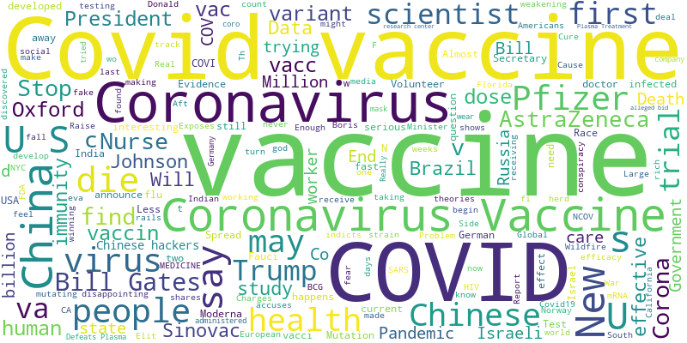
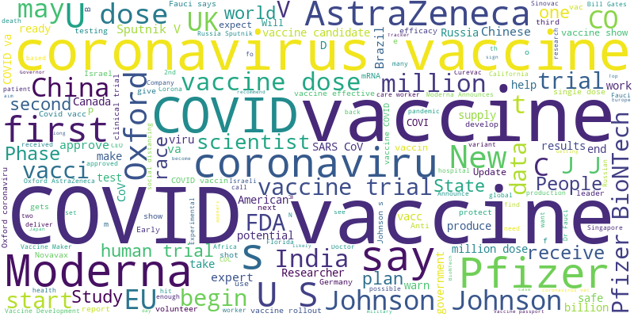
Data WordCloud Comparison
Misinformation
Not Misinformation

Slide 13
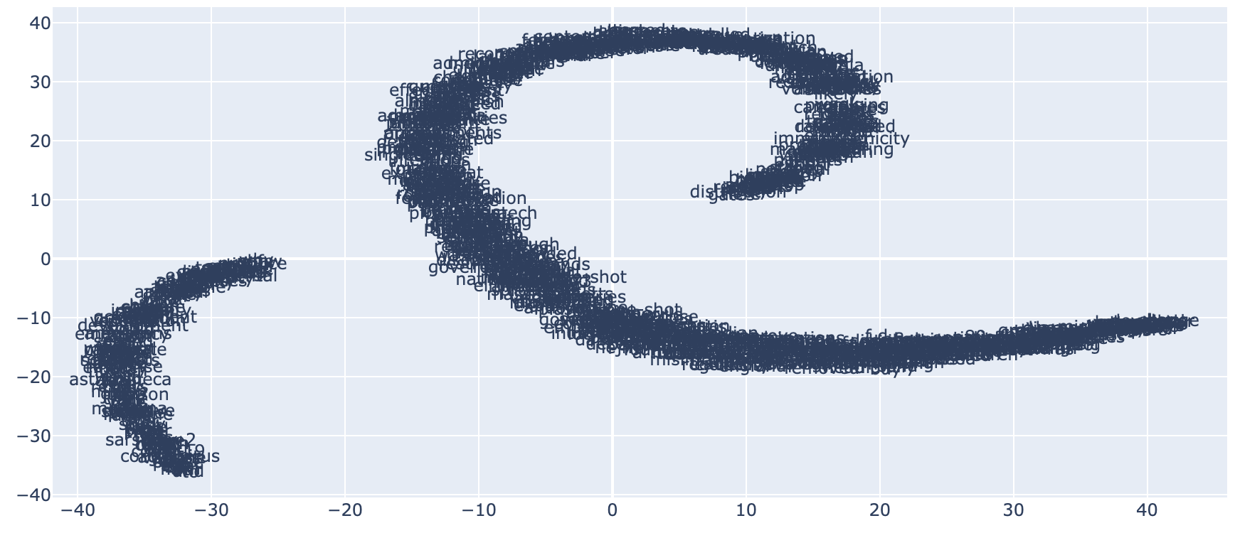
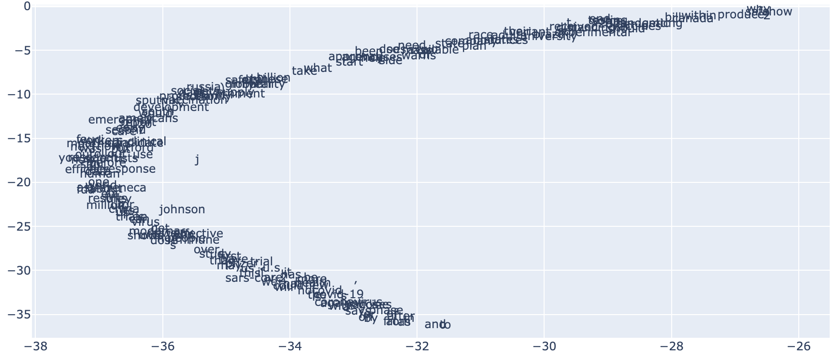
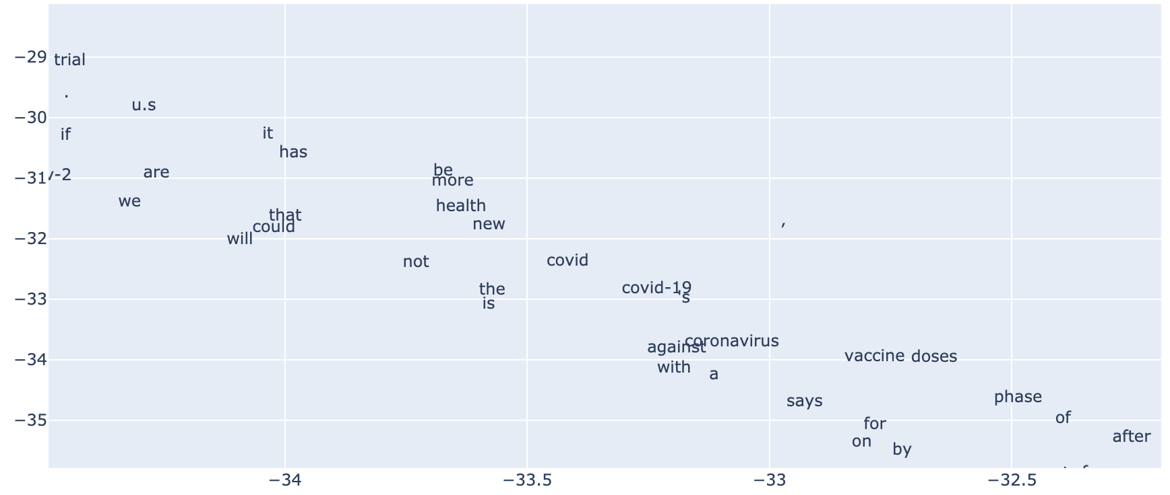
Word2Vec Cluster

Slide 14
Borderline Data
Data that looks close to truths
Issue for unsupervised learning
Strong source of misinformation
Notes:
In our data, there is a lot of what we call Borderline data. Borderline data belongs in the class of misinformation, but is looks very similar to truths. For us as humans, it is extremely easy for us to mislabel this type of misinformation as fact. The reason that we stuck with hand-labeled data and supervised learning instead of unsupervised learning was that our dataset is full of borderline data. Our experiments with unsupervised learning to create classes and clusters without labels did not produce good results compared to supervised learning.
This type of misinformation is also preferred by those aiming to spread misinformation. It is close to facts and at first glance, hard to discern. And in an algorithm, unless it it explicitly labeled as misinformation, it could easily be misclassifed as not misinformaiton

Slide 15
Classification Models

Slide 16
Text Preprocessing for Data
Feature Extraction
Vectorization
Tokenizing and Padding
Word Embeddings of size 50

Slide 17
LITMUS-Inspired Classification Pipeline
GenSim Word2Vec [word2vec-google-news-300]
Classification with multiple models
Tensorflow models
LITMUS uses WEKA SVM

Slide 18
Baseline Models & NLP Analysis
Gaussian Naive Bayesian
Testing Accuracy: 73.06%
Logistic Regression
Testing Accuracy: 85.38%
K-Neighbors
Testing Accuracy: 83.46%
Word Embeddings + NN
Testing Accuracy: 89.40%

Slide 19
Results, Frontend Integration
and Future Work

Slide 20
Results
Identify misinformation from fact regarding the Covid-19 Vaccine
Create a model that can successfully detect misinformation
Best performing model with Word Embeddings

Slide 21
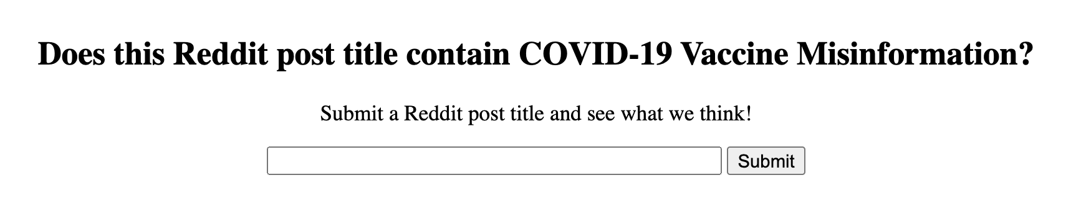
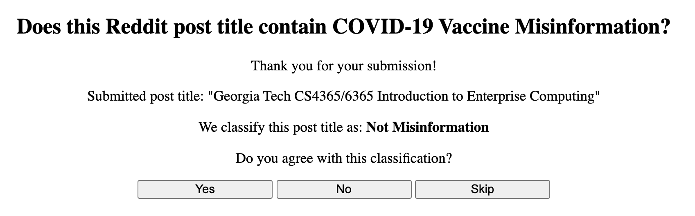
Frontend Purpose
Test classification model
Frozen Keras Neural Network
Provide User Interaction
Gather more training data

Slide 22
Future Work
Gather more training data
Data imbalance/bias
Increase model classification accuracy
Different/better models
Try additional NLP techniques
Improve frontend

Slide 23
Thank you!

