Slide 1

Capstone Project for Springboard Data Science Intensive Program
Santander Product Prediction
Wei-Chun Hsieh

Slide 2

Outline
Introduction
Data exploratory analyses
Build the base model
Parameter tuning vis grid search
Feature Importance
Ensemble learning
Summary
Usage of results

Slide 3
Introduction
Santander is a bank which offers financial products and services. The whole dataset is 1.5 years and has monthly records of multiple columns that store customer’s information, such as customer code, status of employment, customer’s country residence, age, gender of customer, gross income of the household, etc. There are also 24 product columns storing product items a customer has, such as "credit card", "savings account", “mortgage”, “short-term deposits”, “medium-term deposits”, “long-term deposits”, etc.
Data source: https://www.kaggle.com/c/santander-product-recommendation
Business problem: to predict if a customer has an account or not based on the customer’s information.

Slide 4
24 products

Slide 5
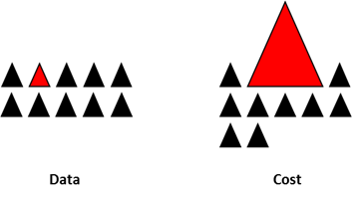
Goal of project: prediction of current account holder
The kaggle challenge: to predict what products Santander’ customers will purchase in the next month based on past data
23 out of 24 products are highly imbalanced datasets
To simplify the modeling problem, we built the prediction model on one product
Select the product “current account” which has the most coverage
Make prediction on if a customer hold the account with bank or not based on customer’s info

Slide 6
Data exploratory analyses
The downloaded training data has 13,647,309 rows. We reduced the input data to 20% of the original training data by randomly sampling the raw data.
Original dataset has Spanish header, I changed the Spanish header to English header so we know fields better.
Found there are NAN and missing values.
Age and seniority have non-numeric values. So we forced non-numeric values to be NaN and removed them.

Slide 7
Description of data fields
Column | Description
employee_index | A active, B ex employed, F filial, N not employee, P pasive
country_residence | Customer's Country residence
sex | Customer's sex
age | Age
first_join_date | The date in which the customer became as the first holder of a contract in the bank
new_customer_index | New customer Index. 1 if the customer registered in the last 6 months
seniority | Customer seniority (in months)
primary | 1 (First/Primary), 99 (Primary customer during the month but not at the end of the month)
customer_type | Customer type at the beginning of the month ,1 (First/Primary customer), 2 (co-owner ),P (Potential),3 (former primary), 4(former co-owner)
customer_relation | Customer relation type at the beginning of the month, A (active), I (inactive), P (former customer),R (Potential)
residence_idx | Residence index (S (Yes) or N (No) if the residence country is the same than the bank country)
foreigner_idx | Foreigner index (S (Yes) or N (No) if the customer's birth country is different than the bank country)
channel | Channel used by the customer to join
deceased | Deceased index. N/S
address | Address type. 1, primary address
province_code | Province code (customer's address)
province_name | Province name
activity_idx | Activity index (1, active customer; 0, inactive customer)
gross_income | Gross income of the household
segment | segmentation: 01 - VIP, 02 - Individuals 03 - college graduated

Slide 8
Raw data
employee_index | N, A, S, F, B
country_residence | ES, BO, AR, IN, RO, PY, US, …, etc.
sex | H, V,
age | 68, 42, 44, 49, 32, 36, 41, 45, 31, 34, 37, 40, 57, 51, 66, 35, 38, 95, 43, 29, 47, 33, 52, 39, …, etc
first_join_date | 2006-11-17, 2006-11-18, 2006-11-19, 2006-11-15, ..., etc]
new_customer_index | 0, 1
seniority | 114, 91, 73, 44, 18, 0, 55, 112, 33, 68, 94, 110, 4, 113, 19, 58, …, etc
primary | 1, 99
customer_type | 1, 1.0, P, 3, 3.0, 2.0, , 2, 4.0, 4
customer_relation | I, A, R, P,
residence_idx | S, N
foreigner_idx | N, S
channel | KAQ, KBF, KAP, KAT, KFC, KFA, KAE, KAA, KAL, KAF, KCI, KHK, 013, …, etc.
deceased | N, S
address | 1
province_code | 28, 26, 48, 8, 50, 41, 35, 33, 51, 25, 43, 5, 47, 15, 7, …, etc.
province_name | MADRID, RIOJA, LA, BIZKAIA, BARCELONA, ZARAGOZA, SEVILLA, …,etc.
activity_idx | 0, 1
segment | 02 - PARTICULARES, 01 - TOP, , 03 - UNIVERSITARIO

Slide 9
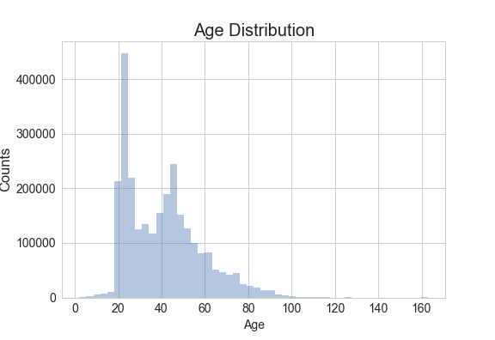
Age distribution: bimodal
Peak for age distribution is around 25 and 45

Slide 10
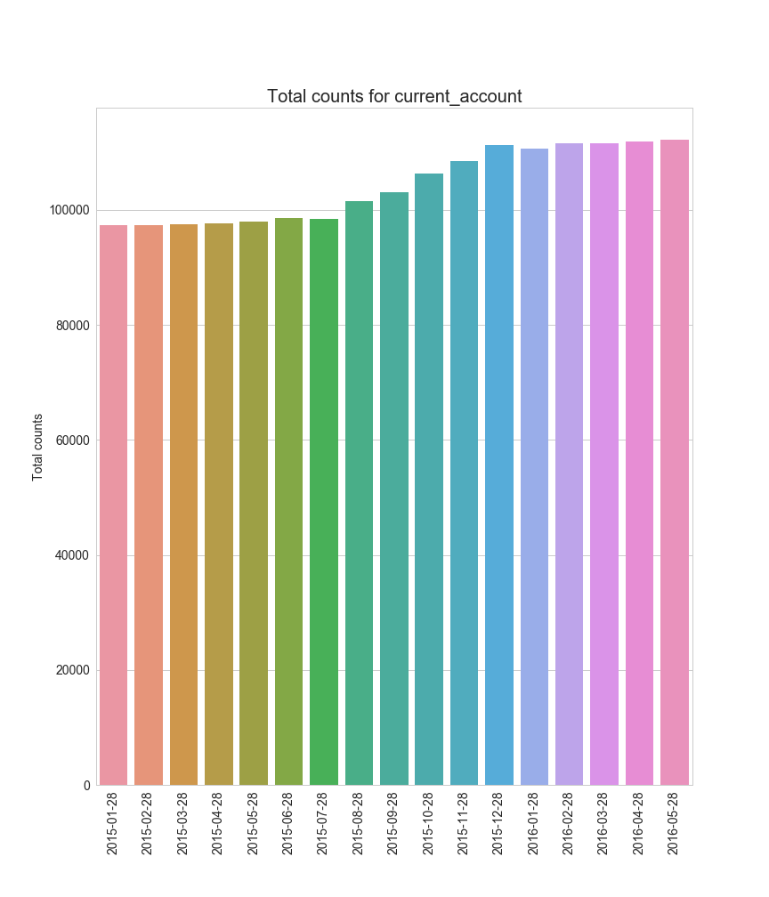
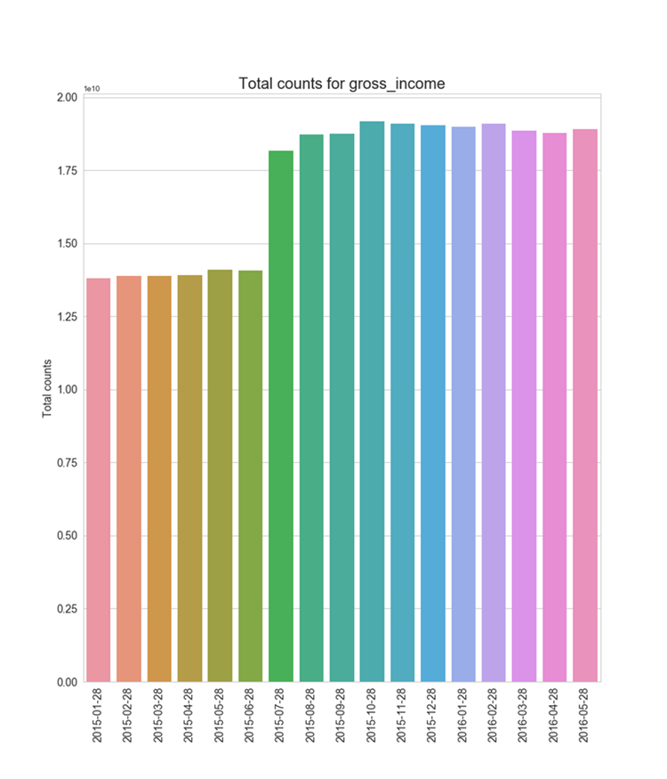
Total counts for current and gross income accounts
Jump on number of gross income accounts after June 2015

Slide 11
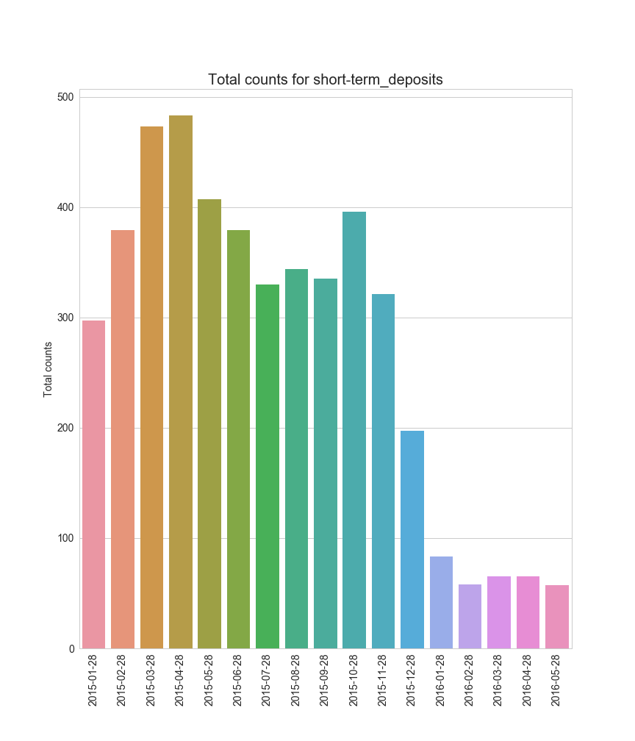
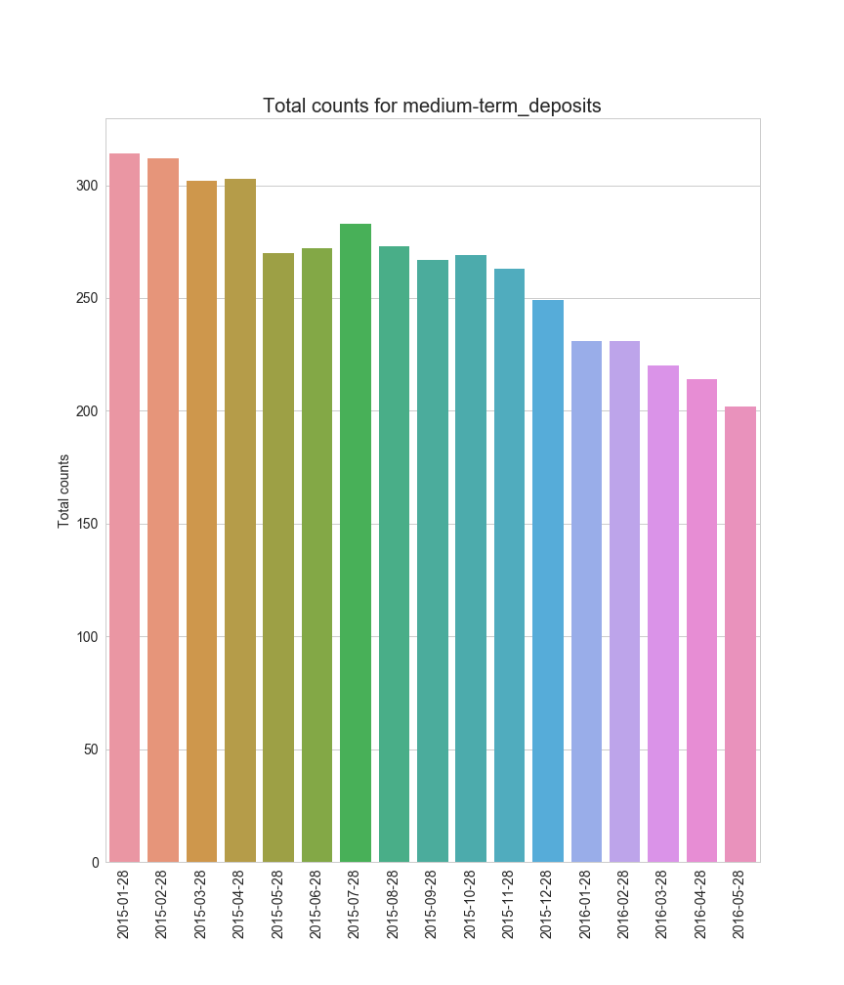
Total counts for short-term and medium-term deposits accounts

Slide 12
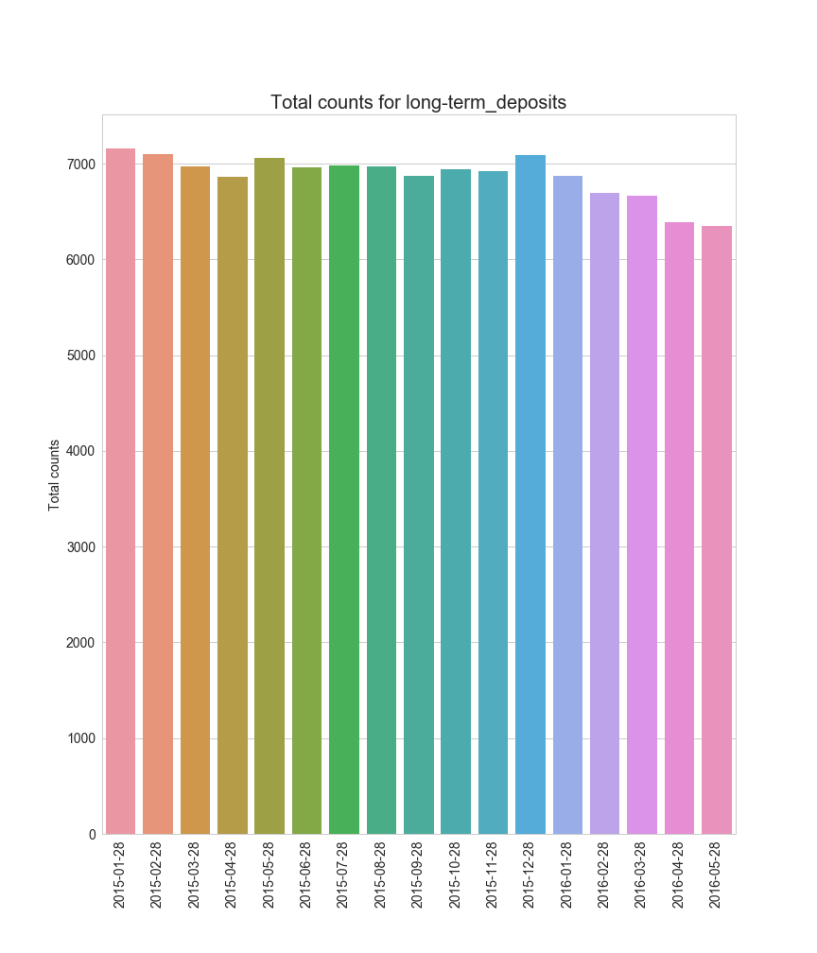
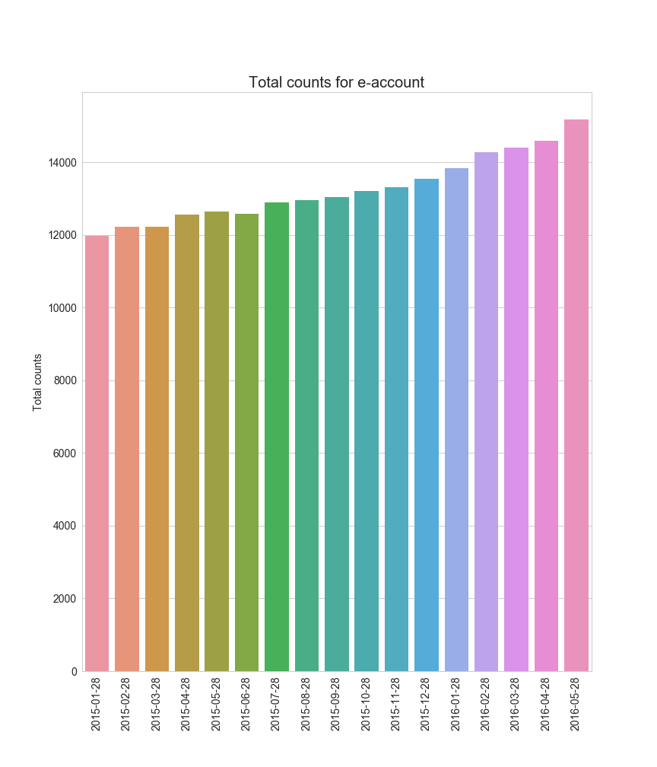
Total counts for long-term deposits and e-account accounts

Slide 13
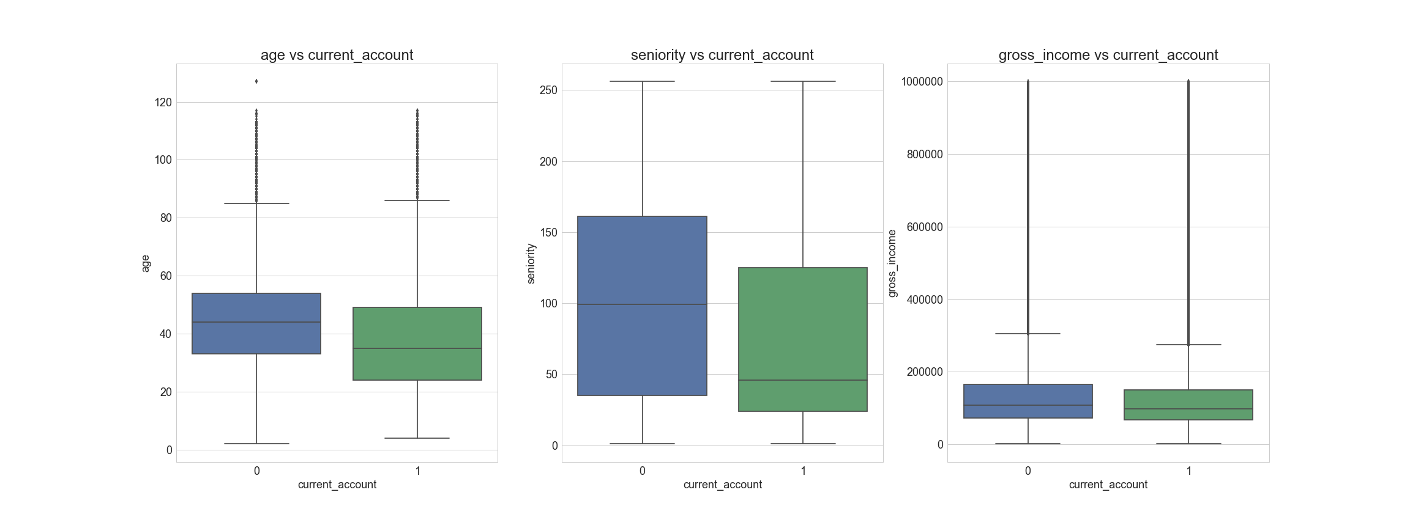
Age, seniority and gross income against current account
Plot data with gross income < 1M so clarity for gross income box plot is better.
Differences between with account (1) and without account (0). Age and seniority tend to be smaller for current account holders.

Slide 14
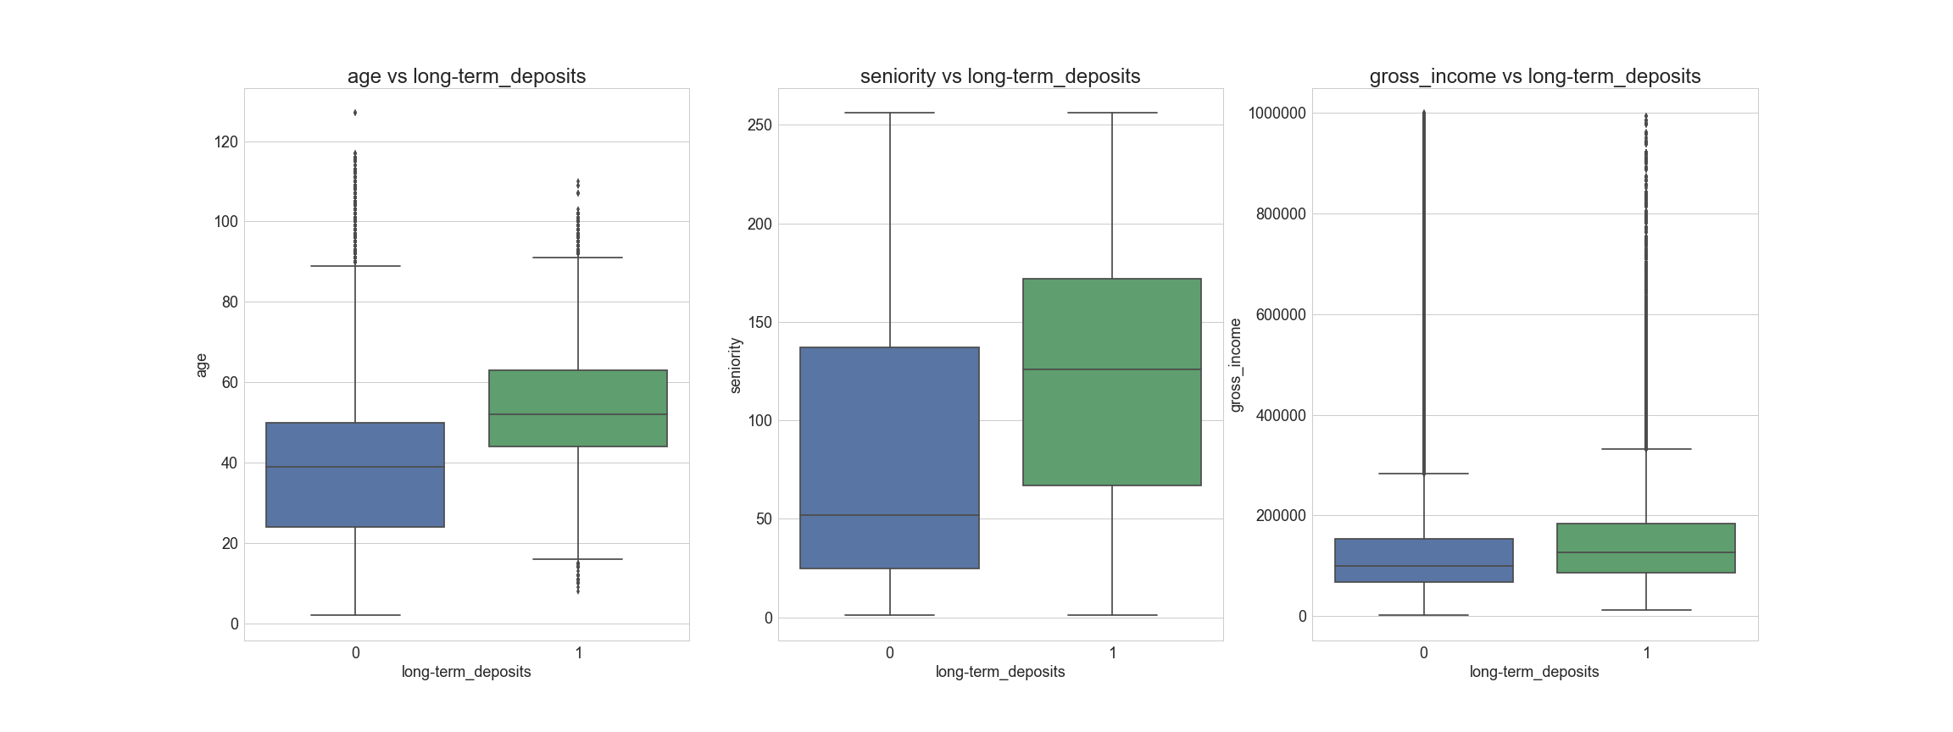
Age, seniority and gross income against long-term deposits account
Differences between with account (1) and without account (0).
Age and seniority tend to be larger for long-term deposits account holders.

Slide 15
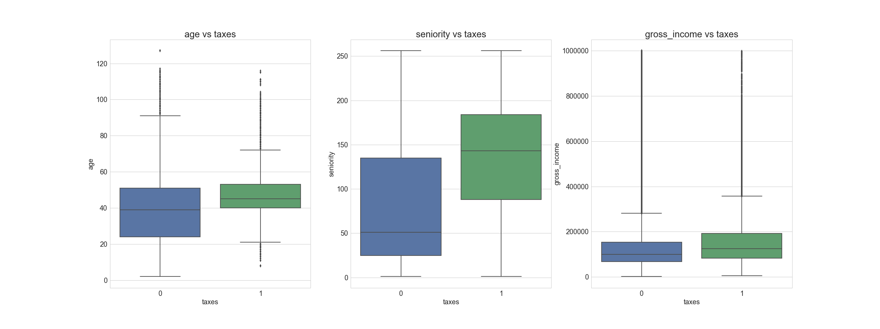
Age, seniority and gross income against taxes account
Differences between with account (1) and without account (0). Data has predicting power.

Slide 16

Find new accounts
How many new accounts are added comparing to the previous month based on the same population.
Compute for the same customers, given that they do not hold account previous month, how many of them add that account in the following month.
How about the time lag for the new accounts?
How about new customers with new accounts?

Slide 17
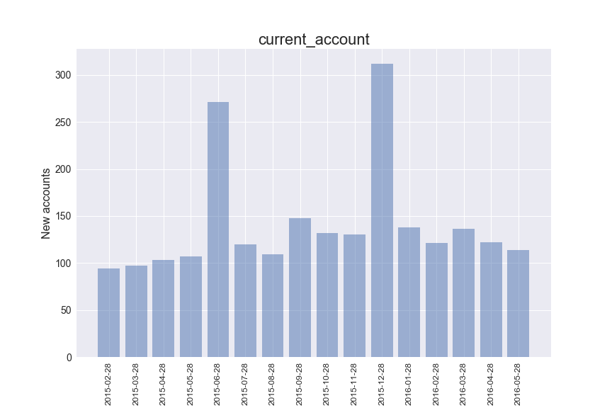
New accounts for the same population Two peaks at 2015-06-28 and 2015-12-28.

Slide 18
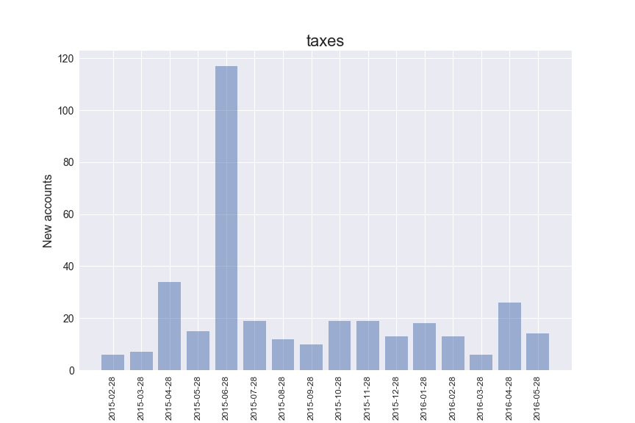
A remarkable peak at 2015-06-28 for the taxes account. (June marks the end of tax year for Spain)

Slide 19
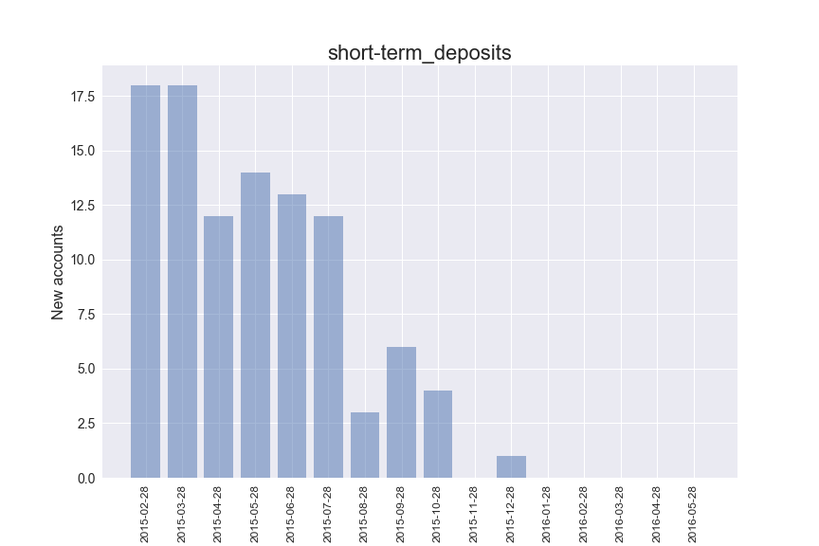
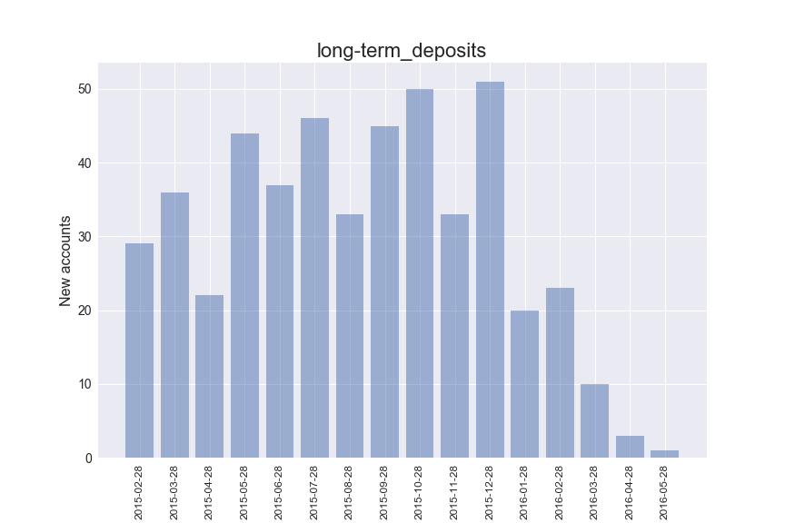
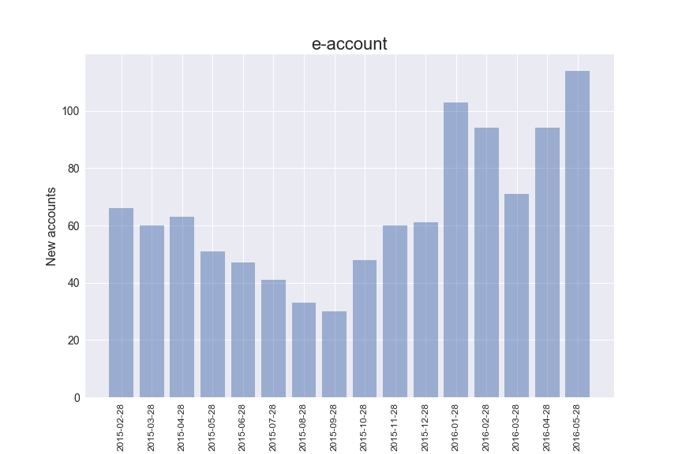
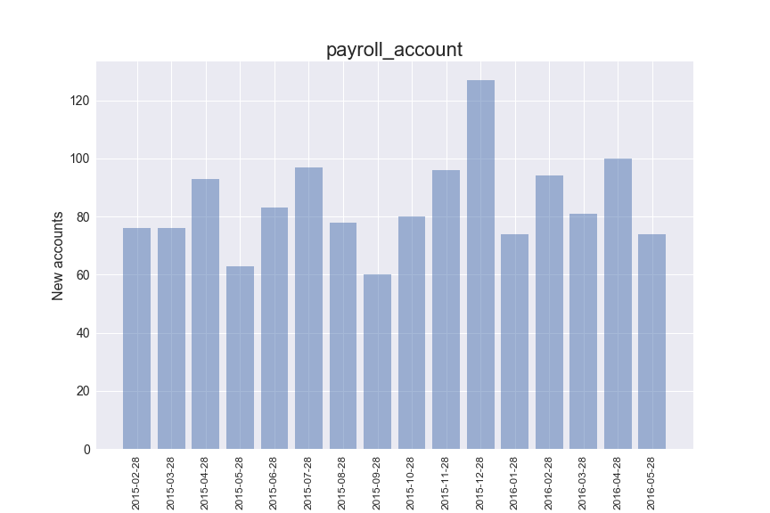
Time series of new accounts
A increasing trend of new accounts for e-account.

Slide 20
Summary for new accounts analyses
There is a remarkable peak at 2015-06-28 for the taxes account.
For the current account, we saw two peaks at 2015-06-28 and 2015-12-28.
There is a increasing trend of new accounts for e-account and a decreasing trend for short-term deposits (no more new accounts in the year 2016).

Slide 21
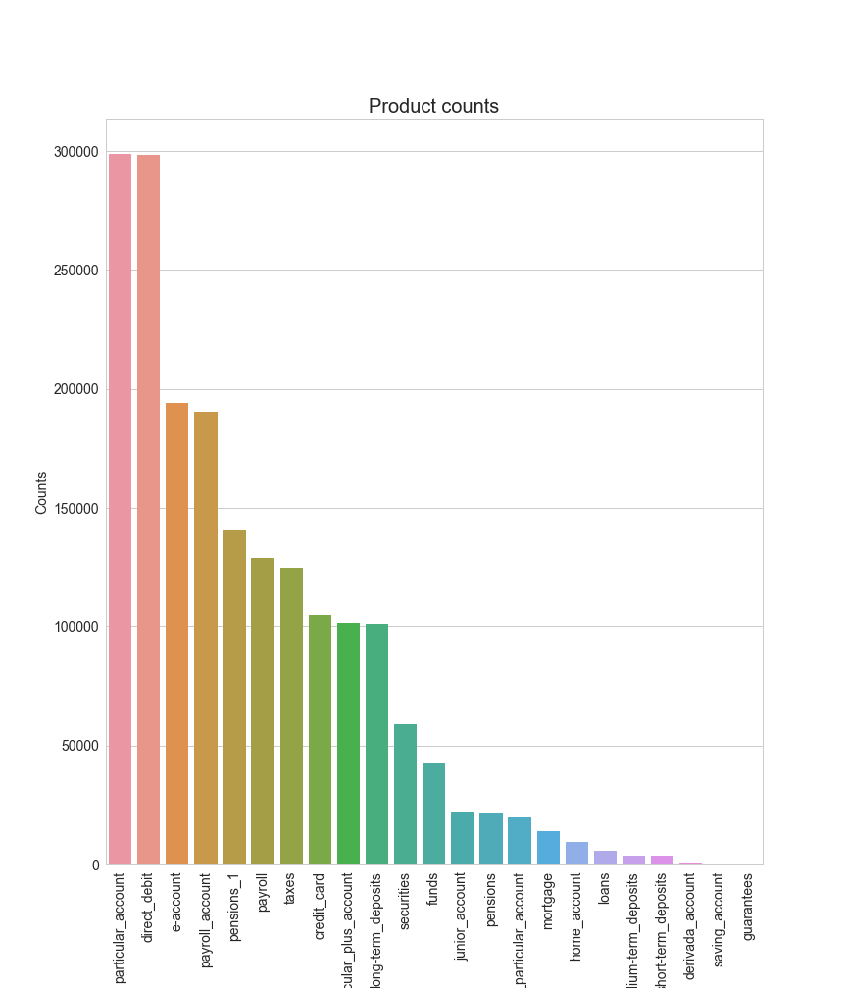
Product counts
Counts is calculated based on 20% of training data from 16 months.
Counts for current_account holders: 1,417,101

Slide 22
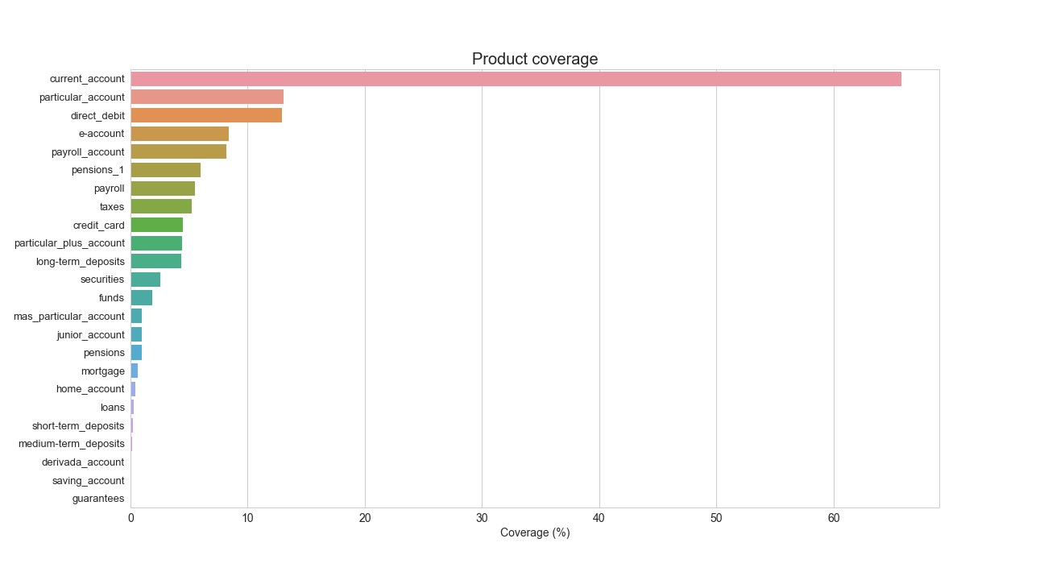
Product coverage Coverage: percentage of account holder
Product “current account” has the most coverage (~66%)

Slide 23
Build the base model
Data preprocessing
Read data as an dictionary and save data as pandas data frame
Remove space and missing data
Check consistency in field values. Value “1.0” and “1” is the same
Check numerical fields only have numerical values. Age and seniority have non-numeric values.
Convert categorical data into numerical data using label encoder
Split data into training and test parts

Slide 24
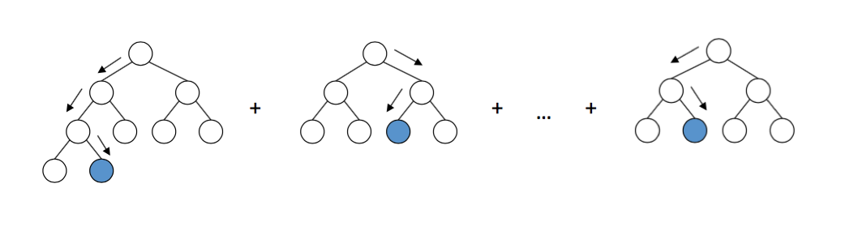
Base model: Xgboost
1. Fit the model
2. Calculate training accuracy
3. Calculate training AUC
4. Calculate testing AUC
5. Plot feature importance

Slide 25
Base model performance
param = {}
seed_val=0
param['eta'] = 0.05
param['max_depth'] = 8
param['silent'] = 1
param['eval_metric'] = "auc"
param['min_child_weight'] = 1
param['subsample'] = 0.7
param['colsample_bytree'] = 0.7
param['seed'] = seed_val
param['objective']='binary:logistic'
Model Report
Accuracy (Train) : 0.7612
AUC Score (Train): 0.822797
Model evaluation on test data
Accuracy (Test) : 0.7608
AUC Score (Test): 0.820525

Slide 26
Parameter tuning vis grid search
Grid search parameter: max_depth and min_child_weight
cv_params = {'max_depth': [3,5,7], 'min_child_weight': [1,3,5]}
ind_params = {'learning_rate': 0.1, 'n_estimators': 1000, 'seed':0, 'subsample': 0.8, 'colsample_bytree': 0.8, 'objective': 'binary:logistic'}
Model with rank: 1
Mean validation score: 0.755 (std: 0.001)
Parameters: {'max_depth': 7, 'min_child_weight': 3}
Model with rank: 2
Mean validation score: 0.755 (std: 0.001)
Parameters: {'max_depth': 5, 'min_child_weight': 3}
Model with rank: 3
Mean validation score: 0.755 (std: 0.001)
Parameters: {'max_depth': 5, 'min_child_weight': 5}

Slide 27
Model score is insensitive to learning_rate and subsample
cv_params = {'learning_rate': [0.1, 0.01], 'subsample': [0.7,0.8,0.9]}
ind_params = {'n_estimators': 1000, 'seed':0, 'colsample_bytree': 0.8,
'objective': 'binary:logistic', 'max_depth': 3, 'min_child_weight': 1}
Best score
mean: 0.75332, std: 0.00061, params: {'subsample': 0.7, 'learning_rate': 0.1},
mean: 0.75336, std: 0.00047, params: {'subsample': 0.8, 'learning_rate': 0.1},
mean: 0.75325, std: 0.00051, params: {'subsample': 0.9, 'learning_rate': 0.1},
mean: 0.74302, std: 0.00046, params: {'subsample': 0.7, 'learning_rate': 0.01},
mean: 0.74295, std: 0.00028, params: {'subsample': 0.8, 'learning_rate': 0.01},
mean: 0.74305, std: 0.00041, params: {'subsample': 0.9, 'learning_rate': 0.01}

Slide 28
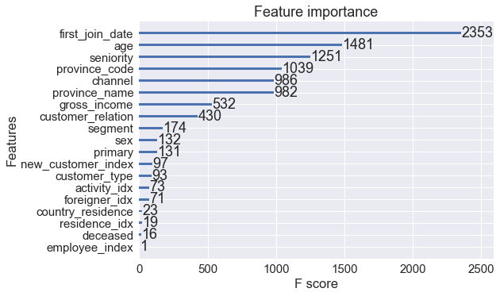
Feature importance Quantify the most important features in the series of trees.
The ‘first_join_data’ feature seems to have the most importance. Age and seniority are also important. Employee index and deceased info are not as important.

Slide 29
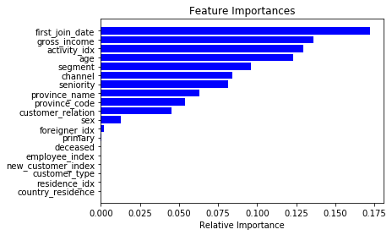
Feature importance: random forest
Xgboost agrees with random forest model mostly in feature importance.
However, activity_idx receives higher importance value in random forest model but has much lower score in xgboost.

Slide 30
Ensemble Learning
Combining Different Models
Use majority voting to predict the class label based on majority of classifiers
Use (1) Logistic Regression, (2) Decision Tree (3) KNN
10-fold cross validation (training data):
ROC AUC: 0.73 (+/- 0.00) [Logistic Regression]
ROC AUC: 0.63 (+/- 0.00) [Decision Tree]
ROC AUC: 0.65 (+/- 0.00) [KNN]
ROC AUC: 0.74 (+/- 0.00) [Majority Voting]
Use (1) Logistic Regression, (2) xgboost (3) Random Forest
10-fold cross validation (training data):
ROC AUC: 0.73 (+/- 0.00) [Logistic Regression]
ROC AUC: 0.82 (+/- 0.00) [Xgboost]
ROC AUC: 0.81 (+/- 0.00) [Random Forest]
ROC AUC: 0.81 (+/- 0.00) [Majority Voting]

Slide 31
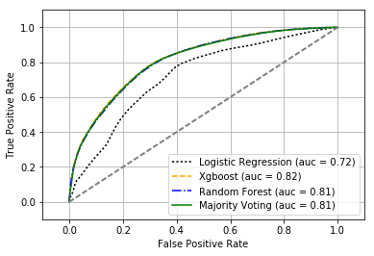
ROC curve

Slide 32
Summary for predictive modeling
First joint day, age, and seniority being the most important features.
Xgboost has the highest AUC score 0.82
Next is random forest model, AUC score 0.81
Tree-base algorithm
AUC value is insensitive to cross validation
Cross validation = 3, AUC ~ 0.82
Cross validation =10, AUC ~ 0.82
Majority voting follows the best model

Slide 33
Summary
Two peaks at 2015-06-28 and 2015-12-28 for new current accounts
A remarkable peak at 2015-06-28 for the new tax accounts (June marks the end of the tax year for Spain)
There is a increasing trend of new accounts for e-account and a decreasing trend for deposits.
Feature against product plots show differences between 0 (without accounts) and 1 (with accounts). Data has predicting power.
Tree-based algorithm outperform other models
Xgboost, random forest have the highest score
Majority voting follows the best model

Slide 34

Usage of results
Find potential customers
Customers who own current accounts may be more interested in other types of accounts, so bank can provide recommendation to those customers
For non-customers (who do not own current accounts), send advertisements to them
Broadcast tax accounts when time is close the end of tax year

Slide 35

Ideas for improvement
Analyze more on data
Feature engineering
Hyperparameter tuning for xgboost model
Try different periods of training data
Recommendation engine
Predicting more products
Try different algorithms
Try penalized models

Slide 36

Acknowledgement
Ikechukwu Okonkwo
XGBoost developers and contributors
scikit-learn developers
Anaconda
Springboard

